Slide 1
2019 Annual Statewide Financial Aid Workshops
Free workshops for high school counselors, student advocates, outreach specialists and community education partners
Notes:
Welcome to our annual Statewide Financial Aid Workshop (SFAW), one of 46 workshops we are holding all over the state. The SFAW series is a partnership effort between the California Association of Student Financial Aid Administrators (CASFAA), Educational Credit Management Corporation (ECMC) and the California Student Aid Commission (CSAC).

Slide 2
THANK YOU for attending!
Notes:
We would like to start by saying thanks. Thank you to everyone here today. We appreciate you taking the time to be here and we certainly appreciate all that you do to help your students.

Slide 3
Agenda
1
California Student Aid Commission & Commission Programs
2
Chafee Grants and Programs for Foster Youth
3
Cal Grants Basics - the A, B, C’s
4
AB 540 and the California Dream Act Application
5
High Schools: Doing your part
6
Resources & Cash for College
Notes:
Here is the agenda for today’s workshop. Please follow along with the workbook and take notes as needed.
We will start out by giving a brief overview of the California Student Aid Commission and the programs we administer. This will be followed by information, updates and eligibility requirements for Cal Grants. We will then move on and cover the California Dream Act Application. Next, we give you a quick overview of what high schools need to do to ensure they have access to WebGrants. Finally, we will go over WebGrants 4 Students, provide you with some additional resources, and briefly talk about the important Cash for College program.

Slide 4
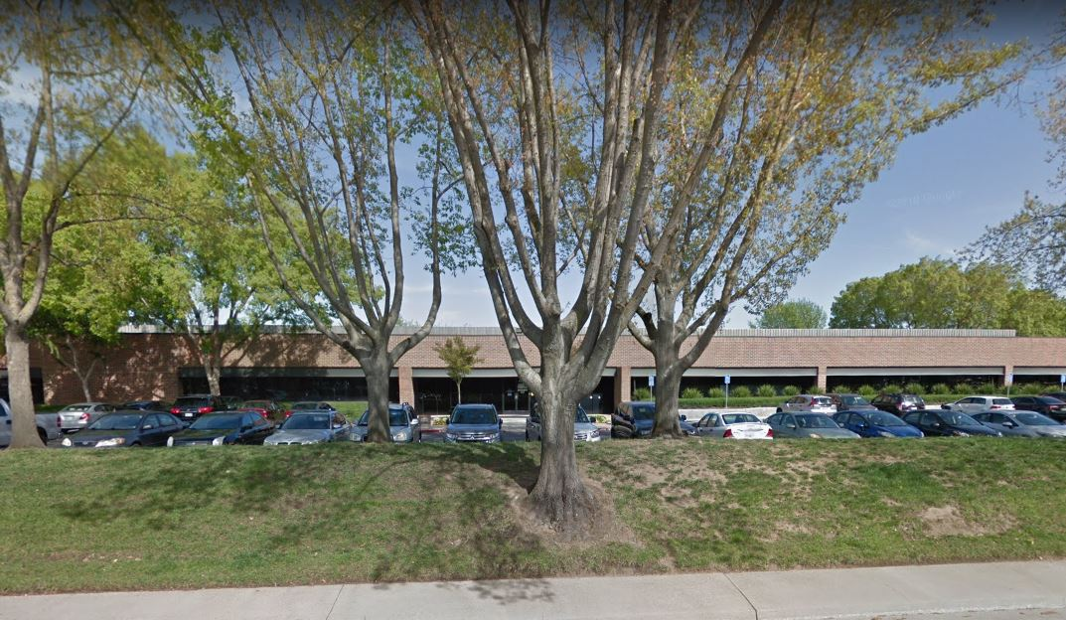
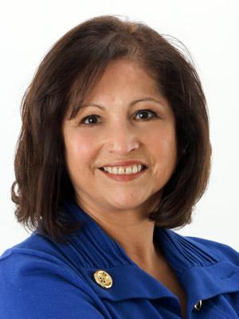
California Student Aid Commission
$100 million dollars
Test your knowledge!
Approximately how much state aid is administered by the California Student Aid Commission each year?
$725 million dollars
$2.2+ billion dollars
$2 billion dollars
$4 billion dollars
$100 billion dollars
New Executive Director-Marlene L. Garcia
Notes:
The Commission was created by the Legislature in 1955 and continues to operate as the principal state agency responsible for administering financial aid programs for students attending public and private universities, colleges, and vocational schools in California.

Slide 5
California Student Aid Commission
Recent Changes
CSAC Institutional Support Unit
Supports High Schools​
WebGrants & GPAs ​
Matching & Editing​
Supports Colleges​
Ad Hoc Trainings​
Specialized Webinars​
HS Counselor Workshops​
Regional Trainings
Institutional Support Unit
Outreach & Training Unit
Notes:
The Commission’s Institutional Support Unit has been split to encompass both Institutional Support and a newly developed unit called Outreach and Training. The Institutional Support Unit provides support to all high school counselors and college financial aid staff across the state via email and phone.
As part of the customer support available to high school counselors, the Outreach and Training unit offers Ad Hoc trainings, the annual Statewide Financial Aid Workshop series, financial aid workshops, regional trainings, monthly live webinars, and staffing at various outreach events. Institutional Support will continue to provide colleges and universities WebGrants support for GPA uploads and matching process, as well as regular communications through the Commission’s Special Alerts and Operations Memos.
If you would like to contact us in regards to Institutional Support and/or Outreach and Training, we can be reached via email at schoolsupport@csac.ca.gov

Slide 6
Commission Programs
Cal Grants A, B & C provide free money to help pay for college for students attending eligible schools in California
For students (families) with higher incomes, up to $177,000 per year, attending a
UC or a California State University
California Chafee Grant
For current or former foster youth. Up to $5,000 per year
Free Money for Foster Youth
For College or Technical and Career Training
Law Enforcement Personnel Dependents Grant (LEPD)
California National Guard Educational Award Assistance Program
Notes:
Although we are best known for the Cal Grant, the largest program that the Commission administers, we also offer students financial assistance for higher education through the Middle Class Scholarship, Chafee Grant for Foster Youth, Law Enforcement Personnel Dependents Grant (LEPD) and the California National Guard Educational Award Assistance Program.
•The Law Enforcement Personnel Dependents Grant (LEPD) is for dependents and spouses of peace officers and firefighters who were either permanently disabled or passed away while in the line of duty.
•The California National Guard Educational Award Assistance Program is for students who are active members of the California National Guard, the State Military Reserve, or the Naval Militia.
For more information on LEPD, please visit this site, https://www.csac.ca.gov/law-enforcement-personnel-dependents-grant-program-lepd
For more information on the California National Guard Educational Award Assistance Program, please visit this site, https://www.csac.ca.gov/california-national-guard-education-assistance-award-program-cng-eaap

Slide 7
California Chafee Grant
Free Money for Foster Youth
For College or Technical and Career Training
Assists current and former foster youth to help pay for college or career/technical training
Administered by the Commission through an interagency agreement with the California Department of Social Services (CDSS)
$17,623,700 federally and state-funded grant, subject to annual availability of funds
Maximum annual award amount is $5,000 per academic year, based on unmet need
Portable award (eligible schools outside of California)
Notes:
The California Chafee Grant for foster youth is administered by the Commission through an interagency agreement with the California Department of Social Services (CDSS)
It assists current & former foster youth that were in foster placement for at least one day between the ages of 16 and 18 to help pay for college or career/technical training
$17,623,700 - federal and state funded grant subject to annual availability of funds
Maximum annual award amount is $5,000 per academic year based on unmet need. Funds may be used towards:
Tuition/fees
Books/supplies
Housing
Transportation
Child Care
For more information about the Chafee Grant, please visit: https://chafee.csac.ca.gov/

Slide 8
Chafee Grant
Eligibility Expanded
AB 1811 trailer bill has expanded eligibility to include students who have not reached their 26th birthday as of July 1st of the award year
Students who applied previously only need to renew their FAFSA/CADAA to receive consideration under this provision
Previously age-ineligible participants have been renewed
Chafee Grant paid participation is limited to 5 total years
Each academic year that a payment greater than $1 is issued counts as 1 year of paid participation
26
23
Notes:
Chafee Grant eligibility expanded to include students who have not reached their 26th birthday as of July 1st of the award year. The previous age limit was 23-years-old.
Chafee maximum paid participation is 5 years consecutive or non-consecutive payments.
AB 1811 Trailer Bill: GSA 2018-36
Students may receive 5 years (consecutive or non-consecutive) of Chafee payment
Note that even a payment of anything greater than $1 counts as 1 year of paid participation.
Link to Special Alert: https://www.csac.ca.gov/sites/default/files/file-attachments/gsa_2019-20.pdf?1565806770
*Please note that the 5 year limit on Chafee is separate than the Cal Grant B For Foster Youth limit of 8 years.

Slide 9
Chafee Grant Eligibility
To be eligible for payment, students must be:
Attending at least half-time
Making Satisfactory Academic Progress (SAP)
Have sufficient unmet need
Be a current/former foster youth who was a dependent or ward of the court, living in foster care for at least one day, between the ages of 16 and 18
Excludes Kin-GAP, legal guardianship, and adoption
Not have received payments for more than 5 years (42 US Code Section 677 (i)(3)
Not have reached their 26th birthday as of July 1st of the award year
Students are NOT required to:
Graduate from high school
Provide a GPA
Register for Selective Service
Meet ability-to-benefit requirements
Be clear of default or overpayments
Apply by March 2nd
Students must still apply by March 2nd to be processed for Cal Grant consideration
Not required
For Chafee
Notes:
There are many aspects of Chafee Grant eligibility that make it very different from traditional financial aid. For example, students without a high school diploma or the equivalent do not have to meet ability-to-benefit requirements, nor be clear of loan default. In addition, male students are not required to register for Selective Service.
Definition of Ability to Benefit: Students who do not have a high school diploma or the equivalent, are typically required to take coursework that leads to a certificate/degree, if receiving federal financial aid. Chafee students are NOT required to take specific degree/certificate-related coursework. In other words, Chafee awardees can take any classes of their choosing.
Award year is from 7/1-6/30. Award processing and payments are allowed through late September.
March 2nd deadline: Does not apply to Chafee. However, it DOES apply to students who also want consideration for Cal Grant. Note: The deadline for Cal Grant B for Foster Youth attending CCC’s is 9/2. The deadline for Cal Grant A at any school segment; or Cal Grant B for students attending CSU, UC, or private colleges is still March 2nd.

Slide 10
Cal Grant B for Foster Youth Lifetime Eligibility Expansion for Cal Grant B Foster Youth Recipients
NEW
AB 1809 extends:
Application Window: Students can apply for a High School Entitlement grant if under age
26 by July 1st of the award year
Application Deadline: from March 2nd to September 2nd for foster youth attending a California community college
Maximum Eligibility: from 4 years to 8 years
of full-time enrollment at any eligible college
Notes:
AB 1809 trailer bill went into effect in the 2018-19 award year, and expanded the eligibility pool for foster youth who are Cal Grant B awardees:
High School Entitlement (E1) window:
Non foster youth: high school seniors and prior-year graduates only
Foster youth: Students who are under age 26 on July 1st of the award year
Application Deadline: Foster youth attending a CA community college are still considered Entitlement applicants, as long as they apply by September 2nd.
Maximum Eligibility: Increased from 4 years to 8 years
Current and former foster youth students (a person whose dependency was established or continued by the court on or after the date on which the person reached 13 years of age) are eligible to receive Cal Grant B High School Entitlement Award consideration as long as they have not yet reached 26 years of age as of July 1 of the initial award year and submit a qualifying high school GPA or test score, regardless of the date of high school graduation or the equivalent.

Slide 11
Middle Class Scholarship
Enrollment Requirements
Must be enrolled at a UC or CSU
Can receive between 10% and 40% of tuition and fees
Receive up to 4 years, depending on education level when awarded
Must be enrolled at least ½ time
1st Undergraduate program
Income ≤ $177,000
Assets ≤ $177,000
UC Maximum award amount for 2019-20: $5,028
CSU Maximum award amount for 2019-20: $2,298
A completed, on time, FAFSA or CADAA application is all that is needed to be considered for the Middle Class Scholarship
Notes:
Students enrolled at a UC or CSU whose income exceeds the limits for Cal Grant A or B, will automatically be considered for the Middle Class Scholarship if they applied on time with the FAFSA or the California Dream Act Application. In order to be eligible, students must be enrolled at least half time in their first undergraduate program, meaning they cannot have previously earned a bachelor’s degree.
Only students who have less than 40% of their UC or CSU fees covered by grants and scholarships are eligible to receive the Middle Class Scholarship. Additionally, students must have income of $177,000 or less and assets of $177,000 or less. Remember, students are also considered for Middle Class Scholarship upon successfully completing an on time FAFSA or CA Dream Act application. No additional application is needed.
Sometimes students do not apply for aid because they believe their family makes too much money to get an award, but that is not always the case. It is important that we encourage all students to apply for financial aid early so that they get consideration for all programs.
Note: Just like with Cal Grants, the 2019-20 Middle Class Scholarship award amounts are subject to change with the governor’s final budget.
For more information about the Middle Class Scholarship, please visit: https://www.csac.ca.gov/middle-class-scholarship

Slide 12
Cal Grant Award for Students
with Dependent Children
New for the 2019-2020 Academic Year
Students with dependent children under 18 years of age for whom they provide more than 50% support can qualify for an increased Access Award
For students attending public institutions
Cal Grant A students (including CCC reserve students) will receive a new Access Award of up to $6,000
The current Cal Grant B Access award will increase to a maximum of $6,000
The current Cal Grant C Books/Supplies award will increase to a maximum of $4,000
As with current Cal Grant programs, students can receive this award for a maximum of four full-time years (400% lifetime eligibility).
Cal Grant B for foster youth may receive up to 800% maximum eligibility.
Notes:
New legislation allows for Cal Grant awarded students with Dependent Children to receive a new, and significantly larger, Cal Grant Access award. Students at California Community Colleges, California State Universities and University of California campuses with dependent children under 18 years of age for whom they provide more than 50 percent support can qualify. Eligibility is initially determined by the dependent children question on the FAFSA and the California Dream Act Application: “Do you now have or will you have children who will receive more than half of their support from you?” The new Access Award pays up to $6,000 for qualifying Cal Grant A and B recipients; or up to $4,000 for eligible Cal Grant C recipients.
This means that there is no automatic CCC reserve for students with dependent
children receiving a Cal Grant A access award at a community college.

Slide 13
Competitive Cal Grant Awards Increased
New for the 2019-2020 Academic Year
Beginning with the 2019-20 academic year, competitive Cal Grants will increase from 25,750 to 41,000
For the first time, AB 540 eligible students will be able to receive a competitive award
Students who do not receive an entitlement award for any reason are considered for a competitive award
The competitive scoring matrix takes these things into consideration:
EXPECTED FAMILY CONTRIBUTION (EFC)
FAMILY INCOME & HOUSEHOLD SIZE
GRADE POINT AVERAGE (GPA)
HOUSEHOLD STATUS (SINGLE INDEPENDENT APPLICANTS ONLY)
STUDENT EDUCATION / ACCESS EQUALIZER
PARENT EDUCATIONAL LEVEL (Parent 1 OR Parent 2)
FAMILY / ENVIRONMENT INDICATORS
Notes:
Beginning with the 2019-20 academic year, competitive Cal Grants will increase from 25,750 to 41,000
For the first time, AB 540 eligible students will be able to receive a competitive award
Students who do not receive an entitlement award for any reason may be considered for a competitive award, assuming that an on-time GPA is submitted

Slide 14
Cal Grant Basics
Notes:
Let’s continue today’s training with a discussion of the Cal Grant program.

Slide 15
Basic Eligibility
Requirements
*U.S. Citizen, Eligible Non-Citizen
*Social Security Number
No Bachelor’s Degree
*California Resident
Meets Selective Service
Not Incarcerated
Not in default on Title IV Student Loan
Enrolled at least Half-Time
Maintains SAP
GPA
Attend Cal Grant Eligible School
* Requirements are
supplanted by other
eligibility criteria for
AB 540 Students
Notes:
To be awarded a Cal Grant, students must meet the basic eligibility requirements. The GPA requirement corresponds to the type of Cal Grant award as you will see in the upcoming pages.
Basic Eligibility Requirements:
be a U.S. citizen or eligible noncitizen or meet AB540 eligibility criteria
have a Social Security number (for FAFSA)
be a California resident for 1 year + 1 day
attend a qualifying California college
not have a bachelor’s or professional degree
be enrolled or plan to enroll at least half time
Register with the U.S. Selective Service (Males 18-25 years old)
Not owe a refund on any state or federal grant or be in default on a student loan
Not be incarcerated
Maintain the Satisfactory Academic Progress (SAP) standards as established by the school. Recipients who do not meet the standards are ineligible for Cal Grant payment and will not use eligibility during the terms they are ineligible for payment.
Apply by March 2nd
have a GPA (or equivalent) when applying
Provide GPA by March 2nd
* AB 540 applicants have other eligibility requirements

Slide 16
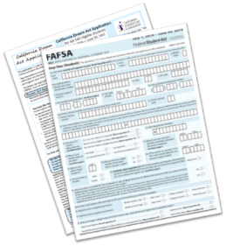
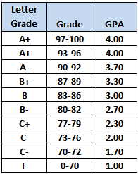
Cal Grant Award Process
Students must fill out a FAFSA or California Dream Act Application beginning October 1st, but no later than March 2nd
Schools need to submit student GPAs by the October 1st deadline
Matched!
+
OR
Application
Notes:
As you probably know, a Cal Grant is a state-funded grant that provides aid to California’s undergraduates, certain associate degree students, vocational training students, and those in teacher certification programs.
The Cal Grant application process has two components and both must be completed by the March 2nd deadline.
The first component is the application form. For many students that means the Free Application for Federal Student Aid or FAFSA. For undocumented students, however, the correct application is the California Dream Act Application (CADAA), which will be discussed in greater detail later.
The second component of the Cal Grant application process is an official student Grade Point Average (GPA), because a student’s GPA is a key factor in determining Cal Grant eligibility. CA Education Code 69432.9 mandates public high schools and charters to electronically upload GPAs for their seniors by October 1st of each year, although the Commission opens the GPA upload functionality as early as May.
A best practice is to submit as early as possible so that students will have the opportunity to be awarded early. It also gives schools more time to receive technical help if they need it. For those of you who are new, electronic GPA submission is not only a critical component of financial aid for your students, it’s also the law for public high schools and highly recommended for all schools.

Slide 17
Cal Grant: Qualifying Factors
Income & Assets
GPA
Financial
Need
Program
Enrollment
Notes:
Once the FAFSA/CADAA has been successfully submitted on-time AND the corresponding GPA has been matched to it, the student will be considered for a Cal Grant. Each Cal Grant has different qualifying factors. The Cal Grant program is divided into three different awards, Cal Grant A, B, and C. The GPA submitted has an impact on qualifying for A or B, or in some cases both. In order to qualify for any of the three programs the student has to have financial need as well as be under the income & asset ceiling reported for 2020-21. Students also need to be enrolled in specific programs in order to be eligible for certain Cal Grants.
Income & Assets/Financial Need: Students must be under the income & asset ceilings, and must have sufficient financial need. “Financial need” is determined by the following calculation, and must meet minimum requirements. The Cal Grant B has a lower income threshold and lower financial need requirement because it was designed for students with lower incomes.
Financial Need Calculation: Financial Need Requirements:
Cost of Attendance (COA) Cal Grant A & C: Max Cal Grant award + $1,500
- Expected Family Contribution (EFC) Cal Grant B: At least $700
Unmet Financial Need
GPA: A student’s GPA has an impact on qualifying for Cal Grant A and/or B. The GPA requirements are: Cal Grant A: 3.0, Cal Grant B: 2.0, Cal Grant C: No GPA requirement
Program Enrollment: Certain Cal Grants require students to be enrolled in specific programs:
Cal Grant A: Minimum 2-year program leading to an Associate or Baccalaureate degree
Cal Grant B: Minimum 1-year program leading to a Certificate, Associate or Baccalaureate degree
Cal Grant C: Minimum 4-month program coded as a vocational/technical/occupational program

Slide 18
Award Cycles
CAL GRANT A & B
ENTITLEMENT
COMPETITIVE
Unlimited
FAFSA & CADAA filers
Limited (12,570)
FAFSA filer priority
E1
HS Seniors & last year’s graduates
H.S. GPA
E2
Transfer from CCC>4-year university
2.4 CCC GPA
Any student who does not meet Entitlement requirements
Notes:
There are two types of Cal Grants: Entitlement and Competitive. While the actual Cal Grant itself is the same, i.e. an entitlement Cal Grant B pays the same as a competitive Cal Grant B, the student cohort being considered for the award is different.
Here’s the only thing you need to remember: Entitlement Cal Grants are guaranteed for students who meet eligibility requirements. Competitive Cal Grants are also great, but much more difficult to get.
NEW!
Dreamers are now eligible for a Competitive Cal Grant effective 2019-20. However, implementation and system programming to include CADAA applicants is still being worked on. Stay tuned!
You don’t need to remember all of these details. Just remember that uploading GPAs on time and preparing your students to start college right after high school will ensure their best opportunity to receive a Cal Grant.

Slide 19
Entitlement vs. Competitive
Entitlement: Guaranteed for students who meet financial and merit requirements
Unlimited awards
March 2nd application/GPA deadline
High school Entitlement (E1): Seniors + prior year grads
Transfer Entitlement (E2): Students who transfer directly from CCC to 4-year university and are under age 28 by 12/31 of the award year
Students enrolled in a CCC Bachelor program are eligible for E2
Cal Grant A & B
Competitive: All other students who do not qualify as High School Entitlement or Transfer Entitlement applicants
Limited to 25,750 awards annually
FAFSA filers are given priority
Notes:
Note: Competitive applicants, just like Entitlement applicants, must provide an on-time GPA & FAFSA/CADAA in order to receive Cal Grant consideration.
Why are entitlement Cal Grants easier to get? Basically, if a student meets the requirements, they are entitled to receive a Cal Grant. PLUS, the state does not put a limit on the number of Entitlement Cal Grants which can be awarded, nor the total dollar amount that can be disbursed to students meeting the basic eligibility requirements. High school graduates and last year’s graduates are eligible for Entitlement Cal Grants as long as the FASFA/CADAA and GPA are received by March 2nd. This is why it is essential to upload GPAs early. Meaning that the easiest time for them to be awarded a Cal Grant is when they graduate from high school, or the year after that.
So what is a competitive award?
A competitive award is a Cal Grant that is awarded based on a scoring matrix. Unlike entitlement awards, competitive awards are limited. Generally speaking, any student who is not awarded a Cal Grant Entitlement award will be considered for a Cal Grant Competitive award. But let’s do the math. Nearly 300,000 students are considered for 41,000 Competitive awards (increased in 2019/20 from 25,750). Students who do not receive a Cal Grant as E1 could have another opportunity for an Entitlement award if they transfer from a Community College to a 4-year (E2). If students do not get a HS Entitlement or Competitive Cal Grant A or B, they have another shot at an Entitlement Award if the following apply:
Transfer Entitlement (E2):
Students who were not previously awarded
Transfer directly from a CA community college to a 4-year university
Under age 28 on December 31 of the award year
2.4 Community College GPA (submitted by the Community College)
Community College enrollment file (submitted by the Community College)

Slide 20
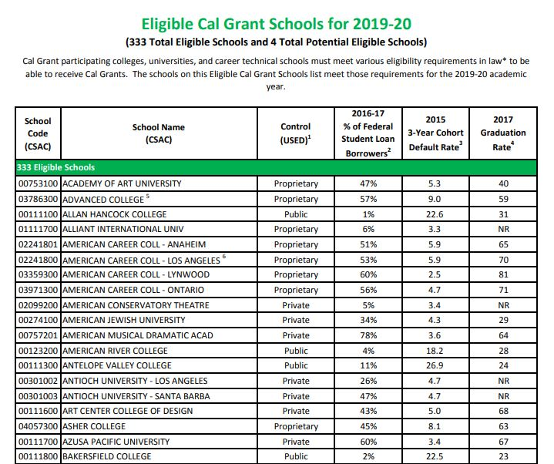
Cal Grant Eligible Schools
www.csac.ca.gov
Notes:
The 2019-20 Eligible Schools list is usually released in November every year, after the Department of Education certifies CDR and graduation rate data in October. To be awarded and paid a Cal Grant award, students must list and attend a Cal Grant eligible college on the FAFSA/CADAA. It is a common misconception among students that the Cal Grant can be used at any college as long as its located in the state of California. While it is true that all public colleges - California community colleges, CSUs and UCs - are eligible, not all private colleges meet Cal Grant eligibility standards.
To help protect both students and state funds, private colleges must meet specific standards to be eligible to participate in the Cal Grant program:
Participates in the Federal Pell Grant program (Title IV), +2 of the following federal student aid programs:
Federal Work Study Program (FWS)
Federal Direct Loan Program
Federal Supplemental Educational Opportunity Grant Program (FSEOG)
In addition, schools with 40% of federal student loan borrowers must also meet the following:
3-year CDR less than 15.5%
2-year graduation rate greater than 30%
Students who wish to be considered for the Cal Grant award should list a Cal Grant eligible college on their financial aid application. Students can search by college name, by city, or by segment. In order to receive notice of their Cal Grant award, the college must be on our eligible colleges list – so please remind your students.
The 2019-20 Cal Grant Eligible Schools list can be found here: https://www.csac.ca.gov/sites/main/files/2019_20_eligible_cal_grant_schools.pdf

Slide 21
Cal Grant A
GPA Minimum: 3.0
Degree Requirements:
Minimum 2 year program
Associate or Baccalaureate Degree
Award Coverage:
Up to 4 years of tuition & fees at eligible California schools
Notes:
Cal Grant A has a minimum GPA requirement of 3.0; and provides assistance with Tuition and Fees for Associate or Bachelor degree programs that are at least 2 years in duration. Cal Grant A awards for students attending a CA Community College are put on CC Reserve for up to 2 years, and a 3rd year of reserve can be requested by students via their student portal.
For academic year 2019-20, the Cal Grant A maximum (up to) award amounts are as follows. Keep in mind that these award amounts may change as the state budget is passed each year:
UC: $12,570
CSU: $5,742
Private colleges fall into 3 categories and maximum (up to) awards are as follows:
For-profit, Western Association of Schools and Colleges (WASC)-accredited: $8,056
For-profit, non-WASC: $4,000
Nonprofit institutions: $9,084
The Cal Grant A cannot be disbursed at a California Community College; rather, the award is kept on reserve for up to 2 years, at which time the award will be payable at a 4-year, tuition-and-fees-charging institution. This is because technically, community colleges charge enrollment fees rather than tuition and fees. The Community College reserve is automatically granted for two years, and can be extended to three years by student request via the student portal, WebGrants4students: https://mygrantinfo.csac.ca.gov/
* New in 2019-20: Students with dependent children may be eligible for up to a $6,000 Access Award. Students who receive this Access Award will begin to use eligibility with their first disbursement. Therefore, for students at a CCC who receive this award, the CC Reserve does not apply.

Slide 22
Cal Grant B
GPA Minimum: 2.0
Degree Requirements:
Minimum 1 year program
Certificate, Associate or Baccalaureate Degree
Award Coverage:
Tuition & fees at eligible California schools for years 2-4
$1,672 Access Award for up to 4 Years
Notes:
Cal Grant B awards have a minimum GPA requirement of 2.0, and have lower income and asset requirements than the Cal Grant A. This award is for lower-income students and provides them with a living allowance (called an access award) as well as assistance with tuition and fees. This grant operates a little differently because in the first year, the vast majority of students receive only the $1,672 access award portion of the grant, with the award for tuition and fees kicking in the second, third and fourth year.
For a Cal Grant B, the coursework must be at least one academic year in length, and may be a certificate or degree program.
New in 2019-20: Students with dependent children may be eligible for up to a $6,000 Access Award.

Slide 23
The Student Success Completion Grant
Formerly the Full Time Student Success Grant
and the California Community College Completion Grant
A maximum of $1,298 annually for 12 through 14 units per term at a California Community College
A maximum of $4,000 annually for 15 units or more per term when enrolled
at a California Community College
Attend a California Community College - Receive a Cal Grant B or C award
Maintain a minimum of 2.00 cumulative GPA - Have sufficient unmet financial need
Maintain federal Satisfactory Academic Progress (SAP) standards while enrolled
Be exempt from nonresident tuition - Maintain full time attendance
Notes:
The Student Success Completion Grant became effective in Fall 2018. It is awarded to California Community College students who collect the Cal Grant B or C and are Full-Time . Students are required to enroll in 12 or more units, meet both college and federal satisfactory academic standards, and be exempt from nonresident tuition.
The award amount is $649-$2,000 per semester (24-30 units maximum, based on state funding).
For more information on The Student Success Completion Grant, visit this link: https://cccco.financialaidtv.com/play/60629-community-college-student-success-completion-grant/60631-what-community-college-student-success-completion-grant

Slide 24
California College Promise Grant
Formerly known as the BOG Fee Waiver
The California College Promise Grant (formerly Board of Governors or BOG Fee Waiver) is available to students who are California residents attending California community colleges. Per-unit enrollment fees (currently $46 per unit) are waived for eligible students
There are three types of CA College Promise Grant fee waivers:
CCPG A-- For students and/or a student's parent who are currently receiving some form of public assistance (AFDC, TANF, CalWORKs, SSI, and General Assistance).
CCPG B -- Based upon current household size and total 2017 income for the student and/or student's parent(s). Income standards are provided by the state Chancellor's Office. A CCPG B may be awarded based upon the income and household size information provided on the FAFSA or California Dream Act application.
CCPG C -- Must demonstrate at least $1,104.00 worth of financial need in order to qualify.
Notes:
The California College Promise Grant (CCCPG), formally known as the Board of Governors Fee Waiver, is administered by California Community Colleges (CCC), and waives enrollment fees for qualifying students attending CCCs. The California College Promise Grant will waive your per-unit enrollment fee (currently $46) at any community college throughout the state.
To participate in the CCCPG, students must:
Enroll at a CCC
Be a CA resident, or AB 540-eligible
Have sufficient financial need
Maintain a GPA of 2.0 or higher
Complete more than 50% of coursework attempted
For the 2017-2018 academic year, nearly one million California community college students received a California College Promise Grant, totaling more than $7.6 million in financial aid.
For more information, visit: https://icanaffordcollege.com/Financial-Aid/California-College-Promise-Grant

Slide 25
Cal Grant B Access Award
To hold or not to hold at the Community College?
Hold?
Use?
Year 1 | Year 2 | Year 3 | Year 4
Award on hold | Award on hold | 2 Years Remain | 1 Year Remains
Community College Only Access |  | Four Year University Access + Tuition/Fees
Year 1 | Year 2 | Year 3 | Year 4
4 Years Remain | 3 Years Remain | 2 Years Remain | 1 Year Remains
Community College Access Only |  | Four Year University Access + Tuition/Fees
Four Year University
Access + tuition/fees paid
Notes:
First a little background information: the Cal Grant B, unlike the Cal Grant A (except for students with dependent children), can be used at a Community College. Students who use their Cal Grant B award at the Community College receive the “Access” portion of the award; basically a stipend, of $1,672 each year to help cover the cost of books, supplies, parking or any other expense related to their education. They are also using up some of their Cal Grant eligibility in doing so. The issue is that these students are often told to put their Cal Grant “on hold” while they are at the community college (where the cost of attendance is LOWER) and save it for the 4-year school (where the cost of attendance is HIGHER)….the idea being to save the Cal Grant award when students need it the most. While the intent behind putting Grant B on hold while at a CCC is well-meaning, in reality, this may result in students losing out on Cal Grant funds.
When a student is awarded any Cal Grant, the clock “starts ticking” in two different ways. The first way, obviously, is that as the Cal Grant is paid out, the corresponding amount of eligibility is used. So when the first year is paid in full, that would leave three years worth of payments. The second way has to do with the student’s educational level. When a high school student graduates and starts college, they are considered to have an educational level of one, i.e. they are freshmen. Even if a student isn’t paid, their education level could become a factor in their remaining Cal Grant eligibility. Also remember that once a student has received a Bachelor’s degree, they no longer are Cal Grant eligible.
So whether it’s a good idea to put the Cal Grant B on hold until the student transfers to a 4 year school really depends on the individual circumstances for each student. There is no one size fits all when it comes to this scenario. Therefore, the student really needs to have those conversations with financial aid staff at their college and the 4 year college they plan to attend.

Slide 26
Cal Grant C
Program Requirements
Vocational/technical/occupational programs
At least 4 months in length
No GPA requirement
Eligible programs listed on USDE E-CAR report
Special consideration for priority occupations & long-term dislocated workers
2019-20 Maximum Award:
Award | CCC | Independent/ Vocational
B/S | $1,094 | $547
T/F | N/A | $2,462
Notes:
If a student is not eligible for a Cal Grant A or B, they could still be considered for a Cal Grant C if they enroll in an occupational or technical program of at least 4 months in length. Students still must meet all income and asset requirements and have financial need, as we discussed earlier. Unlike Cal Grant A or B, Cal Grant C has no GPA submission requirement. Students need to attend a Cal Grant eligible institution that offers a recognized program.
Once students are deemed financially eligible for a Cal Grant C, we ask for additional information via the Cal Grant C Supplement form via their student portal, Webgrants4students, https://mygrantinfo.csac.ca.gov/. The C Supplement form is scored, and students are ranked for eligibility based on certain factors, such as work history, educational history, and unemployment status. Bonus points are awarded for students enrolled in programs that prepare students for work in “Priority Occupations”, identified on the next page.
For more information about Cal Grant C, please visit https://www.csac.ca.gov/post/cal-grant-c-award.
New in 2019-20: Students with dependent children may be eligible for up to a $4,000 Access Award.

Slide 27
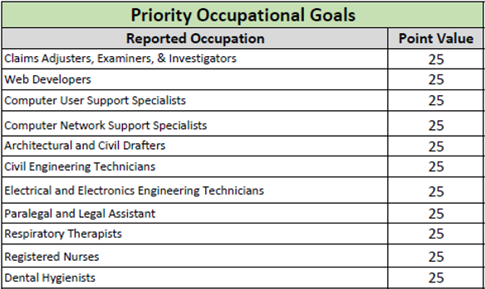
Priority Occupational List
Here is a list of priority occupations that students can potentially study for under the Cal Grant C. Extra points are given for priority occupations in the award scoring process.
Notes:
Here is a list of priority occupations that students can potentially study for under the Cal Grant C. Cal Grant C approved programs are identified on the Cal Grant C Occupational list, and the Priority Occupational list. Extra points are given for students enrolled in priority occupations, during the award scoring process.
Students who are preliminarily awarded the Cal Grant C complete the C-Supplement form and will select the occupation that most closely resembles the type of program they are enrolled in. If a certain occupation isn’t listed or does not closely resemble the student’s intended occupation, they can select “Other.” Extra points are given for priority occupations, however if the student selects “Other,” then they won’t receive those extra points.
In the past, priority was given based on a student’s occupational goal, but now applicants will only receive priority if they select a program that meets at least two of the following criteria:
•High employer need or demand
•High employment growth or industry cluster
•High employment salary and wage projections
•Economic security
For more information about Cal Grant C, and to see the standard Occupational list and the Priority Occupational list, visit https://www.csac.ca.gov/post/cal-grant-c-award.

Slide 28
Which Cal Grant is the Best?
All Cal Grants are free money for college that does not have to be repaid
Completing the FAFSA or the California Dream Act Application on time means that students have applied for all Cal Grants and the Middle Class Scholarship
The system will award the most beneficial Cal Grant based on the student’s need, qualifying factors and type of institution
The FAFSA application and the California Dream Act Application is one stop shopping for most financial aid
Notes:
While there are 3 different types of Cal Grants students can receive, it is important to note that students can only receive one type of grant at any given time, A, B, or C. When students apply for a Cal Grant, they are not applying specifically for just the Cal Grant A or just the Cal Grant B, they are being considered for all three types of Cal Grants as well as the Middle Class Scholarship. In the event that students meet the requirements for multiple grants, the grant deemed most beneficial is applied and students will be notified of the Cal Grant awarded.
Students who are not awarded a Cal Grant after graduating High School still have the opportunity to receive an entitlement award the following academic year if their high school uploads a GPA for their past year graduates. For students at a Community College who do not have a Cal Grant, they may receive a ‘Transfer Entitlement” Cal Grant if they transfer to an eligible four year institution and meet the age and GPA requirements.
For additional information and FAQ about Cal Grants, please use this link:
https://www.csac.ca.gov/post/faq

Slide 29
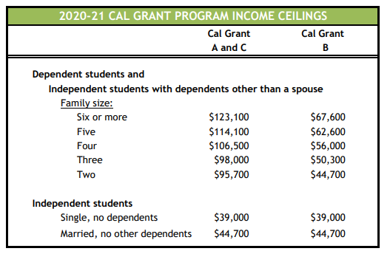
2020-21 Income Ceilings
Notes:
The income and assets of a student or a student’s family is one of the eligibility factors for receiving a Cal Grant. Each year the Commission publishes income and asset ceilings for the Cal Grant Program. These ceilings are subject to change until the annual state budget is passed. Please note that income ceils are contingent on family size and type of award.
For the most up-to-date Cal Grant income and asset ceilings please use this link:
https://www.csac.ca.gov/post/cal-grant-income-and-asset-ceilings

Slide 30
The “No Cal Grant Zone”
Yes. While the income is over the ceiling for Cal Grant B, the GPA and income will allow the Cal Grant A to be awarded.
No. Unfortunately the income is over the ceiling for Cal Grant B and the GPA
is too low for Cal Grant A.
No. Even with a great GPA, the income is over the ceiling for both Cal Grant B and Cal Grant A.
Yes. The lower income and high GPA
will actually make the student eligible for both Cal A and Cal Grant B.
Possibly. When there is a significant change in circumstances, students need to work with their college financial aid office.
GPA
INCOME
Unfortunately, it is not uncommon for students to meet one requirement but not the other
But wait…Araceli’s parents were divorced recently and she now lives with her mother, who makes about $60,000 a year. Does she now qualify for a Cal Grant?
Let’s take a look at some examples. Will these students be eligible to receive a Cal Grant?
Students must meet certain income and GPA requirements to be considered for a Cal Grant
Araceli has a 4.0 GPA and her family of four made $115,000
in 2017. Does she qualify for a Cal Grant?
Cassie has a 2.80 GPA and her family of four makes $60,000. Does she qualify for a Cal Grant?
Jordan has a 3.92 GPA and his family of five makes $99,000. Does he qualify for a Cal Grant?
Fatimah has a 3.21 GPA and her family of three makes $41,500. Does she qualify for a Cal Grant?
Notes:
Let’s talk about something we’re going to call the “No Cal Grant Zone.”
Both the student’s GPA and the family income and assets are used to determine Cal Grant eligibility. It’s important for students to know how their GPA and family income are used in consideration for a Cal Grant and how they can be impacted by both. Remember that Cal Grant A and Cal Grant B have different GPA requirements and different income ceilings. We don’t want students to get caught “in the middle” of these requirements, that is to say with family income too high for a Cal Grant B, but a GPA too low for a Cal Grant A. In that case, they would not be eligible for any Cal Grant because they would be in the “No Cal Grant Zone”.
We recommend that you make students and their families aware of both the Cal Grant GPA requirements and the corresponding income ceilings during the students’ freshman year of high school.

Slide 31
California Dream Act
Notes:
Let’s talk about an important source of aid for California’s undocumented students, or Dreamers. The California Dream Act.
The California DREAM (Development, Relief, and Education for Alien Minors) Act is a package of California state laws that allow some undocumented children who were brought into the US to apply for and receive student financial aid benefits to attend California colleges and universities.
Undocumented students cannot file the Free Application for Federal Student Aid (FAFSA) to apply for federal and state financial aid for college. This means that without the California Dream Act, they would not have access to Cal Grants, one of the state’s main forms of financial aid.

Slide 32
Available Aid for Dreamers in CA
Cal Grant
Middle Class Scholarship
Chafee Grant (Current and former foster youth)
UC University Grant
CSU State University Grant
California College Promise Grant
Student Success Completion Grant
Educational Opportunity Program Services (EOPS)
Work Study Programs (*check with school)
Private Scholarships
Notes:
California is one of the only handful of states which has developed and implemented its own application for eligible undocumented students, in this case the California Dream Act Application.
Eligible students who complete and successfully submit the California Dream Act Application are eligible for a wide range of aid, including Cal Grants, Middle Class Scholarship, Chafee Grant, Institutional Aid, the California College Promise Grants (formally the Board of Governors fee waiver), Dreamer loans at UCs and CSUs as well as other aid and scholarships.
The Educational Opportunity Program (EOP) provides assistance through mentorship, academic programs, financial assistance, counseling/advising, and other campus support services to those who are first-generation college students, and/or from low-income and educationally disadvantaged backgrounds.

Slide 33
Available Aid for Dreamers in CA
Cal Grant B Service Incentive Grant Program
“California Dreamer Service Incentive Grant”
Beginning in 2019–20, Cal Grant B recipients who completed the California Dream Act Application can be considered for one of 2,500 Cal Grant B Service Incentive Grants of up to $3,000 per year.
Eligible students must perform at least 100 hours per quarter or 150 hours per semester of community or volunteer service and attend a California public or independent institution. CSAC will administer the program. Check CSAC e-mails for updates.
Notes:
Coming in 2020-21 – The Cal Grant B Service Incentive Grant Program. Participating student are eligible to receive a grant under the program for a maximum of eight semesters or 12 quarters. Once a student has met the minimum service requirement, the student is eligible for an award of up to one thousand five hundred dollars ($1,500) per semester or one thousand dollars ($1,000) per quarter. These is a limit of 2,500 eligible students simultaneously receiving grants.
For more information on the Cal Grant B Service Incentive Grant Program, please see this Special Alert, https://www.csac.ca.gov/sites/main/files/file-attachments/gsa_2019-23.pdf?1567614324

Slide 34
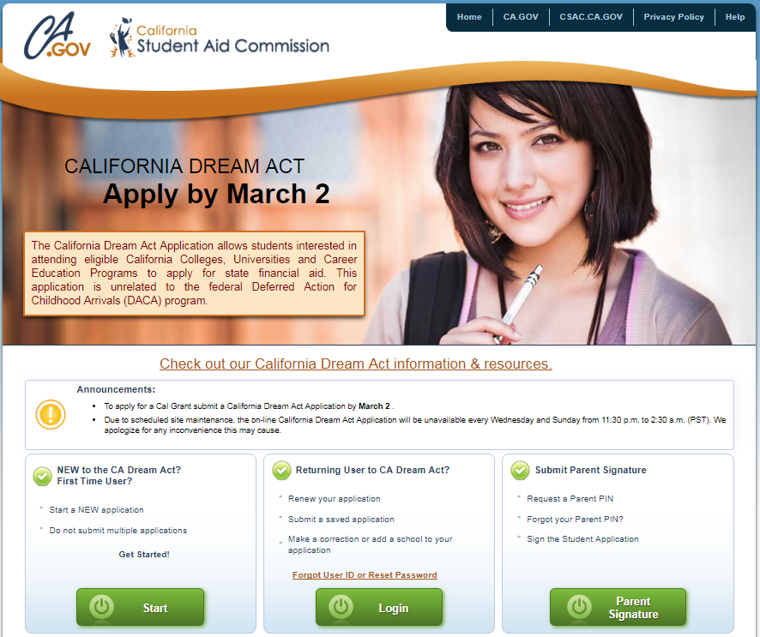
California Dream Act Application
When To Apply:
October 1 – March 2
Who Can Apply?
Undocumented Students
With or without DACA
TPS Status
U Visa Holders
Additional Requirements
Must be eligible to submit the non-resident tuition exemption
Males 18-25 yrs. old must register for Selective Service
Notes:
This California Dream Act Application home page can be found on the Student Aid Commission home page. Once on the site, students, their parents and schools can click on the California Dream Act Resources Page link where they will find all the resources they may need pertaining to the application and more.
New students starting their very first CADAA should click on “Start”. Returning students who are renewing their application for the new academic year should click “Login”, and parents who need to request a new pin, or recover their previous 4-digit electronic pin signature will click on “Parent Signature”.
To go to the California Dream Act Application page, please use this link:
https://dream.csac.ca.gov/
For a paper copy of the California Dream Act Application in English, please use this link:
https://www.csac.ca.gov/post/resources-california-dream-act-application
For a paper copy of the California Dream Act Application in Spanish, please use this link:
https://www.csac.ca.gov/post/resources-california-dream-act-application

Slide 35
AB 540 Requirements
Time and Coursework
Option A:
3 years HS credits and 3 years total attendance at any of these schools in CA
Elementary School
Middle School
High School
Option B (SB 68):
3 years attendance (or equivalent) at any of these schools in CA
High School
Adult School
Community College
Max. 2 years may be applied towards 3-year requirement
Notes:
As of Jan 1, 2018, California Education Code expanded some of the requirements under AB 540. To be eligible under AB540, students must meet 3 requirements. In the first requirement, SB 68 expanded on the equivalency of high school attendance to include adult schools, county office of education, unified school district or high school district, the Department of Corrections and Rehabilitation, and California Community Colleges. This expansion directly benefits students who do not have a California high school diploma or GED.

Slide 36
AB 540 Requirements
Degree or Transfer Eligibility
Graduation from a California High School (or the equivalent, GED, HiSET, TASC, CHSPE) or
Earned an associate’s degree from a California Community College or
Met the minimum requirements to transfer to a CSU or UC
Non-resident Tuition Exemption
Student files waiver (affidavit) with the college or university
Notes:
For the second requirement, SB 68 expanded the high school graduation requirements to include an earned associates degree from a CA Community College; or by meeting the minimum transfer requirements at a CSU or UC.
Lastly, for those with unlawful immigration status, the Non-resident Tuition Exemption waiver declaring that the student has filed or will file an application to legalize their immigration status must be submitted. The affidavit exempts qualifying students from paying nonresident tuition & certifies that students are eligible to apply for Cal Grant under the CADAA.
To see the Commission Special Alert regarding SB 68, please click here:
https://www.csac.ca.gov/sites/main/files/file-attachments/gsa_2018-07.pdf

Slide 37
DACA is a federal program
Valid for 2 years, subject to renewal
Protects individuals who came to the U.S as children from deportation
DACA issues SSN cards “valid for work only”
Submit GPAs using Non-SSN method vs. DACA SSN
DACA students file CADAA vs. FAFSA
Notes:
DACA (Deferred Action for Childhood Arrivals) is a federal program which recognizes undocumented immigrants who were brought here as children and affords them some protections once in the program. Those who apply for DACA and meet the eligibility requirements and background screenings for DACA are protected from deportation for two years and are issued a Social Security Card for work purposes only.
DACA is not a requirement to apply for financial aid with the California Dream Act Application (CADAA).
There are a number of resources to get up-to date information on the most current the status of DACA. Here’s one: https://www.nilc.org/issues/daca/
Another great resource related to supporting undocumented students is Immigrants Rising, which can be found through this link, https://immigrantsrising.org/

Slide 38
Selective Service
Males between ages 18-25 are required to register for Selective Service
Mail paper registration form
Registration card arrives by mail in 2-3 months
Reminder emails sent to male CADAA applicants 17-25 yrs.
SSN is not required to register. SSN field can be left blank
Leave Blank
Registering for Selective Service is a requirement to receive financial aid
Notes:
All males between the ages of 18-25 (including undocumented students) must register for Selective Service in order to receive their financial aid. For Dreamers, the Selective Service requirement can be a barrier as students may not realize they need to register or may be anxious about registering, because they fear their undocumented immigration status will somehow come to light. Selective Service does not share information about a male’s citizenship status and it is stated right on their website. Please make your students aware of this and emphasize that it is a requirement for financial aid. Undocumented students cannot register online, but must use the paper form and mail that in.
Because these students must register by mail, it is critical that they do so as soon as they are approaching their 18th birthday.
We suggest that you print out the form and make it available to your undocumented students. Please use this link to get the printable form.
https://www.sss.gov/Portals/0/PDFs/regform_copyINT_1.pdf

Slide 39
Request a Presentation
Immigrants Rising’s in-person presentations provide information and support so you can see what’s possible for undocumented students.
We cover diverse topics such as immigration law and policy, college access, in-state tuition, financial aid, career opportunities, and how to be a strong ally.
immigrantsrising.org/presentations
The Immigrants Rising
Presentation Team is
available to present at high schools, colleges and organizations in the Bay Area
Notes:
Immigrants rising (formally Educators for Fair Consideration - E4FC) is a San Francisco-based organization that supports undocumented students by advocating for opportunities for undocumented people to get an education, pursue careers, and build a brighter future for themselves and their communities. They offer a wealth of resources to students and to educators including a list of scholarships that don’t require proof of citizenship or legal permanent residency, information on getting legal help and resources about entrepreneurship and starting a business.
The Immigrants Rising website can be found here: https://immigrantsrising.org/
Here is also a link to Immigrants Rising’s Educational Resource Binder: https://immigrantsrising.org/resource/educational-binder/

Slide 40
High Schools
“Doing Your Part”
Notes:
Let’s cover the things that you, your school or your district can do to help ensure students are awarded a Cal Grant and that you can assist them along the way.

Slide 41
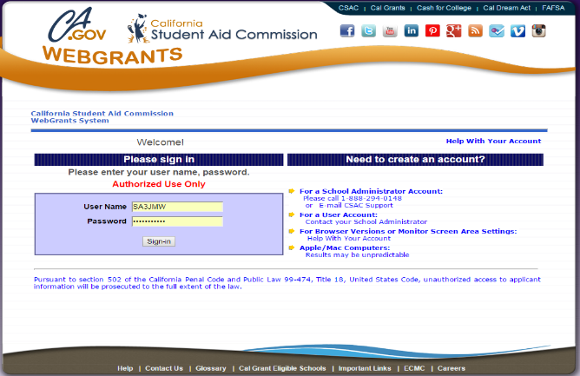
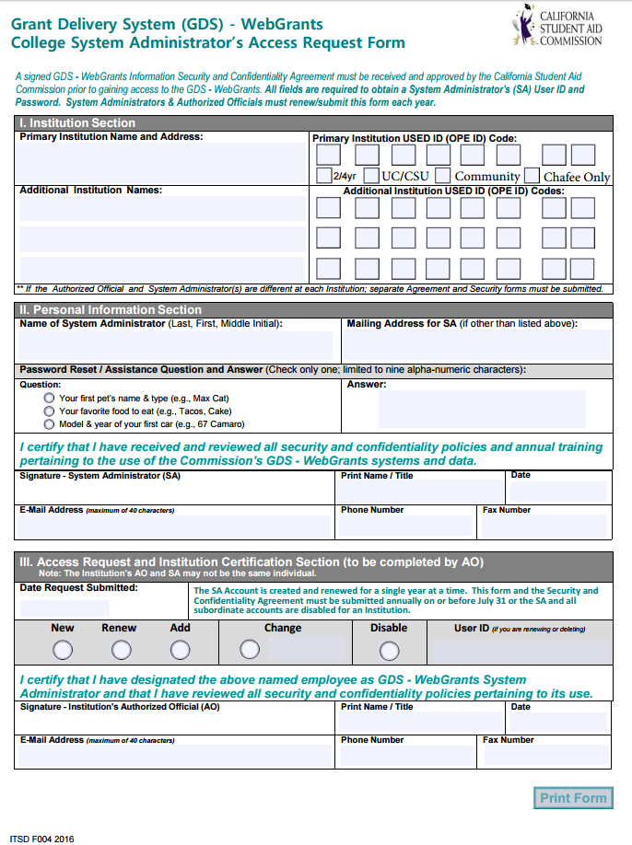
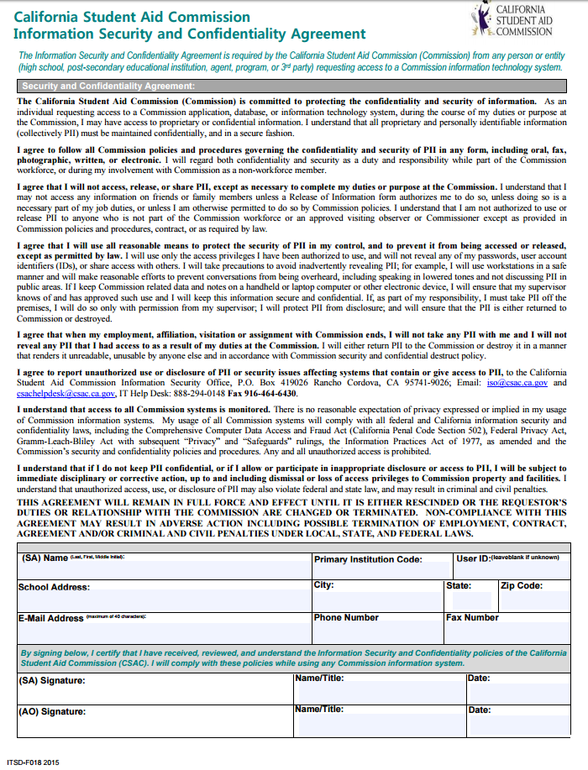
Establish WebGrants Access
Complete and submit:
WebGrants System Administrator’s Access Request Form
FAFSA/CA Dream Act Completion Program Agreement
*Both can be emailed to SchoolSupport@csac.ca.gov
Notes:
The WebGrants system is an important tool you will utilize, even if you don’t upload GPAs. In order to use it, you must first gain access to WebGrants by completing two forms: the High School System Administrator Access Request form and the Information Security and Confidentiality Agreement Form. One last form, the FAFSA/Dream Act Completion Agreement allows high schools and districts to receive certain FAFSA and California Dream Act application filling status information for their students.
WebGrants accounts for high school users are set with a 2 year expiration date, at which point updated forms need to be completed. These forms are available at the California Student Aid Commission’s website and must be submitted before access can be gained by your school. Remember – even if you are not the person involved in the GPA upload process, you still should have access to WebGrants in order to check reports, see which students have been awarded a Cal Grant and assist in the matching process if needed.
To access the forms you need to request WebGrants access, please use this link:
https://www.csac.ca.gov/post/access-forms

Slide 42
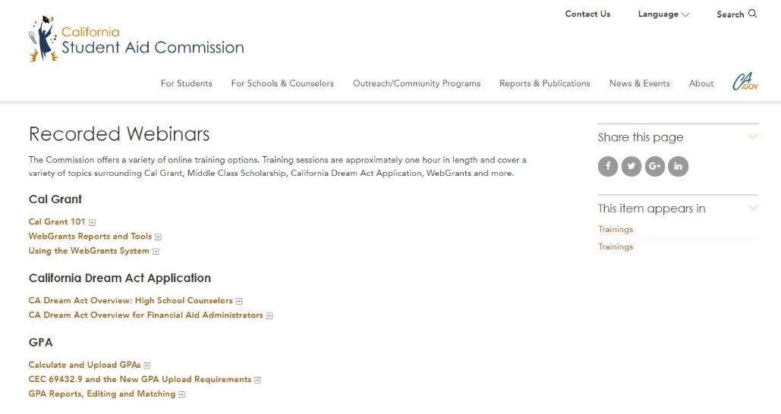
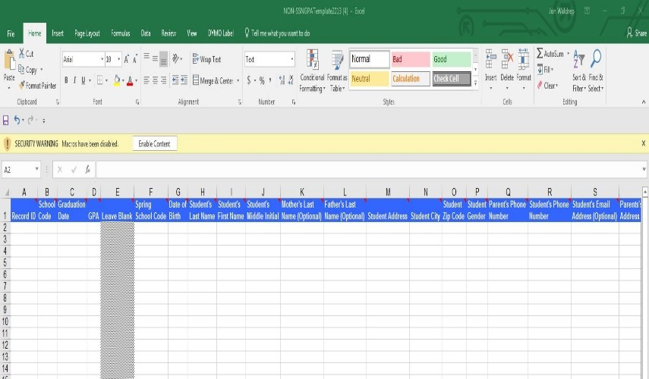
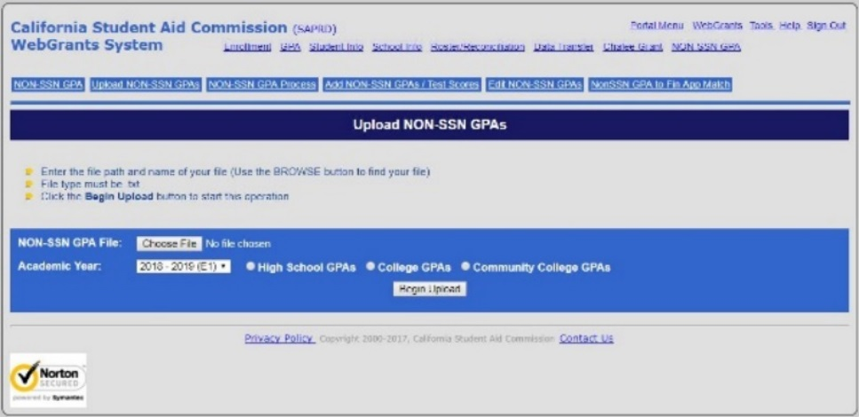
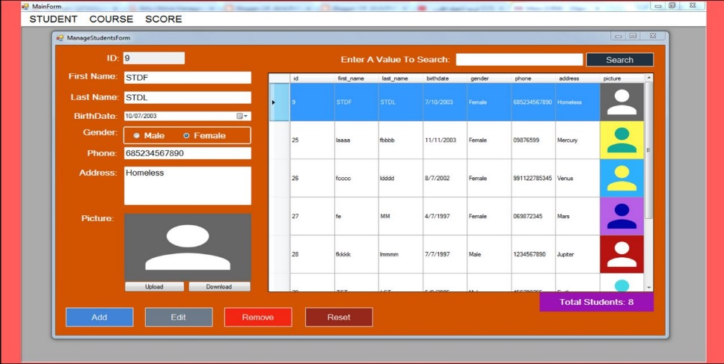
Getting Started: Uploading GPA’s
Remember – We have specific training for the GPA upload process
First – Download the Non-SSN GPA Upload User Guide
Finally – Upload the GPA text file you have created
Then – Download the Non-SSN GPA Excel Template
Or – Use your Student Information System to create a text file
Notes:
If you will be uploading GPAs for the first time, here are the first steps you should take. We are not going to go over all this information in great detail, but please remember we do have training materials on our website, offer live and pre-recorded webinars and are available by phone or e-mail to assist you.
Here’s what you need to do to get started. First – check out our training materials offered on our website or register for a live webinar that covers the NON-SSN upload process. Next - Download Non-SSN Upload User Guide. Then- Download Non-SSN GPA Excel Template. Finally – Upload the text file you created.
For the NON-SSN GPA UPLOAD user guide please use this link:
https://www.csac.ca.gov/sites/main/files/file-attachments/non-ssn_gpa_upload_user_guide_0.pdf

Slide 43
March 2nd Deadline for GPA uploads and Edit Screens
Notes:
The State of California mandates that public schools and charter schools upload GPAs electronically for their senior class by October 1st each year. We suggest that all schools upload GPAs by the state mandated date. March 2nd remains the hard deadline for GPA uploads. Although this is the absolute deadline, please don’t wait to upload GPAs.
March 2nd is also the deadline for schools to use the edit screens to make corrections and help match their students for Cal Grant consideration.

Slide 44
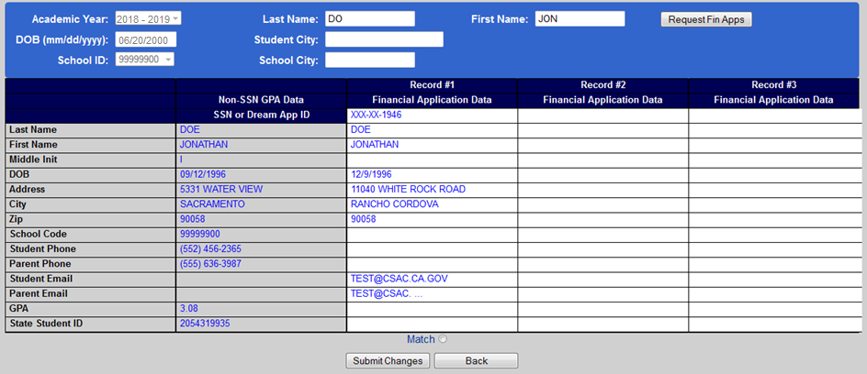
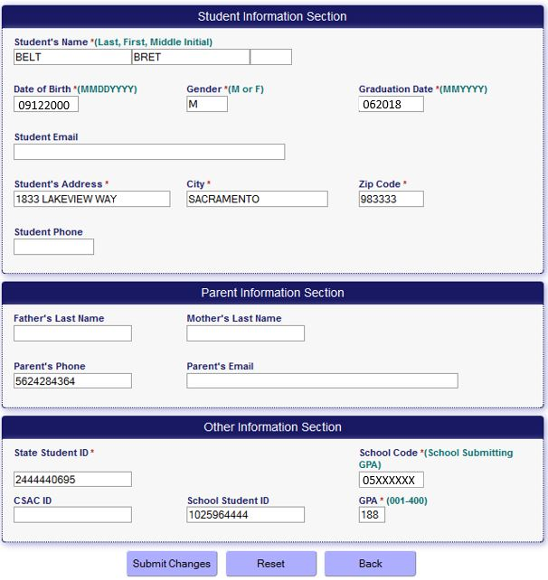
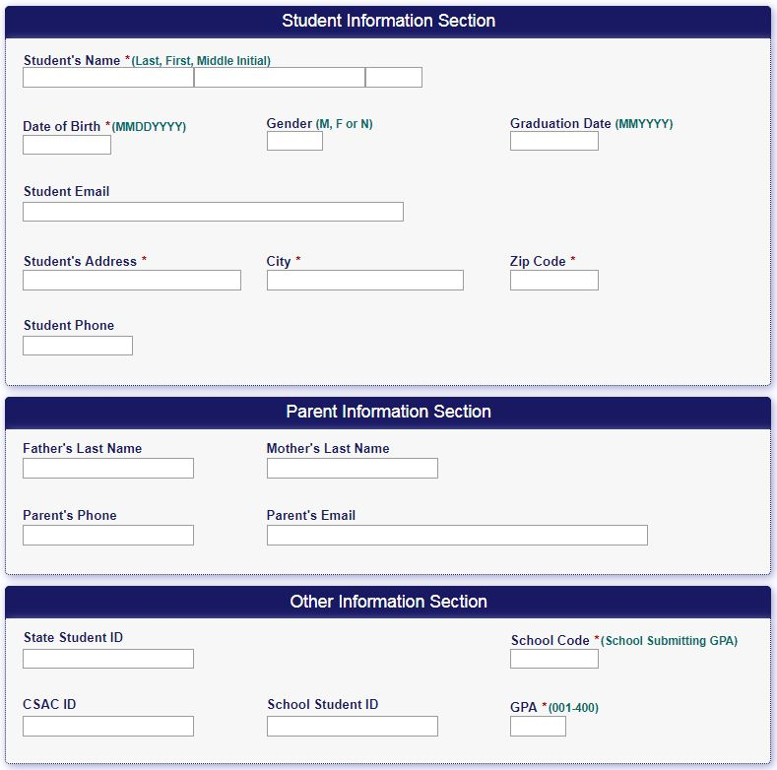
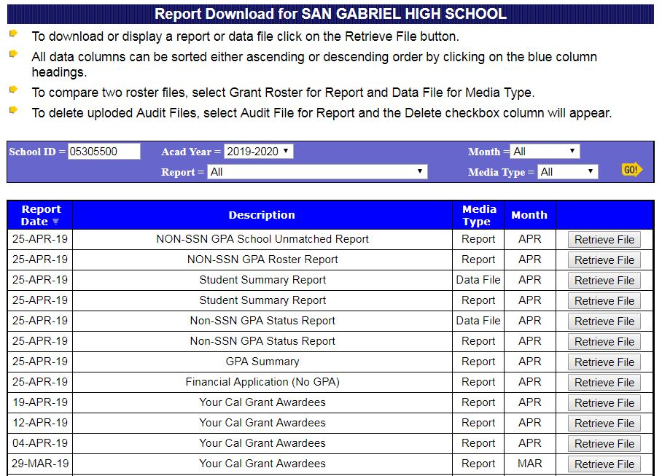
Why would I want WebGrants access if I don’t upload GPAs?
You will have the ability
to edit/correct GPA
data to help your students match
You will have the ability
to review your reports to check the status of all of your students
You will have the ability
to add an individual GPA for a student who wasn’t part of the original upload; i.e. late transfers, makeup credits
You will have the ability
to force match a student’s application to their GPA upload information
New training
modules available!
New training
modules available!
New training
modules available!
Notes:
WebGrants is the California Student Aid Commission’s internet-based access for Cal Grant grade point average (GPA) submission for high schools. While WebGrants provides a high school with the ability to upload Cal Grant GPA data, it also provides the ability to: Access reports, use online services, view your Cal Grant awardees, edit a record, add individual GPA and verify student high school graduation dates.
Please contact the California Student Aid Commission if you have any questions about WebGrants or WebGrants access.
E-mail: schoolsupport@csac.ca.gov

Slide 45
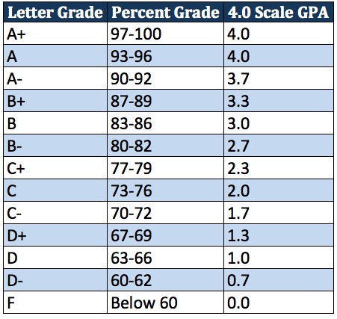
October 1, 2019 GPA Upload Deadline
By law, all public high schools and charters should upload GPAs electronically for their enrolled seniors by October 1st.
Schools shall provide students/parents with an opt-out option no later than January 1st of junior year.
Schools should verify high school graduation by August 31st. Students can also verify on their WebGrants for Students account.
Notes:
All schools should electronically upload Non-SSN GPA’s for all seniors by October 1st of each academic year, except for those students who have opted out.
Schools must create an opt-out option for students and parents.
Schools must provide this opt-out option to students no later than January 1st of the student’s junior year.
We recommend that schools consider passive permission for this opt-out process. For example, an e-mail to parents which states that parents must respond in order to have their student opted out of the electronic upload process.
Schools can create their own Opt-out form or use the one available on the CSAC website.
Schools should verify high school graduation by August 31st of the same academic year following graduation. Schools, school districts and county offices of education all have had the opportunity to upload GPAs.
For more information on the October 1st Deadline, please see this letter from the California Department of Education, https://www.cde.ca.gov/nr/el/le/yr19ltr0926.asp

Slide 46
GPA Calculations
Graduating Freshman or Sophomores
Provide a test score from a GED,
ACT, SAT, TASC or HiSet exam
Graduating Juniors
Use grades earned during 10th grade and the summer following 10th grade
Graduating Seniors
Use grades earned during 10th & 11the grades and summers following
Last Year’s Graduates
Grades earned during 10th, 11th and 12th grades and summers following
Notes:
Traditionally, high schools or districts upload GPAs for their current seniors each year. But there are times when a student will graduate early. Here is how you would handle the GPA upload, or equivalent process, for each academic year.
Most of you know that when submitting GPAs for your current seniors you will only use completed coursework from the 10th grade and the 11th grade and any summer school following those two grades. 9th grade coursework is never included and obviously you won’t include any 12th grade coursework because students are still in that academic year. Acceptable GPAs are unweighted and calculated using a 4.0 GPA scale.
For those students who have graduated from high school the prior year, or the “one year outs” you will use the 10th grade through 12th grade coursework. Once again, 9th grade year coursework is not included. All other rules are applicable to your one year out students.
One last note about uploading GPAs for your past year graduates: Please make that a separate GPA upload and ensure the graduation date is correctly reflected. Uploading for your previous year graduates benefits students who missed the March 2nd deadline, took a “Gap Year” after HS graduation, didn’t apply for financial aid the year they graduated or were disqualified for having GPA below minimum for Cal Grant A or B. Many past year graduates would benefit from having their GPA uploaded electronically!

Slide 47
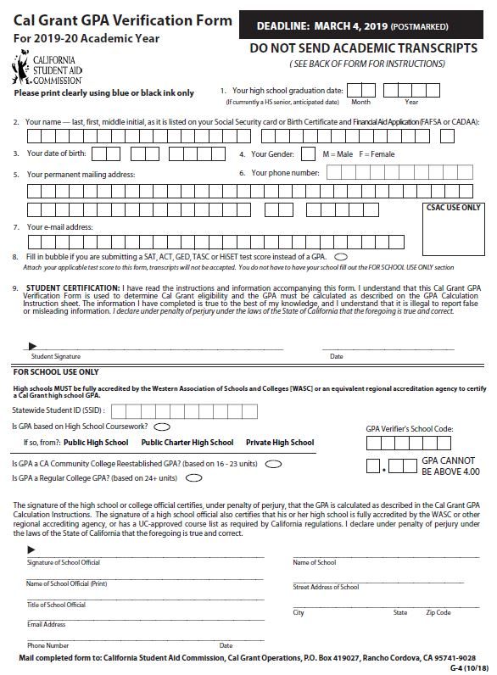
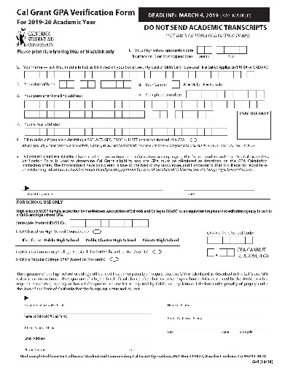
Alternative Academic Qualifiers Test scores converted to a Cal Grant GPA
Test Scores
SAT
ACT
HiSet
TASC
GED
Note: GED can be the equivalent to both a high school diploma and a GPA
Complete questions 1 through 9
Sign the form
Attach a copy of the testing score/report and mail to the Commission by the deadline
Allowed if
Student does not have a GPA
Student has coursework that can’t be converted to a 4.00 maximum GPA
Student attended a non-accredited high school or was home schooled
Notes:
As stated previously, a student’s GPA is a factor in the Cal Grant awarding process. If a student doesn’t have a qualifying GPA, either because their school isn’t accredited or grades were based on pass/fail, then students can submit proof of passing a high school equivalency test such as the GED, SAT, ACT, High School Equivalency Test (HiSET) or Test Assessing Secondary Completion (TASC). Those test scores are converted to a traditional GPA by the Commission, and the student will be processed for award consideration. Student cannot use test scores in lieu of a GPA. If a student has a GPA then a student must use their GPA.
For additional information about the GED, please visit this website: https://www.cde.ca.gov/ta/tg/gd/gedtest.asp
For additional information about the TASC, please visit this website: https://tasctest.com/
For additional information about the HiSET, please visit this website: https://hiset.ets.org/

Slide 48
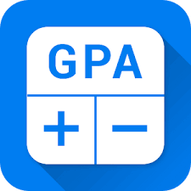
Dual Enrollment What is dual enrollment? How can it affect financial aid?
CAL GRANT
CAL GRANT
High School
Community College
400%
???
Dual enrollment - also known as concurrent enrollment - lets high school students earn college credit for college courses completed while they’re still in high school.
Notes:
Dual enrollment – also known as concurrent enrollment – is provided through three avenues in California, the most popular of which is the College and Career Pathways program. Authorized by Assembly Bill 288 in 2015, the College and Career Pathways program enables high school students to take college courses, taught by college professors, at their high school campus.
The two other dual enrollment programs – one that allows high school students to take college courses on a college campus, and a middle college high school model that integrates a high school ‘campus’ into a community college, also are popular.
It is important to remember that the Student Aid Commission will always want the high school GPA for any dually enrolled student. This is typically not an issue because most high schools upload GPAs early and many dually enrolled students do not obtain a sufficient number of college level units so as to allow a college GPA to be uploaded.
Please bear in mind that it is possible for a student’s financial aid eligibility to be impacted if they have a high number of college units when they graduate from high school.

Slide 49
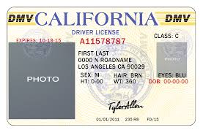
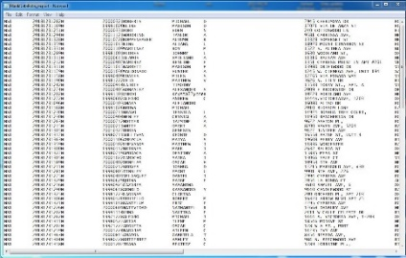
Most common reason for not matching?
Name and address mismatches
GPA Upload
Application
Legal Documents
We recommend that you provide your seniors with the name and address that the school or district will be using to upload their GPA
Remind students to double-check how their names appear on their IDs before completing a financial aid application
Notes:
We can think about the entire process of applying for financial aid as a series of steps. The one obvious component of each step is the student’s name and address and it is critically important in connecting, or matching, one part of the process with the other.
We recommend:
Providing your seniors with the name and address the school or district will be using to upload their GPA. This will alert the student to what will be on the GPA upload and allow them to either request a name change at the school, or to use the exact same name on their application if it is correct. This can be done by providing your students with the “GPA Demographic Verification” form, which can be accessed via CSAC’s webpage and it’s available in the resources section of the workbook.
Contacting us early if you anticipate a matching issue because of a name change, or any other change that would prevent a student from matching
Reminding students that one small error with their name or date of birth on their financial aid application (FAFSA or Dream Act Application) may result in weeks of delays in being processed for award consideration
Reminding students to double-check whatever forms of identification they have before completing a financial aid application. Remember, the college will want their award to be in the same name as their IDs
For a copy of the Cal Grant GPA Demographic Verification form please use this link:
https://www.csac.ca.gov/sites/main/files/file-attachments/g-28_2019_cal_grant_gpa_demographic_verif.pdf

Slide 50
High School Checklist
Upload GPAs by 10/1
Notify juniors of GPA Opt-Out option by 1/1
Edit unmatched GPAs
Match edited GPAs to corresponding FAFSA/CADAA
Assist seniors with creating WebGrants4Students accounts
Verify high school graduation by 8/31
Recommended: Provide demographic verification form in September to seniors in preparation for GPA upload to help prevent name and address mismatches
Notes:
It is the high school’s responsibility to upload, edit & match GPAs, and verify the high school graduation of students who do not self-certify via their WebGrants4Students portal.
The matching/editing process can begin 24 hours after GPAs have been uploaded for students who have submitted their FAFSA/CADAA. The matching process can continue after the March 2nd deadline, through late March.
To view GPA reports, you will need WebGrants access. If you are new to WebGrants, it may be helpful to pull up each report that you have available to you. Please contact the Student Aid Commission if you have any questions.
For link to GPA Matching and Editing Reference Guide, please visit this link: https://www.csac.ca.gov/sites/main/files/file-attachments/gpa_editing_matching.pdf?1570725688

Slide 51
After the Application:
Now what?
Notes:
Let’s take a minute to discuss things to consider after the student has applied with the FAFSA or California Dream Act application.

Slide 52
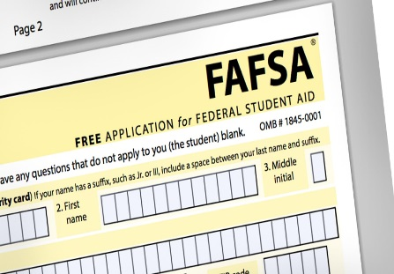
My students have completed their financial aid applications. Now what?
Tip: Students should
look for the Expected Family Contribution
(EFC) on their SAR (FAFSA) or CAL-SAR (CADAA)
Students should apply to all the colleges on their application, and add others, if needed
Have students create a WebGrants for Students account to claim their award & confirm their college of attendance
Ensure that applications are signed by students and a parent, and that they are submitted (not just saved)
Students need to
contact Federal
Student Aid- not
the Student Aid Commission- for
FAFSA corrections
Students should
contact CSAC to assist with any issues they have with the Dream Act Application
FAFSA Help
1-800-4FED-AID
(1-800-433-3243)
California Dream Act Help
(888) 224-7268 (students)
(888) 294-0153 (schools)
studentsupport@csac.ca.gov
Notes:
Make sure your students’ applications were successfully submitted.
Pro Tip: You can verify which students still need to complete their financial aid applications by checking the “Non-SSN GPA Status Report”. This report will show the students that were uploaded on their GPA upload and also provide financial aid application status.
FAFSA - After students submit their FAFSA, they should receive a Student Aid Report (SAR) within 3-5 days via e-mail. If they do not get this e-mail, have them log back into their FAFSA account to check for errors and make corrections if needed. If they need additional help, they can call or use the corresponding chat feature via the usage of the FAFSA website, https://studentaid.ed.gov/sa/fafsa
California Dream Act Application - After students submit their California Dream Act Applications, they will get a system generated e-mail that states the application has processed. If they do not get that e-mail, or think there is an issue with their application, please have them contact Student Support for assistance at the California Student Aid Commission at studentsupport@csac.ca.gov

Slide 53
What if…
Notes:
After the GPA has been uploaded and the application has been submitted there may still be things that must be done to allow that student to successfully process for Cal Grant consideration. Let’s take a look at some typical issues that may cause the student to not get awarded, or to not receive an initial award.

Slide 54
When Your Student is
Not Processing
Some common (and not-so-common) reasons a student may not process for or receive Cal Grant consideration
Was an on-time GPA received? Did it match?
Was the application submitted for the correct academic year?
Was the correct application (FAFSA vs. CADAA) completed?
Was the application submitted on time?
Was the application signed by a parent?
Was a paper parent signature page required?
Is the student a twin?
Are there unresolved errors on the application?
Was an ‘EFC’ generated?
Notes:
There are many reasons why a student’s application may not be processing. Some application errors will cause the application to not even be processed, and thereby will not give these students Cal Grant consideration. Please alert your students to help them prevent errors at the time of application submission:
Submit all applications for the correct academic year, by March 2nd
Create a WebGrants4Students account to monitor your application. Do the green checkmarks appear, indicating that both the application, and the GPA were received?
If the GPA field does not display a green checkmark: Follow up with the High School to submit the GPA (especially important for prior-year graduates)
(Dependent students) Ensure a parent signs the original application, and each subsequent application correction
Review the Student Aid Report for errors. Resolve any application errors
Always list a CA college on the application- even if planning to attend out of state- as a backup plan

Slide 55
When Your Student is
Not Awarded
Some common (and not-so-common) reasons a student may not process for or receive Cal Grant consideration
No California college listed/attending out of state
Not attended Cal Grant eligible school
Not enrolled in eligible program
Does not meet residency requirements
Not eligible due to income or assets above the ceiling
Not eligible due to low GPA
Student does not have sufficient unmet financial need
Notes:
There are multiple reasons why a student may not receive a Cal Grant.
In order receive Cal Grant consideration, meaning that CSAC will process the application: an on-time application and matched GPA are required. Students may not qualify because their income is too high, or GPA is too low.

Slide 56
Awarding Issues and Solutions
Issue | Solution | WebGrants Report | Student Outreach | Contact CSAC
Student’s name is different | Edit GPA Record | Non-SSN GPA Status Report | X
Incorrect DOB | Edit GPA Record | Non-SSN GPA Status Report | X
Mailing address is different | Edit GPA Record | Non-SSN GPA Status Report | X
“No ISIR Data Found” message | Speak with student | Student Summary Report | X | X
GPA matched to someone else (i.e. twins) | Speak with student, Edit GPA Record | Non-SSN GPA Status Report |  | X
Filed incorrect or duplicate financial aid app | File correct financial aid app, Contact CSAC (G-55 form) | Non-SSN GPA Status Report | X | X
No GPA submitted | Add a single GPA, not as a batch | Non-SSN GPA Status Report or Financial Aid (NO GPA) Report |  | X
Notes:
This chart shows common awarding issues & solutions. All of these errors can be corrected by high school WebGrants users before March 2nd. Any corrections after 3/2 are handled via the appeal request process, and require Student Aid Commission management review and approval.

Slide 57
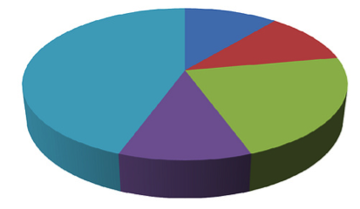
Students need to understand their Financial Aid Package
Cal Grant
Student Loans
Pell Grant
Institutional Aid
Work Study
California College Promise Grant
Student Success Completion Grant
Private Scholarships
It is important that students going to college have
FINANCIAL AID LITERACY
Notes:
Beginning 2020/21: AB 2015 (Reyes) requires public high schools & charters to provide instruction on how to complete the FAFSA/CADAA before entering 12th grade: https://leginfo.legislature.ca.gov/faces/billTextClient.xhtml?bill_id=201720180AB2015
It is important that students going to college have FINANCIAL AID LITERACY
Where is my financial aid coming from?
What was the application process for each type of aid?
What do I have to do to maintain eligibility for the aid I’m receiving?
How can I get updated information for each type of financial aid I am receiving?
How long will my financial aid last?
California College Promise Grant (Formerly known as the Board of Governors Fee Waiver)
The California College Promise Grant is available specifically for students at California community colleges. The California College Promise Grant will waive your per-unit enrollment fee (currently $46) at any community college throughout the state. For the 2017-2018 academic year, nearly one million California community college students received a California College Promise Grant, totaling more than $7.6 million in financial aid. https://home.cccapply.org/money/california-college-promise-grant
Student Success Completion Grant
With the Student Success Completion Grant, you could get up to $4,000 per year to help take more classes, ensuring you stay on track to graduate and get your degree faster. The more classes you take, the more money you’re eligible to receive. If you are a full-time student and a full-time Cal Grant B or C recipient, the Student Success Completion Grant will provide an additional $1,298 (if you’re attending 12-14 units per semester) or up to $4,000 (if you’re attending 15+ units per semester) annually. That’s on top of the annual Cal Grant awards you’re eligible to receive! So, you’ll want to take at least 15 units per semester to receive the most money.

Slide 58
The Summer Melt
When college intending-students fail to enroll in any college in the fall after high school
A high percentage of high school seniors who are accepted at a college never make it there. Who is affected the most?
How can we best help these kids make it to college in the Fall?
Teens who would be the first in the family to attend college
Connect students to community advocates and organizations
Black,
Hispanic and Latino
teens
Get students connected
to college mentors
Remind students to stay on top of their emails and respond timely
Help teens understand their financial aid status and the true cost of college
Teens who are
current or former
foster youth
Teens who come from low-income households
Notes:
The "summer melt" refers to the phenomenon of college-bound high school seniors who fail to matriculate into college. There are a number of complex factors that contribute to this trend—the sticker shock of the true cost of college, the absence of school support, confusion over paperwork, lack of parental guidance, and the teenage tendency to procrastinate.
This is why it is especially important for high schools to submit GPAs for 1-year-outs!
In order to best help these students, we can also:
Get them connected to college mentors
Connect them to community advocates and organizations
Remind them to stay on top of their emails and respond promptly
Help them understand their financial aid status and the true cost of college

Slide 59
Sunset of SSN GPA Upload
Beginning with the high school senior class of 2020 (award year 2020-21) the Commission will remove the capability for schools to upload student GPAs using Social Security numbers in WebGrants
We will continue to offer ongoing training for the NON-SSN GPA upload method
Notes:
Beginning in the 2020-21 award year (i.e. the high school senior class of 2020), the Commission will remove the capability for schools to upload student GPAs using SSNs in WebGrants. GPAs from that point forward must be submitted without SSNs, using the “Non-SSN GPA” method.
Schools should ensure their student information systems (i.e. Aeries, Power School, Illuminate, Infinite Campus) have the capability to produce GPA files in text (.txt) format without SSNs. We suggest that you contact your vendor directly, as we have no expertise in any of these systems. The Commission will offer live webinar training on a continuous basis to assist schools that are new to this process or need a refresher. Please check our training page regularly to view our upcoming webinars.
File path on WebGrants:
WebGrants --> Non-SSN GPA --> Upload Non-SSN GPA’s
(Photo is of Las Teresitas Beach in Tenerife)

Slide 60
GPA Upload Corrections
Password protected email if providing an SSN
List both incorrect and correct information
Provide your contact information in case we need clarification
Email: schoolsupport@csac.ca.gov
Notes:
We know how hard schools work to upload correct information, but sometimes errors occur. Let’s say incorrect information was submitted to the Commission. In order to make a correction, you could edit the information in WebGrants if the Non-SSN method was used and the GPA was not matched.
After the March 2nd deadline, if the incorrect GPA was submitted with a SSN or Non-SSN, you would send an encrypted email with the school letterhead requesting the correction. You will need to include all of the student’s information and clearly state what was incorrect and what is correct. Also, be sure to add your contact information, just in case we have questions or need clarification.

Slide 61
WebGrants 4 Students
Notes:
We have talked about the kinds of financial aid students can receive, and the resources available to you and your students regarding state funded financial aid; let us round out our discussion by talking about the steps students need to take to get awarded.
Citizens and eligible non-citizens, such as green card holders, should fill out a FAFSA to be considered for both state and federal aid. Undocumented students should fill out a California Dream Act Application to be considered for institutional and state financial aid. The corresponding application should be completed by the March 2nd deadline to give the student their best chance at receiving an award.

Slide 62
https://mygrantinfo.csac.ca.gov
Notes:
NOTE: WebGrants 4 Students is going through an upgrade and the look of the platform will change.
All students must create a WebGrants 4 Students account. The web address is https://mygrantinfo.csac.ca.gov/.
Once on this page, students should click on the create an account link, to create their account and log into the system.
It’s important that they create their account using the exact spelling of their name as provided on their FAFSA or California Dream Act Application. For example, if the student has a hyphenated last name listed on the application, they should be sure to use that same hyphenated last name when creating a Webgrants 4 Students account.
Until we complete our WebGrants upgrade, please let students know that mobile devices like smartphones and tablets are not compatible with our system. Students should use a laptop or desktop computer to avoid compatibility issues. It’s important to note WebGrants is only compatible with Internet Explorer or Mozilla Firefox web browsers when using this website.

Slide 63
Main Menu – Action Items
Create a WebGrants for
Students Account
Confirm School or Make a School Change
Confirm High School
Graduation
Notes:
These requirements are only for students who have been awarded a Cal Grant.
The Cal Grant link will take your student to the Cal Grant Main Menu. If there is a stop sign, that means the student must complete the requirements listed by following the posted links. The student may be presented with up to two requirements: Confirmation of School of Attendance and/or Certify High School Graduation Date. These requirements must be completed for the holds to drop off in order for the student to be paid their Cal Grant.
The confirmation of the school (college) of attendance becomes active in February and the high school graduation confirmation link will become active beginning on the first day of the month in which the student will be graduating. For example, if a student will be graduating on June 15th, the High School Graduation confirmation link will become active in WebGrants beginning on June 1st.

Slide 64
Confirming School of Attendance
Notes:
Let’s take a look at the first requirement: Confirmation of School of Attendance. This is where students will confirm what college they plan on attending.
Beginning in February, students who have been awarded a Cal Grant can begin to confirm their school (college) of attendance. We realize that most students still won’t know what school they will be attending until much later, often not until schools start to send acceptance letters. That is not an issue. Students can confirm their school of attendance at any time once that window is open. If the school of attendance changes, students can simply perform a school change on their WebGrants 4 Students account.
After clicking the Confirmation of School of Attendance link, students will be presented with two options. If the school listed will be the school of attendance, they can simply make this confirmation right then and there. By default, we will show the first school listed on the student’s FAFSA or California Dream Act application.
If students end up going to a school they didn’t initially list on their FAFSA or California Dream Act Application, they will need to go back into the application first to add the new school before they go through this process.

Slide 65
School Change
Notes:
If the school listed is not the school they’ll be attending, they can request a school change by simply clicking on the Submit School Change link.
Make sure the correct award year is selected. The corresponding page will display the schools the student listed on their financial aid application, as well as the option to Complete a School Change to a completely new school.
Students must certify they’ve read and understood the statements presented with the school change then hit submit. Once they have completed this requirement, they will receive a notification that the school of attendance has been confirmed.

Slide 66
High School Graduation Verification
Notes:
Although high schools and high school districts are requested to verify their students’ high school graduation, students also have the option to confirm their high school graduation if their school has not completed this process. A student’s Cal Grant Entitlement award is placed on-hold until the high school graduation requirement is satisfied.
The student must select the option that best fits his or her current educational status. For the vast majority of students that will mean they have met all graduation requirements, so they will select option A, then certify, then hit submit.
Once the student has completed this requirement, they will get a notification that their high school graduation date has been successfully certified. Once all requirements have been completed, they will no longer be visible on the Cal Grant Main Menu.

Slide 67
New Student
Landing Page
Will replace WebGrants for Students
Students will be able to log into their accounts directly from the CSAC homepage
Compatible with multiple browsers and devices
All state financial aid that students are receiving listed in one place
Notes:
Here’s a mock-up of what the Student Landing Page might look like. This would replace the current WebGrants for Students accounts.
It is worth mentioning that not all programs will display for all students, but rather only those that are applicable to that particular student.

Slide 68
HS Graduation Verification
Only Cal Grant awardees who do not self-certify via student portal will require High School Graduation verification
Notes:
Like we said in the previous slide, although a student is able to self-verify their high school graduation, we count on the High School WebGrants administrator to ensure High School graduation verification is done for all students no later than 8/31 following graduation. The High School Graduation Verification screen is accessed from the GPA Menu in WebGrants. This screen is made available the month students graduate and it only lists your Cal Grant awardees. For example, if your students graduate in the middle of June then the screen is made available early June.
You can assist your students in verifying their graduation status by selecting from the following options. Students also have the option to do this in WebGrants for Students. You will select GRADUATED for students who graduated receiving a diploma. If you are certain a student did not or will not graduate, you will select NOT GRADUATED. This withdraws their award.
The Pending option should be marked for students who are still working on meeting HS graduation requirements. For example, they may be attending night classes, summer school or even attending an adult school program. After the student graduates, the school official must come back to this screen in WebGrants to release the award. The verification of graduation still needs to be completed or the student will be withdrawn.
When the ‘pending’ option is selected, students will receive a message in their WebGrants for Students account letting them know that the self-certification option is not available and to contact the Commission to certify their high school graduation. If the high school does not update the status, students will be required to submit a copy of their high school diploma and the high school graduation certification form (G-8). To obtain the form, students can contact Student Support at 1-888-224-7268 or at studentsupport@csac.ca.gov
You could also use this option for students who are no longer at your school. If the ‘Not graduated’ status was reported in error, the student can appeal to the Commission by providing their HS transcripts or Diploma reflecting their HS graduation date. The student has until December 31 of the award year to satisfy high school graduation requirements to retain their Cal Grant award.

Slide 69
Additional Information
&
Resources
Notes:
We would now like to go over some additional updates and resources available to you.

Slide 70
Race To Submit Dashboard
Leaderboard
Ranks schools based on % of completed applications with matched GPAs. 8 levels determined by the graduating class size
Export
Download data for all school districts, and counties in CSV format
Search
Interactive search with auto-completion to search by school names, districts, and/or counties
FAFSA/CADAA +
GPA
Aggregate counts of financial aid applications that have successfully matched to students’ GPAs.
FAFSA/CADAA
Applications
# of applications received from California high school seniors
Notes:
Winners of Race to Submit are chosen based on # of applications submitted with matched GPAs. Note: There are now 8 levels as opposed to 7.
The Race to Submit Dashboard (Dashboard) allows high schools, school districts, counties, students, organizations and the public to track schools’ financial aid application counts and Cal Grant awarding by academic year. The intent of the tool is to encourage teachers, counselors, and other school administrators to reach out to students and guide them through the financial aid application process to ensure timely submission by the March 2 Cal Grant deadline.
The Dashboard is updated twice per week and displays information by high school, school district, and county. The dashboard displays the following information:
• FAFSA/CADAA [submitted and completed]
• Number of Cal Grant applications [submitted and completed]
• Number of students eligible for Cal Grants
• Number of Cal Grant awards
Schools can compare their numbers against schools within their district, their county or check where they rank on the “Leaderboard.” The leaderboard is separated into 8 levels depending on a school’s graduating class size. Similarly, this data can be downloaded for analysis by clicking on the “Export” button.
To view Race to Submit Dashboard, please visit this link, https://webutil.csac.ca.gov/dashboard/

Slide 71
Race To Submit Dashboard
Remember
When the 2020-21 Dashboard becomes available, senior enrollment still reflects 2019 data
Updates
Senior enrollment is updated by CA Dept. of Education to reflect current senior class numbers at the end of the calendar year
Class of 2019
Class of 2020
Notes:
It is important to note that CSAC uses prior year certified October senior enrollment counts instead of current enrollment data because the California Department of Education (CDE) doesn’t release current enrollment data until April of the following year. CSAC will use updated senior enrollment data when we receive this data from CDE to determine the winners for Race to Submit. Obviously, senior enrollment counts may differ between the two years and the Commission has requested that CDE provide current senior enrollment data much sooner for purposes of the Race To Submit campaign. Discussions on the possibility of this happening are continuing.

Slide 72
Private Scholarships
FREE financial aid!
The majority will require one or more of the following:
Application
Essay
Letter(s) of recommendation
Transcript
Interview
Presentation
Engage in volunteer activities
The grand prize winner for the best tux and the best prom dress each gets $10,000.
Pokémon World Championship Scholarship
There are scholarships for almost everyone!
Clowns of America International Scholarship
Create-A-Greeting-Card Scholarship
Prom Guide's Cutest Couple Contest
Zombie Apocalypse Scholarship
Little People of America Scholarship
Notes:
Scholarships are free money for college. The majority of scholarship applications will consist of an application, a letter of recommendation (usually from a teacher, counselor, coach, community member, etc.), academic transcripts and the occasional interview. Often, the more prestigious or high award scholarships will often have an interview built into the selection process.
To view the Fastweb website, please visit this website, https://www.fastweb.com/
To view the Careeronestop website, please visit this link, https://www.careeronestop.org/
To view the Scholarships.com website, please visit this link, https://www.scholarships.com/
To view the Bigfuture website, please visit this link, https://bigfuture.collegeboard.org/
To view list of undergraduate scholarships that don’t require proof of citizenship or legal permanent residency, please visit: https://immigrantsrising.org/resource/list-of-undergraduate-scholarships/

Slide 73
The grand prize winner for the best tux and the best prom dress each gets $10,000.
Notes:
One of our favorite scholarships is the Duck Brand Tape, “Stuck at the Prom Scholarship” in which applicant must create and accessorize their prom outfit with duct tape. The grand prize winner for best tux and best prom dress each gets $10,000.

Slide 74
Notes:
Travis Credit Union is 209,991 members strong with more than $3.1 billion in assets, serving 12 counties with 24 branches. What sets Travis Credit Union apart from the rest is their commitment and dedication toward building authentic community impact through what they call their “Awesome Cause” – Financial Education, Financial Literacy and Financial Advocacy.
At Travis, they believe in sponsoring financial education programs and helping their members become financially literate and self-sufficient.
Learn more at: traviscu.org/awesomecause or follow them on social media at @TravisCU.

Slide 75
What is a Cash for College workshop?
FREE financial aid application assistance workshops
Financial aid experts and volunteers assist students and parents with completing the FAFSA, CA Dream Act and Chafee Applications
Why Partner with CSAC?
We administer the bulk of financial aid
We administer the California Dream Act Application
We provide $300 to campuses with qualifying workshops
We send educational and student-centered materials for free
We provide training videos and presentations for students & volunteers
We assist in acquiring volunteers and offer other resources and support
Notes:
Cash for College workshops are workshops in which families and their students can attain help in completing their FAFSA or CADAA or Chaffee Grant for Foster Youth applications.
During the 2019-2020 academic year, we will have hosted over 300 Cash for College workshops across the state.
Interested in hosting?
Register your school or organization at https://www.cash4college.csac.ca.gov/Organization/CCFC_CreateOrganization

Slide 76
Central Coast
Central Valley
East Bay
Long Beach
Los Angeles
Merced
Northcoast
Sacramento
San Diego and Imperial
San Francisco
San Jose
Santa Barbara
Solano
South County Gilroy
South San Joaquin
15 Regional Consortia Serving
126 School Districts
Notes:
California Student Opportunity and Access Program (Cal-SOAP), a program funded by the Commission, is another great student resource.
The Cal-SOAP is an organization that goes into schools in particular areas to raise achievement levels of low-income students. They focus on regions with low college participation rates and assist with tutoring, financial aid workshops and more. You can learn more about Cal SOAP on our website, https://www.csac.ca.gov/california-student-opportunity-and-access-program-cal-soap

Slide 77
List-Serv Notifications
Watch or listen to live or recorded Commission meetings! www.csac.ca.gov
Notes:
Another great resource, and one you should all subscribe to, is our listserv. There is a link to subscribe at the bottom of the Commission’s homepage at www.csac.ca.gov. Once you subscribe, you will receive operations memos and special alerts in your email to keep you up to date and informed about financial aid programs and operations. This is extremely important because as you all might know the world of financial aid keeps changing and there are always new updates.
Commission meetings can be followed live, but are also recorded so you can watch them any time. Be sure to check in to be better informed about the changes within CSAC and financial aid across California.
For link to list-serve sign up, please visit this link https://www.csac.ca.gov/pod/subscribe-list-serv

Slide 78
It’s easy to subscribe to the CSAC List-Serv!
Add your name
Add your e-mail
Chose your categories
Complete Captcha
Click Summit!
Notes:
Signing up for the CSAC List-Serv is quick and easy!

Slide 79
Training and Outreach
Financial Aid Nights
Dreamer Conferences
College Fairs
High School Groups
Tailored Webinars
Need more information?
Contact our Training and Outreach Unit
trainingandoutreach@csac.ca.gov
Notes:
The California Student Aid Commission may be available to provide training and/or attend outreach events such as:
Financial Aid Nights
Dreamer Conferences
College Fairs
Tailored webinars
Any training requests will be handled by the Institutional Support Unit, whereas Outreach requests (i.e. presenter request, tabling event, college fair, financial aid night) will be handled by our Specialized Program and Outreach unit. Either way, you will first need to submit a training request form, which can be provided to you by contacting the Institutional Support Unit. Because we are a small unit, we don’t have the resources to attend every event, so requests are reviewed on a case-by-case basis.

Slide 80
2019 Arthur S. Marmaduke
High School Counselor Award
Ms. Holmes implemented multiple Cash for College events over the past eight years.
She contributed to doubling the number of students who were awarded Cal Grants at West High School.
She initiated and implemented the idea of visiting West High School’s main feeder schools to inform incoming students about high school life, emphasizing the importance of taking the right classes, and getting involved in school.
She increased the number of students at West High School who have met the A-G requirements by 12 percent since she began visiting schools twelve years ago.
2018-19 Arthur S. Marmaduke Award Winner
Meagan Holmes (center),
West High School, Bakersfield
Notes:
The Arthur S. Marmaduke award is an award that goes to one outstanding California high school counselor who demonstrates exemplary skills in helping students fulfill their dreams of going to college. The high school counselor awarded receives a cash award. Counselors can be nominated by district and county leadership, school counselor/teacher colleague, and/or site administrators.
A Special Alert and other communications are released annually with details of the application process, including links to the nomination form and deadline, so please make sure have signed up our List-Serv e-mail communications.

Slide 81
Fund Your Future Magazine Use our EPubs ordering system
http://www.fundyourfuture.org
Notes:
We offer a resource called the Fund Your Future Magazine. We also have other online and printed publications available in different languages. To check what resources we currently have available, please check EPubs, https://webutil.csac.ca.gov/epubs/

Slide 82
Please take our survey
(and get this!)
Give specific feedback about this workshop:
what to add/remove
ways to improve content/flow
Directly impacts next year’s workshops
Complete the Survey and receive a training certificate
Notes:
We send all participants a survey following each workshop. We encourage you to respond to this survey to let us know not only what you thought about today’s workshop, but to offer ideas or suggestions on what additional material you would like to see added or changed. If you complete the survey but don’t get your Certificate of Completion within a few days after that – please check your spam folder. If you still don’t see it, please contact us.
Remember, most of the changes we make each year to our trainings come as a result of your input and suggestions.

Slide 83
Thank You for Attending!
Please
remember
to take
our survey
Check our website for
upcoming
trainings
Contact us
anytime for
assistance
California Student Aid Commission
Institutional Support Unit
1-888-294-0153
schoolsupport@csac.ca.gov
www.csac.ca.gov
Notes:
We want to thank you for attending this training. We hope the information we’ve provided today proves to be helpful to you in assisting your students. We know that you make a difference in the lives of your students and we encourage you to keep up the good work. Together we can changes lives and make education financially accessible to all students.
If you have additional questions that come up later, we encourage you to contact Institutional Support by phone or email. Please don’t forget to complete our survey so you can receive your Certificate of Attendance. Finally, if you are new to WebGrants or you just need a refresher on uploading GPAs or using reports, we have ongoing, live webinars on a number of those topics. Please check our website or contact us for additional information.

