Slide 2
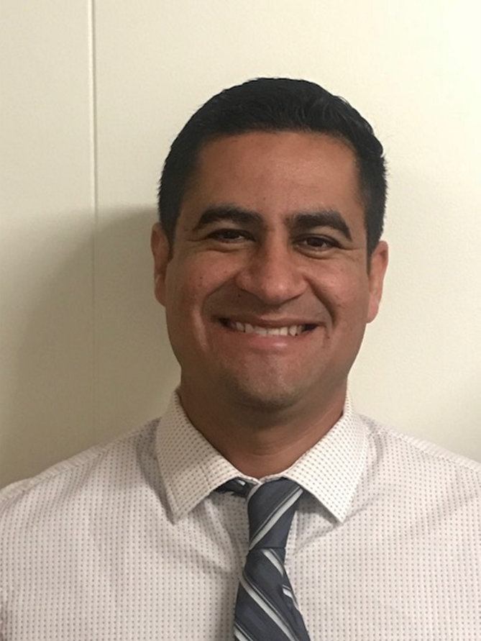
Catalina Cifuentes
Executive Director,
College and Career Readiness
ccifuentes@rcoe.us
Dr. Pedro Caro
Coordinator,
College and Career Readiness
pcaro@rcoe.us

Slide 3
Webinar Tips
This webinar is being recorded so that others may listen to it at a later time for reference and will be uploaded to the RCEC Youtube page as well as www.rcec.us once you log in to access the content of the webinar series
All connections to this live Webinar feature have been accounted for so please do not forward the Zoom link or invite anyone to join because you are taking someone else’s spot and Zoom will automatically start kicking off connections randomly
All participant mics have been muted and only panelists and facilitators have the ability to unmute anyone
Since all participants have been muted, please use the Q&A and chat screens to enter your questions
Participants can submit a question in the Q&A box at the bottom of the screen for the panelists
Only panelists and facilitators will be able to respond back to those questions and can do so publicly or privately to the individual
Participants can submit comments or questions in the chat box if they would like to engage with each other
**Every effort has been made to ensure the security of this webinar from “zoombombers” but in the event that we experience that, please stay calm and we will resume as soon as the technical difficulties have been resolved.**

Slide 4
FOR MORE INFORMATION AND RESOURCES PLEASE VISIT US @
www.rcec.us

Slide 5
A Counselor’s Guide to
Nicohl Shelton Webb
Pate’s Creek Elementary
Henry County Schools
nwebb@henry.k12.ga.us
www.twitter.com/counselorPCE
bit.ly/webbeginca

Slide 6
By the end of this session, you will be able to:
understand how Google can help with time management, data entry, tracking, and effectiveness.
understand how Google helps with collaboration.
begin implementing at least one application when this session ends or perfect your knowledge to add more to your toolbox

Slide 7
What is your Google experience?
Go to www.menti.com and put in the code 92479 in order to answer some questions about your journey with Google!

Slide 8
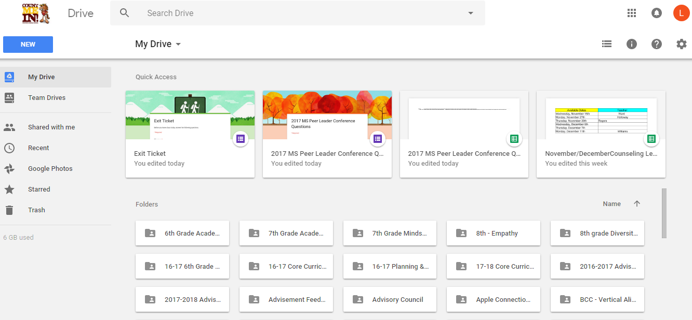
Google Drive
15 GB of free Google online storage, to keep photos, stories, designs, drawings, recordings, videos – anything.
Your files in Drive can be reached from any smartphone, tablet, or computer.
You can quickly invite others to view, download, and collaborate on all the files you want–no email attachment needed.
Create and collaborate with others. Share documents and files, build out spreadsheets and make a presentation on the fly with our Docs, Sheets and Slides apps.
You can also purchase a larger cloud storage plan as you need it.
https://www.google.com/drive/
Example:
Notes:
Nicohl

Slide 9
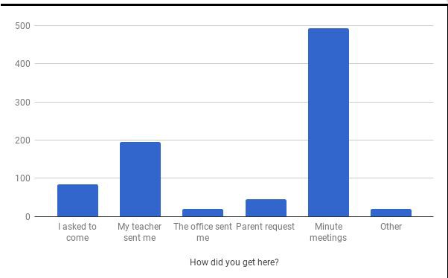
TOP TIPS WITH GOOGLE
Documentation
Data
Forms, Forms and More Forms
Google Classroom
Google Sheets
Google Keep

Slide 10
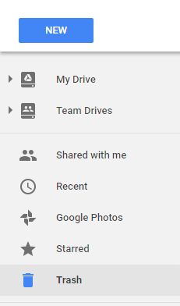
Google Drive
Create a shared storage space for a team. Never worry about things disappearing when a team member leaves!
Your home base for all folders, files, docs, slides, forms, sheets, and more!
When others share docs, slides, and other content with you, it will appear in “shared with me”
Quickly access your most recently viewed/modified documents
Notes:
Nicohl

Slide 11
Google Drive to Google Apps
Docs
Slides
Forms
Sheets
Notes:
????

Slide 12
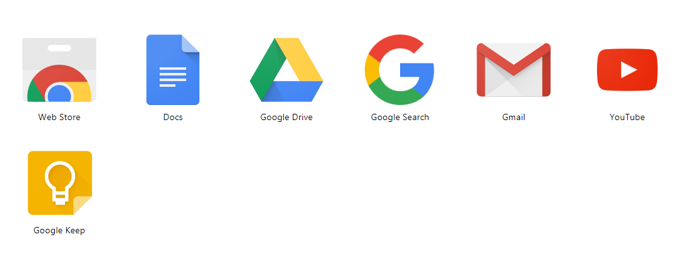
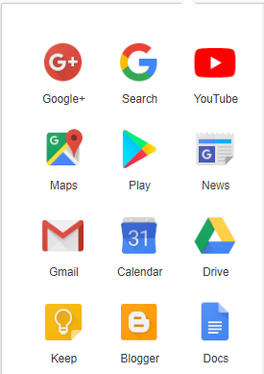
Accessing Google Apps
Notes:
????

Slide 13
Accessing Google Apps
Wherever you are Google is with you!
Notes:
????

Slide 14
Google Docs
Google’s version of Word
Free
Google Docs brings your documents to life with smart editing and styling tools to help you easily format text and paragraphs. Choose from hundreds of fonts, add links, images, and drawings.
Access, create, edit, and COLLABORATE your documents wherever you go — from your phone, tablet, or computer — even when there's no connection.
Everyone can work together on the same document at the same time.
https://www.google.com/docs/about/
Example:
Docs Example
Notes:
Nicohl

Slide 15
Google Slides
Google’s version of PowerPoint
Free
A variety of presentation themes, hundreds of fonts, embedded video, animations, and more.
Access, create, edit & COLLABORATE your presentations wherever you go — from your phone, tablet, or computer — even when there’s no connection.
Use for professional development presentations, core curriculum presentations, student created assignments
https://www.google.com/slides/about/
Example:
Slide Presentation Example
Notes:
Laura

Slide 16
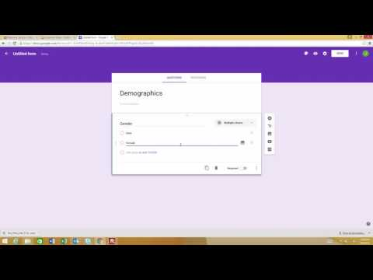
Google Forms
Free
Plan your next event, manage registrations, whip up a quick poll, collect email addresses for a newsletter, create a pop quiz, and much more.
Choose from a bunch of question options, from multiple choice to dropdowns to a linear scale. Add images and YouTube videos, etc.
Responses to your surveys are neatly and automatically collected in Forms, with real time response info and charts. Or, take your data further by viewing it all in Sheets.
https://www.google.com/forms/about/
Example:
Forms Example
Notes:
Dwight

Slide 17
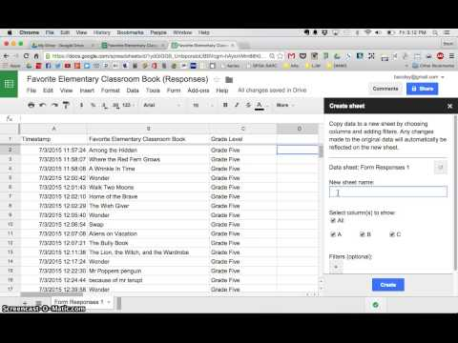
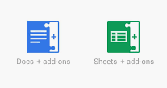
Favorite Add-Ons
Docs to Forms
EZ Query
Power Tools
Split Names
Yet Another Mail Merge
Add-ons are customized extensions of G Suite productivity applications such as Google Sheets, and Google Docs and Google Forms. Add-ons lets you create shortcuts quickly and easily.

Slide 18
Google faux pas
Have you ever shared a Google Doc, Slide, Sheet with a colleague to use, but they forgot to “make a copy” and they ended up editing your version? Click here for some easy steps to force someone to make a copy!

Slide 19
Examples of Paperless Forms Using Google
Needs Assessment for Teachers
http://goo.gl/forms/RzzcqCZ2jD
Mentor Program Referrals
http://goo.gl/forms/pyaxCoHZzE
Minute Meetings
http://goo.gl/forms/NPbRRXj1Ek
Notes:
????

Slide 20
Google Sheets
Google’s version of Excel
Free
Google Sheets makes your data pop with colorful charts and graphs. Built-in formulas, pivot tables and conditional formatting options save time and simplify common spreadsheet tasks.
Access, create, edit, and COLLABORATE your spreadsheets wherever you go — from your phone, tablet, or computer — even when there’s no connection
Everyone can work together in the same spreadsheet at the same time.
https://www.google.com/sheets/about/
Example:
Sheets Example
Notes:
Mike

Slide 21
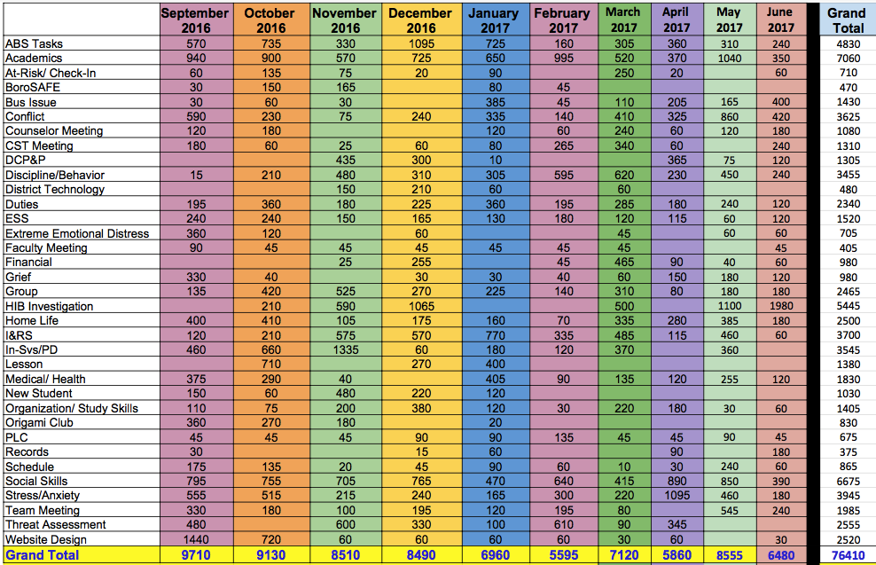
How can I:
keep an effective & efficient counselor log?
track data?
use data to advocate for my students and program?
Link to Google Sheet for Counselor Log/Data Collection (make a copy of it for yourself).
Taken from: https://www.angelacleveland.com/presentations

Slide 22
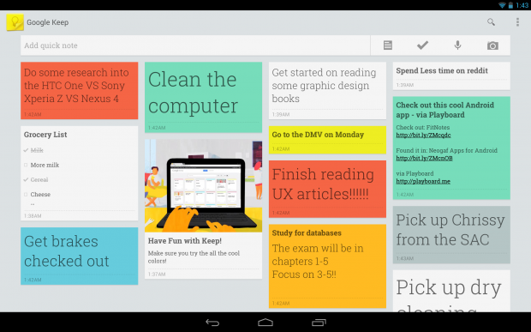
Google Keep

Slide 23
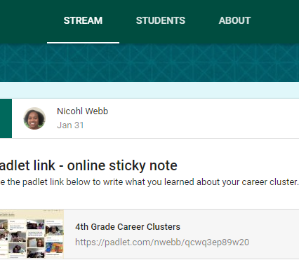
Google Classroom
Google Classroom is a free web service developed by Google for schools that aims to simplify creating, distributing and grading assignments in a paperless way. School Counselors can use this for Career Cluster lessons and to disseminate information.
How to get started with Google Classroom?
Example:

Slide 24
Why Google CLASSROOM?
Google Classroom encompasses the G Suite tools into an easy-to-use package that will help educators easily create a paperless classroom, distribute assignments quickly, and give real-time feedback to students. Educators can assign work to students based on their unique needs with options for differentiation. Best of all, it is a student-centered digital space that helps them stay informed, organized, on-task and gives students time to explore projects and assignments more deeply all on one platform that can be accessed on any device.

Slide 25
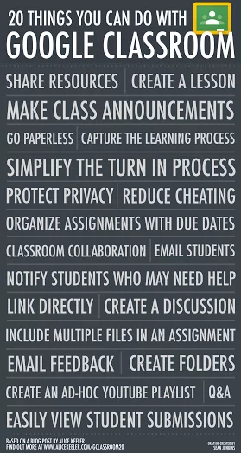
How can I use Google Classroom?
Post Class Announcements
Create a Discussion
Share Resources
Go Paperless
Email Students
Extra-curricular Club Communication

Slide 26
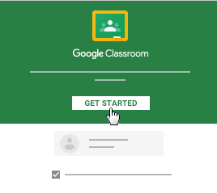
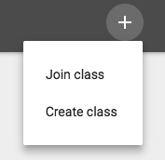
Create your First Class
Click the on the top right to create or join your first class
The next several slides taken from Hollie Sisk, Google Certified Educator

Slide 27
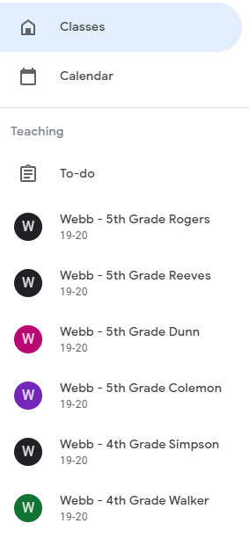
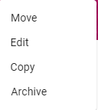
Classroom Home Screen
Create/ Join
Main Menu
Class Menu
You can drag the tiles to organize your classes
You can drag the tiles to organize your classes
Create/ Join
Drive Folder
Drive Folder
The Classroom Home Screen is where you will access and manage the classes you have created, co-teach, or are enrolled in.
Notes:
The Classroom Home Screen will house all of the classes you have created. Check out this video to learn more about how to navigate the Classroom Home Screen. Watch this video if you need to edit a class after it has been created.

Slide 28
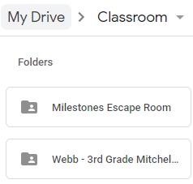
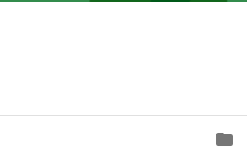
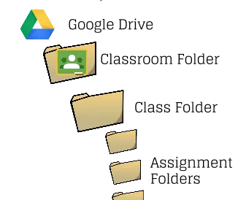
Classroom Google Drive Folder
Read this article from Alice Keeler to understand the Classroom Folder
A Classroom Google Drive Folder will automatically be created and linked to your My Drive when creating or joining a new class
Drive Folder
Or watch this YouTube video from Rich Kiker that explains the Drive Organization
Notes:
Do not delete this folder!
Alice Keeler article and Rich Kiker YouTube Video

Slide 29
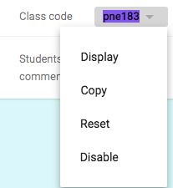
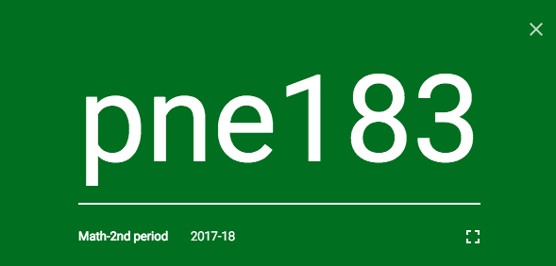
Share your Code Invite Students to JOIN the Class
Invite students by email
Share the Class Code
Now you have the option to display the code in full screen so students can see it clearly
Full Screen
Notes:
Inviting students to a class either by email or share the class code. Maximum class size students & teachers is 1,000.

Slide 30
Congratulations!
Now that you have built your mission control, what can you do with it?

Slide 31
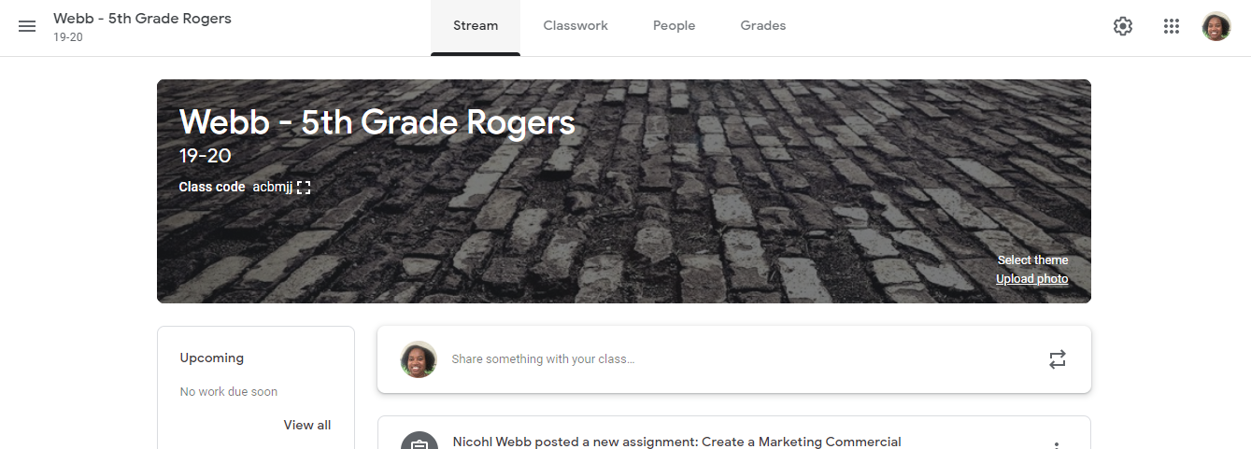
Stream=Classroom Homepage
Switch between classes and settings
Class Information and Important Links
Switch between classes and settings
Add Students
Change class theme
Name of Class and Section
Name of Class and Section
Change class theme
Show upcoming assignments
Filter class stream by adding topics
Click to add announcements, questions, assignments or reuse posts
Notes:
Introduction to the Classroom home screen

Slide 32
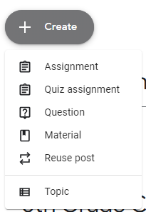
Let’s Explore
Use the Create button at the top of your Google Classroom Class to create material for the classroom.

Slide 33
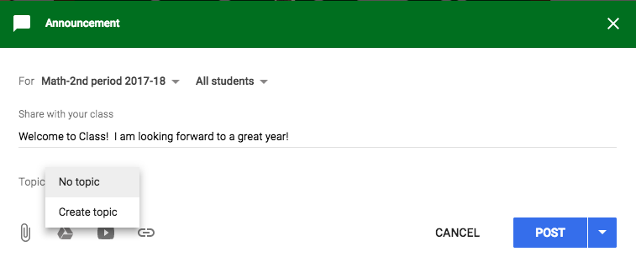
Create Material
May post announcement to more than one class
Choose to send announcement just to selected students
Create topics to help filter your stream
Choose to publish now, schedule for later, or save as a draft
Add attachments, Drive files, YouTube videos, or links
Notes:
Adding Announcements is a good way to communicate with your class and give them up-to-date information.
TIP: if you assign an activity outside of the Classroom (like a blog post), you can link to it in an announcement so there is a record of it in your class.

Slide 34
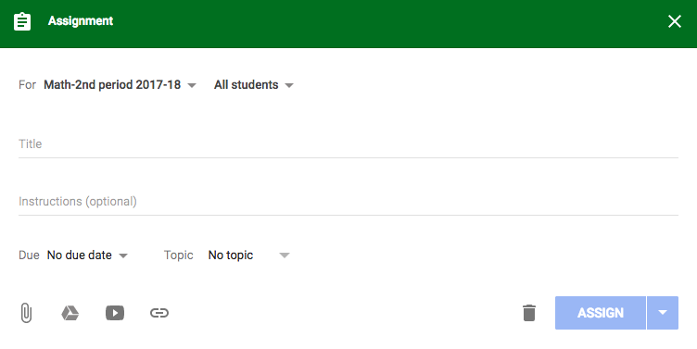
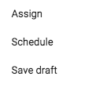
Create an Assignment
May post announcement to more than one class
Choose to send announcement just to selected students
Name your assignment
Provide detailed instructions for students
Choose a due date and time
Create or add topics to help filter your stream
Choose to Assign now, Schedule, or Save Draft
Add attachments, Drive files, YouTube videos, or links
Choose to discard

Slide 35
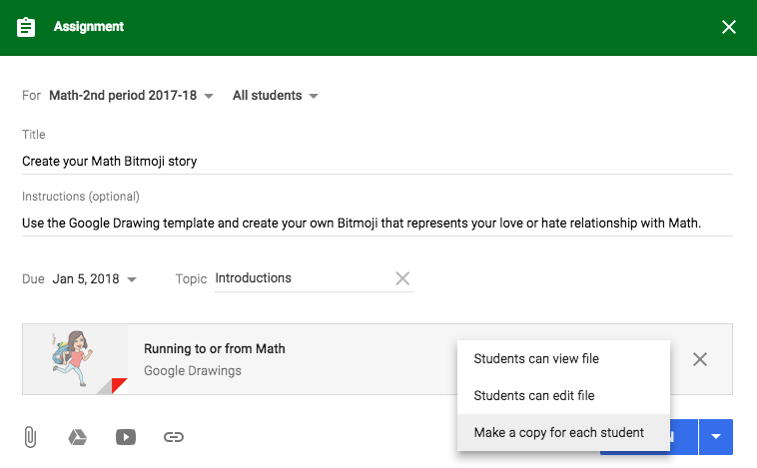
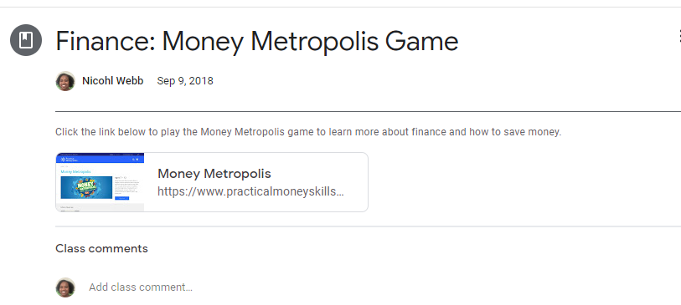
Example
FIle sharing settings allow you to choose how you share files with students.
Notes:
Making a copy for each student when inserting an item from your Google Drive is the equivalent of going to the copier and physically making a paper copy for each student. If you make copies, the files are automatically stored in students’ class folders in Google Drive. The default is Students Can View File, the other choice is Students can Edit this File. However, unless they need to work on a collaborative document take caution...if you choose Students Can Edit this File then the first student to open it will edit it for everyone. Please be sure to Make a Copy for Each Student if they will need to make changes inside the document (like fill in the blanks, short answer, etc.)

Slide 36
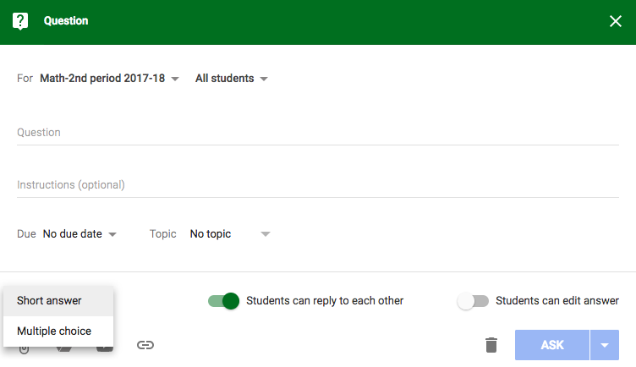
Create a Question
May post announcement to more than one class
Choose to send announcement just to selected students
Ask question
Provide detailed instructions for students
Choose a Short Answer or Multiple Choice format
The teacher can allow students to reply to each other or edit answers
Choose to Ask now, Schedule, or Save Draft
Add attachments, Drive files, YouTube videos, or links
Choose to discard

Slide 37
Managing the Stream

Slide 38
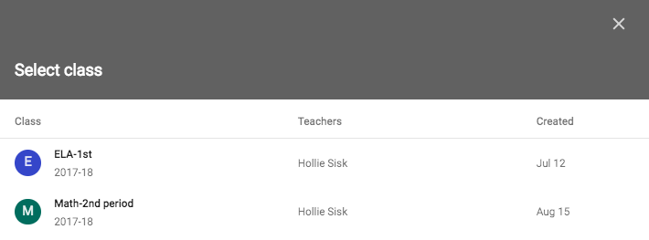
Reuse a Post
1.
Select a class, then choose which post to reuse from that class
2.
3.

Slide 39
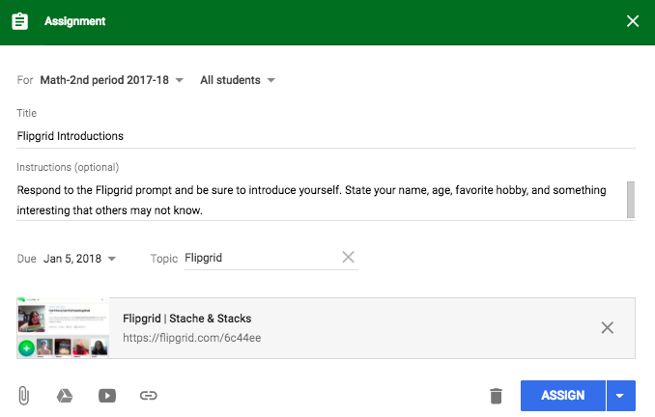
Reuse a Post
Example
Now make changes to this reused assignment as needed. Add a due date or include additional resources.
Choose a due date and time

Slide 40
Edit a Post
Edit a Post
Notes:
Once the post is displayed on the Class Stream, you have the ability to edit an announcement, assignment, or question by selecting the three snowballs on the right and then choose to either move it to the top of the Stream, edit the post, delete the post, or copy the link.

Slide 41
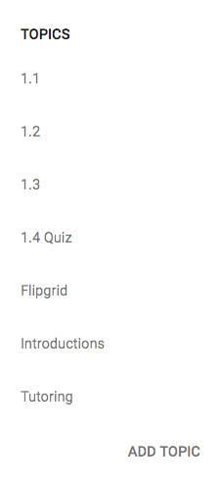
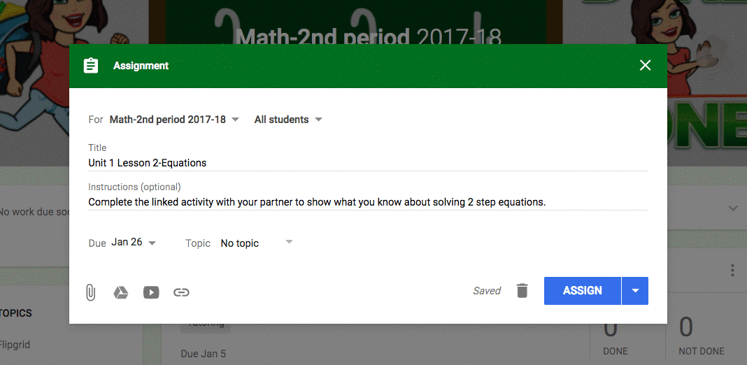
Using Topics
Click to Filter
Add a new topic or select from a previously created topic.
Notes:
Topics offers some interesting ways to possibly organize the Stream. You can only assign ONE topic per assignment. Choose a system that works for your class. Probably the most obvious way to assign topics to assignments is by unit. Unit 1, Unit 2, Unit 3, etc…
Check out this blog post from Alice Keeler about using Topics.

Slide 42
Google Classroom For PD
Easy to join as a PD class
Can easily share resources through Google Drive
Use for virtual faculty meetings. Can add as a discussion or use Google Hangouts as a way to add content.
No More Remind, No Problem! You can use Google Classroom for class announcements, scholarship updates, senior info, etc.

Slide 43
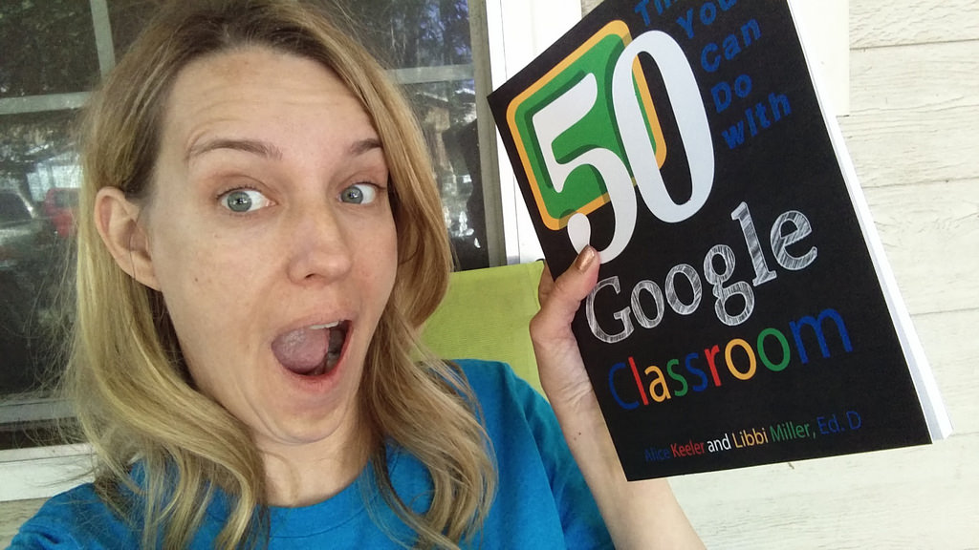
Great “Googley” People to Follow
Alice Keeler-Google Classroom Queen
Alice is a Math teacher that is also a Google Guru. She gives great advice for best practices when using Google Classroom like staying organized with naming conventions for assignments. She has also created extensions such as Classroom Split, so students can see the directions and their work side by side.
Kasey Bell-Shake Up Learning All things Google Whizz! Kasey is an awesome person to follow and add to your PLN. She has recently collaborated with Matt Miller from Ditch That Textbook and they have created the Google Teacher Tribe podcast. You must subscribe and tune in.

Slide 44
Practice Time!
Create a Google Slide/Doc or Form
Create a Class in Google Classroom
Add your creations to the padlet: www.bit.ly/CsGoogle
Notes:
????

Slide 45
Thank you!
Nicohl Shelton Webb
Pate’s Creek Elementary
Henry County Schools
nwebb@henry.k12.ga.us
www.twitter.com/counselorPCE
www.instagram.com/techlovingschoolcounselor
https://bit.ly/webbeginca

Slide 46
Round of Applause for our Presenter!!
Nicohl Webb
Notes:
Castro Slide

Slide 47
We are here to support you!
Please reach out to College and Career Readiness with any needs at your school site, professional development topics, or general questions at:
Catalina Cifuentes ccifuentes@rcoe.us
Dr. Pedro Caro pcaro@rcoe.us
Notes:
Castro Slide

Slide 48
FOR MORE INFORMATION AND RESOURCES PLEASE VISIT US @
www.rcec.us

