Slide 2
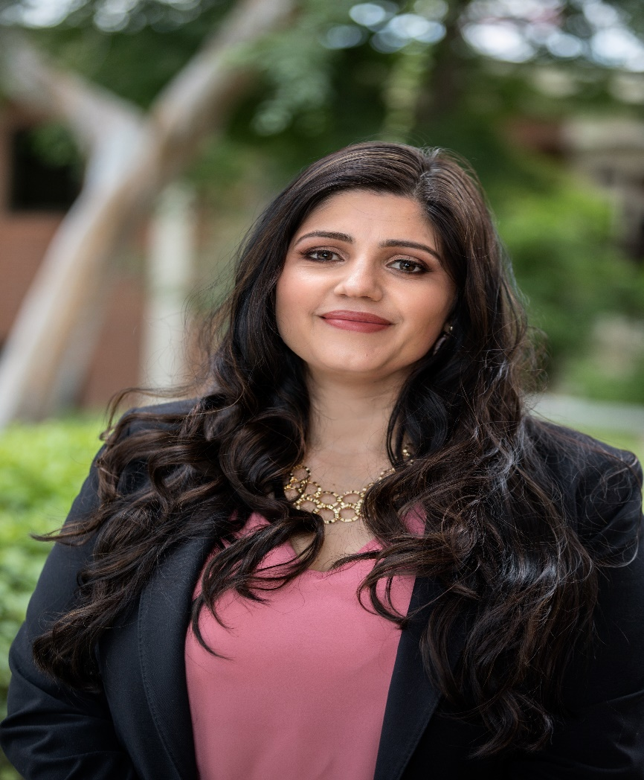
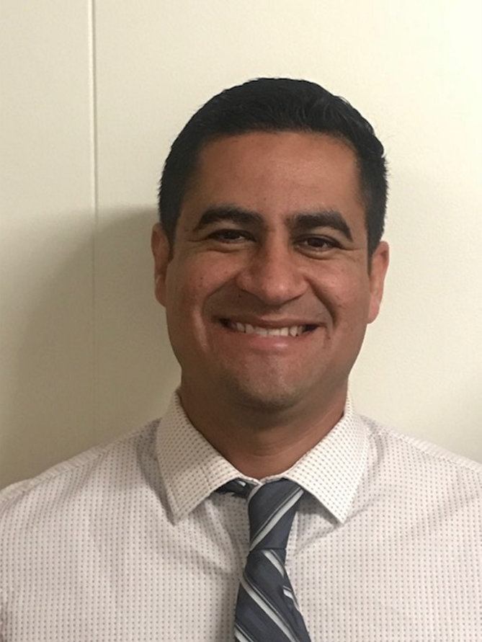
Catalina Cifuentes
Executive Director,
College and Career Readiness
ccifuentes@rcoe.us
Dr. Pedro Caro
Coordinator,
College and Career Readiness
pcaro@rcoe.us

Slide 3
Webinar Tips
This webinar is being recorded so that others may listen to it at a later time for reference and will be uploaded to the RCEC Youtube page as well as www.rcec.us once you log in to access the content of the webinar series
All connections to this live Webinar feature have been accounted for so please do not forward the Zoom link or invite anyone to join because you are taking someone else’s spot and Zoom will automatically start kicking off connections randomly
All participant mics have been muted and only panelists and facilitators have the ability to unmute anyone
Since all participants have been muted, please use the Q&A and chat screens to enter your questions
Participants can submit a question in the Q&A box at the bottom of the screen for the panelists
Only panelists and facilitators will be able to respond back to those questions and can do so publicly or privately to the individual
Participants can submit comments or questions in the chat box if they would like to engage with each other
**Every effort has been made to ensure the security of this webinar from “zoombombers” but in the event that we experience that, please stay calm and we will resume as soon as the technical difficulties have been resolved.**

Slide 4
Riverside County NSC StudentTracker Aggregate Report (Spring 2020)
Percent of Students Enrolled in College the Fall Immediately After High School
100%
75%
57.8%
60.1%
60.5%
61%
53.7%
55.1%
56.3%
percent
51.5%
50%
25%
0%
2012
2013
2014
2015
Class
2016
2017
2018
2019

Slide 5
CA is Improving FAFSA Completion Rates!
https://formyourfuture.org/fafsa-tracker/
As of May 8, 2020 California is the only state that has improved the % completion of applications from class of 2019 to class of 2020
In 2019 California was ranked 25th for FAFSA application completion and currently ranked 15th for class of 2020
California CSAC Race to Submit Dashboard- https://webutil.csac.ca.gov/Dashboard/
Riverside County Race to Submit Dashboard- http://www.rcec.us/scorecard/
Notes:
Castro Slide

Slide 6
FOR MORE INFORMATION AND RESOURCES PLEASE VISIT US @
www.rcec.us

Slide 7
How Districts can Support the Senior Class of 2020’s Transition to Post-Secondary
Riverside County Office of Education Presentation May 21, 2020

Slide 8
HI, I’M BILL
Bill DeBaun
Director of Data and Evaluation
National College Attainment Network (NCAN)

Slide 9
MY GOALS FOR TODAY
Understand five key actions districts and school can take right now to keep seniors on a postsecondary pathway
Connect to the best resources for taking those actions
Ask questions and share strategies and success stories from your own experiences

Slide 10
WHO IS NCAN?

Slide 11
WHAT NCAN BELIEVES AND DOES
NCAN’s Vision: All students have an equitable opportunity to achieve social and economic mobility through higher education.
NCAN’s Mission: To build, strengthen, and empower communities and stakeholders to close equity gaps in postsecondary attainment for all students.
NCAN’s Strategies: Build network capacity, advocate for policy solutions, and support systems change.

Slide 12
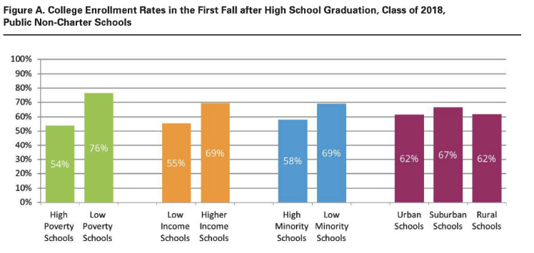
Talent is everywhere, but opportunity is not.

Slide 13
IMMEDIATE NEXT STEPS FOR HELPING HIGH SCHOOL SENIORS TRANSITION TO A 2-/4-YEAR COLLEGE OR CERTIFICATE PROGRAM 5 Actions for Districts and Schools to Take Right Now

Slide 14
1. Conduct a senior exit survey now. 2. Focus on Free Application for Federal Student Aid (FAFSA) completion. 3. Decode financial aid offers and compare costs. 4. Navigate decision deadlines. 5 .Combat summer melt.

Slide 15
KEY THEMES
Take stock of current practice
Engage staff and stakeholders
Identify and strengthen external partnerships
Have a plan for collecting and sharing data

Slide 16
1. Conduct a senior exit survey now.

Slide 17
CONDUCT A SENIOR EXIT SURVEY NOW
Why: Good data inform good practice. Districts and schools need to understand where students are now and what they need next. Having data from the senior survey will shape the supports seniors receive both between now and graduation and this summer.

Slide 18
CONDUCT A SENIOR EXIT SURVEY NOW
What to ask:
What is the most current update we have about seniors’ postsecondary aspirations and plans?
How will the supports we provide to students differ based on what we learn from those data?
What resources can we provide to students to maintain their postsecondary aspirations?
Do we have partners that can help support students? Who are they and how can they help?

Slide 19
CONDUCT A SENIOR EXIT SURVEY NOW
Do this next:
Collect the following data:
Postsecondary intention, FAFSA completion status, state financial aid application status, are student’s applications completed?, list of college/university decisions by student (accepted, waitlisted, denied), has the student made a final choice about where to attend?
Ensure the right personnel have the right data
Solidify the process for updating data as students are contacted and new information is obtained
Convene relevant personnel and partners to get on the same page about how you will support students between now and graduation and over the summer

Slide 20
2. Focus on Free Application for Federal Student Aid (FAFSA) completion.

Slide 21
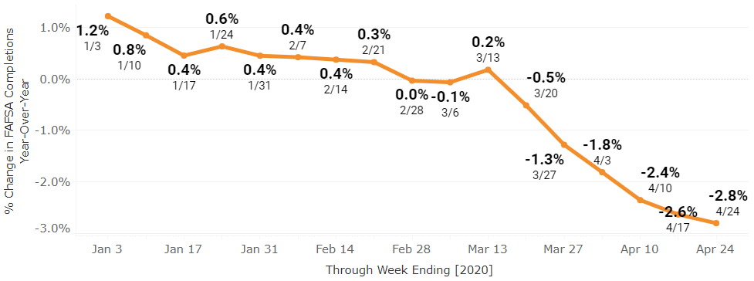
FOCUS ON FAFSA COMPLETION
Why:

Slide 22
FOCUS ON FAFSA COMPLETION
What to ask:
What percent of our seniors have completed the FAFSA?
What are the FAFSA completion statuses of our seniors? (FAFSA not started, FAFSA submitted but not processed, FAFSA submitted successfully, selected for verification, Student Aid Report received)
What are our FAFSA completion activities? Which of these can be converted to virtual delivery?
Are there community partners I could draw on/train to advance our FAFSA completion efforts?

Slide 23
FOCUS ON FAFSA COMPLETION
Do this next:
Understand current FAFSA completion rates (schoolwide, districtwide, and by student, if possible).
Sign agreement with state to receive student-level FAFSA completion data (if not already receiving it).
Inventory current FAFSA completion practices with district/school counseling staff, and identify which can continue virtually.
Find external partners with capacity to supplement FAFSA completion services for students and families;
If those partnerships already exist, brainstorm with them how to provide continuity of services by shifting supports to be virtual.

Slide 24
3. Decode financial aid offers and compare costs.

Slide 25
Decode financial aid offers and compare costs
Why: For students attending a college or university, financial aid offers, sometimes called award letters, are a critical component of deciding where to go.
For students to make the best postsecondary decision, they need guidance about what their financial aid offers actually mean.

Slide 26
Decode financial aid offers and compare costs
What to ask:
What is our district’s/school’s current approach to financial aid offer advising?
What avenues do we have for collecting students’ financial aid offers virtually? How can we help students send these in?
What are the right tools, platforms, or approaches to adopt to help students and families compare their aid offers?

Slide 27
Decode financial aid offers and compare costs
Do this next:
Understand the state of seniors’ current acceptances and compare applications to FAFSA submissions to make sure that they overlap and there are no college applicants who haven’t applied for federal financial aid.
Review Student Aid Reports to ensure students have submitted their FAFSA to all colleges on their lists, especially to the colleges where they have been admitted.
Ask students if they would like help understanding their financial aid offer(s). Some may not!
Adopt a comparison tool and map out a process for walking students and families through their financial aid offer(s).
Brainstorm external partners who can offer review services for students and families.
Keep notes in a centralized place about assisted students and families, especially with regard to any needed follow-up once they consider the aid offer comparison.

Slide 28
4. Navigate decision deadlines.

Slide 29
NAVIGATE CHANGING DECISION DEADLINES
Why: May 1 is traditionally National Decision Day for students to make their college commitments, but institutions across the country are shifting decision deadlines. Students need support to ensure they make their decision on revised deadlines and to know what the implications are of committing to a college.

Slide 30
NAVIGATE CHANGING DECISION DEADLINES
What to ask:
How many of my students have already made a commitment to an institution? How many more will need to make a commitment?
How can we celebrate National Decision Day virtually?
What is the best way to connect students and families with school counselors if they need advice navigating their enrollment decision?
What process will students follow to confirm to which college(s) final transcripts should be sent? How will the process of sending those transcripts change for school counselors?
Will my district increase the number of summer hours for school counselors? What will this look like and what services will they provide?

Slide 31
NAVIGATE CHANGING DECISION DEADLINES
Do this next:
Map out key dates and deadlines for institutions where students are most often matriculating (e.g., top 10, from National Student Clearinghouse (NSC) data.
Contact local IHEs (where students are most likely to matriculate) to determine the types of outreach they are doing for their applicants. How can you work together to deliver this important messaging?
Help students investigate and understand if they are eligible for a housing deposit waiver from their institution of choice.

Slide 32
5 .Combat summer melt.

Slide 33
COMBAT SUMMER MELT
Why: Summer melt occurs when a student who is accepted to a postsecondary institution fails to enroll or attend in the fall, for any number of reasons. It is one of the most studied phenomena in the college access and success field, and there are proven strategies for supporting students from high school graduation to postsecondary enrollment.

Slide 34
COMBAT SUMMER MELT
What to ask:
What does our district/school currently do to prevent summer melt, if anything?
Which staff are available and willing to work extra hours over the summer to support students? What provisions/stipulation does our union contract make for these kinds of additional hours? What funds are available to pay school counselors and other advisers to provide this support?
For our district/school, is the best approach to combat summer melt in-person (i.e., drop-in centers, summer office hours), virtual (text messaging campaigns), or a hybrid model?
Are there outreach efforts being made by colleges and universities to provide transition assistance to their applicants/our students?
Is there a specific person at most-attended colleges and universities who I can connect to students by sending an introductory email, making a phone call, or facilitating an e-intro via a virtual platform?

Slide 35
COMBAT SUMMER MELT
Do this next:
Recruit staff willing to work summer hours either in-person or virtually.
If pursuing a text messaging model, gather a list of student and parent phone numbers to enter into the text messaging platform.
Secure content for text messaging and make a schedule (either from existing sources or develop in house).
Identify a point person for the text messaging campaign and determine which platform or vendor you will use to manage the campaign
Whenever possible, send texts in English and the students’ home language to ensure they understand the content of the message.

Slide 36
Thank you for coming! Contact Me any time!
Bill DeBaun, NCAN: debaunb@ncan.org

Slide 38
Actions to Take Right Now to Help Seniors Transition After Graduation (Avoiding Summer Melt)
Robin Ellison
Rancho Verde High School Counselor
rellison@valverde.edu
Hector De Leon
Alumni of RVHS 2019, UCLA Freshman
Alexsys Hornsby
Alumni of RVHS 2015, UC Berkeley Grad 2019

Slide 39
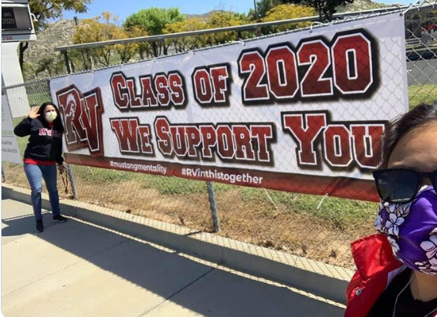
Rancho Verde High School
Located In Moreno Valley
Population 2000 Students
Free and Reduced Lunch: 77%
Hispanic/ Latino: 64.8%
African-American: 23.0 %
White 4.7 %
English Learners 5.6%

Slide 40
What is Summer Melt?
Summer Melt is a term traditionally used by college admissions officers to describe the phenomenon of students who are eligible for college or even those who have registered for college that decide not to attend in the Fall and instead “melt’ away during the Summer.

Slide 41
Primary Reasons for Summer Melt
Financial Issues
Lack of College Knowledge
Insufficient Availability of Guidance and Resources
Pandemic - ” Nearly Half of U.S. Families Say The Pandemic Has Changed Their College Plans”. Forbes 5/18/20

Slide 42
Determine which of your graduating students intend to go to college in the fall after high school graduation
Use Senior Exit Surveys
Use transcript request records
Data from school counselors
Collaborate with colleges directly

Slide 43
How we help our Seniors …..
Assist students with follow-up for 2/4 year colleges and universities.
Teach them how to navigate the college web portals and the college phone system (now focus on emails)
How to read Financial Award Letters (guidance techs, interns)
Tuition Bills
Deadlines/fees (the most up to date information)
Placement Exams & Orientations
Practical life skills (health insurance, budgeting, meal plans, what to pack, transportation to college).

Slide 44
What it has looked like Traditionally
Two to five counselors would work various hours on campus from June –July (unofficially in August)
Auto dialer messages went out to the families to reach the entire graduating class, notifying them that counselors would be available to help them over the summer.
Seniors were told in person during senior check out
Utilized Graduation Practices
Reminders went out on various platforms

Slide 45
How we can reach our Seniors now
Google Classroom
Zoom Meetings
Remind
Phone calls
Website
Office Hours
Email is king right now

Slide 46
Recommendations
Your Summer Melt program needs to fit your senior needs
Do what works for you (use your preferred methods of communication)
Teamwork
Be Creative….think outside the box
Alumni Assistance -Hector De Leon and Alexsys Hornsby
Alexsys’s link http://Tinyurl.com/lexxscollegiateguide
lexxs collegiate guide
Data- How many students did you help, trends and barriers etc.
Stay Updated
Bonus- Be Preventative…….College Now!

Slide 47
Resources Data Collection

Slide 48
Resources Senior Exit Survey

Slide 49
Questions?

Slide 50
Round of Applause for our Presenters!!
Bill Debaun
Robin Ellison
Hector De Leon
Alexsys Hornsby
Notes:
Castro Slide

Slide 51
We are here to support you!
Please reach out to College and Career Readiness with any needs at your school site, professional development topics, or general questions at:
Catalina Cifuentes ccifuentes@rcoe.us
Dr. Pedro Caro pcaro@rcoe.us
Notes:
Castro Slide

Slide 52
FOR MORE INFORMATION AND RESOURCES PLEASE VISIT US @
www.rcec.us

Slide 53
