Slide 1
Addressing the Vaping Epidemic Within a Tiered System of Support
K. Buchan & T. Stallions

Slide 2
Tobacco Free California - Flavors Hook Kids
Notes:
Tobacco Free California | Flavors Hook Kids | "Nicotine Equals" April 2019
Teens are vaping more than ever. Juul, Suorin, Phix, Bo, and other flavored e-cigarettes hook kids, but addiction is only the start. Watch the commercial to learn the effects of nicotine on the teen brain.
www.FlavorsHookKids.org

Slide 3
“VAPING IS A YOUTH EPIDEMIC...
‘We must take action now to protect the health of our nation’s young people.’”
-US Surgeon General
Notes:
Tonia

Slide 4
Addressing the Vaping Epidemic Within a Tiered System of Support
K. Buchan & T. Stallions

Slide 5
Program Description
The goal of the session is to provide prevention and intervention strategies for 6-12 grade students who are exposed to the peer pressure, advertising and marketing of vaping. The information will include current research, data, and use of appropriate theories for substance use/abuse counseling.
Attendees will walk away with a concrete plan to address this modern epidemic.
An additional handout will be distributed at the session.
Notes:
Tonia

Slide 6
Introductions
Kathryn Buchan, MS, PPS, APCC
Tonia Stallions, MS, PPS

Slide 7
Learning Outcomes
Develop a comprehensive plan for an anti-vaping policy within a tiered system of support
List at least five specific techniques to integrate vaping prevention/intervention policy into a tiered system of support
Implement specific skills within a tiered system of support to address the vaping epidemic.
Increase positive school behavior
Notes:
Kathryn

Slide 8
Room Poll
Do you use behavior/discipline data to make decisions?
Do you use a tiered system of support at your site (MTSS, PBIS, RTI)?
Do you have a defined tiered system of support surrounding vaping prevention & intervention at your site?
Notes:
Kathryn

Slide 9
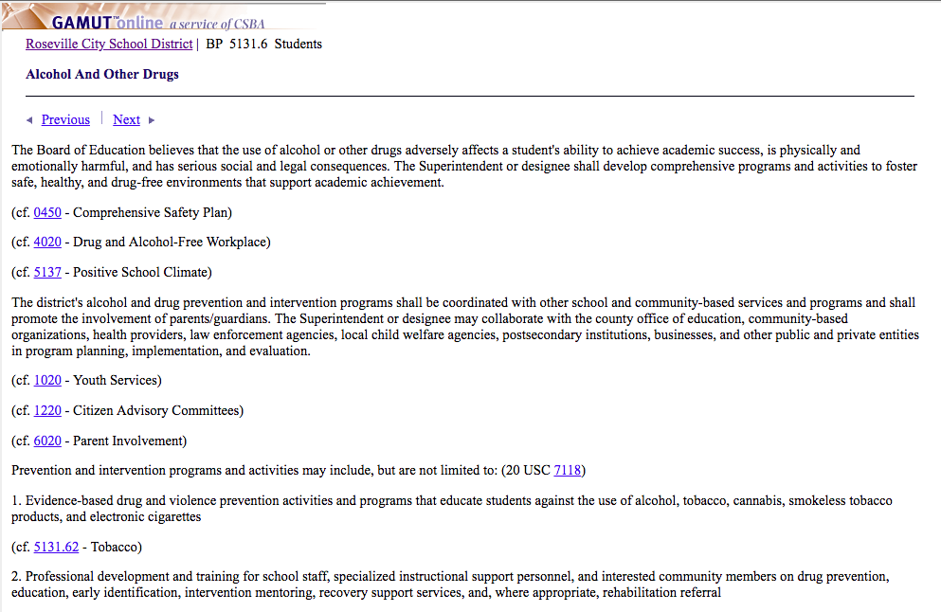
Background Knowledge - Drug & Alcohol Policy
The Superintendent or designee shall develop comprehensive programs and activities to foster safe, healthy, and drug free- environments that support academic achievement.
Prevention and intervention programs may include, but not limited to:
1.) Evidence based drug...prevention activities and programs that educate students against the use of...electronic cigarettes.
2.) Professional development and training for school staff...
3.) School-based mental health services, including early identifcaton of drug and referrals to counseling services….
4.) Programs and activities that provide mentoring and school counseling to ALL students, including students who are at risk of drug use and abuse.

Slide 10
Data
“...‘vaping’—among middle and high school students increased alarmingly between 2017 and 2018, with over 3.6 million kids currently using e-cigarettes in 2018.”
US Food & Drug Administration, National Youth Tobacco Survey, 2018

Slide 11
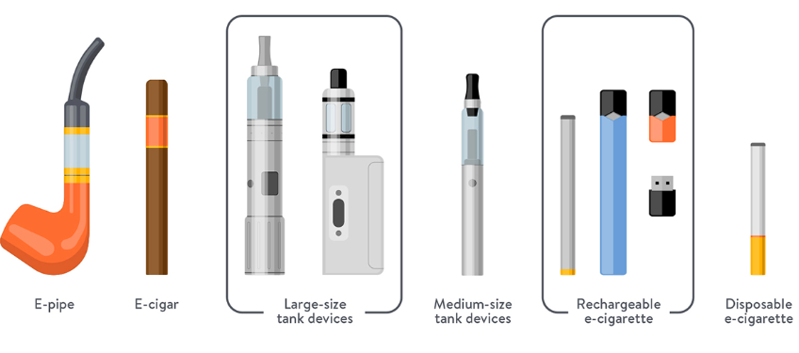
What is an e-cigarette?
Battery-operated devices used to heat and aerosolize a liquid in order to deliver nicotine, flavorings, and other chemicals that users inhale.
Notes:
https://www.allegropediatrics.com/blog/blog/from-our-docs/e-cigarette-qanda-with-dr-spanier
E-cigarettes (also referred to as “e-cigs,” “e-hookahs,” “mods,” “vape pens,” “vapes,” “tank systems,” and electronic nicotine delivery systems) are battery-operated devices used to heat and aerosolize a liquid in order to deliver nicotine, flavorings, and other chemicals that users inhale
Look like flash drives, pens, and everyday items.

Slide 12
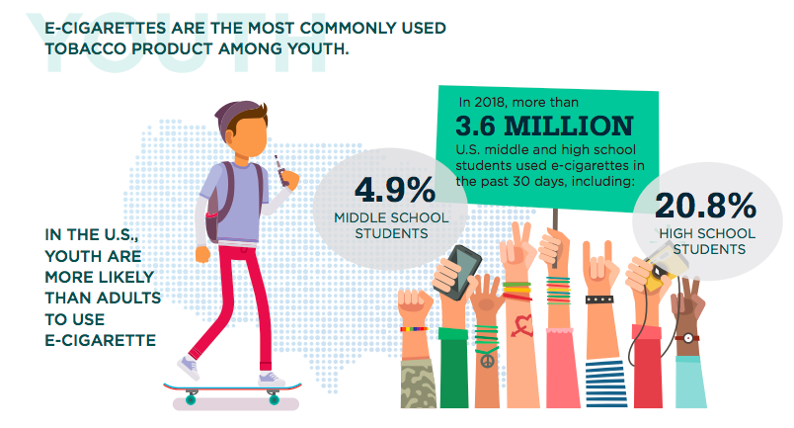
Who is using?
www.cdc.gov
Notes:
https://www.cdc.gov/tobacco/basic_information/e-cigarettes/about-e-cigarettes.html

Slide 13
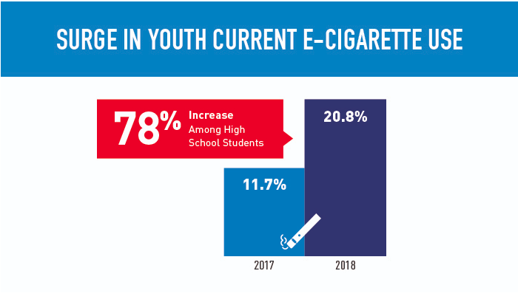
High School
U.S. Food & Drug Administration
Notes:
https://www.fda.gov/tobacco-products/youth-and-tobacco/2018-nyts-data-startling-rise-youth-e-cigarette-use

Slide 14
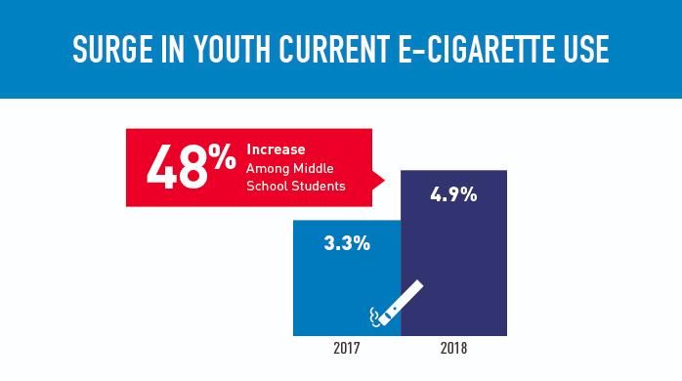
Middle School
U.S. Food & Drug Administration

Slide 15
Tobacco Product Use Among Middle and High School Students — 2011–2018
Notes:
https://www.cdc.gov/mmwr/volumes/68/wr/mm6806e1.htm
Vital Signs: Tobacco Product Use Among Middle and High School Students — United States, 2011–2018
Weekly / February 15, 2019 / 68(6);157–164
On February 11, 2019, this report was posted online as an MMWR Early Release.
Andrea S. Gentzke, PhD1; MeLisa Creamer, PhD1; Karen A. Cullen, PhD2; Bridget K. Ambrose, PhD2; Gordon Willis, PhD3; Ahmed Jamal, MBBS1; Brian A. King, PhD1 (View author affiliations)

Slide 16
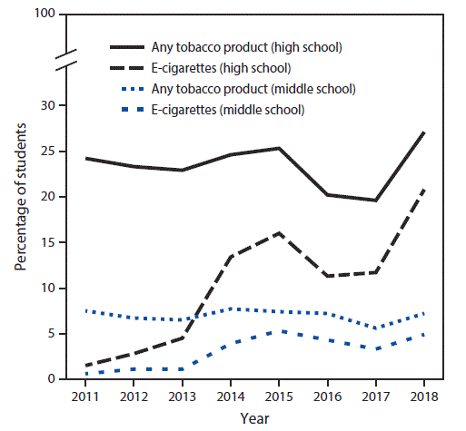
1 in 5 and 1 in 20, high school & middle school students, respectively, used e-cigarettes in 2018.
National Youth Tobacco Survey, United States, 2011–2018
Notes:
https://www.cdc.gov/mmwr/volumes/67/wr/mm6745a5.htm?s_cid=mm6745a5_w

Slide 17
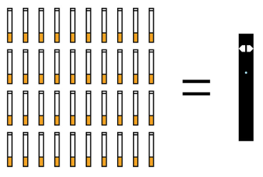
DATA
According to the CDC:
Tobacco use is the leading cause of preventable disease and death in the United States; nearly all tobacco product use begins during youth and young adulthood.
All JUUL e-cigarettes have a high level of nicotine.
According to the manufacturer, a single JUUL pod contains as much nicotine as a pack of 20 regular cigarettes.
National Academy of Medicine:
In 2018, found that e-cigarette use increases the frequency and amount of cigarette smoking in the future.
electronic cigarettes were the most commonly used product among high school, 3.05 million and middle school 570,000 students.
e-cigarette use increased 77.8% among high school students and 48.5% among middle school students.
Notes:
https://www.cdc.gov/mmwr/volumes/68/wr/mm6806e1.htm
https://www.cdc.gov/tobacco/basic_information/e-cigarettes/Quick-Facts-on-the-Risks-of-E-cigarettes-for-Kids-Teens-and-Young-Adults.html

Slide 18
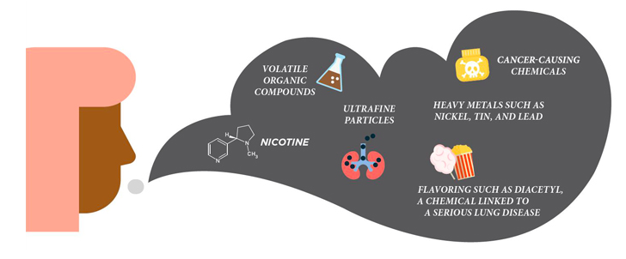
Facts
Notes:
E-cigarettes contain chemicals that can cause irreversible lung damage and alter teen brains.
• Nicotine is highly addictive and exposure during adolescence can harm the developing brain.
• Youth who use e-cigarettes are more likely to go on to use traditional cigarettes.
• In the short term, e-cigarette aerosol can irritate your lungs, throat and eyes. It can also make it more likely that you’ll catch colds or get the flu.
https://www.cdc.gov/tobacco/basic_information/e-cigarettes/index.htm
VOC: Benzene (found in crude oil and a major part of gasoline)
Ultra Fine particles and chemicals: Acetone (nail polish), Rubidium (fireworks), Formaldehyde (embalming liquid), etc

Slide 19
Brainstorm
Notes:
Stanford Tobacco Prevention Toolkit

Slide 20
Brainstorm
Why do people your age use e-cigs/vapes?
Why do people your age NOT use e-cigs/vapes?
tricks
flavor
risk
peer pressure
USB size flash drive
bored/anxiety/depression
curious
dependent
relax or calm down
talk with others
be part of a group
unwind
ease frustration
help me forget about quitting
relieve disappointment
be social at parties
feel better
look more like an adult
hearing certain music
seeing advertisements/product
scared
illegal
unhealthy
independent
taste
Notes:
Teen intervene

Slide 21
Notes:
Kathryn
https://www.manateeschools.net/Page/5824
Vaping prevention/intervention is not a system that stands alone, it is part of MTSS.

Slide 22
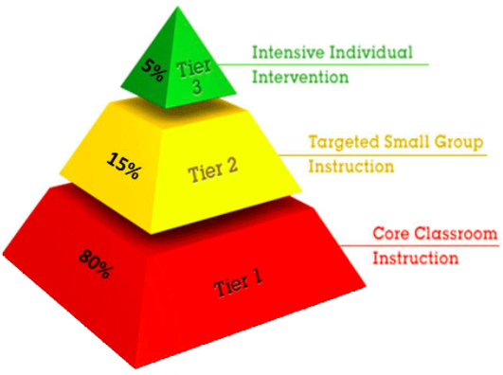
Tiered System of Support Framework
Notes:
https://www.pbis.org/school/swpbis-for-beginners/pbis-faqs
http://www.aldineisd.org/about/departments_overview/curriculum_department/response_to_intervention_rti/rt_i_models/
https://www.pbis.org/school/swpbis-for-beginners/pbis-faqs
Crowd survey - how many people have a Tiered System of Support at their school?

Slide 23
Framework Used to Integrate Tiered System of Support and Vaping Prevention/Intervention
A tiered system of support and drug use policy can be conceptualized in the same framework
3 tiered system of support
Universal (80-100%)
Targeted (10-20%)
Intensive Services (1-5%)

Slide 24
Why Integrate Vaping Prevention/Intervention into a Tiered System of Support?
Drug use is a behavior that impacts all students
Using a tiered system of support to implement vaping prevention/intervention creates more efficient and effective systems

Slide 25
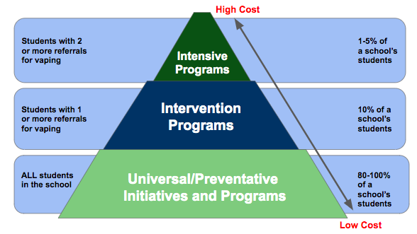
Examples of Vaping Prevention/Intervention Integrated into 3 Tier System

Slide 26
How to Find Handouts
bit.ly/2019vapingepidemichandouts

Slide 27
Overview of Tier 1 Strategies
Vaping Prevention Classroom Lessons
Adult Education
Vaping Prevention Information on School Website & Social Media Accounts
Awareness Campaign
Notes:
Kathryn

Slide 28
Vaping Prevention
Classroom Lesson Options
ASCA Mindset & Behavior Aligned Classroom Lesson (Handout #1)
Stanford Tobacco Prevention Toolkit Lessons (Handout #3)
CDC Presentation for Youth (Handout #5 a-b)
Placer County Tobacco Control Program Student Classroom Lesson or Assembly (Handout #11)

Slide 29
ASCA Aligned Vaping Prevention Classroom Lesson (Handout #1)

Slide 30
ASCA Aligned Vaping Prevention Classroom Lesson
Pre/Post Survey
Aligned to ASCA Mindsets & Behaviors (B-LS 9) (Handout #2)
Lesson Agenda
Why People Use Vapes
Health Risks
Dealing with Peer Pressure
Lesson Objectives
Explore why students may vape
Understand the health risks
Identify ways to combat peer pressure
Identify the importance of gathering evidence and considering multiple perspectives so I can make informed decisions about vaping
B-LS 9. Gather evidence and consider multiple perspectives to make informed decisions

Slide 31
Stanford Tobacco Prevention Toolkit Vaping Prevention Classroom Lesson (Handout #3)
Notes:
2 & 4 hour version for 2020
An alternative to suspension

Slide 32
Stanford Tobacco Prevention Toolkit Vaping Prevention Classroom Lesson
Stanford Tobacco Prevention Toolkit
Updated 2020
6 unit lesson
Multiple powerpoint options
Handouts
Easy to edit
Notes:
https://med.stanford.edu/tobaccopreventiontoolkit.html

Slide 33
Supplemental Handout for Toolkit (Handout #4)
Notes:
Teen Intervene curriculum
https://www.teenvogue.com/story/how-to-say-no-to-drinking-and-drugs
https://www.treatmentsolutions.com/blog/15-ways-a-teen-can-say-no-to-alcohol-and-drugs/

Slide 34
CDC Presentation for Youth Vaping Prevention Classroom Lesson (Handout #5)

Slide 35
CDC Presentation for Youth Vaping Prevention Classroom Lesson
CDC Presentation for Youth
Updated April 2019
Current
Visually pleasing
Built in comprehension quiz (T/F)
Cannot edit slides
Notes:
https://www.cdc.gov/tobacco/basic_information/e-cigarettes/youth-guide-to-e-cigarettes-presentation.html

Slide 36
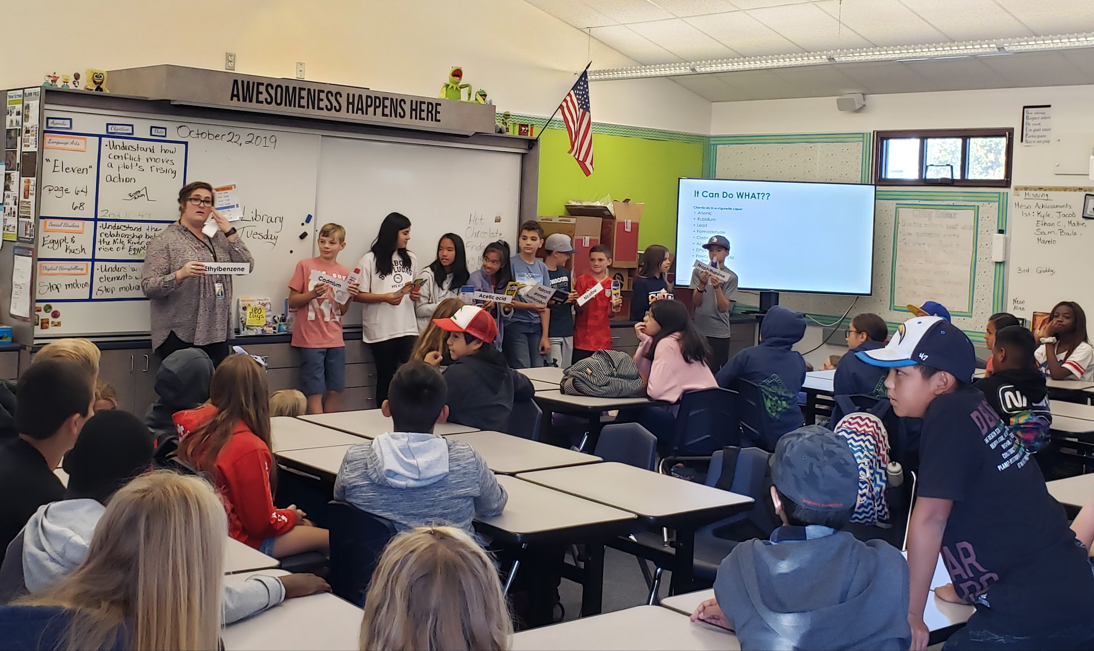
Placer County Tobacco Control Program Student Lesson

Slide 37
Adult Education (Handout #6)
Parent Night
Partner with a community organization
i.e. County Office of Health and Human Services: Tobacco Control Program
Advertise and market the event
Provide online/virtual/recording option, if possible
Provide materials to send if parents are unable to make it
Staff meeting presentations (Handout #7 & #8)

Slide 38
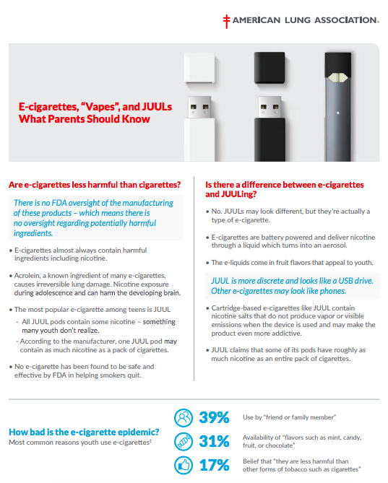
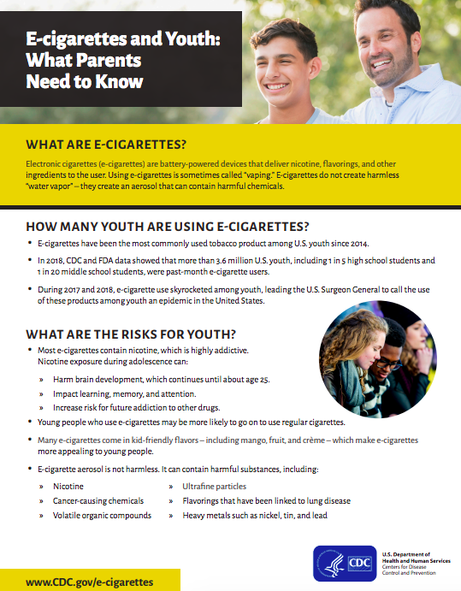
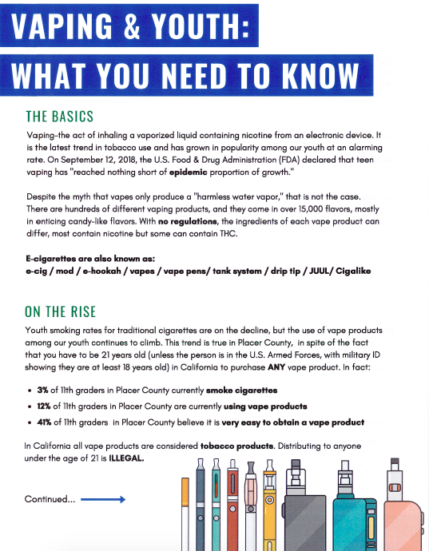
Handouts for Adult Education
(Handout #9)
(Handout #10) (Handout #11)

Slide 39
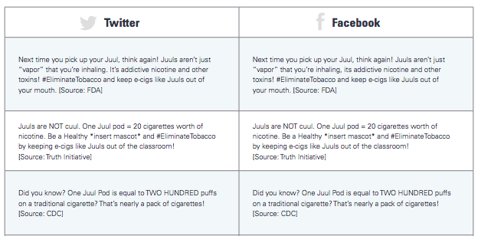
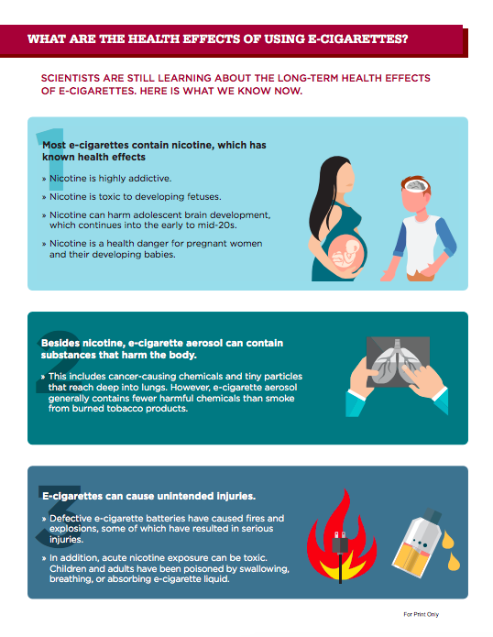
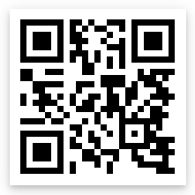
Vaping Prevention Information on Websites & Social Media Accounts (Handout #12)
School Website, Twitter, Instagram, & Facebook posts
Share Infographic (Handout #13)
Share PSA’s
Vaping Prevention Video - Nevada County Office Education
Share ways on how to contact the school counselor
QR Code
Notes:
http://nevco.org/programs-services/tupe/
https://static1.squarespace.com/static/5b44c763f93fd47365eee37f/t/5bcf8f58ec212d121f29564e/1540329310737/ETU_SMToolkit.pdf

Slide 40
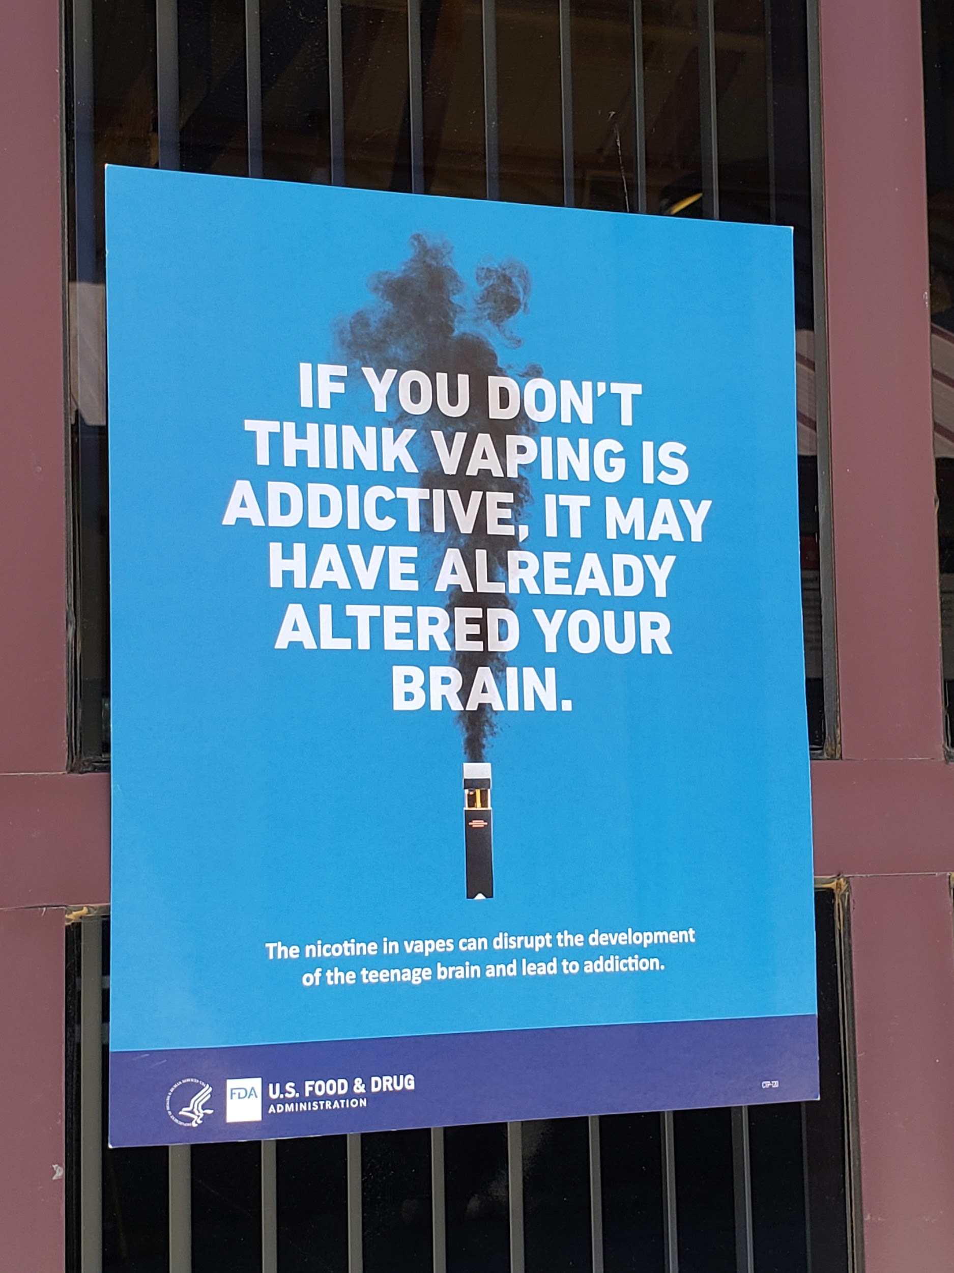
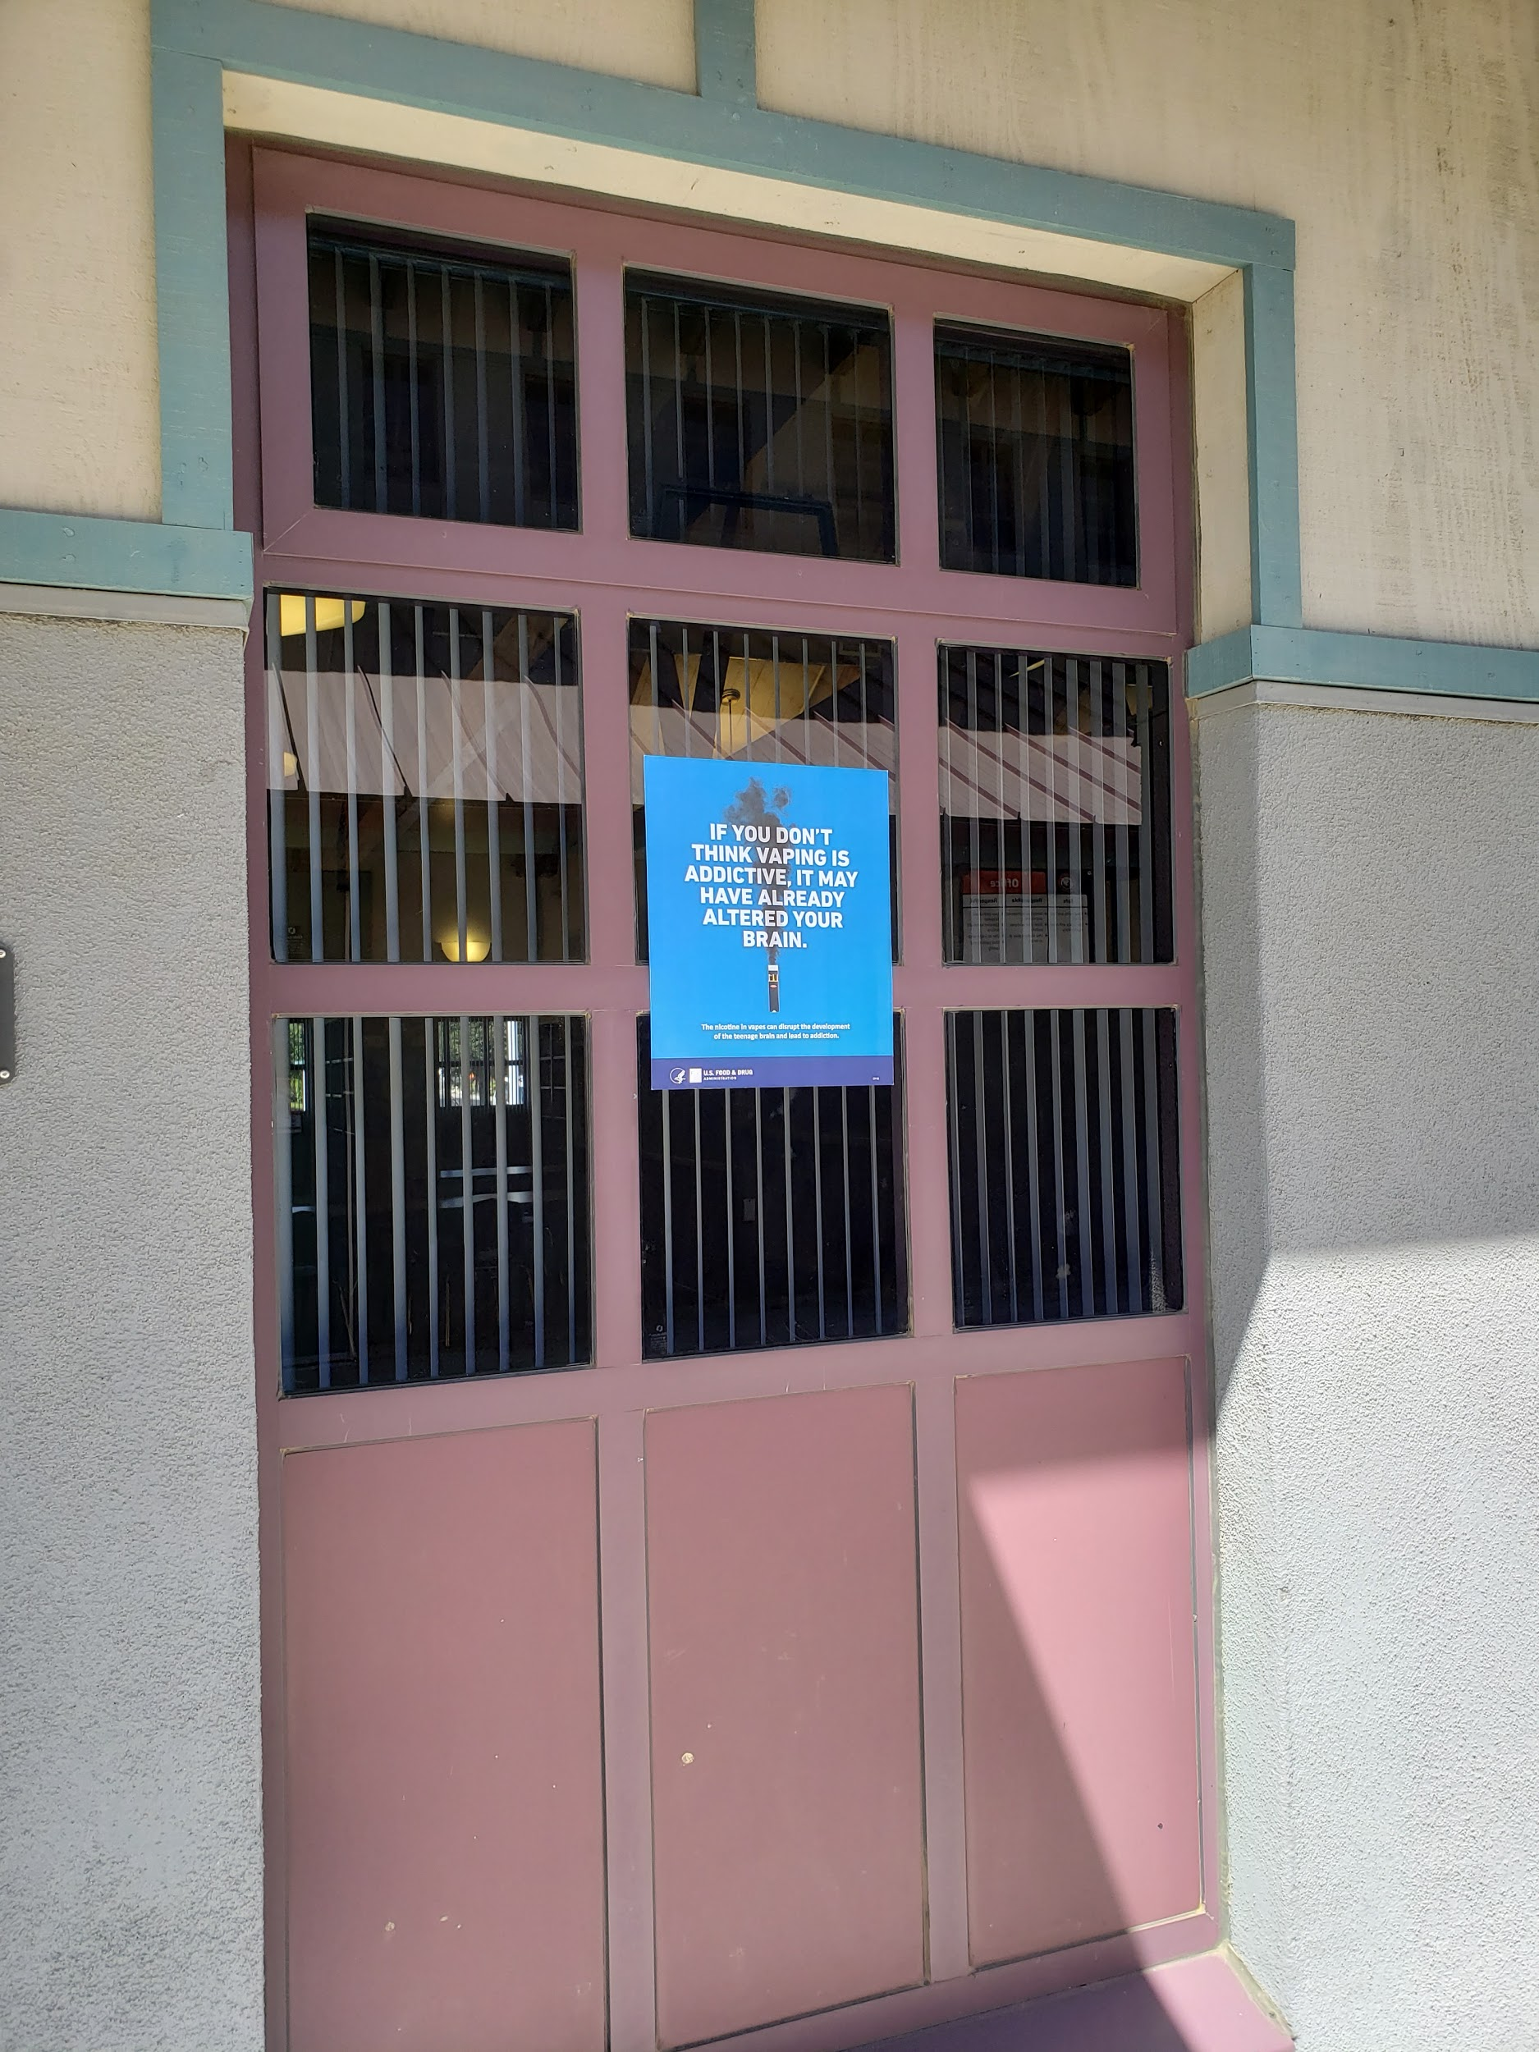
Vaping Awareness Campaign
Posters on Campus
Red Ribbon Week
Posters on campus
Poster competition
Essay contest
Assembly
Classroom lessons (Handout #1)
Parent emails
https://digitalmedia.hhs.gov/tobacco/print_materials/search
Notes:
Google search:
FDA Tobacco Education & Prevention Resources - Posters and Flyers (FREE)

Slide 42
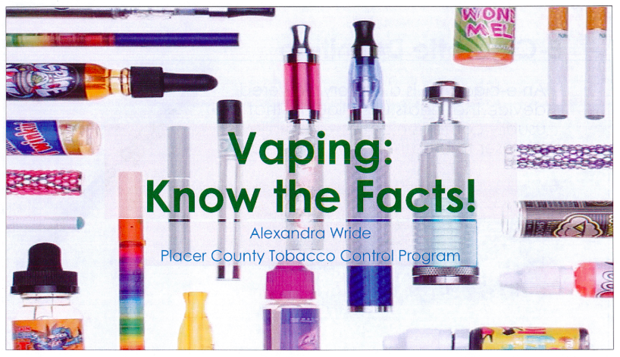
Tobacco Control Student Assembly (Handout #14)

Slide 43
Overview of Tier II Strategies
Small group counseling using Stanford Tobacco Prevention Toolkit lessons
Targeted parent education
Partner with community organization for targeted on-site student education

Slide 44
Small Group Vaping Intervention Counseling
Target students who have one or more office referral for vaping use or possession
Use Stanford Tobacco Prevention Toolkit as a group counseling lesson plan template (Handout #3)
Provide psychoeducation in the group
Distribute American Lung Association Teen worksheet (Handout #15)
Collect perception data
Pre/post survey
Align perception data collection with ASCA Mindset & Behaviors
Collect outcome data
Can use number of office referrals for vaping
Notes:
Alternative to suspension

Slide 45
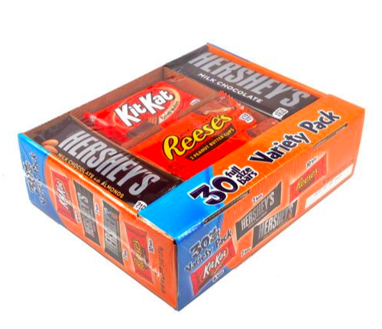
Ending Small Group

Slide 46
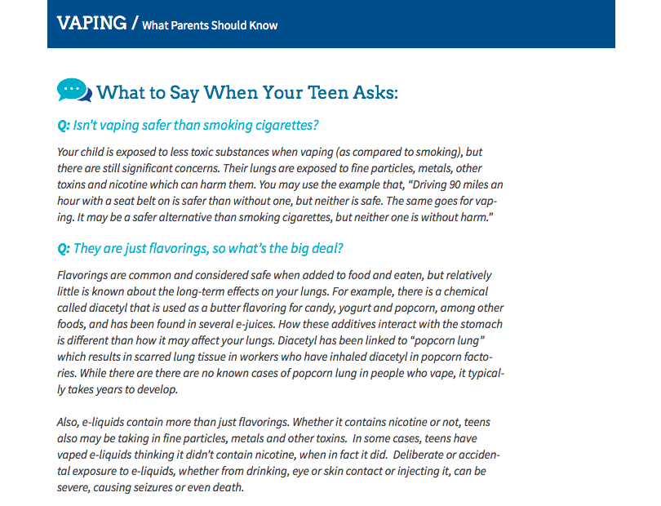
Targeted Parent Education
Directly provide information to parent in response to student office referral for vaping
Same response for every parent
Administrators could provide this service if making the initial contact home about disciplinary action
Counselor can provide:
Parent fact sheet
Handouts from parent night
Referrals to outside services
Handout How To talk to Your Kids (Handout #16)
Notes:
https://drugfree.org/newsroom/news-item/partnership-for-drug-free-kids-launches-vaping-resource-for-parents/?mc_cid=c0a3d82e3b&mc_eid=26127a3fbb

Slide 47
Partner with Community Agencies for Targeted On-Site Student Education
Work with an outside organization to provide small group/classes for youth
before school hours
during school hours
after school hours
Work with district to create a MOU
Possible community organizations to partner with could include:
Drug & alcohol recovery centers
County programs
Private practice

Slide 48
Overview of Tier III
Individual Counseling
Brief Intervention
Teen Intervene
Meeting with Probation Officer
Referral to Outside Community Agency for Substance Abuse Counseling

Slide 49
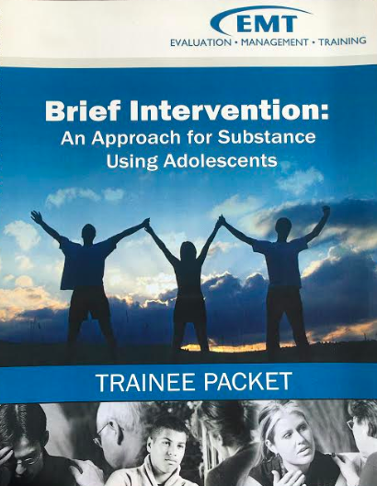
Brief Intervention For Substance Using Adolescence
For students who have received 2 or more referrals for vaping involvement on campus
Evidence-based approach for adolescents ages 11-18
BI is a short-term counseling type of intervention that consists of 2 to 4 sessions aimed at adolescents who use alcohol, tobacco and/or other drugs. This approach uses motivational interviewing, cognitive behavior therapy and the stages of change model to meet the needs of adolescents.
For adolescents who use and are experiencing relatively few problems with their use
www.emt.org/BriefIntervention
Notes:
http://www.ca-cpi.org/ta-training-services/events-schedule/
www.emt.org/BriefIntervention

Slide 50
Teen Intervene
For students who have received 2 or more referrals for vaping involvement on campus
Evidence-based program for adolescents 12-19 years old suspected of experiencing a mild or moderate substance use disorder
Covers all drugs - focuses on alcohol, marijuana, and tobacco use.
Program is designed to include teens’ parents or guardians.
Incorporates the stages of change model, motivational interviewing, and cognitive-behavioral therapy and has been expanded to offer a full Screening, Brief Intervention, and Referral to Treatment (SBIRT) model.
Notes:
Teen Intervene Curriculum - Ken C. Winters

Slide 51
Meeting with Probation Officer
Include parent, student, counselor, administrator, and probation officer
Goal is to gather information & identify barriers to sobriety
Examine what resources are available for family
Emphasize impact of use during meeting

Slide 52
Referral to Outside Community Agency for Substance Abuse Counseling
Work with outside organization to create a referral system
Have materials on hand to provide to parents
Release of information
Notes:
10 talking tips handout

Slide 53
Case Study Directions: Identify the tiered supports in this case study and name the tier.
Sarah is an 8th grade student. Over the course of the school year, Sarah received two seperate office referrals for vaping related incidents. The counselor performed a core curriculum lesson in her classroom about the risks of vaping and her mother received a e-cigarette infographic about the risks in October. After the first office referral for vaping in the school bathroom, Sarah participated in a small group to learn about the impact of using vapes. Finally, after her second office referral for charging a JUUL device on a school computer, Sarah worked individually with the school counselor and completed brief intervention counseling. With little improvement, Sarah was referred to a community based agency for drug counseling services.
Core Curriculum Lesson
Infographic
Small Group
Brief Intervention
Referred
Notes:
Tonia

Slide 54
Integrating Vaping Prevention into Tiered Systems of Support
How did it look for us as we integrated vaping prevention supports with a tiered system of support to create a comprehensive system that reached all students?

Slide 55
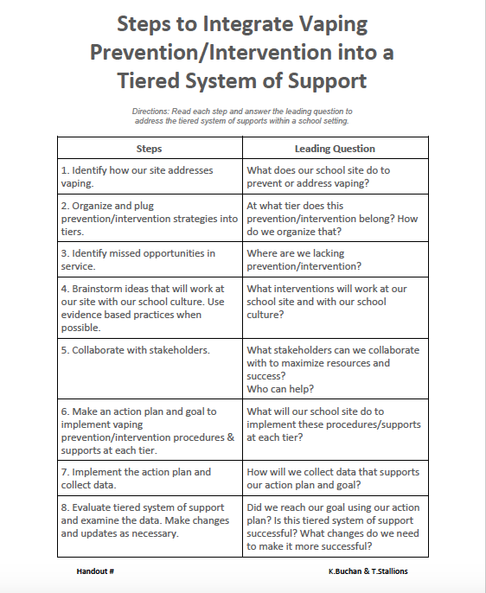
Steps to Integrate Vaping Prevention into a Tiered System of Support (handout #17)
Directions: Read each Step and answer the Leading Question to
address the tiered system of supports within a school setting.

Slide 56
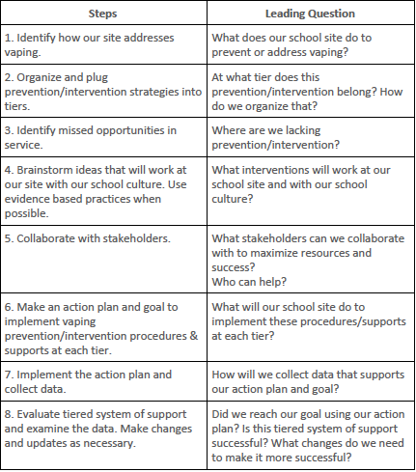
Steps to Integrate Vaping Prevention into a Tiered System of Support
Directions: Read each Step and answer the Leading Question to
address the tiered system of supports within a school setting.
infographic, refer to agency
infographic = Tier 1, refer to agency = Tier 3
Tier 1 & 2
awareness campaign, small groups, meetings
admin, teachers, parents, community resources
sharing: calendars,events w/ staff, advisory council, & stakeholders, and assign tasks
data from SIS, pre & post survey
yes, small group outcome data shows success, repeat.
Notes:
# ASCA Handout

Slide 57
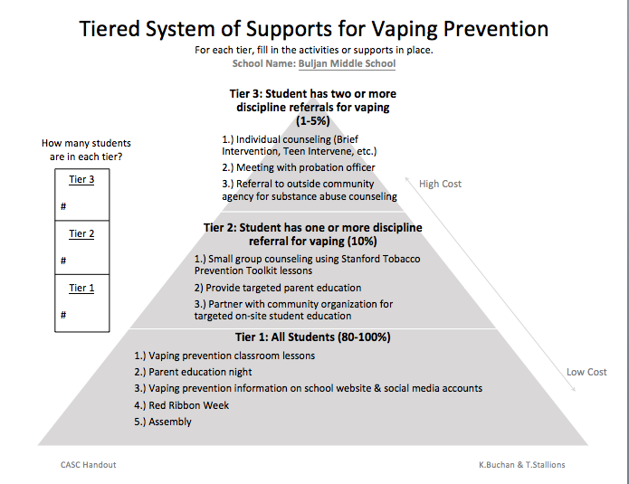

Slide 58
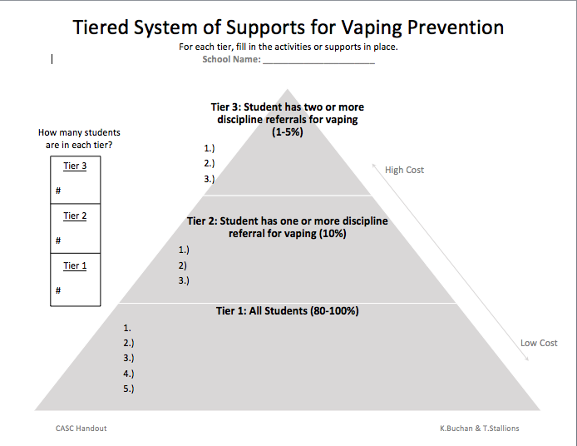
Handout #18

Slide 59
Questions?

Slide 60
Your Turn! How do YOU create a tiered system of support for vaping prevention and intervention? (Handout #18)
Get into small groups or work individually
Use the “Steps to Integrate...” handout to guide
Fill in the “Triangle”
Work time
Feedback/Discussion/Questions

Slide 61
References
Adams, Jerome. “Surgeon General’s Advisory on E-Cigarette Use Among Youth.” Surgeon General.
“Alcohol and Other Drugs.” GAMUT Online : Roseville City School District : Alcohol And Other Drugs BP 5131.6, www.gamutonline.net/district/rosevillecity/DisplayPolicy/598706/5.
Centers for Disease Control and Prevention. Presentation for Youth. www.cdc.gov/tobacco/basic_information/e-cigarettes/youth-guide-to-e-cigarettes-presentation.html.
Center for Tobacco Products. “2018 NYTS Data: A Startling Rise in Youth E-Cigarette Use.” U.S. Food and Drug Administration, FDA, 2018, www.fda.gov/tobacco-products/youth-and-tobacco/2018-nyts-data-startling-rise-youth-e-cigarette-use.
Cullen, Karen, et al. “Notes from the Field: Use of Electronic Cigarettes and Any Tobacco Product Among Middle and High School Students - United States, 2011–2018 | MMWR.” Centers for Disease Control and Prevention, Centers for Disease Control and Prevention, 16 Nov. 2018, www.cdc.gov/mmwr/volumes/67/wr/mm6745a5.htm?s_cid=mm6745a5_w.
Feliz, Josie. “Partnership for Drug-Free Kids Launches Vaping Resource for Parents.” Where Families Find Answers on Substance Use | Partnership for Drug-Free Kids, 28 Nov. 2018, drugfree.org/newsroom/news-item/partnership-for-drug-free-kids-launches-vaping-resource-for-parents/?mc_cid=c0a3d82e3b&mc_eid=26127a3fbb.
“Learn about the Social and Health Effects of Vaping.” Flavors Hook Kids, Tobacco Free California, www.flavorshookkids.org/#.
Nevada County Tobacco Use Prevention Education Program (TUPE).. “Tobacco Use Prevention Education (TUPE).” Tobacco Use Prevention Education (TUPE), 2018, nevco.org/programs-services/tupe/.
“Resources to Learn More about e-Cigarette Use among Youth and Young Adults: Know the Risks: E-Cigarettes & Young People: U.S. Surgeon General's Report.” Know the Risks: E-Cigarettes & Young People, U.S. Department of Health and Human Services, 2019, e-cigarettes.surgeongeneral.gov/resources.html.
“Social Media Toolkit.” Eliminate Tobacco Use. https://static1.squarespace.com/static/5b44c763f93fd47365eee37f/t/5bcf8f58ec212d121f29564e/1540329310737/ETU_SMToolkit.pdf
Surgeon General. “Fact Sheet.” U.S. Department of Health and Services.
Wride, Alexandra. “Vaping: Know the Facts.” Placer County Tobacco Control Program of Health and Human Services. PDF.
Wride, Alexandra. “Vaping: Understanding the Craze.” Placer County Tobacco Control Program of Health and Human Services. PDF.

Slide 62
Contact Us…
Kathryn Buchan
kbuchan@rcsdk8.org
Tonia Stallions
tstallions@rcsdk8.org

