Slide 2
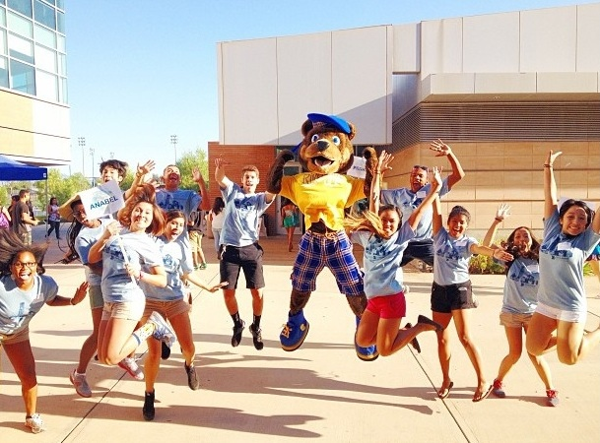
Agenda
Program Overview
Program Performance
Program Logistics
Positions and Responsibilities
Registration
Digital Platform
Student Expectations
Communication
Reports

Slide 3
Advanced Placement Readiness (APR) Program
AP Biology
AP Calculus AB
AP Chemistry
AP Computer Principles
AP English Language
AP English Literature
AP Human Geography
AP Physics
AP Statistics
AP US History
AP World History
Provide Supplemental Instruction to AP Students
Increase number of passing scores on AP Exams
Provide professional development to AP teachers
Eleven (11) AP courses supported

Slide 4
Advanced Placement Readiness Program
Spring 2020 by the numbers. . .
2,946 | Number of students who registered for AP Readiness last year
4,700 | Number of AP Exams taken by AP Readiness students last year
35.4% | AP Exam passing rate for Riverside County last year
61.0% | AP Exam passing rate for students attending 3 or more AP Readiness Sessions last year.

Slide 5
2020 AP Exam Passing Rates by Sessions Attended
Attended 0 Sessions | 35.4%
Attended 1+ Sessions | 53.9%
Attended 3+ Sessions | 61%
Attended 6+ Sessions | 65.5%

Slide 6
AP Readiness Session Dates (Saturday)
Session Instructional Schedule
Session 1
9 a.m. – 10:35 a.m.
Session 2
11 a.m. – 12:35 p.m.
Each Saturday will use the same “Bell” schedule
Breaks for students and teachers are built into the schedule
September 19, 2020
October 10, 2020
November 7, 2020
December 5, 2020
January 16, 2021
February 13, 2021
March 6, 2021
April 10, 2021

Slide 7
Program Logistics
Positions and Responsibilities
Registration
Digital Platform
Communication
Student Expectations
Reports

Slide 8
Positions and Responsibilities
Program Director – James Keipp, UCR
Responsible for overall management and operation of the AP Readiness Program
Program Coordinator – Angelica Sandoval Magana, UCR
Works with Program Director and provides the necessary support to accomplish the program’s goals and objectives
RCOE Point of Contact – Gil Compton, College and Career Unit
Acts as liaison between Riverside County Office of Education to support APR program, districts, and schools.

Slide 9
Positions and Responsibilities (continued)
District Level Point of Contact
Districts are asked to identify a district-level staff member to act as a liaison between the district, APR, and RCOE to support program
Site Level Point of Contact
Schools are asked to identify a site-level staff member to act as a liaison between the school, UCR APR, and RCOE to support the program and communication with students, parents, and participating teachers.

Slide 10
Positions and Responsibilities (continued)
Instructor
Instructors are responsible for to plan for program sessions to ensure that the material presented best fits the needs of students and participating teachers.
Instructors will work under the direct supervision of the Program Director. Instructors are required to plan and deliver instruction and lead post-instruction question and answer periods for students.
Instructors will be compensated by UCR per Saturday and will be contracted as “Vendors” under the University of California employment guidelines, policies, and practices.
Notes:
Instructors must have the ability and motivation to teach in a virtual setting and be prepared to transition to traditional instructions at the UCR campus if/when the program returns to in-person instruction.

Slide 11
Positions and Responsibilities (continued)
Participating Teacher
Participating teachers are hired to partner and support APR Instructors.
To qualify, a participating teacher must be currently teaching the AP course or credentialed to teach the AP course in the future.
Participating teachers will be compensated $120 per Saturday (2 Sessions).
Participating teachers will be assigned to partner with Instructors to provide instructional support, session management, and assistance in both the direct instruction and Q and A portions of the session.
Complete Educator Evaluation at end of each day.
Notes:
Co-Host/Facilitate Small Breakout rooms under the Guidance of the APR Instructor (if necessary)
Complete Educator Evaluation at end of Day
Submit Required UCR Payment Procedure the receive Stipend
Have a great experience & learn a lot & support students towards a “5” of their AP Exam !!

Slide 12
Positions and Responsibilities (continued)
AP Teacher
AP Teachers not filling Participating Teacher duties are encouraged to attend AP Readiness Sessions with their students.
Data clearly links improved student attendance with AP Teacher attendance.

Slide 13
Program Registration
AP Teacher and Student Registration Link
Register on or before September 11, 2020
Registration is required for participation
Teachers and Students will use their school email to register
Parent emails can also be included to enhance communication
Cellphone numbers are used for text reminders and will not be shared
Session Links and updates will be sent prior to each session

Slide 14
Digital Platform - Zoom
The AP Readiness Program will use the Zoom digital platform to conduct the virtual classroom sessions.
Zoom links will be PASSWORD protected and emailed to registered teachers and students on the Tuesday prior to each session.
Each AP Course classroom will have an assigned Instructor and Participating Teacher.
Question and Answer segments will be included in each class session.
Notes:
Sessions will not be recorded

Slide 15
Digital Platform - Zoom
Instructors and Participating Teachers should log-on using their classroom link by 8:30 a.m. on the morning of their session.
Students and AP Teachers should log-on by 8:45 a.m. using their classroom link on the morning of their session.
Technical support will be provide by UCR for each Saturday session. Information will be sent with session links.
UCR AP Readiness will host a Question and Answer Zoom meeting on September 16th at 6 p.m. Link will be sent with registration confirmation.

Slide 16
Program Communication
APR Program website will be updated to reflect upcoming sessions and information.
Registration will remain open for the entire program year.
Subject topics and links will be sent 5 days prior to each Saturday session.
Session information will also be shared on AP Readiness Instagram and Twitter pages.

Slide 17
Student Expectations
Registration is only required once (Please register by September 11, 2020 to attend 1st session).
Students can join the program throughout the year.
Use First Name, Last Name, and School as your “Zoom” onscreen name.
Appropriate dress and camera background is expected.
Stay “muted” during session unless participating at the Instructor’s direction.
Do not take photos or engage in “private chats” with other students.
Only attend the subject session for which you are registered.
Complete the Student Evaluation at the end of each APR day.

Slide 18
Program Reports
Student and Teacher attendance reports will be available for school and district staff after each session.
Attendance reports will be generated from registration and log in information.
Additional Reports
2019-2020 APR Performance Reports
Spring 2020 College Board AP Examination Reports
2019 Instructional Planning Reports
2019 AP Potential Reports (PSAT data)
National Student Clearinghouse Reports (College Enrollment)
Contact Gil Compton at RCOE for more information (gcompton@rcoe.us)

Slide 19
Questions

Slide 21
Contact Information
Program Director – James Keipp, UCR
Responsible for overall management and operation of the AP Readiness Program
Program Coordinator – Angelica Sandoval Magana, UCR
Works with Program Director and provides the necessary support to accomplish the program’s goals and objectives
RCOE Point of Contact – Gil Compton, College and Career Unit
Acts as liaison between Riverside County Office of Education to support APR program, districts, and schools.

