Slide 2
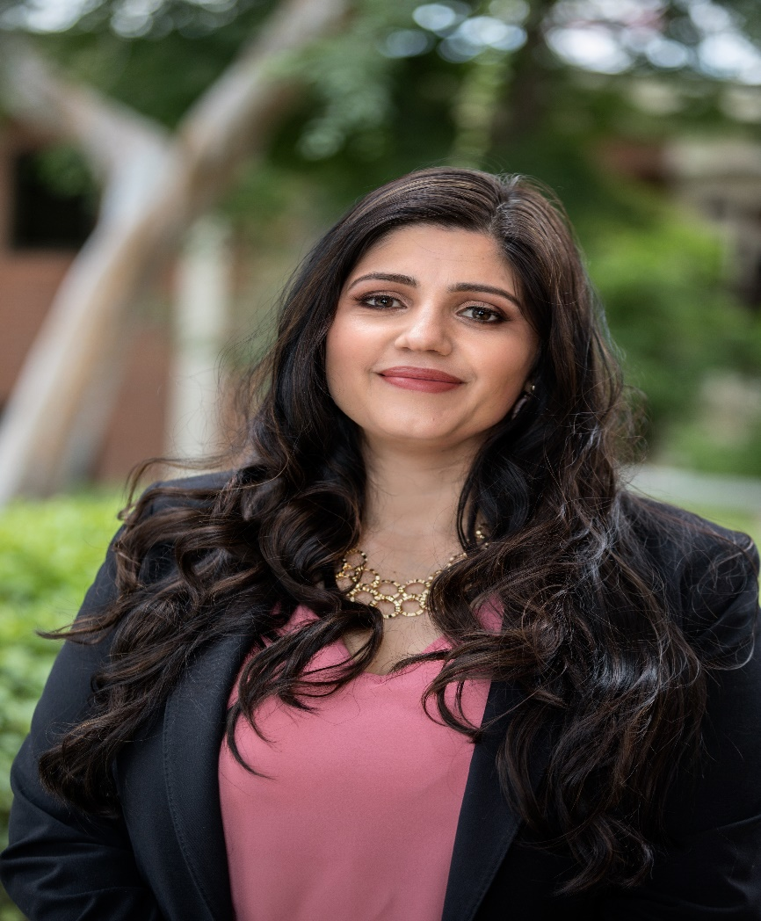
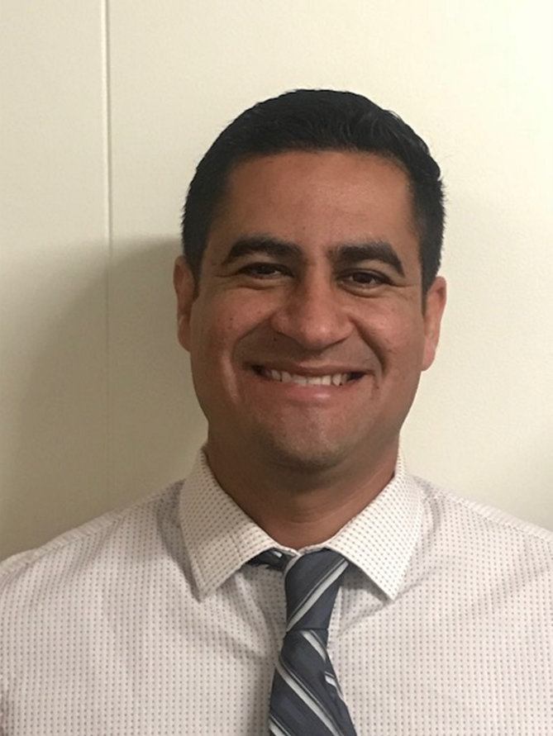
Catalina Cifuentes
Executive Director,
College and Career Readiness
ccifuentes@rcoe.us
Dr. Pedro Caro
Coordinator,
College and Career Readiness
pcaro@rcoe.us

Slide 3
Webinar Tips
This webinar is being recorded so that others may listen to it at a later time for reference and will be uploaded to the RCEC Youtube page as well as www.rcec.us once you log in to access the content of the webinar series
All connections to this live Webinar feature have been accounted for so please do not forward the Zoom link or invite anyone to join because you are taking someone else’s spot and Zoom will automatically start kicking off connections randomly
All participant mics have been muted and only panelists and facilitators have the ability to unmute anyone
Since all participants have been muted, please use the Q&A and chat screens to enter your questions
Participants can submit a question in the Q&A box at the bottom of the screen for the panelists
Only panelists and facilitators will be able to respond back to those questions and can do so publicly or privately to the individual
Participants can submit comments or questions in the chat box if they would like to engage with each other
**Every effort has been made to ensure the security of this webinar from “zoombombers” but in the event that we experience that, please stay calm and we will resume as soon as the technical difficulties have been resolved.**

Slide 4
FOR MORE INFORMATION AND RESOURCES PLEASE VISIT US @
www.rcec.us

Slide 5
Bridging A Successful Elementary-to-Middle School Transition in a Virtual Environment
Erin Bundrige & Laura Ross

Slide 6
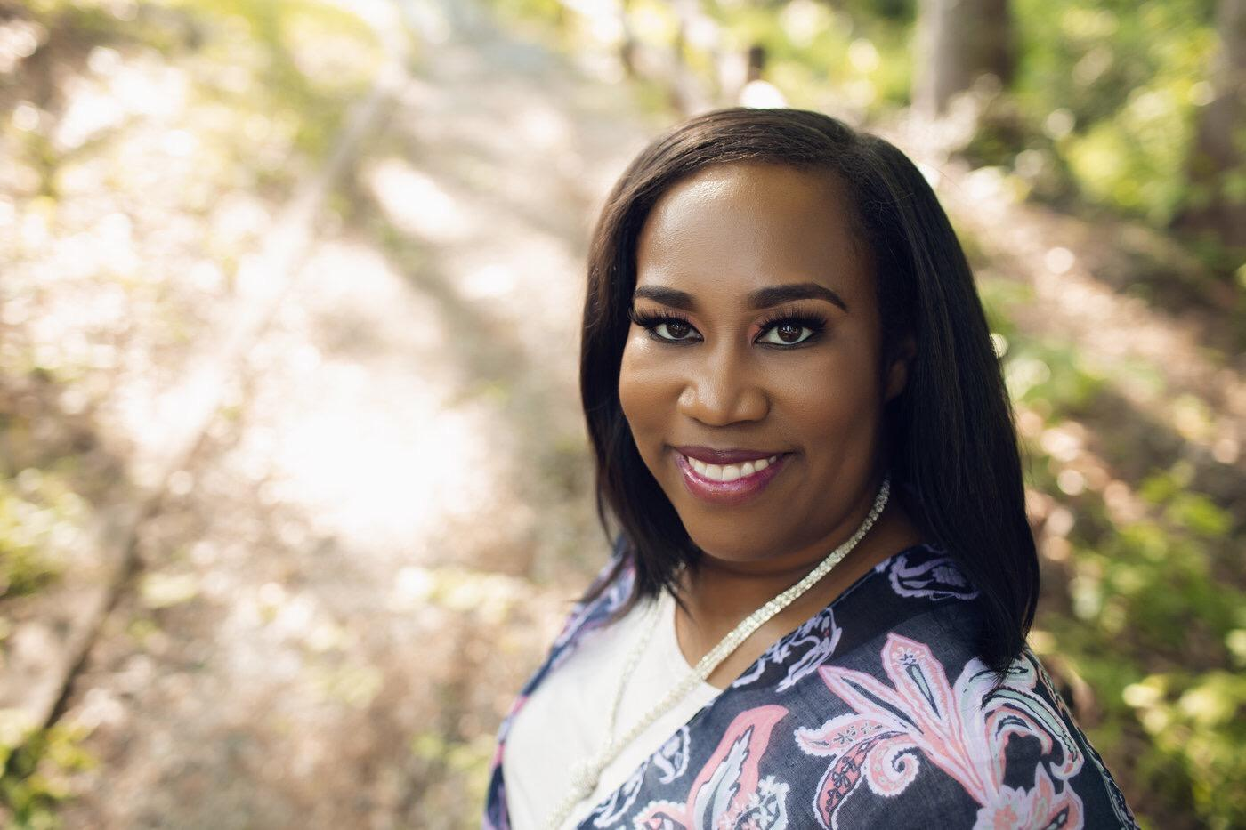
Erin Bundrige
16 years in education (8 years MS & ES teacher)
8 years as a counselor (6 ES, 2 MS)
Woodland Middle School
GSCA Middle Liaison
HCS Counseling Leadership Team
Woodland Middle School
Stockbridge, Georgia
6th, 7th, 8th
811 Students
~ 53.7% Free/Reduced Lunch
~ 24.7% White ~ 55.5% Black
~ 11.7% Hispanic ~ 5.9% Biracial
ebundrige@gmail.com
Twitter & Instagram: @counselor_erin
Notes:
Erin

Slide 7
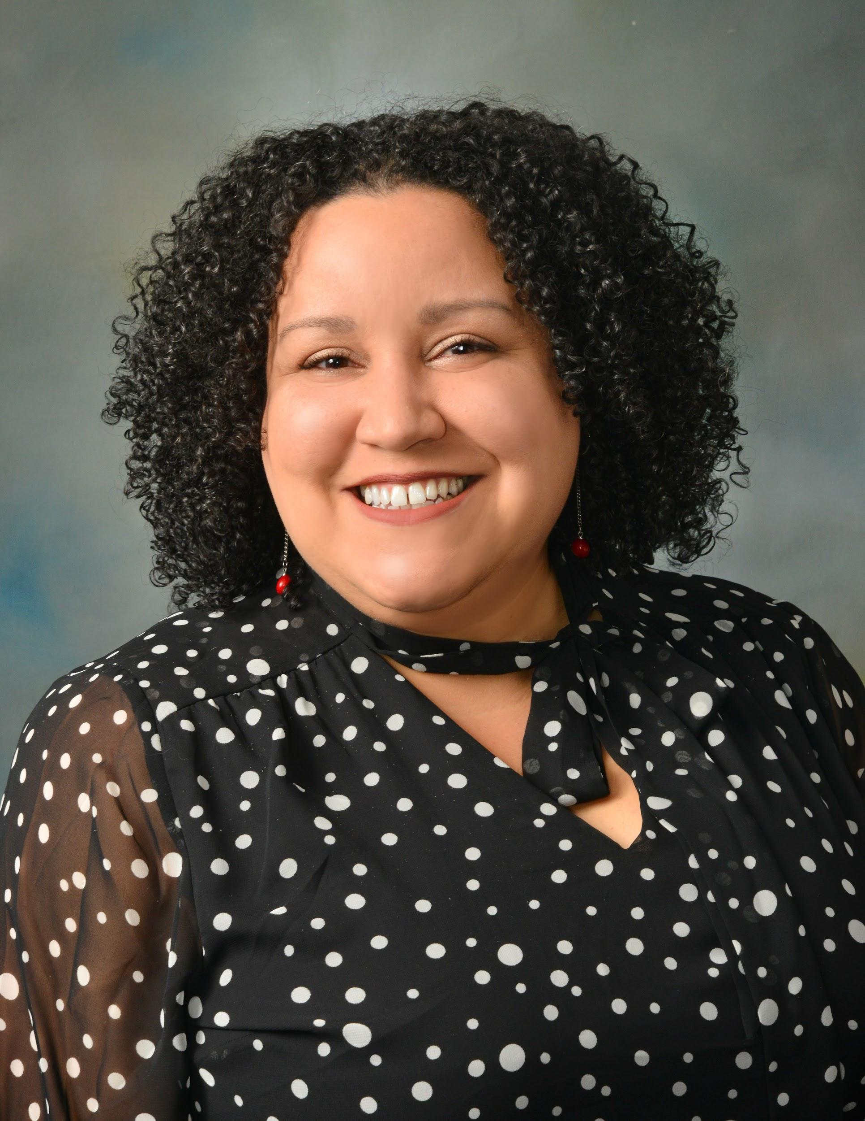
Laura Ross
ASCA 2020 School Counselor of the Year
14 years (8 ES, 6 MS)
FFMS Lead School Counselor
GSCA Executive Board - Metro Director
GCPS Middle School Counselor Steering Committee
Counselors for Computing Consultant
Five Forks Middle School
Lawrenceville, Georgia
Recognized ASCA Model Program
6th, 7th, 8th
1275 Students
~ 40% Free/Reduced Lunch
~ 32% White ~ 28% Black
~ 19% Asian ~ 18% Latino
lauraruthross@gmail.com
www.theconnectingcounselor.com
Twitter & Instagram: @LRossSchCnslr
Notes:
Laura

Slide 8
What did you already have planned?
How can you make it virtual?
Notes:
Laura

Slide 9
1.
For Students

Slide 10
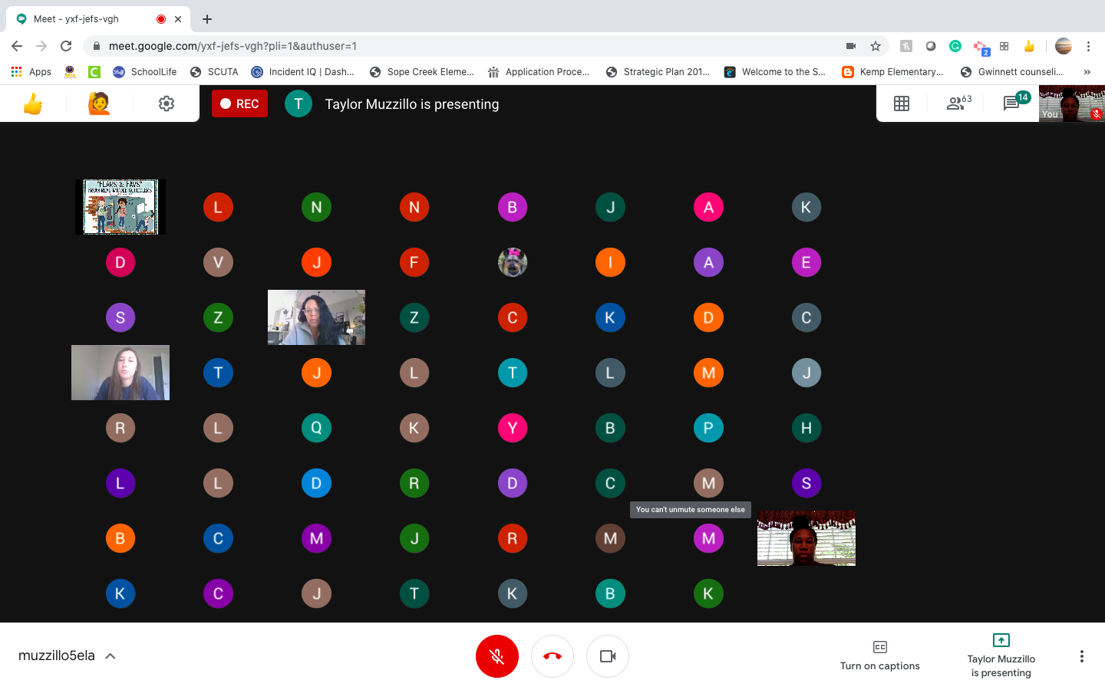
Virtual Meetings
Virtual Middle School Transition
Middle School Kahoot
Middle School Reminders
Middle School Scavenger Hunt
Questions & Answers (on Flipgrid)
Notes:
Can delete if you want to…

Slide 11
6th Grade Website
Tour
Advice from students
Locker practice
Padlet

Slide 12
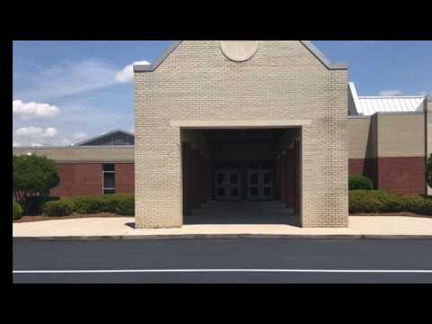
Welcome Videos

Slide 13
Welcome Videos
6th Grade Lead teacher.mov
Welcome to Woodland pt. 2

Slide 14
Voice Over/Video Slideshow for Rising 6th Students
Welcome to Five Forks

Slide 15
Highlight Activities on social media, school website, etc.
FFMS Performing Arts
FFMS Clubs & Activities List
FFMS Clubs & Activities Website
6th Grade Supply List

Slide 16
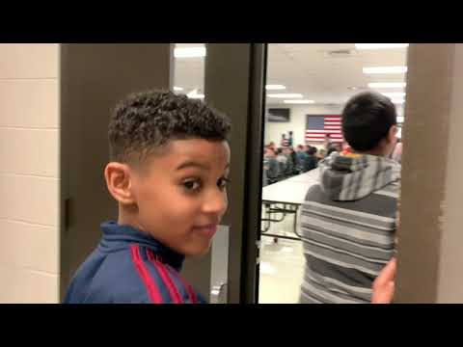
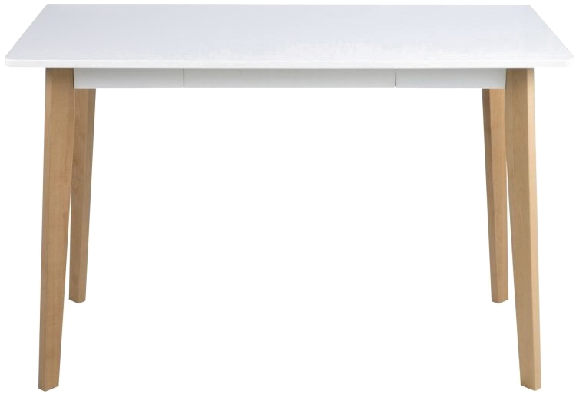
Welcome to FFMS!
Click on each object for links to information about 6th Grade at FFMS!
STEAM
6th Grade Supply List
Clubs
& Activities

Slide 17
Creating a Bitmoji Scene
Open google slide
Click Background or Google image Search for “wall floor background”
Insert or Add the Background to your slide.
Add you Bitmoji using the Google Chrome Bitmoji Extension
Insert Images of furniture/pictures with transparent background through Web Search or Copy for Google Image Search
Insert Links or Embed Videos to the Images you Inserted
Insert Text Box to Add Text where Needed
You can download as a pdf & the links will save
FB Group: Bitmoji Craze for Educators

Slide 18
1.
For Parents

Slide 19
Communication with Parents
Weekly newsletters to parents
Smore Newsletter
Parent Brochure
WMS Parent Brochure
Virtual parent night

Slide 20
Rising 6th Grade Information
FFMS Fine Arts Selection Form - Spring 2020
Rising 6th Grade Fine Arts Selection Letter - Spring
6th Grade STEAM Team Informational Presentation
Brookwood Cluster Writing Institute
Learn About the Music Department Classes (Band, Chorus, Orchestra)
6th Grade Medication Flyer for Parents
Five Forks Fathers- Learn How You Can Get Involved!
FFMS Rising 6th Grade Parent Presentation Video
FFMS Rising 6th Grade Parent Presentation Slides
Welcome To Your Media Center
FFMS Counseling Brochure
FFMS Clubs and Activities Page
Rising 6th Grade Parent Welcome Letter
A Day in the Life of a 6th Grade Bronco- Video

Slide 21
A DAY IN THE LIFE OF A 6TH GRADER AT FFMS

Slide 22
Questions?

Slide 23
Round of Applause for our Presenters!!
Erin Bundrige
Laura Ross
Notes:
Castro Slide

Slide 24
We are here to support you!
Please reach out to College and Career Readiness with any needs at your school site, professional development topics, or general questions at:
Catalina Cifuentes ccifuentes@rcoe.us
Dr. Pedro Caro pcaro@rcoe.us
Notes:
Castro Slide

Slide 25
FOR MORE INFORMATION AND RESOURCES PLEASE VISIT US @
www.rcec.us

Slide 26
