Slide 1
California’s Vision for College Affordability Lande Ajose, Ph.D.
CA College Affordability Summit| November 2019 Senior Policy Advisor to Gov. Gavin Newsom

Slide 2
The Newsom Administration’s Vision
California For All
Governor Newsom aspires to
tackle the cost crisis facing California
create a just state for all Californians, and
demonstrate that government can be both progressive and effective for all
Confronting the cost crisis
Justice for all
Effective government
2

Slide 3
Higher Education and the Vision
Confronting the Cost Crisis
College Affordability
- Tuition
- Debt
- Financial Aid
Justice For All
Higher Education Equity
- Access
- Completion
- Achievement Gaps
Effective Government
Oversight, Governance and Accountability
- Data
- Coordination

Slide 4
2019-2020 Budget makes historic investments in higher education
$1.6B increase in higher education
Freezes tuition and increases enrollment slots at both the University of California and California State University systems for the 2019-2020 school year
Expands the California College Promise to fund two years of free community college for full-time California students
Targets funds for addressing student hunger, housing and basic needs at CSU, UC and community colleges
Provides $41.8M to increase the number of competitive Cal Grant scholarships from 25,750 to 41,000 for qualified Californians
Provides $96.7M to support the living expenses of student parents with dependent children to increase degree completion
Designates resources for summer financial aid at UC and CSU
Supports special programs for foster youth, veterans and formerly incarcerated individuals to promote their academic success
Expands research in dyslexia and neurodiversity at the UC and CSU
Addresses student mental health needs at the UC, CSU, and community colleges
Provides $50M in start-up monies for college savings accounts for California children

Slide 5
Confronting the Higher Education Cost Crisis means Addressing Affordability
The Cal Grant program is a need-based financial aid program that awards nearly $2.5B annually
Cal Grant award amounts are primarily based around tuition and fees, including the 100% systemwide guarantee at UC and CSU.
Governor Newsom is committed to moving towards meeting Total Cost of Attendance (TCA)
TCA at many of California schools exceeds $30,000
The current model does not effectively serve community college students
Students at independent nonprofits also receive a fixed amount to support their education
Debt
Financial Aid
Tuition

Slide 6
California Financial Aid: Pros and Cons
Through the Cal Grant Program, California provides a strong baseline of student aid:
Entitlement programs guarantee Cal Grant aid to students who qualify, and who apply by the deadline
Tuition & fee link (at public universities) provides stability
More resources are needed, especially to address non-tuition expenses
Given California’s high costs of living, a tuition-focused financial aid system is not sufficient for low-income students
The complexity and lack of coordination around California financial aid undermines the effectiveness of the aid itself

Slide 7
California Student Aid Commission adopted four principles for reform
Remove eligibility and access barriers in the current Cal Grant program
Age limit
Time since high school graduation
GPA requirement
Change the model of the Cal Grant program to focus on total cost of attendance
Currently, most awards are linked to tuition and fees
Reinstate a formula for an annual adjustment to the maximum Cal Grant for students attending private nonprofit institutions
Support additional Cal Grant eligibility for students taking summer coursework

Slide 8
The Current Cal Grant System
PROBLEM
The Cal Grant program is overly complex, with differing GPA requirements, eligibility criteria, and award amounts
Cal Grant A covers tuition and fees at a public university, but currently provides no benefit at a CCC
Cal Grant B provides lower-income students with grants for non-tuition expenses (books, supplies, etc.) but does not cover tuition for first-year university students
Cal Grant C provides money for books and equipment to eligible community college students
Many students with significant financial need are not eligible for any Cal Grant aid
Some moderate income students are eligible for the Middle Class Scholarship (income and asset ceiling up to $177K)

Slide 9
A Simplified Cal Grant System
Potential SOLUTION
Streamline state aid programs into a single Cal Grant
Available to all first-time California students with financial need
Award amounts would vary based on need (or other factors, such as income)
A simpler system for students, families, and schools to understand

Slide 10
Removing Eligibility Barriers
PROBLEM
Potential SOLUTION
Too many low-income students, with significant financial need, are ineligible to receive a Cal Grant under current provisions:
High School Entitlement is guaranteed for one year after HS graduation
Transfer Entitlement must be claimed before age 28
Three distinct GPA requirements:
3.0 HS GPA for HS Entitlement Cal Grant A
2.0 HS GPA for HS Entitlement Cal Grant B
2.4 CCC GPA for Transfer Entitlement
Eliminate eligibility requirements for Cal Grant based on:
Time since HS graduation
Age
GPA minimum

Slide 11
Estimating Student Financial Need
PROBLEM
Potential SOLUTION
Student need is currently calculated using fixed income and asset ceilings that do not:
Take into account the high cost of living in California
Reflect a student/family’s actual ability to pay for college
Base student financial need for Cal Grant on Expected Family Contribution (EFC), in two stages:
First, use the current EFC as determined by the FAFSA
Ultimately, develop and implement an adjusted EFC formula, broken down (if possible) by region

Slide 12
Focusing on Total Cost of Attendance
PROBLEM
Cal Grant award amounts are primarily based around tuition and fees, including the 100% system-wide guarantee at UC and CSU.
Potential SOLUTION
Refocus the Cal Grant model towards TCA, using a formula that limits a student’s out-of-pocket cost:
Determine what a reasonable “self-help” expectation might be, which could be comprised of any combination of work income or loan dollars
Subtract the adjusted parents’ contribution, the student expectation, and federal grant aid from TCA
The remainder could be covered by a new Cal Grant Affordability Guarantee

Slide 13
Legislative Policy Proposals
Cal Grant Reform Act
(AB 1314 – Medina)
CA Community College Financial Aid
Program (SB 291 – Leyva)
Consolidates the Cal Grant A, B, and C Programs into one Cal Grant Program
Consolidates the Middle Class Scholarship into the one Cal Grant Program
Authorizes the use of Cal Grant awards during summer terms and/or sessions
Removes all of the following barriers for determining eligibility with regard to:
Age;
Years out of high school;
Grade Point Average (GPA);
AB 540 status
Based on a funding formula for student need, using family income and total cost of attendance to determine the award amounts for students
Requires each eligible community college to calculate the award amount by subtracting the “expected family contribution,” “reasonable student contribution,” and “gift aid received by the student,” from the “cost of attendance” for each term in an academic year for each eligible at that college.
Declares the Legislature’s intent to appropriate monies for the program from future Budget Acts with the appropriation specifying the percentage of the sum from to be awarded to each eligible student for that academic year.

Slide 14
The California College Promise – “Free” Community College
Waives enrollment fees for all first-time, full-time community college students
Full time is defined as 12 units
Expanded in 2019-2020 to include second year students
Estimated cost in 2019-2020 is $88M
Colleges have discretion in how they choose to use resources:
Instead of covering fees, colleges can use resources to invest in student success strategies such as advising, tutoring, textbook vouchers, or childcare facilities

Slide 15
WHY DOES THIS MATTER?
Notes:
More than 1 in 3 California workers earn less that $15/hr.
Variance by place, race and gender
Half of all Latino workers in California earn less than $15/hr.

Slide 16
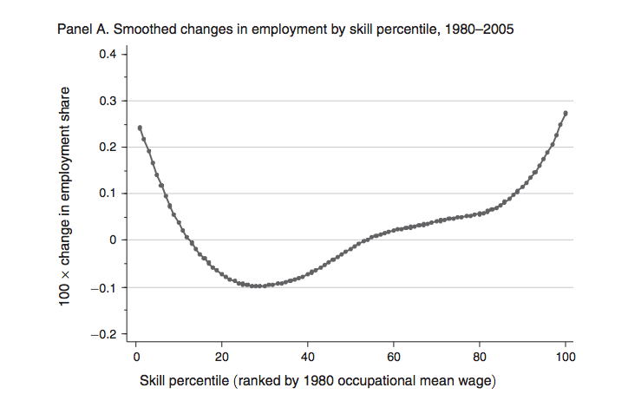
JOB GROWTH LIMITED TO LOW-SKILL & HIGH-SKILL JOBS
Changes in Employment by Percentile, 1990-2005
Notes:
There has been a following out of middle skill jobs
While training and upskilling workers has been our go-to approach for low skill workers, workers are limited by the jobs that actually exist in the labor market
A focus on skills alone can not address underlying structural factors in the labor market

Slide 17
Wages are decoupled from productivity
WAGES DOUBLED FROM PRODUCTIVITY
Notes:
Even though workers have become more productive, their wages have not matched that increased productivity
Increasing skills without addressing factor that are driving down wages is an incomplete strategy

Slide 18
Most skilled workforce ever
MOST SKILLED WORKFORCE EVER
Notes:
We have the most skilled workforce in history (35%)

Slide 19
WHO MAKES LESS THAN $15 IN CALIFORNIA?
Notes:
More than 1 in 3 California workers earn less that $15/hr.
Variance by place, race and gender
Half of all Latino workers in California earn less than $15/hr.

Slide 20
20% OF WORKERS IN CA MAKING LESS THAN $15 HAVE A COLLEGE DEGREE
Notes:
One is 5 Californians have a college degree -- more evidence that college alone is not enough to improve outcomes for low wage workers

Slide 21
Notes:
California For All.

