Slide 1
Virtual Tech Tools 2.0
Nicohl Shelton Webb
Henry County Schools
bit.ly/webbcatech2
nwebb@henry.k12.ga.us

Slide 2
Meet your presenter
Nicohl Shelton Webb
Elementary School Counselor
Henry County Schools
You can reach me at : nwebb@henry.k12.ga.us
www.twitter.com/CounselorPCE
www.instagram.com/techlovingschoolcounselor

Slide 3
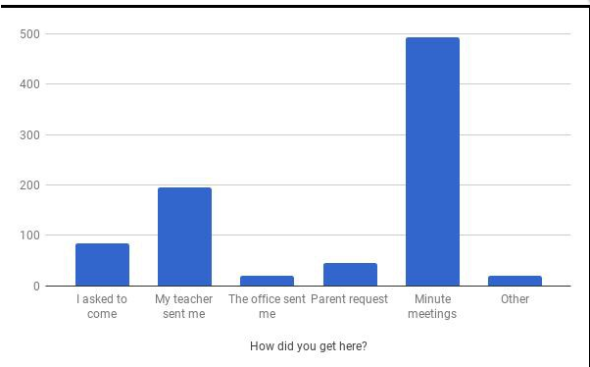
TOP TIPS WITH GOOGLE and More
Documentation
Data
Forms, Forms and More Forms
Google Classroom
Google Sheets
ScreenCastify

Slide 4
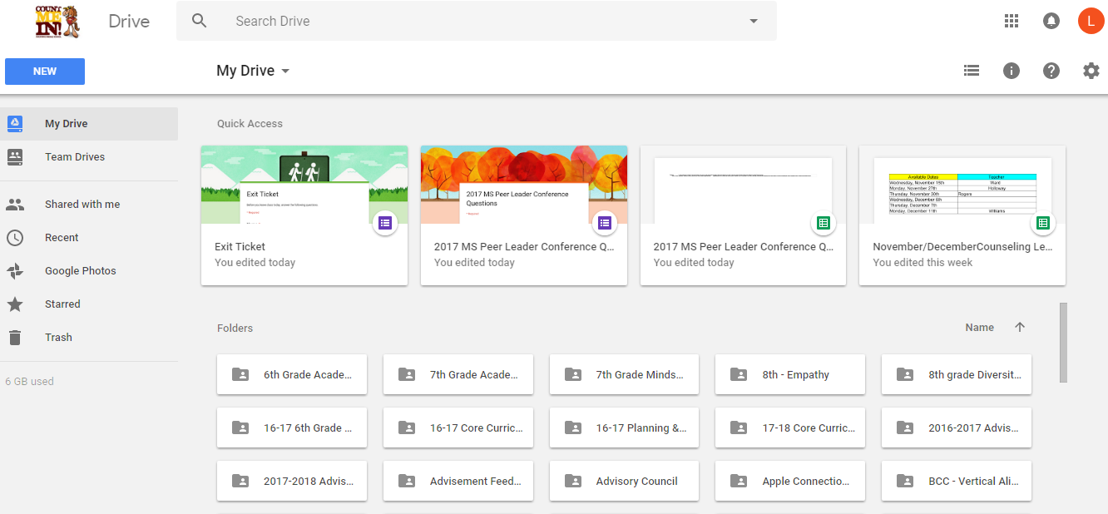
Google Drive
15 GB of free Google online storage, to keep photos, stories, designs, drawings, recordings, videos – anything.
Your files in Drive can be reached from any smartphone, tablet, or computer.
You can quickly invite others to view, download, and collaborate on all the files you want–no email attachment needed.
Create and collaborate with others. Share documents and files, build out spreadsheets and make a presentation on the fly with our Docs, Sheets and Slides apps.
You can also purchase a larger cloud storage plan as you need it.
https://www.google.com/drive/
Example:
Notes:
Nicohl

Slide 5
Google Drive to Google Apps
Docs
Slides
Forms
Sheets
Notes:
????

Slide 6
Google Docs
Google’s version of Word
Free
Google Docs brings your documents to life with smart editing and styling tools to help you easily format text and paragraphs. Choose from hundreds of fonts, add links, images, and drawings.
Access, create, edit, and COLLABORATE your documents wherever you go — from your phone, tablet, or computer — even when there's no connection.
Everyone can work together on the same document at the same time.
https://www.google.com/docs/about/
Example:
Docs Example
Counseling Bingo Activity
Notes:
Nicohl

Slide 7
Google Slides
Google’s version of PowerPoint
Free
A variety of presentation themes, hundreds of fonts, embedded video, animations, and more.
Access, create, edit & COLLABORATE your presentations wherever you go — from your phone, tablet, or computer — even when there’s no connection.
Use for professional development presentations, core curriculum presentations, student created assignments
https://www.google.com/slides/about/
Example:
Slide Presentation Example
Notes:
Laura

Slide 8
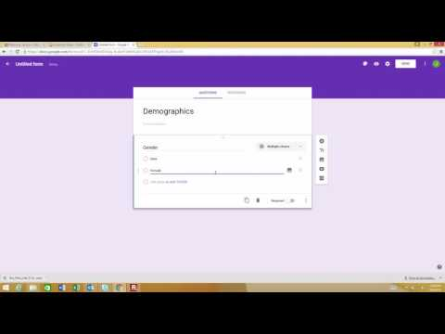
Google Forms
Free
Plan your next event, manage registrations, whip up a quick poll, collect email addresses for a newsletter, create a pop quiz, and much more.
Choose from a bunch of question options, from multiple choice to dropdowns to a linear scale. Add images and YouTube videos, etc.
Responses to your surveys are neatly and automatically collected in Forms, with real time response info and charts. Or, take your data further by viewing it all in Sheets.
https://www.google.com/forms/about/
Example:
Forms Example
Notes:
Dwight

Slide 9
Google Sheets
Google’s version of Excel
Free
Google Sheets makes your data pop with colorful charts and graphs. Built-in formulas, pivot tables and conditional formatting options save time and simplify common spreadsheet tasks.
Access, create, edit, and COLLABORATE your spreadsheets wherever you go — from your phone, tablet, or computer — even when there’s no connection
Everyone can work together in the same spreadsheet at the same time.
https://www.google.com/sheets/about/
Example:
Sheets Example
Notes:
Mike

Slide 10
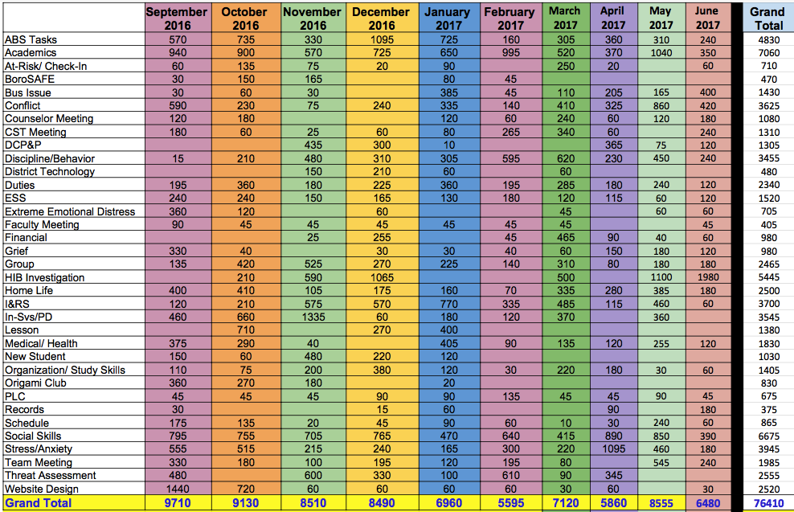
How can I:
keep an effective & efficient counselor log?
track data?
use data to advocate for my students and program?
Link to Google Sheet for Counselor Log/Data Collection (make a copy of it for yourself).
Taken from: https://www.angelacleveland.com/presentations

Slide 11
Google faux pas
Have you ever shared a Google Doc, Slide, Sheet with a colleague to use, but they forgot to “make a copy” and they ended up editing your version? Click here for some easy steps to force someone to make a copy!

Slide 12
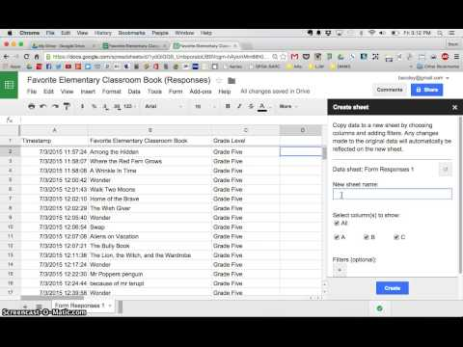
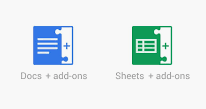
Favorite Add-Ons
Docs to Forms
EZ Query
Power Tools
Split Names
Yet Another Mail Merge
Sheets Text to Column
Add-ons are customized extensions of G Suite productivity applications such as Google Sheets, and Google Docs and Google Forms. Add-ons lets you create shortcuts quickly and easily.

Slide 13
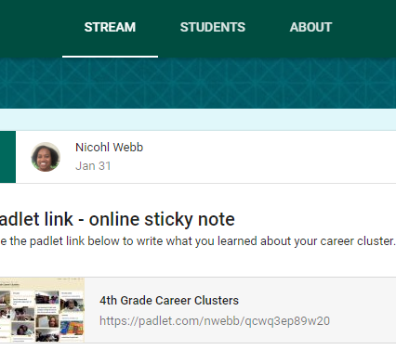
Google Classroom
Google Classroom is a free web service developed by Google for schools that aims to simplify creating, distributing and grading assignments in a paperless way. School Counselors can use this for Career Cluster lessons and to disseminate information.
How to get started with Google Classroom?
Example:

Slide 14
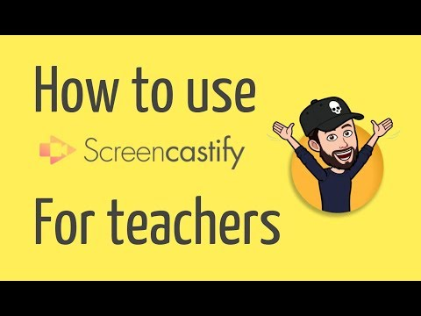
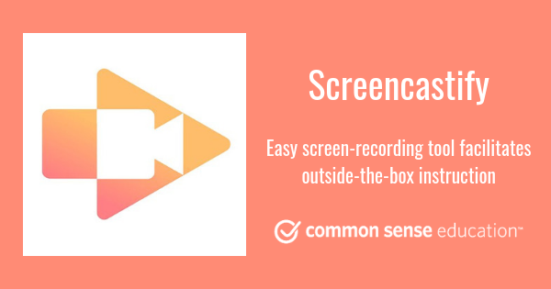
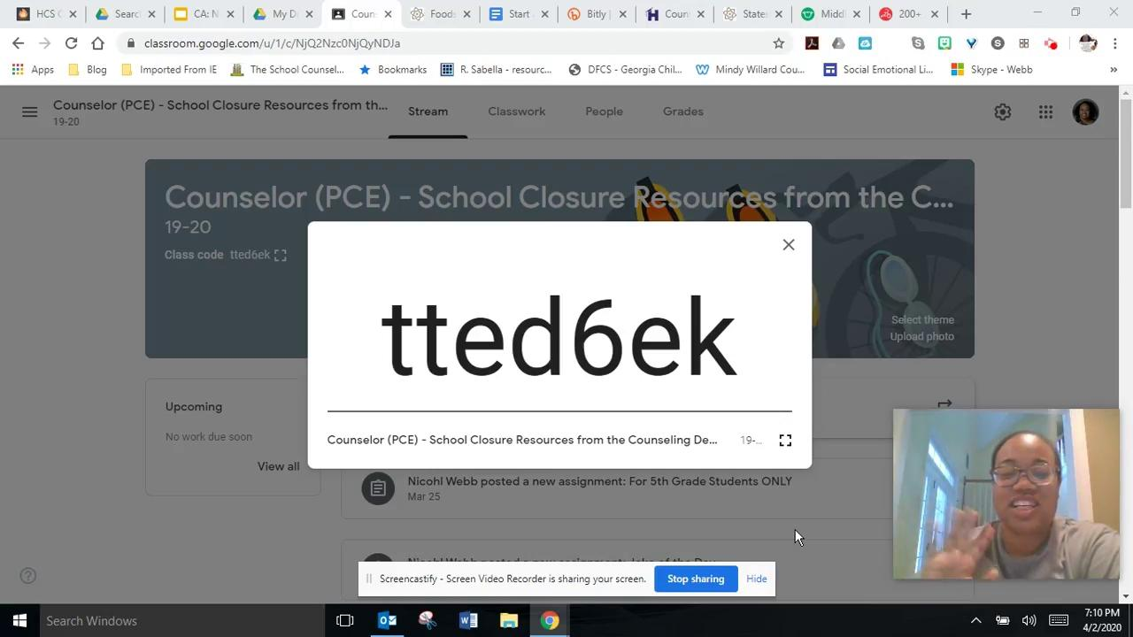
Screencastify is my new best friend!
Screencastify is an ultra simple screen recorder that will supercharge the way you communicate at work. Record, edit and share HD videos in seconds.

Slide 15
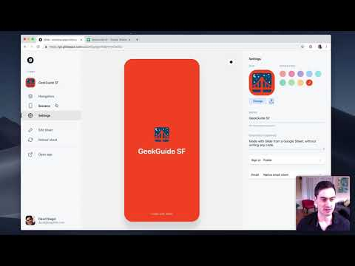
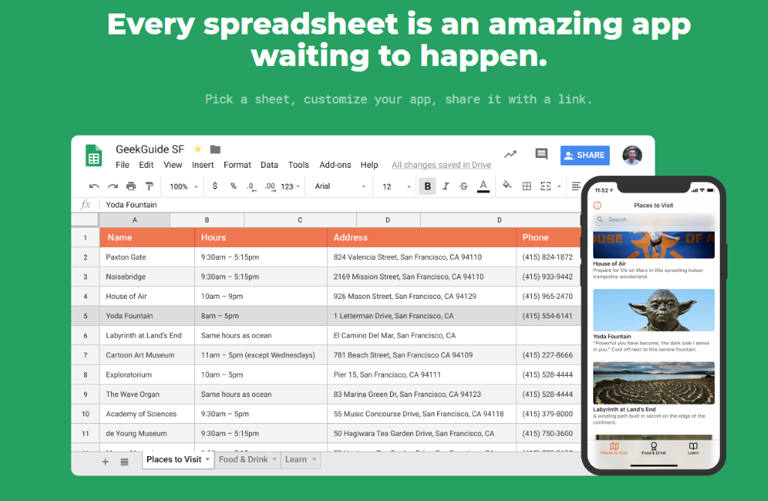
Glide App
Glide turns spreadsheets into beautiful, easy-to-use apps, without code. Pick a spreadsheet or start with a template, customize your app, then share it instantly.

Slide 16
THANKS!
Nicohl Shelton Webb
nwebb@henry.k12.ga.us | www.twitter.com/CounselorPCE www.instagram.com/techlovingschoolcounselor www.bit.ly/webbcatech2

