Slide 1
Closing Achievement Gaps through a Comprehensive School Counseling Program
Dr. Yuridia Nava- School Counselor Riverside Poly High School
Adjunct Professor La Sierra University

Slide 2
Overview/Objectives
The School Counselors Why?
What is a Comprehensive School Counseling Program
Components of a Comprehensive School Counseling Program
Data Informed Program
Collaboration
Advocacy
Closing Equity Gaps
MTSS
Examples
Increasing School Wide Collaboration
Success Stories
Activity/Wrap Up

Slide 3
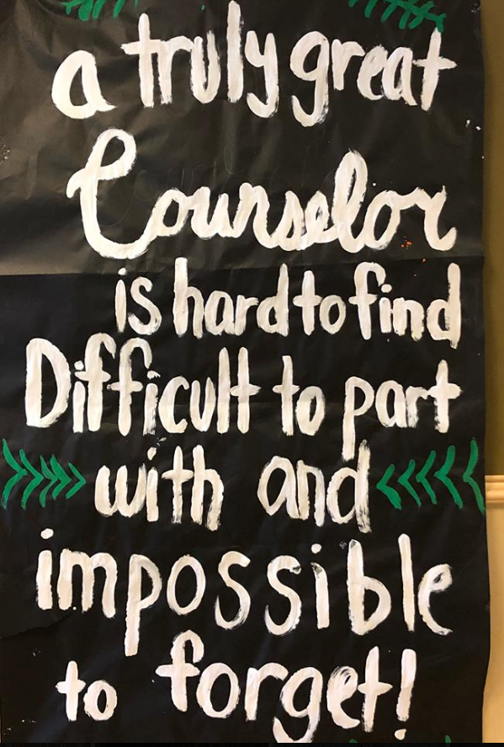
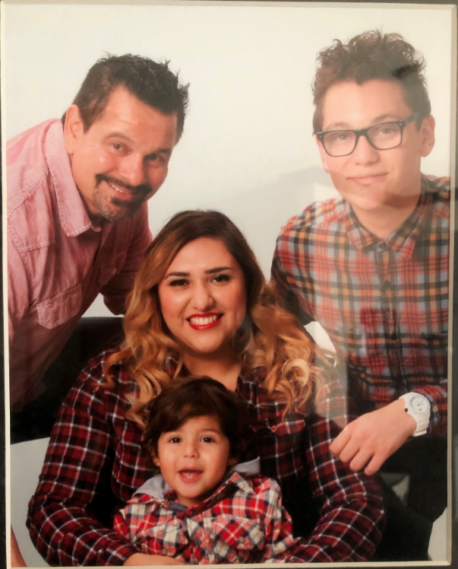
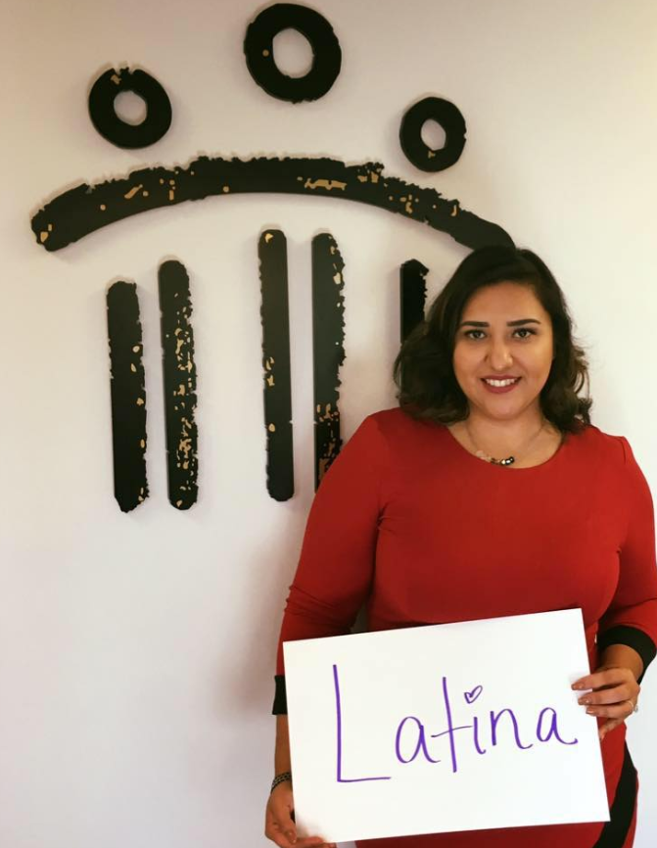
Yuridia Nava- Ed.D.
Education
Ed. D Educational Psychology – La Sierra
Ed. S School Psychology – La Sierra
PPSY- School Psychology- La Sierra
MA- School Counseling- Redlands
Administrative Services Credential- Redlands
Drop out Prevention Specialist- Sacramento State
Certifications
Family Wellness
Trauma Crisis Counseling
Applied Suicide Intervention Skills
Specialist College Admissions
Specialist Anxiety and Stress Management
Specialist Grief and Loss
Specialist Closing the GAP
Specialist Ethical Standards
Leadership
Board Service 10+ Years
ASCA RAMP Reviewer
RUSD Equity Task Force
RCOE Counselor on Special Assignment
Instructional Leadership Team Lead
ACA Multicultural and Social Justice Committee
Western States Leadership Committee
Awards
RAMP School of Distinction 2017
Women of Distinction State Assembly
Excellence in Counseling State Assembly
Top Advisor – Riverside Mayors Office
ASCA SCOY Finalist
CASC School Counselor of the Year
FUSD Best Practices Elementary Level
Certificate of Excellence California Student Aid Commission
Glaes Nobel Educator of Distinction

Slide 4
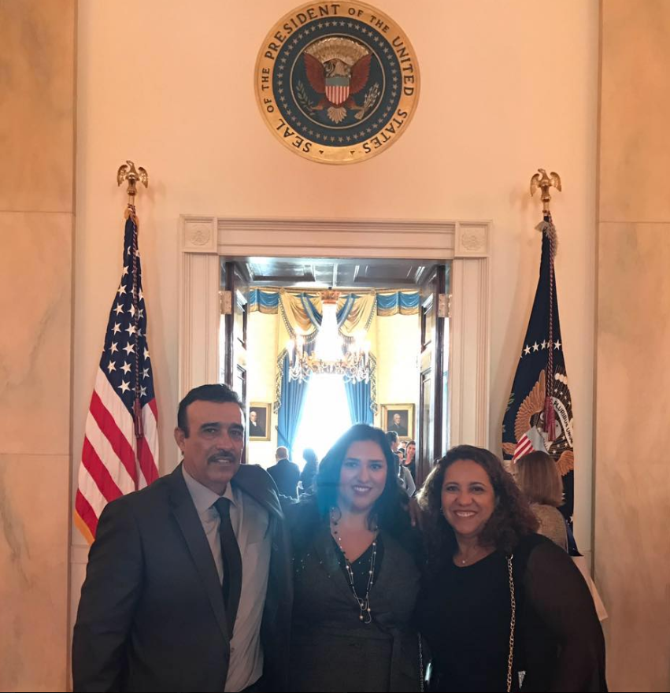
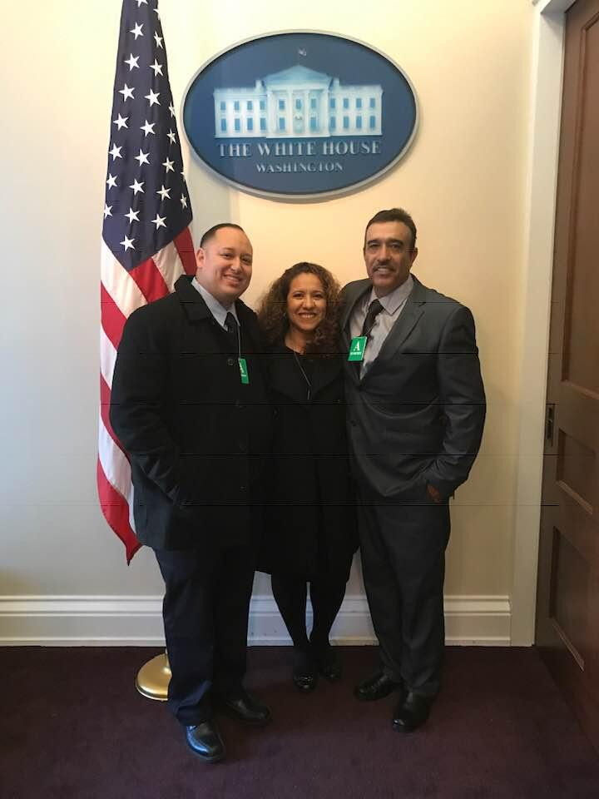
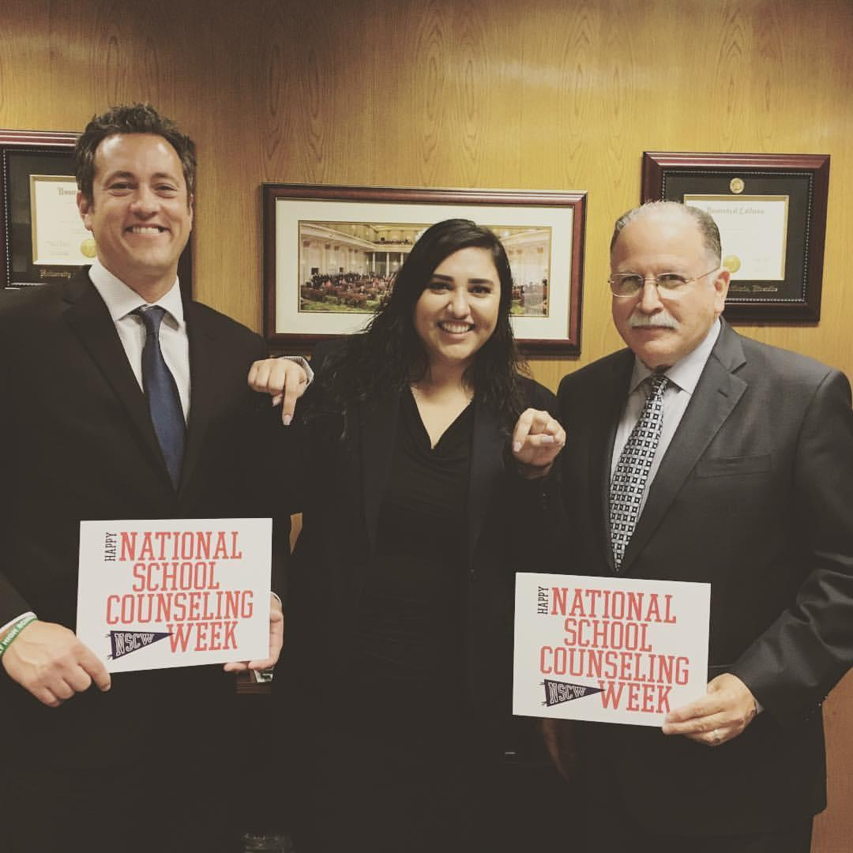
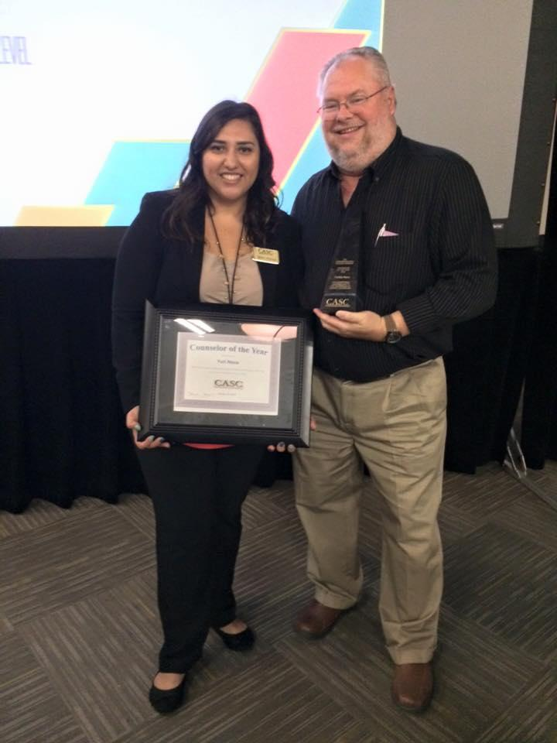
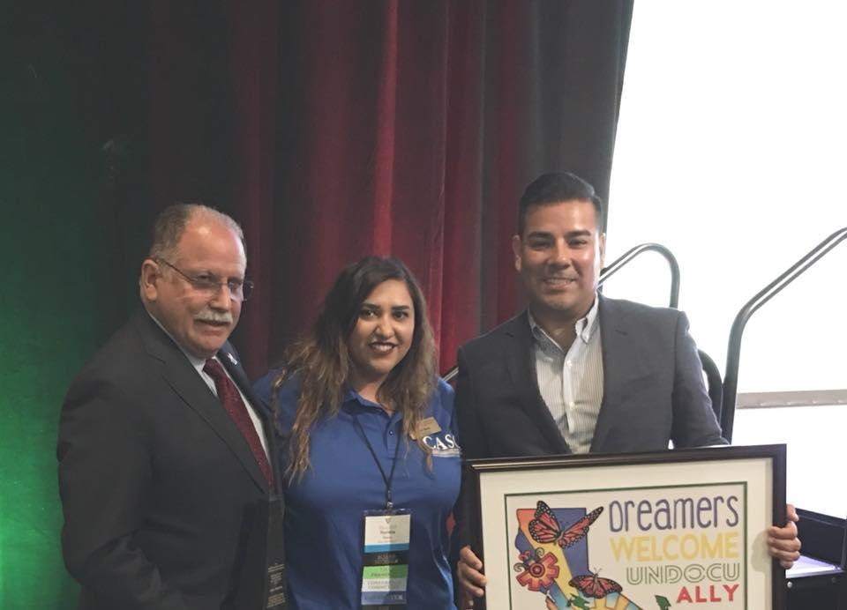
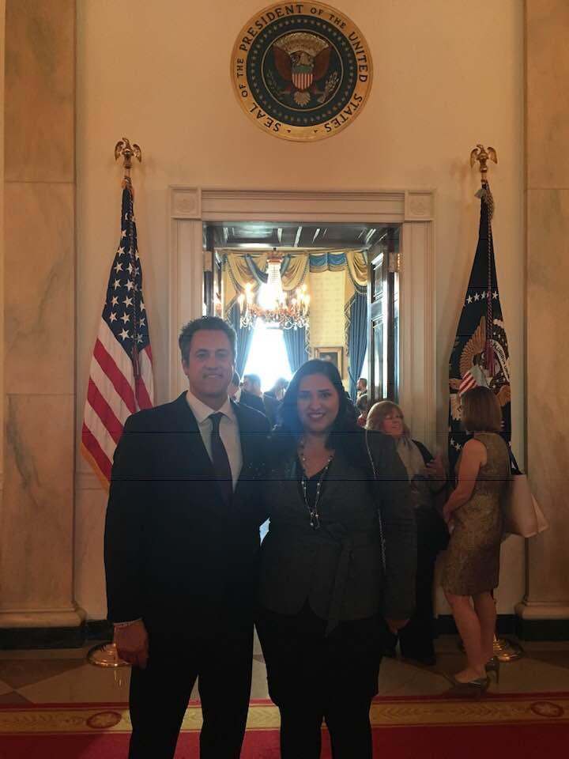
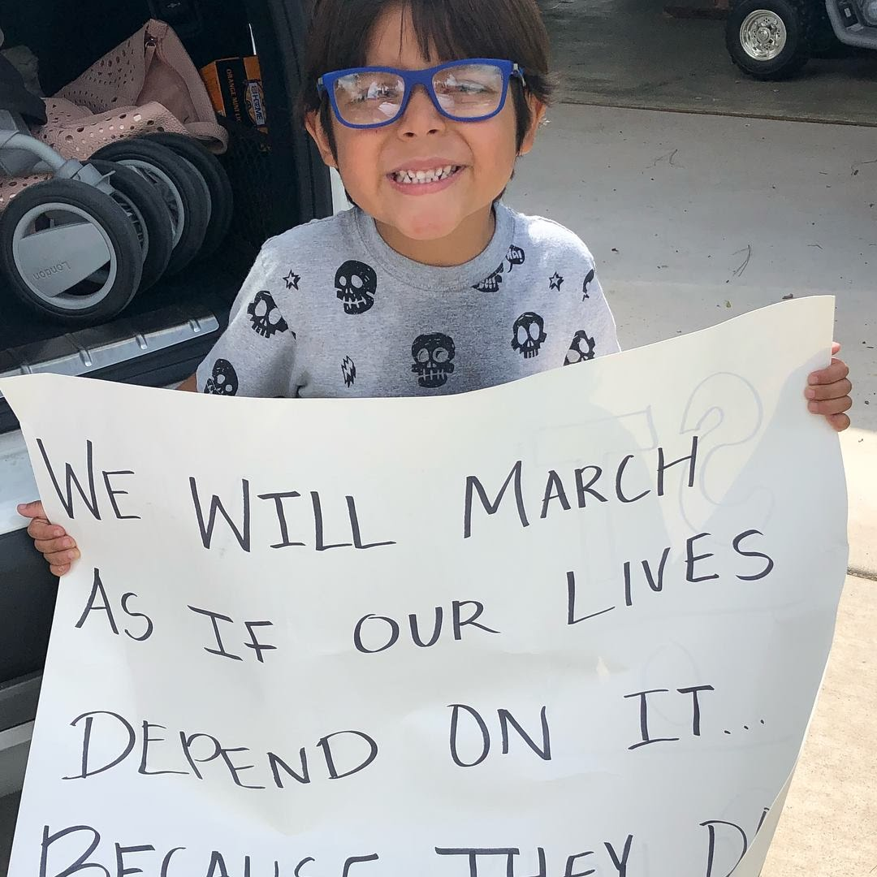

Slide 6
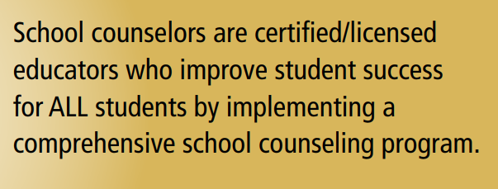
School Counselors Why
Maximizing student success
Student Advocates
Notes:
American School Counselor Association (ASCA) Position School counselors recognize and distinguish individual and group differences and strive to equally value all students and groups. School counselors are advocates for the equitable treatment of all students in school and in the community.

Slide 7
Comprehensive School Counseling Programs
Follow the American School Counselors Association (ASCA) National Model
Have 12 Components
Align with school, district, county, & state mission & vision and LCAP priorities
Set GOALS annually
Review DATA annually (Classroom Lessons, Small Groups, School Wide Attendance, Achievement, & Behavior Data)
Identify equity gaps

Slide 8
ASCA Model: Closer Look
Mission
Vision
Administrative Conference
Goals
Mindsets & Behaviors
Instruction
Small Groups
Instruction Results Reports
Small Group Results Reports
Closing the Gap Action Plan
Closing the Gap Results Reports
Reflection
Notes:
The School Counselor’s Role School counselors develop and implement a comprehensive school counseling program promoting equity and access for students. School counselors work to help close achievement, opportunity, attainment and funding gaps in their schools, districts and communities. School counselors are mindful of school and community perceptions of the treatment of underrepresented groups and understand the importance of collaborating with school and community groups to help all students succeed. School counselors demonstrate cultural competence. School counselors promote equitable treatment of all students by: • Using data to identify gaps in achievement, opportunity and attainment • Advocating for rigorous course and higher education for underrepresented groups. • Maintaining professional knowledge of the ever-changing and complex world of students’ culture • Maintaining knowledge and skills for working in a diverse and multicultural work setting • Informing school staff of changes regarding different groups within the community • Promoting the development of school policies leading to equitable treatment of all students and opposing school policies hindering equitable treatment of any student W W W . S C H O O L C O U N S E L O R . O R G • Promoting access to rigorous standards-based curriculum, academic courses and learning paths for college and career for all students • Developing plans to address over- or underrepresentation of specific groups in programs such as special education, honors, Advanced Placement and International Baccalaureate • Creating an environment that encourages any student or group to feel comfortable to come forward with problems • Collaborating with families in seeking assistance services for financial literacy, job skills and placement and free services (such as childcare assistance) as well as providing parents educational opportunities to assist them in supporting their students’ education • Acting as a liaison between home and school promoting an understanding and encouraging creative solutions for students handling multiple responsibilities beyond a typical load

Slide 9
Closing the Gap- Comprehensive School Counseling Program Component
Closing-the-gap activities are multi-tiered, data-driven and address academic, behavioral or attendance discrepancies existing between student groups.
Reflection-
How was the gap defined?
Why were activities chosen?
How will data results help?
Notes:
How the gap was defined through data (e.g. school data profile, school improvement plan/goals, disaggregated data reports, etc.). ■ Why the activities or interventions were chosen (e.g. best practice, action research, evidence based, research informed). ■ Explains how the data results will help: ● Deliver intervention/activities more effectively (considering content, strategies, time). ● Collect data more accurately (asking better questions based on quality content). ● Target ASCA Mindsets & Behaviors ● Make decisions about which intervention/activities to continue, add or discontinue.

Slide 10
Closing the Gap- Comprehensive School Counseling Program Component
School Data Profile
-Attendance
-Behavior
-Achievement (Grades/Test Scores)
-A-G
-FAFSA/Dream Act
- AP/Honors Enrollment
Equity Lens (CDE Priority Groups)
African American Foster Youth Special Education ELL/ELD
Notes:
How the gap was defined through data (e.g. school data profile, school improvement plan/goals, disaggregated data reports, etc.). ■ Why the activities or interventions were chosen (e.g. best practice, action research, evidence based, research informed). ■ Explains how the data results will help: ● Deliver intervention/activities more effectively (considering content, strategies, time). ● Collect data more accurately (asking better questions based on quality content). ● Target ASCA Mindsets & Behaviors ● Make decisions about which intervention/activities to continue, add or discontinue.

Slide 12
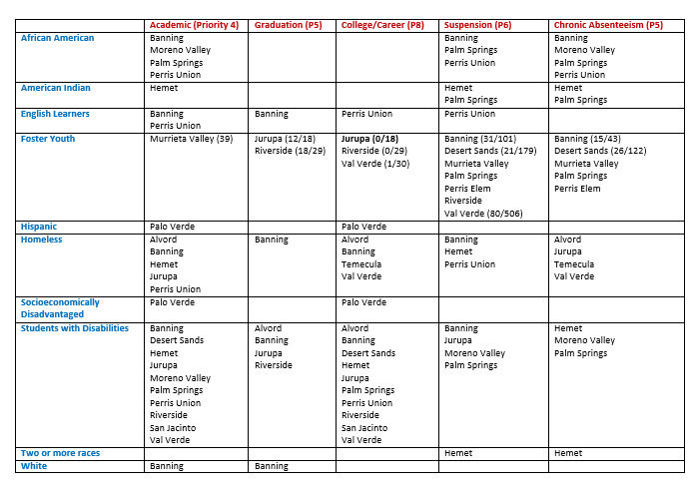
DI & CSI Schools

Slide 13
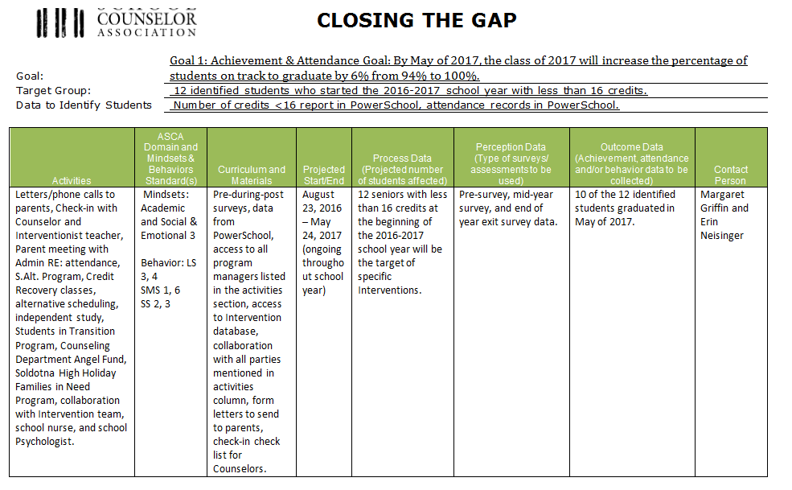
Example- Saldotna High School
Activities-
Individual Counseling
Meeting w/ Principal
Parent Meeting
SST/SIT
83% ON TRACK

Slide 14
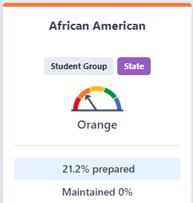
School Site Example - High School
-Large Group Instruction
-Small Group Counseling
-Individual Counseling
Notes:
when i arrived at Poly the UC/CSU rate was 40% end of 2014-2015 Prior to that it was 33% - we have grown almost 10 % in less than 5 years !

Slide 15
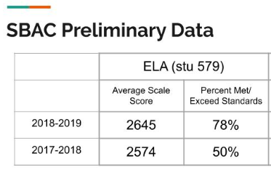
Poly High School Equity Wins
FAFSA rate has gone from 50% in 2013 to 84% in 2018
Provided target interventions in 2014-2015 to 9th grade students in math double block (three sections)
Reduced F rate by 70%
A-G has increased 19% from 33% in 2014 to 52% in 2018
A-G Audits 2x Year
50% increase in enrollment in females taking AP Science courses (Physics/Environmental/Chemistry)
SBAC Scores for ELA 28% increase and 14% increase in Math
African American A-G went from 33% in 2014 to 49% in 2018 (16% Growth)
African American graduation rate has increased from 92% in 2013 to 100% in 2019

Slide 16
School Wide Collaboration:Counseling Advisory Council
Addressing Equity by including all stakeholders
Should include
All admin
Parents
Teachers
Students
School Board/Community Member
Present School Wide Data
Present/Review Goals annually
Notes:
Role definition for school counselors Opportunity to talk to stakeholders about what we are doing It is a mechanism for stakeholder input about proposed changes Chance to find out what method of communication works best Gain insight about ways to increase parent participation in counseling programs PURPOSE IS HONEST COMMUNICATION AMONG ALL PARTIES ABOUT THE IMPORTANT WORK OF THE SCHOOL COUNSELORS AS IT RELATES TO THE SCHOOL AND DISTRICT MISSION AND GOALS!!!

Slide 17
Principal/Counselor(s) Relationship
Successful schools today are predicated on student outcomes (Hattie, 2012; Darling-Hammond, 2010). Leadership in these schools that serves the growth of others is required to navigate the storms of social and cultural shifts, epidemics of addiction, poverty, human isolation and despair combined with the urgency of academic success for everyone (Greenleaf, 2002; Reeves, 2006).

Slide 18
Principal/Counselor(s) Partnerships
“Principals cannot lead schools alone. By empowering your school counselors, you create relationships and trust. School counselors must become critical partners in a leadership team in order to address school wide equity and access barriers impacting student achievement …”
Melissa Odegard-Koester – Educational Leadership and Counseling Professor Southeast Missouri State University

Slide 19
Administrators/School Counselor Role in Comprehensive School Counseling Programs

Slide 21
Questions & Contact Information
Dr. Yuridia Nava
Poly High School
951-788-7203 x 64217
ynava@rusd.k12.ca.us

Slide 22
Resources/References
https://ahed.assembly.ca.gov/sites/ahed.assembly.ca.gov/files/hearings/Heritage%20Assembly%20IHE%20Hearing%202016%2009%2022%20SMALL.pdf
www.schoolcounselor.org
https://slideplayer.com/slide/15734450/
www.cde.ca.gov (Data Quest)

