Slide 1
Closing the GAP for High School Graduation
Murrieta valley unified school district’s
“journey towards equity”
Erika Bennett, Coordinator Student Support
Diana Ruiz, Lead Counselor Vista Murrieta High School

Slide 2
MVUSD Mission To inspire every student To Think, To Learn, To Achieve, To Care.
Mission Statement
MVUSD Educational Services embraces the diversity of students, families, and staff by fostering intentional, equitable learning experiences focused on the whole student which leads to personalized achievement and career and/or college readiness culminating in lifelong learners who make positive contributions to society.

Slide 3
MVUSD Equity Blueprint
Understand the Why?
Create an Equity Blueprint
Frame & Reinforce the Equity Foundation
Build the Equity Framework (Intentionality)

Slide 4
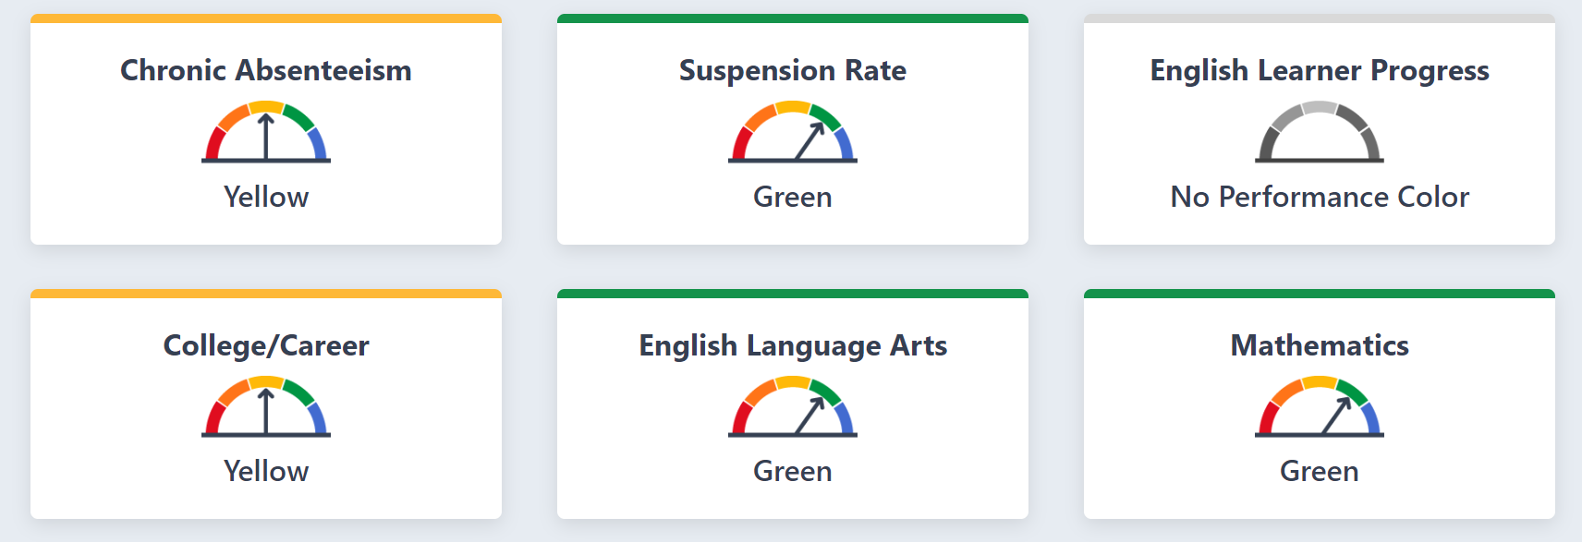
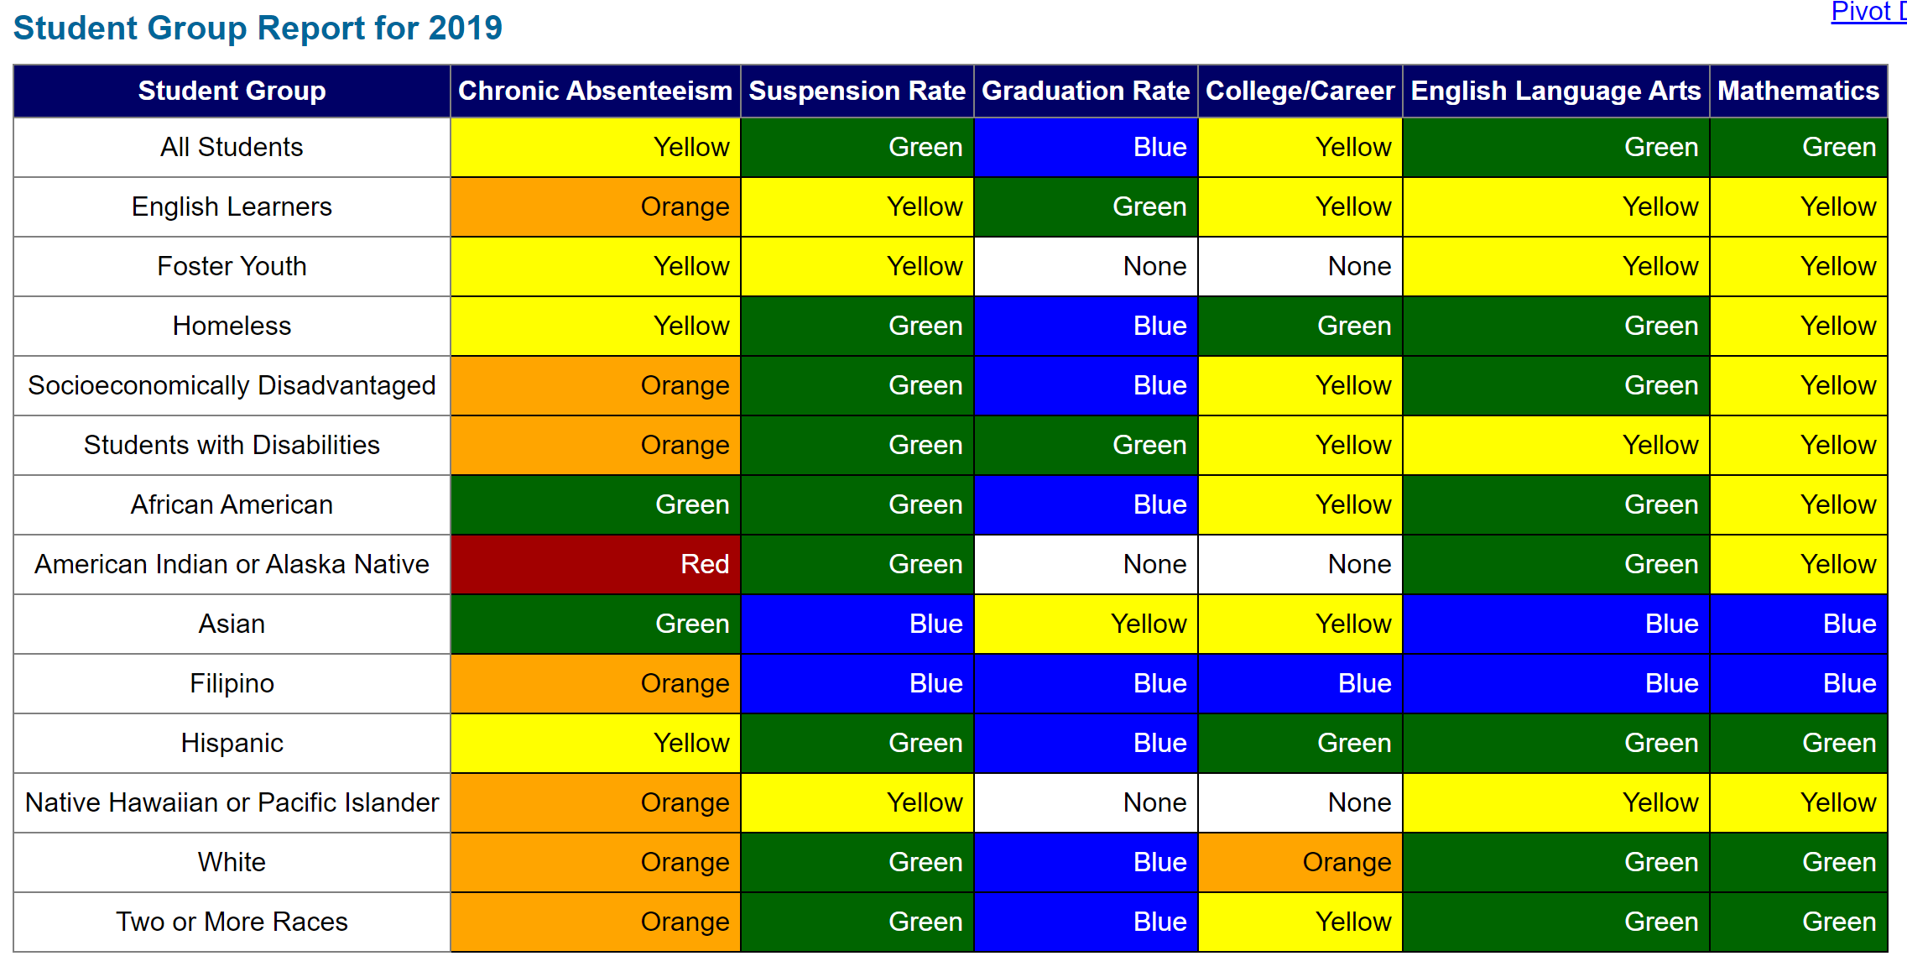
Notes:
Mary: even a bigger realization came about when we looked at each of the specific subgroups

Slide 5
District Focus (Equity Blueprint)
Superintendent Focus on Equity
Build Awareness of Inequity
LCAP Development
Awareness and Training with Board of Education and District Staff
Ed. Services and Student Support Focus on Equity

Slide 6
VMHS Focus
Staff Meeting “Talks”
Data Specialists (English, Math, Science)
Credit Recovery during the school day and co-enrollment with MCA
Broncotorials (Saturday)
School Counselor Intentional Guidance
Career and College focus for each student
School Counseling Scope and Sequence for each grade level
CCGI
Transcript review each semester (A-G Spreadsheet)
1 on 1’s for each student 2x’s a year
Grade level informational sheet
Focus on CCI (College Career Indicator)
School Counselor “non-negotiables”
Notes:
Diana

Slide 7
Transcript Reviews
Counselors are responsible for maintaining a live spreadsheet for juniors and seniors to keep track of Graduation status, semester A-G status, FAFSA status, LCAP information and post high school plans.
Updated twice a year when counselors meet with students one on one in the Fall/Spring
Review current grades
Grade level timelines – Senior / Junior
CCGI milestones
Recommend to "Broncotorials" - Saturday School
Registration
Credit Recovery / Summer School

Slide 8
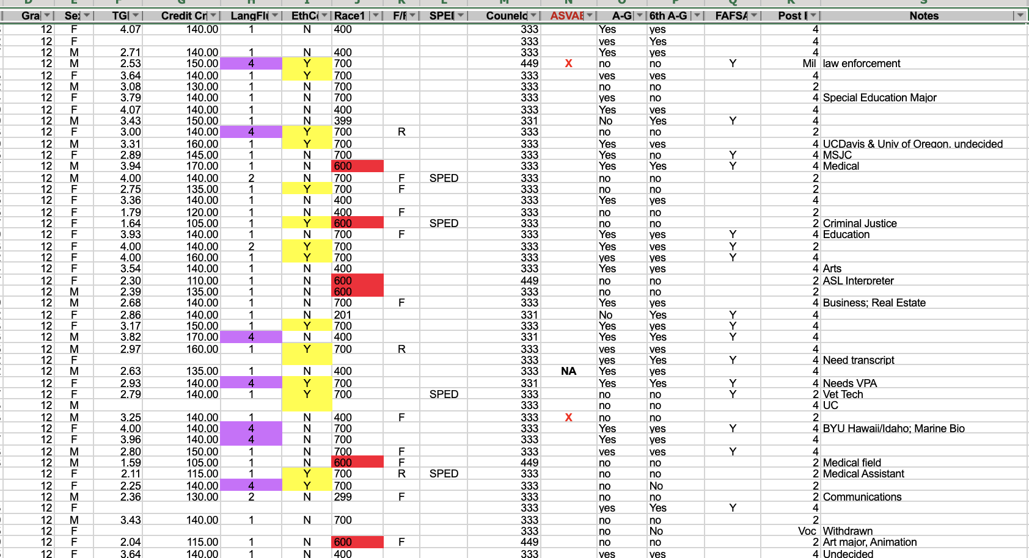
Trascript Review Spreadsheet details
Student Name
Grade
Credits
GPA
LCAP info, Program info
ASVAB
FAFSA
A-G status per semester
Post High School Plans

Slide 9
Broncotorials
Broncotorials are a FREE Saturday academic support program for all current VMHS students grades 9-12. Teachers and staff are available to help in the following areas:
English
History/Social Sciences
Math
Science
Quiz/Test make up
AP Course Study Sessions
Broncotorials are hosted on select Saturdays and are supported by NHS/CSF tutoring. We offer 7 Broncotorials per year, recoup ADA on 6 of these per year. $$$$

Slide 10
Credit Recovery
Credit Recovery classes are built in the master schedule to support student's areas of need for A-G or for graduation.
Fall 2019 – 3 APEX sections for students needing credit recovery in English, Social Sciences – 44 students
Math 1 sem 2 credit recovery 24/25 passed
APEX: 45/80 complete APEX courses needed to meet A-G or graduation
Spring 2020 - 8 sections: semester 1 Math I, Math II, Bio, Chemistry in addition to English, Social Sciences, and electives options.
245 students enrolled for Spring

Slide 11
MVUSD At-A-Glance

Slide 12
Student Population

Slide 14
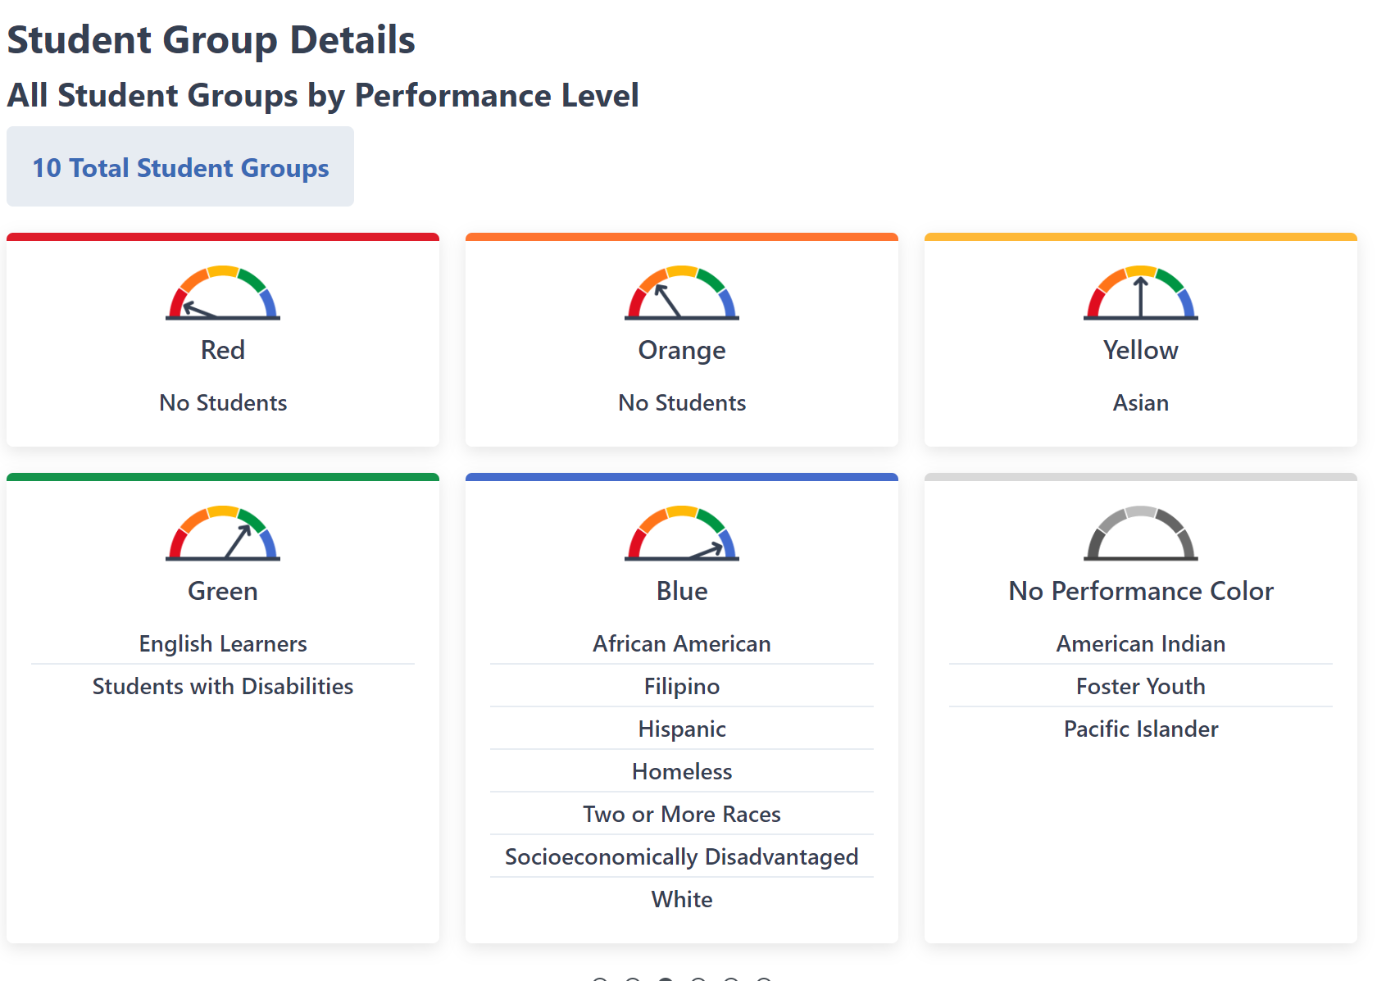

Slide 15
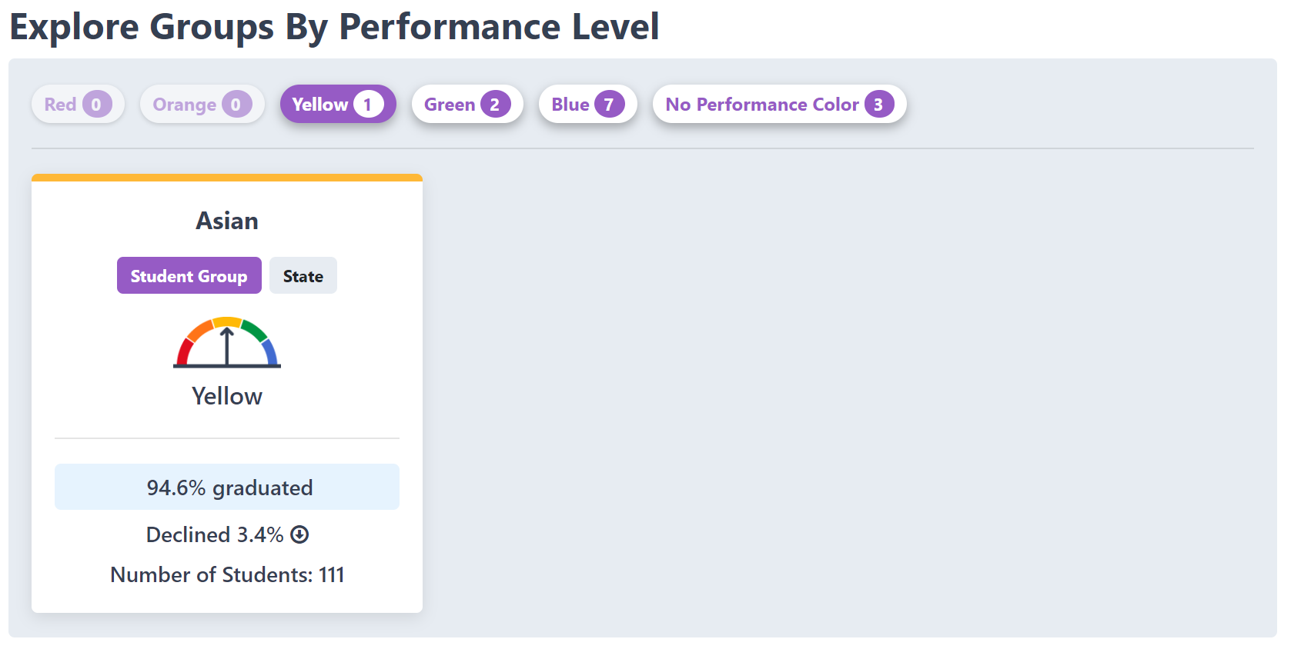

Slide 16
NEXT STEPS…
Intentional focus on Asian, English Learner and Students with Disabilities
Determine needs of Asian student priority group
EL Coordinator, Bilingual Aides, EL Team at each secondary site, new EL Curriculum, continual review of EL student progress (student by student) Re-classification and EL Scope and Sequence
Special Education clearly defined Transition Plan, academic rigor, mainstream
Intentional focus on African American and Hispanic Student Priority Groups
Student intervention lists (review each grading period)
Male Mentoring Program

Slide 17
NEXT STEPS Cont…
Focus on Equity
District and Site Equity Plans
Equity Institutes (mandatory participation from each school site)
Leadership Equity Book Talks
District-wide Professional Development with an Equity Lens
Focus on College Career Indicator (CCI)
Counselor PD on CCI and areas of focus
Aeries 4-year Academic Plan
CCI Parent Letter, Student Focus during next testing cycle
CCI Professional Development for each secondary site

Slide 18
THANK YOU!
Erika Bennett
Diana Ruiz
Murrieta Valley USD
Coordinator, Student Support
Email: ebennett@murrieta.k12.ca.us
Phone: (951) 696-1600 ext. 1164
Murrieta Valley USD
Lead Counselor, Vista Murrieta High School
Email:
druiz@murrieta.k12.ca.us
Phone: (951) 894-5750 ext.

