Slide 1
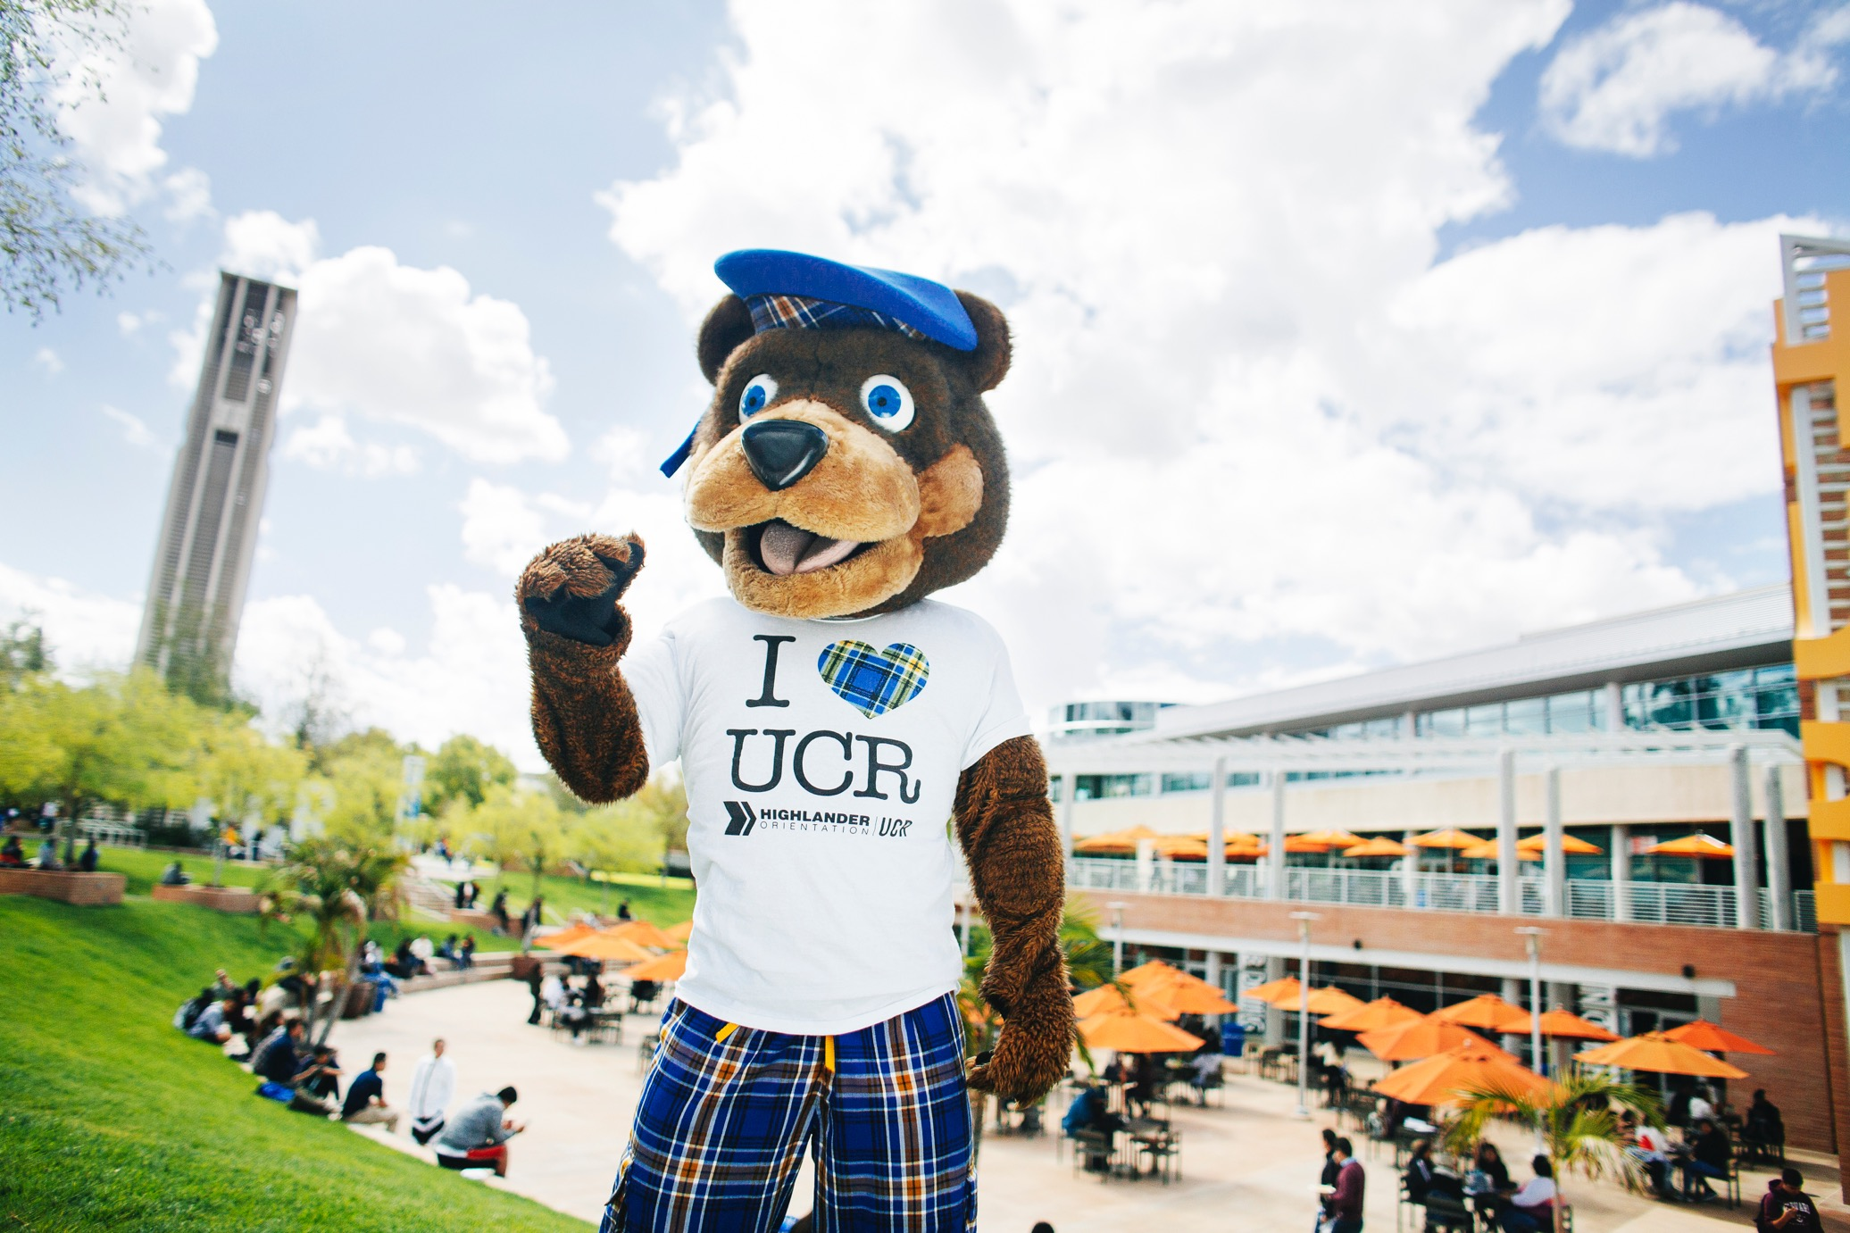
Freshman Admissions
Riverside County:
Rachel “Rae” Reynolds
(she/they pronouns)
rachel.reynolds@ucr.edu
951-285-5360
Need more info? Have more questions?
housinginfo@ucr.edu
finaid@ucr.edu
honors@ucr.edu
orientation@ucr.edu
Check out our Video Webinars from Highlander Week Live:
https://highlanderday.ucr.edu/freshman-webinars
THANK YOU!
Take a guided or self-guided virtual tour of UC Riverside today!
admissions.ucr.edu/visit
admissions.ucr.edu
admissions@ucr.edu
(951) 827-3411
Follow us on social media!
ADMISSIONS.UCR.EDU

