Slide 1
Using Data in Your School Counseling Program
Notes:
Erika

Slide 2
Welcome!
Erika Gardner
High School Counselor
San Jacinto High School
San Jacinto Unified School District
Email: egardner@sanjacinto.k12.ca.us
Kristina Gurganus
High School Counselor
San Jacinto High School
San Jacinto Unified School District
Email: kgurganus@sanjacinto.k12.ca.us
Notes:
Erika/Kristina

Slide 3
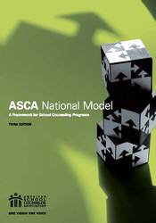
Today we will cover...
1) Where do we find data?
2) The Different Types of DATA
3) Pre-Post Tests: Why and How?
4) Developing Goals and Action Plans
Notes:
Erika

Slide 4
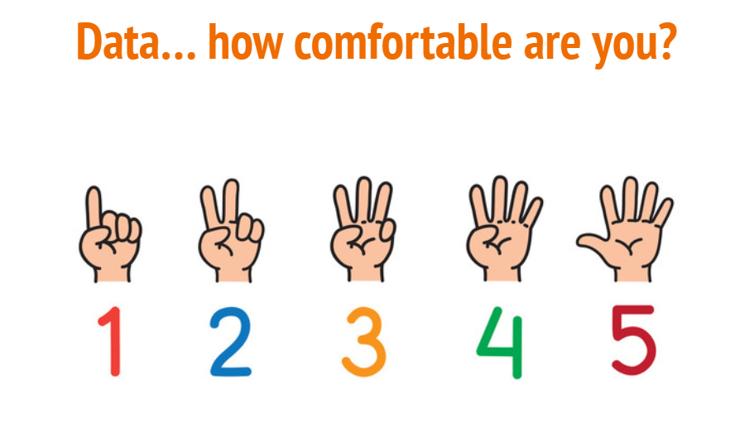
Notes:
Erika

Slide 5
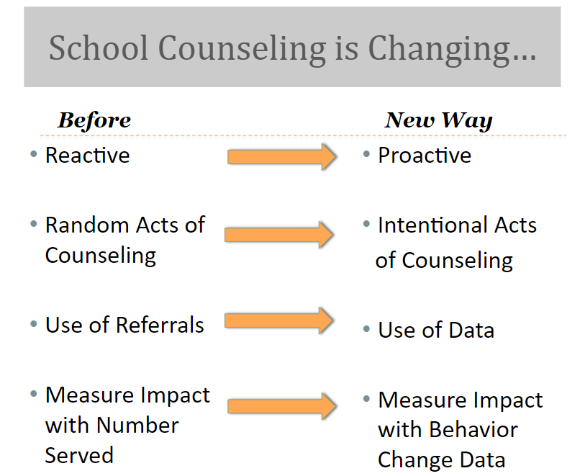
WHY is data important?
Comprehensive school counseling program
Ensures every student receives the benefit of a school counseling program
Use to monitor progress
Measure impact of interventions
Share what you learn
Improve program and services!
Notes:
Erika

Slide 6
Where do I find data?
1.
Notes:
Erika

Slide 7
Data we collect
Aeries: Academic, Behavior, Attendance
California Dashboard
DataQuest
Counselor Created Surveys: student, staff, parent
Counselor 101 Inventory
Subgroup Data
Cal-Grant
Core Curriculum Data
Scholarships
AP/IB/Dual Concurrent Enrollment
CTE Completer
CHKS
Focus Group: Student Voice
Notes:
Erika

Slide 8
The Different Types of Data
2.
Notes:
Kristina

Slide 9
Three Types of Data
Process Data: What was the process and who was involved? This is where you explain how you went through the process of change. Explain the amount of kids and from what grade-levels (who was impacted). Also, think about what you did, when, and how often you did it.
Perception Data: How are their Attitudes, Knowledge and Skills different? This is where your subject (kids, parents, staff) show you that they can do whatever it was you taught them or they now have new beliefs since they have been through your process of change. This type of data would include results from a pre/post assessment, survey, school-wide initiatives, needs assessments, etc.
Outcome/Results Data: People can show you evidence or proof of impact. This data is the result on a bigger scale. What impact has it made on achievement and achievement-related data?
Notes:
Kristina

Slide 10
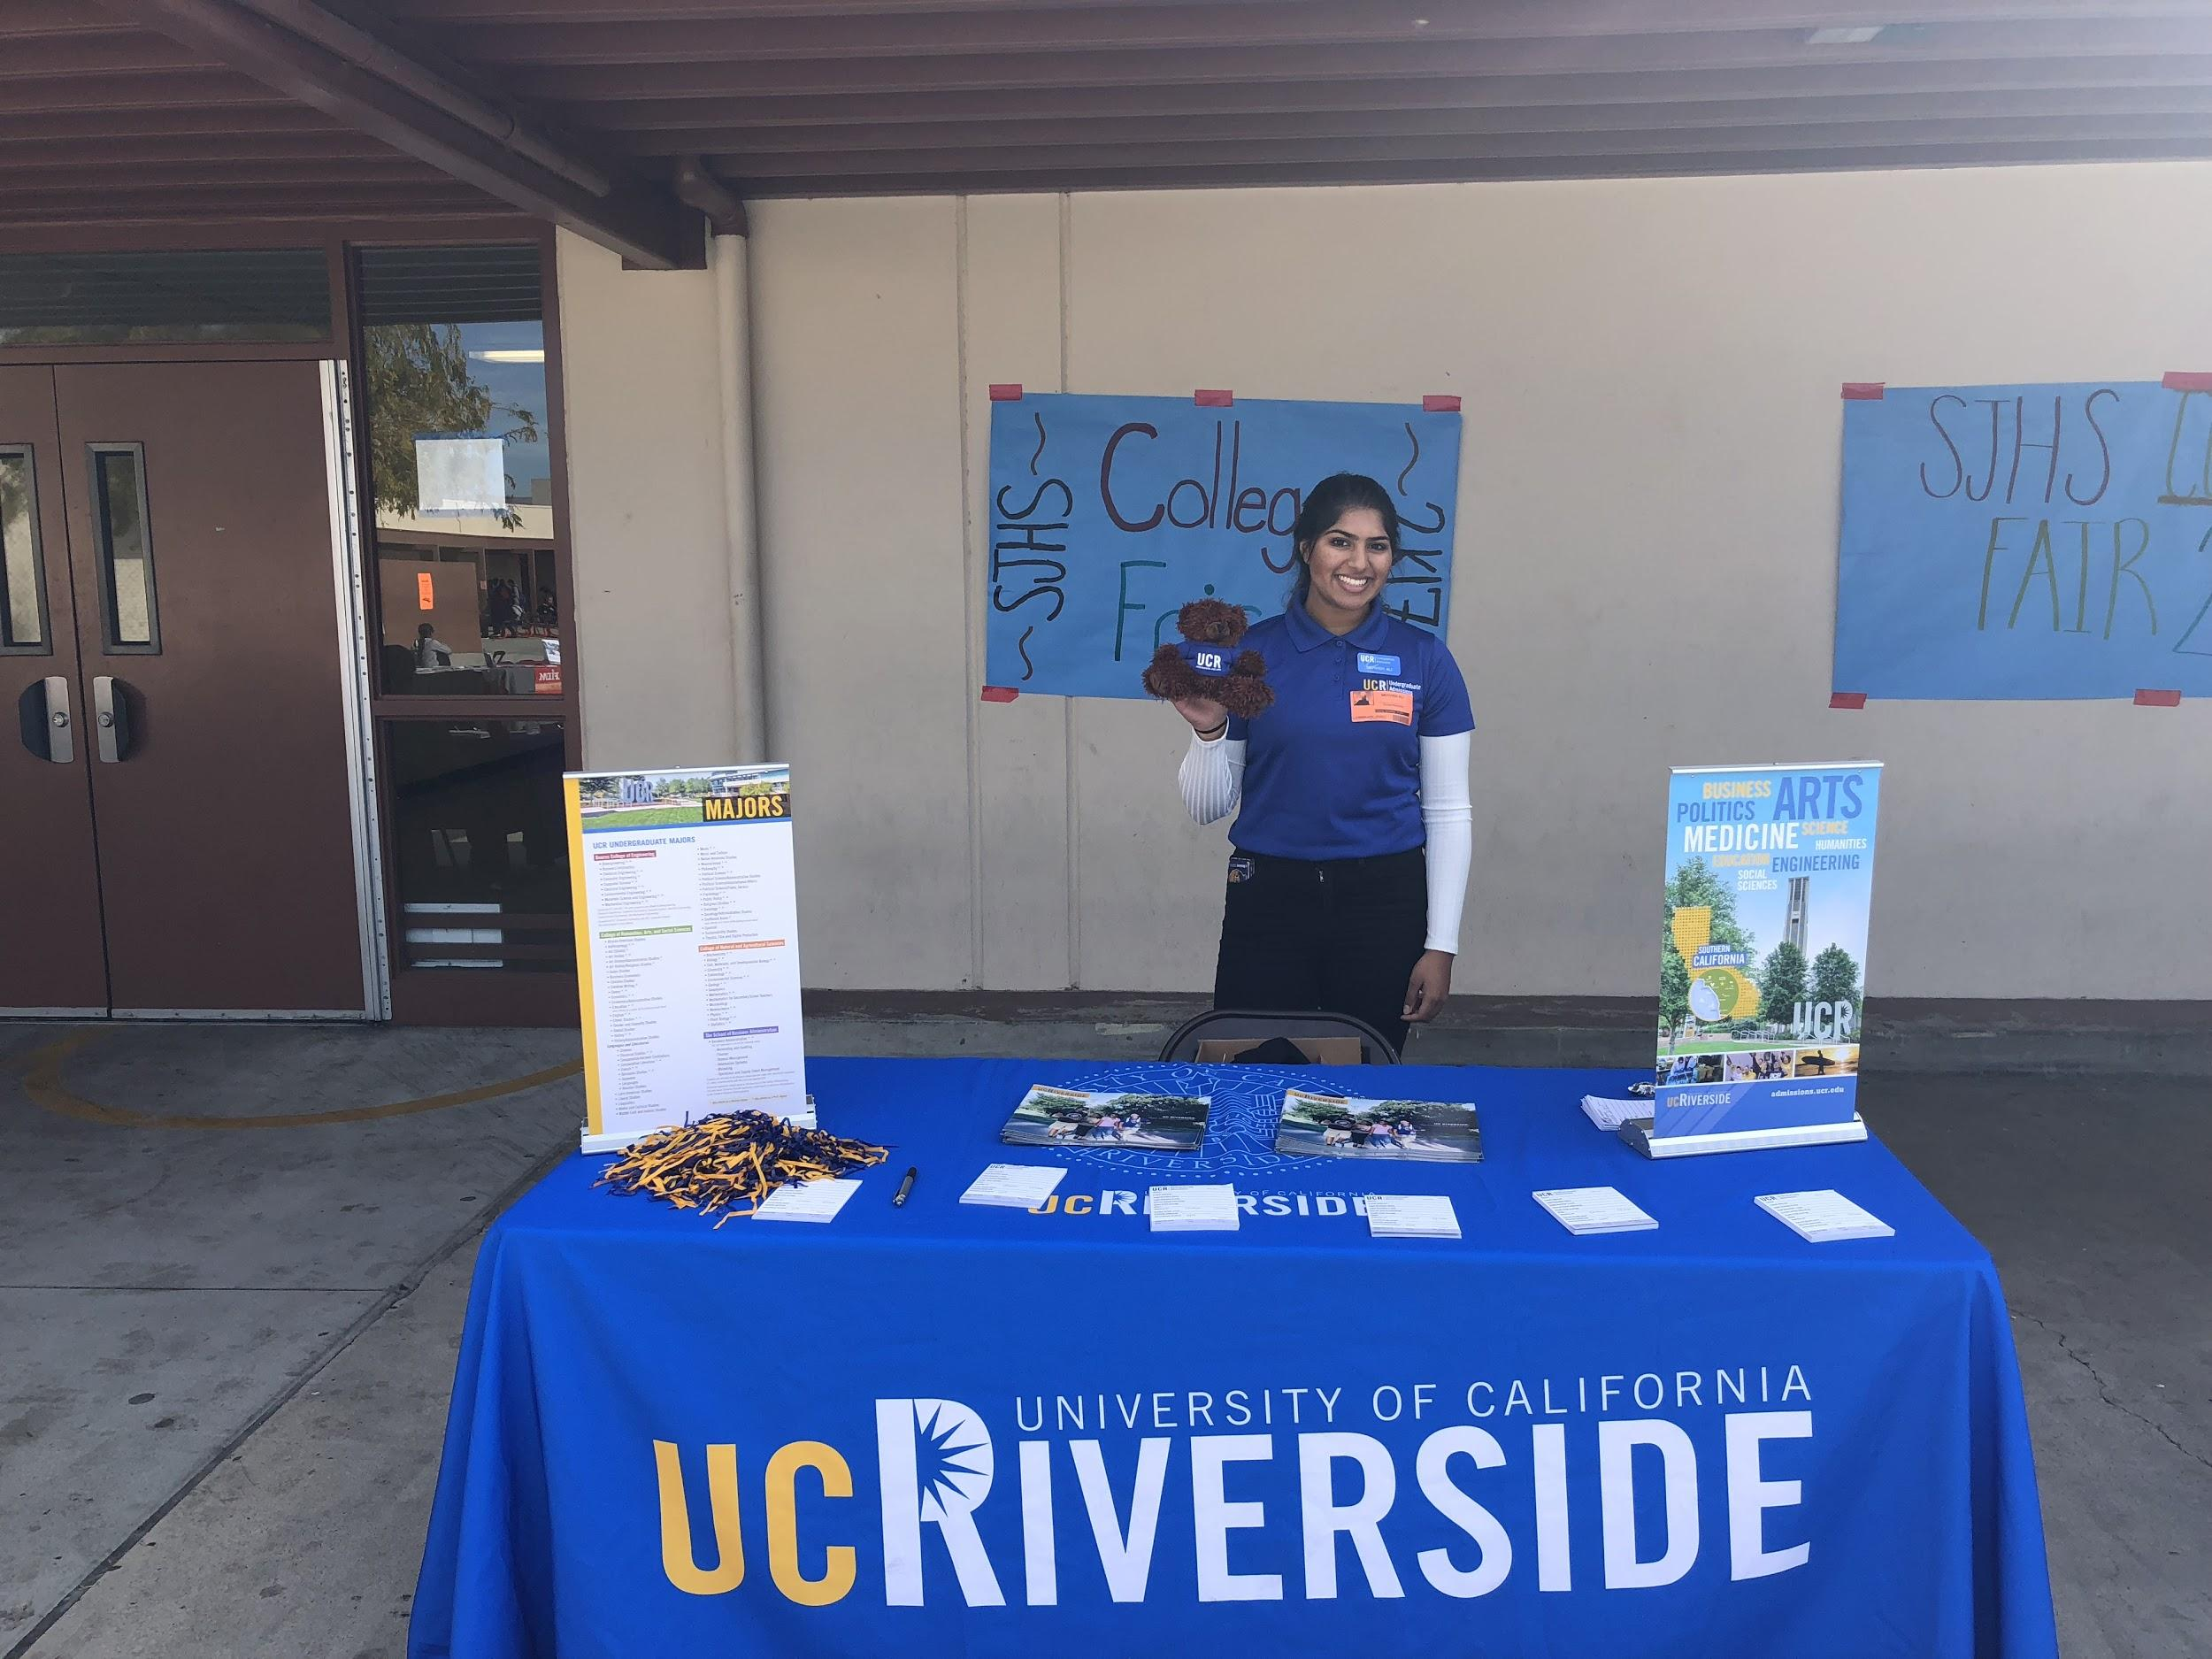
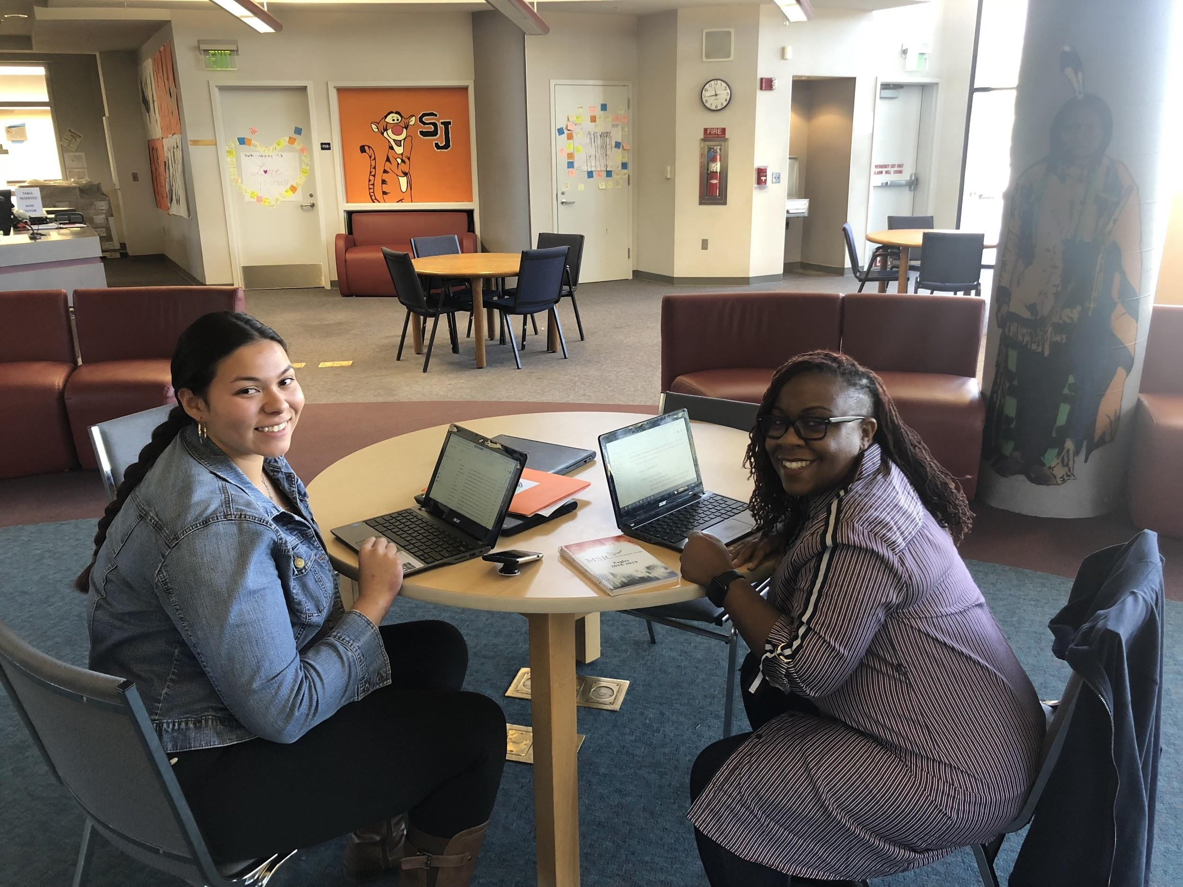
Process Data: The 4 W’s
Who: | ALL Seniors
What: | Financial Aid and College Application Workshops
When: | 20 Scheduled Days in October and November for a total of 41 Workshops
Where: | Library
Who: | ALL Students
What: | College and Career Rush: 28 Four-Year, Community, Trade/Technical, Armed Services
When: | October 29, 2018
Where: | SJHS Quad
Notes:
What the counselor DID not the difference it made
Kristina

Slide 11
Ex. Data- EL Focus Group
HIGHLIGHTS:
Improve basic English skills for comprehension
Students would like to see a respectful environment on campus among students and staff
Love the support in core classes from EL Aides!
Listen to students, make them feel connected and comfortable
More teacher check-in with students, show patience and caring
WHO: 8 students identified as being in EL program - newcomers, reclassified, ELPAC 1 & 2 / 3 & 4
WHAT: Counselor Generated questions surrounding relationships, instruction and engagement
WHEN: November 13 during Intervention
Shout out to:
Gallegos, Wilson, Willis, Coach K.
Notes:
Kristina

Slide 12
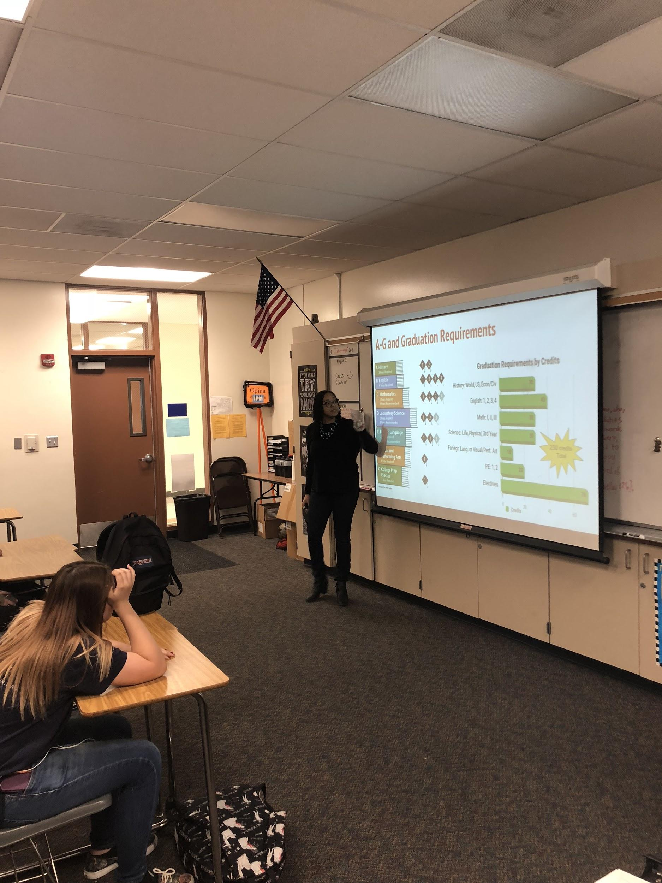
This Year in Numbers!
412 Total!!
188 Guidance Lessons
1 Counselor Connection 101 Video Lesson
45 College and Career Making it Happen
16 Counselor Connection 201 (Grade Level Meetings)
18 FAFSA Linked Lessons
16 APEX Talks
85 Pre-Course Selection
7 ELPAC Talks (Classroom)
226 Workshops
2 New Student Orientation
1 NCAA
6 Parent Workshops
6 Tiger Talks
58 College & Financial Aid Applications
30 ELPAC Talks (Individual*)
14 College Kick-Off
15 SIR Meetings (Individual*)
85 Course Selection (Individual*)
7 Scholarships
**Numbers calculated by periods set aside.
Notes:
Kristina

Slide 13
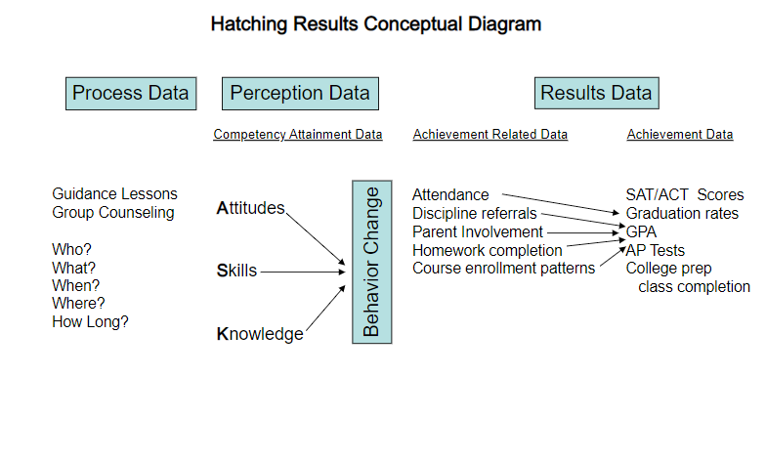
Perception Data
“Data elements that research has identified as impacting student achievement”!
Attitudes, Knowledge, Skills
Pre/Post Tests
Know, Believe, Demonstrate
“ASK them what they’ve learned!”
(The Use of Data in School Counseling, Hatch, 2013
Notes:
Kristina

Slide 14
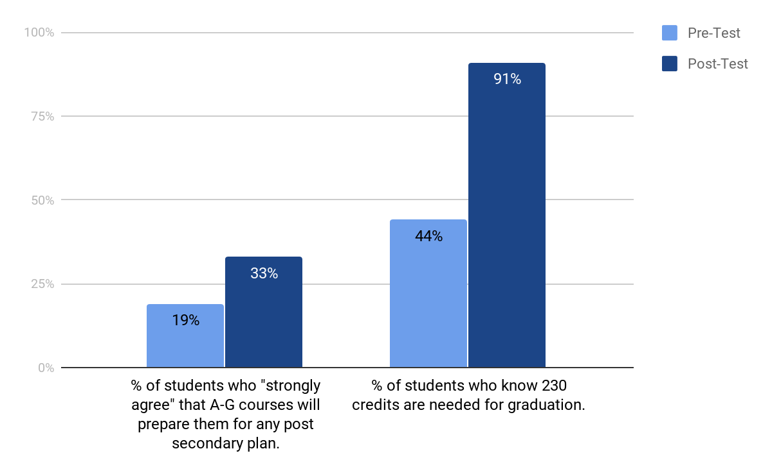
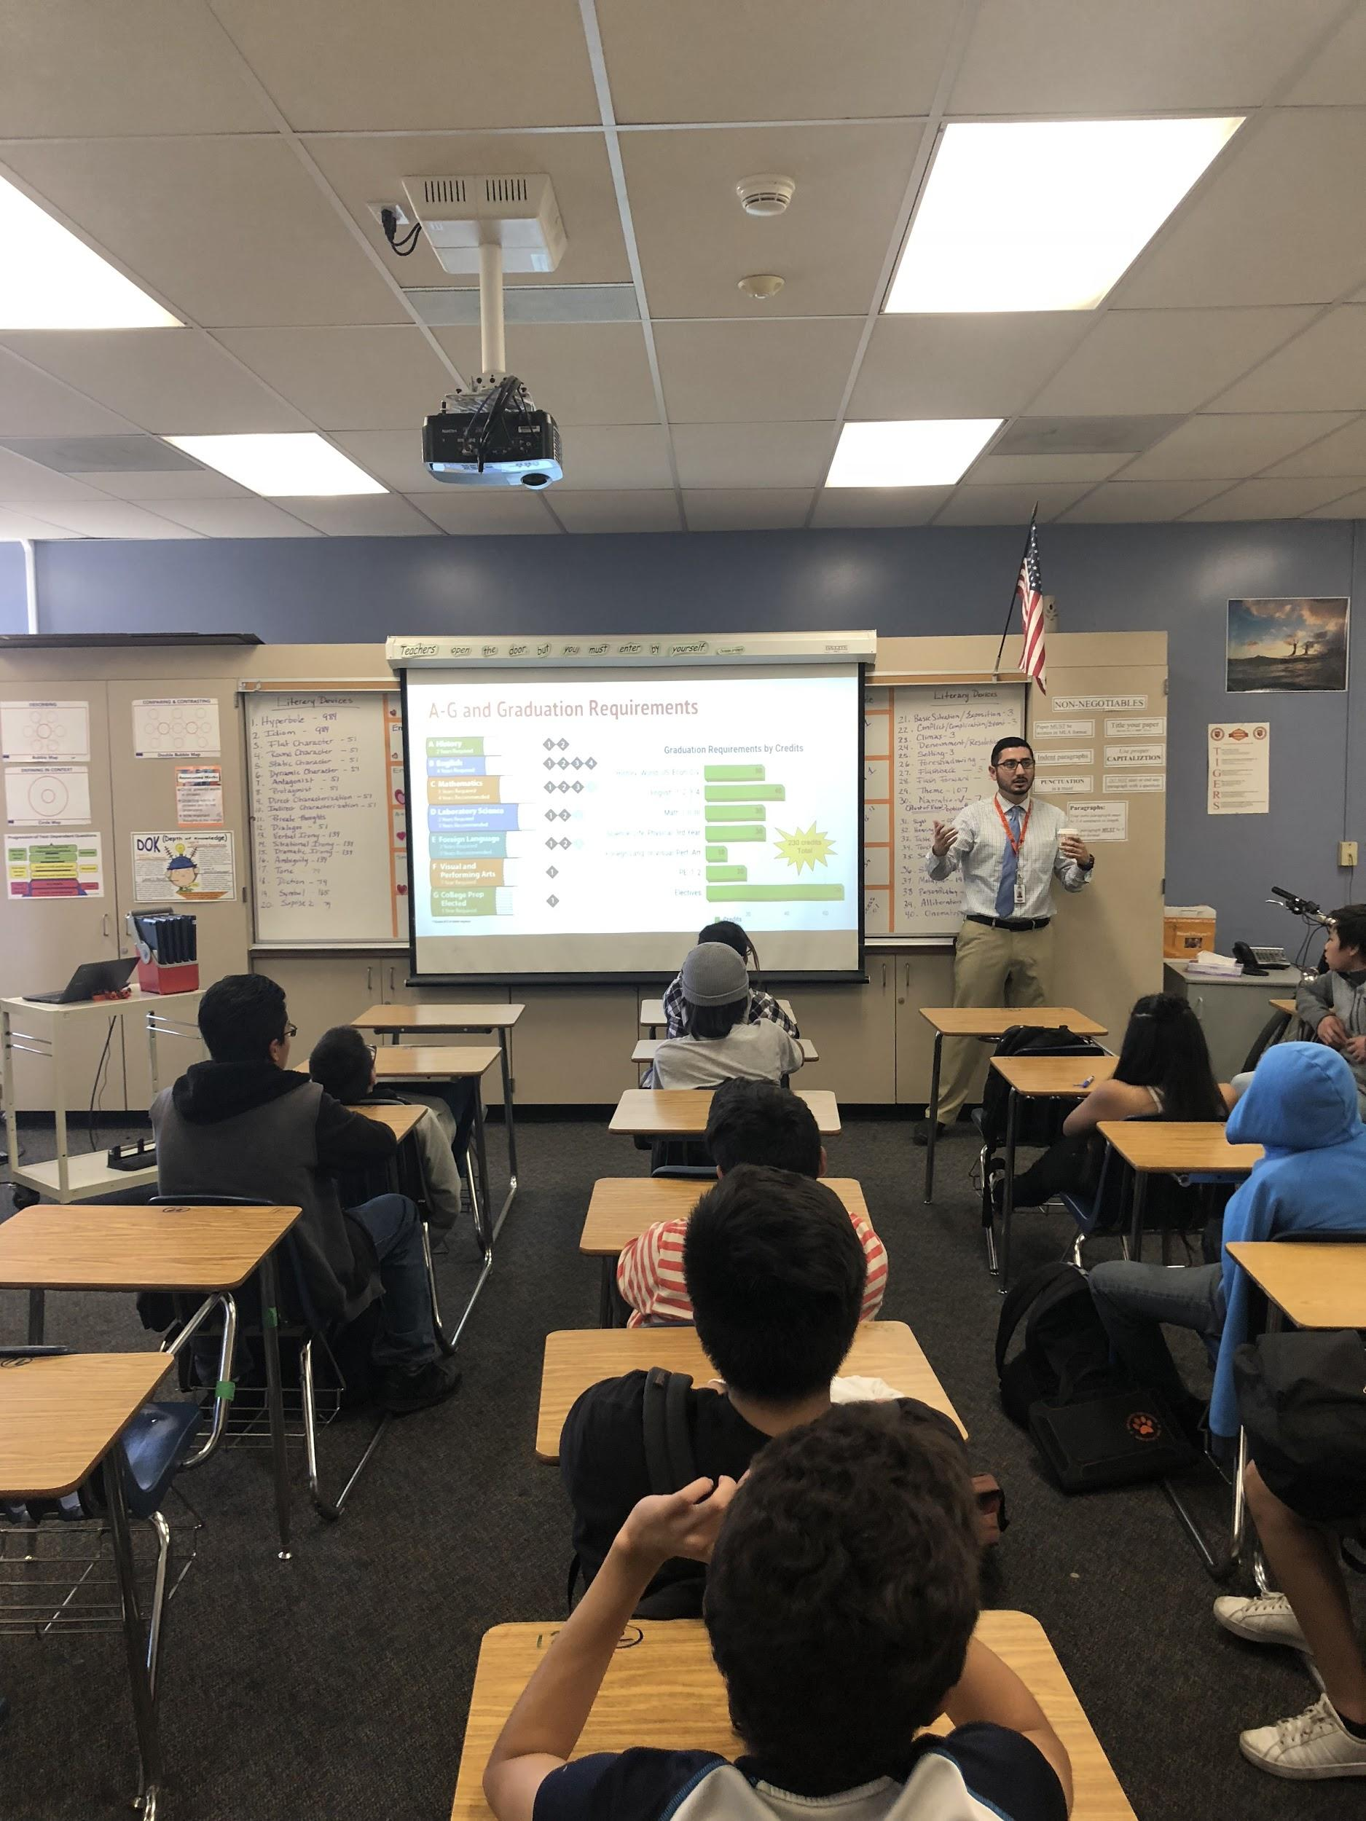
Pre-Post Test Data 9th/10th Grade College & Career Making it Happen
107% CHANGE
Shifting Attitudes & Teaching Knowledge!!!
74% CHANGE!
Notes:
Kristina

Slide 15
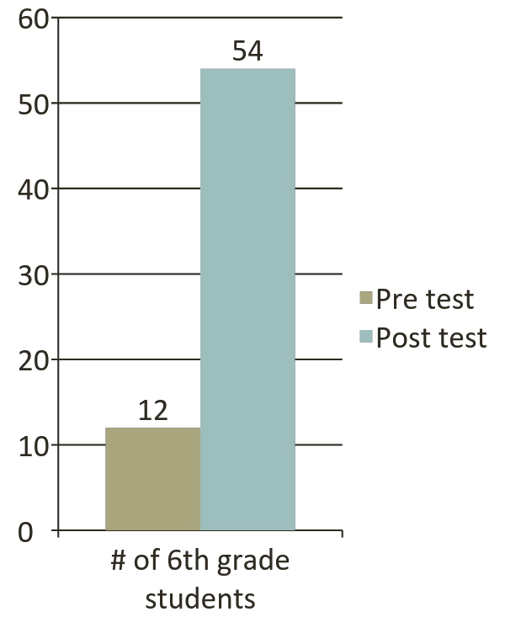
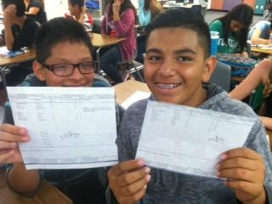
Skill: # of Students who Could Calculate a GPA from a Scenario
Question: “Calculate a student’s GPA”
Notes:
Kristina

Slide 16
Outcome/Results Data:
Attendance Rates
A-G Rates
College Career Indicators
Graduation Rate
SAT/ACT
AP/IB
Discipline Rates
Course Enrollment Patterns
Suspension Rate
FAFSA/CADAA completion rates
Parent Involvement
Notes:
Erika

Slide 17
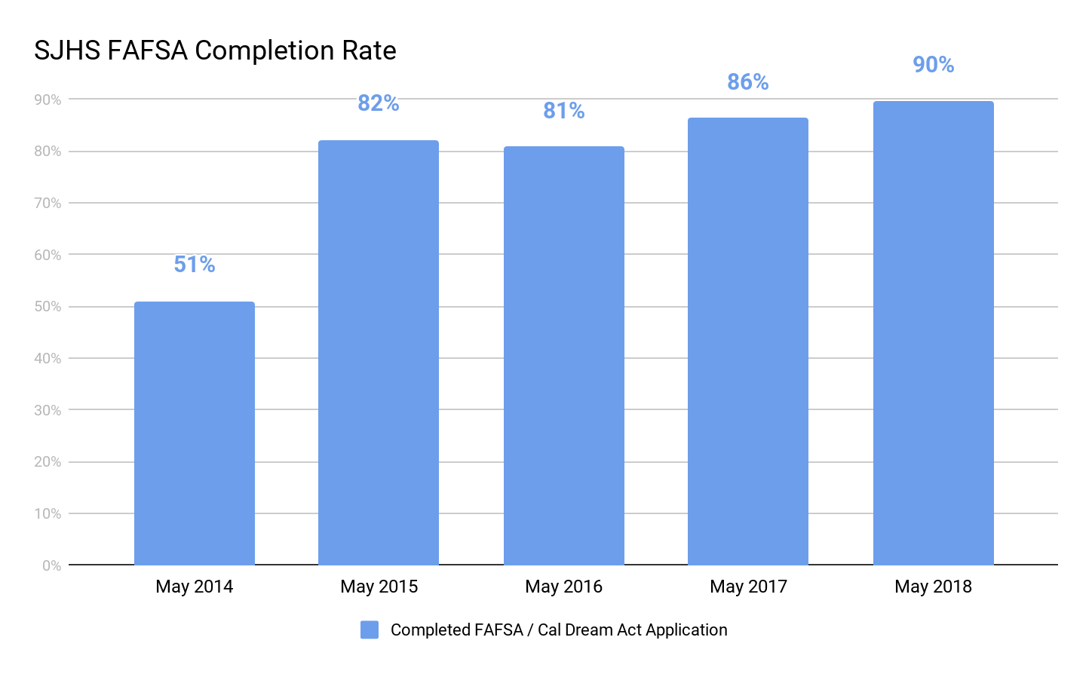
Financial Aid SMART Goal - Class of 2018
By June 2018, the percent of seniors submitting the FAFSA or Ca DREAM Act will increase from 85% to 86%.
N=276
N=376
N=361
N=406
N=486
GOAL EXCEEDED!!
Notes:
Erika

Slide 18
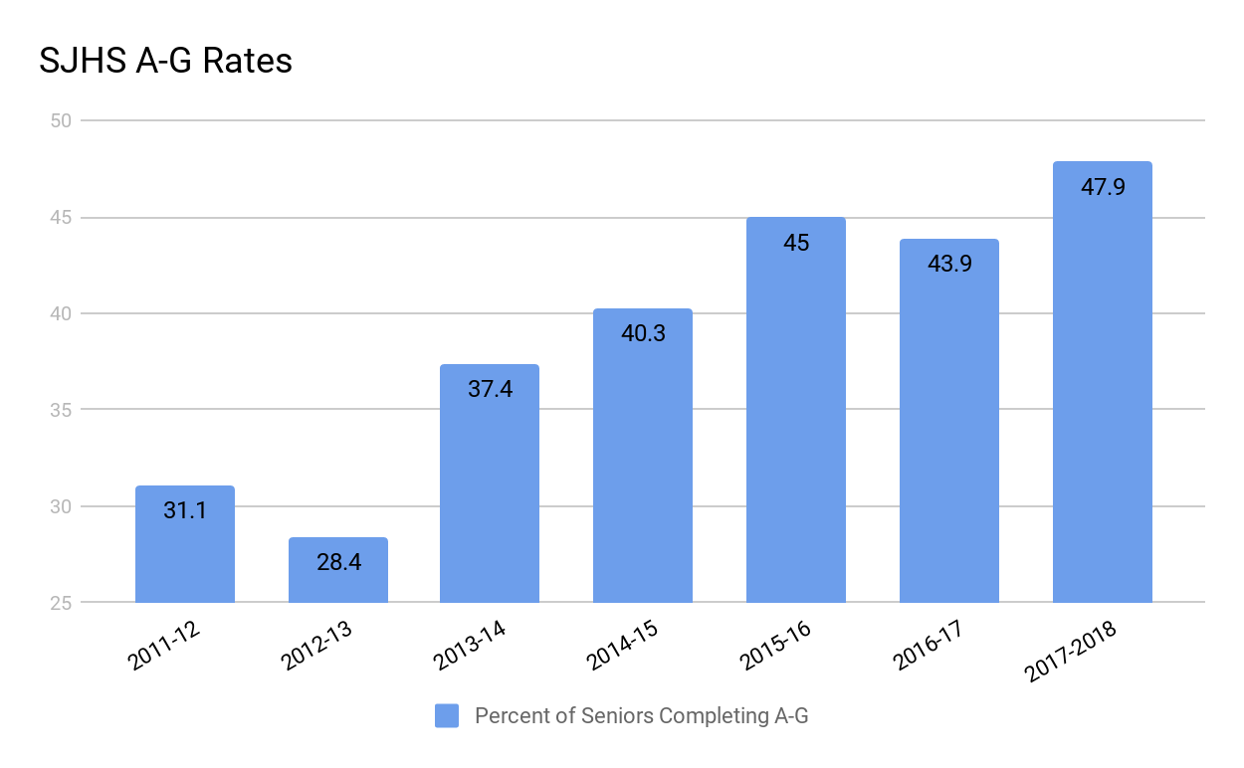
College Eligible (A-G) Rates
Notes:
Erika

Slide 19
Pre-Post Tests: Why and How?
3.
Notes:
Erika

Slide 20
Was this a good use of instructional learning time?
Was this a valuable use of school counselor or student time?
What is a Pre/Post Test?
Given after a lesson is delivered in order to…
Determine how to improve your lesson
Advocate for Students and School Counseling Services
Promote Systemic Change
(The Use of Data in School Counseling, Hatch, 2013)
Notes:
Erika

Slide 21
Creating a Pre/Post Test
Develop Questions that Measure Student’s:
Attitudes - What you want me to believe that I did not believe before?
Measure opinions/beliefs. Most often done by LIKERT SCALE. Level of agreement
“I believe that adults care about me”
“I agree that the a-g requirements will prepare me for any post-secondary plan”
Knowledge- What you want me to know that I didn’t know before?
Factual Question-Either correct or not correct. Multiple Choice. True/False
“What are the three R’s of Bullying?”
“How many credits are needed in order to graduate from SJHS?”
Skills- What you want me to demonstrate that I did not demonstrate before?
-->Application/Demonstration of what has been learned
“What would you do?” Scenario
“Here is a copy of Sally’s recent grades, what is her GPA?”
(The Use of Data in School Counseling, Hatch, 2013)
Notes:
How to measure, ways to ask questions
Kristina

Slide 22
Tips For Creating Pre/Posts
Keep it Short! 5-8 Questions
AVOID Essay tests, fill in the blanks or short answers!
Try not to use paper…
Try Google docs, Naviance, Plickers!
Pilot your survey-modify if needed
Try giving it a week before the lesson to see what they already know!
It’s best if you don’t try to not use questions with double negatives ;)
Don’t try to be Neutral!
Pay attention to language that is developmentally appropriate
Your LESSON is the BEST way to decide what to ask
Notes:
Kristina

Slide 23
Sample Pre/Post Test
Attitude
Knowledge
Skill
Notes:
Kristina

Slide 24
Quiz Time!!! A, K or S?
Notes:
KAHOOT
1) I beleive A-g Courses will prepare me for any post-secondary plan (Likert agree, strongly, disagree, strongly) A
2)I believe that only high income families can afford college (agree, strongly, disaree, strongly) A
3) Withdrawal, fits of anger, and loss of interest are all examples of what K
Social bullying
Self harm
Defiance
EWS
Disruptive behavior
4) Which class is not an A-G Course
Spanish 1
Math 2
PE
Draw/paint
5) Felix has been going through some hard things at home and has told his friend Rudy. Rudy has tried to be there for Felix by listening to him and checking on him, but he's is still worried. What can Rudy do next?

Slide 25
4.
Developing Goals and Action Plans
Notes:
Erika

Slide 26
Action Plan Examples
Small Group Action plan
Core Curriculum plan
Closing-the-gap plan
What are Action Plans used for?
What goes into an Action Plan?
Where to access an Action Plan?
Who to share an Action Plan with?
Notes:
Erika

Slide 27
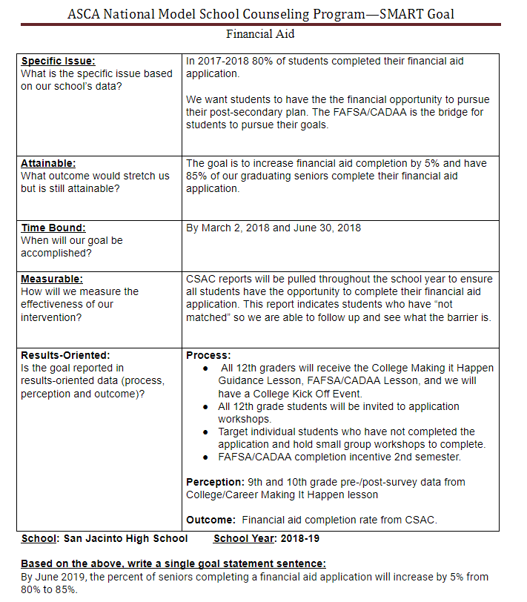
SMART Goal- Financial Aid
Notes:
Erika

Slide 28
Notes:
Erika/Kristina

Slide 29
Thanks!
Any questions?
You can find us at
egardner@sanjacinto.k12.ca.us
kgurganus@sanjacinto.k12.ca.us

