Slide 1
Crisis Response Protocol

Slide 2
Distance Learning Crisis Response Protocol
Overview:
What to do should a student report that they want to kill themselves or others?
How to keep the student engaged while methodically dismissing your class?
What questions to ask to determine next steps?
Who should I call?
What should I say?
Who do I inform?

Slide 3
Student Expresses Self Harm
What do I do?

Slide 4
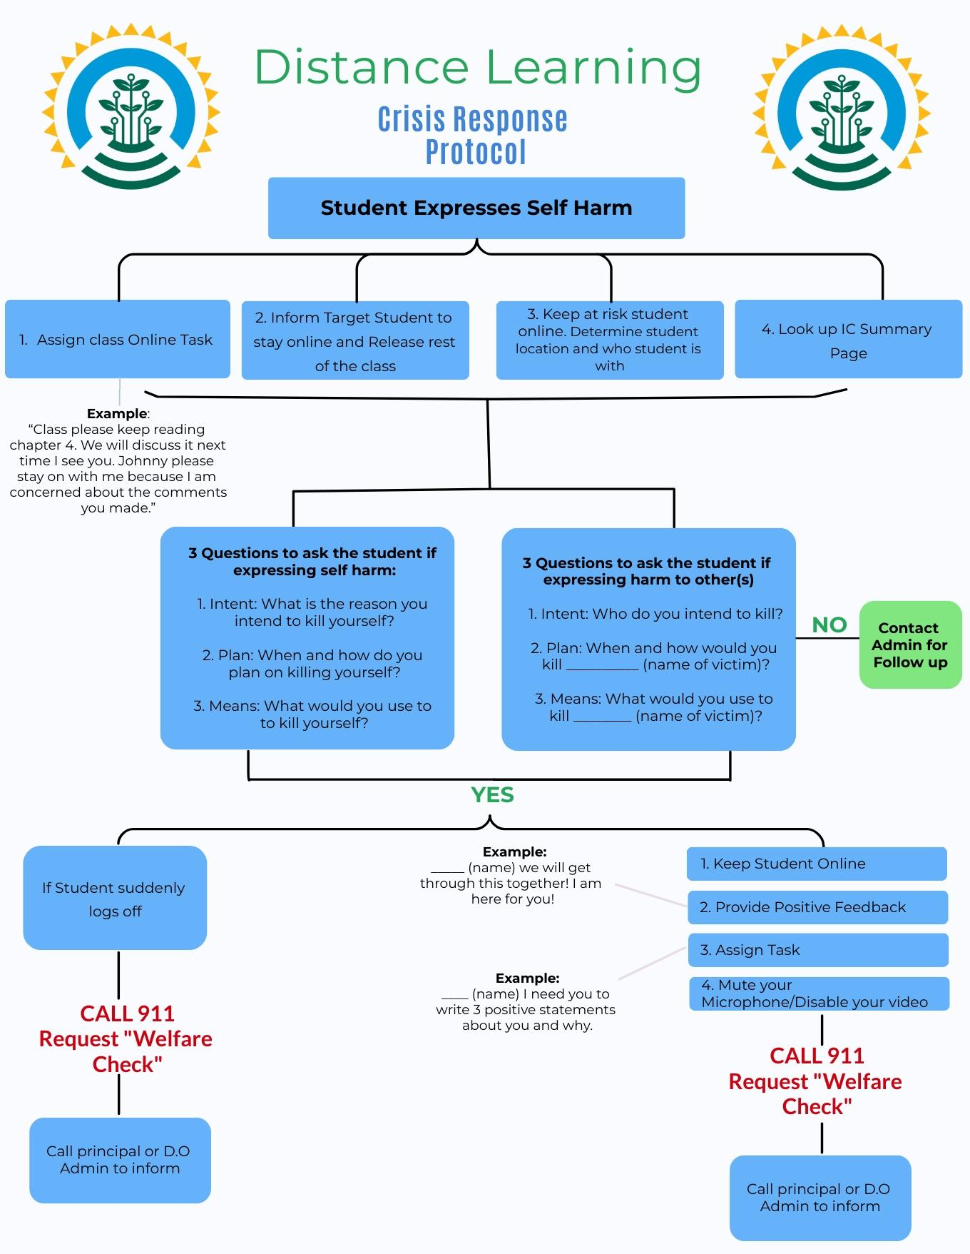

Slide 5
Assign class an online task
Example: Class please keep reading chapter 4. We will discuss it the next time I see you. Johnny please stay on with me because I am concerned with the comments you made
Look up Infinite Campus summary page for at risk student information
Inform target student to stay online and release the rest of the class
Keep at-risk student online
How to keep the student engaged while methodically dismissing your class?
Step One
Step
Two
Step
Four
Step
Three

Slide 6
What do I ask?

Slide 7
3 questions to ask the student if expressing self harm
3 questions to ask the student if expressing harm to other(s)
What questions to ask to determine next steps?
3
3
Intent: What is the reason you intend to kill yourself?
Plan: When and how do you plan on killing yourself?
Means: What would you use to kill yourself?
Intent: Who do you intend to kill?
Plan: When and how would you kill _____ (name of victim)
Means: What would you use to kill _____ (name of victim)

Slide 8
If student answers no
Contact Admin for follow up

Slide 9
If student answers yes
What do I do?

Slide 10
What Do I do now?

Slide 11
If student logs off
Student stays logged on with you
1
4
Keep student online
Provide positive feedback (____ (name) we will get through this together! I am here for you
Assign task (____(name) I need you to write 3 positive statements about you and your reason for these statements.
Mute your microphone and disable your video
CALL 9 1 1 Request a “WELFARE CHECK”
Call principal or DO admin to inform
CALL 9 1 1 Request a “WELFARE CHECK”
Call principal or DO admin to inform

Slide 12
Tarasoff
If the student reports intent, plans, and means of harming someone else you have an obligation to inform the victim under the “Tarasoff” rules.
Please consult with your administrator who can help you contact the intended victim. You must inform the victim of the name of student making threats and the plan that was shared with you.
Do not provide any other information about the student making threats
Notes:
Ed code for tarasoff

Slide 13
Who do I inform

Slide 14
Who do I inform
On the back of the Crisis Response Protocol will be the names and phone numbers of site and district administrators.
PLEASE CALL US

Slide 16
Training Staff
Staff Training Video created with this presentation
Individual Site Google Meet Q and A sessions
Google Form Ticket-out-the-Door to verify completion of the training by staff

Slide 17
Student Lessons
Anger Management
Empathy
Grief
Motivation
Self-Advocacy and Empowerment
Social Skills

Slide 18
Questions?

