Slide 2
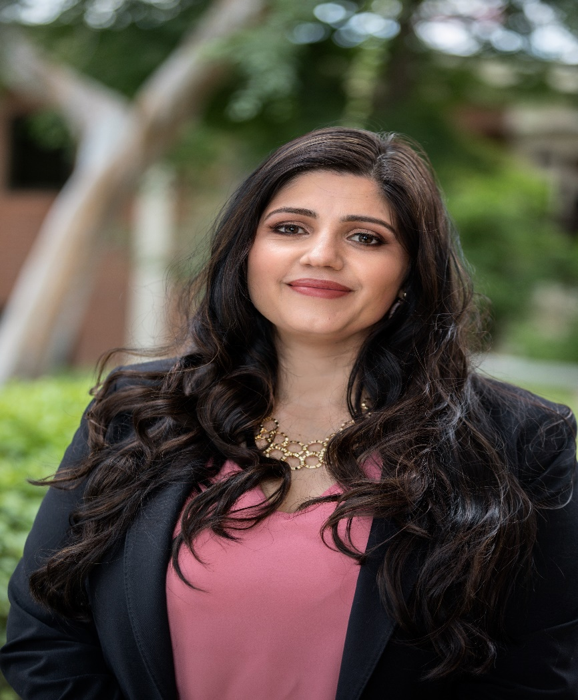
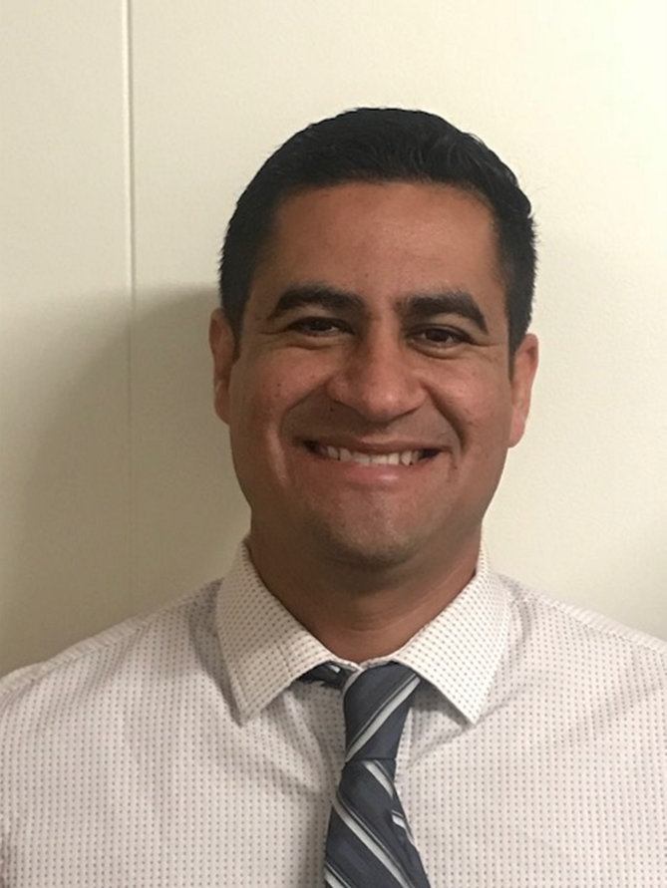
Catalina Cifuentes
Executive Director,
College and Career Readiness
ccifuentes@rcoe.us
Dr. Pedro Caro
Coordinator,
College and Career Readiness
pcaro@rcoe.us

Slide 3
Webinar Tips
This webinar is being recorded so that others may listen to it at a later time for reference and will be uploaded to the RCEC Youtube page as well as www.rcec.us once you log in to access the content of the webinar series
All connections to this live Webinar feature have been accounted for so please do not forward the Zoom link or invite anyone to join because you are taking someone else’s spot and Zoom will automatically start kicking off connections randomly
All participant mics have been muted and only panelists and facilitators have the ability to unmute anyone
Since all participants have been muted, please use the Q&A and chat screens to enter your questions
Participants can submit a question in the Q&A box at the bottom of the screen for the panelists
Only panelists and facilitators will be able to respond back to those questions and can do so publicly or privately to the individual
Participants can submit comments or questions in the chat box if they would like to engage with each other
**Every effort has been made to ensure the security of this webinar from “zoombombers” but in the event that we experience that, please stay calm and we will resume as soon as the technical difficulties have been resolved.**

Slide 4
FOR MORE INFORMATION AND RESOURCES PLEASE VISIT US @
www.rcec.us

Slide 5
California State University
COVID-19 Response, Updates & FAQs

Slide 6
Fall 2020 Updates
Grades and GPA FAQs
AP and IB Exams
Fall 2021 Updates
Financial Aid
Keep in Touch
Resources
AGENDA
San Jose State

Slide 7
Bakersfield
Channel Islands
Dominguez Hills*
East Bay
Humboldt
Maritime
San Francisco
San Marcos*
Sonoma Stanislaus
*Transfers Only
Fall 2020 Redirection
https://www2.calstate.edu/apply/redirection/Pages/default.aspx
Sonoma State

Slide 8
Campus | Deadline
Bakersfield | 5/1/2020
Channel Islands | 6/1/2020
Chico | 6/1/2020
Dominguez Hills | 6/1/2020
East Bay | 6/1/2020
Fresno | 5/1/2020
Fullerton | 5/1/2020
Humboldt | 6/1/2020
Long Beach | 5/1/2020
Los Angeles | 5/1/2020
Maritime | 5/1/2020
Monterey Bay | 6/1/2020
Northridge | 5/1/2020
Pomona | 6/1/2020
Sacramento | 6/1/2020
San Bernardino | 6/1/2020
San Diego | 5/1/2020
San Francisco | 6/1/2020
San Jose | 6/1/2020
San Luis Obispo | 5/1/2020
San Marcos | 6/1/2020
Sonoma | 6/1/2020
Stanislaus | 5/1/2020
CSU Intent Deadlines
(as of April 29, 2020)
CSU Fullerton
Notes:
Campuses are willing to work with any students who may need more time beyond their current intent date and those who may need a waiver of the deposit

Slide 9
Students should contact the campus admission office
Each campus has their own procedure
Campuses will consider requests on a case-by-case basis
Admission Defer Request
CSU Northridge

Slide 10
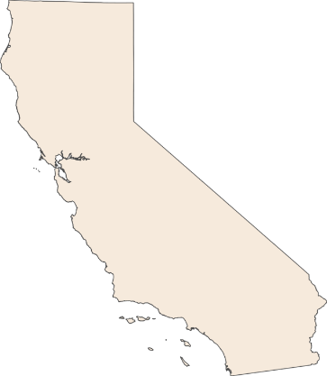
CSU campuses will accept Credit or Pass grades for winter, spring or summer 2020 terms
Early Start program will not take place for summer 2020
Campuses will not rescind admission offers based on non-receipt of transcripts through fall term
Students will remain conditionally admitted until transcript is received
AP and IB Exam scores will continue to be accepted
Humboldt
Chico
Sacramento
Sonoma
Cal Maritime
San Francisco
East Bay
Stanislaus
San Jose
Monterey Bay
Fresno
San Luis Obispo
Bakersfield
Channel Islands
Northridge
Los Angeles
San Bernardino
Pomona
Dominguez Hills
Fullerton
Long Beach
San Marcos
San Diego
Fall 2020 Accommodations & Guidance
Notes:
Early Start – campuses will still make the appropriate placements. Students who would have attended Early Start will be placed in college level English and math with Supplemental instruction or in a stretch course depending on the individual campus approach.

Slide 11
Winter, Spring, or Summer 2020
Accept P (CR) grades for “a-g” Requirements? | Yes
Accept combination of letter grades and P (CR) ? | Yes
Accept D or F grades? | NO
Does P (CR) need to be equivalent to a specific grade? We are expecting P (CR) to represent C- or better | No
Will P (CR) be used in GPA calculation? | No
Will honors, AP, or IB with P (CR) grade get GPA bump? | No
Will P (CR) validate subject deficiencies? | YES
FAQs: Grades & GPA
San Jose State
Notes:
We have heard of some schools altering their grading scale for the spring 2020 term. We ask that this is notated on the final transcript.
Current seniors who have been offered admission to a CSU campus for fall 2020 are expected to meet their conditions/provisions of admission, including earning C- or better grades (or P/CR grades) in their spring coursework.
A pass grade will validate Math, language other than English and Chemistry

Slide 12
CSU will continue to award credit consistent with previous years
AP Exams with score of 3, 4, or 5
IB Exams will be accepted with CSU required passing score
See CSU External Exam page for details
FAQs: AP and IB Exams
Chico State
Notes:
The College Board has modified the AP exams for 2020; exams will be online, will be 45 minutes in length, and will cover only content that most schools likely would have covered through early March.
IBO has cancelled all spring 2020 IB exams around the world, but they are implementing external assessment measures to award scores consistent with the scores typically awarded for their exams.

Slide 13
CSU Campuses will not use SAT or ACT Exam scores in fall 2021, winter, 2022 and spring 2022 admission cycles
Applicants need to:
Be a high school graduate or equivalent
Complete the 15-unit comprehensive “a-g” pattern of college prep courses
Earn a qualifying “a-g” GPA
California residents and CA HS Grads will meet CSU minimum eligibility by earning a 2.5 or greater “a-g” GPA
California residents and CA HS Grads with GPA between 2.0 and 2.49 may be evaluated based on supplemental factors
Fall 2021 Accommodation and Guidance
Notes:
ACT and SAT test scores will not be used in any admission decision process.
If a student is admitted to a CSU and an applicant has already taken and submitted their scores they will be used to assist with college level English and math placement

Slide 14
Each CSU campuses will determine the supplemental factors used
Impacted campuses and programs may also use supplemental factors
Supplemental factors could include:
Courses exceeding minimum “a-g” courses
Household income
Extracurricular involvement
Work experience
Math/QR GPA
Educational program participation
Others
2021-22 Supplemental Factors
CSU Long Beach
Notes:
Each campus will determine factors and will be posted on their website. The CO will also have one site with the information and links.
Changes will be made to the application to collect some additional data from FTF applicants.

Slide 15
ALL students are strongly encouraged to enroll in a yearlong senior-year English course and a mathematics/quantitative reasoning course
Student-specific Early Assessment Program (EAP) guidance will largely not be available at the time of senior year course registration
These courses could include:
Expository Reading and Writing (ERWC)
Math Reasoning with Connections (MRWC)
Fall 2021 First-Year Students
Sacramento State

Slide 16
Student and family financial situation changed after submitting the FAFSA
Students should visit campus financial aid website
FA Office can assist in determining if changes in income could result in additional aid
Financial Aid
Sonoma State
Notes:
CSU students financially impacted by the COVID-19 pandemic may contact their campus financial aid office with questions related to additional financial assistance. Visit the campus website for more information on the process and for contact information. Your campus financial aid office will assist you in determining if changes to your parents/your income could result in additional financial aid for the 2020-2021 school year. CSU campuses are diligently working to assist students during this difficult time.​​

Slide 17
Receive our email updates
Sign up at:
Counselors.Calstate.edu
Add Calstateapply@Calstate.edu to your contact or safe list
Email questions to: Calstateapply@Calstate.edu
Keep in Touch
Humboldt State

Slide 18
COVID-19 Guidance
Cal State Apply - https://www2.calstate.edu/apply/Pages/default.aspx
First-Year Student Guidance - https://www2.calstate.edu/apply/freshman/Pages/first-time-freshman-guidance.aspx
FAQ - https://www2.calstate.edu/apply/Pages/first-time-freshman-faq.aspx
Resources
CSU Northridge

Slide 19
Application Period: October 1st – November 30th

Slide 20
Thank you for all you are doing for our students!
VISIT US AT!
https://www2.calstate.edu/Apply
April Grommo
Director, Enrollment Management Services
San Jose State

Slide 21
Round of Applause for our Presenter!!
April Grommo
Notes:
Castro Slide

Slide 22
We are here to support you!
Please reach out to College and Career Readiness with any needs at your school site, professional development topics, or general questions at:
Catalina Cifuentes ccifuentes@rcoe.us
Dr. Pedro Caro pcaro@rcoe.us
Notes:
Castro Slide

Slide 23
FOR MORE INFORMATION AND RESOURCES PLEASE VISIT US @
www.rcec.us

Slide 24
