Slide 1
CSUSB Early Outreach
CSU Academic Preparation and Updates from the California State University Chancellor’s Office
February 4, 2020
Aurora Vilchis, Early Start Program Coordinator
vilchis@csusb.edu / (909) 537-4457
Faye Wong, Early Assessment Program Coordinator
FWong@csusb.edu / (909) 537-3506

Slide 2
Overview
Introductions
Early Assessment Program (EAP)
Expository Reading & Writing Course (ERWC)
Quantitative Reasoning (QR)
Early Start Program (ESP)
Coyote First STEP (CFS)
CSUSB Quarter to Semester Conversion (Q2S)
Resources and Q & A
Notes:
Craig

Slide 3
CSU EARLY ASSESSMENT PROGRAM (EAP)
EVOLUTION
Standardized Testing and Reporting
Additional multiple choice questions
Plus 45-minute Essay
Student must release scores to CSU
Results mailed August (senior year)
11th Grade Testing (SBAC)
Professional Learning
GOAL
The goal of the EAP program is to have California high school graduates enter the CSU fully prepared to begin college-level study.
Smarter Balanced Assessment Consortium
Test renders CAASPP EAP scores
Student must release scores to CSU
Scores available 6-8 weeks after district testing completion
Additional Senior Year Preparation
Notes:
Faye:
EAP has a history of evolving (STAR → SBAC), with EO1110 we’ll continue to evolve but EAP is the first multiple measure available to prospective CSU students. Our goal and components remain. Does not impact admissions. Still have to release scores.

Slide 4
Expository Reading & Writing Course (ERWC) 3.0
2019-2020 Transition Year
2020-2021 Full Implementation
11th Grade ERWC adoption is the same process as 12th Grade
CalPADS Code-2118
All teachers teaching ERWC must have attended 4-day and received a certificate of completion
Online Community http://writing.csusuccess.org/
CAR/ERWC Moved to Chancellor’s Office LB
Middle School ERWC - Don Powell dpowell@rcoe.us

Slide 9
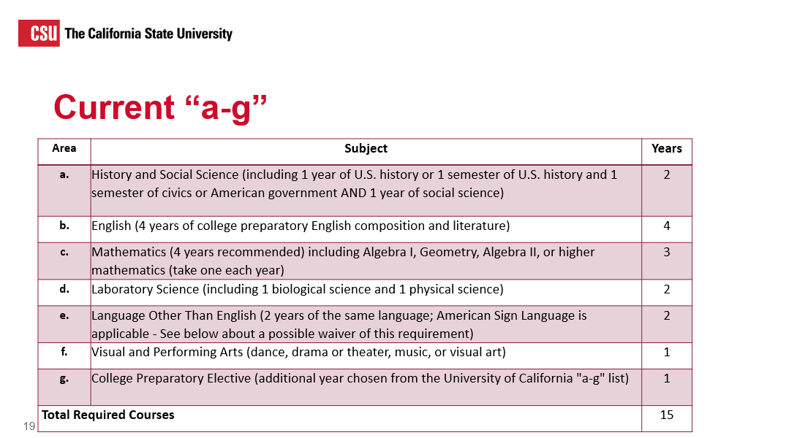

Slide 13
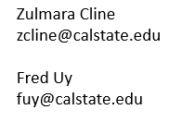
Notes:
MRWC provides an opportunity for STEM students who struggled with Algebra II to gain broader depth of understanding before moving into the Calculus Pathway
For Foundational Credential teachers, there may be an option to add in a calculus unit and prepare for and complete CSET Mathematics Subtest III, thus allowing them to obtain a full mathematics credential.
CSU Bridge Courses: Funded by CDE MRCI-Mathematics Readiness Challenge Imitative
Alternative pathway to advance math, emphasizes on understanding of math practices, strengthens and deepens the understanding of key algebra concepts, and post alg II
Monterey
Northridge
SAC
SB-MRWC 20 districts, 48 HS, 74 teachers, 2963 students
SD

Slide 14
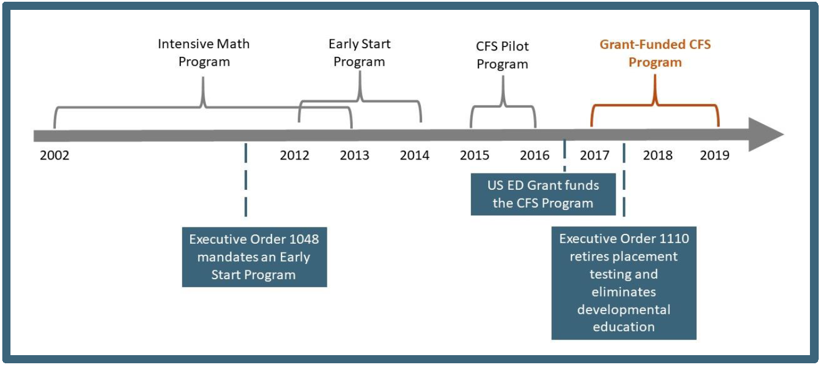
Early Start Program (ESP)
The Early Start Program serves CSU admitted first - time freshman requiring skills development in written communication and/or mathematics/quantitative reasoning to better prepare students and increase their ability to successfully complete their baccalaureate degree in a timely manner.

Slide 15
Multiple Measures
Standardized Tests
California Assessment of Student Performance and Progress (CAASPP)/ESP
SAT/ACT
AP
High School GPA
High School Coursework
High School Math GPA
Notes:
Distribute Roadmap document

Slide 16
Placement Categories
Fulfilled Requirement (category I)
Has fulfilled the GE Subarea A2 and/or B4 requirement
Enroll in GE “Ready” (cat. II)
Ready for placement in a GE Subarea A2 and/or B4 course
Enroll in Supported GE “Ready with Support” (cat. III)
Placement in a supported GE Subarea A2 and/or B4 course and recommended Early Start
ESP Required “Ready with Support and Early Start” (cat. IV)
Require placement in a supported GE Subarea A2 and/or B4 course and required Early Start
Notes:
Aurora
New Academic Pathways brochure
Page 8 & 9 are English
Page 10 & 11 are Math

Slide 17
Coyote First STEP (CFS) Student Transition Enrichment Program
Students participate in an intensive summer math program.
Students experience life in the residence halls
Become better acquainted with the campus
Make some new friends along the way
The program is FREE of cost to students
https://www.youtube.com/watch?v=muHt3sBUWYs
Summer 2017 – 1,136 participants (48% of fall 17 incoming freshman)
Summer 2018 – 542 participants (21% of fall 18 incoming freshman)
Summer 2019 – 500 participants (17% of fall 19 incoming freshman)
Notes:
Fall 17 total 2364 (48% participated)
Fall 18 total 2574 (21% participated)
Fall 19 total 2926 (17% participated)

Slide 18
CFS Goals
Math Self-Efficacy
Students will increase their beliefs about their math capabilities.
Connection
Students will develop positive connection with peers, staff and faculty members within the university.
Navigation
Students will be able to identify campus resources that provide social, health and academic support
College Skills
Students will develop stronger skills associated with college success
Notes:
Each one as backup

Slide 19
Quarter to Semester Conversion
Fall 2020
Q2S
Catalog Rights
No loss of academic progress
No increased cost for degree completion
Notes:
CSUSB will move from a Quarter to a Semester Academic Calendar in Fall 2020, in alignment with our CSU and Community College partners.

Slide 20
GI 2025
Purpose
The California State University launched its CSU Graduation Initiative 2025 in January 2015 with a clear goal: to increase graduation rates for our 475,000 students across all 23 campuses.
Objectives
Increasing the 6-year graduation rate for first-time freshmen to 62%
Increasing the 4-year graduation rate for first-time freshmen to 30%
Increasing the 4-year graduation rate for transfer students to 83%
Increasing the 2-year graduation rate for transfer students to 45%
Eliminating the achievement gap
Notes:
We are being asked to essentially triple our 4-year graduation rate while reducing any equity gaps. In general, this means increasing units attempted/completed while reducing DFWI rates and making sure all student benefit.

Slide 21
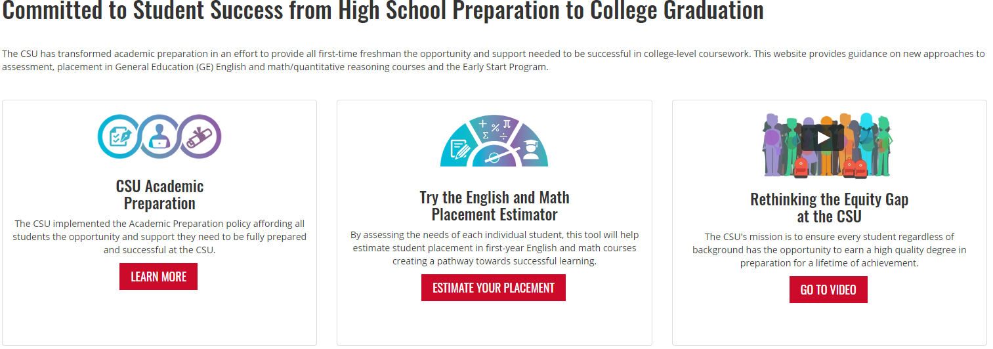
Resources
www.csustudentsuccess.org

Slide 22
CSU Dashboards

Slide 23
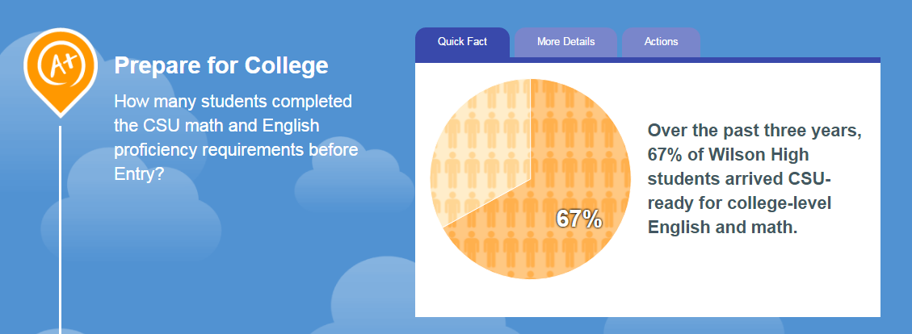
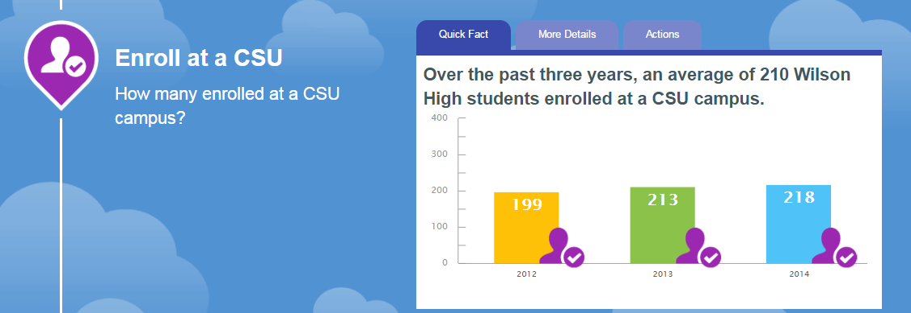
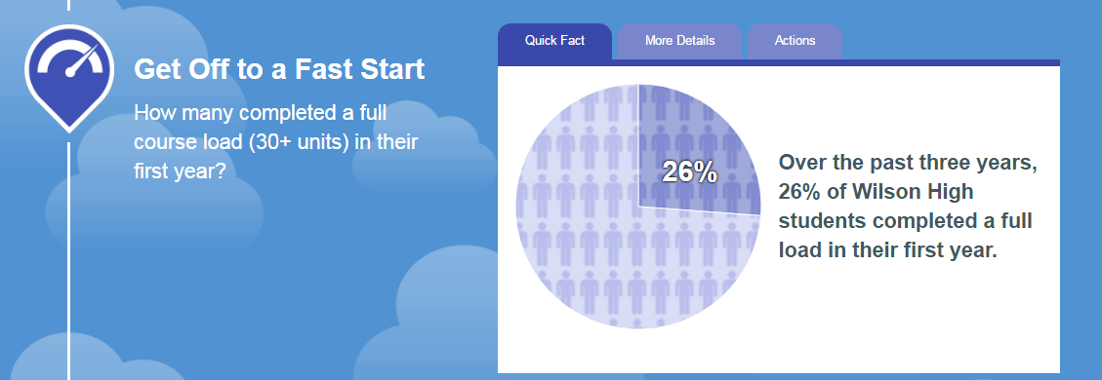

Slide 24
Academic Preparation Brochure

Slide 25
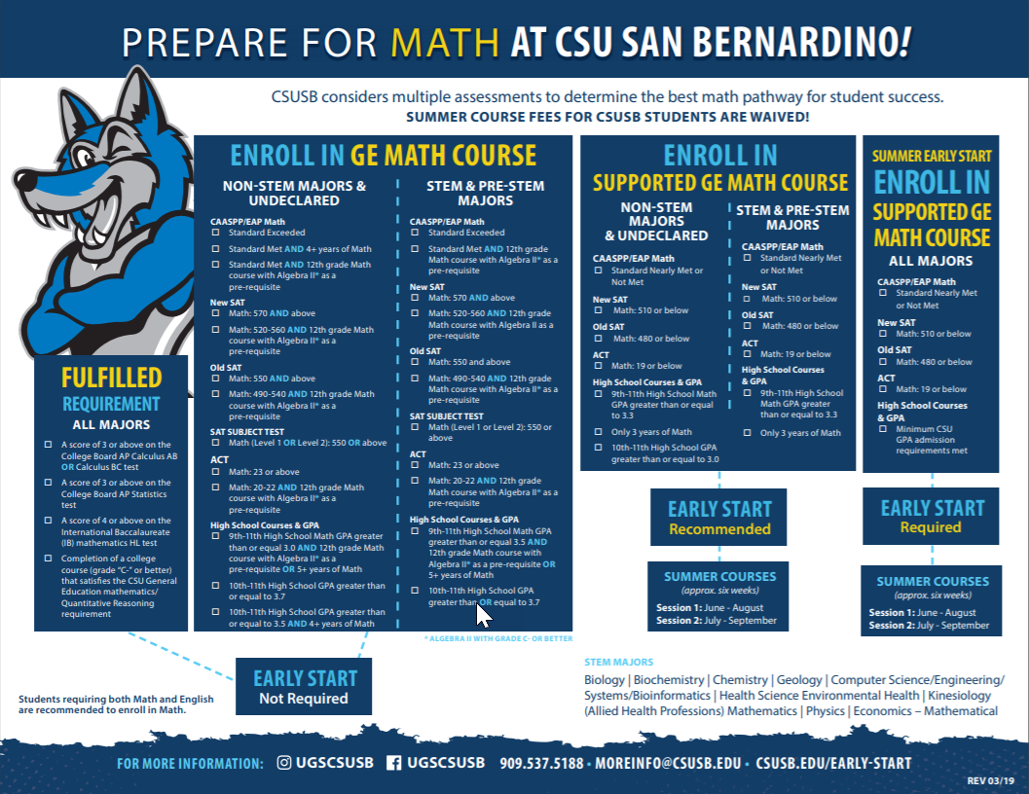
Math Placement

Slide 26
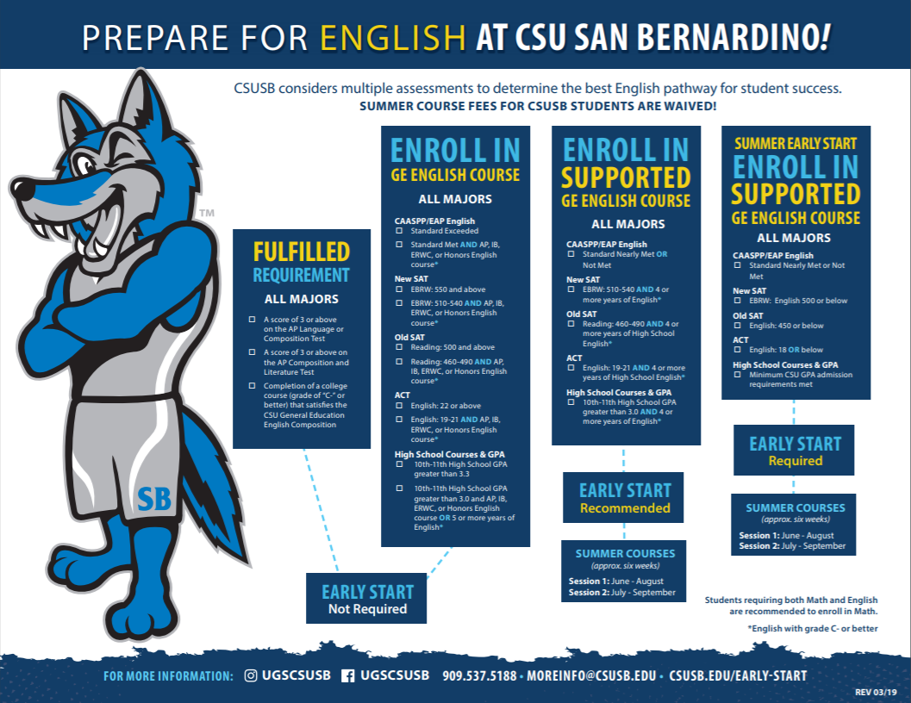
English Placement

Slide 27
Undergraduate Studies

Slide 29
Dates to Remember
ERWC 2-day Update Session: March 5-6 (Rancho)
CSUSB Counselor’s Day: April 24
ERWC Leadership: June 22

