Slide 2
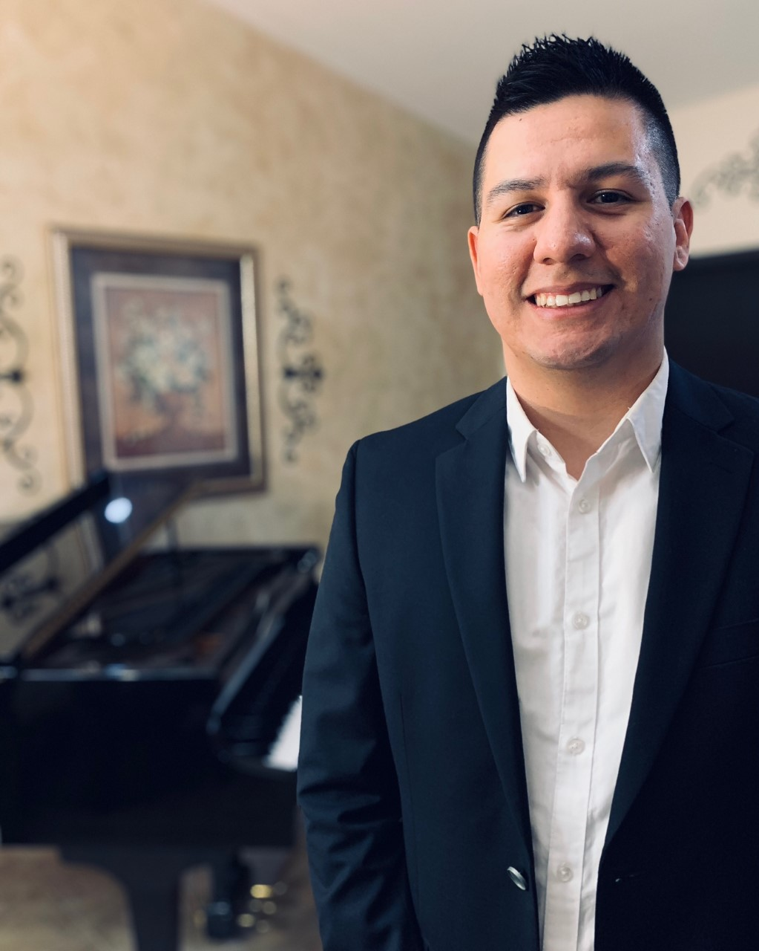
Motivational Music 8:00 a.m.
Alfonso Olachea
School Counselor
La Quinta High School
Desert Sands Unified School District
THANK YOU FOR YOUR SERVICE!

Slide 3
Welcome

Slide 4
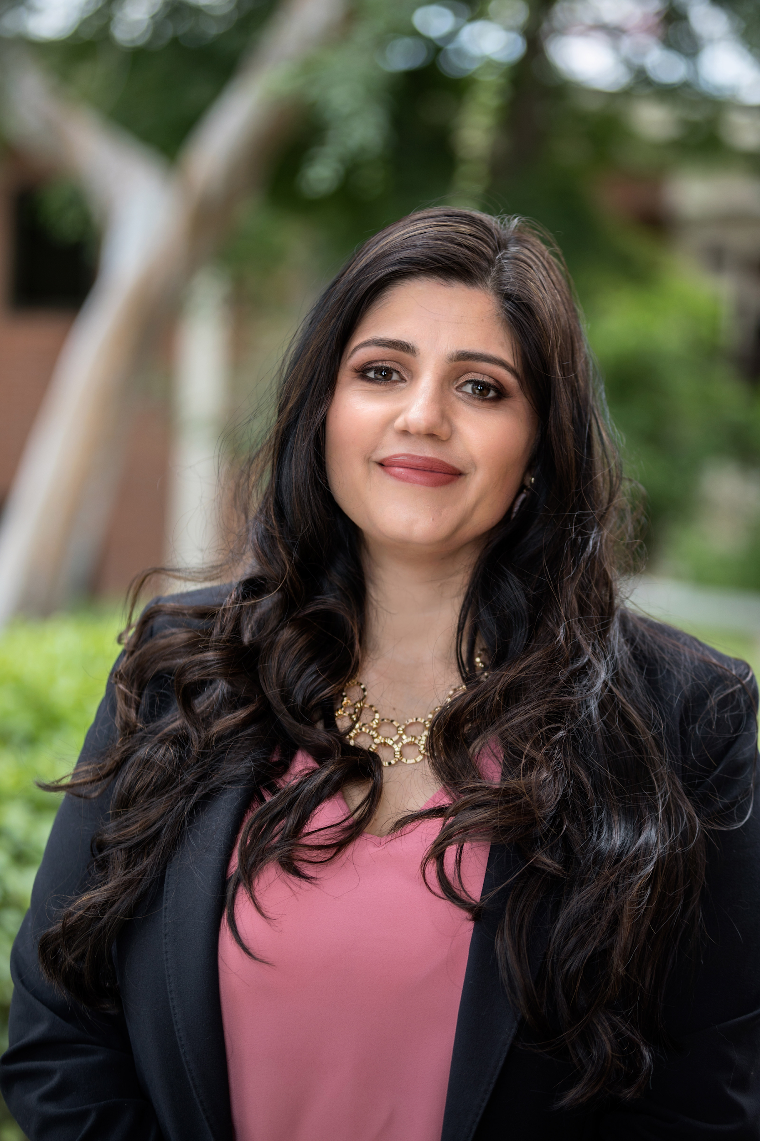
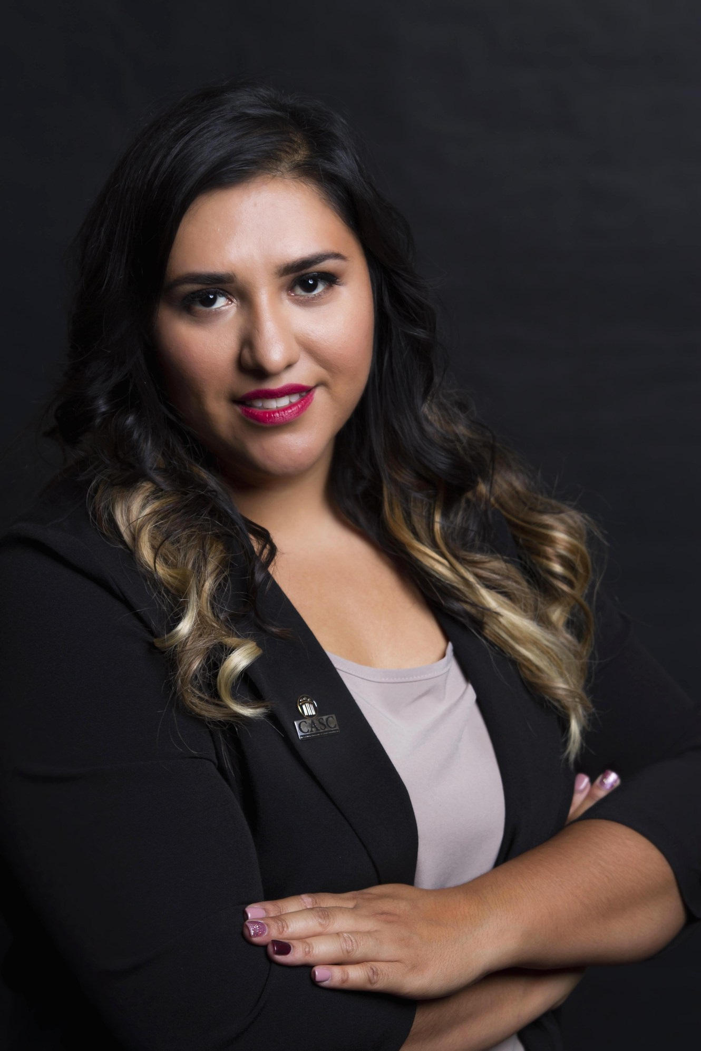
Catalina Cifuentes
Executive Director
College and Career Readiness
Dr. Yuridia Nava
Coordinator
College and Career Readiness

Slide 5
Use #SCLN2021 for a chance to win a DoorDash gift card!
@RCOE
@RCECUS @riverside_coe

Slide 6
LETS CELEBRATE OUR WINNERS
FROM DAY 1
Amanda @Cottonwood Hemet USD
Lupe Mares- Desert Sands Unified

Slide 7
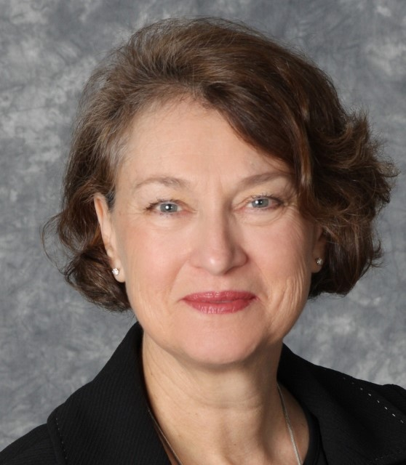
Dr. Carolyn Stone
ASCA Ethics Chair
University of North Florida
Professor of Counselor Education

Slide 8
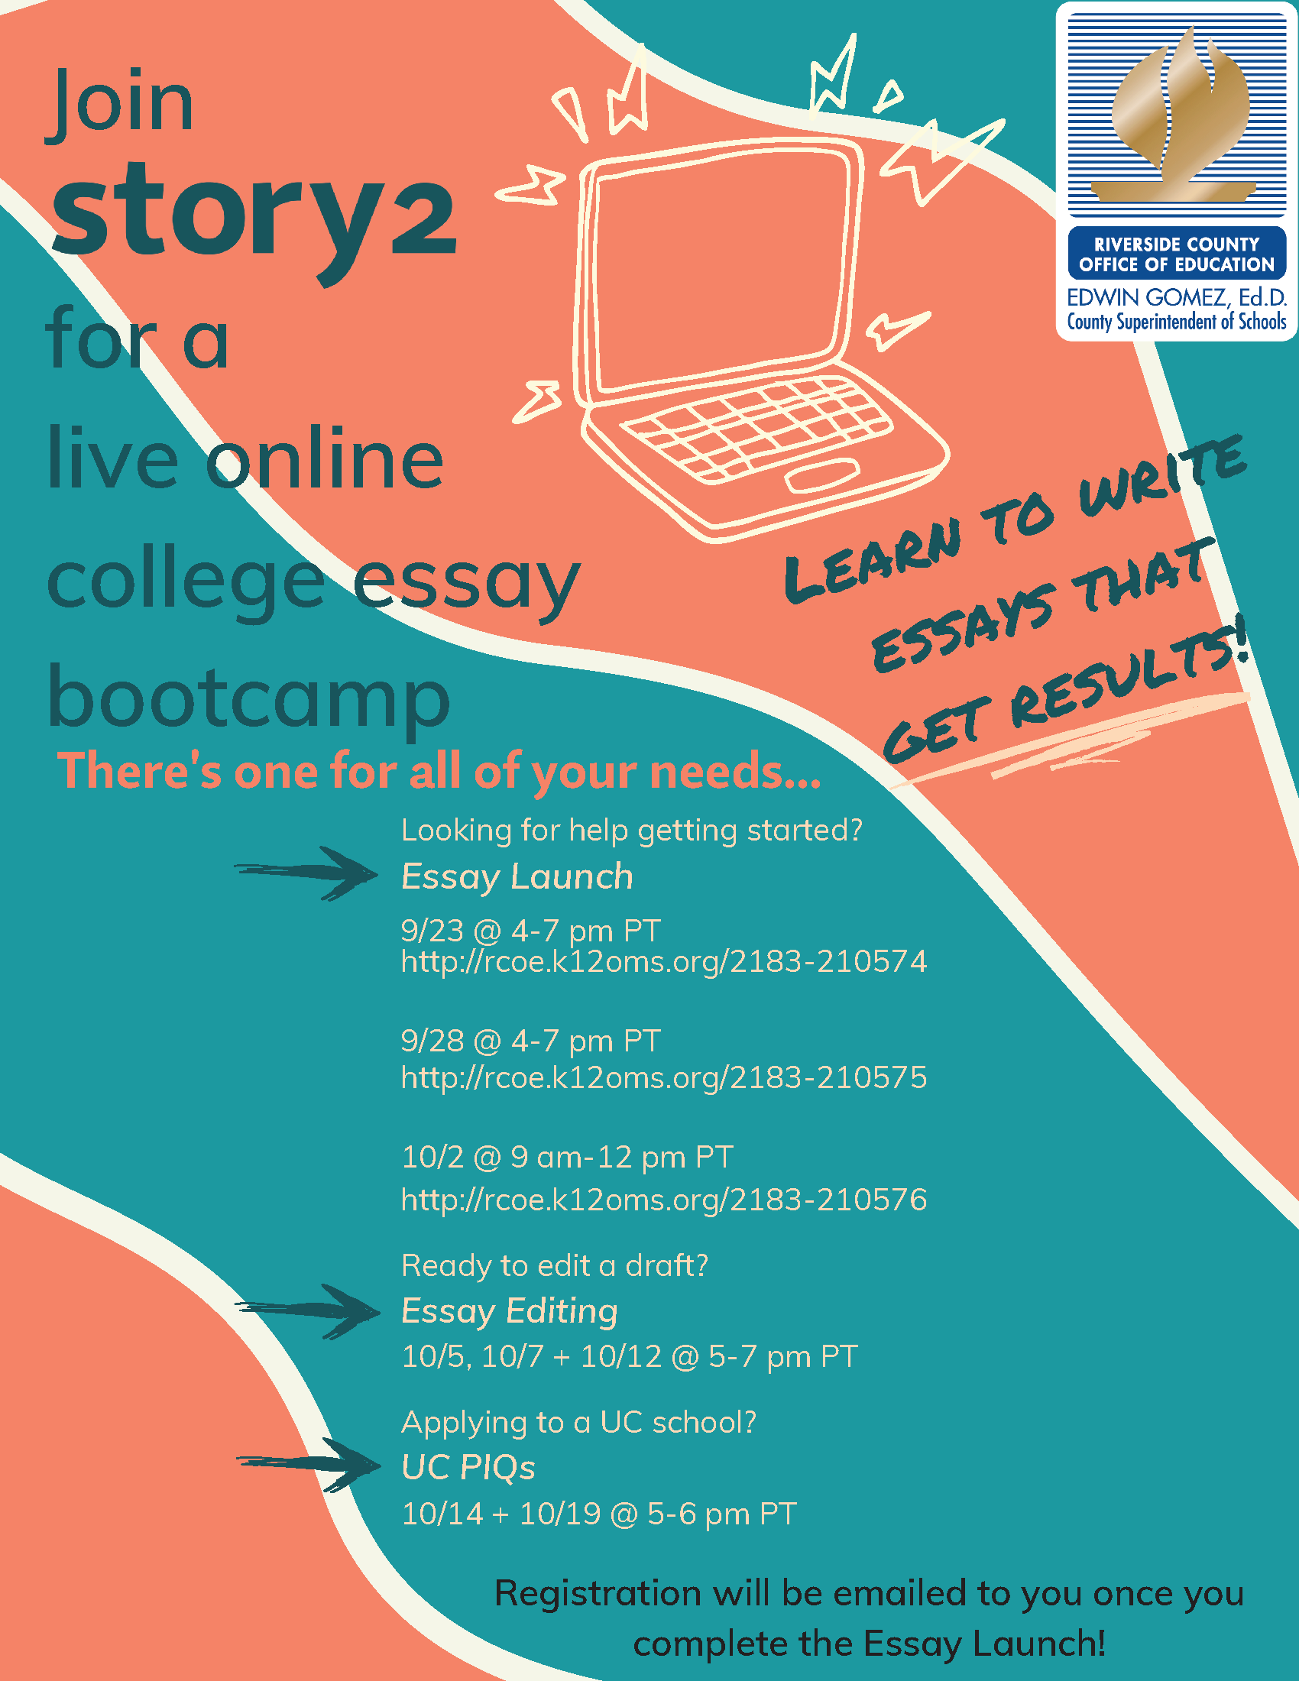
Personal Statement and UC PIQ Support for Class of 2022
October 2nd

Slide 9
https://apreadiness.ucr.edu/

Slide 10
https://a.flexbooker.com/reserve/collegecomeback#chooseService

Slide 11
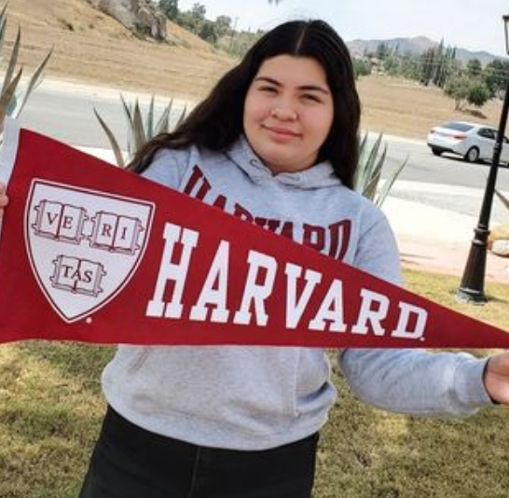
http://www.rcec.us/college-kickoff

Slide 12
Network Session Tips & Tricks
•All sessions are being recorded so that others may listen at a later time and will be uploaded to the Sched App through October 29, 2021 and then be moved to the RCEC website. For directions on how to make a FREE account on the RCEC website to access all materials and resources, please visit the MAP section of your Sched app.
•Since all participants have been muted, please use the Q&A and chat features to enter your questions.
•Each breakout session is 60 minutes including the Q&A so if we don’t get to your question, please submit it in the chat and we will try to send out an FAQ with the answers.
**Every effort has been made to ensure the security of this webinar from “zoombombers” but in the event that we experience that, we will resume as soon as the technical difficulties have been resolved.**

Slide 13
Use #SCLN2021 for a chance to win a DoorDash gift card!
@RCOE
@RCECUS @riverside_coe

