Slide 1
GPA Uploads and WebGrants
California Student Aid Commission

Slide 2
CA Education Code 69432.9
Mandates all public and charter high schools to electronically upload GPAs for seniors by October 1st
Provide students/parents opt-out option no later than January 1st of junior year
Verify high school graduation by August 31st of academic year following graduation
Notes:
The WebGrants system is an important tool you will utilize, even if you don’t upload GPAs. In order to use it, you must first gain access to WebGrants by completing two forms: the High School System Administrator Access Request form and the Information Security and Confidentiality Agreement Form. One last form, the FAFSA/Dream Act Completion Agreement allows high schools and districts to receive certain FAFSA and California Dream Act application filling status information for their students.
WebGrants accounts for high school users are set with a 2 year expiration date, at which point updated forms need to be completed. These forms are available at the California Student Aid Commission’s website and must be submitted before access can be gained by your school. Remember – even if you are not the person involved in the GPA upload process, you still should have access to WebGrants in order to check reports, see which students have been awarded a Cal Grant and assist in the matching process if needed.
To access the forms you need to request WebGrants access, please use this link:
https://www.csac.ca.gov/post/access-forms

Slide 3
Getting WebGrants Access
Notes:
The WebGrants system is an important tool you will utilize, even if you don’t upload GPAs. In order to use it, you must first gain access to WebGrants by completing two forms: the High School System Administrator Access Request form and the Information Security and Confidentiality Agreement Form. One last form, the FAFSA/Dream Act Completion Agreement allows high schools and districts to receive certain FAFSA and California Dream Act application filling status information for their students.
WebGrants accounts for high school users are set with a 2 year expiration date, at which point updated forms need to be completed. These forms are available at the California Student Aid Commission’s website and must be submitted before access can be gained by your school. Remember – even if you are not the person involved in the GPA upload process, you still should have access to WebGrants in order to check reports, see which students have been awarded a Cal Grant and assist in the matching process if needed.
To access the forms you need to request WebGrants access, please use this link:
https://www.csac.ca.gov/post/access-forms

Slide 4
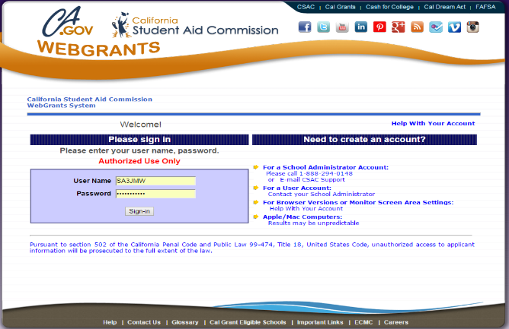
Establishing WebGrants Access
Complete and submit:
WebGrants System Administrator’s Access Request Form or User Access Request Form
Information Security and Confidentiality Agreement
Email to schoolsupport@csac.ca.gov
WebGrants users have access to:
Upload GPAs
Edit and force-match unlinked GPAs
GPA reports
Check the GPA and application status of all of your students
Notes:
The WebGrants system is an important tool you will utilize, even if you don’t upload GPAs. In order to use it, you must first gain access to WebGrants by completing two forms: the High School System Administrator Access Request form and the Information Security and Confidentiality Agreement Form. One last form, the FAFSA/Dream Act Completion Agreement allows high schools and districts to receive certain FAFSA and California Dream Act application filling status information for their students.
WebGrants accounts for high school users are set with a 2 year expiration date, at which point updated forms need to be completed. These forms are available at the California Student Aid Commission’s website and must be submitted before access can be gained by your school. Remember – even if you are not the person involved in the GPA upload process, you still should have access to WebGrants in order to check reports, see which students have been awarded a Cal Grant and assist in the matching process if needed.
To access the forms you need to request WebGrants access, please use this link:
https://www.csac.ca.gov/post/access-forms

Slide 5
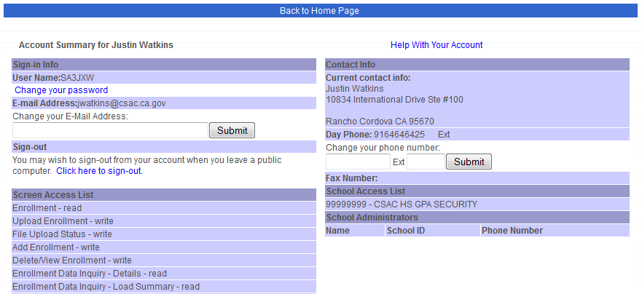
Your Account Details
You will have access to certain screens (read, write, or grant)
Keep your personal info up-to-date (phone number, email address)
Change your password if necessary
}

Slide 6
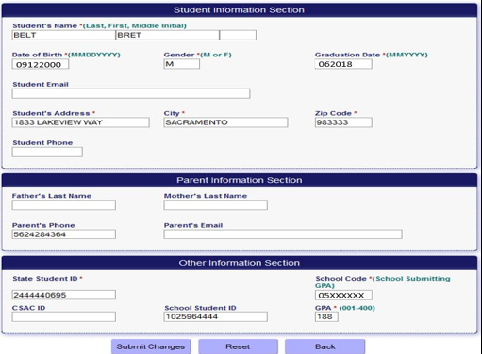
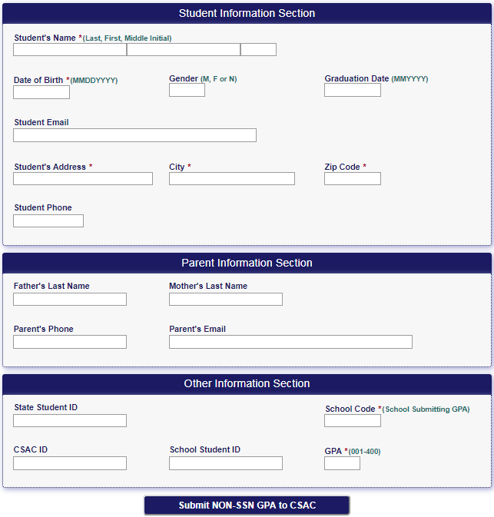
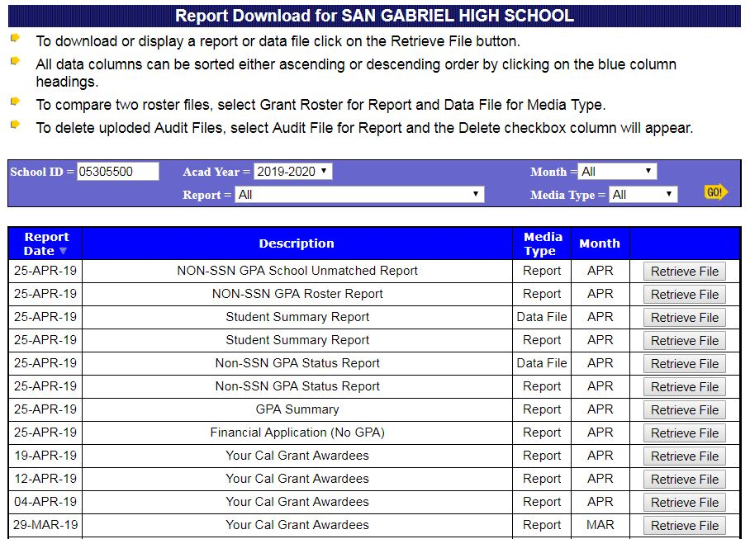
Why would I want WebGrants access if I don’t upload GPAs?
Only students with matched GPAs will be given Cal Grant consideration. High school campuses/districts are required to resolve unmatched GPAs in WebGrants.
Only applications with matched GPAs are counted in “Race to Submit”
You will have the ability
to add an individual GPA for a student who wasn’t part of the original upload; i.e. late transfers, makeup credits
You will have the ability
to edit/correct GPA
data to help your students match
You will have access to GPA reports to check the GPA and application status of all of your students
You will have the ability
to force-match a student’s GPA to the corresponding application
Notes:
WebGrants is the California Student Aid Commission’s internet-based access for Cal Grant grade point average (GPA) submission for high schools. While WebGrants provides a high school with the ability to upload Cal Grant GPA data, it also provides the ability to: Access reports, use online services, view your Cal Grant Awardees, edit a record, add individual GPA and verify student high school graduation dates.
Please contact the California Student Aid Commission if you have any questions about WebGrants or WebGrants access.
E-mail: schoolsupport@csac.ca.gov

Slide 7
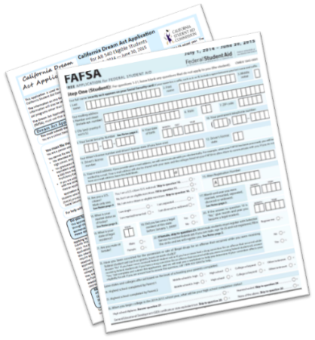
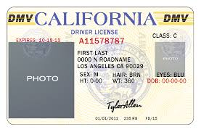
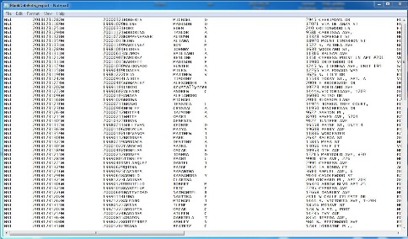
Most common reason for not matching?
Name and address mismatches
Application
Legal Documents
Prior to uploading GPAs…
We recommend that you provide your seniors with the name and address that the school or district intends to use to upload their GPA
Notes:
We can think about the entire process of applying for financial aid as a series of steps. The one obvious component of each step is the student’s name and address and it is critically important in connecting, or matching, one part of the process with the other.
We recommend:
* Providing your seniors with the name and address the school or district will be using to upload their GPA. This will alert the student to what will be on the GPA upload and allow them to either request a name change at the school, or to use the exact same name on their application if it is correct. This can be done by providing your students with the “GPA Demographic Verification” form, which can be accessed via CSAC’s webpage and it’s available in the resources section of the workbook.
* Contacting us early if you anticipate a matching issue because of a name change, or any other change that would prevent a student from matching
* Reminding students that one small error with their name or date of birth on their financial aid application (FAFSA or Dream Act Application) may result in weeks of delays in being processed for award consideration
* Reminding students to double-check whatever forms of identification they have before completing a financial aid application. Remember, the college will want their award to be in the same name as their IDs
For a copy of the Cal Grant GPA Demographic Verification form please use this link:
https://www.csac.ca.gov/sites/main/files/file-attachments/g-28_2019_cal_grant_gpa_demographic_verif.pdf

Slide 8
GPA Tools &
File Layout

Slide 9
High School Checklist
September- February
September
Confirm demographic information prior to uploading GPAs to help prevent name and address mismatches
October
10/1 Upload GPAs for current seniors
10/1 Upload GPAs for last year’s grads
November- February
Work GPA reports weekly to identify unmatched GPAs
Edit GPAs to mirror students’ FAFSA/CADAA each week
Match edited GPAs to corresponding FAFSA/CADAA
Assist seniors with creating WebGrants4Students accounts
January- August
January
1/1 Notify juniors of GPA opt-out option
March
3/2 Last chance for final GPA uploads: transfer students, makeup credits
May
2021-22 GPA upload functionality opens
August
Verify high school graduation by 8/31
Notes:
It is the high school’s responsibility to upload, edit & match GPAs, and verify the high school graduation of students who do not self-certify via their WebGrants4Students portal.
The matching/editing process can begin 24 hours after GPAs have been uploaded for students who have submitted their FAFSA/CADAA. The matching process can continue after the March 2nd deadline, through late March.
To view GPA reports, you will need WebGrants access. If you are new to WebGrants, it may be helpful to pull up each report that you have available to you. Please contact the Student Aid Commission if you have any questions.

Slide 10
GPA Calculations
Graduating Freshman or Sophomores
Provide a test score from a GED,
ACT, SAT, TASC or HiSet exam
Graduating Juniors
Use grades earned during 10th grade and the summer following 10th grade
Graduating Seniors
Use grades earned during 10th & 11the grades and summers following
Last Year’s Graduates
Grades earned during 10th, 11th and 12th grades and summers following
Notes:
It is the high school’s responsibility to upload, edit & match GPAs, and verify the high school graduation of students who do not self-certify via their WebGrants4Students portal.
The matching/editing process can begin 24 hours after GPAs have been uploaded for students who have submitted their FAFSA/CADAA. The matching process can continue after the March 2nd deadline, through late March.
To view GPA reports, you will need WebGrants access. If you are new to WebGrants, it may be helpful to pull up each report that you have available to you. Please contact the Student Aid Commission if you have any questions.

Slide 11
Preparing for the GPA Upload
Note: This is a technical process. Work with your IT department for support
GPAs are uploaded via text (.txt) files. Some Student Information Systems (SIS), such as Aeries®, produce an upload-ready GPA text file
If your system does not support this functionality, prior to uploading:
Refer to Non-SSN GPA User Guide for proper formatting
Import your GPA data using the Commission’s Non-SSN GPA Excel template
Convert the Excel template to a text file

Slide 12
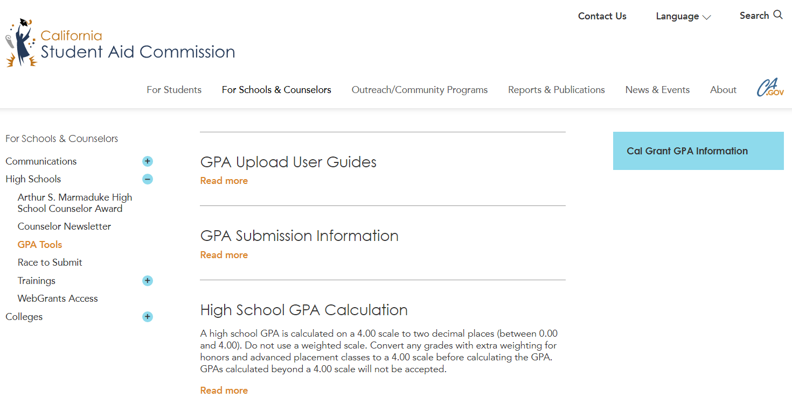
Non-SSN GPA Excel Template
csac.ca.gov: For Schools & Counselors>High Schools>GPA Tools
Notes:
High school staff can find all user guides, GPA Excel templates, calculation information, and the demographic verification form.
Before uploading, save both the Non-SSN GPA User Guide & Non-SSN GPA Excel template to your computer. To ensure a successful upload, you will want to refer to the Non-SSN GPA Upload User Guide for proper formatting of the record layout for your Excel template. Improper formatting will result in a failed upload attempt.
From the CSAC home page, www.csac.ca.gov:
High Schools:
Click on “For Schools & Counselors”>”High Schools”>(CLICK) “GPA Tools”:
Non-SSN GPA User Guide- click “Read more” link under “GPA Upload User Guides”
GPA Excel Template- click “Read more” link under “GPA Submission Information”
Colleges:
Pathway for GPA Upload User guide: “For Schools & Counselors”>”Colleges”>“Resource Documents”
Non-SSN GPA Template: “For Schools & Counselors”>”Colleges”>“Technical Documents”
Let’s take a look at the Record Layout on the next slide.

Slide 13
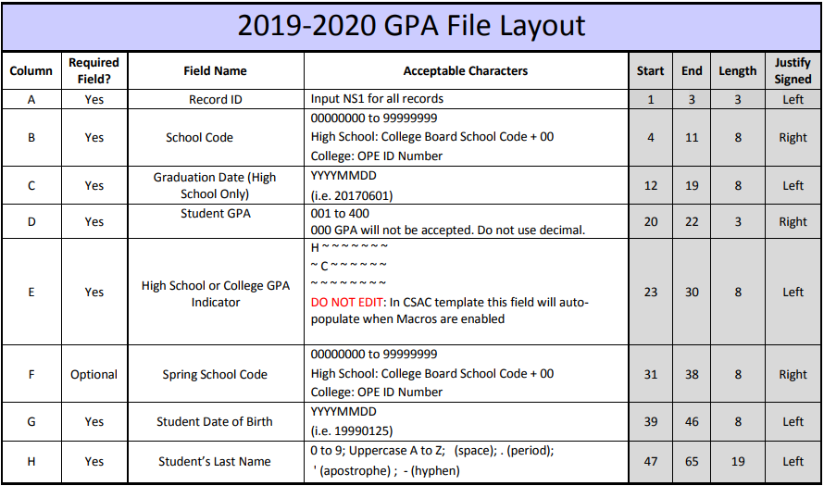
Non-SSN GPA File Layout
Common errors:
School code entered with 6 digits vs. 8
Leading zeros not visible
Format cells “as text” so Excel recognizes leading zeros
Grad date/DOB: Use YYYYMMDD format:
06/01/2020 20200601
Incorrect graduation year: 2020 vs. 2021
GPAs submitted with decimals
Last name exceeds 19 characters

Slide 14
Formatting the Non-SSN GPA Excel Template
When the template is first opened, “Enable Editing” to activate the Macros:

Slide 15
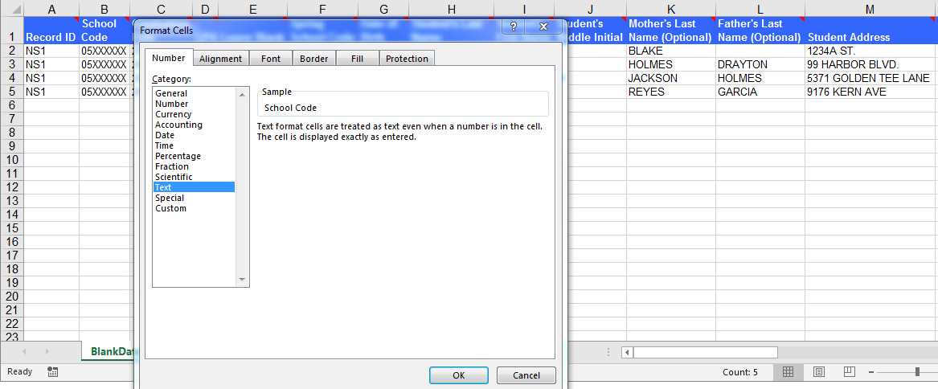
Formatting the Non-SSN Excel Template
Double Check formatting:
All required fields contain data
Leading zeros visible on School Code (column B)
Grad date/DOB in YYYYMMDD format
Correct Graduation Date: 2020 vs. 2021
GPA formatted without decimals; max 400
2 separate files for current seniors & last year’s grads
If copying/pasting data into Excel vs. importing, be mindful of formatting:
Extra characters and spaces cause misalignment of rows/columns
If just 1 record is formatted incorrectly/invalid, upload will fail
Leave columns E & V blank

Slide 16
Run the Macro to Convert Excel (.xls) to Text (.txt)
Under “Macro Name”, scroll down to select “StartDataTools”
Select “Run” to activate the macro wizard

Slide 17
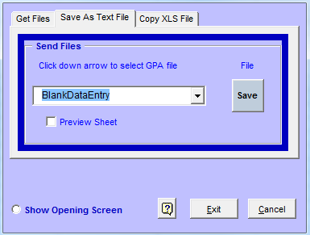
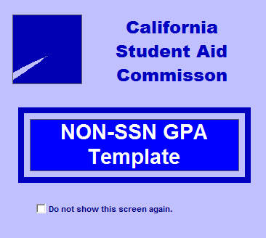
Run the Macro to Convert Excel to Text
“Save As Text File”
Default name: “BlankDataEntry”
Save to your computer

Slide 18
Next Steps: Test & Upload Text File
Text file is now saved under the default file name “BlankDataEntry”:

Slide 19
Test & Upload
Your Text File

Slide 20
Test & Upload the Text File

Slide 21
Test & Upload the Text File
“Begin Upload” does not actually upload the file. It tests the file for any invalid records first
If even 1 record is invalid, the file will need to be corrected and re-tested, until all errors are resolved

Slide 22
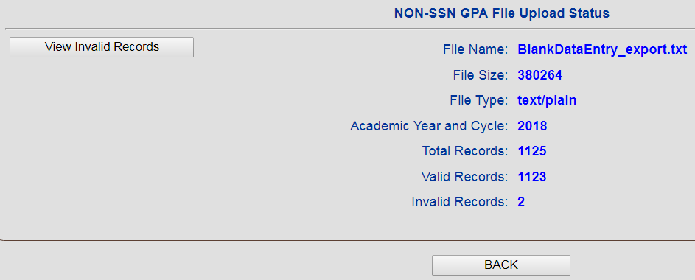
Invalid Records
Tip: Fix errors in Excel vs. text file
1126
1123
3

Slide 23
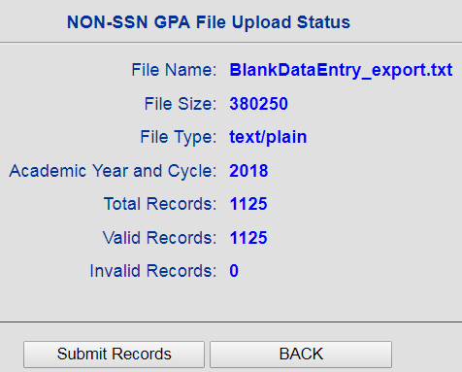
Upload Text File
Continue to clean up and test your text file until zero invalid records are returned:
Click “Submit Records” to complete the upload process
1126
1126

Slide 24
Manual GPA Submission
GPAs manually added after March 2 are late, & will be not be given consideration for the HS Entitlement (E1) award cycle
Contact CSAC for the proper way to submit a late GPA appeal prior to March 2nd

Slide 25
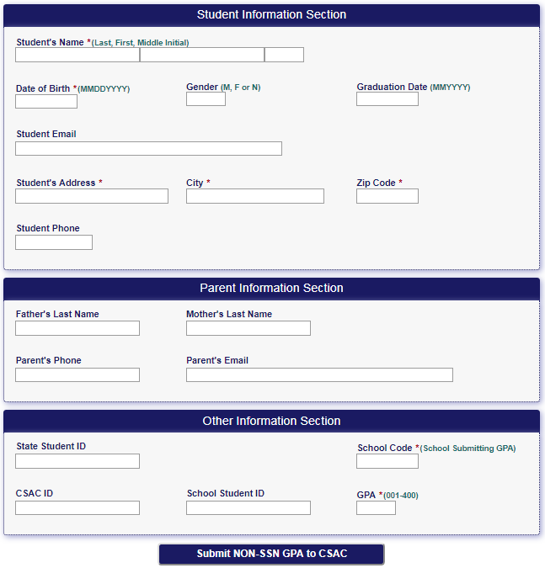
Manual GPA Submission
*
Red asterisks * indicate required fields.
Include optional data to increase chances of a successful match
*
*
*
*
*
*

Slide 26
GPA Reports

Slide 27
GPA Reports
Work GPA reports weekly between October and March 2nd:
Confirm GPA uploads
Identify unmatched GPAs to edit
Identify incomplete financial aid applications
Outreach to students for application completion/correction

Slide 28
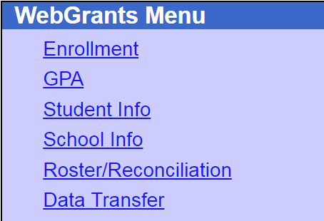
GPA Reports
1
2
3
Notes:
To begin, from the Portal Menu, select the “WebGrants” link.

Slide 29
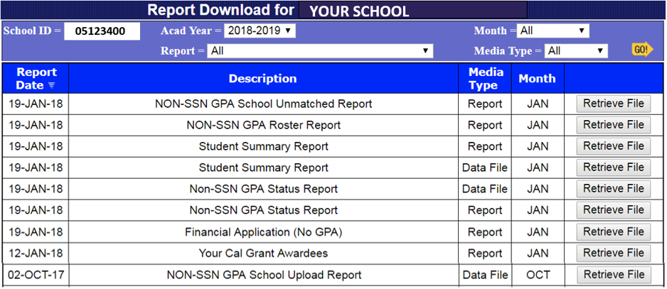
GPA Reports
Media Types
Report: Opens in new window as a text file
Data File: Import to Excel to filter results
* Contact your campus WebGrants System Administrator to obtain access to GPA reports
2020-2021

Slide 30
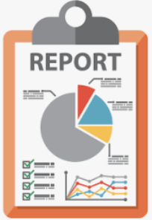
GPA Reports
Non-SSN GPA School Upload Report
Confirm Non-SSN GPA Uploads
Non-SSN GPA Status Report
Identify unmatched GPAs
Use Student Aid Report (SAR)/Cal-SAR for editing/matching
Identify missing applications (“NO APP”)
Remind students to submit FAFSA/CADAA by the March 2nd deadline
Tip: Look for key/legend at the top or the bottom of reports

Slide 31
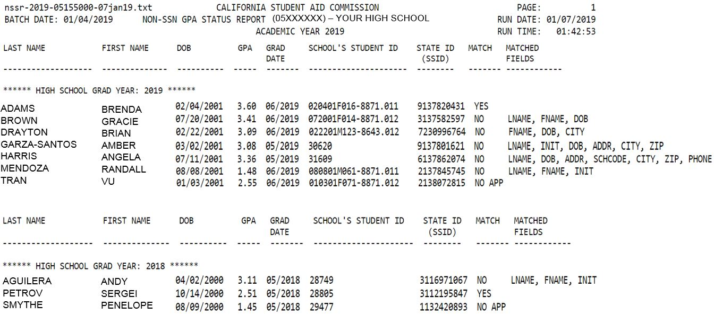
Non-SSN GPA Status Report
YES= GPA matched to FAFSA/CADAA. No further action needed
2020
Outreach to all following students:
NO= Unmatched
Ask students to provide SAR/Cal-SAR
Edit GPA to mirror SAR/Cal-SAR
NO APP= No application found
Remind students to submit a FAFSA/CADAA
2020
`
2019
Notes:
The newest and most comprehensive report offered, the Non-SSN GPA Status Report combines nearly all reports into one. This report identifies matched GPA records, unmatched records, and students who have not submitted a financial aid application. Displays GPA, provides School and State Student ID, and total count. Current seniors and previous graduates who list your high school on the FAFSA/CADAA are sorted by graduation year.
(CLICK) Notice the 2 columns, “Match”, and (CLICK) “Matched Fields”.
“Match” column indicators:
(CLICK) “Yes”: GPA and financial aid application matched. No further action needed.
(CLICK) Outreach to students with “NO” and “NO APP” in the “Match” column:
“No”: GPA and financial aid application do not match. Partially matched fields are identified in the adjacent “Matched Fields” column. Contact students to provide their SAR/Cal-SAR. Then, edit GPAs to mirror the SAR/Cal-SAR
“FNAME, LNAME, INIT”: If the only matched fields are “FNAME, LNAME, INIT”, WebGrants has found an application with the same name in our database. But since the other unique identifiers, such as DOB, address, school code, etc. do not match, this student is likely not YOUR student, and this further indicates that YOUR student did not submit an application. This scenario is very common, and when you consider the hundreds of thousands of FAFSAs/CADAAs received every year, it is easy to understand that there could be multiple applications with the same names. This is especially true for students with common names. Treat this student like any student with the ”no app” flag.
“No App”: Student did not submit financial aid application. Outreach to students prior to March 2nd to remind them to submit the application before the deadline.
(CLICK) This is the report legend. It alerts counselors to remind students with “NO APP” to submit a FAFSA/CADAA.

Slide 32
Edit & Match

Slide 33
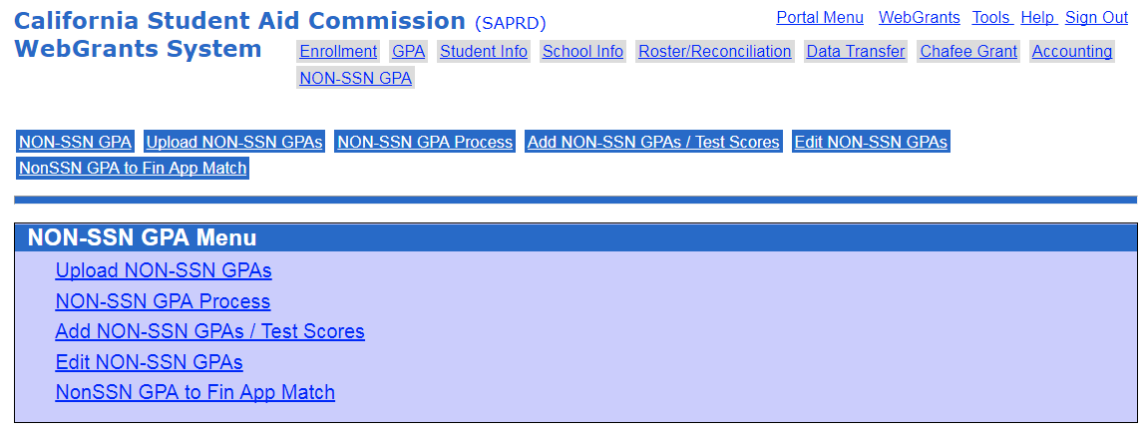
4 Steps to Edit & Match GPAs
Identify unmatched GPAs on the Non-SSN GPA Status report
Contact student to obtain Student Aid Report (FAFSA) or Cal-SAR (CADAA)
Edit GPA to mirror SAR/Cal-SAR
Match the edited GPA to the FAFSA/CADAA using “Non SSN to Fin App Match”
3.
4.

Slide 34
Edit GPA
After obtaining the SAR/Cal-SAR from the student…
Edit GPA to mirror SAR/Cal-SAR: Query GPA with the partial or full first name (Shannon), DOB, and School ID used during the upload. Click on student’s name (hyperlink) to open GPA record. Tip: Omit last name for better results
Note: Records appearing in green have already been matched, and cannot be updated
Enter partial or full first name to expand or limit search results.
67089 57 2.44 AGUILERA-GONZALEZ, SHANNON 10/26/1998 1234 5TH AVENUE, PINOL 95060 05329300

Slide 35
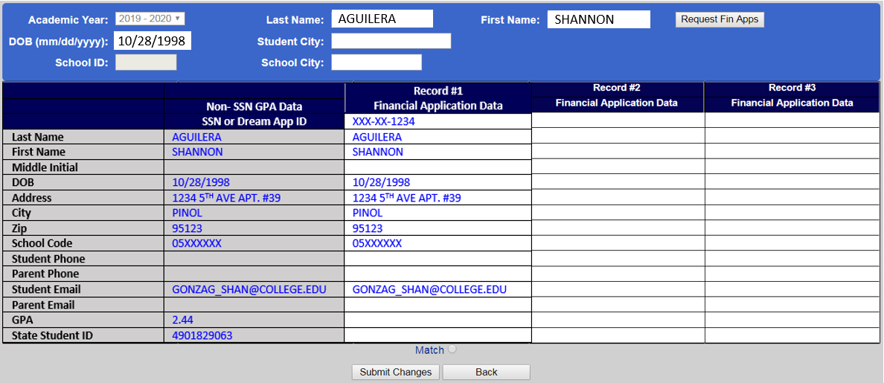
Match GPA
Match the edited GPA: Force-match GPA to financial aid application using “Non-SSN to Fin App Match” screen
{
Green = successful match. Application will now be processed for HS Entitlement Cal Grant consideration!
AGUILERA, SHANNON 10/26/1998 1234 5TH AVENUE APT #39, PINOL 95123 05XXXXXX GONZAG_SHAN@...

Slide 36
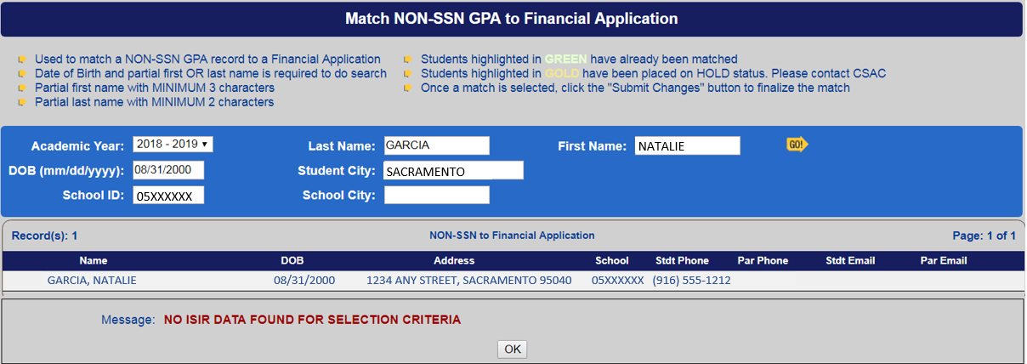
No ISIR Data Found…
“No ISIR Data Found…” error messages means that WebGrants could not locate the financial aid application you queried. This message will display if:
Application was not submitted
Application was submitted within last 10 days
Match is attempted before editing the GPA
Contact CSAC to resolve

Slide 37
Best Practice
Review Non-SSN GPA Status report weekly
Outreach to students with:
Unmatched GPAs: Request SAR/Cal-SAR for editing & matching purposes. The matching functionality remains available beyond March 2nd
NO APP: Remind students to submit a FAFSA/CADAA
Remind students:
Confirm applications are complete, and that the parent has signed with pin signature
Create a WebGrants4Students account via https://mygrantinfo.csac.ca.gov/ to monitor and claim their awards
Students and parents can attend a local FREE Cash For College workshop for assistance with FAFSA/CADAA, and Chafee applications

Slide 38
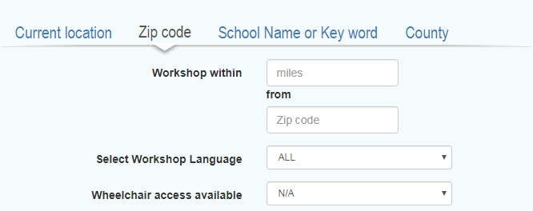
https://www.cash4college.csac.ca.gov/

Slide 39
Register for Notifications & Reminders
CSAC communicates with schools via List-Serv:
Upcoming deadlines
Legislative updates
WebGrants maintenance & outages
Notes:
To sign up for List-Serv and receive the Operations Memos and Special Alerts directly to your e-mail, navigate to our main homepage and (CLICK) scroll all the way to the bottom of the screen.
http://www.csac.ca.gov/pod/subscribe-list-serv

Slide 40
Questions?

Slide 41
California Student Aid Commission
Thank You!
Institutional Support Unit
888-294-0153
Schoolsupport@csac.ca.gov

