Slide 2
Engaging Students and Families
Considerations for engaging and supporting students and families in a virtual environment.

Slide 3
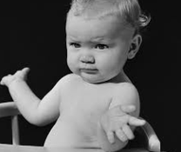
Who would have thought….???
We would see a time where the entire educational system shut down
Protest swept the nation for months in a row
Attending a social gathering could had serious health risks
Students would attend class and wash the breakfast dishes at the same time
That your professional attire could legitimately include your favorite fuzzy slippers
That you would become a tech expert

Slide 4
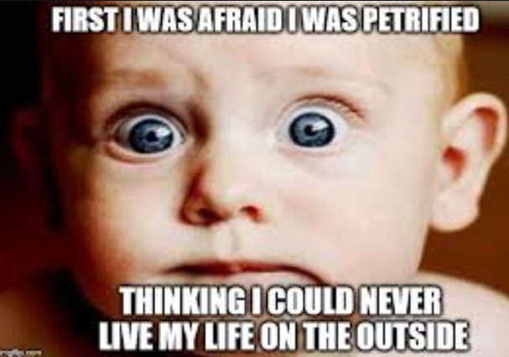
But here we are…….
Just Remember
This is normal! It’s OK
…and the show must go on!!!!
You got this!!!!

Slide 5
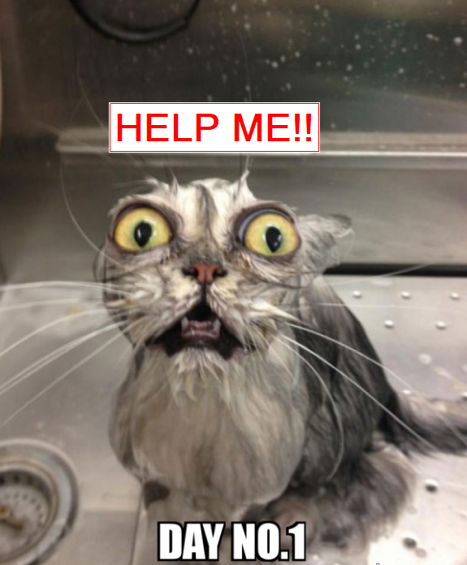
Day 1 of Virtual School……..

Slide 6
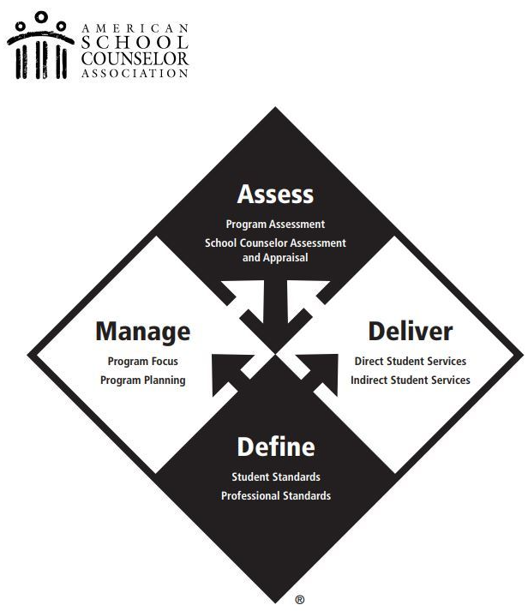
The role is the same…..our environment changed.
Remember the important role you play in a students education
Draw on your previous experiences?

Slide 7
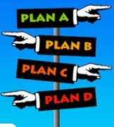
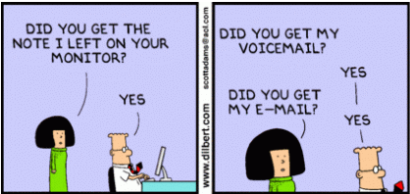
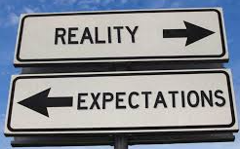
Manage Expectations
&
What can you control
What can you not control
Technology will fail
Kids will be confused
You will be confused
Develop Contingency Plans
What happens if the technology fails?
Over communicate/in multiple forms

Slide 8
Know the services are you providing?
Small groups
Classroom core curriculum lessons
Grief counseling
Academic advising
Parent meetings
Individual student meetings
Not all tech tools are made equal….think about what is most appropriate for your activity.

Slide 9
What tools/platforms are your school using?
Learn only what you need to know.
Pick one or two tools that you will use to delve deeper into.
Find the balance between multi-tasking and overdoing it.
It’s not a race and there are no medals for winners or trophies participants.

Slide 10
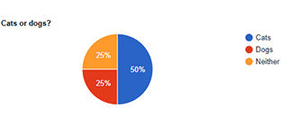
Make your time in the virtual world effective and engaging
Techniques
Welcomes
Polls
Speaking protocols
Over explain
Synchronous and asynchronous activities
Web-based resources

Slide 11
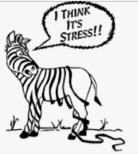
Technology fatigue is real… Self care is important!!!
We’ve all been here!!!
Give yourself grace…no one you work with has experience in this.
You can’t give your best when you have nothing to give.
…..and here!!!
Let’s not get here!!!
…too late????
Remember what makes you happy…do more of that.

Slide 12
What questions do you have?

