Slide 2
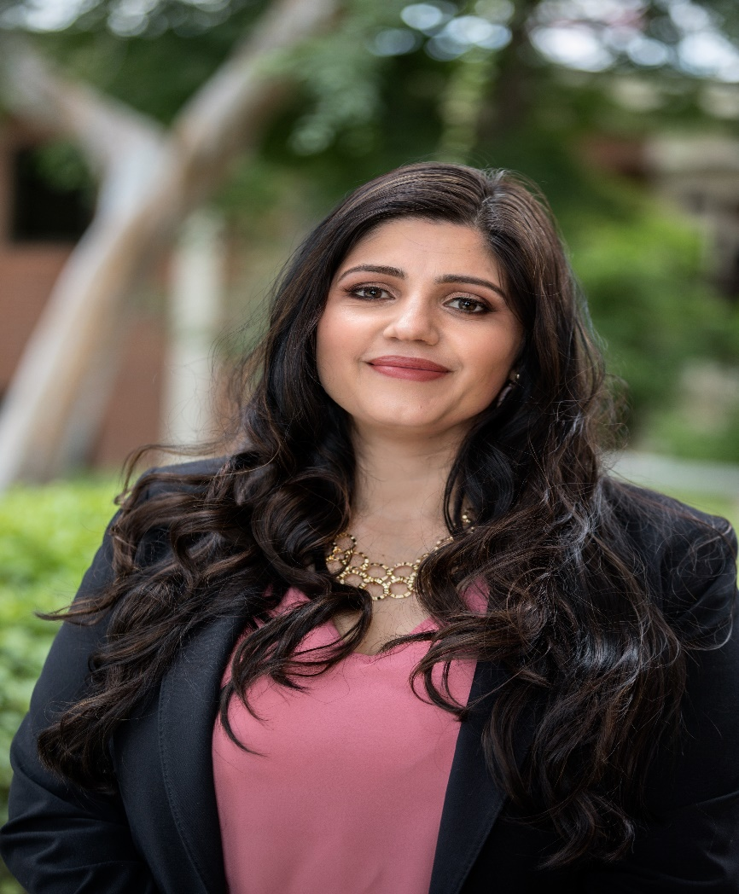
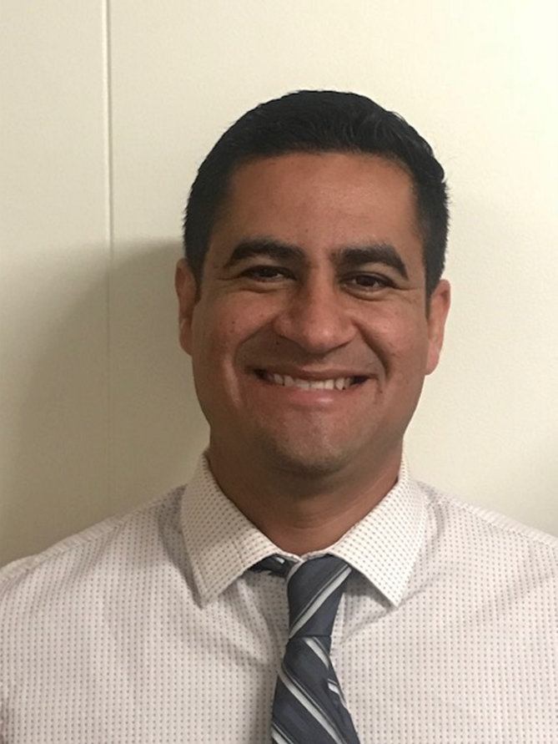
Catalina Cifuentes
Executive Director,
College and Career Readiness
ccifuentes@rcoe.us
Dr. Pedro Caro
Coordinator,
College and Career Readiness
pcaro@rcoe.us

Slide 3
Webinar Tips
This webinar is being recorded so that others may listen to it at a later time for reference and will be uploaded to the RCEC Youtube page as well as www.rcec.us once you log in to access the content of the webinar series
All connections to this live Webinar feature have been accounted for so please do not forward the Zoom link or invite anyone to join because you are taking someone else’s spot and Zoom will automatically start kicking off connections randomly
All participant mics have been muted and only panelists and facilitators have the ability to unmute anyone
Since all participants have been muted, please use the Q&A and chat screens to enter your questions. We will NOT be using the raised hands feature.
Participants can submit a question in the Q&A box at the bottom of the screen for the panelists
Only panelists and facilitators will be able to respond back to those questions and can do so publicly or privately to the individual
Participants can submit comments or questions in the chat box if they would like to engage with each other
**Every effort has been made to ensure the security of this webinar from “zoombombers” but in the event that we experience that, please stay calm and we will resume as soon as the technical difficulties have been resolved.**

Slide 4
FOR MORE INFORMATION AND RESOURCES PLEASE VISIT US @
www.rcec.us

Slide 5
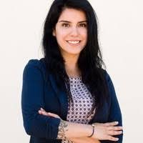
Carissa Marin
Professional Development & Digital Learning Specialist
cmarin1@mvusd.net
@RADteacherMarin
peaceloveeducation
bit.ly/LINKS4padres

Slide 6
Counselor Resources for Parent Support
Communication
Learning at Home
Technology
bit.ly/LINKS4padres

Slide 7
Effective Communication
Create one message
Consider different modes of delivery
Utilize district/site platforms
Translation in multiple languages
This Photo by Unknown Author is licensed under CC BY

Slide 8
Learning at Home
Create a schedule for the household
Dedicate a space for learning
Take frequent breaks
Schedule in meals and snacks
Be patient and positive
Limit screen time with video games, social media, etc.
If your children are stuck:
Reach out to the teacher
Have them research the topic
They can review what the teacher has given

Slide 9
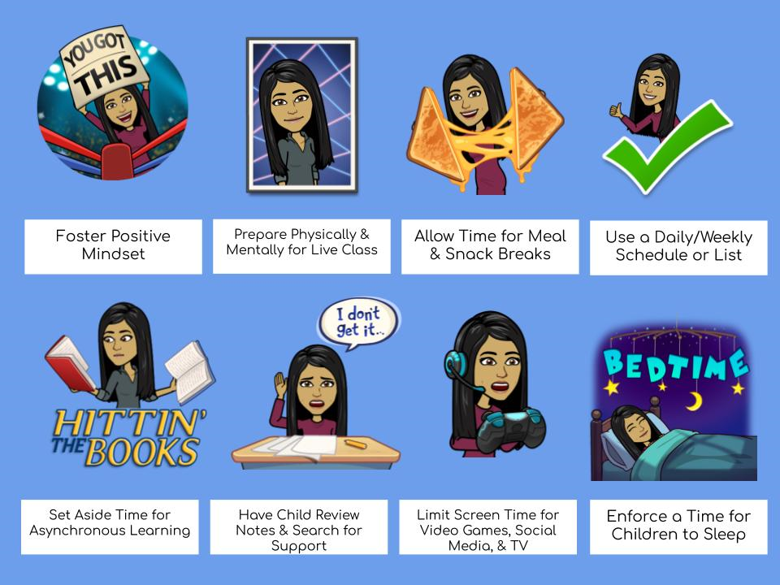

Slide 10
Technology Support
Google Applications
Office 365
Internet safety
Bridge the digital divide/barrier
Free Internet Options

Slide 11
Noe Alvarado Ed.S.
Oceanside USD
noe.alvarado@oside.us
Jen Inaba, Ed.S.
Encinitas USD

Slide 12
NASP & CASP Resources
NASP (Family tips)
Addressing stigma/racism
Modeling compassion
Avoiding stereotyping
Identifying red flags for:
Depression, anger
Responding to the passing of a family member
How to build self-esteem
CASP (Tools, strategies)
Mindfulness classes (free)
Emotional regulation tools
Visuals like “mood meters”
Games/activities
Art resources
Classes, visuals, abstract art
Accessing state parks

Slide 13
Final Message
Knowing the communities you serve
Respecting cultural norms
Empowering parents
Traditional forms of dealing with death, trauma, depression
Limited resources
Encourage communication
Community resources
Additional Resources:
Love and Logic: https://www.loveandlogic.com/collections/spr20/products/love-and-logic-parenting-online
Mental health resources: https://www.mentalhealth.gov/talk/parents-caregivers
Restorative Practice: https://www.restorativeresources.org/uploads/5/6/1/4/56143033/restorative_practices_parent_handbook_pdf.pdf

Slide 14
Ian Sherman
intern@inlandempiregia.org
www.iestudents.org

Slide 15
Round of Applause for our Presenters!!
Carissa Marin
Moreno Valley USD
Noe Alvarado, Ed.S.
Oceanside USD
Jen Inaba, Ed. S.
Encinitas USD
Ian Sherman
Growing Inland Achievement
Notes:
Castro Slide

Slide 16
We are here to support you!
Please reach out to College and Career Readiness with any needs at your school site, professional development topics, or general questions at:
Catalina Cifuentes ccifuentes@rcoe.us
Dr. Pedro Caro pcaro@rcoe.us
Notes:
Castro Slide

Slide 17
FOR MORE INFORMATION AND RESOURCES PLEASE VISIT US @
www.rcec.us

Slide 18
