Slide 1
Essential Advocacy for School Counselors During the Budget Crisis and COVID-19
College and Career Readiness Unit
Riverside County Office of Education

Slide 2
Objectives
Understand the implication of the revised California budget on education and school counseling programs
Explore the needs assessment as tool to inform key stakeholders and drive program planning action for the upcoming school year
Develop an Annual Student Outcome Goal Plan to create SMART goals and multi-tiered systems of support

Slide 3
Agenda
Introduction
Budget Updates and Implications
Step 1 - Identifying Needs
Step 2 - Using Data to Drive Action
Step 3 - Program Planning for Next Year
School Showcase - Step 4 (Action and Advocacy)
A Call to Action and Next Steps

Slide 4
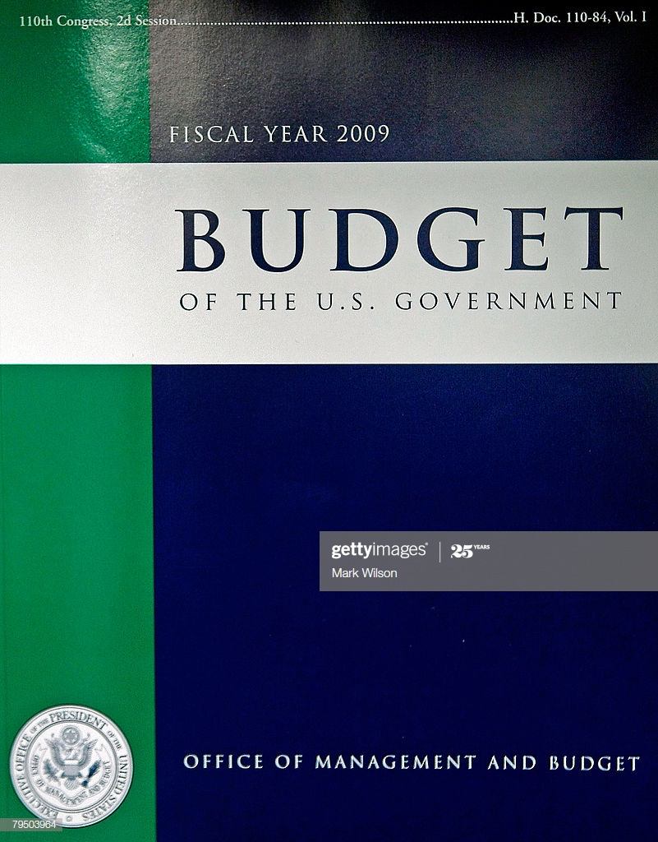
We’ve Been Here Before...
2008

Slide 5
California State Budget Headlines
$19 Billion decrease in Education Funding due to financial crisis caused by the COVID-19 situation
Loss of expected $2.31 cost of living increase
10% loss to Local Control Funding Formula without Federal funding
$5.3 Billion in funding deferrals creating major cash flow disruption for districts to payroll
Approximately 90% of school district budgets are for personnel costs
Notes:
Gil

Slide 6
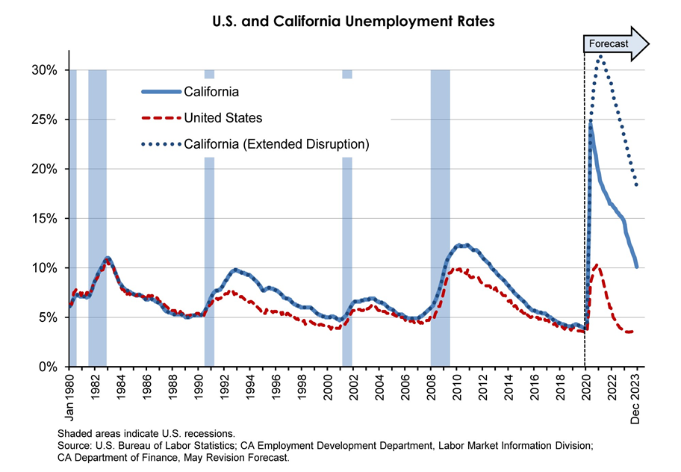
Present
Great Recession
Notes:
Gil

Slide 7
How Do Districts Make Staffing Decisions?
Attempt to keep cuts as far from the classroom as possible
Evaluate “Value Added” positions for district mission
Measure impact of decreasing or eliminating particular job functions (Layoffs?)
Negotiate with Labor Unions (Certificated and Classified)
Reduction in Force
Notes:
Gil

Slide 8
STEP 1 : Needs Assessment
Understand the current state of students, teachers and families
Identify strengths, areas of growth and gaps
Help develop action plans and SMART goals for the upcoming school year for classroom lessons, small groups
Identify support certain students needs individually
Gather data beneficial to school or programs such as but not limited too (Athletics, ASB, Clubs, Mental Health Providers, agencies, admin, SpEd, AVID, Homeless, Foster Youth, etc).
Notes:
Yuri- needs assessments are important because it helps you gather initial baseline data on your students and school CLIMATE. It assesses the culture and current state of your students
They help a school and counseling program determine the gaps that are preventing it from reaching its desired goals. FOr example, if you can pinpoint that your Homeless, First generation students need help completing the FAFSA< this could drive your completion rates to be higher by identifying those students and providing counselors with a special list (TLC) or people in charge of their students in such a program.
Remember that the object of a needs assessment is not for the counselor or counseling team to take on the entire data and actions. It’s also to collaborate and share results with those who CAN also help your students succeed. Remember the saying, “it takes a village” if for example your homeless students all need helps with school supplies, you advocate for that from your admin or district person in charge and show the results to get needed supplies. Needs assessments data is to be shared with stakeholders such as teachers, school psych, admin, district personnel, coordinators, attendance offices, etc.
Needs assessment addresses these concerns from all levels, starting at the 30,000 foot view and drilling down further and further into the individual school, groups of students, and individual students, in order to arrive at a plan with specific actions for improvement.

Slide 9
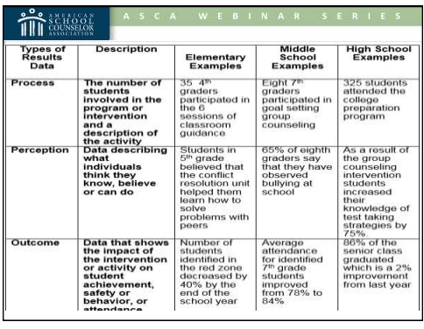
Determine Questions & Distribution Framework
GET CREATIVE! HAVE A PLAN!
Perception Questions = Likert Scale (1-10)
I FEEL, I THINK, I BELIEVE, I KNOW, I CAN
Ask students to fill out needs assessment during the initial classroom visit in the FALL or during registration in the spring for next year planning
Have incoming 9th graders fill out a needs assessment during 8th grade registration/orientation
Have PTA, ELAC, or other evening parent clubs/school organizations put the survey on their agenda and ask them to have parents fill it out (digitally & electronically)
Always have paper copies for students/parents w/out wifi or phones
Ask Club or Program Advisors to partner with you and have students fill out needs assessments for participation points. This data benefits them also!
Give incentives (first ten students to complete, random drawings, class with most participation ,etc)
ASCA Handout
Notes:
Yuri – we have multiple choice, open ended, but I always get asked as a ASCA RAMP reviewer, when do you do scaling questions… anytime you want to gage perceptions of your students, parents, teachers, staff you use Likert scales also known as rating scales
Perception – what students think they believe (attitudes), can do (skills) or understand (knowledge) (e.g., 75% of group believe their school is safe; 58% of students know how to write a goal) what students FEEL, THINK, I believe, I know, ETC
Perception data is meaningful because it provides answers to how students are different because of the school counselor's intervention. This is captured in POST tests (after you have delivered a classroom lesson or small group)
Perception data is used to effect changes in the learning environment which is captured when you ask them in a needs assessment
Having a plan is important, it creates collaboration, transparency, and buy in from different stakeholder groups. If you take the time to state why this is important and how their help will assist students, it 1) educates and 2) build your ally group so that you don’t have to do everything ALONE . There is no reason to carry to weight of an entire counseling program alone, just like we share in the education of our kids assigned to us with their teachers they have or coaches, we too must look to others to assist us in delivering services.

Slide 10
Helpful Considerations
Who is your target audience?
What information do you want to know about them?
Why are you asking this particular question?
How will you collect data?
How will you use this data strategically?
Who might you share this data with?
Notes:
Pedro

Slide 11
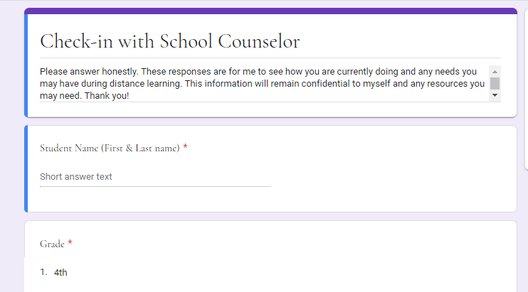
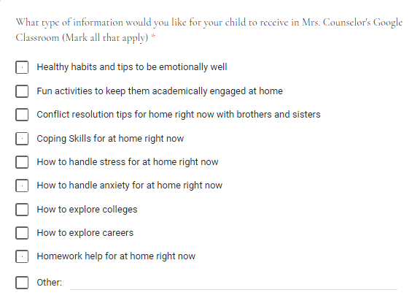
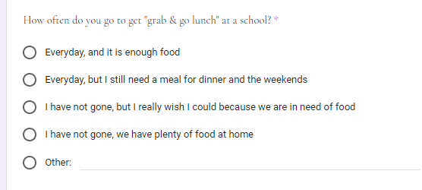
Sample Needs Assessments
Needs Assessment to Use for Students During COVID-19
Needs Assessment to Use for Families During COVID-19
Notes:
Pedro

Slide 12
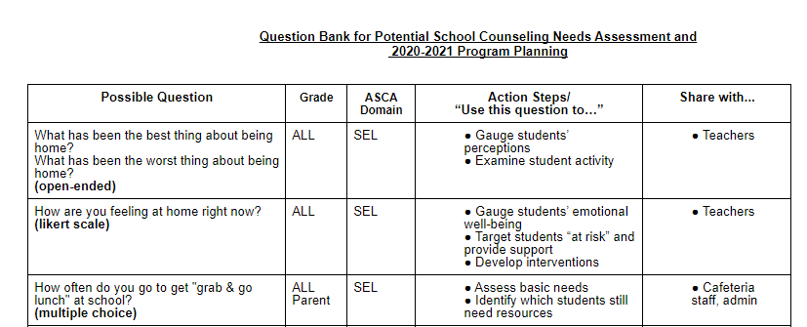
Have A Question Bank
BENEFITS!
Efficiency
Collaboration
Evaluation/Reflection
Question Enhancement
RCOE QUESTION BANK LINK
Notes:
having other teachers, admin, or even classified staff take a look at your question bank or surveys gives you another fresh set of eyes or a different way to ask a question that could make 1) better sense for your student or parent or 2) ask in a way that your student/parent can easily understand- sometimes what we think in our head sounds right but it may be confusing for others
Question bank can be used for pre-testing, development, review and revision of a lesson. When question banks are established in schools, students can use them for self evaluation in their spare time to get student perspective on the sample questions

Slide 13
Best Practice:
Needs Assessment During COVID-19

Slide 14
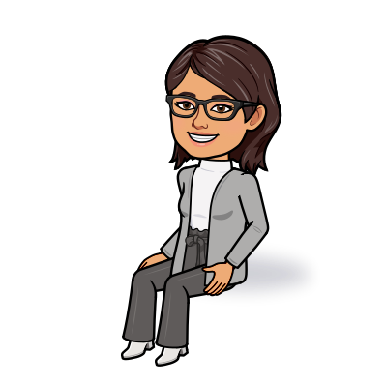
Sunnymead Middle School
School Counseling Team
Sample Check-In Needs Assessment
Mrs. Cornejo
Mrs. Cortes
@counselorsSMMS

Slide 15
Needs Assessment
Plan
Collaborate
Purpose of Questions
Action Plan
Review Data
Create Smart Goal
Implement Action Plan
Share Outcome

Slide 16
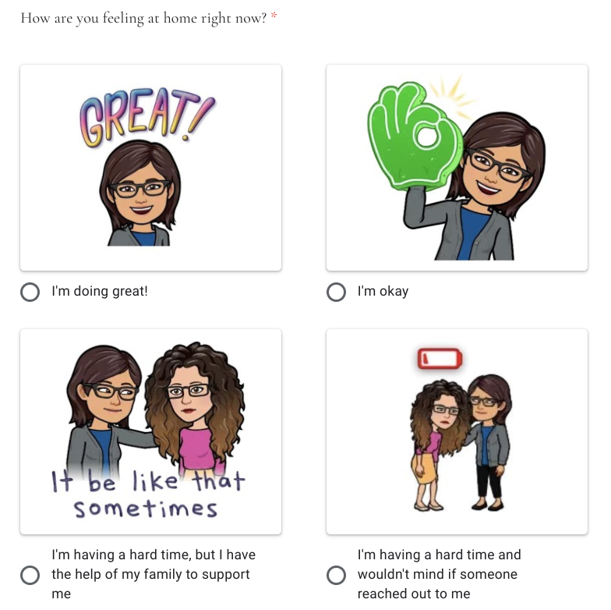
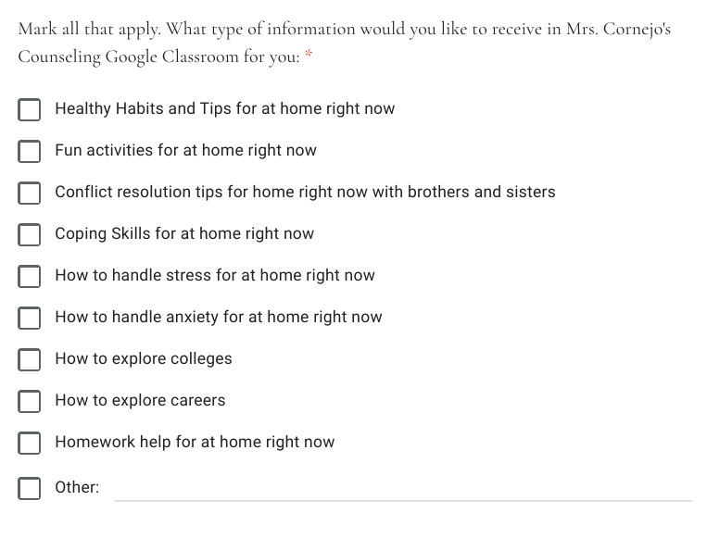
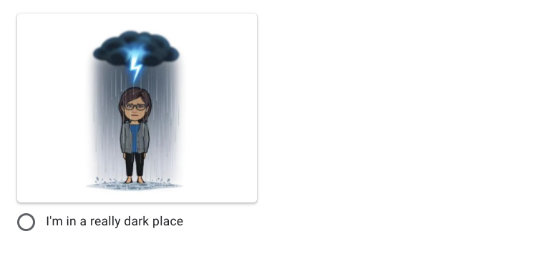
Plan & Collaborate
Sample Check-In Form

Slide 17
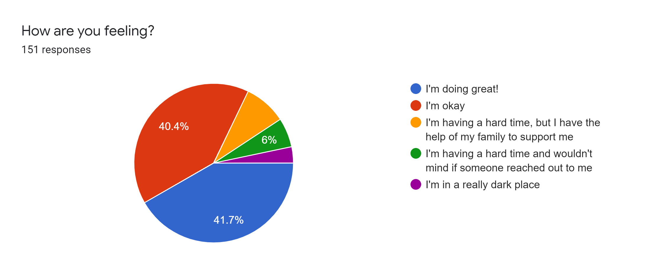
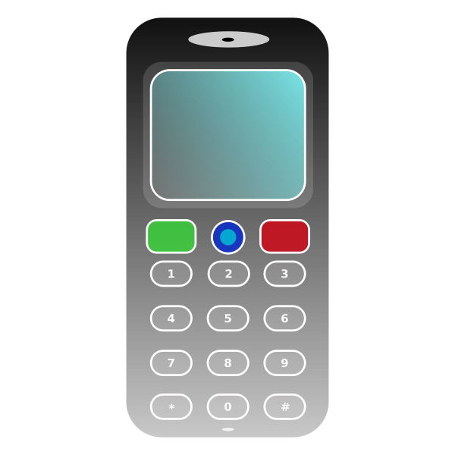
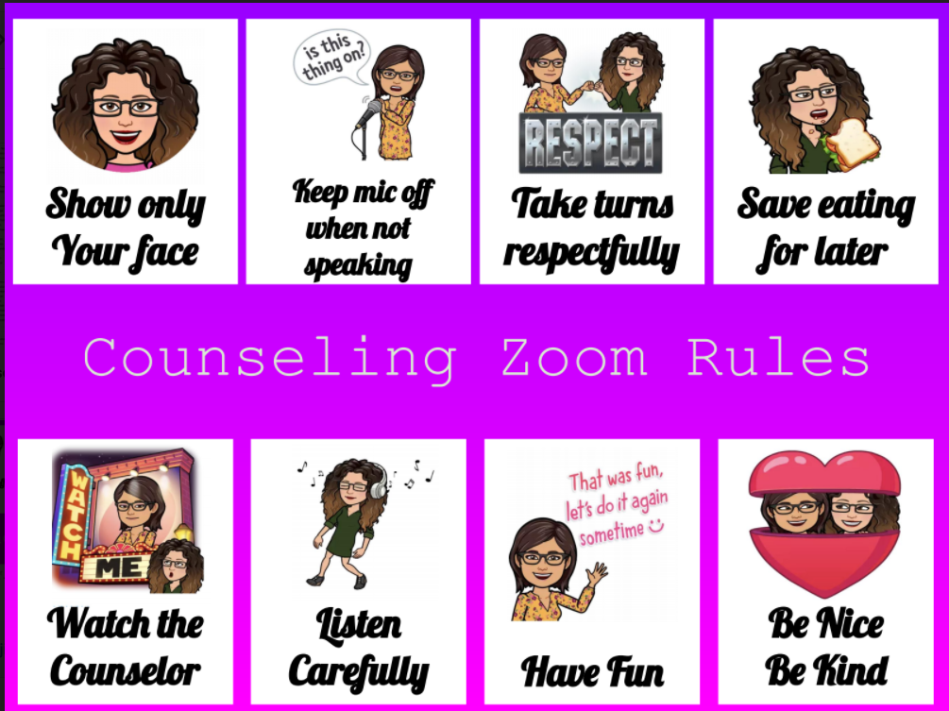
Purpose of the Questions = Action Steps

Slide 18
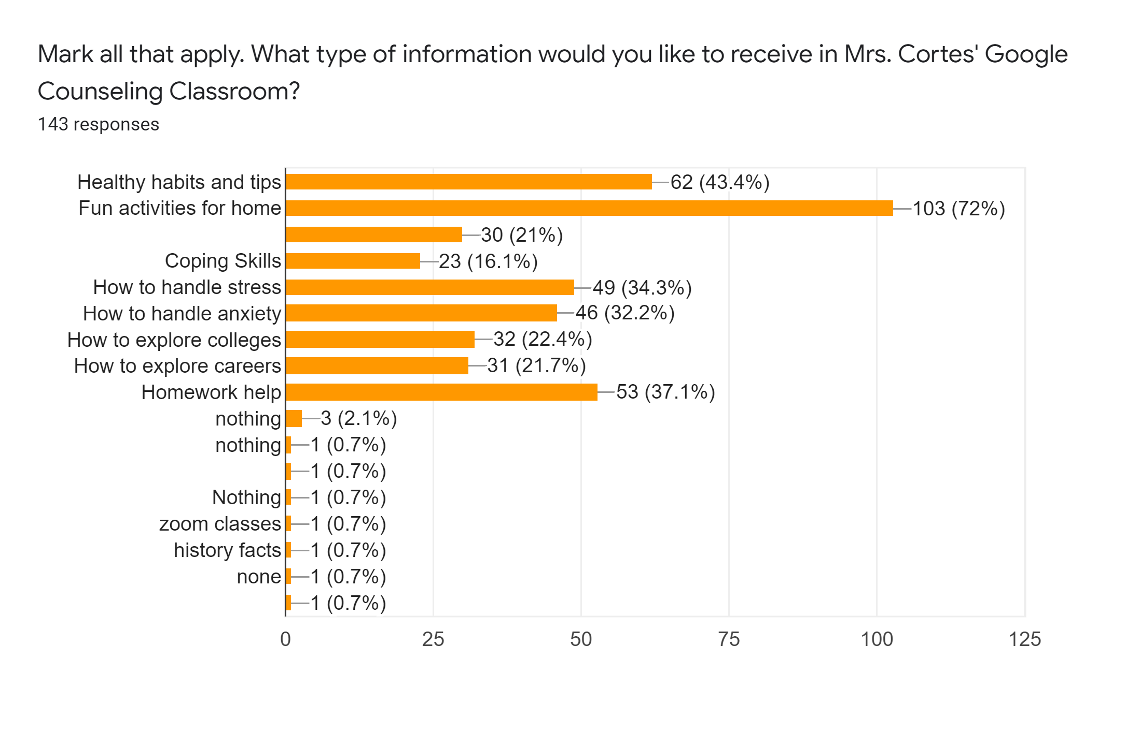
Purpose of the Questions = Action Steps
Do you know how to contact your teacher?

Slide 19
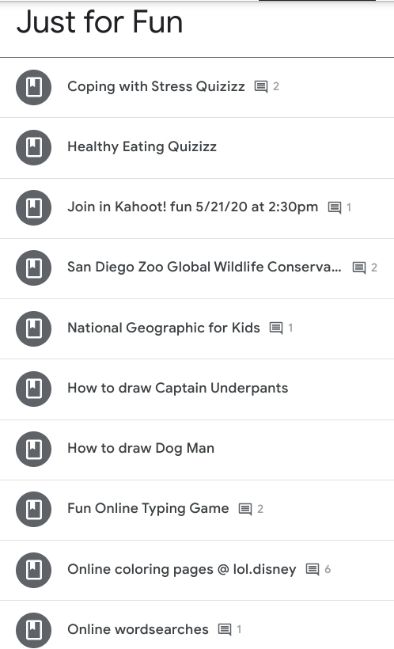
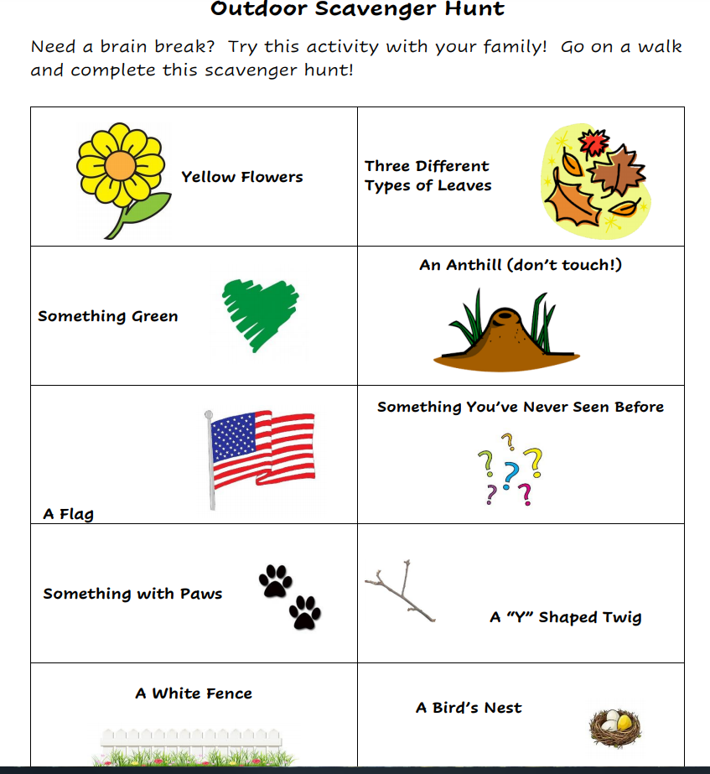
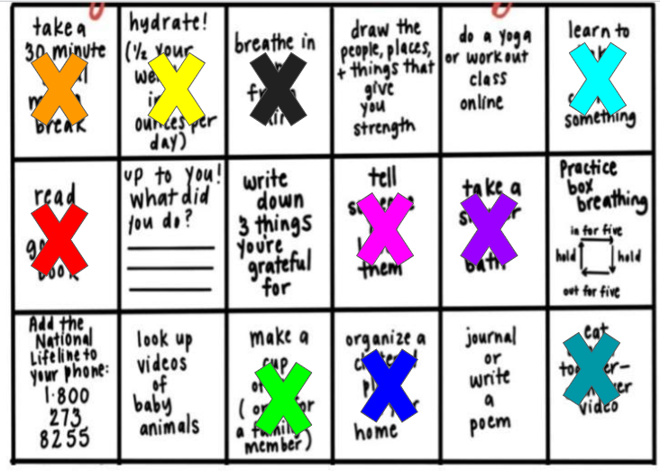
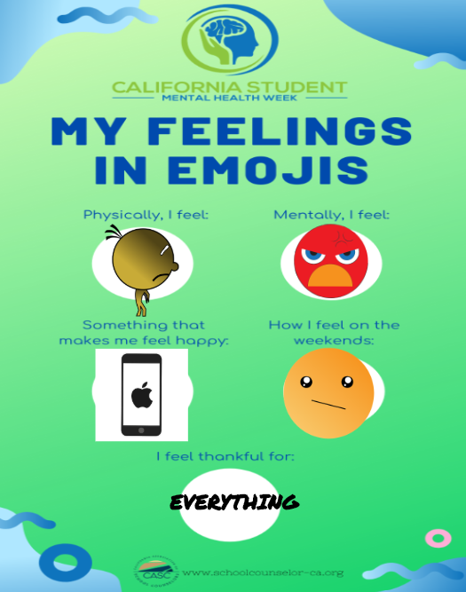

Slide 20
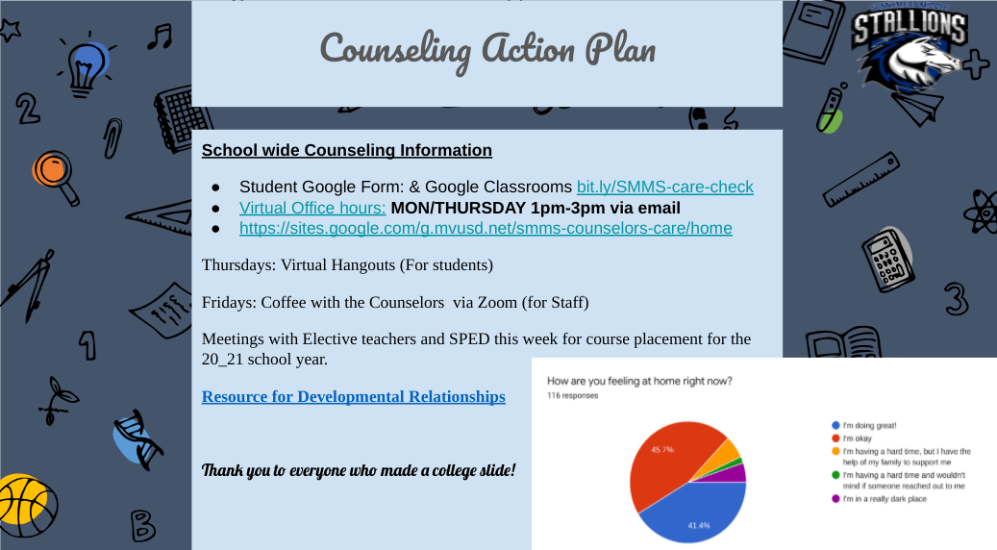
Share Data to Key Stakeholders
Staff meetings
Admin/Counseling meetings
Counseling Team meeting to discuss next steps/planning

Slide 21
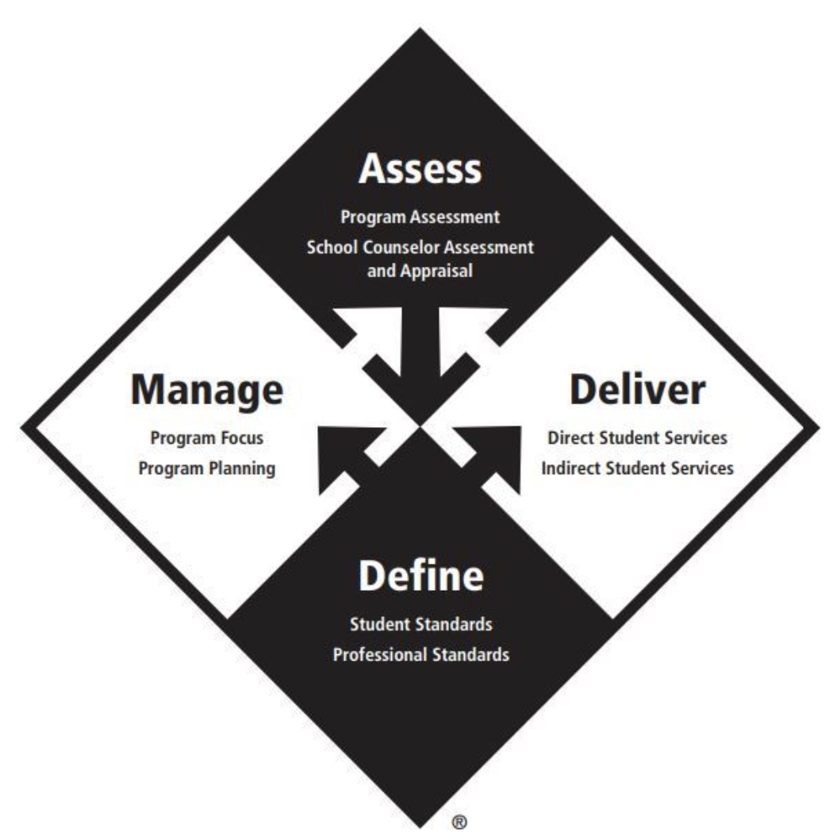
Using Data to Drive Your School Counseling Program
CATHERINE WALLACE
Career Technical Education Counselor
Corona-Norco Unified School District

Slide 22
Using Data and Needs to Drive Program
The results from the questions you created from your “Needs Assessment” need to drive your counseling program.
Use the results to create baseline data
Analyze the results to determine your greatest areas of need
Target Student Population (gender, ethnicity, grade level?)
By which domain?
Create goals for 2020-2021 school year with your baseline data
Who will you target?
How will you measure if you achieved your goal?
Participation, Assessment (Pre and Post), Student Performance (Grades, G.P.A, Engagement)
Use the ASCA National Model to organize your goal and action plan
COVID-19 has created a new set of challenges and needs for our students and families.

Slide 23
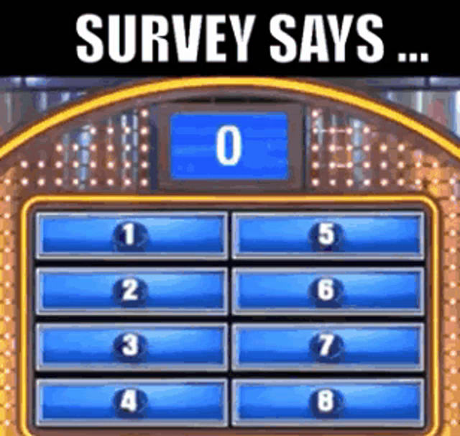
The Results

Slide 24
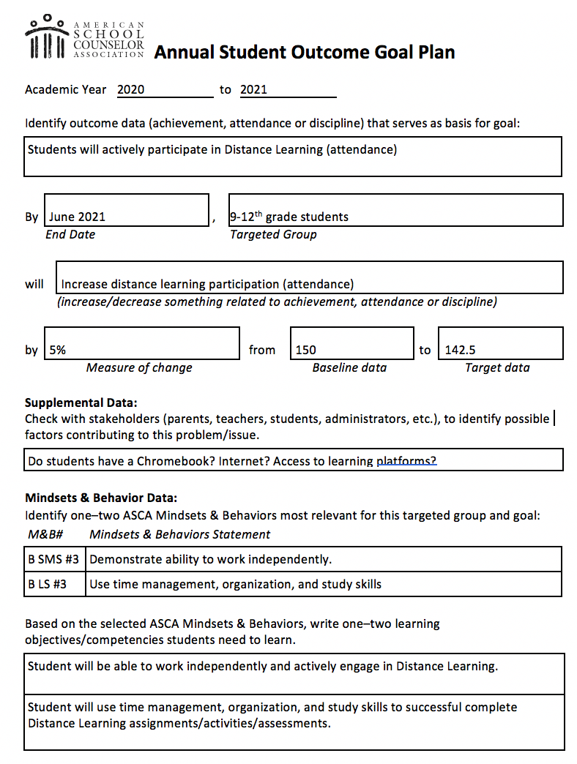
Annual Student Outcome Goal Plan
#1
Based on results of Needs Assessment
Academic Goal for 2020-2021
Increase student engagement in Distance Learning
Domain - Academic
Target students (9th -12th grade)
How will I assess?
Pre/Post Assessment
Track Participation (collaborate with teachers)
Grades

Slide 25
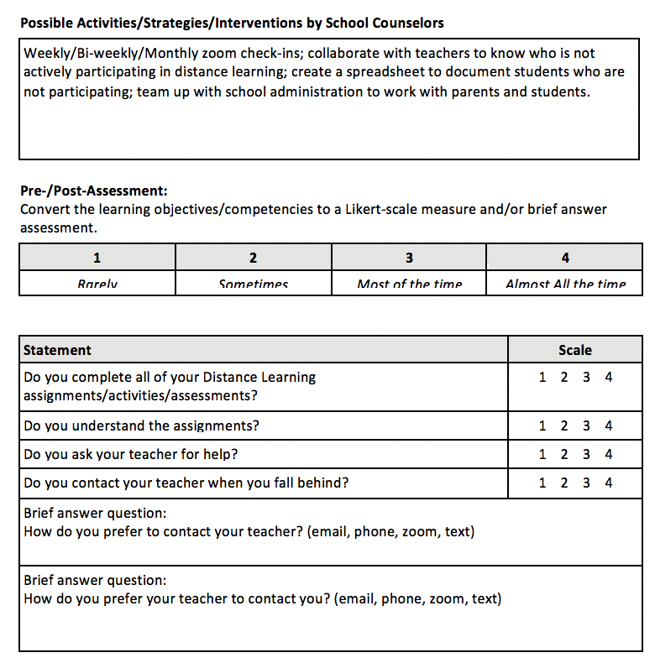
Annual
Student Outcome
Goal Plan

Slide 26
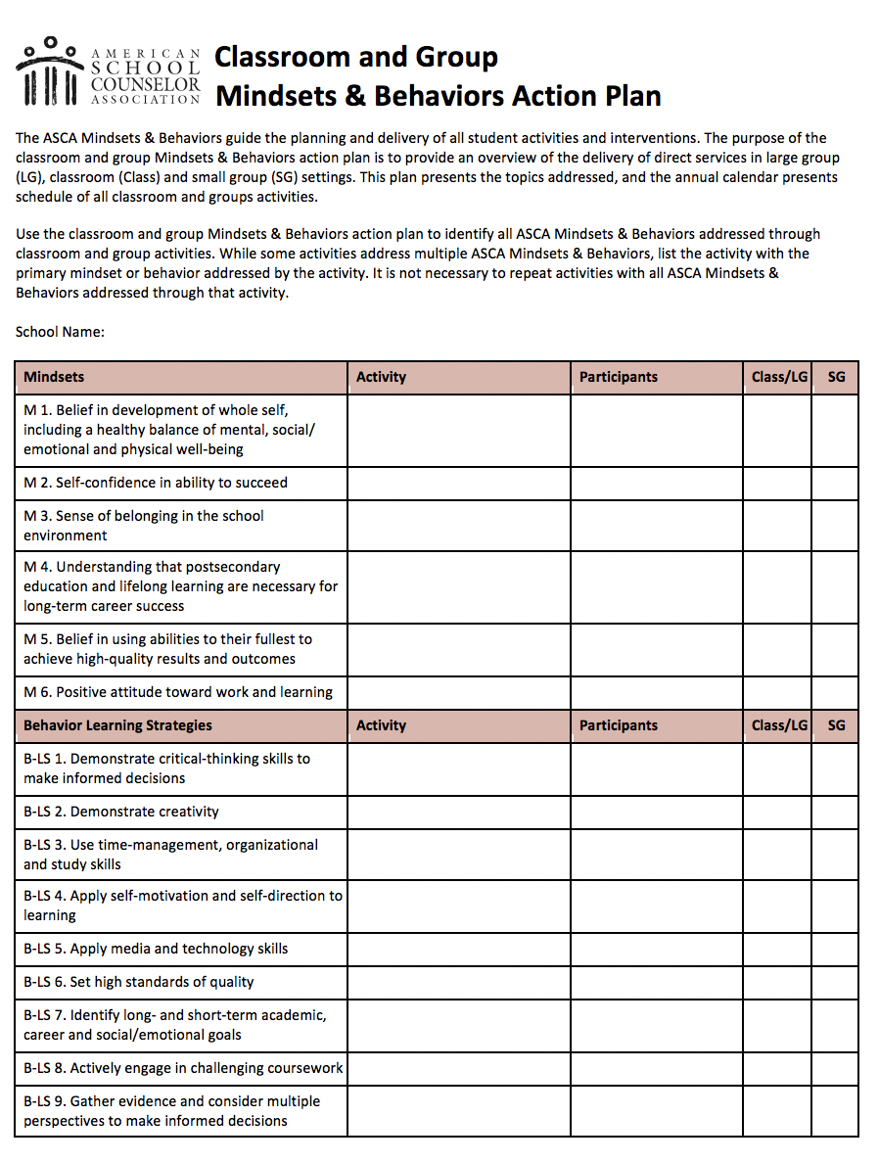
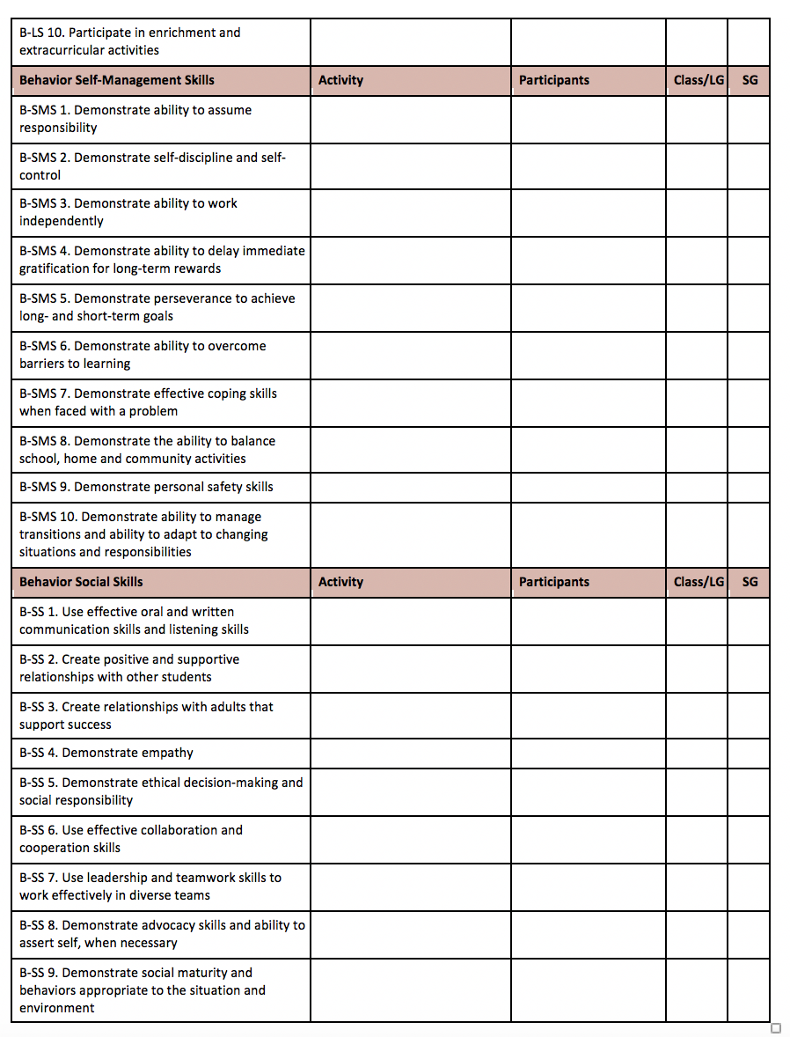
Aligning Your Goals to the ASCA National Model
#2
Pick 2 or 3

Slide 27
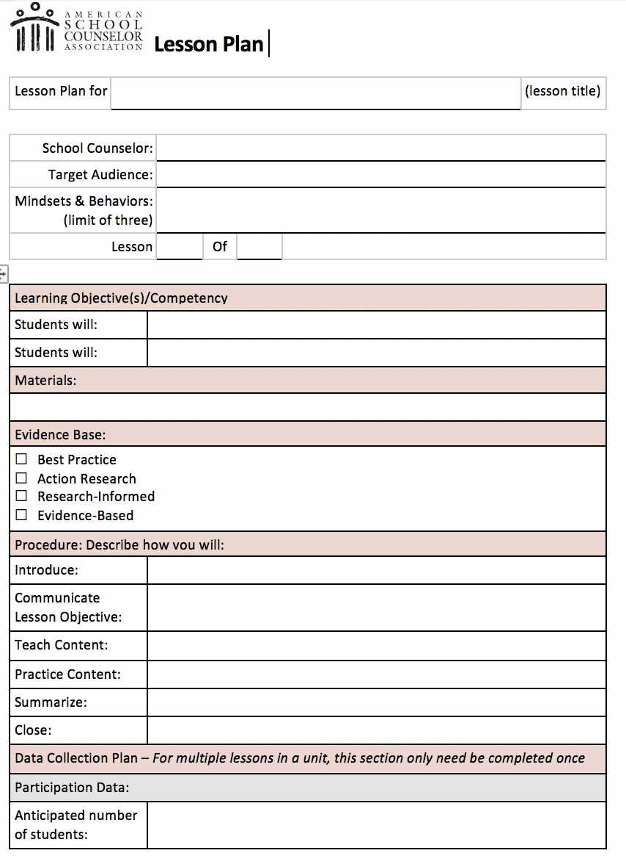
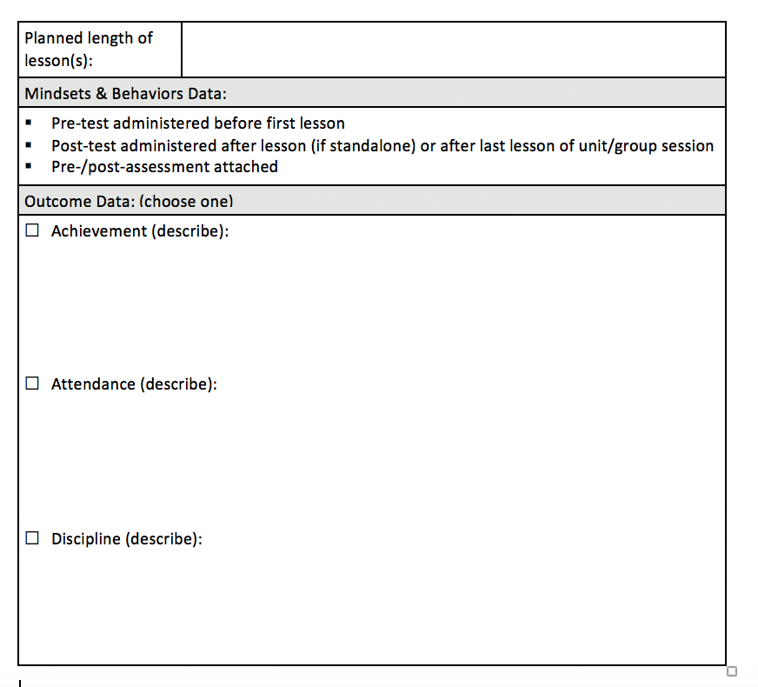
Aligning Your Goals to the ASCA National Model
#2

Slide 28
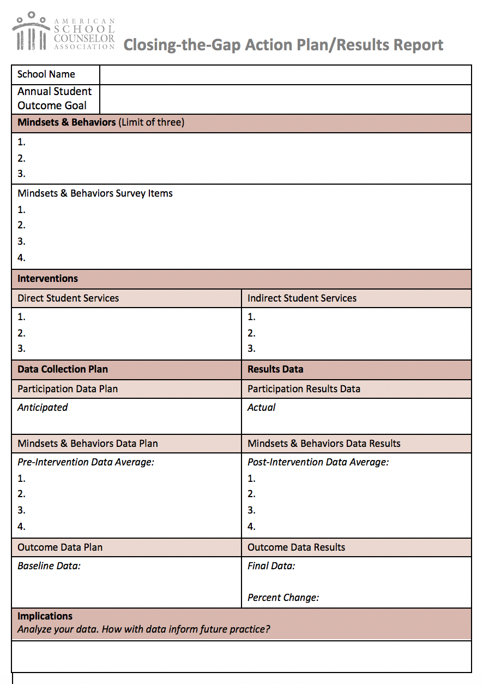
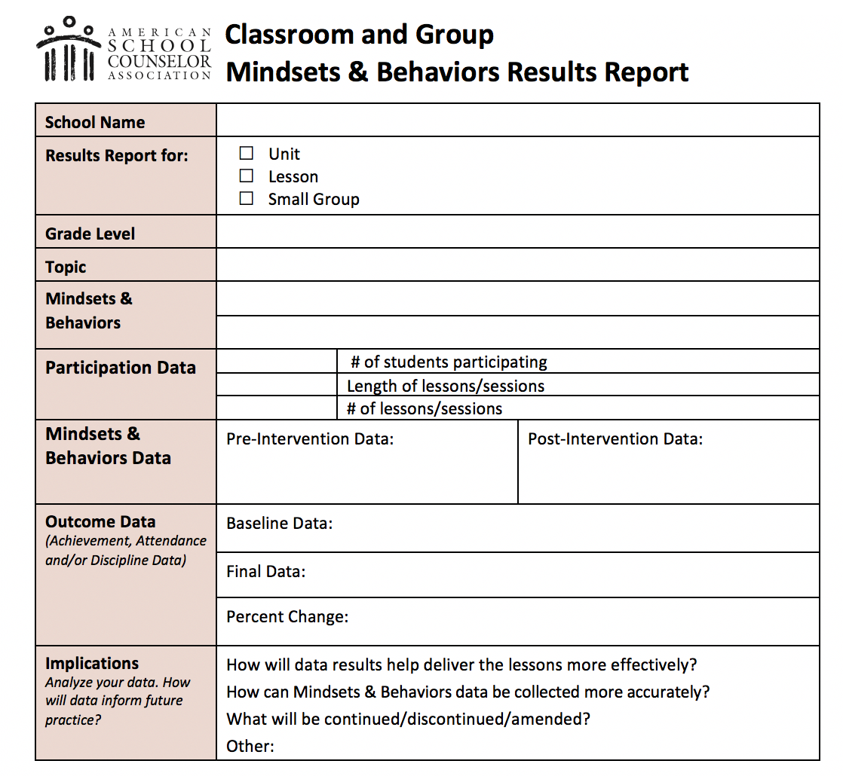
Aligning Your Goals to the ASCA National Model
#3
#4

Slide 29
Best Practice--
Adapting SMART Goals During COVID-19
Raymond Cree Middle School Counseling Team
Gustavo Ochoa and Marisol Guerrero

Slide 30
A Call to Action
Would your site level leadership, teachers, families, etc. advocate for your role and do they have data examples of why your position is essential?
Have you reviewed your communication and outreach plan for students, families and community members including replying to emails, counseling website, newsletters, etc.?
Can you demonstrate through outcome data and results your impact on various student groups? (ex: Students with disabilities, English Learners, etc.)
Have you modified and updated your school counseling program to meet the needs of our new student learning environment?
Have you analyzed your current data including student participation in distance learning to be proactive for the upcoming school year which could include distance or a hybrid model?
Are your prepared to provide more than student stories to advocate just how essential you are to the lives of students?

Slide 31
Where Do We Go From Here?
To access all of the webinars, resources and handouts, please visit www.rcec.us
Additional support?
We are here to help!
Catalina Cifuentes, Executive Director, CCR ccifuentes@rcoe.us
Dr. Pedro Caro, Coordinator, CCR pcaro@rcoe.us

Slide 32
Thank You!

