Slide 1
Everything CollegeBoard
Riverside County Office of Education
College and Career Readiness Unit
Notes:
Welcome - Catalina and Gil

Slide 2
Webinar Tips
•This session is being recorded so that others may listen at a later time and will be uploaded to the RCEC website.
•All participant mics have been muted and only panelists and facilitators have the ability to unmute anyone.
•Since all participants have been muted, please use the Q&A and chat features to enter your questions.
**Every effort has been made to ensure the security of this webinar from “zoombombers” but in the event that we experience that, we will resume as soon as the technical difficulties have been resolved.**

Slide 3
Agenda Overview
Understanding Test Optional - Office of the UC President Update
Overview of PSAT and RCOE PSAT Subsidy
Need to Know Information - College Board SAT
Spring 2020 AP Examination Reports - Performance and Participation
AP Examination Registration for 2021
AP Readiness Program Update
Notes:
Gil
https://globalmeet.webcasts.com/starthere.jsp?ei=1331023&tp_key=3c8f0ffa3b College Board Counselor Workshop 2020 - California

Slide 4
Notes:
Gil

Slide 6
National Student Clearinghouse Data - Spring 2020
2019 Riverside County High School Graduates - 30,320 = 90.1% Graduation Rate
 | Number | Percent
Enrolled in College | 19,421 | 64.1%
Enrolled in 2-year | 11,670 | 38.5%
Enrolled in 4-year | 7,751 | 25.6%
Enrolled in Private | 1,670 | 5.5%
Enrolled In State | 17,706 | 58.4%
Enrolled Out of State | 1,715 | 5.7%

Slide 7
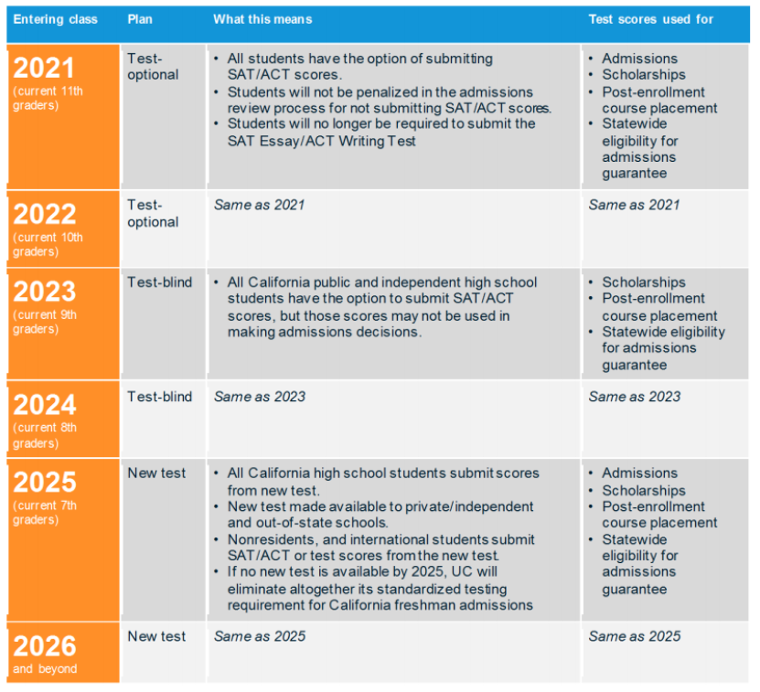
University of California: Timeline is Now Pending
As of September 1, 2020 the original plan above is on hold pending the recent Alameda County court decision. UC system said it “respectfully disagrees” with Tuesday’s ruling and is “evaluating whether further legal actions are called for.” UC added that each campus “carefully assessed” whether to use SAT and ACT scores for fall 2021 and fall 2022.
Notes:
https://edsource.org/2020/university-of-california-must-stop-all-use-of-sat-and-act-in-admissions-judge-orders/639499

Slide 8
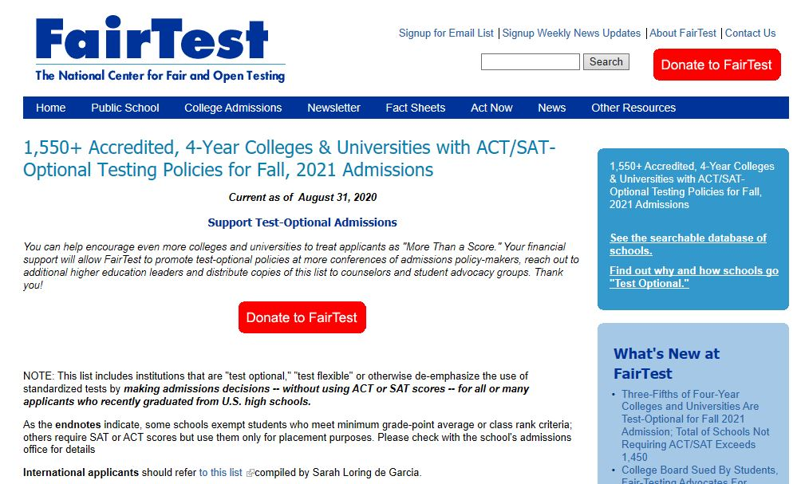
http://fairtest.org/university/optional
Notes:
Catalina -
Student looking beyond California and/or Privates
Scholarship
http://fairtest.org/university/optional

Slide 9
Riverside County PSAT Project Intent
RCOE PSAT Subsidy to offset cost
Increase student access to the PSAT 10 and PSAT 8/9
Use the PSAT AP Potential Report to increase student access and success in courses of rigor
Notes:
Gil - The RCOE PSAT subsidy program continues to provide a subsidy to school districts to offset the cost of administering the PSAT 10 for High Schools and the PSAT 8/9 for 8th grade students in K-8 school districts in RIverside County. The subsidy is approximately $4 - $6 per student depending on each district’s unduplicated student numbers.
There are many benefits to administering the PSAT to students.
Increase student and parent awareness of the examination
Offer a practice examination for the college entrance examination, SAT
Generate an AP Potential list for AP course recruitment
Provide broad program evaluation data on feeder middle school academic rigor and student performance

Slide 10
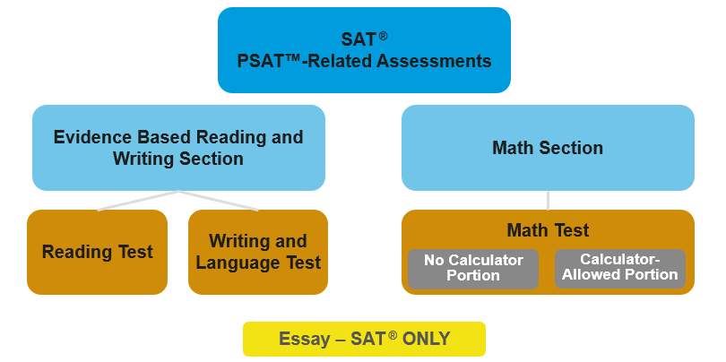
SAT and PSAT Format
College Board SAT-K12-Teacher-Training-Module-1 Key-Features
Notes:
Ask: What do you know about the SAT? This is an opportunity to learn about participants’ prior knowledge.
The assessments in the SAT Suite have two sections: The Evidence-Based Reading and Writing section, and the Math section.
The Evidence-Based Reading and Writing section comprises two tests: the Reading Test and the Writing and Language Test.
The Math section has two portions: a portion in which students are allowed to use a calculator and a portion in which they are not allowed to use a calculator.
The SAT Essay is optional, only available on the SAT (not on the PSAT/NMSQT, PSAT 10, or PSAT 8/9) and earns scores separate from the 1600 scale.
The length of the SAT is three hours, with an added 50 minutes for the essay.
PSAT-Related Assessments have the same format as the SAT. The Essay is only offered on the SAT

Slide 11
SAT College and Career Readiness Benchmarks
75% likelihood of earning at least a C in a first-semester, credit-bearing course in a related subject.
Grade-level benchmarks are based on expected student growth year after year.
College Board SAT-K12-Teacher-Training-Module-1 Key-Features
Notes:
Depending on what grade a student is in when they take the PSAT test the College Board has established benchmark scores. The scores listed here represent the estimated score by grade level that a student needs to have a 75% confidence level that he/she is on track to earn at least a “C” grade in the first-semester of a credit-bearing subject related course.

Slide 12
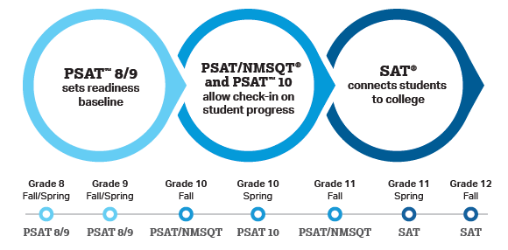
SAT Suite of Assessments - Cross-Reference Guide
College Board SAT-K12-Teacher-Training-Module-1 Key-Features
Notes:
Gil -
At this time no Riverside school districts are signed up for any Fall testing during the school day. The PSAT subsidy will be open all year. We will work together to aim for the Grade 10 Spring Testing. Is there any discussion needed on Grade 11 Fall PSAT at this time? Grade 11 PSAT/NMSQT is not eligible for the RCOE subsidy.
Kenyatta - additional information or comments

Slide 13
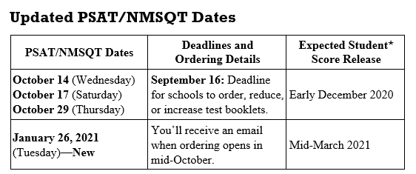
Notes:
Important dates. Note the new January date recently added.

Slide 14
Important Reminders
Students may only take the PSAT/NMSQT once.
Test booklets sent for one test can’t be used for a different test date.
School can choose from any of the October and January administrations to test their students.
There is no minimum for the number of students who can test on any of the administration dates.
Flexible Order Information
Notes:
11th grade students may only take the PSAT/NMSQT once.

Slide 15
College Board Updates
Assessment Update: No unused test fees
COVID Updates
https://pages.collegeboard.org/collegeboard-covid-19-updates
SAT Test Center Updates:
Find a Test Center: https://collegereadiness.collegeboard.org/sat/register/find-test-centers
Test Center Closures: https://collegereadiness.collegeboard.org/sat/register/test-center-closings
Kenyatta Price Director
State & District Partnerships
The College Board | Western Regional Office
kprice@collegeboard.org
Notes:
PSAT - the why behind the test and how to utilize results
Instructional planning reports
Dates - Fall
Dates - Spring administration
College Board professional development behind the test results

Slide 16
SAT (Saturday) Dates and Deadlines
SAT Test Date | Regular Registration Deadline | Late Registration Deadline
October 3, 2020 | September 4, 2020 | September 22, 2020
November 7, 2020 | October 7, 2020 | October 27, 2020
December 5, 2020 | November 5, 2020 | November 24, 2020

Slide 17
School Day SAT
SAT Test Dates | Order Deadlines
March 3, 2021 | January 8, 2021
March 24, 2021 | January 29, 2021
April 13, 2021 | February 12, 2021
April 27, 2021 | February 26, 2021

Slide 18
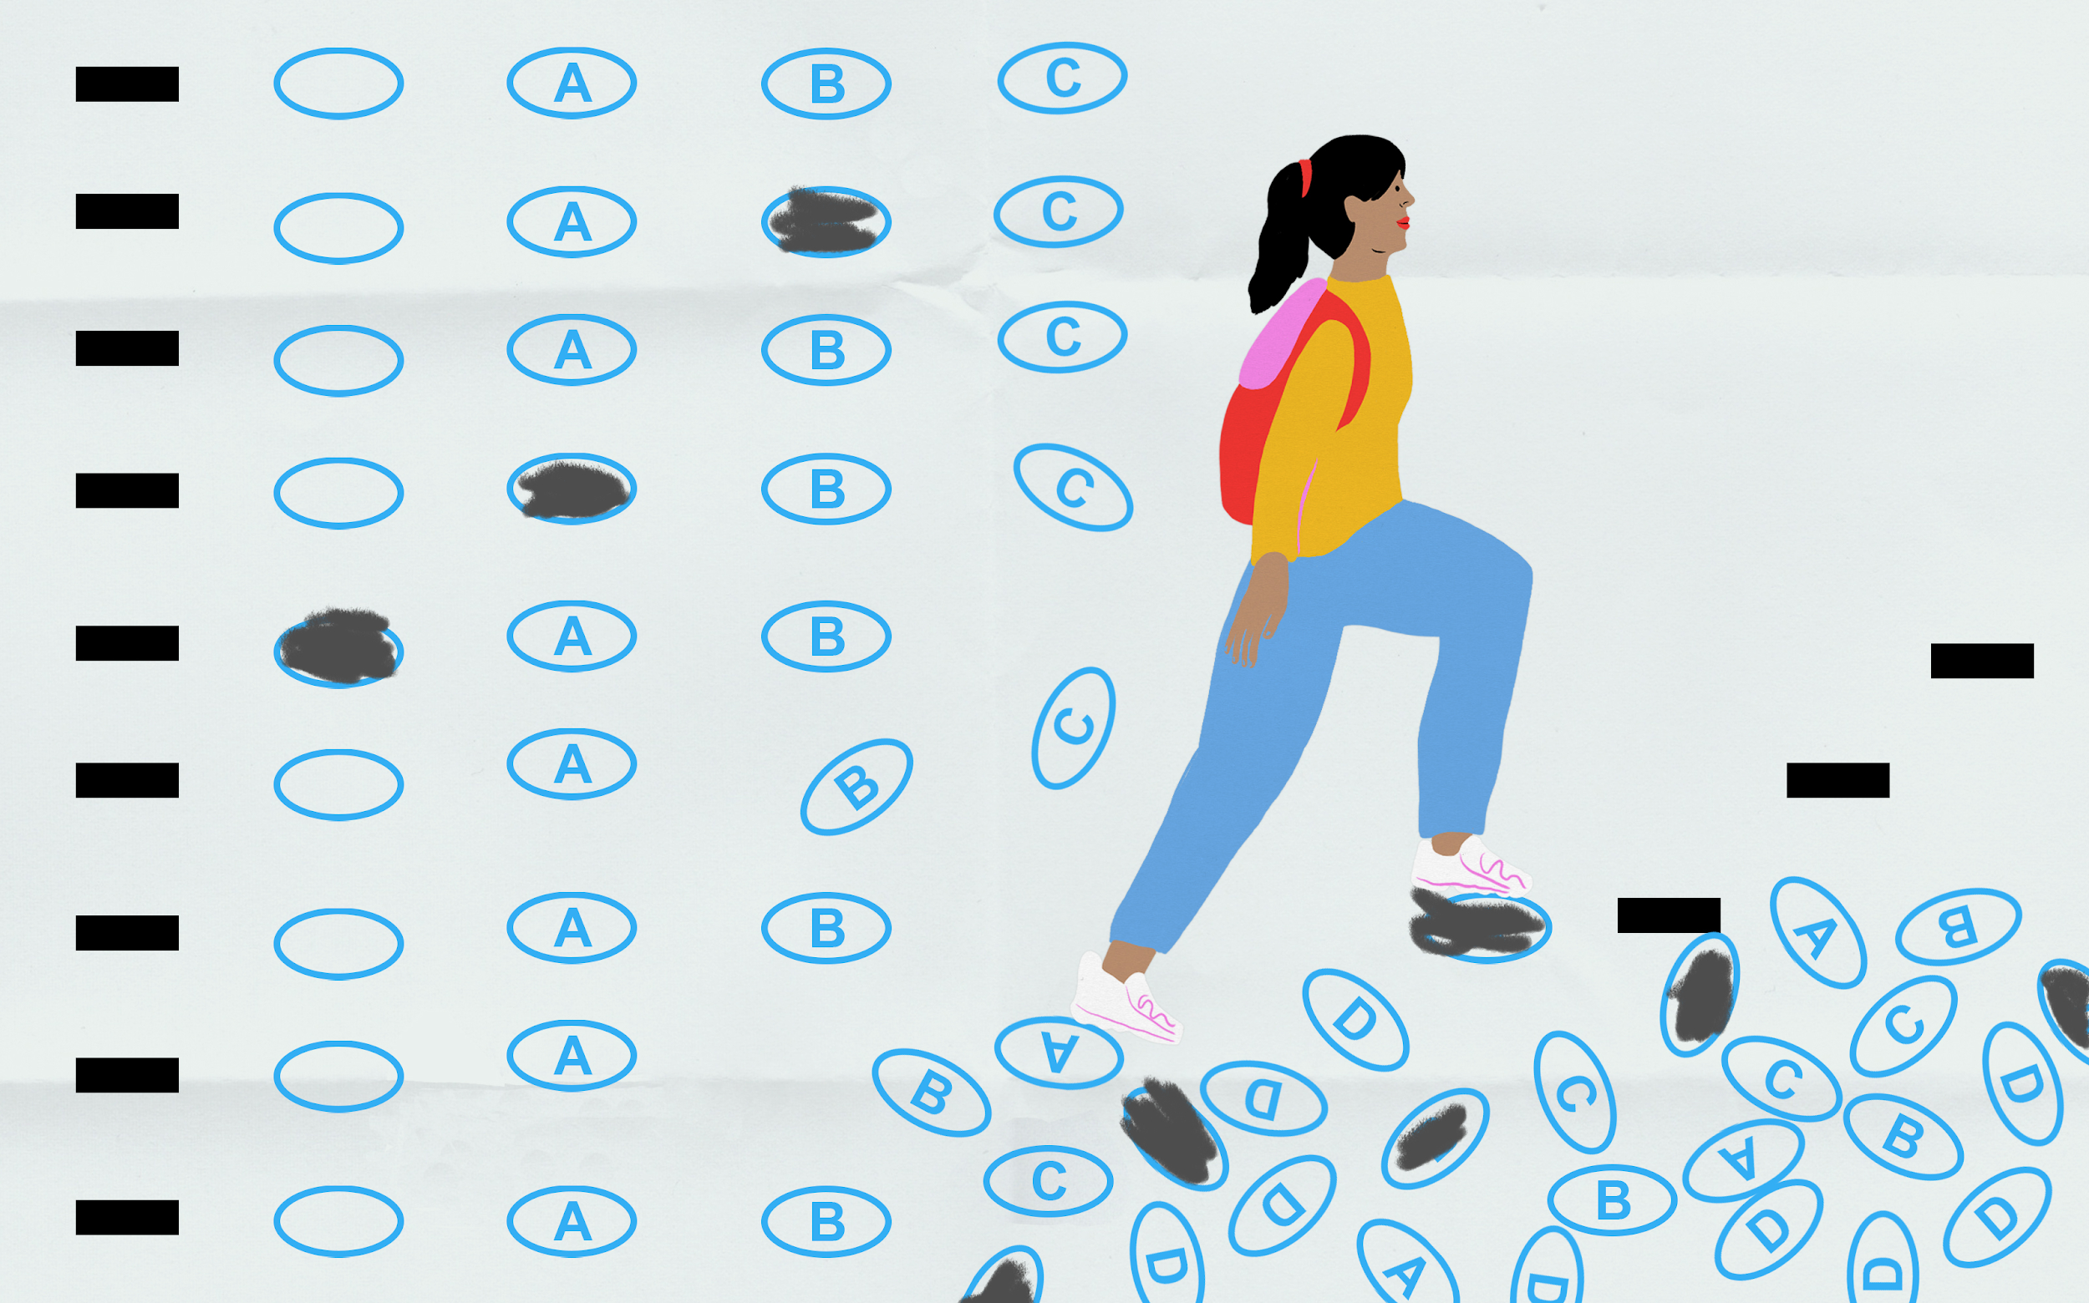
School Day SAT
SAT School Day Provides schools and districts a way to offer the SAT
School Day administration helps eliminate access issues and builds a college going culture on campus
SAT and SAT with Essay are available
Students may qualify for fee reduction

Slide 19
Advanced Placement Exams - Spring 2020
Results are in and RCOE can assist with downloading performance reports.
RCOE can assist with performance analysis and staff presentations.
Instructional Planning Reports are not available this year.
Professional Development Idea - Calibrate 2020 exams across schools and districts. Let us know if you would be interested.
Notes:
Gil - Shifting gears - let’s discuss AP testing. As you know, RCOE has a data sharing agreement with each district in Riverside County. THis gives us the ability to support you with data questions, access, and reports. The RCOE College and Career Readiness Unit is also available to host informational meetings and staff trainings related to AP Courses. Contact Gil Compton for follow up.

Slide 20
Spring 2020 AP Exam Reports
Roster and Student Reports
Teachers, school and district administrators have access to SUBJECT SCORE ROSTER reports.
Additionally, school and district administrators have access to:
Student Datafile
Organization Score Roster
Student Score Report
Scholar Roster
RCOE can provide College Board Roster and Student Reports for you upon request.

Slide 21
Spring 2020 AP Reports (cont.)
Summary Reports
Current Year Score Summary
Scholar Summary
Fiver Year Score Summary
District Summary by School
Summary by Student Demographics (Grade level, Race Ethnicity, Fee Reduction, Gender)
Equity And Excellence
Need training? RCOE CCR can provide school and district level support to help you access and analyze your AP Scores
Notes:
Note on the Equity and Excellence Report - This report provides you with a means to assess both the equity and excellence of your school’s AP program. Specifically, it shows the proportion of your school’s entire senior class who scored a 3 or higher on an AP Exam at any point during high school. Additionally, you can see what percentage of your school’s entire tenth, eleventh, and twelfth grade classes took and scored a 3 or higher on at least one AP Exam in May 2020.
In this calculation, students who score a 3 or higher on an AP Exam are counted only once, regardless of how many AP Exams they took and were successful in. There is no way to inflate this percentage by restricting access to AP; students who earn 1s or 2s on AP Exams neither increase nor reduce the percentage. In addition, by showing the proportion of the overall population — not just the AP classroom — educators are better able to determine the extent to which their overall population is receiving access to advanced academics in high school.

Slide 22
Riverside County 2020 AP Spring Testing Results
by the Numbers
31,028
Students
48,669
Exams
39,735
Exams Taken
8,934
Missed Exams

Slide 23
2020 AP Exam Spring Participation for Riverside County
Range of Participation by School Site
97.06%
81.64%
18.36%
Highest Participation
Percent of Registered Students Participating in the Spring 2020 AP Exams.
Percent of Registered Students who did not test.
23.83%
Lowest Participation

Slide 24
2021 AP Exam Registration
 | Description | Cost/exam
Fall Registration | Exam ordered by November 13, 2020 | $95
Late Registration | Ordered Nov. 14 2020 - March 13, 2021 | $135 $95 + $40 late fee
Unused/canceled exam | No fees for unused exams or canceled exams ordered by November 13, 2020
There is no risk having every AP student register for the exam before November 13, 2020 because, given this year’s unusual circumstances, College Board will waive the $40 per exam cancellation or unused exam fee for any student who decides not to test.
Notes:
Every AP student should register for the exam before November 13 because there is no risk to do
so: given this year’s unusual circumstances, we’ll waive the $40 per exam cancellation or unused
exam fee for any student who decides not to test.
•
Students who don’t register by November 13 and then decide they want to test will incur the usual
$40 late registration

Slide 25
2020 AP Readiness Program Report
12,166 | Number of students from AP Readiness Program participating schools who took an Exam in an AP Readiness subject area
4,301 | Number of students passing the exam
35.4% | Percent of students earning a passing score
64.7% | Percent of students not earning a passing score
Notes:
http://www.rcec.us/race-to-rigor/ to watch the AP Readiness onboarding video and download the PPT uses
https://apreadiness.ucr.edu/ap-readiness-registration Link for students and teachers to register

Slide 26
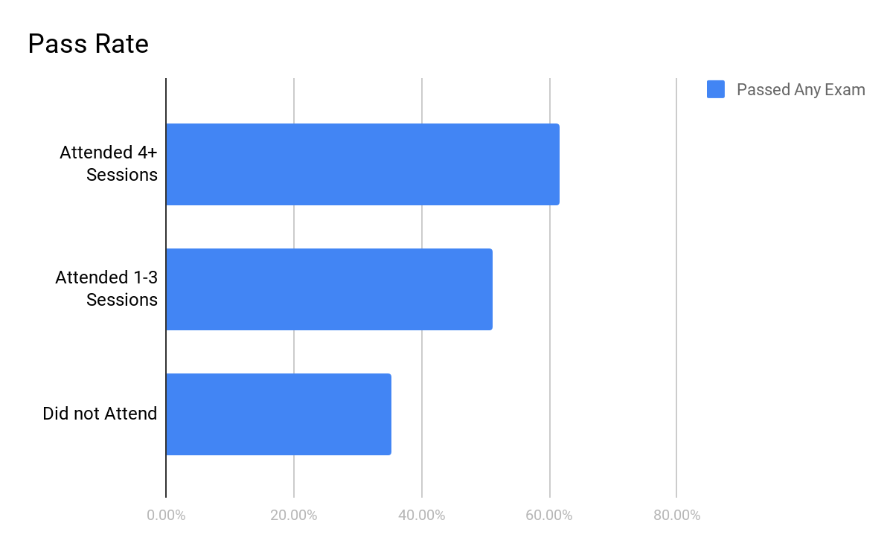
AP Readiness Program
61.7%
51.2%
35.3%

Slide 27
2020 AP Readiness Program Report
2,946 | Number of student who participated in at least one AP Readiness session
1838 | Number of students who attended 1 or more sessions and took the AP exam
53.9% | Percent of students who attended 1 or more sessions and earned a passing score on the AP Exam
61% | Percent of students who attended 3 or more sessions and earned a passing score on the AP Exam
65.5% | Percent of students who attended 6 or more sessions and earned a passing score on the AP Exam

Slide 28
2020
AP Readiness Program Report
Number of Sessions | Student Numbers | Passing Rate
1 | 739 | 49.4%
2 | 392 | 49.5%
3 | 237 | 59.5%
4 | 164 | 61.6%
5 | 135 | 57.0%
6 | 91 | 67.0%
7 | 51 | 66.7%
8 | 29 | 58.6%
Notes:
171 students attended the APR Program for six or more sessions. We are setting a goal for this number to increase to 300 students this year.
Attendance rate for the entire program was 29% last year. We are setting a goal to hit 40% attendance rate this year. Imagine what this will do to our AP Examination data!

Slide 29
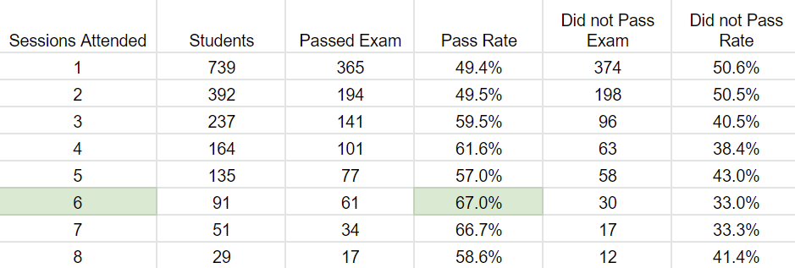
AP Readiness Program - By Number of Sessions Attended
Notes:
171 students attended the APR Program for six or more sessions. We are setting a goal for this number to increase to 300 students this year.
Attendance rate for the entire program was 29% last year. We are setting a goal to hit 40% attendance rate this year. Imagine what this will do to our AP Examination data!

Slide 30
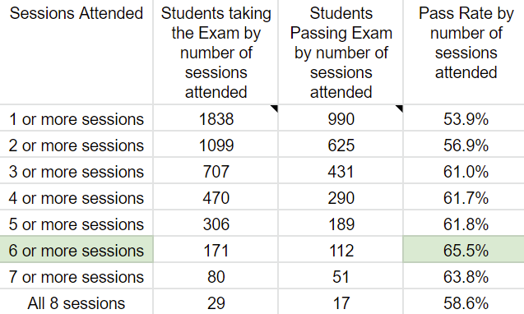
AP Readiness Program - Roll up Numbers
Notes:
Just another way to look at the data.
GIl

Slide 31
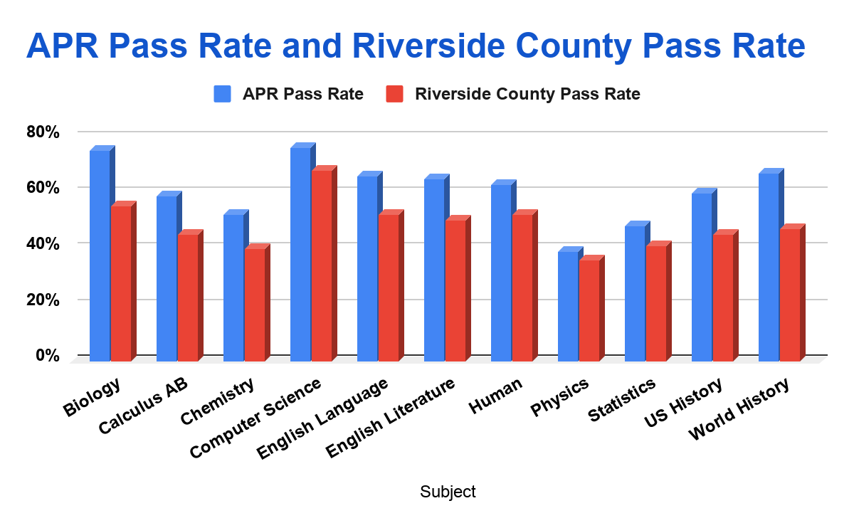
Students Attending 3+ sessions by Subject
Notes:
We are working on school specific data reports. Contact Gil Compton for details. We can provide you with the list of students who attended, which subject they attended, if they took the AP Exam, and their score.

Slide 32
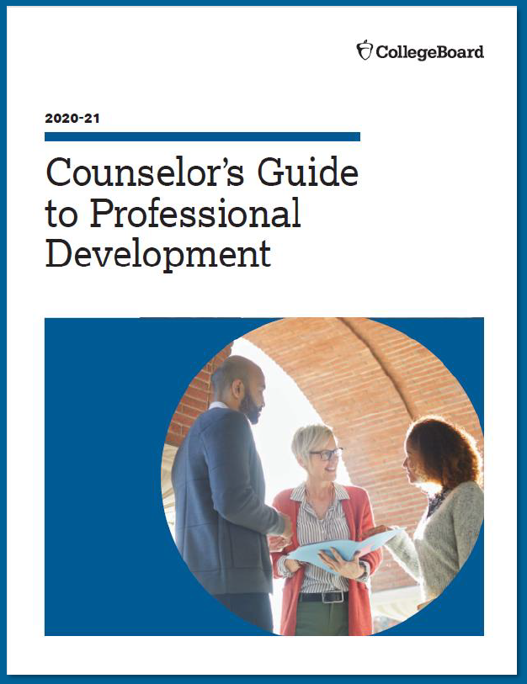
2020-21 Counselor Professional Development
Available for download at Collegeboard.org/counselors in mid-August and at Counselor Workshops!
College Board Counselor Workshops
Fall into PSAT series
Spring into the SAT series
Counselor Webinar series
E-learning modules

Slide 33
Counselor Recognition Program
Important Announcement
Highlighting the work of innovative, results-oriented middle and high school counselors
Visit Collegeboard.org/counselors to nominate a school counselor by October 23, 2020

Slide 34
Financial Aid Information and Resources
1
2
3
4
Big Future
Federal Student Aid sites
National Association of Student Financial Aid
National College Attainment Network
https://bigfuture.collegeboard.org/
https://studentaid.gov or https://fafsa.gov
https://wwwnasfaa.org/
https://www.ncan.org/

Slide 35
The Intersection of Academic and Finances
Looking at College “match”
 | Academics | Finances
Reach School | Test scores lower than average admit scores | Beyond family resources Reduced spending? Working too much? Significant borrowing?
Match School | Solid test scores (GPA and course lists when applying for test optional) | Meets family resources, some work, some borrowing.
Safety School | Test scores and GPA higher than average scores | Below family resources Save for Master’s Degree

Slide 36
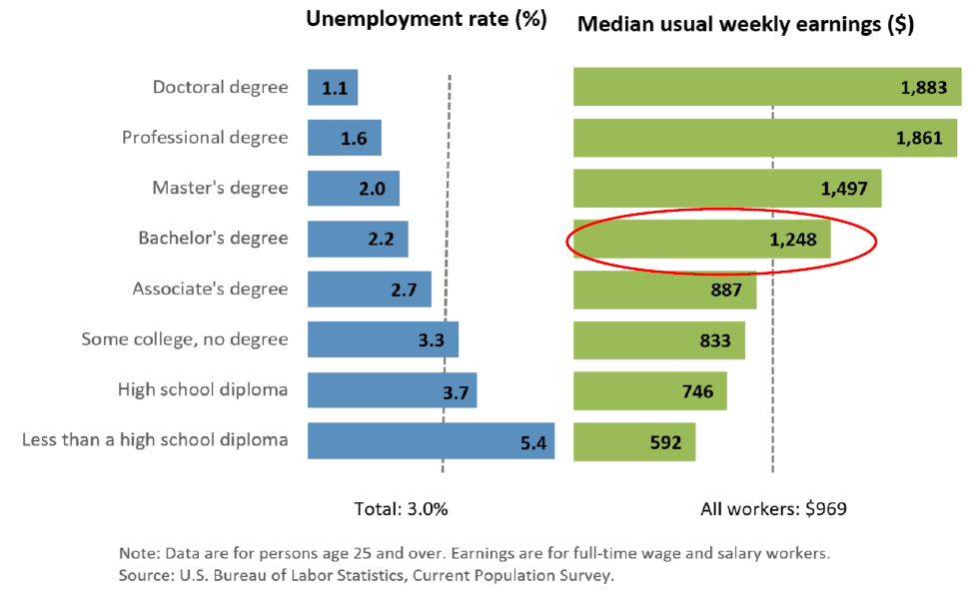
2019 Unemployment rates and earnings by education level

Slide 37
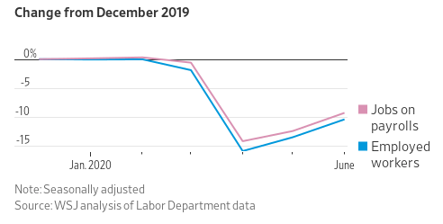
What Jobs Were Hit Hardest by Coronavirus - and which have bounced back?
In the first half of 2020, we saw a decade’s worth of employment gains wiped out in two months, and then about a third of the 21 million lost jobs recovered.

Slide 38
RCOE Grading Practices Forum 2020
Building Interest and Investment in Equitable Grading Practices
September 29th and October 13th / 3:30 pm - 5:30 pm
2 Sessions / 2 Hours per session
Cost $49
Introduction to equitable grading and example practices
Evidence of the impact of equitable grading
Grading during remote learning
Notes:
Structure: Two 2-hour interactive workshops (Fall and Winter?)--unlimited # of participants
Goals:
Build interest and investment in equitable grading so that schools can pursue this work (via book/article study, PLC's)
Generate support among teachers to join county-supported cohorts in 2021-22
Content:
Overview of history of the history of traditional grading
The urgency to make grading more equitable
Introduction to equitable grading and example practices
Evidence of the impact of equitable grading
Grading during remote learning

Slide 39
Thank You!
For more information or questions, please contact:
Catalina Cifuentes, Executive Director, CCR
ccifuentes@rcoe.us
Gil Compton, Director I, CCR
gcompton@rcoe.us

