Slide 1
Federal Updates & The FAFSA
© 2017 CASFAA
Notes:
Welcome to the High School Counselors Workshop, sponsored by the California Community Colleges Student Financial Aid Administrators Association (CCCSFAAA), the California Association of Student Financial Aid Administrators (CASFAA), ECMC and the California Student Aid Commission (CSAC).
Today, we’re going to go through a number of updates to the financial aid process, most of them from the federal government, the FAFSA process, and special situations you probably have all heard from your most at-risk students. There aren’t many changes to the FAFSA, so we will spend more time discussing these special circumstances that need that extra attention.
We will have time at the end of the presentation for any questions, so please try to hold questions until then.

Slide 2
Last Minute Updates
Slides with updates and new slides not found in the paper workbook will have
in the bottom/right corner, so take a photo to capture the information.
© 2017 CASFAA
Notes:
As is always the case, there are some last minute updates received AFTER we sent this presentation for printing in the High School Counselors Workshop workbook. So, when you see this camera icon in the bottom right corner of a slide, you should take a picture of the slide, as this is a slide that is not in the printed workbook or a slide with updated information.
After all of the workshops have ended, CSAC and CASFAA will post the final version of this PowerPoint presentation, which include ALL slides, notes, and all updates.

Slide 3
What’s New for 2018–2019
Early FAFSA Launch – 2nd year
2018–2019 FAFSA available starting on October 1, 2017, at fafsa.gov
Change to October 1 launch is permanent
Earlier Income Information now Required
2016 tax & income information required
IRS Data Retrieval Tool available upon launch of FAFSA (October 1)
© 2017 CASFAA
Notes:
The 2018–2019 FAFSA cycle, like the 2017-2018 FAFSA cycle, will begin earlier than previous FAFSA application cycles. Beginning October 1, 2017, your students will be able to fill out their FAFSAs for the 2018–2019 school year. As recently as the 2016-2017 cycle, they had to wait until January 1.
The earlier submission date is a permanent change, enabling students to complete and submit a FAFSA as early as October 1 every year.
With the adjustment to the timetable for FAFSA availability, there is also a change in the income and tax reporting on the FAFSA. For the 2018–2019 FAFSA, students and parents will report income and tax data from 2016.
One benefit of this change is that applicants will no longer need to estimate tax information—and many of them will be able to retrieve their information directly from the IRS using the IRS Data Retrieval Tool, right from the first day the FAFSA is available. We’ll talk about other benefits in a moment.

Slide 4
Reasons for the Changes
Alignment
Many admissions application deadlines occur in the fall
FAFSA completed at same time = less confusion
Certainty
No need to estimate income and tax info
IRS Data Retrieval Tool available when FAFSA launches
Earlier receipt of Expected Family Contribution (EFC)
Less Time Pressure
More time before (most) state and school deadlines
More time to compare schools and award letters before the May 1 National Candidate’s Reply Date
© 2017 CASFAA
Notes:
Recent research and the Department of Education’s own data suggest that implementing an earlier start date and using earlier income information will benefit students.
Reason #1: Alignment
This is a benefit of the earlier launch date.
For some students, the traditional FAFSA application cycle is not aligned with college admissions application deadlines, which typically occur in the fall prior to the FAFSA launch. The new financial aid application process better aligns with the college admission process for those students.
Reason #2: Certainty
This is a benefit of the FAFSA asking for Prior-Prior Year income and tax information.
Many deadlines for state aid, including California, are as early as March. When the FAFSA asked for information about tax forms that weren’t due until April 15, applicants had to estimate income and/or taxes paid in order to meet those state deadlines.
Many students and parents mistakenly thought they were not able to file a FAFSA until after they filed their tax return. This caused many students to miss certain federal, state and/or institutional financial aid deadlines.
As a result of the change to requiring Prior-Prior Year income and tax information, more students and families will be able to complete FAFSAs using data imported electronically from the IRS, rather than submitting applications with estimates that may need correcting later.
Students also will have information about their Expected Family Contributions earlier, helping them as they go through the college application and selection process.
Reason #3: Less Time Pressure
This is a benefit of both the early launch and earlier income and tax info being required.
Students and parents will have more time to explore and understand financial aid options and apply for aid before state and school deadlines.
Note: some financial aid deadlines for first-come, first-served aid changed from “as soon as possible after January 1” to “as soon as possible after October 1.”
If a student fills out the FAFSA earlier and gets aid offers from schools earlier, he or she will have more time to compare schools before committing to one.
Studies show that students who apply during the first three months of the FAFSA submission period tend to receive, on average, twice as much grant (free) money.

Slide 5
FAQs About Timing & Reporting
Can a student choose to report 2017 income information?
No – student does not have a choice of which year to report
Must report info for the year that is required by the FAFSA
Remember – Certain items on FAFSA are “as of today,” so students must read each question and fill out accordingly
© 2017 CASFAA
Notes:
Can a student choose to report 2017 income information if the family’s financial situation has changed since their 2016 taxes were filed?
No. Please emphasize to your students that they cannot choose which year’s information to report. They cannot substitute 2017 tax returns for 2016 tax returns, even if they have already filed their 2017 federal income tax returns.
The student must report the information the FAFSA asks for. If the family’s income has changed since the 2016 tax year, the student should provide 2016 information on the FAFSA, submit the FAFSA, and then talk to the college financial aid office about any changes in the family’s situation.
Note: For certain items on the FAFSA, such as marital status and asset information, the student must report these items “as of today.” For example: the balance of cash, checking and savings accounts “as of today” is easy to look up and report.
However, it could get tricky when it comes to the student’s or parent’s marital status. The FAFSA asks for marital status “as of today” (the day the FAFSA is completed and submitted). So, if the student or parent is married now but wasn’t in 2016 (and therefore didn’t file taxes as married), the spouse’s income and share of net asset values will need to be included on the FAFSA. Similarly, if the student or parent filed 2016 taxes as married but is no longer married when filling out the FAFSA, the spouse’s income and his/her share of net asset values will need to be excluded from the amounts listed on the FAFSA.

Slide 6
FAQs About Timing & Reporting
Will students receive aid offers earlier if they apply earlier?
Not necessarily – some schools will make offers earlier; others won’t
collegescorecard.ed.gov allows for cost comparison of schools based on averages
© 2017 CASFAA
Notes:
Will students receive aid offers earlier if they apply earlier?
Not necessarily, as some schools will make offers earlier while others won’t.
You might want to recommend that students look at the College Scorecard at collegescorecard.ed.gov to compare costs at different schools while they wait for aid offers to arrive.
Note: The maximum Federal Pell Grant or state Cal Grant awards for 2018–2019 won’t be known until late 2017 or early 2018, so keep in mind that even that if a student does receive an aid offer early, the offer could change due to various budgetary constraints.

Slide 7
What’s Changing for 2018-2019
IRS Data Retrieval Tool (IRS DRT)
Enhanced privacy for IRS DRT users
Limit on information displayed to applicant
Information encrypted and hidden from applicant’s view
Messaging presented on-screen regarding inability to see information
© 2017 CASFAA
Notes:
There are some changes occurring in regards to the IRS Data Retrieval Tool for the 2018-2019 FAFSA application cycle.
For those who hadn’t heard, sometime in March 2017 the IRS disabled the Data Retrieval Tool, due to security concerns. Shortly thereafter, it was announced that the Tool would remain unavailable for the remainder of the 2016-2017 and 2017-2018 FAFSA cycles. But, over the summer, it was announced that the Tool would be available for the 2018-2019 FAFSA cycle.
With this announcement came information regarding enhanced privacy for IRS Data Retrieval Tool users. In particular, data imported through the IRS DRT into a FAFSA will not be displayed. The information, encrypted in the transfer process, will be hidden from the applicant’s view on both the Data Retrieval Tool and FAFSA websites. Applicants will see messages on the FAFSA webscreens regarding this.

Slide 8
What’s Changing for 2018-2019
IRS Data Retrieval Tool (IRS DRT)
Amended tax return filers can use IRS DRT
Information transferred from IRS to FAFSA will be from original tax return
IRS will provide an indicator regarding filing of amended tax return
Removal of filtering question on FAFSA regarding filing of an amended tax return
Messaging to student/parents to contact FAO
© 2017 CASFAA
Notes:
Some good news for students and parents who filed amended tax returns – They can now use the IRS Data Retrieval Tool. Bad news – the data that will be transferred will be from the original tax return filed by the student or parent. But, the IRS will provide an indicator letting the college know that they (the IRS) have an amended tax return on file, and that the student or parent should contact their college’s Financial Aid Office if changes are needed to any of the data transferred from the IRS.

Slide 9
Mid-Cycle Changes
Responsive Web Application
Improves experience for students completing the FAFSA on a mobile device or tablet
Multi-phase implementation of functionality
© 2017 CASFAA
Notes:
More good news – this time for FAFSA applicants who use mobile devices or tablets for accessing the FAFSA.gov website. The online user experience for these users will be improved due to more responsive web design. Having a more flexible web portal that adjusts automatically to meet the requirements of the applicant’s device will make access more efficient.
This redesign will be applied in a multi-phased approach, so not all functions will be impacted during the initial 2018-2019 application cycle.

Slide 10
Mid-Cycle Changes
Integration with College Scorecard
FAFSA applicants can link to the College Score Card website
Transfer up to ten college selections into the FAFSA
collegescorecard.ed.gov
© 2017 CASFAA
Notes:
Lastly, for mid-cycle changes, students who logon to the FAFSA.gov website will be given the opportunity to link to the College Scorecard website, listed on the bottom of the slide, to research colleges. From the College Scorecard website they will be able to transfer up to 10 college selections into their FAFSA. If fewer than 10 are transferred, the FAFSA applicant can add additional colleges while completing their FAFSA.

Slide 11
Federal Student Aid ID (FSA ID) Enhancements
SMS/text messaging option for performing certain actions
Resetting forgotten password
Retrieving forgotten username
Unlocking an account
© 2017 CASFAA
Notes:
A number of enhancements have been made to the Federal Student Aid ID (FSA ID) process, considering the lingering issues students and parents are having in creating, retrieving, and unlocking their FSA IDs. To assist, students and parents can add a mobile number from a cell phone or other mobile device to their FSA ID account information, so that they can reset a forgotten password, retrieve a forgotten username, or unlock an account.

Slide 12
FSA ID Enhancements
“Significant Date” challenge question now optional
Option to link FSA PIN to FSA ID removed
New USDE video tutorials
How to Create Your FSA ID
How to Retrieve Your FSA ID Username
How to Reset Your FSA ID Password
© 2017 CASFAA
Notes:
One of the hardest Challenge Questions for students and parents to answer has been the Significant Date question. The date could not be your birthdate, and apparently many high school teenagers don’t have significant dates to reference in their life… yet. Now, the Challenge Question regarding a Significant Date is optional.
Also, as FSA PINs have been fully retired at this point, having passed the 18-month point for when a PIN would expire if not used, the option to link a PIN to an FSA ID has been removed.
Lastly, a number of videos have been created by the U.S. Department of Education (USDE) to help students and parents create an FSA ID, retrieve a username, or reset a password. These videos are available through the FSA YouTube webpage.

Slide 13
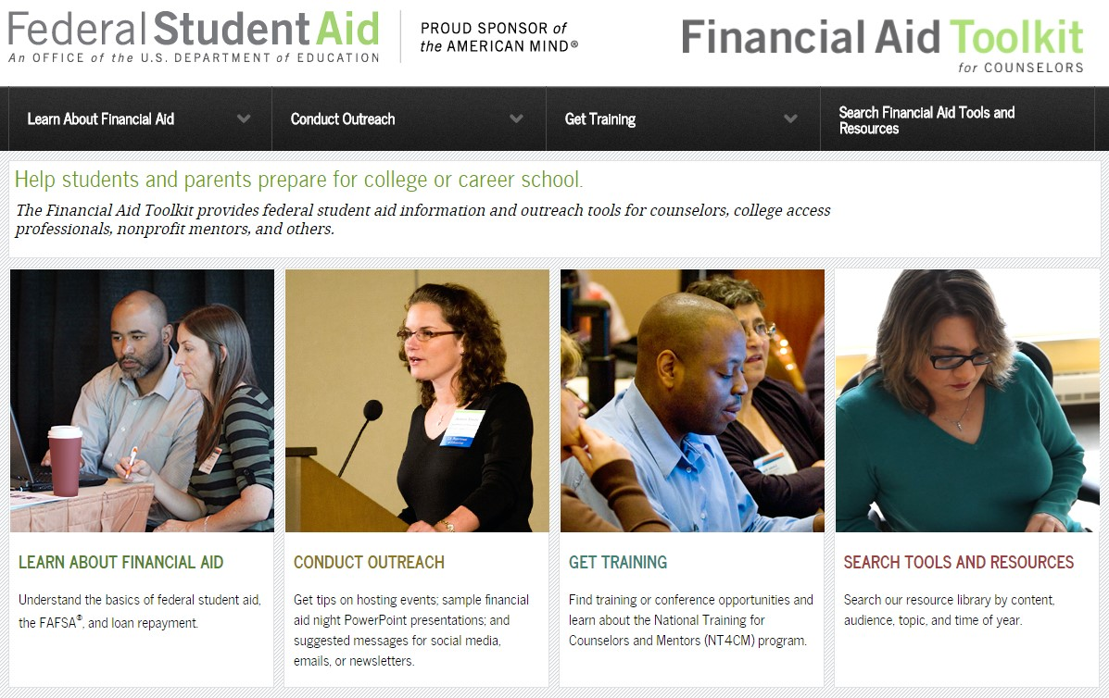
Materials & Resources for Outreach
Financial Aid Toolkit
FinancialAidToolkit.ed.gov
© 2017 CASFAA
Notes:
To help high school counselors and college financial aid staff, Federal Student Aid created the Financial Aid Toolkit, available at FinancialAidToolkit.ed.gov. The toolkit consolidates Federal Student Aid resources into a searchable online database for use by organizations and individuals who interact with, support or counsel students and families on making financial preparations for postsecondary education.

Slide 14
Materials & Resources for Outreach
Financial Aid Toolkit
Talking points
Table of FAFSA launch dates and tax years
Fact sheets for counselors, parents, and students
Outreach calendar
PowerPoint presentations
Information regarding upcoming webinars
© 2017 CASFAA
Notes:
You’ll find general information about the FAFSA, as well as tips and talking points for your outreach to students and their families. Items you can use in your outreach, including fact sheets, videos, infographics, sample tweets, and more, are available for download through the Toolkit. And, if you’re looking for webinars to brush up on financial aid, the Toolkit has the information you need.

Slide 15
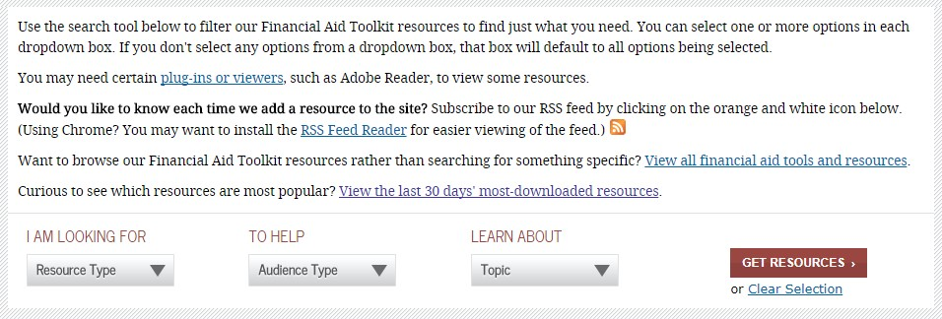
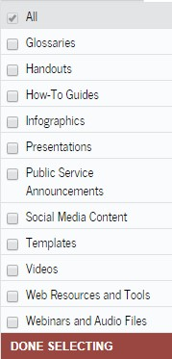
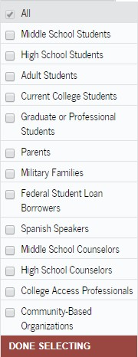
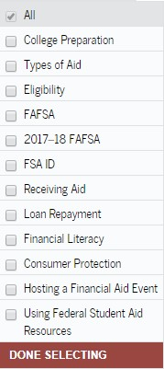
Materials & Resources for Outreach
Financial Aid Toolkit – Resources
FinancialAidToolkit.ed.gov/resources
© 2017 CASFAA
Notes:
In particular, if you navigate to the Resources section of the Toolkit, you’ll be presented with drop-down menus from which you can filter your choices for the types of resources you seek, the audience you are working with, and the specific topic you want to cover. For illustration purposes, we’ve shown all the current choices on each of the drop-down menus on the Resources page.

Slide 16
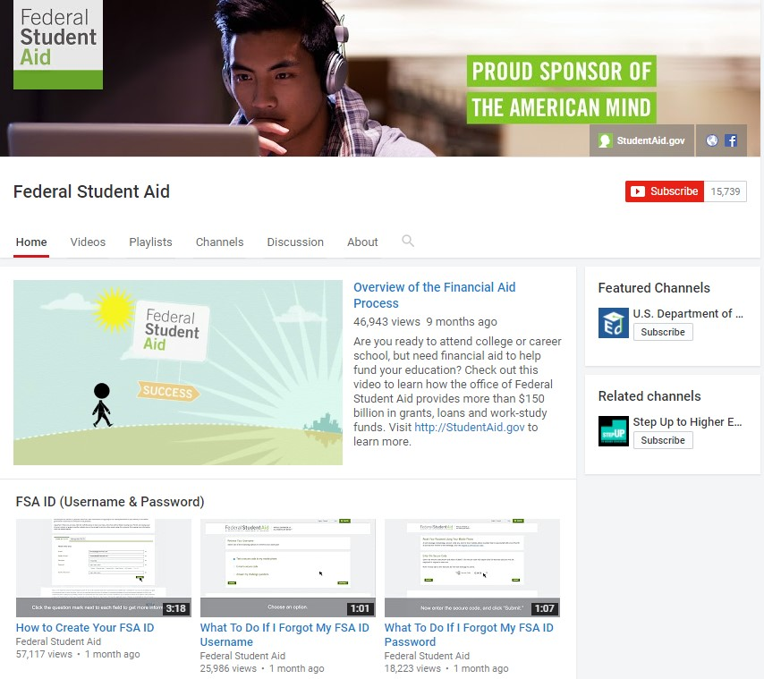
Materials & Resources for Outreach
Social Media
Twitter.com/FAFSA
Facebook.com/ FederalStudentAid
YouTube.com/ FederalStudentAid
FSA’s YouTube Page
© 2017 CASFAA
Notes:
The Office of Federal Student Aid is on Twitter and Facebook and encourages counselors and college access mentors to retweet or share posts. Federal Student Aid also has a YouTube channel with several playlists on college-prep and financial aid topics, including the FAFSA. You are welcome to link to the videos or embed them in your own website. Federal Student Aid’s content is in the public domain, so you may share it (as long as you don’t charge people for it).

Slide 17
FAFSA on the Web (FOTW)
© 2017 CASFAA

Slide 18
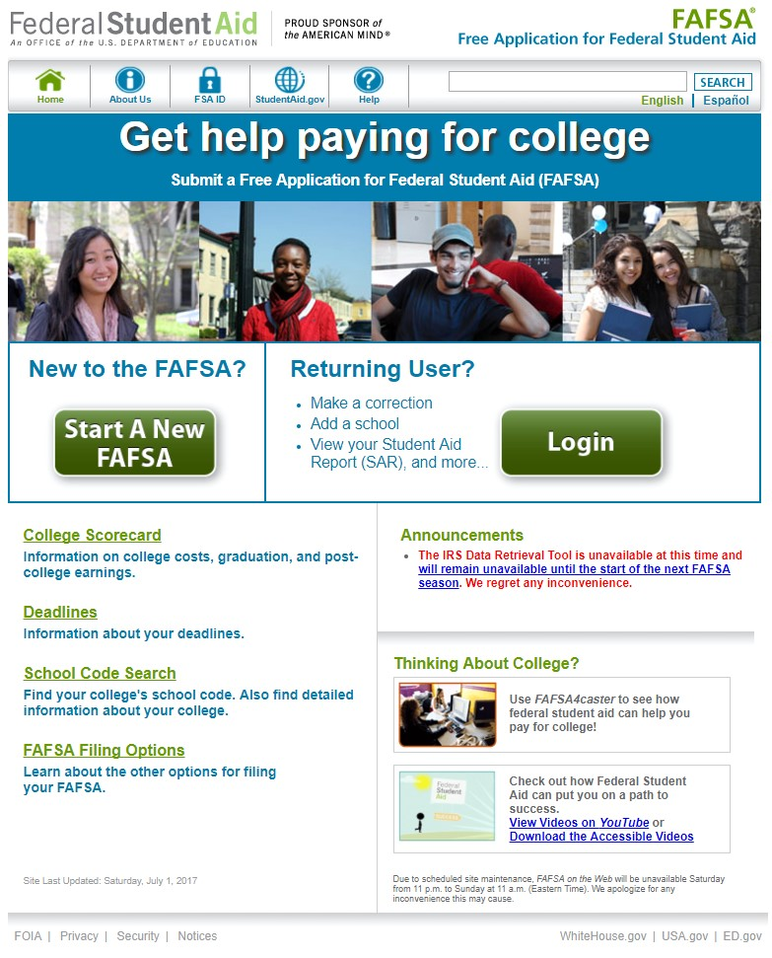
FAFSA on the Web (FOTW)
Start here for:
Initial FAFSA
Corrections
Signatures / FSA ID
Continuing a saved FAFSA
Renewal FAFSA
www.fafsa.gov
© 2017 CASFAA
Notes:
As mentioned earlier, there are only a few major changes to the actual application to the 2018-2019 FAFSA. Through the FAFSA on the Web (FOTW) website, students can still:
Complete their initial FAFSAs,
Make corrections to their FAFSAs—updating income and tax information, adding/deleting schools & updating housing plans,
Enter signatures—using student and/or parent FSA IDs,
Continue to complete a saved FAFSA, and
Complete a renewal FAFSA—in subsequent years, students will be able to submit a renewal FAFSA which will pre-populate demographic fields from a previous year’s FAFSA.

Slide 19
FOTW – Seven Sections of FAFSA Fun!
1 – Student Demographics
2 – School Selection
3 – Dependency Status
4 – Parent Demographics
5 – Financial Information
6 – Sign and Submit
7 – Confirmation
© 2017 CASFAA
Notes:
For 2018-2019, the FAFSA on the Web (FOTW for short), still has seven sections. We won’t cover all sections this year at the workshop, but instead focus on three sections that give our shared students the most headaches. In particular, we will look at School Selection, Dependency Status, and a portion of the Parent Demographics sections in the next few slides.

Slide 20
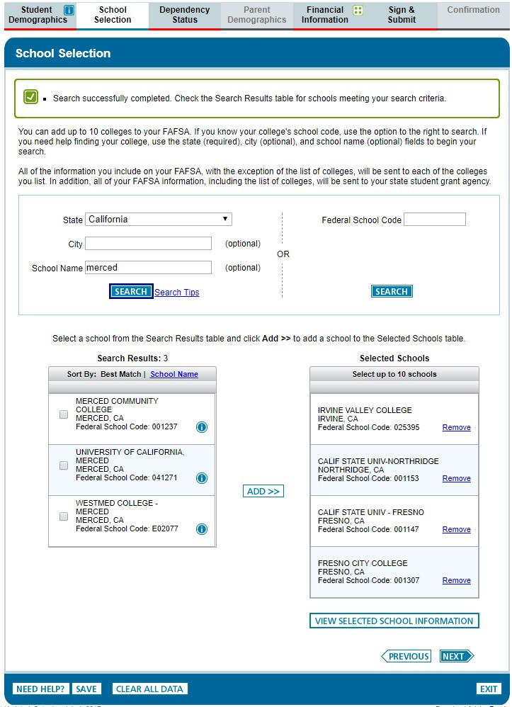
School Selection
1
2
3
© 2017 CASFAA
Notes:
As mentioned earlier, students can transfer up to ten colleges from the College Scorecard website. If they choose not to, then the process for adding colleges to their FAFSA will look the same as it has for the past few years when they arrive at the School Selection section (say that fast!). There are still a few tips to give for students completing this section of the FOTW.
First: Students can enter up to ten colleges on FOTW. Students who are applying to a greater number of schools will have the opportunity to add additional colleges and/or correct their FAFSA information after initial submission and processing of their FAFSA.
Second: There is no need to put schools in any particular order. Colleges, when they receive the results of a student’s FAFSA, will only see their college in the School Selection section. For Cal Grant awarding, CSAC will require students to select their college of attendance at some point AFTER the results of the student’s FAFSA are processed and Cal Grant eligibility is determined.
Third: For students who are absolutely certain they are leaving California to attend an institution outside the state – we highly recommend they include at least one “fallback” school in California. Why? Although they could add a California school AFTER March 2 and still be given Cal Grant consideration, having at least one California college listed BEFORE March 2 will allow the student to see if they have Cal Grant eligibility at a California school and the corresponding award amount.
If a student does not list any California schools on their initial FAFSA, they will be withdrawn from Cal Grant consideration. If they later decide to attend a school in California, they will need to add that school to their FAFSA application AND complete the “Entitlement Cal Grant Application Correction Form.” They can do this via their WebGrants 4 Students account or by contacting the California Student Aid Commission. This will then allow them to be “reprocessed” by CSAC for Cal Grant consideration.
Fourth: When schools have Early Admission deadlines or Priority Processing deadlines for financial aid, students should make sure they include them on their initial FAFSA submission.
Now, to address students who are considering more than 10 colleges. If you have students who are in this status, they should follow the four rules we just talked about. Once their FAFSA is processed, they can go back to FOTW, log in, go to the School Selection section, remove schools, then add new schools. They, and their parents, will need to use their FSA IDs to resubmit their information, but all the new schools will now receive their FAFSA information. Once a school receives it, even if a students takes the school off of their list, the school can process the student for financial aid.
Students can also utilize the DRN number on their Student Aid Report (SAR) and call the Federal Student Aid Information Center at 1-800-4-FED–AID (1-800-433-3243) where they can assist in adding colleges to the student’s School Selection section.
If students use the FAFSA website, it’s a quick 1-2-3 process. First, they should search for their college (pick the state and a couple of major words in the name of the school – no need to get it exactly perfect). Hit the search button. Second step – a listing of colleges satisfying the search requirements should pop up. The student can click the box to the left of the college, or colleges, they want to add to their list. Third step – hit the Add button. The selected colleges should now show up on the right side, where the student can have up to 10 colleges selected to receive the results of their FAFSA.

Slide 21
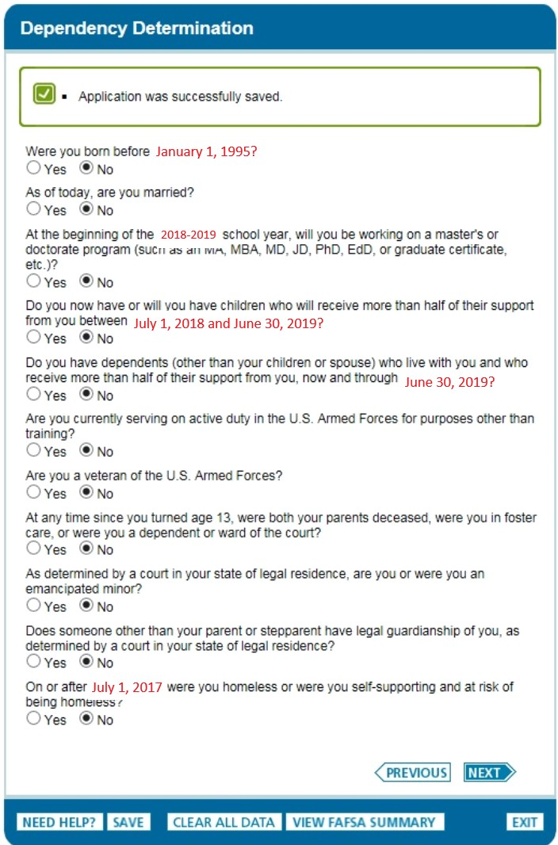
Dependency Determination
NO to all questions:
makes the student “dependent”
Must submit parent information
Note: Child must be supported financially —more than 50%
© 2017 CASFAA
Notes:
The FAFSA uses this Step to determine the dependency status of the student for financial aid purposes. Students may think they are independent, but the FAFSA questions in this section will determine if the student is determined to be independent or dependent.
The first few questions in this section will be pre-filled with answers based on information the student answered in Step One of the form. For example, the question regarding “working on a master’s or doctorate program” refers to the student’s initial academic program of study, not their future plans beyond their initial undergraduate work.
Children — answering YES to this question means the student must be providing more than 50% of the child’s financial support throughout the upcoming school year (July 1, 2018 to June 30, 2019). It is not only a matter of caring for the child. Additionally, “child” can include an expected birth (but not yet born) during the specified period. Note that providing more than half support counts support received from sources other than the student’s parents, such as TANF or support from the student’s boyfriend/girlfriend, as though it were provided by the student.
There is a similar financial requirement for claiming other dependents living with the student.
For most high school graduates, they will answer NO to the questions regarding children and other dependents.
Note: A student who can answer YES to any question in this section will be considered an Independent student for financial aid purposes.
Now that we’ve touched on the first five questions, let’s dive into some of the trickier questions in this section.

Slide 22
Foster Youth
Select YES if at any time since the student turned age 13, he/she was in foster care even if no longer in foster care today due to:
Adoption
Reunification
Reached the age of majority (18 yrs.)
Note: Documentation may be required
© 2017 CASFAA
Notes:
The FAFSA notes that students should answer YES if at any time since they turned age 13 they were in foster care, even if they are no longer in foster care today. For federal student aid purposes, a ward of the court is not someone who is incarcerated. Also, the financial aid administrator at the college or university may require the student to provide proof that he or she was in foster care or a ward of the court.

Slide 23
Emancipated Minors
Select YES if the student:
as of today, is an emancipated minor, or
was an emancipated minor immediately before turning 18 years old
Note: Documentation (issued from a court in the student’s state of legal residence) may be required
© 2017 CASFAA
Notes:
Students should answer YES if they can provide a copy of a court’s decision that as of today they are an emancipated minor. They can also answer YES if they can provide a copy of a court’s decision that they were an emancipated minor before they reached the age of being an adult in their state (18 years in California). The court must be located in the student’s state of legal residence at the time the court’s decision was issued.
Students should answer NO if the student is still a minor and the court decision is no longer in effect or the court decision was not in effect at the time the student turned 18 (became an adult in California).
The financial aid administrator at the college may require the student to provide proof that he/she was an emancipated minor.
An emancipated minor is not the same as emancipation from child support. The former occurs prior to the child reaching the age of majority while the latter occurs when the child reaches the age of majority. This is a common misunderstanding.

Slide 24
Legal Guardianship
YES, if… | NO, if…
Student can provide a copy of a court’s decision that as of today he or she is in a legal guardianship. | Student is still a minor and the court decision is no longer in effect.
Student can provide a copy of a court’s decision that he or she was in a legal guardianship immediately before he or she reached the age of being an adult in his or her state. | The court decision was not in effect at the time the student became an adult.
The court was located in the state of legal residence for the student at the time the court's decision was issued. | The guardianship was established by an attorney but not ordered by a court.
© 2017 CASFAA
Notes:
For this question, the definition of legal guardianship does not include the student’s parents, even if they were appointed by a court to be the student’s guardian. Students cannot be considered a legal guardian of themselves.
A legal guardianship established by an attorney is not sufficient. The legal guardianship must have been ordered by a court of competent jurisdiction in the student's state of legal residence.

Slide 25
Homeless, Unaccompanied Youth
Select YES if any time after July 1, 2017, the student meets ALL three criteria
“Homeless” or “at risk of being homeless”
Lacking fixed, regular and adequate housing. Includes living in shelters, parks, motels or cars, couch surfing, or temporarily living with other people because the student has nowhere else to go, AND
“Unaccompanied”
Not in the physical custody of a parent or guardian, AND
“Youth”
Under 24 years of age
Resources for homeless students: NAEHCY.org
© 2017 CASFAA
Notes:
Students should answer YES if they received a determination at any time on or after July 1, 2017, that he/she was an unaccompanied youth who was homeless or, at risk of being homeless.
• Homeless means lacking fixed, regular and adequate housing, which includes living in shelters, motels or cars, couch surfing, or temporarily living with other people because you had nowhere else to go.
• Unaccompanied means the student is not living in the physical custody of a parent or guardian.
• Youth means the student is under 24 years of age.
Students should answer NO if the student is not homeless, at risk of being homeless or if he/she does not have a determination. Students should contact their financial aid office for assistance if they do not have a determination but believe they are an unaccompanied youth who is homeless or is an unaccompanied youth providing for his/her own living expenses and who is at risk of being homeless.
The financial aid administrator may require the student to provide a copy of the determination if the student answers YES to any of these questions.

Slide 26
Homeless, Unaccompanied Youth
Students are considered to be independent if they are determined to be Homeless Unaccompanied Youth by:
The student’s high school or school district homeless liaison, or
The director of an emergency shelter or transitional housing program funding by HUD, or
The director of an a runaway or homeless youth basic center or transitional living program, or
The college’s financial aid administrator determines they meet the requirements for consideration
© 2017 CASFAA
Notes:
Certifying officials include high school district home liaison, U.S. Department of Health and Urban Development (HUD) homeless assistance program director or designee, Runaway and Homeless Youth Act (RHYA) program director or their designee. Also, the college’s financial aid administrator can certify the student meeting the Homeless Unaccompanied Youth status, based on the preponderance of available information presented by the student.

Slide 27
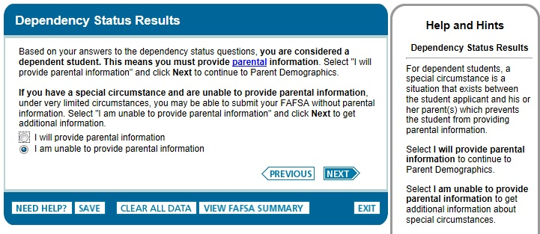
What if…
© 2017 CASFAA
Notes:
If a student has answered NO to all of the questions in this Step, he/she will be considered a Dependent student for financial aid purposes. As such, he/she will be required to provide parental information in the next Step we’ll cover.
For those rare instances where a student cannot provide parental information but has answered NO to all of the questions, they have an option to continue completing and submitting their FAFSA. As noted on the screen, they can mark the “I am unable to provide parental information” button, click on NEXT…

Slide 28
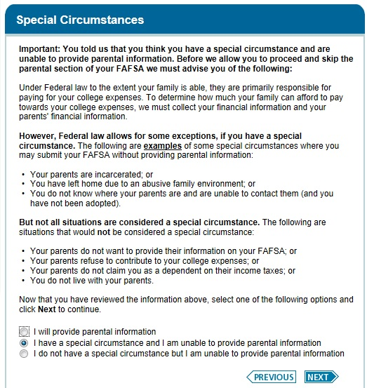
…then…
Colleges have the authority to “override” federal dependency status
Process will vary college to college
Note: Student MUST follow up with college
© 2017 CASFAA
Notes:
… and they will see this screen [on slide].
The student can continue to complete their FAFSA, skip the Parents section, submit their FAFSA, and it will be processed but only for unsubsidized Direct Stafford Loans initially. No EFC (Expected Family Contribution) will be calculated, but all of the listed colleges will receive the FAFSA information. The student will need to follow up with the college (or colleges) for each college’s process for determining if they can be considered Independent due to special or extenuating circumstances.

Slide 29
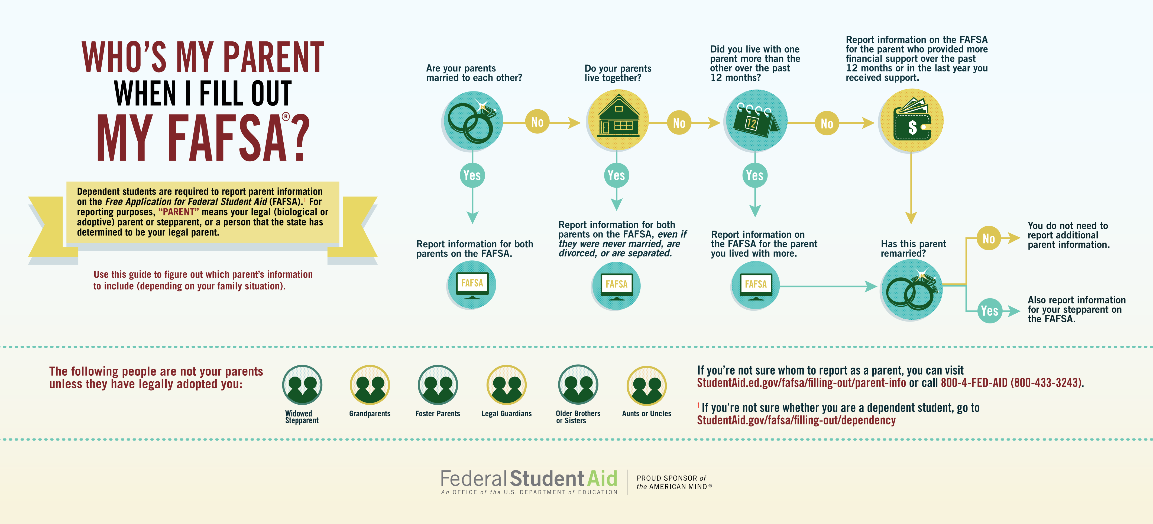
Whose info goes on a FAFSA?
Bit.ly/parentonFOTW
© 2017 CASFAA
Notes:
Otherwise, for a large majority of students coming out of high school, we can assume they are considered as Dependent for financial aid purposes. Oftentimes, there are questions regarding which parent, or parents, the student should use for supplying financial and household information on the FAFSA. For a quick reference, here’s a nice breakdown that should cover 99% of all possible combinations of parents.
Let’s go through the flowchart –
Are your parents married to each other?
Do your parents live together?
Did you live with one parent more than the other over the past 12 months prior to submitting the FAFSA?
If your custodial parent was divorced or separated, has that parent remarried?
By using this graphic, available in our online Reference Section, you and your students can easily determine which parent’s information to report on the FAFSA.
Keep in mind, this flowchart also works for students with same sex parents. If a student’s parents are the same sex and married, for example, the student would use both parents’ information on the FAFSA, unless the parents are divorced or separated.

Slide 30
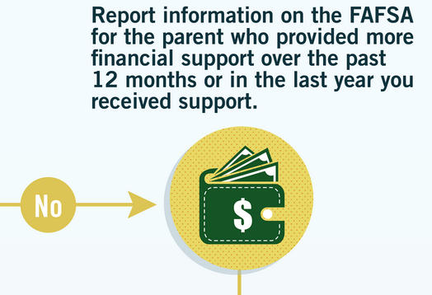
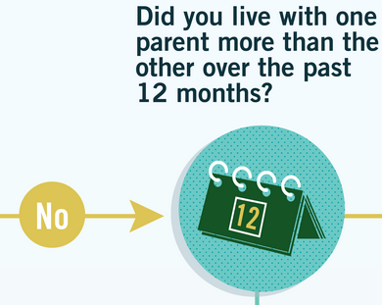
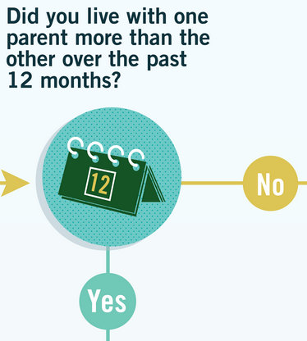
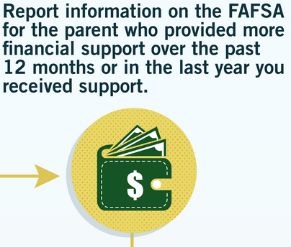
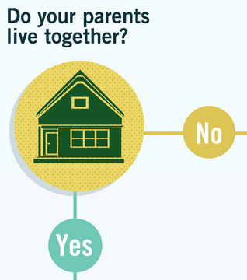
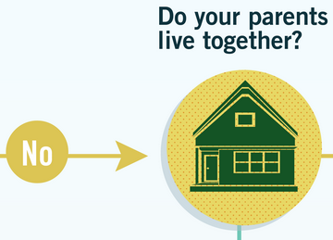
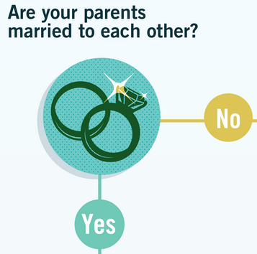
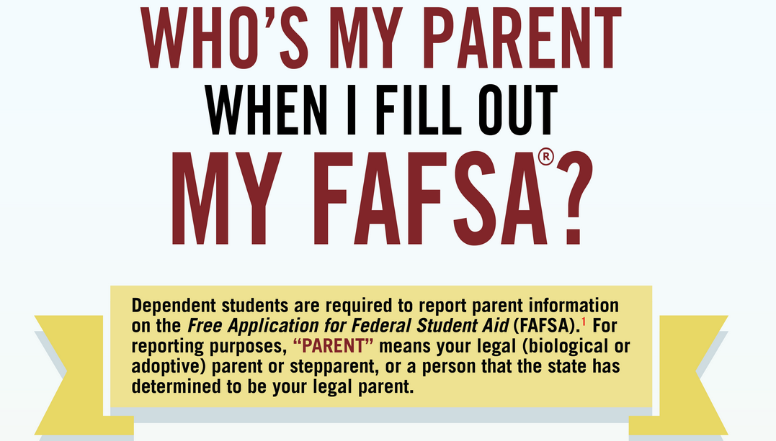
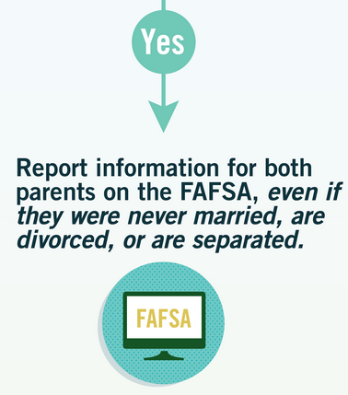
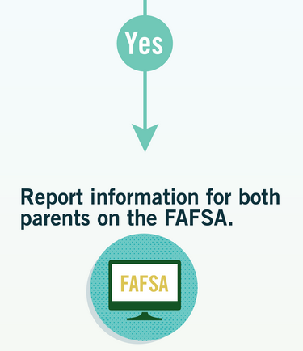
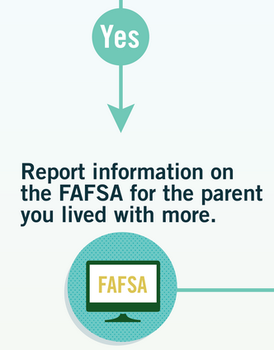
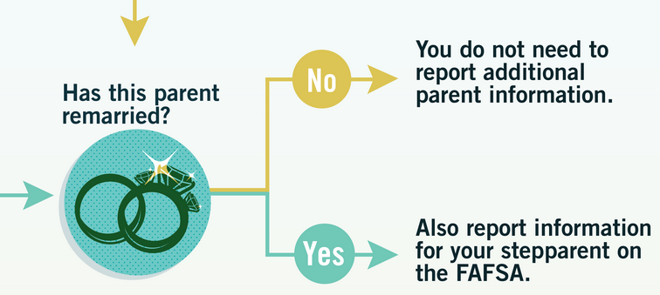
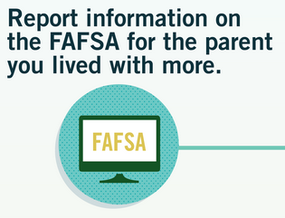

Slide 32
Marital Status Responses on the FAFSA
Never Married
Unmarried and both parents living together
Married or Remarried
Divorced or Separated
Widowed
© 2017 CASFAA
Notes:
When it comes time to select their response on the FAFSA, the student and his or her parents (if applicable) will be presented with the choices on the slide. Be sure to report the parent and student’s marital status as of the day the FAFSA is completed.

Slide 33
Divorced or Separated Parents
Provide information for the parent(s) with whom the student lived with most during the 12 months prior to filing the FAFSA
If the student spent equal time with both parents, use the information for the parent who provided the greatest amount of financial support for the student in the 12 months prior to filing the FAFSA
If both parents are still living together, use information for both parents on FAFSA, even if the parents are separated, divorced or never married
© 2017 CASFAA

Slide 34
Remarried Parent
Provide information about the custodial parent and stepparent regardless of any:
Agreement of “nonsupport”
Prenuptial agreement
Divorce decree designating tax filing exemptions
Note: A parent claiming the student on his or her tax return need not be the parent required to provide data on the FAFSA
Note: Children of parent and stepparent should be included in the household size and number in college questions on the FAFSA (if they currently provide and will continue to provide more than half of their support for the coming academic year)
© 2017 CASFAA
Notes:
If the parent has remarried after being widowed or divorced, provide information for the parent and stepparent. A stepparent's children are counted on the FAFSA if the stepparent provides more than half their support, even if the children don't live with the stepparent.

Slide 35
NO Parental Information
Do not provide parent information for
Foster parent(s)
Student is automatically considered an independent student
Grandparents, other relatives, or guardian(s)
Colleges may use professional judgment to allow the student to file as an independent student
Exception: Adoptive parents
© 2017 CASFAA
Notes:
We want to reiterate that foster parents and grandparents or other legal guardians should not provide parental information unless they have legally adopted the student.

Slide 36
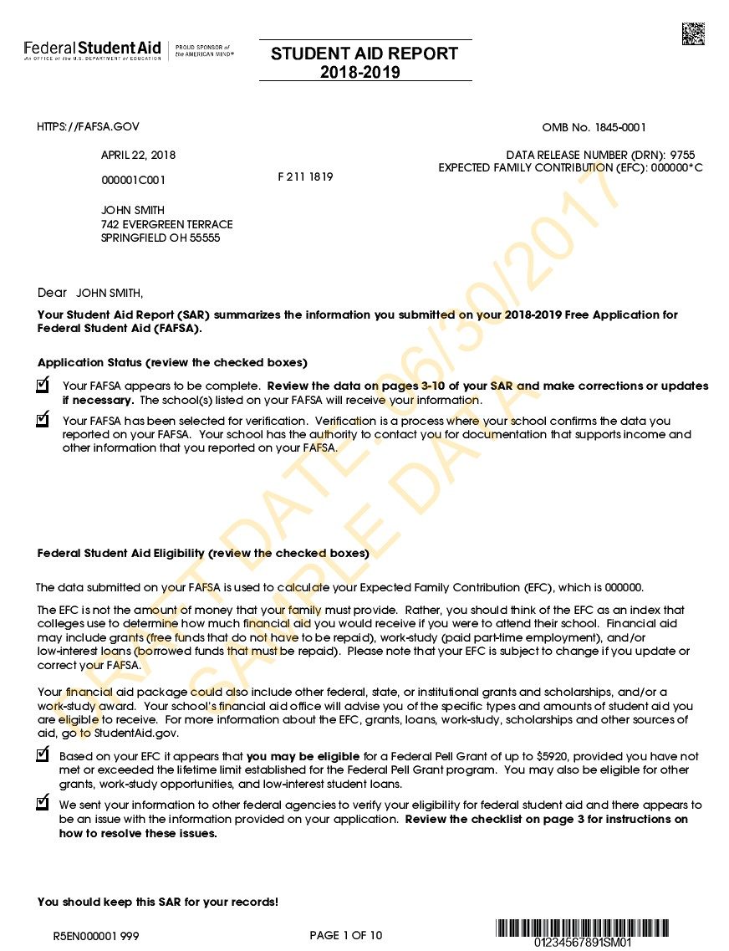
Student Aid Report (SAR) and Acknowledgement
Sent electronically or by mail
Summarizes FAFSA information
Displays EFC and DRN (upper right-hand area on the SAR)
EFC - Expected Family Contribution Used to determine eligibility for federal aid
DRN - Data Release Number Used to add additional schools
© 2017 CASFAA
Notes:
Once a student’s FAFSA is processed, the student will receive notification of their Student Aid Report (SAR) – the output document from a processed FAFSA. A Student Aid Report Acknowledgement is sent electronically to students who supplied a valid email address on their FAFSA, or by mail for those who either supplied an invalid email address or no email address. The SAR summarizes the information the student and parents provided on their FAFSA.
The SAR will contain the student’s official Expected Family Contribution (EFC), which the college will use to determine federal financial aid eligibility.
And, the student again will see their Data Release Number (DRN).

Slide 37
FAFSA Demonstration Website
fafsademo.test.ed.gov
Username: eddemo
Password: fafsatest
2018-2019 test system available September 24
© 2017 CASFAA
Notes:
The U.S. Department of Education has a test system for financial aid administrators and high school counselors. If you’d like to create a “dummy” FAFSA, check out the questions, see how the skip logic reacts to answers you input, or just look at the FAFSA of the Web webpages, check out the test site at fafsademo.test.ed.gov. The username to use is eddemo, and the password is fafsatest. The 2018-2019 test system will be available September 24. If you go into the system before September 24, you will find data relating to the 2017-2018 FAFSA on the Web, not the upcoming 2018-2019 FAFSA.

Slide 38
Special Circumstances
© 2017 CASFAA

Slide 39
What are Special Circumstances?
Some situations where a college may review and modify the student’s eligibility for aid:
Income adjustments
Circumstances affecting EFC
Selective Service status
Dependency status
Unaccompanied homeless youths
Foster youths
Adverse home situations
Notes:
Special circumstances are those scenarios you hear from your students when they can’t figure out how to answer a question or questions on their FAFSA, or when they present living situations beyond the typical family. This can include situations where there is a significant change in income or assets for a student’s parent, a question about Selective Service eligibility, a question as to the dependency status of the student, and other scenarios.
Financial Aid Administrators (FAAs) have the authority to make certain adjustments to the information presented on the FAFSA to help account for the unusual circumstances our students face. This authority falls under the general title of Professional Judgment when applied by the FAA.

Slide 40
Professional Judgment
Authority given by Congress to FAAs under the HEA
A decision to make a change to some aspect of student eligibility or cost of attendance that is NOT regulated by the USDE
Notes:
Reviews of special circumstances utilize the Professional Judgment of the college’s Financial Aid Administrator (FAA). This authority was granted by Congress through the Higher Education Act (HEA). It allows the FAA to make changes to data on a student’s FAFSA, or change a student’s cost of attendance, on a case-by case basis, based on special circumstances. The U.S. Department of Education gives the FAA leeway to account for such circumstances when these documented circumstances affect a student’s aid eligibility.
Although there are many more possible areas where an FAA can exert his/her PJ beyond the examples on the previous slide, we want to focus on some of the more common scenarios you, as high school counselors, might see on a regular basis. After the scenarios, we can discuss other circumstances you have seen, and hopefully give you some insight into how best to counsel your students.
Some examples of other areas PJ can be applied: Selective Service status (for students who have changed their gender), loan eligibility, cost of attendance, private K-12 tuition, costs associated with a disability, medical expenses, one-time lump sum payments, child/dependent care expenses, and satisfactory academic progress standards.

Slide 41
Scenario
Sandra’s single mother was laid off from her job in July. Sandra’s 2018-2019 FAFSA reflects income information from 2016, when her mother was still working.
What options does Sandra have?
What can the Financial Aid Office do?
Notes:
As noted, Sandra and her mother were required to provide income and tax information from 2016 on the 2018-2019 FAFSA. And, although Sandra starts college in Fall 2018 at her local community college campus, she cannot update the FAFSA to include future income figures from 2017. But, considering the circumstances at hand, Sandra should be counseled to meet with her college Financial Aid Advisor regarding a review of her income information. Colleges may call their forms and processes different things, but Sandra’s circumstances are quite common. As such, almost every college has a “Review of Income” or “Loss of Income” form and process. Using Professional Judgment as authorized by the U.S. Department of Education, a college Financial Aid Administrator may make changes to the figures used on the FAFSA, based on documented circumstances, and use the updated Expected Family Contribution (EFC) for determining aid eligibility for the student.

Slide 42
Scenario
Glenda, a continuing student at her local Cal State, has applied for financial aid. Her parents’ income increased significantly in 2016, as her mom started working again to help with new expenses. As such, Glenda no longer qualifies for grant aid.
However, the student’s brother was killed in an auto accident and the family is still paying for funeral expenses. And, her parents have huge medical bills due to her father’s recent diagnosis with cancer. The student is concerned she may not be able to attend college this coming academic year.
How might you counsel Glenda?
What can the Financial Aid Office do?
Notes:
In this scenario, Glenda should certainly talk to her college Financial Aid Advisor at her college. Although the family has seen a significant increase income from 2015 (from which the student received a good financial aid package for the past year) to 2016 (from which the student’s coming school year’s aid is based), actual PAID EXPENSES for the funeral and/or medical expenses for the father’s cancer treatment may be considered in a Professional Judgment (“PJ”) review. The student would be advised to bring in documentation of the paid expenses, along with written explanations of these circumstances.
Depending on whether the medical expenses are PAID or only BILLED could be a determining factor in a PJ review. Actual payments obviously affect the available income of the family to provide overall support for the family and for the student to attend college, so the Financial Aid Office staff will need to review the overall situation to determine if the expenses can be considered when recalculating Glenda’s aid eligibility.

Slide 43
Scenario
Harriet is under 24 years of age and lives with her grandparents, while her parents live in a different country. Should she list her grandparents’ income on the FAFSA?
How might you advise Harriet?
What can the Financial Aid Office do?
Notes:
Unless Harriet’s grandparents have legally adopted her, the answer is the question in the scenario above is NO. Since Harriet is under 24 years of age, the student is a dependent for financial aid purposes. Therefore, she must provide parental information. If the parent(s) are working in a foreign country, currency amounts need to converted to dollars for calculating income, taxes, and asset values. The parent(s) will need to print the signature page, sign, and mail to the FAFSA Processor, UNLESS one of the parents is eligible to obtain an FSA ID. The FAFSA “save key” will help facilitate completion of the FAFSA by parents who live outside the U.S.
But, what if there are other circumstances to Harriet’s situation? For example, what if the student hasn’t had contact with the parents for a few years, and there were tensions when last they all lived together as a family? What if the student cannot find or contact the parents? In circumstances like these, the Financial Aid Administrator may be able to override the student’s dependency status, assuming appropriate and corroborating documentation can be provided. But, even with a review of circumstances like these, the Financial Aid Office would not require income information from the grandparents. However, if the grandparents pay for some of the student’s expenses, this cash support is reported as untaxed income to the student on the student’s FAFSA.
If the student’s grandparents are legal guardians to the student, as ordered by a court in the student’s state of residence, then the student is considered independent. A legal guardianship established by an attorney is not enough for the student to be considered independent.
Lastly, if the grandparents had legally adopted the student, then we would use their income on the FAFSA. But, this is probably a rare instance.

Slide 44
Scenario
Flora had a baby in her senior year of high school. She lives with her boyfriend (the father of her baby) and his parents. She is unemployed, but her boyfriend just got a job. They are both applying for financial aid.
Who can claim the baby as their dependent (on the FAFSA)?
How might you counsel Flora?
What type of documentation would the Financial Aid Office request?
Notes:
Flora, if she is providing more than 50% of her baby’s support, can consider her baby as her dependent when completing her FAFSA. As such, Flora would be an independent student for financial aid purposes. Cash support received from the boyfriend and government benefit programs can be considered when trying to meet the “more than 50%” threshold. So long as the support is coming from sources other than Flora’s parents, Flora can count it as part of her support of her baby.
Flora’s boyfriend could, possibly, also consider the baby as his dependent when completing his FAFSA. This will depend upon how much support he is providing for the child.
The Financial Aid Office would probably need to know more than what’s presented above. For example, is the student or boyfriend receiving any government support? Is there any cash aid or in-kind support being received from family or friends?
The best counsel would be to have Flora and her boyfriend meet with their college Financial Aid Advisor to make sure the Financial Aid Office has a full understanding of the circumstances surrounding the support for the baby of the student. Considering the Student Aid Reports for Flora and her boyfriend may appear unusual (after all, both SARs may indicate household sizes of two, with low or now income), as long as the Financial Aid Office understands the reality of the support and living circumstances, both students might be processed correctly for the financial aid programs for which they are eligible.

Slide 45
Scenario
Juan has been living in Oakland with his aunt for the last two years while finishing high school. His parents moved back to Mexico with his three sisters. He reported his aunt’s income on the FAFSA, with a family size of two.
Juan’s father recently moved back to the Bay Area and is working.
Did Juan complete his FAFSA correctly?
If not, whose income should be reported?
What should the household size be?
How might you counsel Juan?
What can the Financial Aid Office do?
Notes:
The easiest answer to any of the questions above is for the first question. Unless Juan’s aunt legally adopted him, he should not have used her income on his FAFSA. As for whose income to report, assuming Juan is a dependent for financial aid based on all of the other federal criteria, he would need to supply financial and household information for him and his parents. Even if Juan is not living with his father, he would use his parents’ income information. We may need to figure out the current marital status for Juan’s parents in order to calculate the size of the household.
Although Juan may not need or deserve a PJ review, his college Financial Aid Advisor should review his application, help him make corrections as needed, and counsel Juan on any issues that involve the collection of the correct information for his FAFSA.

Slide 46
Scenario
Davis has been couch surfing for the past year, staying with friends and family members. His single dad has been in and out of jail, but when he’s out he stays with Davis. Mom has been out of the family picture since Davis was three, and he doesn’t know her whereabouts.
How might you counsel Davis?
What can the Financial Aid Office do?
Notes:
Davis may not meet the Unaccompanied Homeless Youth criteria on the FAFSA where he could obtain documentation from a homeless or runaway shelter, but with his circumstances he should certainly meet with his college Financial Aid Advisor for assistance. Depending upon a number of factors, the college Financial Aid Administrator could confirm his homeless status. At a minimum, a personal interview or meeting with the Financial Aid Administrator will probably be required, as they need to determine if the student, by preponderance of available information, meets the intent of the criteria for unaccompanied homeless youth.

Slide 47
Reference Materials
© 2017 CASFAA

Slide 48
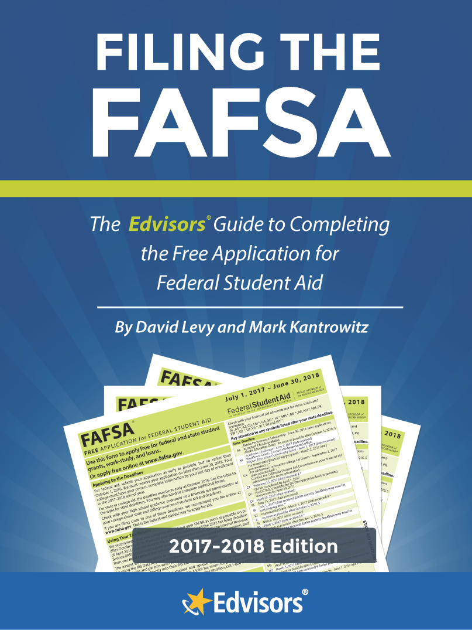
Must-Have, Comprehensive Resource
Increase eligibility for student aid
Avoid common errors
Complete the FAFSA quickly, easily and accurately
Free download at: edvisors.com/fafsa-book
© 2017 CASFAA
Notes:
Now, whether for you or your students, there’s a great resource available to help with the deep details of the FAFSA.
An Excellence in Financial Literacy Education (EIFLE) Award winner and Amazon.com bestseller, Filing the FAFSA is a handy book published by Edvisors and co-authored by David Levy and Mark Kantrowitz. Mark is the go-to financial aid expert, having started the general financial aid website finaid.org and fastweb.com many years ago, and current publisher of Cappex.com. David Levy, former Financial Aid Director at Caltech and current member of the CASFAA High School Relations Committee (the same people co-sponsoring today’s High School Counselors Workshop), has been instrumental in editing both this presentation today and in creating the book Filing the FAFSA.
The free book brings you:
A step-by-step guide to the FAFSA,
A guide to increasing eligibility for student aid,
Help in how to avoid common errors, and
Assurance your students and parents can complete the form quickly, easily and accurately.

Slide 49
Reference Materials
www.csac.ca.gov/
doc.asp?id=1438
© 2017 CASFAA
Notes:
We will continually post new items we think you’d like to see and use, on the CSAC webpage for high school counselors. This PowerPoint will be posted to the website along with the Reference Items included in the book, and more.

Slide 50
Questions?
© 2017 CASFAA
Notes:
Questions?
Don’t forget – You can find all kinds of reference items, resources, weblinks, and more at the CSAC webpage, noted on the previous slide.

