Slide 1
Foster Youth and the Chafee Grant: Strategies for Success to Support and Engage Students
November 15th, 2019

Slide 2
Why this Matters
College & Financial Aid Outcomes for Foster Youth

Slide 3
College Aspirations vs. College Realities
91% want to go to college
Notes:
This study looks at foster youth students within California.
Our foster youth understand that a college degree is desirable - 91% report that they want to go to college.
However, aspiring to college and making it through to that degree are two different things.
Source:
CalYouth Study (http://www.chapinhall.org/sites/default/files/CY_YT_RE0516_1.pdf) page 64.

Slide 4
College Aspirations vs. College Realities
43% enroll in college
Notes:
Foster youth face many obstacles and information gaps along the way - only 43% end up enrolling in community college in California.
Source:
At Greater Risk (http://www.cacollegepathways.org/wp-content/uploads/2016/01/at_greater_risk.pdf) page 12.

Slide 5
College Aspirations vs. College Realities
8% complete a degree
Notes:
Once in college, foster youth also experience unique challenges - resulting in just 8% completing a 2- year or 4-year degree by the age of 26.
Many foster youth face unique barriers that are linked with poor academic outcomes for foster youth.
Foster youth often get labeled as “not college material” or “not college ready”, however it is important to be aware of the factors that may be contributing to their current performance in school and know that these youth, in spite of these challenges, can still go to college and be successful. It’s up to us, as caring and supportive adults, to continue to help them reach their goals and believe in their potential.
Source:
8% is from the Midwest study (http://www.chapinhall.org/sites/default/files/Midwest%20Evaluation_Report_4_10_12.pdf) page 20.

Slide 6
Frequent Changes in Schools
This may lead students to:
Foster youth are
4 times more likely than their peers to change schools in a given school year
Fall behind with course material
Receive only partial credit from not finishing a full-term course
Have difficulty forming trusting relationships with teachers, peers and school counselors who may be able to help them academically
Notes:
Research shows that children and youth in foster care are four times more likely to change schools in a given school year than other students.
This instability comes from frequent placement changes and can lead to students falling behind in studies, missing needed classes and being unable to form relationships with teachers, peers and school counselors who may be able to help them academically.
Changing schools can be traumatic for many students, and is often also associated with changes in their neighborhood, community, friends and even family.
Source:
Barrat, V. X., & Berliner, B. (2013). The Invisible Achievement Gap, Part 1: Education Outcomes of Students in Foster Care in California’s Public Schools. San Francisco: WestEd.

Slide 7
The Role of Trauma
90% of children in foster care have experienced a traumatic event, with nearly half reporting exposure to four or more types of traumatic events.
Foster youth transitioning to adulthood have a greater likelihood of experiencing physical and mental health problems than their non-foster peers.
Notes:
Jessica
Source-
https://www.chapinhall.org/wp-content/uploads/CY_YT_RE0518_1.pdf

Slide 8
Foster Youth Often Lack Information and Support
Lack consistent adult role models
Lack information about higher education, financial aid, and other supports
Lack support in applying to college
Notes:
This slide highlights some additional reasons why foster youth may struggle to realize their college dreams.
Lack of adult role models to provide support and guidance.
Lack of support applying to college. Filling out applications for college, including applying for financial aid, can often be challenging and overwhelming. Most students benefit from having an adult assist them with this process, but for many foster youth, they lack this type of support and guidance.
Lack of information about higher education, financial aid, support, and resources. Many foster youth may not learn about the resources available to support them, until it is too late.
High school counselors often label foster youth as not college ready
High schools often don’t have the appropriate supports for SPED students

Slide 9
Foster Youth are Missing Out on Aid
Source: Cal-Pass Plus 2016-2017 statewide data

Slide 10
The CA Foster Youth FAFSA Challenge!
17/18: 45%
18/19: 57%
Goal for 19/20: 65%
Get involved with your County Office of Education (COE) FYSCP: https://www.cde.ca.gov/ls/pf/fy/
Notes:
Describe what it is in a nutshell
An initiative to increase the rates of financial aid attainment for California’s high school seniors in foster care.
The initial goal was to reach 60% completion.
Focusing on FAFSA works. We have seen success
Connect with your FYSCP

Slide 11
Financial Aid
Special Considerations for Foster Youth

Slide 12
Special Immigration Juvenile Status (SIJS)
A pending application for SIJS does not make you eligible for federal financial aid
If an undocumented student does not have an application for SIJS pending, contact the child welfare agency
Undocumented children involved in adoption or guardianship proceedings who have been adopted, abused or neglected may be able to obtain SIJS and apply to become a lawful permanent resident (LPR)
Notes:
Undocumented students should submit the CADAA until they have received permanent resident status (e.g., a Green Card). After a student receives permanent resident status, they should submit the FAFSA. A student who has permanent resident status is eligible for federal student aid.
Note that an application for permanent residency is not sufficient. A student cannot file the FAFSA as an eligible noncitizen until they have actually received their Green Card.

Slide 13
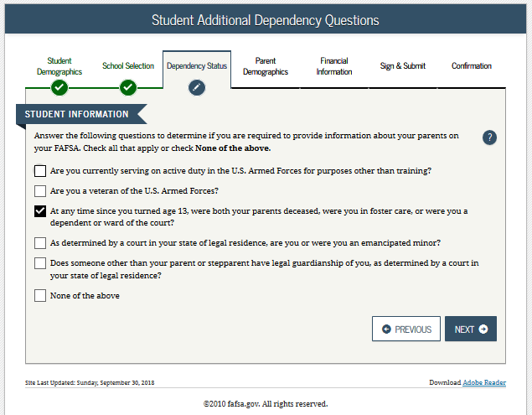
Dependency Determination
Dependency Status on the FAFSA
Current or former foster youth may qualify for “Independent Student Status” on the FAFSA if they can answer “Yes” to any part of either of these two questions:
“At any time since you turned age 13, were both your parents deceased, were you in foster care, or were you a dependent or ward of the court?”
OR
“Does someone other than your parents or stepparent have legal guardianship of you, as determined by a court in your state of legal residence?”
Notes:
While we won’t discuss every question on the FAFSA application today, this is probably the most significant section for foster youth, so it is important to inform them that they may qualify for Independent Status depending on when they were in foster care.
If they can answer yes to either of these questions, they will not need to fill out the Parent Demographics Section.
If they qualify for independent status, they will be directed to the following section to complete only financial information for themselves.
Foster parents, relative caregivers and legal guardians do not qualify as “parents” on the FAFSA. It is important that your child does not provide your financial information on the FAFSA. They may qualify for less money if you do so.
Even if the youth was in foster care, or was a dependent or ward of the court, for just one day after they turned 13, they qualify as a independent student for the purposes of the FAFSA.
If the youth was a dependent or ward of the court, but remained in the legal custody of their parents, they are not consider a ward of the court for the purposes of the FAFSA and therefore do not qualify for “Independent Status” on the FAFSA.
Other groups can also qualify for independent status, such as individuals who are married, have children or are in the military. Some foster youth may qualify for Independent Status within one of the other categories. These questions are presented one-by-one when filling out an electronic application. Once they answer Yes to any of the questions, the remaining questions will not be asked.

Slide 14
How is Foster Youth Status Verified?
Automatic verification through a data match with the California Department of Social Services (CDSS)
Only submit a verification letter if data match is unsuccessful.
HOW TO PROVIDE VERIFICATION OF FOSTER YOUTH STATUS:
Current foster youth: Contact your county social worker or Independent Living Program (ILP).
Former foster youth: Can also contact the State Foster Care Ombudsman’s Office: 877-846-1602.
Notes:
Although a ward of the court letter is no longer needed for the FAFSA, students may need it to access other benefits at their campus for foster youth. It is encouraged that they still request a copy, as they may need it in the future.

Slide 15
Additional Special Considerations for Foster Youth
Foster youth DO NOT have to report the following information in the financial section :
Extended Foster Care (AB 12) benefits, commonly known as SILP payments, even if SILP payments are sent directly to youth.
Supplemental Security Income (SSI)
Foster youth should self-identify on the FAFSA by marking yes to the question asking:
“are you a foster youth or were you at any time in the foster care system”
Notes:
Here is some additional information about special considerations for foster youth to be mindful of on the FAFSA.
By self-identifying on the FAFSA as a foster youth, students may get connected with additional resources and supports on their campus.
Facilitator’s Note: SILP payments do not need to be reported, including the infant supplement if you have a parenting youth.

Slide 16
TIP
Tips to help foster youth access maximum financial aid:
Ensure FAFSA workshop materials are inclusive of Foster Youth
Ask students if they have access to their Social Security Card
Make sure students have a personal email (not a school email)
Challenge questions may be triggering
Help students create a system to store passwords and usernames

Slide 17
Chafee Grant
Notes:
17

Slide 18
Chafee Grant:
First time applicants must submit a separate application at chafee.csac.ca.gov
Up to $5,000 for up to 5 years (whether or not consecutive) up until the age of 26
Can be used in-state and out-of-state at colleges & CTE programs.
Must be a dependent or ward of the court at least one day between the ages of 16-18.
Notes:
The Chafee grant provides up to $5,000 of free money for current and former foster youth that meet the eligibility requirements to help pay for college or career and technical education.
To get this money though, they must complete a separate application after they have completed the FAFSA or CADAA. This can be completed online or on a paper application.
Applicants only need to apply for the first time. After they have applied and received money they do not need to reapply each year. Their foster youth status will be automatically verified through the California Department of Social Services (CDSS), so they will not need to provide a Ward of the Court Letter
Students should apply by the March 2nd deadline in order to get the maximum award amount. Students can still apply after the March 2nd deadline, but may not receive as much money.
Students can use this money at community colleges, 4-year universities or qualified vocational-trade programs. This money can also be used at colleges out-of-state.
Eligibility Criteria:
Be a current or former foster youth who was a dependent or ward of the court, living in foster care, at any time between the ages of 16 and 18
Youth who were/are in kin-gap, non-related guardianship or were adopted, are eligible only if a dependent or ward of the court, living in foster care, was established between age 16-18
Not have reached your 26th birthday as of July 1 of the award year
Have financial need
Must be a California resident or meet CA Dream Act eligible criteria
Students are not required to have a high school diploma
Can be used for up to 5 years (whether or not consecutive), Each academic year that a payment greater than $1 is issued counts as 1 year of paid participation
Previously, the Chafee Grant was only for foster youth ages 21 and under, however, California revised the eligibility requirements in 2018. Foster youth who were previously ineligible because they were over 21 can now qualify if they up until the age of 26 and will be automatically re-enrolled.
$17.6 million in federal and state funded grant subject to annual availability of funds
Prior to AB 1811, the amount allocated for the Chafee Grant was $14,333,755. $3.3 million was added to award additional students the eligible expansion of

Slide 19
To be eligible for payment, students must:
Enroll in a program at least one academic year long
Attend at least half-time
Make Satisfactory Academic Progress (SAP)**
Demonstrate sufficient unmet need
* Students are NOT required to:
Provide a GPA
Graduate from high school
Meet ability-to-benefit requirements
Have a social security number
Register for Selective Service
Be clear of default or overpayments
Apply by March 2nd
* For Chafee Grant only. Students applying for Cal Grant and other aid must still meet all deadlines and other requirements
Notes:
AB 1811 Trailer Bill: GSA 2018-36
Students may receive 5 years (consecutive or non-consecutive) of Chafee payment
Award year is from 7/1-6/30. Award processing and payments are allowed through late September.
Ability to benefit: coursework that leads to a certificate/degree. Chafee students are required to take specific degree/certificate-related coursework. In other words, Chafee awardees can take classes of their choosing.

Slide 20
Did you Know…
Chafee Grant is NOT financial aid
It falls under California Health & Human Services guidelines, and therefore may be used for expenses beyond just undergraduate tuition, books, & supplies:
Chafee funds may be used towards rent, transportation, and childcare
Chafee funds can be used for post-grad studies and teacher certification
Funds are payable to students, “in care of” the college
Chafee funds cannot be withheld from students who have a balance owed to the school without written student consent

Slide 21
Application Process
The Chafee Grant application process has 3 components to determine preliminary eligibility. A GPA is not required:
Components:
Frequency:
Once
Once
Annually
2020-2021 FAFSA or CADA
* Students should complete the Chafee application and FAFSA/CADAA for the year they plan to enroll
Notes:
Step 1: Student must apply for the Chafee grant by completing the Chafee application. The application process includes the student completing the FAFSA or Dream Act application every year. This means undocumented students that meet the AB540 requirements are eligible for the Chafee grant (as long as they meet the other requirements) .
The application process also includes Department of Social Services verification of former foster care. CSAC receives this verification electronically each month, directly from DSS. There are cases where the student is not included in the file received from DSS. In those cases, the students have to complete manual certification (downloadable from the CSAC website), obtain signature from case worker or Independent Living Coordinator (ILP), and return the form to CSAC. The student application process and DSS verification only happens one time throughout the entire eligibility period.
The March 2nd Cal Grant deadline does not apply for the Chafee grant application. However, students should complete the FAFSA or CADAA by March 2nd to be considered for a Cal Grant. Students may receive both Chafee Grant and Cal Grant, if the have sufficient unmet need.

Slide 22
Chafee Grant Application
If foster youth status is not automatically matched through CDSS, it can be manually verified

Slide 23
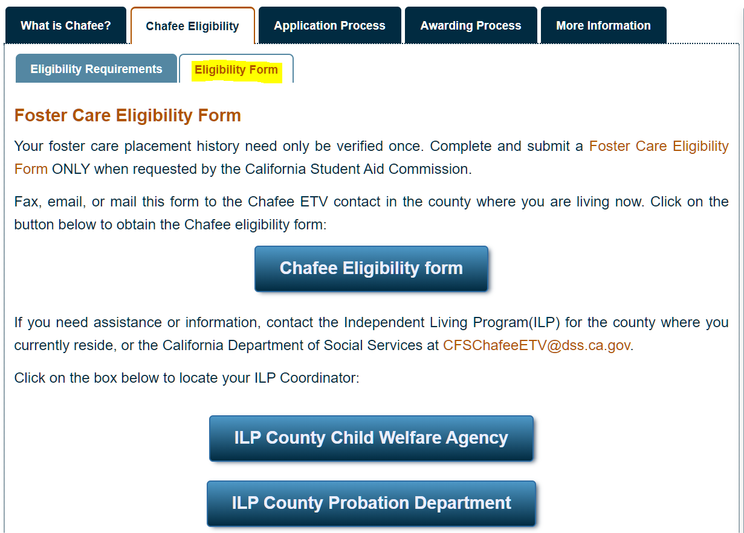
https://chafee.csac.ca.gov/

Slide 24
WebGrants 4 Students
Notes:
24

Slide 25
WebGrants 4 Students Accessible from csac.ca.gov
All students must create their student portal to:
Identify pending requirements
Report a school change
Update contact information
View payment history
Confirm remaining eligibility
Verify GPA was submitted (Cal Grant only)
Claim Cal Grant awards
Notes:
Here you can see the information required in order to create an account for the first time. This is the same information required by the legacy application. A student must have a current year application on file in order to create an account. For example, once the 2020-21 AY goes live, a student must have completed the 2020-21 application to create an account. (Check with Pankaj if still true)

Slide 27
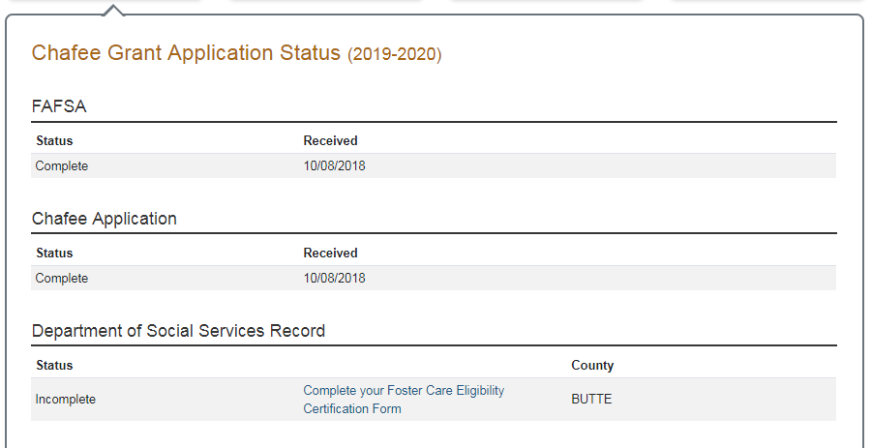
Award Pending

Slide 28
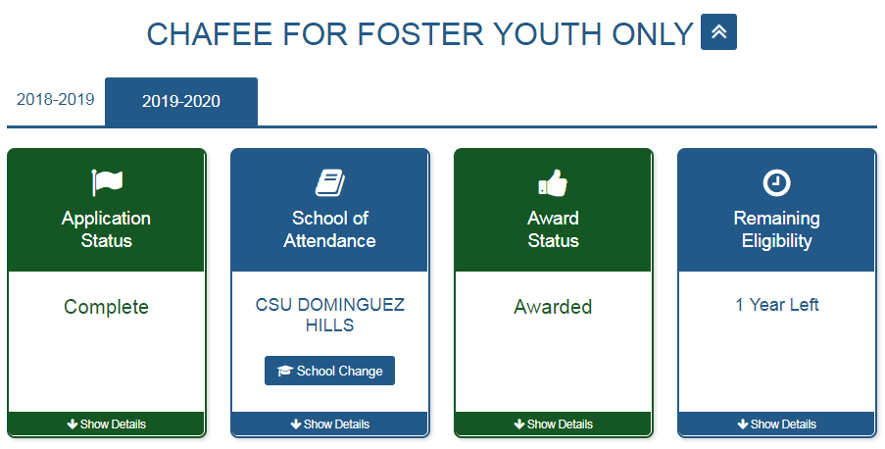
School of Attendance

Slide 29
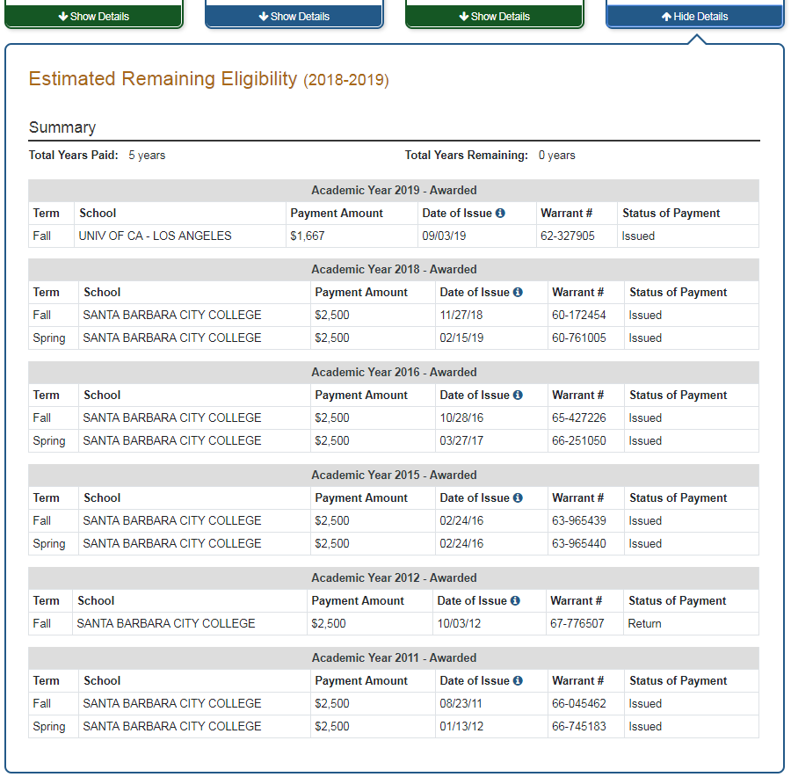

Slide 30
Cal Grant
Notes:
30

Slide 31
Cal Grant B for Foster Youth Lifetime Eligibility Expansion for Cal Grant B Foster Youth Recipients
NEW
AB 1809 extends:
Application Window: Students can apply for a High School Entitlement grant if under age 26 by July 1st of the award year
Application Deadline: from March 2nd to September 2nd for foster youth attending a California community college
Maximum Eligibility: from 400% (4 years) to 800% (8 years) of full-time enrollment at any eligible college
Notes:
Current and former foster youth students (a person whose dependency was established or continued by the court on or after the date on which the person reached 13 years of age) are eligible to receive Cal Grant B High School Entitlement Award consideration as long as they have not yet reached 26 years of age as of July 1 of the initial award year and submit a qualifying high school GPA or test score, regardless of the date of high school graduation or the equivalent.
The maximum eligibility has been increased from 4 years to 8 years.

Slide 32
New for the 2019-2020 Academic Year
Cal Grant Award for
Students with
Dependent Children
Students with dependent children under 18 years of age for whom they provide more than 50% support can qualify for an increased Access Award
For students attending public institutions
Up to $6,000 for qualifying Cal Grant A & B recipients, or
Up to $4,000 for eligible Cal Grant C recipients.
Cal Grant B for foster youth may receive up to 800% maximum eligibility
Notes:
New legislation allows for Cal Grant awarded students with Dependent Children to receive a new, and significantly larger, Cal Grant Access award. Students at California Community Colleges, California State Universities and University of California campuses with dependent children under 18 years of age for whom they provide more than 50 percent support can qualify. Eligibility is initially determined by the dependent children question on the FAFSA and the California Dream Act Application: “Do you now have or will you have children who will receive more than half of their support from you?” The new Access Award pays up to $6,000 for qualifying Cal Grant A and B recipients; or up to $4,000 for eligible Cal Grant C recipients.
This means that there is no automatic CCC reserve for students with dependent
children receiving a Cal Grant A access award at a community college.

Slide 33
Student Support
Phone: (888) 224-7268
Email: studentsupport@csac.ca.gov

Slide 34
Applying to College
Special considerations for foster youth

Slide 35
Considerations for Current and Former Foster Youth Students
Encourage youth to check off the “foster youth” box to get connected to resources when applying to community college
Application fee waiver at up to 4 CSU’s and 4 UC’s

Slide 36
Matriculation and Enrollment
Supporting foster youth to successfully enroll
Notes:
The focus of this lecture is largely going to be on the matriculation and enrollment process at California’s community college, however we will also share briefly about California’s four-year universities.

Slide 37
California College Promise Grant
Waives the cost of course fees
Foster youth can maintain this fee waiver regardless of academic performance
Notes:
The matriculation process varies at each community college, including the dates and deadlines. Students should get connected to their campus early to benefit from this resource.
Homeless youth must also participate in orientation, complete the assessment process and develop an education plan to receive priority registration at community colleges.

Slide 38
Priority Registration
Must be in foster care on or after their 16th birthday and under the age of 26
Available at community colleges, CSU’s and UC’s. Eligibility at UC’s varies.
At CCC’s, must complete orientation, the assessment process and develop an education plan.
Notes:
The matriculation process varies at each community college, including the dates and deadlines. Students should get connected to their campus early to benefit from this resource.
Homeless youth must also participate in orientation, complete the assessment process and develop an education plan to receive priority registration at community colleges.

Slide 39
Priority Access to On-Campus Housing
Foster youth have priority access to on-campus housing at CSU’s and UC’s
Priority housing varies at each campus
Notes:
CSU’s and UC’s also offer unique benefits for homeless youth.
Homeless youth have priority access to on-campus housing. Some students can even stay on campus year round. Priority housing varies across each campus, so it’s recommended that homeless youth get connected to support on their campus to navigate this process.
The definition for priority housing for homeless students is the same as the definition for priority registration.

Slide 40
Setting up Foster Youth for College Success
Campus Based resources and supports for foster youth

Slide 41
Foster Youth Success Initiative (FYSI)- http://extranet.cccco.edu/Divisions/StudentServices /FosterYouthSuccessInitiatives.aspx
At least one FYSI Liaison for foster youth is at each of the California community college campuses.
Often housed in the financial aid office
Notes:
Each California community college has a Foster Youth Success Initiative (FYSI) Liaison
The FYSI Liaison can be a great advocate and support for foster youth at their campus to successfully access financial aid, register for classes and get connected to meaningful support.
A list of each FYSI Liaison can be found in the above link.

Slide 42
Extended Opportunity Programs & Services (EOPS) and Educational Opportunity Program (EOP)
Offers academic counseling, book grants & more!
Most foster youth qualify!
Limited space, so apply early at time of application!
Helps low-income, educationally disadvantaged students complete their educational goals
Notes:
All California community colleges offer EOP&S to enable low-income, educationally disadvantaged students to complete their educational goals. Foster youth are generally considered eligible for EOP&S.
Students must be California residents (inclusive of students who meet California Dream Act/AB 540 criteria – which is further explained in the financial aid section).
At CSU & UC campuses, this program is called EOP (Educational Opportunity Program). It will admit students who do not meet regular admission assistance, as well as those that meet regular admission criteria.
These programs have limited space so it’s important to apply as early as possible.
For CSU and UC schools, make sure to apply when doing the general admissions application.
They provide a lot of great support such as more individualized academic counseling, book grants and more.
Some exceptions can apply to allow for less than 12 units. You should always consult the local campus for the most up to date and detailed information.

Slide 43
NextUp (formerly CAFYES)- nextup.cccco.edu
Academic and personal counseling; Emotional support
Students must be:
Under age 26
In foster care on or after their 16th birthday
Enrolled in at least 9 units
Also apply for EOP&S
Books & supplies
Seminars & workshops
Meal cards, bus passes, gas cards
Tutoring
Cultural events
Agency and community referrals
Notes:
Within EOP&S is NextUp, which was formerly called the CAFYES (Cooperating Agencies Foster Youth Education Support) Program.
NextUp is a state funded program just for foster youth at 45 community colleges in California (as of 2018)
11 programs are currently located in Los Angeles County: East LA College, Long Beach City College, Los Angeles Valley College, Los Angeles Mission College, Los Angeles Pierce College, Los Angeles Trade Tech, Los Angeles City College, Los Angeles Southwest College, Los Angeles Harbor College, Pasadena City College, and West LA College.
Some exceptions can apply to allow for less than 9 units. You should always consult the local campus for the most up to date and detailed information.
Students must apply for EOP&S and CAFYES. Like EOP&S, students must be California residents (inclusive of California Dream Act/AB 540 students).

Slide 44
Foster Youth Campus Support Programs
Campus advocate
Have a central touchpoint to serve as “one-stop” resource on campus
Support specific to foster youth
Offer workshops and partnerships tailored for FY
Sense of Community
Connect with others with similar experiences to normalize being a FY in college
Additional Resources
May offer meal vouchers and other resources to fill gaps
Various names: Guardian Scholars, Renaissance Scholars, LINC, etc.
Found at most community colleges, CSU’s, UC’s and some private schools
Exact program eligbility requirements and services will vary by school.
Notes:
Most colleges, CSU’s and UC’s, and even some private schools, have foster youth campus support programs. In LA County, for example, every community college has a foster youth support program in addition to their Foster Youth Success Initiative (FYSI) Liaison for maximum support.
Each program may have a different name, such as Guardian Scholars or Renaissance Scholars. These different names can make it confusing but students can always look up a program at the California College Pathways website, which is listed on an upcoming slide.
These programs have different funding streams and can vary in the services they provide, the staff they have and the eligibility criteria for admission into the program.
Many offer food assistance, such as food pantries, meals or food gift cards. Some also provide other support such as hygiene products, school supplies, tutoring or public transportation assistance
Get students connected to these programs early on. The sooner the better! Attending college can be scary and overwhelming for many students, but helping facilitate a warm-handoff with the staff in these programs directly, before school even starts, can help a student feel more comfortable and supported.

Slide 45
General Campus Resources & Supports
Counseling & Psychological Services
Tutoring
CalWorks & CARE
Food Assistance
Student Disability Services
Cultural Programing &
Student Clubs
Notes:
In addition, colleges today offer a range of services to address the holistic needs of students. Programs like CalWorks & CARE can support students who are parenting, and are avialable at every community college. These programs offer additional resources such as job placement and child care.
Mental health & well-being is an important component for every student’s success. For many students, the transition into college and young-adulthood can be difficult. College is often a stressful experience. In addition, foster youth have experienced complex trauma and may benefit from counseling or psychological services while in college. The impact of trauma doesn’t end simply because a student turned 18.
Food insecurity is a common issue for college students. Many campuses provide food pantries, meal vouchers, or other types of food assistance. It’s important to note that, while low-income college students generally don’t qualify for Cal Fresh (i.e. food stamps), foster youth can receive these benefits if they are part of EOP/EOPS, CAFYES, Guardian Scholars, DSPS, or if they receive a Cal Grant or Chafee grant.
Note: Additional Cal Fresh eligibility guidelines are available in All County Letter 17-05.
All campuses offer academic support services like tutoring and study skills workshops. Students can often access free one-on-one or group tutoring.
All colleges and universities also offer student disability services for students with physical, mental, or learning disabilities etc. However, it’s up to the student to disclose if they have a disability in order to get the support they need. Students should be encouraged to proactively disclose their status early on, rather than waiting for a problem to arise.
If a student had an Individualized Education Plan (IEP) in high school, they can share it with the office of student disability services to receive such support as:
-Receiving full-time enrollment status while taking a reduced unit load (which can help with financial aid);
-Assistance with note-taking;
-Special test-taking conditions (ex: extra time, quiet environment);
-Interpreters; and
-Assistive technology
-AB490 Liason can offer assistance
Finally, most colleges and universities also offer cultural programming and student clubs. One example is Umoja, which is a community dedicated to supporting the cultural and educational experiences of African American students. These groups and clubs can provide a positive community and support for students.

Slide 46
Helpful Resources

Slide 47
www.student.cacollegepathways.org
STUDENT RESOURCE PORTAL
*Find campus contact information here!
Notes:
The California College Pathways website has a lot of great resources for you and your youth, including a tab where you can search and find staff contact information for a college near youth.
Just click “Find Campus Support Programs” to locate a Foster Youth Success Initiative (FYSI), NextUp, or campus support program staff member and their contact information for colleges throughout California.
A version for adults and providers can be found at cacollegepathways.org

Slide 48
Foster Youth Educational Planning Guide
Use the Foster Youth Educational Planning Guide for step-by-step information on how to prepare and apply to college
Available for FREE at: www.jbay.org/fy-ed-planning-guide
Notes:
Applying for financial aid is just one of the many college matriculation steps.
The Foster Youth Educational Planning Guide can be a helpful tool to remember all the steps necessary from middle school to high school to successfully prepare a foster youth for postsecondary education.
This guide also includes resources available to foster youth at both California community colleges and CSU and UC’s.

Slide 49
Financial Aid Guide for California Foster Youth Available in English and Spanish! Can be found at: www.jbay.org/ca-fy-financial-aid-guide/ cacollegepathways.org/financial-aid student.cacollegepathways.org/financial-aid

Slide 50
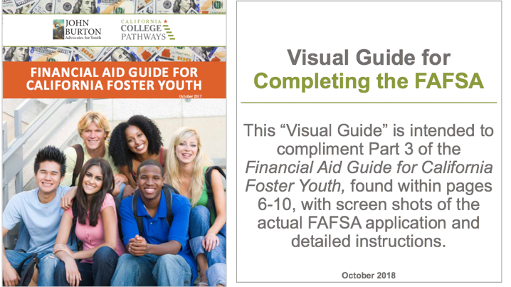
Visual FAFSA Guide
Can be found at:
www.jbay.org/ca-fy-financial-aid-guide/ cacollegepathways.org/financial-aid student.cacollegepathways.org/financial-aid

Slide 51
Question & Answer
Jessica Petrass, LCSW
jessica@jbay.org
Notes:
Simone

