Slide 2
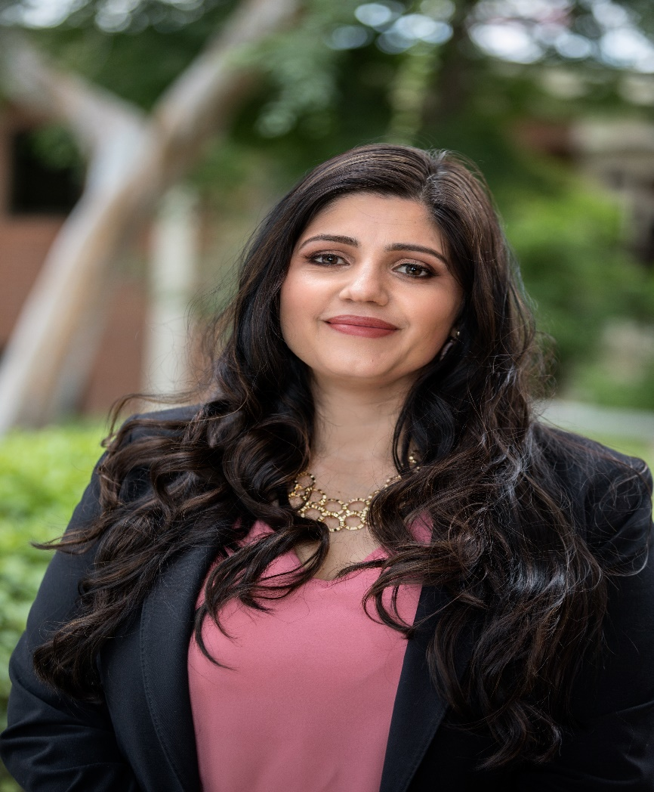
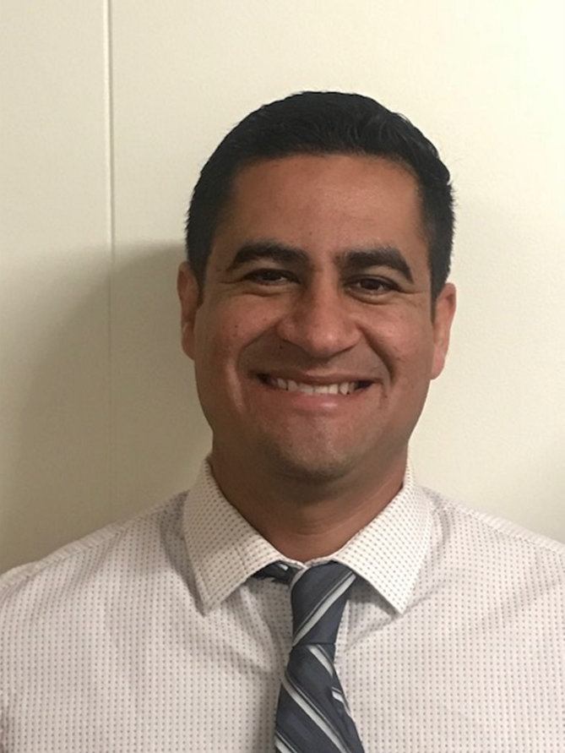
Catalina Cifuentes
Executive Director,
College and Career Readiness
ccifuentes@rcoe.us
Dr. Pedro Caro
Coordinator,
College and Career Readiness
pcaro@rcoe.us

Slide 3
Webinar Tips
This webinar is being recorded so that others may listen to it at a later time for reference and will be uploaded to the RCEC Youtube page as well as www.rcec.us once you log in to access the content of the webinar series
All connections to this live Webinar feature have been accounted for so please do not forward the Zoom link or invite anyone to join because you are taking someone else’s spot and Zoom will automatically start kicking off connections randomly
All participant mics have been muted and only panelists and facilitators have the ability to unmute anyone
Since all participants have been muted, please use the Q&A and chat screens to enter your questions
Participants can submit a question in the Q&A box at the bottom of the screen for the panelists
Only panelists and facilitators will be able to respond back to those questions and can do so publicly or privately to the individual
Participants can submit comments or questions in the chat box if they would like to engage with each other
**Every effort has been made to ensure the security of this webinar from “zoombombers” but in the event that we experience that, please stay calm and we will resume as soon as the technical difficulties have been resolved.**

Slide 4
FOR MORE INFORMATION AND RESOURCES PLEASE VISIT US @
www.rcec.us

Slide 5
From Middle-to-High School: Resources for a Successful Transition in a Virtual Environment
Laura Ross

Slide 6
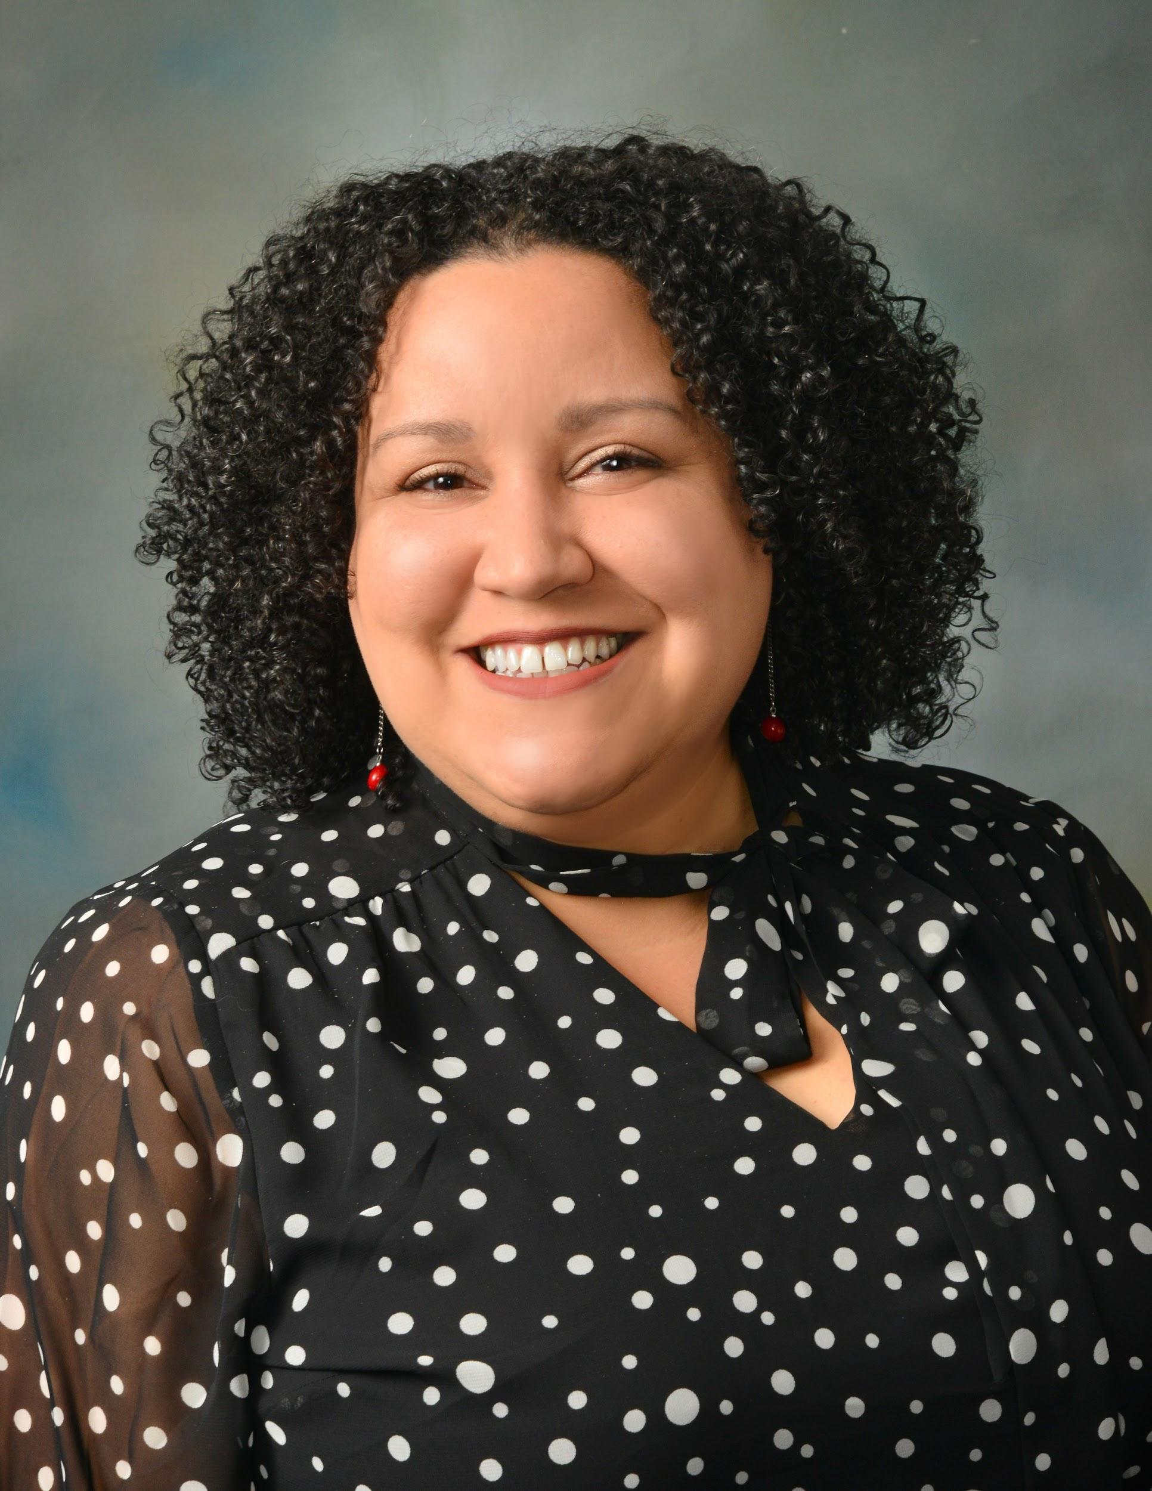
ASCA 2020 School Counselor of the Year
14 years (8 ES, 6 MS)
FFMS Lead School Counselor
GSCA Executive Board - Metro Director
GCPS Middle School Counselor Steering Committee
Counselors for Computing Consultant
Laura Ross
lauraruthross@gmail.com
www.theconnectingcounselor.com
Twitter & Instagram: @LRossSchCnslr

Slide 7
Five Forks Middle School
Lawrenceville, Georgia
Recognized ASCA Model Program
6th, 7th, 8th
1275 Students
~ 40% Free/Reduced Lunch
~ 32% White
~ 28% Black
~ 19% Asian
~ 18% Latinx
Brookwood High School
Snellville, Georgia
9th, 10th, 11th, 12th
3,560 Students
~ 29% Free/Reduced Lunch
~ 34 % White
~ 29% Black
~ 17% Asian
~ 16% Latinx
~ 4% Multiracial

Slide 8
Why is it important to implement transition activities virtually?

Slide 9
What did you already have planned?
How can you make it virtual?
Who do you need to collaborate with?

Slide 10
Peer Leader Visit
Connect with High School Counselors
Peer Leaders create a screencast of their presentation
Share on 8th Grade Counseling Page

Slide 11
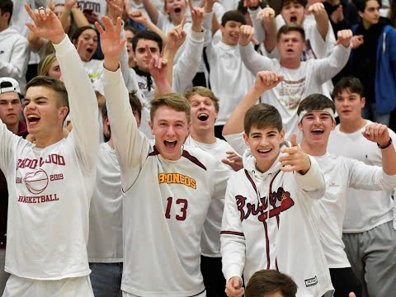
Rising 9th Grade Activities Night
High School Create Video
Video & Info Share on MS & HS Sites
Club Descriptions HS Website
Google Sign Up Form

Slide 12
High School Credits in 8th
Letters & Forms Mailed home to Parents/Guardians
Posted info on social media and websites
Screencast of Slideshow
3 Options to Return

Slide 13
Information Share on Middle School & High School Websites and Social Media

Slide 14
Share Info in One Place
Ms. Ross 8th Grade Counseling Page
Google Sites
Smore
Bitmoji Scene

Slide 15
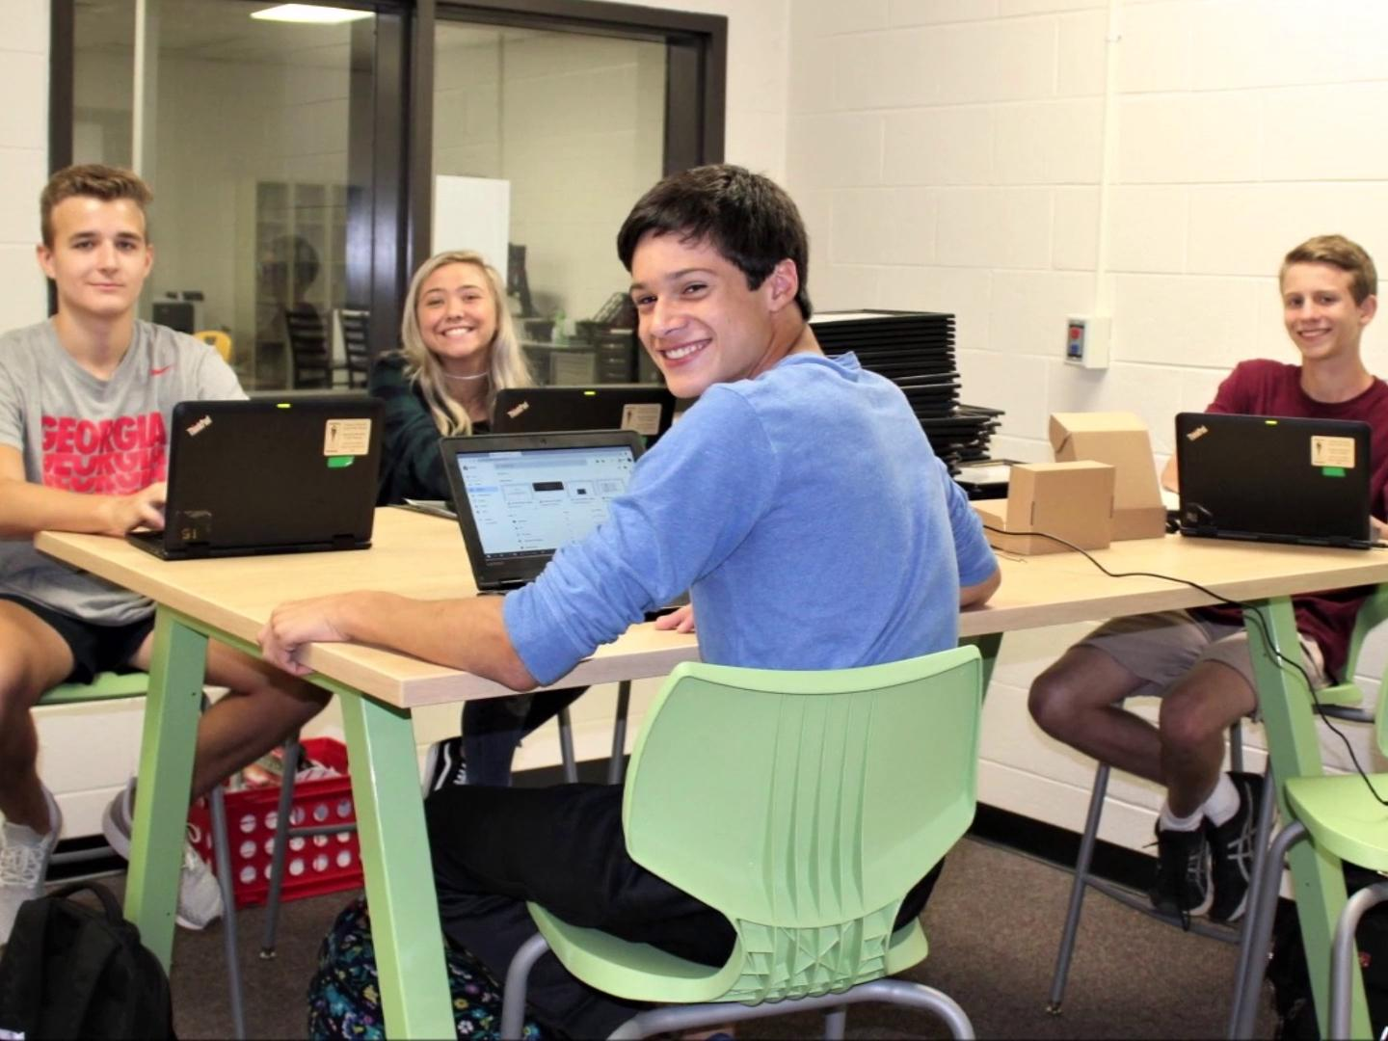
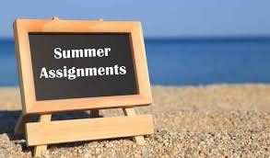
Congratulations 8th Graders! You are now high schoolers! You will truly be missed at Five Forks!
Click on each picture or poster for information to help you be successful as a 9th grader! You’ve Got This, Class of 2024!

Slide 16
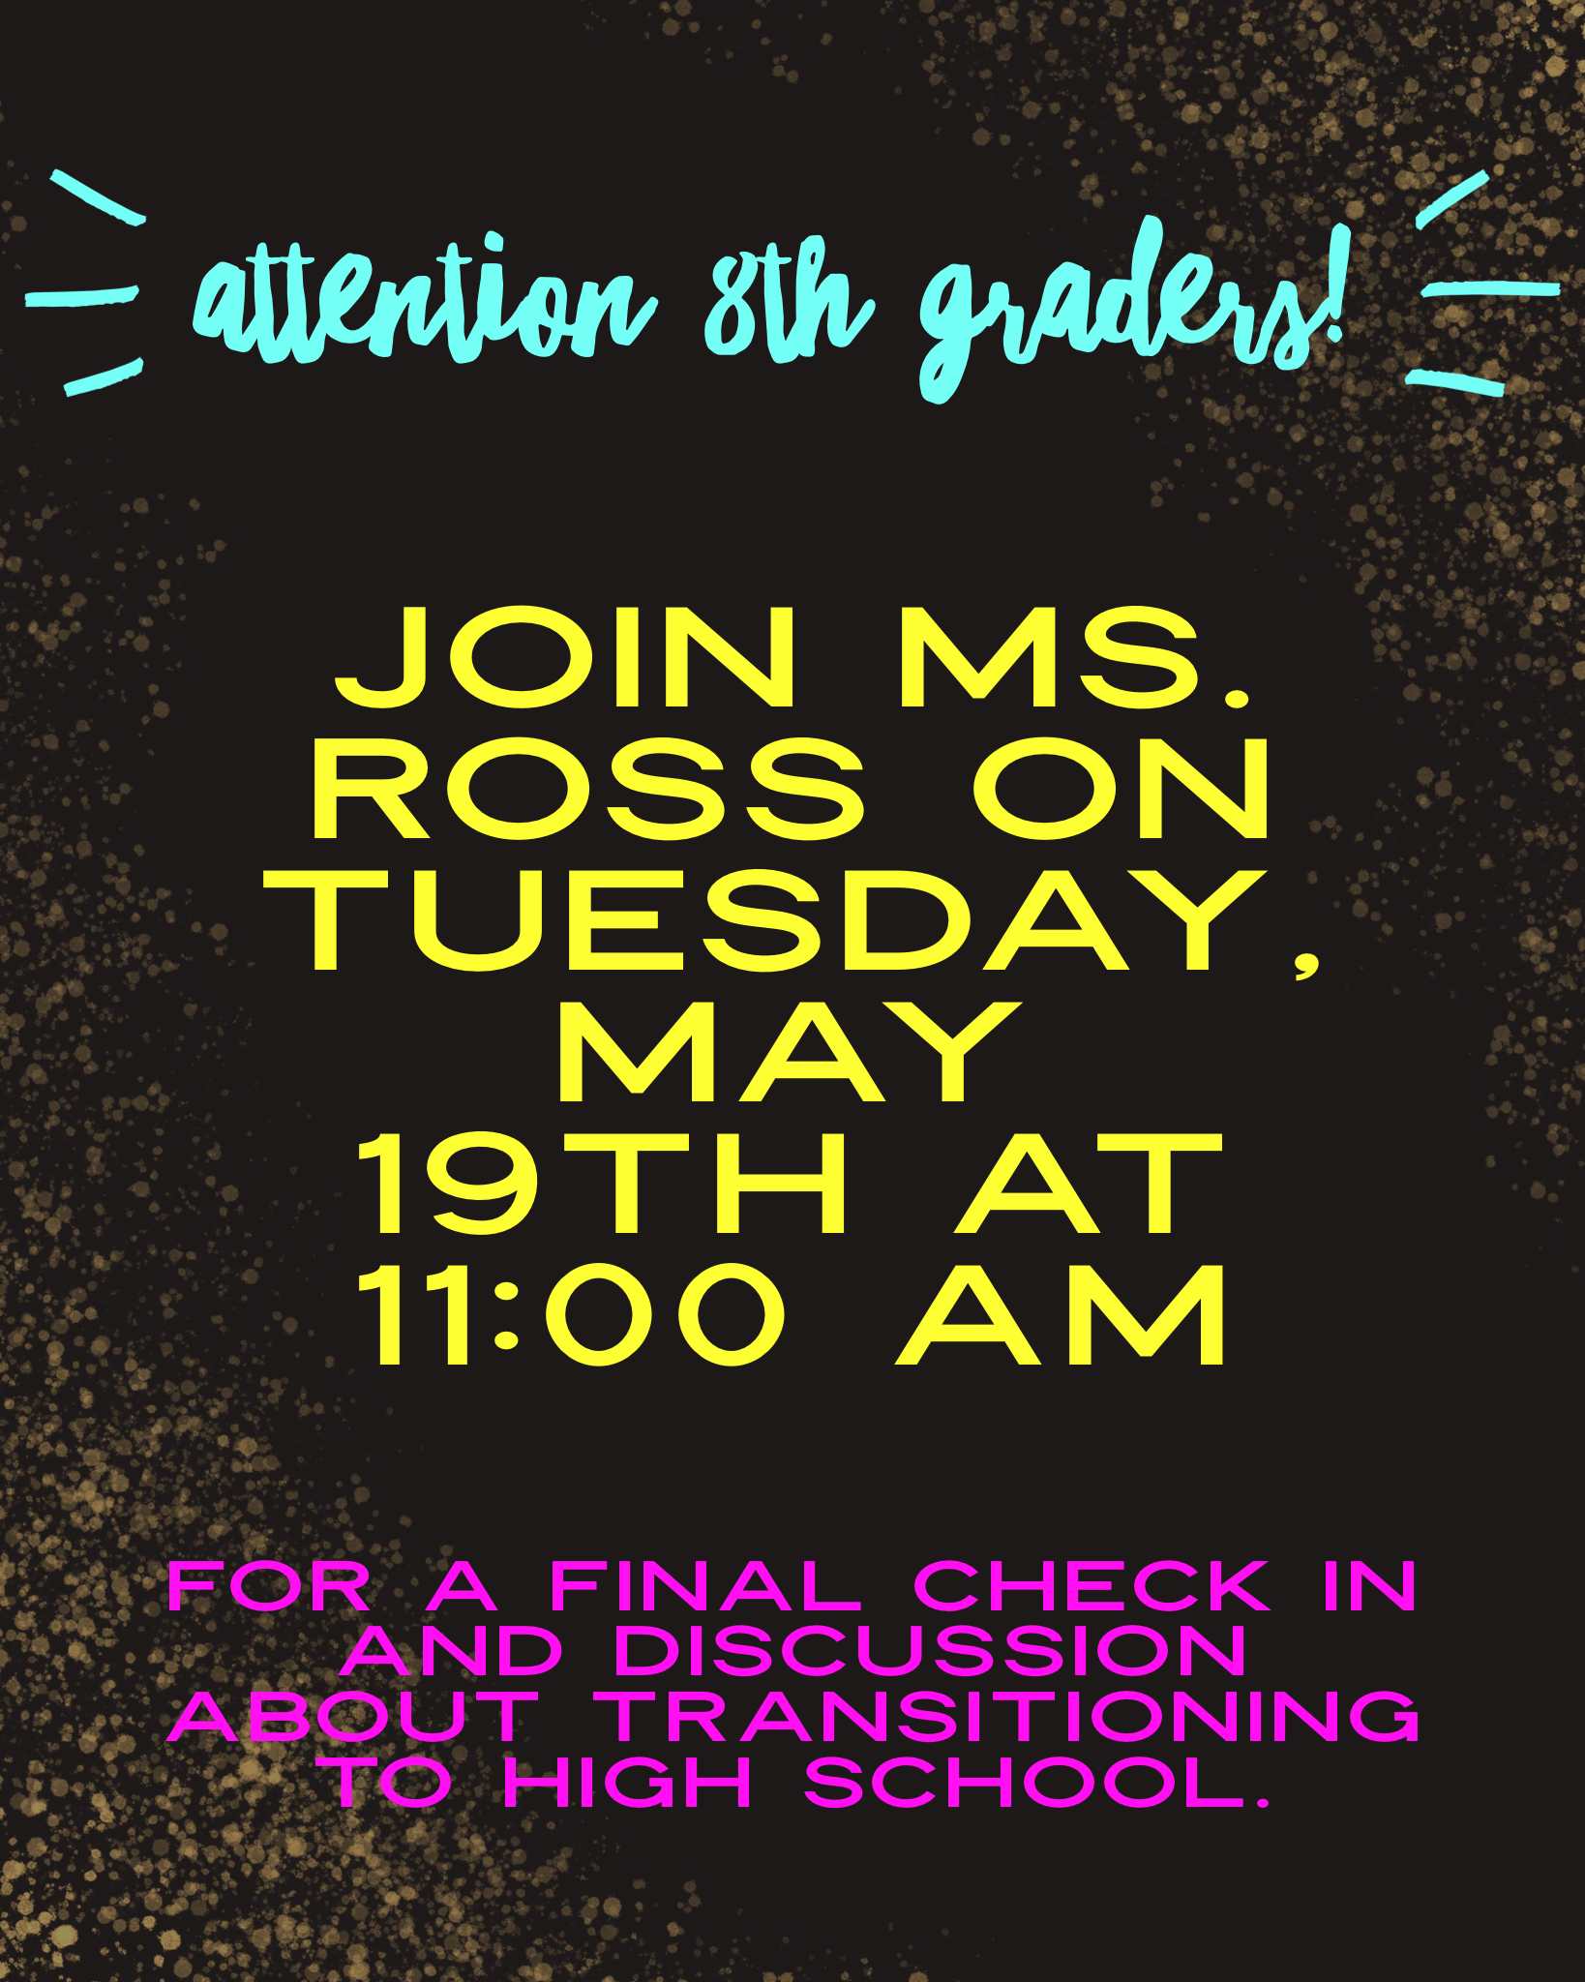
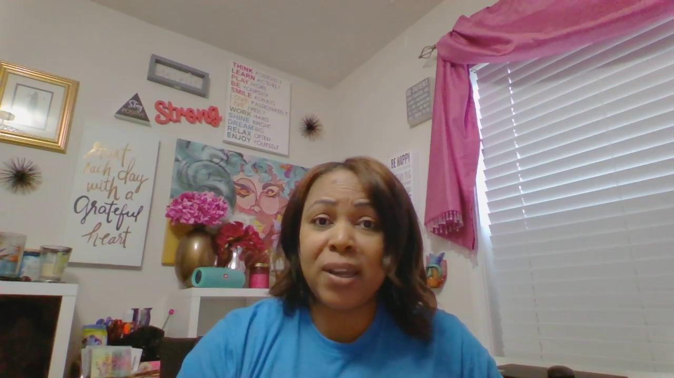
Check In & Chat w/ 8th and 9th Grade Counselors
Zoom or Google Meets
Flipgrid Advice from High School Students
Padlet Questions

Slide 17
Questions?

Slide 18
Round of Applause for our Presenter!!
Laura Ross
Notes:
Castro Slide

Slide 19
We are here to support you!
Please reach out to College and Career Readiness with any needs at your school site, professional development topics, or general questions at:
Catalina Cifuentes ccifuentes@rcoe.us
Dr. Pedro Caro pcaro@rcoe.us
Notes:
Castro Slide

Slide 20
FOR MORE INFORMATION AND RESOURCES PLEASE VISIT US @
www.rcec.us

Slide 21
