Slide 1
Get Ready for Middle School!
Your Name Here,
XYZ Middle School

Slide 2
Why Are We Here?
6th graders sometimes feel nervous about middle school
We want you to feel confident and with lots of information to help you transition
We want to introduce ourselves

Slide 3
XYZ Middle School
Administration
Mrs. Brown–Principal
Mrs. Smith - Assistant Principal
Mrs. Williams - Assistant Principal
School Counselors
Mrs. Brown - 6th
Mr. Hayes - 7th
Mrs. Lopez - 8th

Slide 4
Differences
Elementary
Middle School
One Teacher
Recess
Start time—8:00
End Time—2:30
Classes chosen for you
Multiple Teachers
No Recess
Start Time—8:45 End Time—2:55
Choice of electives

Slide 5
Differences Continued
Letter Grades
ID’s
Electives
Support Classes

Slide 6
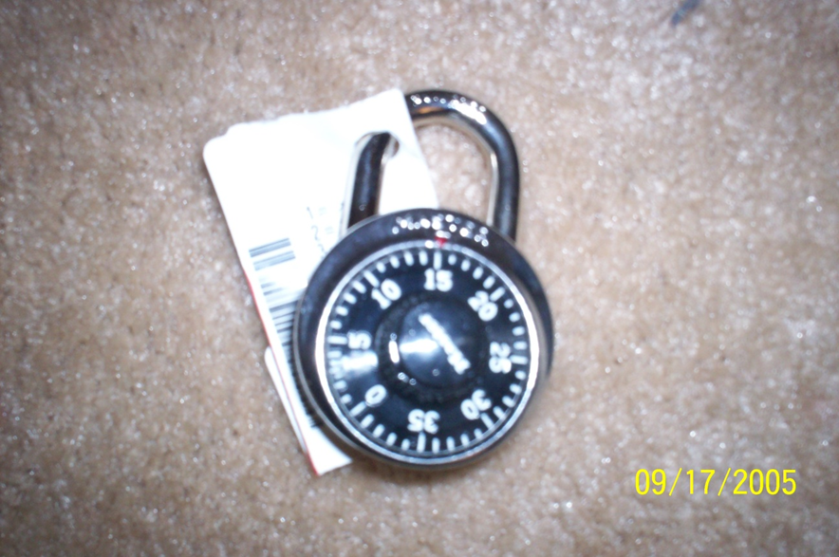
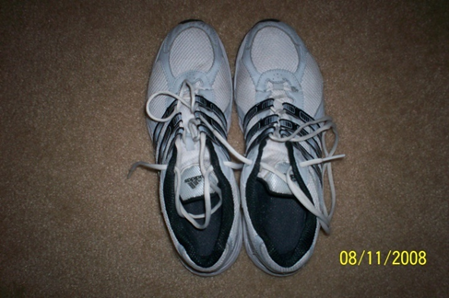
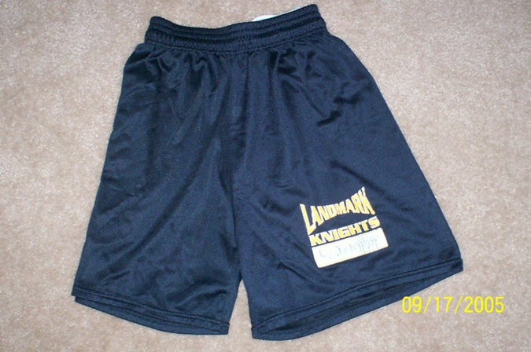
Physical Education
PE:
Locks
Shoes
Dressing Out

Slide 7
Middle School Myths
Middle school is all work and no play
I wont see any of my friends anymore
I have to shower when I’m at PE

Slide 8
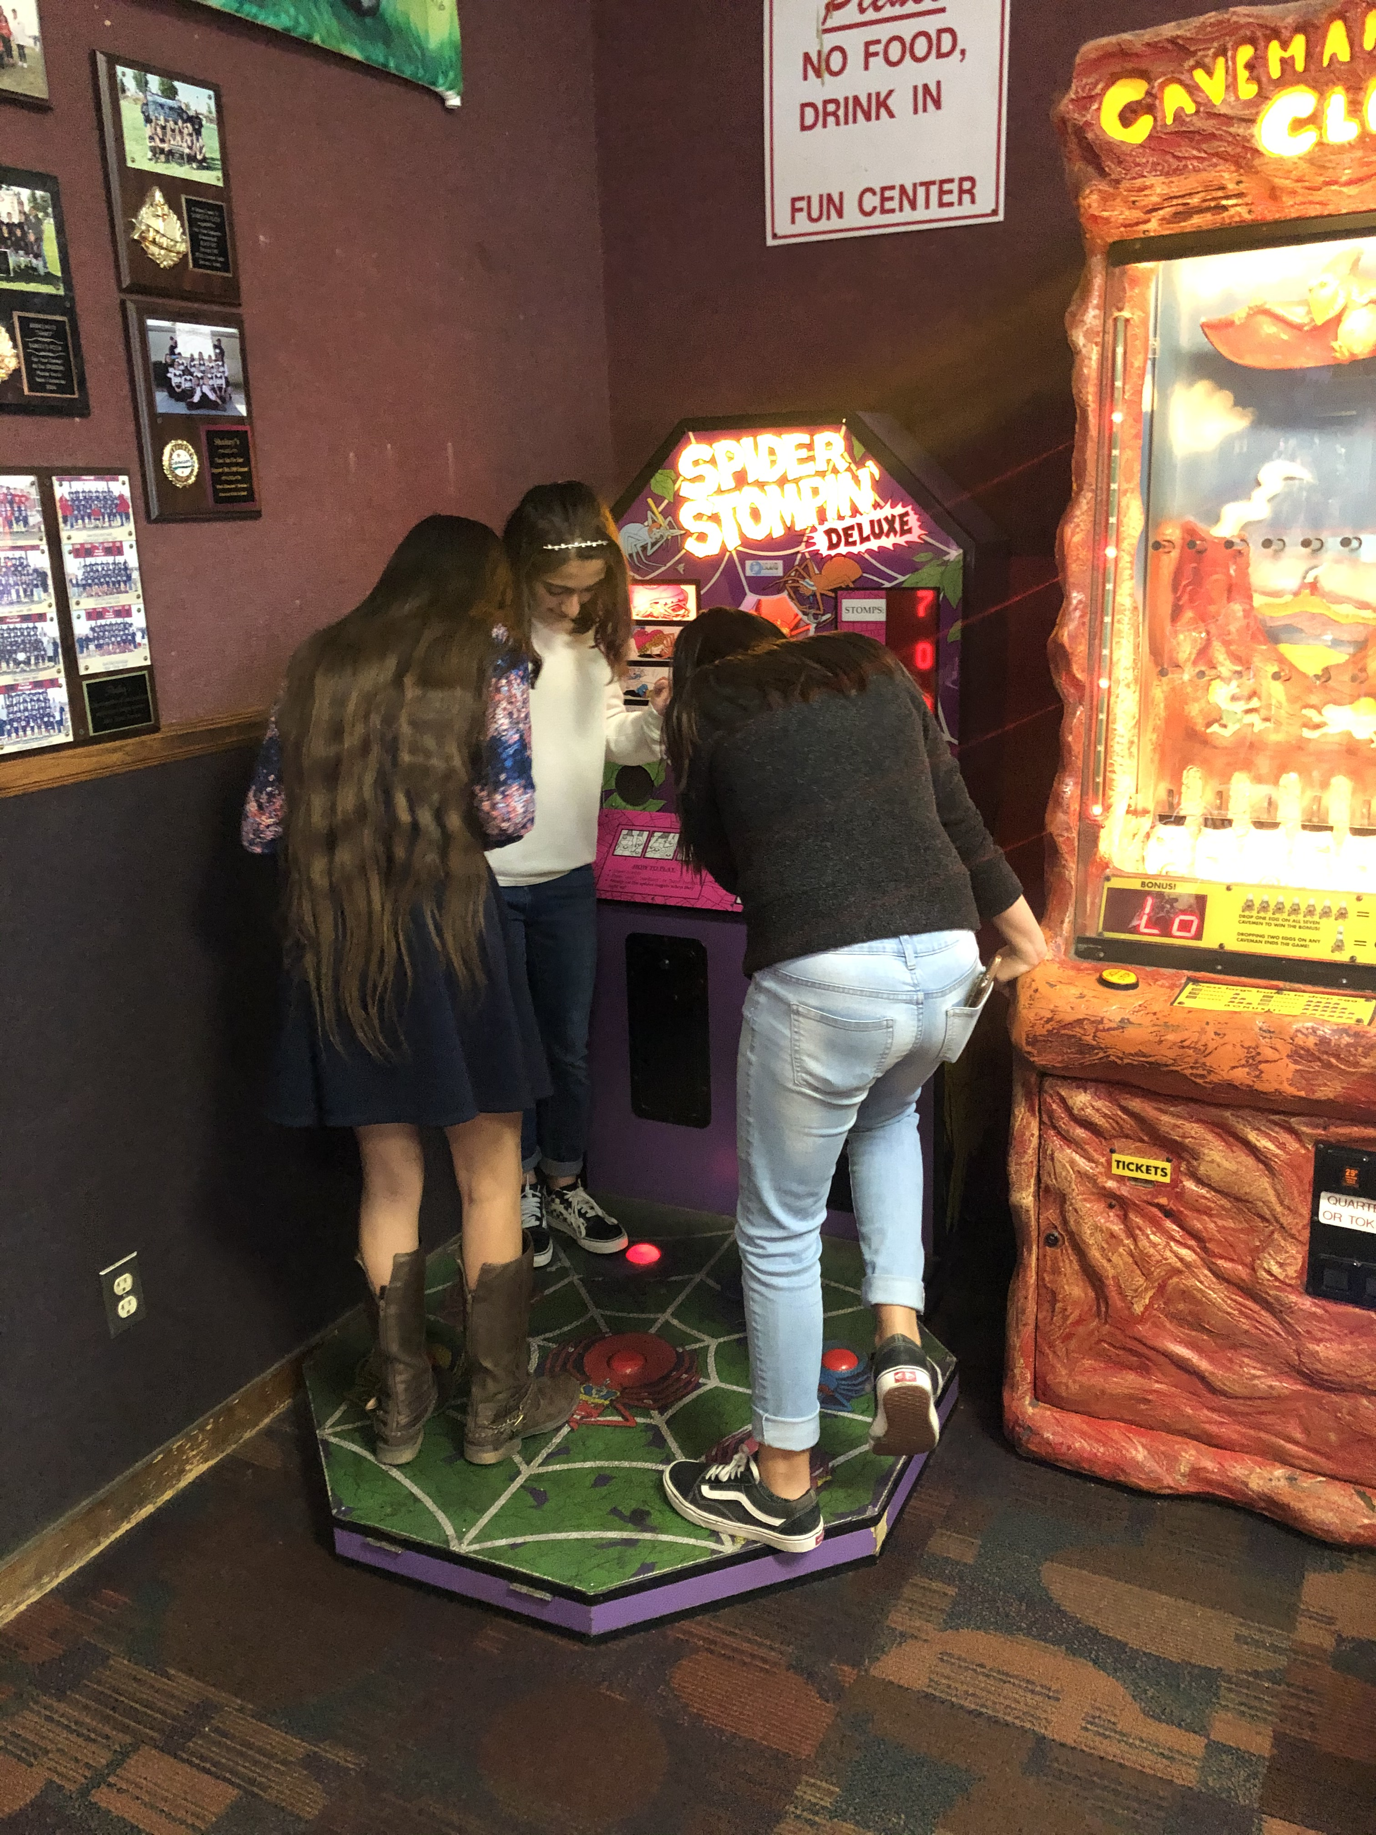
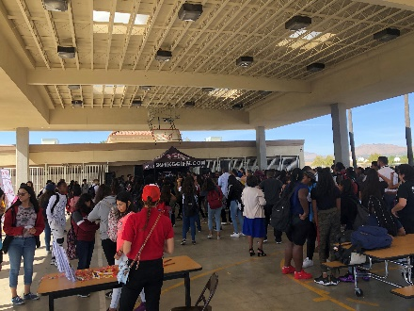
Fun
Students of the Month
Sports
Clubs
Safety Patrols
Dances
Lunch Activities
Spirit Dress Days

Slide 9
Choosing an Elective Class
An elective is a class you get to CHOOSE!
Some electives offered include:
ART
AVID
COMPUTER
BAND
And more
Students who get good grades are able to choose an elective

Slide 10
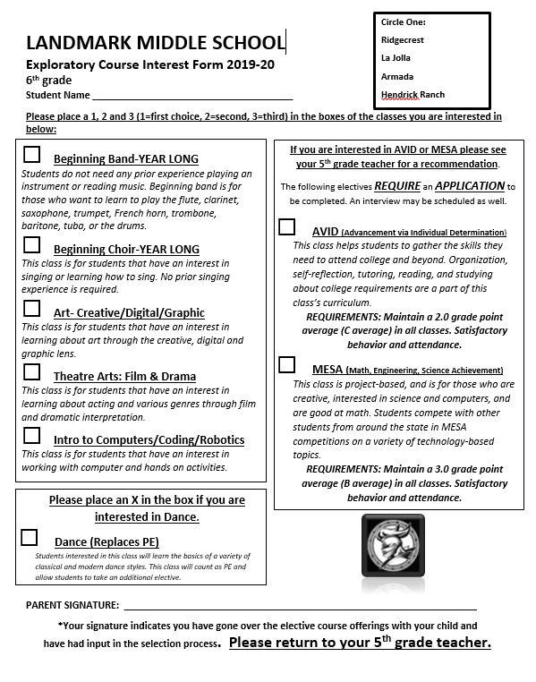
Elective form

Slide 11
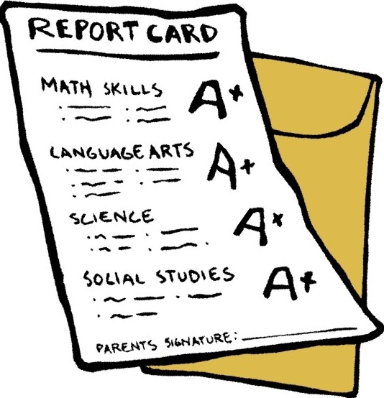
How I do I get placed in 6th grade classes?
Your placement in classes in 6th grade is generally based on 3 things:
Test scores
Grades in 5th grade
Teacher Recommendations

Slide 12
Do Academics Really Matter?
Middle school is more focused on grades and being a great student!
Great middle school students become great high school students
You have to be more responsible!

Slide 13
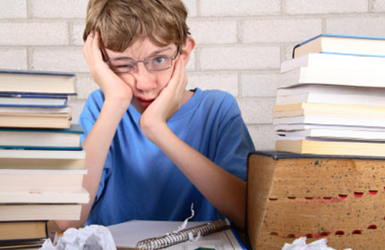
Develop Good Habits
Attendance is KEY!
Get your homework DONE and TURNED IN
Ask for HELP
Take care of YOURSELF!
Be ORGANIZED

Slide 14
Being Organized
Use a Planner
Come to school PREPARED
Manage your time WISELY
Check your BACKPACK

Slide 15
Making Positive Choices
In middle school, all students are expected to follow the rules.
Choosing to break a rule can lead to serious consequences such as
Detentions
Friday School
Dress Codes

Slide 16
What Can I Do Now?
The important thing to remember is…
It’s NOT TOO LATE!
You still have time to improve:
Your grades
Your attendance
Your behavior

Slide 17
Important Information
Please return your Exploratory Interest Form to your 5th grade teacher.

Slide 18
Thank You!
We cant wait to see you to at XYZ Middle School!
If you have any questions, give those to your teachers and they can email us.
Have a great rest of the year!

Slide 19
Quiz Time!
One difference between elementary and middle school is _________________
What is one way to be organized?
__________________________________
Getting placed in 6th grade classes is based on?
________________________________________
The mascot at XYZ Middle School is __________

