Slide 1
Student Leadership at Roberts Elementary

Slide 2
Student Leaders
“We only get one chance to prepare children for a world none of us can possibly predict, what are we going to do with that one chance?”
—Principal Muriel Summers, A.B. Combs Elementary

Slide 4
Our Mission
Our mission, at Roberts Elementary School, is to encourage our staff and students to continuously seek knowledge, develop leadership skills, and learn to lead others while providing service to our school and community.

Slide 5
Leadership at Roberts
Student Leadership Development
Continue to develop our Be The Leader (BTL) Program. The BTL program was designed to build student leaders within the North Gwinnett Cluster ultimately helping students become accountable for their own learning. Specific initiatives will be to establish:
LEVEL 1 (Student Responsibility): Student responsibility for behavior, classroom rules and procedures actively in place, duties and responsibilities for students, etc.
LEVEL 2 (Academic Independence): Student led conference, data presentations, academic responsibility, etc.
LEVEL 3 (Teacher Legacy): Personal growth and leadership, mentoring, visits, etc. Teacher input for menu of opportunities.
LEVEL 4 (Community Impact): Local community activity.
Peer Leader program for students in grade 5

Slide 6
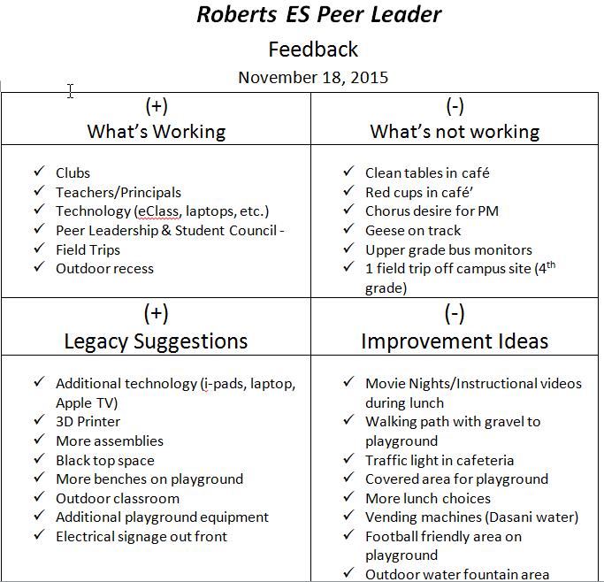
Peer Leaders

Slide 7
Rex Readers
Rational
Selection
Training
Logistics
http://www.jimwrightonline.com/pdfdocs/prtutor/peerTutorManual.pdf

Slide 8
Rex Readers Data
Process
Perception
Outcome

Slide 9
New Student Group
Welcome Bags
Welcome Lunch
Welcome Video

Slide 10
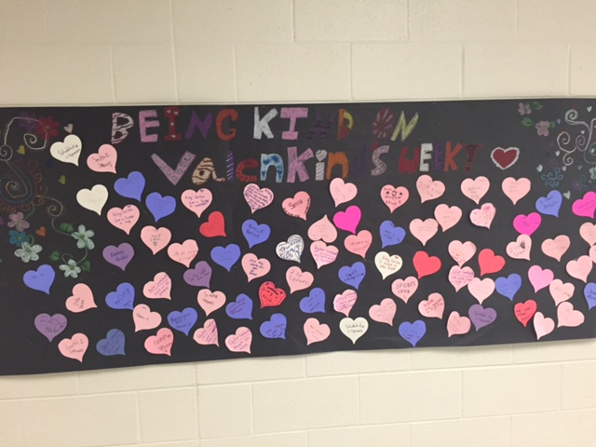
Valenkinds Week
Daily Activities
Posters
Announcements

