Slide 1
Accuplacer App. Preparation for College Assessment
HHS Counseling

Slide 2
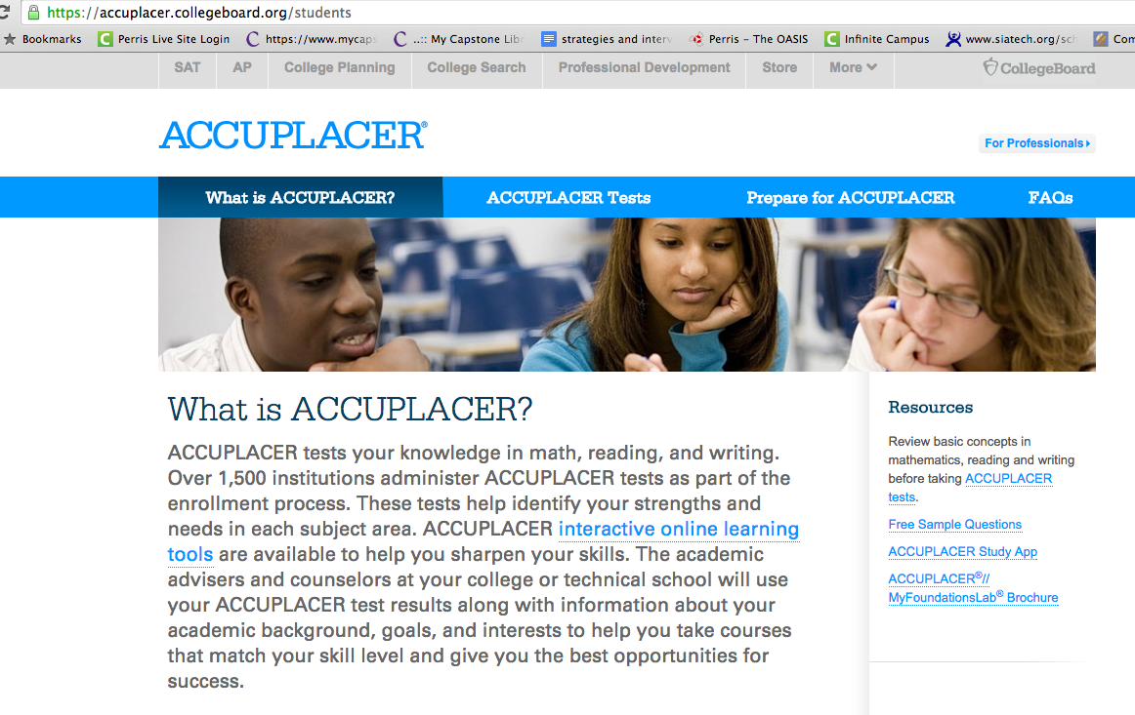
College Board Website

Slide 3
Scroll down to find the Accuplacer App.

Slide 4
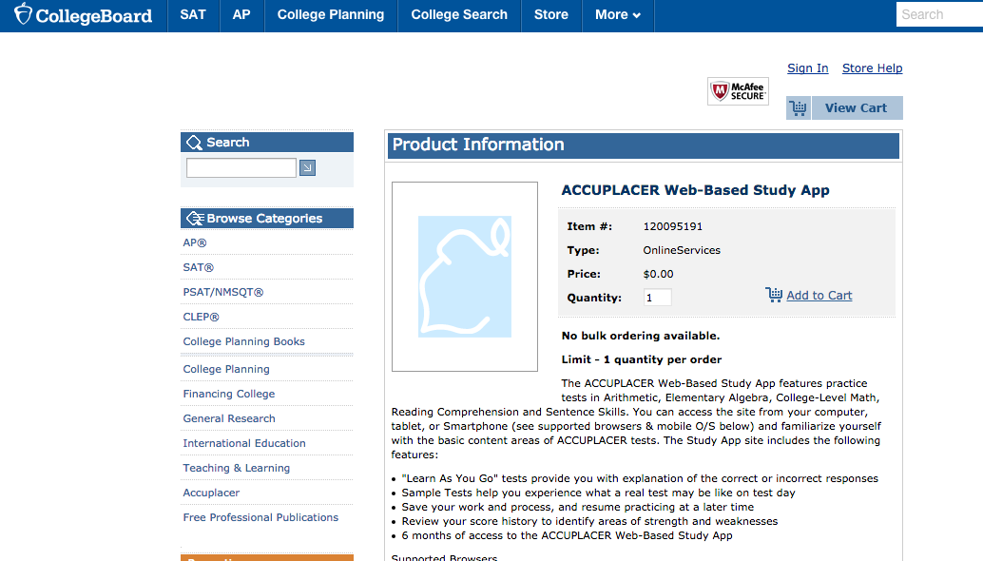
Add the App. to your cart..

Slide 5
Check-out

Slide 6
Enter Billing Information… the App is FREE

Slide 7
Confirm Order

Slide 8
A confirmation email will be sent to your email account..

Slide 9
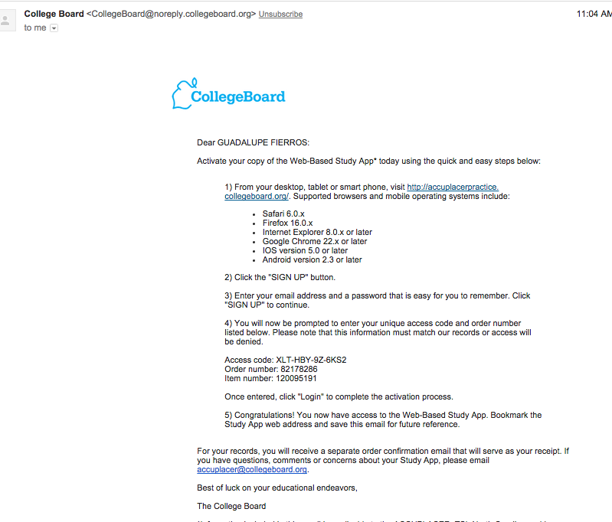
Check your email for Access code & order number information needed to activate your account.

Slide 10
Once you click on the link, it will take you to this page to create a new account.

Slide 11
Create a password

Slide 12
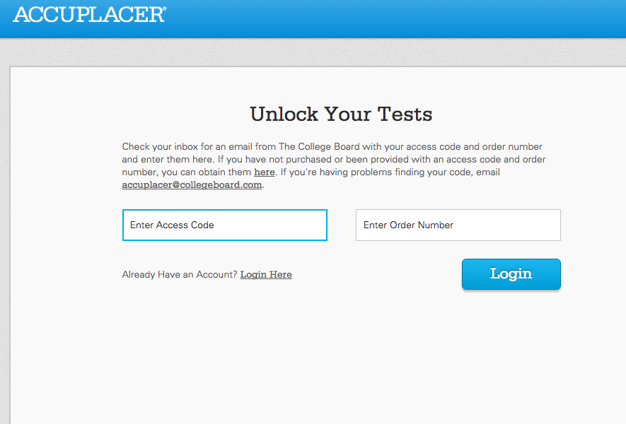
Enter access code and order number from your email.

Slide 13
Account created! Sign-In

Slide 14
Once signed in, you will have access to various practice tests.

Slide 15
Click on the practice test to begin…

Slide 16
Sample Test

