Slide 1
College and Career Readiness
Division of Educational Services

Slide 2
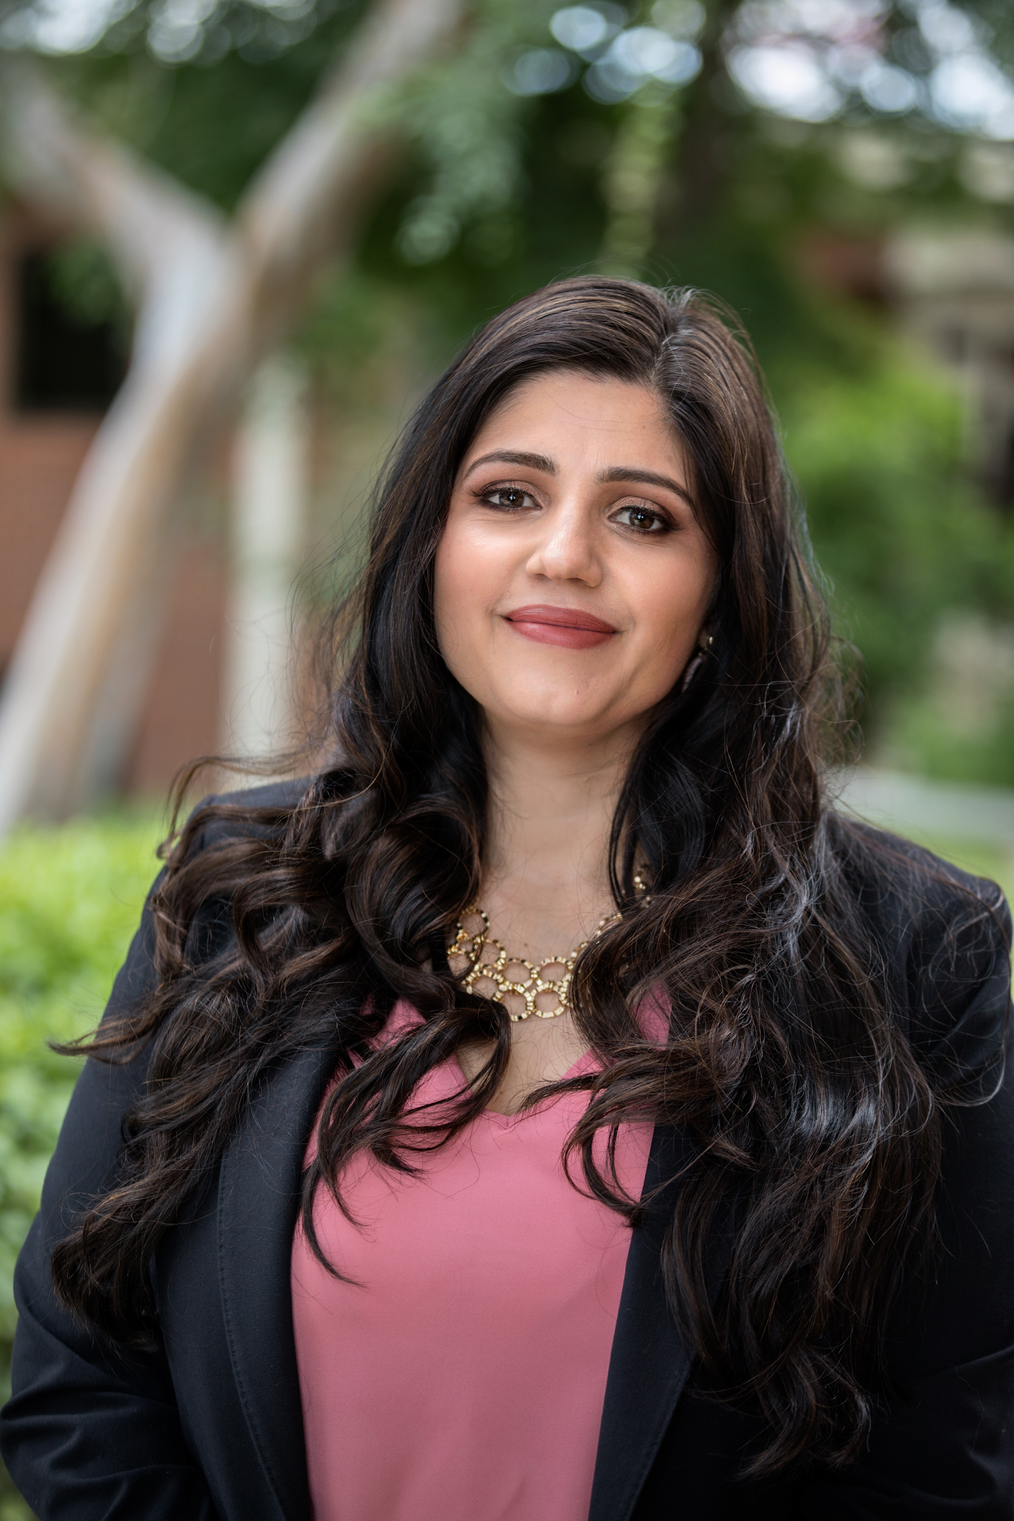
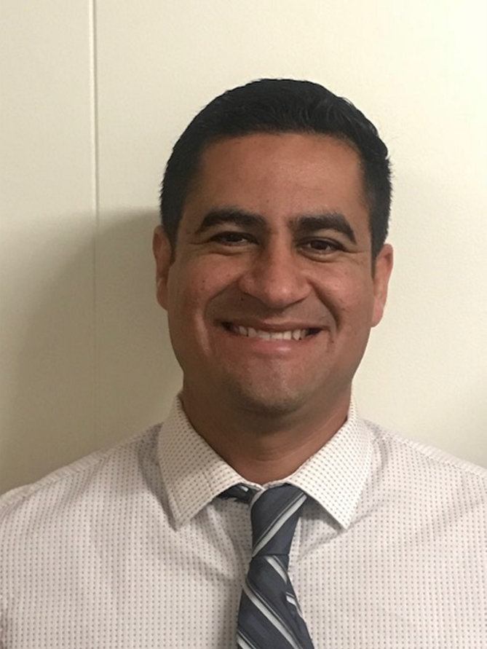
Catalina Cifuentes
Executive Director,
College and Career Readiness
ccifuentes@rcoe.us
Dr. Pedro Caro
Coordinator,
College and Career Readiness
pcaro@rcoe.us

Slide 3
Webinar Tips
This webinar is being recorded so that others may listen to it at a later time for reference and will be uploaded to the RCEC YouTube page as well as www.rcec.us once you log in to access the content of the webinar series
All connections to this live Webinar feature have been accounted for so please do not forward the Zoom link or invite anyone to join because you are taking someone else’s spot and Zoom will automatically start kicking off connections randomly
All participant mics have been muted and only panelists and facilitators have the ability to unmute anyone
Since all participants have been muted, when panelists/facilitators ask you a Y/N question such as can you all hear me, participants should use the “raise your hand” icon
Participants can submit a question in the Q&A box at the bottom of the screen for the panelists
Only panelists and facilitators will be able to respond back to those questions and can do so publicly or privately to the individual
Participants can submit comments or questions in the chat box if they would like to engage with each other
**Every effort has been made to ensure the security of this webinar from “zoom bombers” but in the event that we experience that, please stay calm and we will resume as soon as the technical difficulties have been resolved.**

Slide 4
Supporting High School Students and Continuing Your Counseling Program in a
Virtual Environment

Slide 5
2020 AP Exam Updates
Kenyatta Price, Director
Ricky Cherry, Associate Director
Joshua Olatunde, Associate Director
April 2020

Slide 6
Agenda Recap AP Updates– College Board 2020 SAT Updates (April 14th Announcements) – College Board

Slide 7
2020 AP Exams
For most subjects, the exams will be 45 minutes long, plus an additional 5 minutes for uploading. Students will need to access the online testing system 30 minutes early to get set up.
Exams will not require any test booklet shipments, external proctors, or any additional workload for schools.
The exam content will only include topics and skills most AP teachers and students have already covered in class by early March.
Students will be able to take these streamlined exams on any device they have access to—computer, tablet, or smartphone. Taking a photo of handwritten work will also be an option.
Most exams will have one or two free-response questions, and each question will be timed separately. Students will need to write and submit their responses within the allotted time for each question.

Slide 8
2020 AP Exams
Certain courses–Art and Design: 2D; Art and Design: 3D; Computer Science Principles; Drawing; Research; and Seminar–will use portfolio submissions.
Students taking world language and culture exams will complete two spoken tasks consistent with free-response questions 3 and 4 on the current AP Exam.
Written responses will not be required for these exams.
No cancellation or unused fees will be assessed this year
If a student does not take the exam on either testing date, it will be treated as an unused exam. In that way, students/families can “choose to cancel” their exam. The coordinator would not need to mark the exam as canceled or unused in AP Registration and Ordering – that will be done automatically, and as confirmed above, they will receive a list of those students after the make-up exam window.
Instructional resources launched on 3/25/20--free remote learning resources. https://www.youtube.com/user/advancedplacement

Slide 9
2020 AP Exams
Exams will be given from May 11–22.
Make-up test dates will be available for each subject from June 1–5.
It is recommended students test during the primary administrations from 5/11-22 to avoid testing conflicts and allow for a make-up if they are ill or have a technical issue.
Students that have technology issues while taking their online AP Exam in the Primary Exam window, May 11 – 22, will need to complete an incident report in order to get access to testing in the Make-up Exam window. The APC or AP Teacher will not be able to complete the incident report for the student.
Each subject’s exam will be taken on the same day at the same time, worldwide.
Exam schedule and course-specific information: https://apcoronavirusupdates.collegeboard.org/educators/taking-the-exams/ap-exam-schedule#courseSpecific

Slide 10
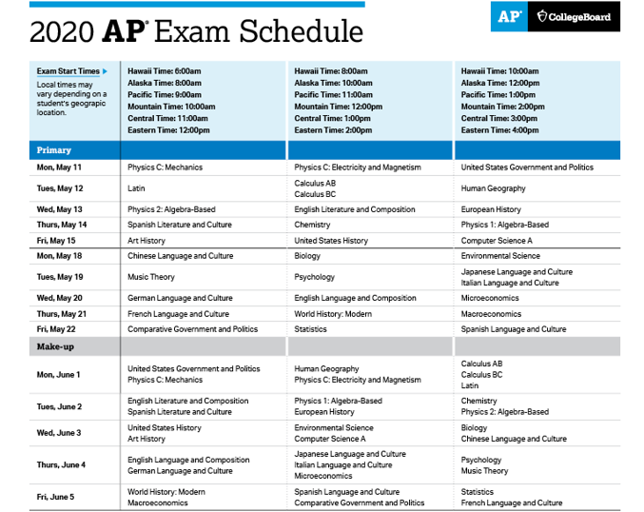

Slide 11
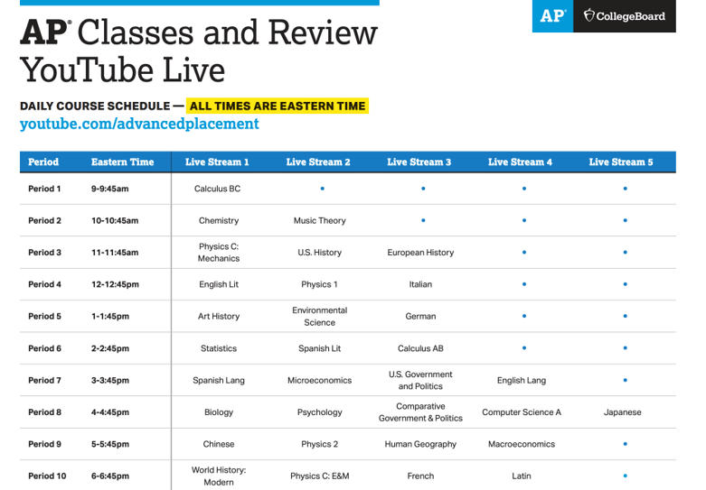

Slide 12
2020 AP Exams
Student’s work will be scored by our network of college faculty and AP teachers, and reported on a 1-5 scale
We anticipate releasing scores as close to the usual July timeframe as possible
Scoring

Slide 13
2020 AP Exams
Coordinators should indicate student’s fee reduction eligibility in AP
registration and Ordering as soon as possible. Deadline extension: May 26, 11:59pm EST
Because there is no Calculus AB subscore, we are allowing students to switch from Calculus BC to Calculus AB and vice versa at no charge by Monday, April 20th, 11:59 p.m. EST.
If you have students who would like to switch from taking Calculus BC to Calculus AB, please ensure that those students have entered the join code for whatever Calculus AB section you would like them to join (teacher-led or exam only). Once you have confirmation they are registered for the section, please call AP Customer Service for educators (877-274-6474) for further instructions. You can see p. 81 of the AP Coordinator's Manual Pt 1 for additional guidance. Although our deadline for these changes is April 20th at 9:59pm (PST), I highly recommend you begin this process as soon as possible, as some of these steps may take a few days to process.
Details regarding accommodations will be shared closer to the exams.
April 13th: Optional Student Practice section that includes the most relevant FRQs to help them practice the concepts and skills that will be tested in May 2020. They can answer these in any order and will have an opportunity to review how each question will be scored before they submit.

Slide 14
2020 AP Exams
We’re using a range of digital security tools and techniques, including plagiarism detection software and post-administration analytics, to protect the integrity of the exams
AP teacher will receive copies of student’s work
Students who:
submit responses that mirror online content or other students’ submission
share or receive content or exam responses
engage in any plans or efforts to provide or gain an unfair advantage
will be subjected to the following actions;
Blocked from testing
Cancelled AP scores
Notification sent to HS and colleges/universities of which they have applied or plan to apply
Prohibited from taking any CB exams
In certain circumstances, CB may inform law enforcement
Test Security

Slide 15
2020 AP Exams
Playback the 2020 AP Exam Updates with Trevor Packer presentation
Review the Updates for AP Students and Schools Affected by Coronavirus website including 2020 Exam Schedule | Course Specific Information | Exam Security/Test Day Protocols
Review the Updates for AP Coordinators at Schools Affected by Coronavirus website
Let us know about Students with a Need for Mobile Tools or Connectivity
Consider fee collection providers to assist with Managing Fee Collection
Join and participate in the AP Coordinator Online Community - a professional learning network connecting AP Coordinators worldwide. Register using your College Board professional login
Resources
Upcoming Webinars
April 20 (11:59 p.m. ET) | Deadline to switch a student’s AP Calculus Exam or switch a student’s AP Art and Design Exam.
May 26 (11:59 p.m. ET) | Deadline to indicate students’ fee reduction status in AP Registration and Ordering.
June 20 | Deadline to confirm accuracy of student school code
June 26 | Postmark deadline for 2020 AP Exam payment to be sent to College Board. The invoice will be generated after the makeup AP Exam testing window in early June.

Slide 16
2020 SAT Updates
If it’s safe from a public health standpoint, there will be weekend SAT administrations every month through the end of the calendar year, beginning in August. This includes a new administration in September and the previously scheduled tests on August 29, October 3, November 7, and December 5.
To replace canceled SAT School Day administrations this spring, the College Board will offer the SAT in schools this fall. Almost all of College Board state partners and many of its district partners have expressed interest in providing SAT administrations during the school day later this fall. This is an important opportunity for the many students who take the SAT for free as part of state- and large district-sponsored programs. Specific information about state and district testing will be shared with our partners in the coming weeks so they may create their testing plans for students.
In the unlikely event that schools do not reopen this fall, the College Board will provide a digital SAT for home use, much as the organization is delivering digital exams for three million Advanced Placement (AP) students this spring. As with at-home AP Exams, the College Board would ensure that at-home SAT testing is simple; secure and fair; accessible to all; and valid for use in college admissions. Like the pencil-and-paper test, a digital, remote version of the SAT would measure what students are learning in school and what they need to know to be successful in college. The digital, at-home SAT would build on the organization’s experience over the past year of delivering the SAT digitally in schools in several states and districts. While the idea of at-home SAT testing is new, digital delivery of the test is not.
Over the coming weeks, the College Board will provide students, families, and K–12 and higher ed members with new information about testing plans, including via pages.collegeboard.org/sat-covid-19-updates.

Slide 17
College Board Contacts
Kenyatta Price Director, K-12 State and District Partnerships kprice@collegeboard.org
California Riverside County Riverside USD RCOE San Bernardino County Chaffey Joint UHSD Chino Valley USD Fontana USD Rialto USD San Bernardino USD SBCSS Victor Valley UHSD | Arizona Arizona DOE Chandler USD Gilbert Public Schools Glendale UHSD Great Hearts Academies Mesa Public Schools Peoria USD Phoenix UHSD Scottsdale USD Tanque Verde USD Tempe UHSD Tucson USD
Ricky Cherry Associate Director, K-12 State and District Partnerships rcherry@collegeboard.org
Butte County Chico USD Los Angeles County Chico USD Compton USD Covina-Valley USD El Monte UHSD Pomona USD Whittier UHSD Monterey County Monterey Peninsula USD Orange County Brea-Olinda USD Fullerton Joint UHSD Garden Grove USD Newport-Mesa USD Orange COE Orange USD Santa Ana USD Tustin USD | Riverside County Alvord USD Beaumont USD Coachella Valley USD Corona-Norco USD Hemet USD Lake Elsinore USD Murrieta Valley USD Perris UHSD San Jacinto USD Val Verde USD San Bernardino County Apple Valley USD Redlands USD Upland USD Santa Barbara County Lompoc USD Santa Barbara USD
Joshua Olatunde Associate Director, K-12 State and District Partnerships jolatunde@collegeboard.org
Alameda County Alameda USD San Lorenzo USD Contra Costa County Liberty UHSD Los Angeles County Lynwood USD Montebello USD Norwalk-La Mirada USD Paramount USD Walnut Valley USD Orange County Huntington Beach UHSD Placer County Placer UHSD Rocklin USD | Riverside County Desert Sands USD Moreno Valley USD Palm Springs USD Temecula Valley USD San Bernardino County Hesperia USD San Joaquin County Manteca USD Santa Barbara County Santa Maria Joint UHSD Santa Clara County Campbell UHSD Los Gatos-Saratoga Joint UHSD Palo Alto USD Santa Cruz County Pajaro Valley USD Sonoma County Pataluma City School District Santa Rosa City School District

Slide 18
Jenny Cortez, LCSW
Social Work and Mental Health Specialist
Murrieta Valley HS
(951) 304-1606 (During COVID-19)
jcortez@murrieta.k12.ca.us
Nicole Castro
High School Counselor
Murrieta Valley HS
(951) 304-1650 (During COVID-19)
ncastro@murrieta.k12.ca.us

Slide 19
High School Counselor: Phase I
March 13-March 27
Preparing for Possible School Closure
1)Identify High Risk Student List
2) Troubleshoot email and communications
Notes:
Castro Slide

Slide 20
High School Counselor: Phase I
1) High Risk Student List:
School Counselors and Mental Health Therapist worked together to create a list of students with Emotional, Mental and/or Health Concerns
Example of students on the list:
Student with 504 Accommodations Plans
Students with Safety Plans (previous suicide attempt or ideations)
Students in Counseling Groups and/or frequent visitors to the Counseling Office
Notes:
Cortez Slide
Shared Spreadsheet to help keep counselors and mental health communication open
Collaborated for those students who were duplicates

Slide 21
High School Counselor: Phase I
2)Troubleshoot email and communications:
ALL MVUSD students have Microsoft 365 email accounts that are connected to their AERIES account.
Prior to school closure, our Guidance Secretary sent emails to all teachers asking them to have all students check to make sure they were able to access their emails.
If they had difficulties, they were sent up to the office to help troubleshoot.
District has a general email for parents and students to submit questions, concerns or to get assistance.
Notes:
Castro Slide

Slide 22
High School Counselor: Phase II
April 6 - June 6
Distance Learning
1) Create a Weekly Counselor Newsletter/Bulletin
2) Create a COVID 19-Counselor Resource Page
3) Create HS counselor “to-do” list for 2nd semester
4) Virtual check-ins and sessions with students on high-risk list
*Murrieta Valley Unified School District Counselors ALL worked together to create and share our resources. This helped us streamline resources for all.
Notes:
Castro Slide

Slide 23
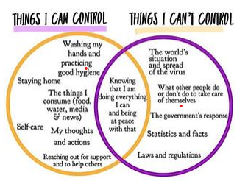
High School Counselor: Phase II
1) Create a Counselor Newsletter/Bulletin:
With so many emails being sent to our parents/students from our District office, we wanted to streamline communication from Counseling
Sections include:
Counselor Office Hours
Happy News
Frequently Asked Questions
Social and Emotional Support
Mental Health Theme with videos and worksheets
Tips on being a successful long-distance learner
Previous Bulletins: March 23-27, April 6-11, April 13-17
Notes:
Cortez Slide
Weekly Themes - stress management, anxiety, grief and loss, caring for the caregiver, etc.

Slide 24
High School Counselor: Phase II
2) Create a COVID-19 Counselor Webpage:
Webpage created on our Counseling Home Page to provide students and parents with resources to support them during the COVID-19 Pandemic.
Murrieta Valley HS COVID-19 Counseling Resource Page
Sections include:
Counselor Weekly Updates
Student and Family Well-being: Tools and Resources
Crisis Resources Links
Notes:
Castro/Cortez Slide

Slide 25
High School Counselor: Phase II
3) Create HS counselor “to-do” list for 2nd semester on Google doc:
Keep our "Counseling Teams" on track for the semester, we created a Excel Spreadsheet with our "to do" items with links
Sections include:
Social Emotional High-Risk student check-ins
Seniors at risk
Juniors at risk
Summer School
Credit Recovery List
Course Requests
504's
Notes:
Castro Slide

Slide 26
High School Counselor: Phase II
4) Virtual Check-Ins & Sessions with High-Risk Students:
Using MiTel software to connect with students and parents via phone.
Using Microsoft Bookings App to allow students and parents/guardians to set appointments with us as needed.
MVHS Virtual Counseling Appointments
Support students who are struggling with emotional and mental health concerns.
Consent Forms created to get approval from parents for teleconferencing and check-ins for the remainder of the year.
Microsoft 365 Electronic Consent Form created to make it easier to get consent from parents/guardians.
Conduct virtual telehealth sessions using Microsoft Teams.
Connect families to community resources as needed.
Notes:
Cortez Slide

Slide 27
High School Counselor: Phase II
What’s Worked?
Teamwork (sharing resources)
Utilizing current technology like Microsoft 365, Aeries Communication, Mitel Phone lines, Haiku for teachers
Struggles?
Helping/reaching students who have gone “DARK”
Difficulty getting in contact with students/families
Learning and using new platforms we weren’t familiar with before.
Notes:
Castro Slide

Slide 28
Melina Gonzalez
Heritage High School
Lead Counselor
melina.gonzalez@puhsd.org
Cheri Adame
College and Career Counselor
Heritage High School
cheri.adame@puhsd.org
Julie Zierold
Director of Curriculum & Instruction
julie.zierold@puhsd.org

Slide 29
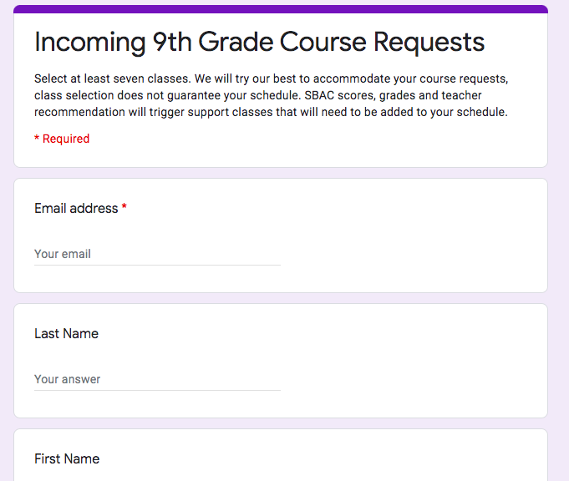
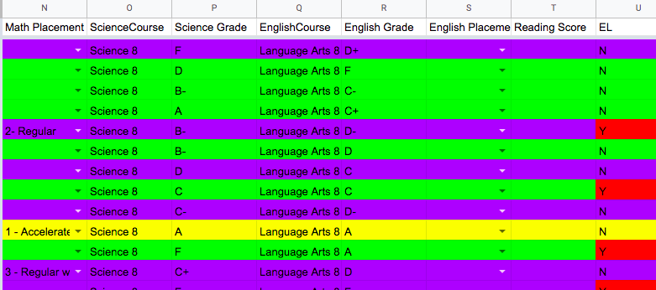
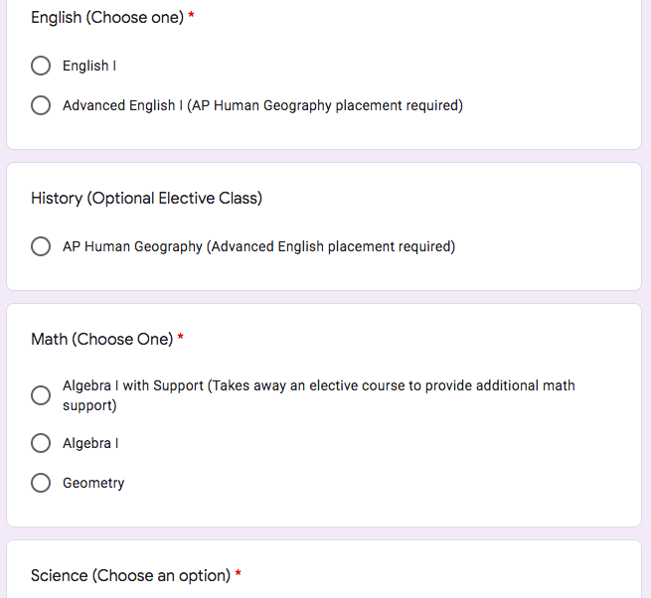
Middle School Communication
*We created a Google Survey that went out to all the middle school students to select courses for next school-year. Close contact with Middle School Counselors who have assisted us in following up with students.
*Our 9th grade counselor has a Google shared document where teachers provide math, science and English recommendations (Sped and ELL students are identified)
*Our Website has a whole section for middle school articulation with class selection sheet, 4 year plan, programs applications and PowerPoint with our school information.

Slide 30
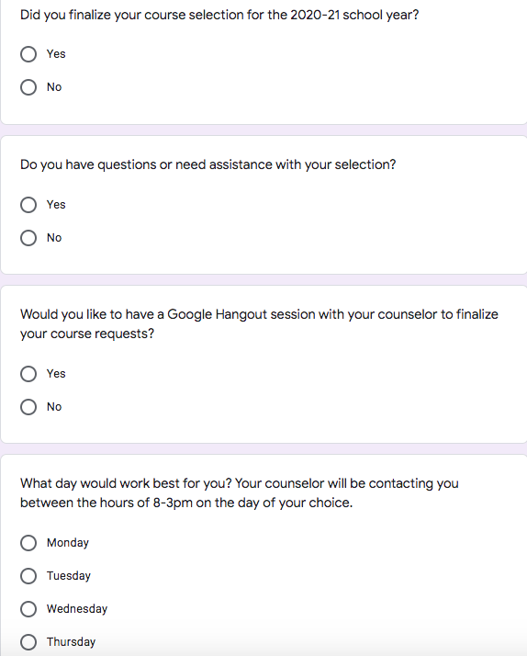
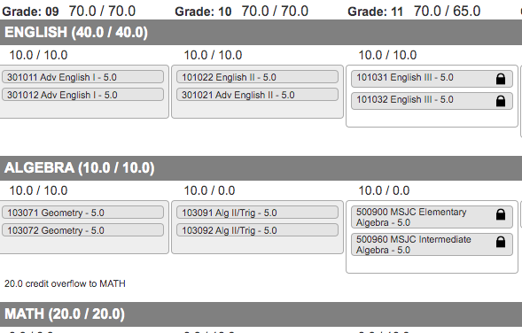
Student Course Selection/Communication
*All students attended a Course Selection presentation before we left the school. The majority of the students had already selected their classes.
*We created a Google Survey for students to request assistance/support to finalize their classes for next school year.
*We also emailed and we made personal contact to the students that had no classes selected through Google voice and Google meets.
*EL Team met before the shutdown, students were provided with work packets and workbooks to take home. EL teachers try to meet with students through Google Meets at least once a week. Any emails that have gone out are translated in Spanish.
Google Survey

Slide 31
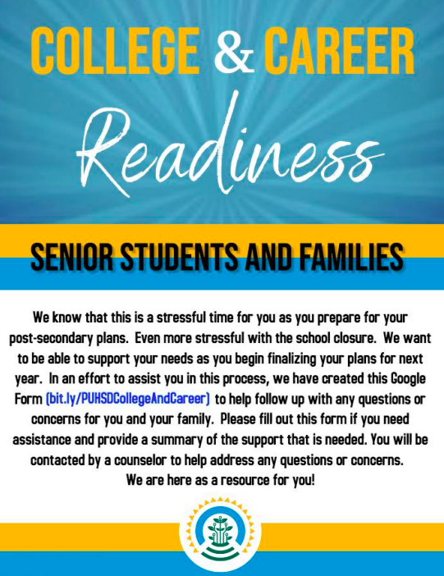
College and Career Counseling Resources and Supporting the Class of 2020
PUHSD Landing Page - PUHSD Distance Learning: https://sites.google.com/puhsd.org/distancelearning/
Link includes many resources for Seniors. We have included the following information and categories:
SIR - Registration and links to important UC/CSU dates and information
FAFSA/CADAA Webgrants, Financial Aid Award Letters, and Appeals
Link to College and Career Readiness Support CCRC Support Request Form
Community College
Common App
Scholarships
College Board

Slide 32
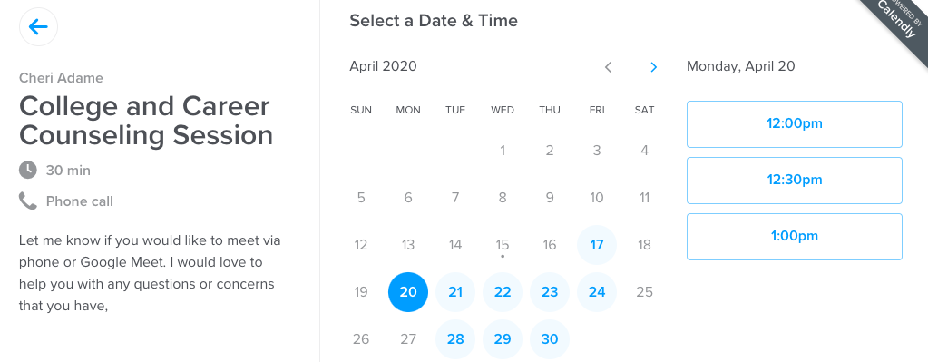
College and Career Counseling Resources During COVID-19
Other Tools and Resources:
Calendly to schedule appointments - phone, google hangouts, links to your Google Calendar. You can control the appointment times
Google Hangout/Meet/Voice
CCGI Screencast College Search Screencast
MSJC Dual/Concurrent Matriculation Information Screencast
Social Media, Blackboard, PeachJar
Future Plans - more Screencasts to support other categories in College and Career

Slide 33
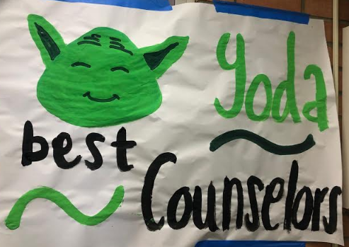
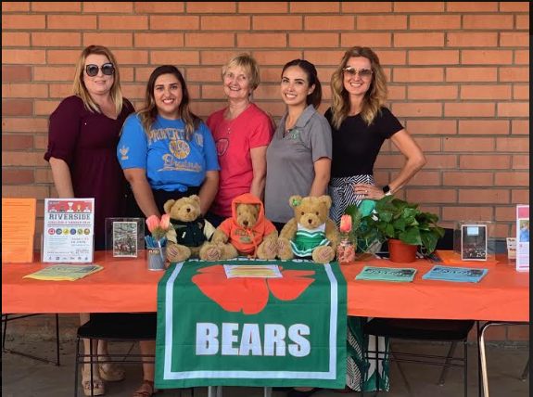
Dr. Yuri Nava- School Counselor
Adjunct Professor-La Sierra University
ynava@riversideunified.org
951-788-7203 x 64217

Slide 34
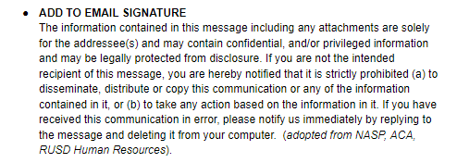
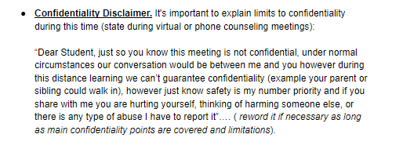
Unified Best Practices
District Level
Collaborative Approach
Uniform Disclaimers

Slide 35
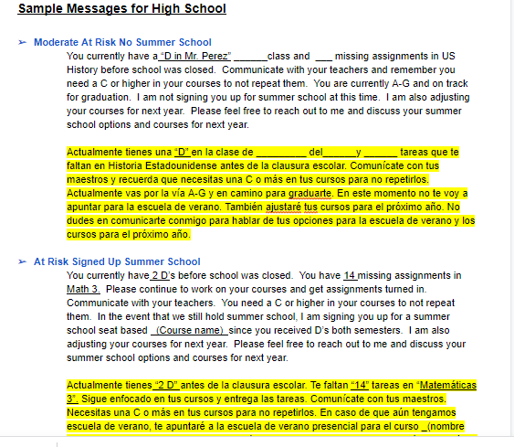
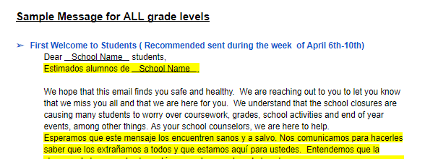
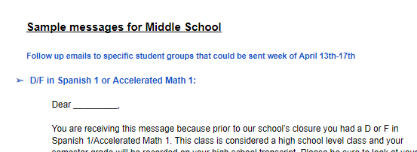
District Level Unified Best Practices
Uniform Student/Family Messaging

Slide 36
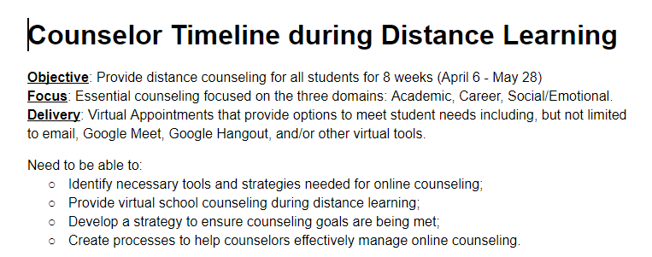
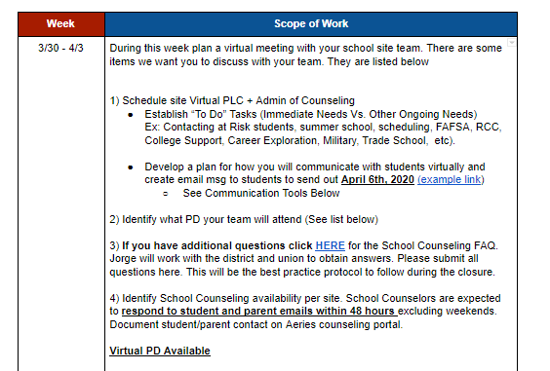
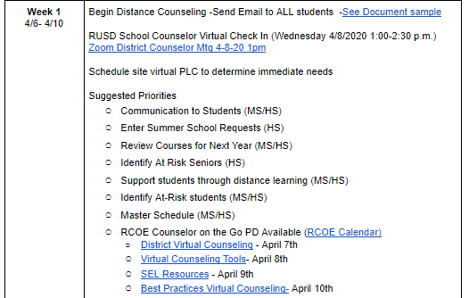
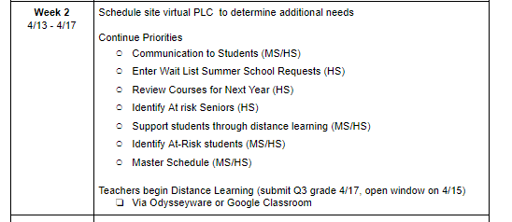
District Level Unified Best Practices
8 Week Virtual Counseling Plan/Timeline

Slide 37
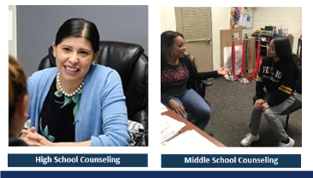
District Level Unified Best Practices
District Counseling Website
Student & Parent Tab
Uniform Resources
Academic
College
Career
Social/Emotional
Foster Youth
Graduation

Slide 38
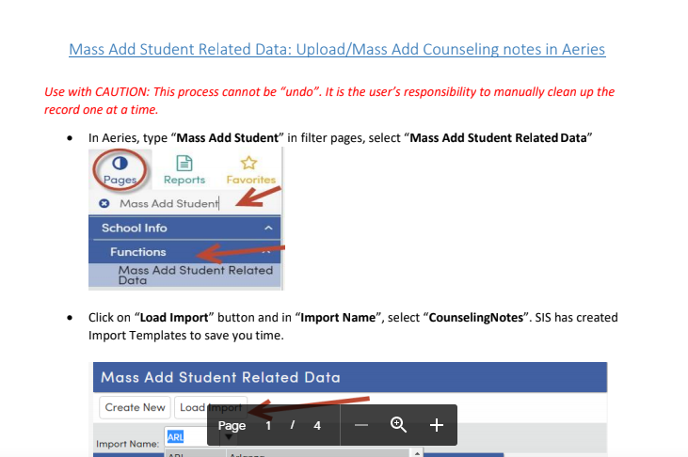
District Level Unified Best Practices
Uniform Documentation (Data)
District Counseling Virtual PLC

Slide 39
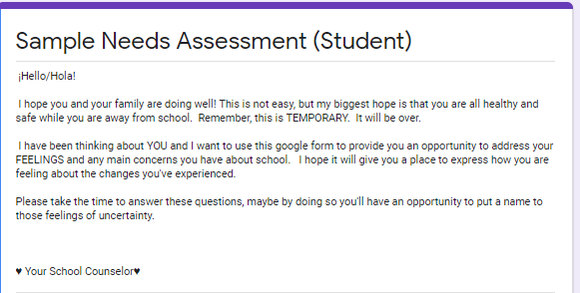
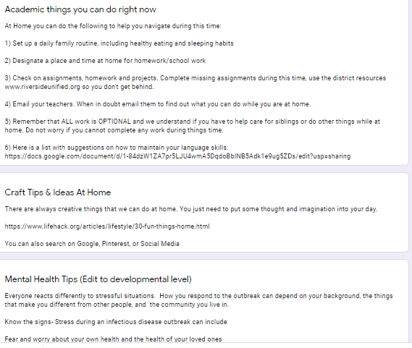
District Level Unified Best Practices
Needs Assessment (English/Spanish)
Questions
What do you miss the most?
List your TOP concerns about school
What personal concerns do you have
What resources do you need?
College
Career
Personal
Academic
Other
What do you need help with right now ? (Transcripts, Schedule, College Applications, Scholarships, other, etc.)
Embedded Resources

Slide 40
Site Level ~ Poly High School
Senior Master List (Data)
Demographic Data
Programs
AVID
Foster
Homeless
GPA
A-G
FAFSA/CADA
Post Secondary Plan

Slide 41
Site Level ~ Poly High School
Senior Graduation Audit
180 Status
130 Status
Quarter 3 Senior Grades Audit

Slide 42
Site Level ~ Poly High School
Crisis Confidential List (Data)
Demographic Data
Programs
Actions
Outcome
Type of Crisis
Counselor
Time
Virtual Peer Support Groups
Based on Need
Based on Data

Slide 43
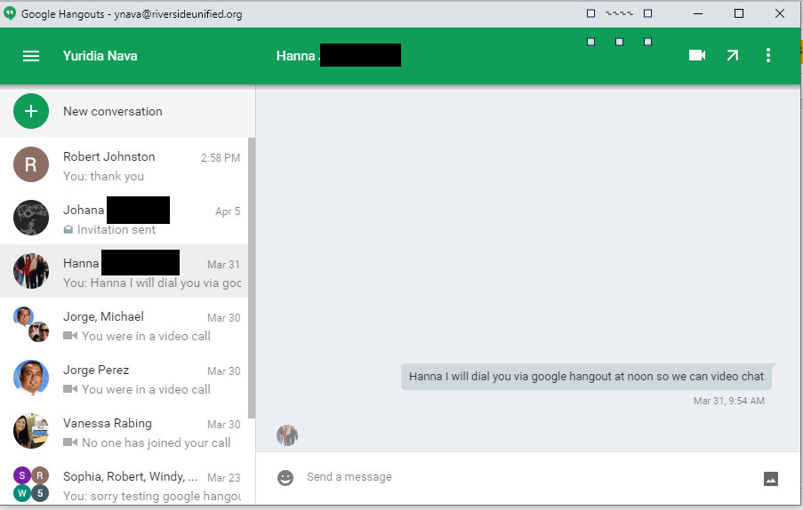
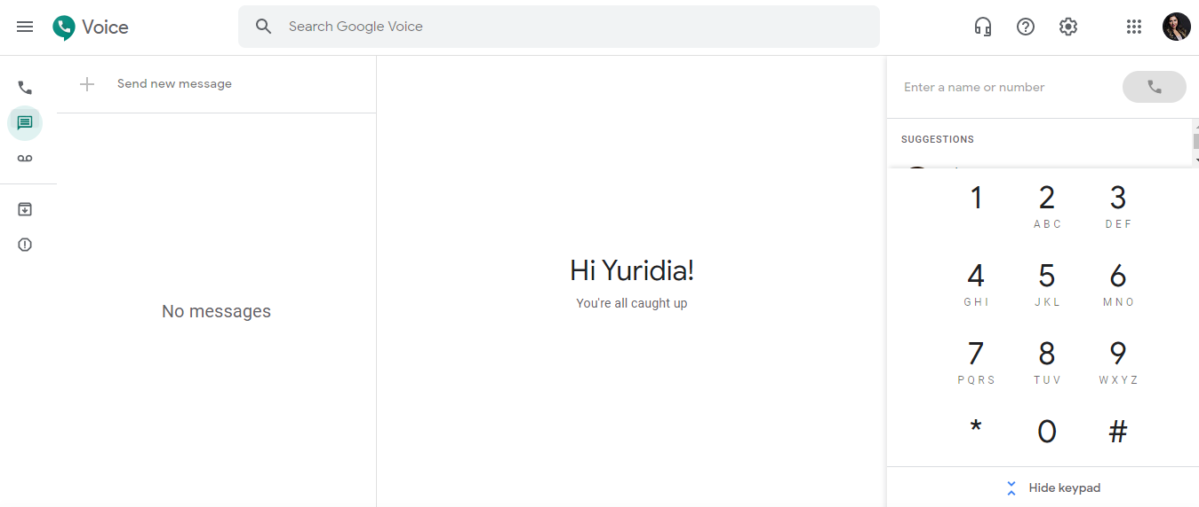
Site Level ~ Poly High School
Strategic Communication
Emails & Phone Dialers
Multiple Communication Options
Email
Google Voice
Google Hangout
Google Chat
Remind App
Linked Office Phone

Slide 44
Site Level ~ Poly High School
Daily Office Hours
Publish School Website
Publish Counseling Website
Virtual Check In w/The Counselor
Team Counseling Website
Weebly & Google Sites
COVID-19 Tab

Slide 45
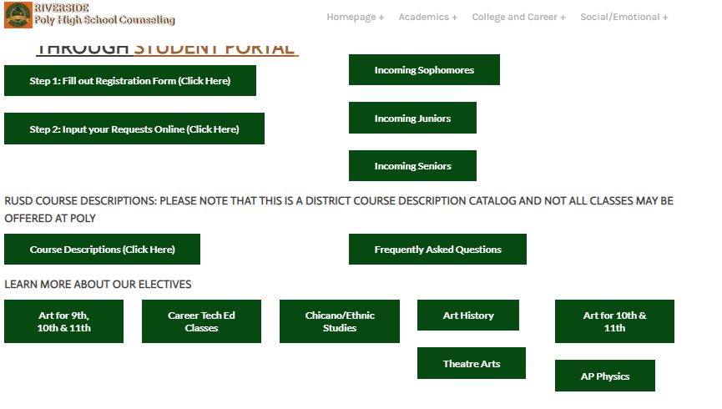
Course Selection (Online w/Recordings)
Senior Celebration (School Wide/Clubs)
Social Media (Instagram/Facebook)
Counselor Guest w/Teacher Distance Learning
Collaborative Approach (Weekly PLC)
Utilizing Counseling Interns

Slide 46
University of California
UC Berkeley: Admission Office | Admitted Student website | Counselor Information UC Davis: Admission Office | Freshman Decision Day | Transfer Decision Day | Virtual Tour UC Irvine: Admission Office | Celebrate UCI Day | Virtual Tour UC Los Angeles: Admission Office | Bruin Bound | Virtual Tours UC Merced: Admission Office | Webinars and Videos | Virtual Tours UC Riverside: Admission Office | Highlander Day | Virtual Tours UC San Diego: Admission Office | Triton Day | Transfer Triton Day | Virtual Tour UC Santa Barbara: Admission Office | Webinars and Online Events | Virtual Tour UC Santa Cruz: Admission Office | Admitted Student website | Virtual Tour UC Housing: https://admission.universityofcalifornia.edu/counselors/files/campus-housing_admitted-students.pdf?mc_cid=03c2a450e8&mc_eid=dfdd2bed7c

Slide 47
University of California Updates
May 9, 2020 UC Analytical Writing Placement Exam (AWPE) has been cancelled. Students intending to take the AWPE on May 9th will have other opportunities to satisfy UC’s Entry Level Writing Requirement and will hear more about these options from their intended UC campus in the coming months.
Eligibility in the Local Context (ELC) has suspended the student data submission process by high schools in 2020. While schools will not need to submit student data to ELC this year, the ELC status determination will continue to be made upon submission of the UC application, as in past years. The ELC process for high schools will resume in 2021. If you have questions, please email elc@ucop.edu.

Slide 48
University of California Updates
A-G course submission update: If your school is transitioning to online instruction as a temporary measure due to public health precautions related to COVID-19, please know that this situation DOES NOT require you to re-submit your A-G course descriptions. No action is needed, and in no way does this situation affect the status of your A-G approved courses.
UC School Counselor Webinar Series: https://admission.universityofcalifornia.edu/counselors/resources/hs-webinar-series/?mc_cid=03c2a450e8&mc_eid=dfdd2bed7c

Slide 49
The California State University
The CSU will accept grades of "Credit" or "Pass" to satisfy "a-g" requirements completed during winter, spring or summer 2020 terms. All prior coursework must be graded and a grade of C- or better must be earned for the course to satisfy “a-g" requirements. Grades of credit/pass or no credit/non-passing will not be included in the calculation of high school GPA.
CSU campuses will assess and initially place students in first-year English/Math based on multiple measures: high school and college courses completed, GPAs and test scores (SBAC, ACT, SAT) that students have submitted thus far.

Slide 50
The California State University
The CSU will not facilitate a systemwide Early Start Program in summer 2020; individual CSU campuses may offer summer transitional programs (e.g. Summer Bridge) in virtual formats.
The CSU requests that high schools that can provide transcripts by July 15, 2020, do so; however, campuses will continue to accept transcripts through the fall 2020 term. CSU campuses will not rescind conditional offers of admission based on the non-receipt of transcripts. If a student is not able to provide an official transcript, due to extended school closure, CSU campuses may use unofficial or self-reported data for senior year grades and graduation status.

Slide 51
The California State University
New first-year students will remain in a conditionally admitted status until the CSU campus receives a final transcript document and review of the transcript for a-g requirements is completed.
If a student has not met all a-g requirements after review of their final transcript document, at that time, CSU campuses may use admission exceptions on a case-by-case basis if students are no longer CSU-eligible, based on the inability to complete all “a-g" courses in which they were enrolled in spring 2020.ii Consideration can include how well the student is doing academically in fall 2020. Students should in no way assume that enrollment in Fall 2020 CSU courses means that an exception will be automatically granted.

Slide 52
The California State University
The College Board has announced changes to the AP exam content and format for spring 2020. The CSU will honor all existing transferable credit articulation for spring 2020 AP exams on which scores of 3, 4, or 5 are earned.
​CSU campuses are individually considering their extension of intent to enroll and/or housing deposit deadlines. Intent to enroll deadlines will consider the campus' capacity to provide timely information regarding financial aid awards to students and families. More information will be forthcoming.​
https://www2.calstate.edu/apply/Pages/contact-a-campus.aspx

Slide 53
Additional Support Sites
NACAC: https://www.nacacnet.org/news--publications/newsroom/college-admission-status-coronavirus/
NACAC College Admissions Decoded Podcasts: https://www.nacacnet.org/news--publications/podcast-college-admissions-decoded/
Dr. Laura Owen- American University: https://www.american.edu/centers/cprs/school-counselor-covid-19-resources.cfm?fbclid=iwar2nidkv0p8hxccv0lf4ptmcq2mcfana0yhr97hnzr8agxhvqcp-n9grywi

Slide 55
We are here to support you!
Please reach out to College and Career Readiness with any needs at your school site, professional development topics, or general questions at:
Catalina Cifuentes ccifuentes@rcoe.us
Dr. Pedro Caro pcaro@rcoe.us
Notes:
Castro Slide

Slide 56
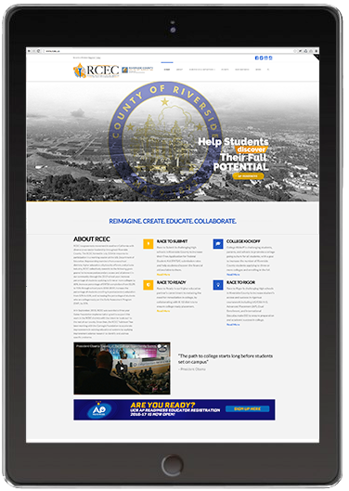
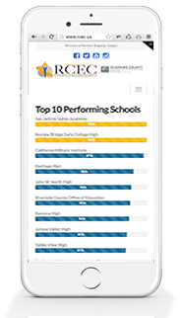
FOR MORE INFORMATION AND RESOURCES PLEASE VISIT US @
www.rcec.us

Slide 57
