Slide 2
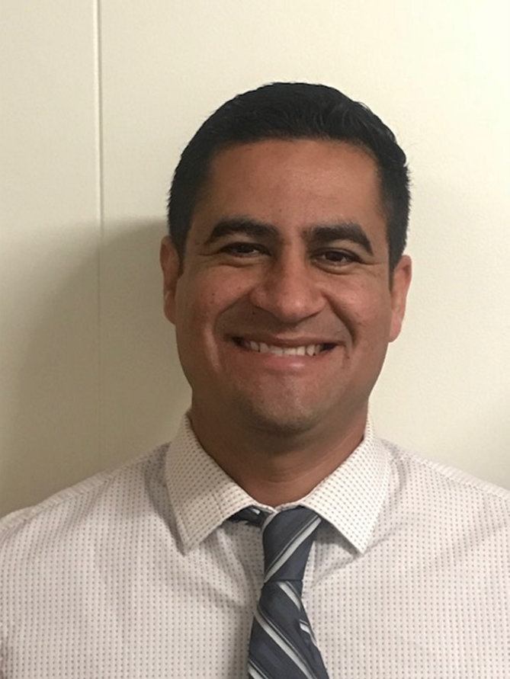
Catalina Cifuentes
Executive Director,
College and Career Readiness
ccifuentes@rcoe.us
Dr. Pedro Caro
Coordinator,
College and Career Readiness
pcaro@rcoe.us

Slide 3
Webinar Tips
This webinar is being recorded so that others may listen to it at a later time for reference and will be uploaded to the RCEC Youtube page as well as www.rcec.us once you log in to access the content of the webinar series
All connections to this live Webinar feature have been accounted for so please do not forward the Zoom link or invite anyone to join because you are taking someone else’s spot and Zoom will automatically start kicking off connections randomly
All participant mics have been muted and only panelists and facilitators have the ability to unmute anyone
Since all participants have been muted, please use the Q&A and chat screens to enter your questions
Participants can submit a question in the Q&A box at the bottom of the screen for the panelists
Only panelists and facilitators will be able to respond back to those questions and can do so publicly or privately to the individual
Participants can submit comments or questions in the chat box if they would like to engage with each other
**Every effort has been made to ensure the security of this webinar from “zoombombers” but in the event that we experience that, please stay calm and we will resume as soon as the technical difficulties have been resolved.**

Slide 4
FOR MORE INFORMATION AND RESOURCES PLEASE VISIT US @
www.rcec.us

Slide 5
Virtual Tech Tools 2.0
Nicohl Shelton Webb
Henry County Schools
bit.ly/webbcatech2

Slide 6
Meet your presenter
Nicohl Shelton Webb
Elementary School Counselor
Henry County Schools
You can reach me at : nwebb@henry.k12.ga.us
www.twitter.com/CounselorPCE
www.instagram.com/techlovingschoolcounselor

Slide 7
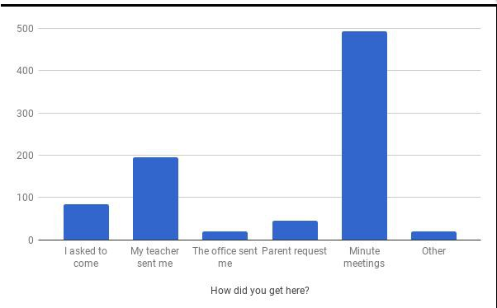
TOP TIPS WITH GOOGLE and More
Documentation
Data
Forms, Forms and More Forms
Google Classroom
Google Sheets
ScreenCastify

Slide 8
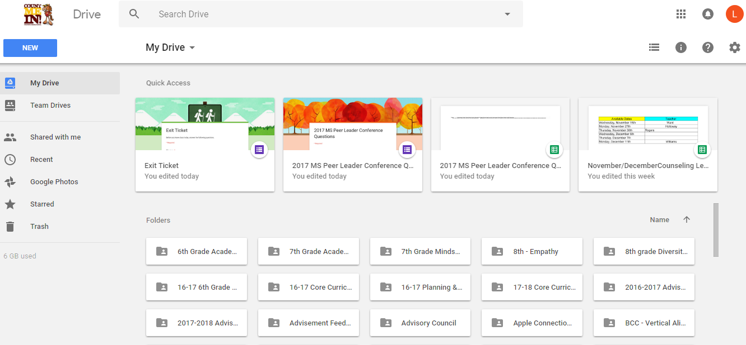
Google Drive
15 GB of free Google online storage, to keep photos, stories, designs, drawings, recordings, videos – anything.
Your files in Drive can be reached from any smartphone, tablet, or computer.
You can quickly invite others to view, download, and collaborate on all the files you want–no email attachment needed.
Create and collaborate with others. Share documents and files, build out spreadsheets and make a presentation on the fly with our Docs, Sheets and Slides apps.
You can also purchase a larger cloud storage plan as you need it.
https://www.google.com/drive/
Example:
Notes:
Nicohl

Slide 9
Google Drive to Google Apps
Docs
Slides
Forms
Sheets
Notes:
????

Slide 10
Google Docs
Google’s version of Word
Free
Google Docs brings your documents to life with smart editing and styling tools to help you easily format text and paragraphs. Choose from hundreds of fonts, add links, images, and drawings.
Access, create, edit, and COLLABORATE your documents wherever you go — from your phone, tablet, or computer — even when there's no connection.
Everyone can work together on the same document at the same time.
https://www.google.com/docs/about/
Example:
Docs Example
Notes:
Nicohl

Slide 11
Google Slides
Google’s version of PowerPoint
Free
A variety of presentation themes, hundreds of fonts, embedded video, animations, and more.
Access, create, edit & COLLABORATE your presentations wherever you go — from your phone, tablet, or computer — even when there’s no connection.
Use for professional development presentations, core curriculum presentations, student created assignments
https://www.google.com/slides/about/
Example:
Slide Presentation Example
Notes:
Laura

Slide 12
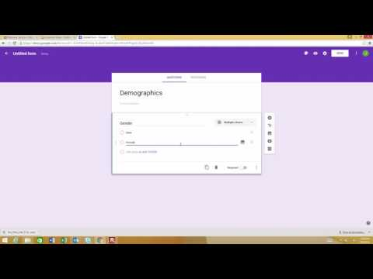
Google Forms
Free
Plan your next event, manage registrations, whip up a quick poll, collect email addresses for a newsletter, create a pop quiz, and much more.
Choose from a bunch of question options, from multiple choice to dropdowns to a linear scale. Add images and YouTube videos, etc.
Responses to your surveys are neatly and automatically collected in Forms, with real time response info and charts. Or, take your data further by viewing it all in Sheets.
https://www.google.com/forms/about/
Example:
Forms Example
Notes:
Dwight

Slide 13
Google Sheets
Google’s version of Excel
Free
Google Sheets makes your data pop with colorful charts and graphs. Built-in formulas, pivot tables and conditional formatting options save time and simplify common spreadsheet tasks.
Access, create, edit, and COLLABORATE your spreadsheets wherever you go — from your phone, tablet, or computer — even when there’s no connection
Everyone can work together in the same spreadsheet at the same time.
https://www.google.com/sheets/about/
Example:
Sheets Example
Notes:
Mike

Slide 14
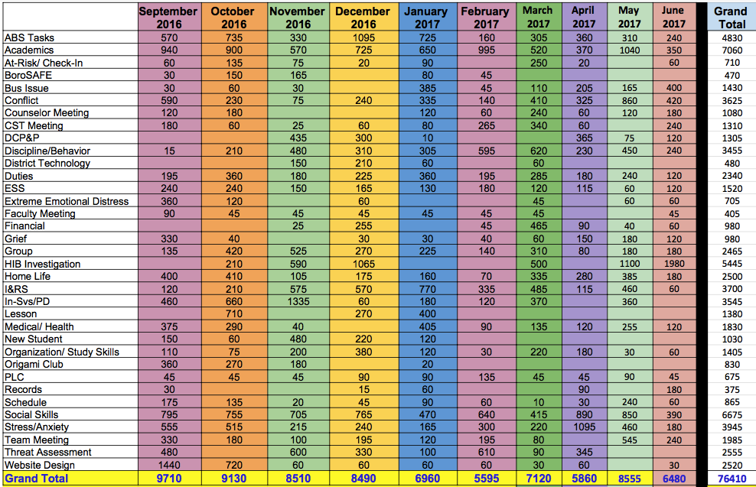
How can I:
keep an effective & efficient counselor log?
track data?
use data to advocate for my students and program?
Link to Google Sheet for Counselor Log/Data Collection (make a copy of it for yourself).
Taken from: https://www.angelacleveland.com/presentations

Slide 15
Google faux pas
Have you ever shared a Google Doc, Slide, Sheet with a colleague to use, but they forgot to “make a copy” and they ended up editing your version? Click here for some easy steps to force someone to make a copy!

Slide 16
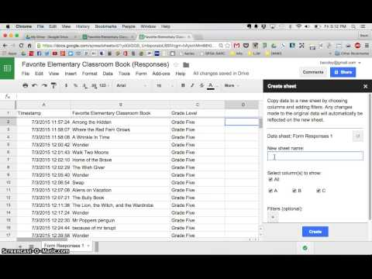
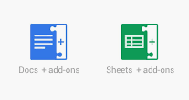
Favorite Add-Ons
Docs to Forms
EZ Query
Power Tools
Split Names
Yet Another Mail Merge
Sheets Text to Column
Add-ons are customized extensions of G Suite productivity applications such as Google Sheets, and Google Docs and Google Forms. Add-ons lets you create shortcuts quickly and easily.

Slide 17
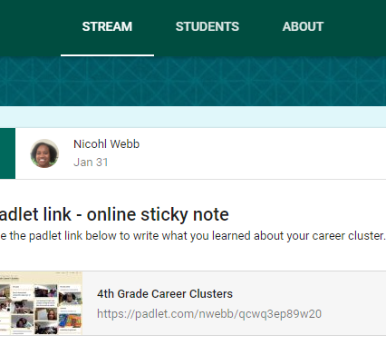
Google Classroom
Google Classroom is a free web service developed by Google for schools that aims to simplify creating, distributing and grading assignments in a paperless way. School Counselors can use this for Career Cluster lessons and to disseminate information.
How to get started with Google Classroom?
Example:

Slide 18
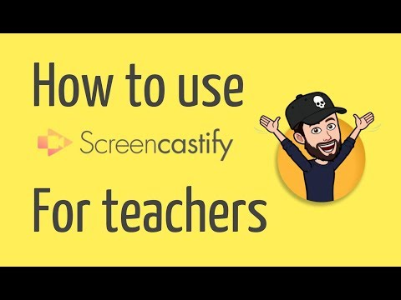
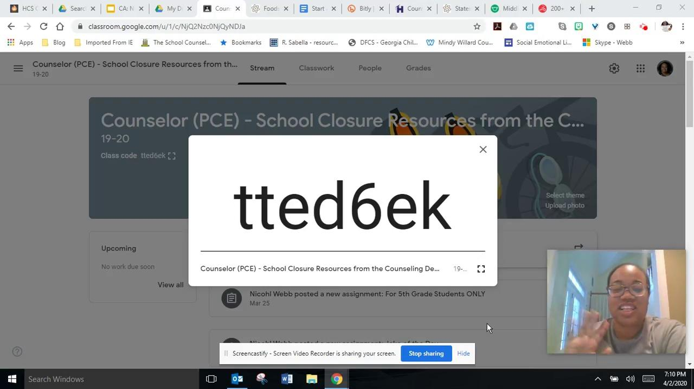
Screencastify is my new best friend!
Screencastify is an ultra simple screen recorder that will supercharge the way you communicate at work. Record, edit and share HD videos in seconds.

Slide 19
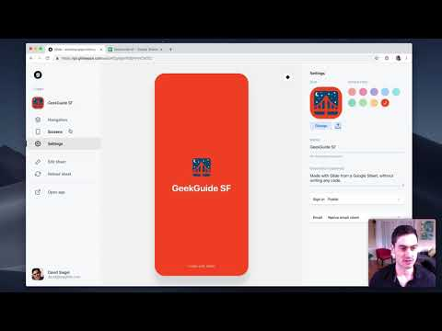
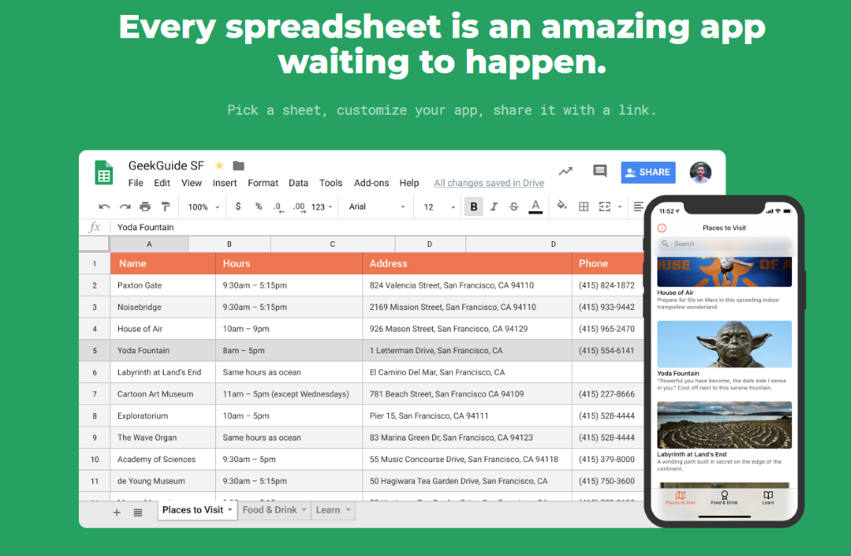
Glide App
Glide turns spreadsheets into beautiful, easy-to-use apps, without code. Pick a spreadsheet or start with a template, customize your app, then share it instantly.

Slide 20
THANKS!
Nicohl Shelton Webb
nwebb@henry.k12.ga.us | www.twitter.com/CounselorPCE www.instagram.com/techlovingschoolcounselor www.bit.ly/webbcatech2

Slide 21
Round of Applause for our Presenter!!
Nicohl Webb
Notes:
Castro Slide

Slide 22
We are here to support you!
Please reach out to College and Career Readiness with any needs at your school site, professional development topics, or general questions at:
Catalina Cifuentes ccifuentes@rcoe.us
Dr. Pedro Caro pcaro@rcoe.us
Notes:
Castro Slide

Slide 23
FOR MORE INFORMATION AND RESOURCES PLEASE VISIT US @
www.rcec.us

