Slide 1
Leading High Schools to Integrate the ASVAB CEP into College and Career Readiness February 7, 2018: RCOE School Counselor Leadership Network Riverside Convention Center, Riverside, California
Gil Compton Shannon Salyer, Ph.D.
Director RCOE College & Career DOD Office of People Analytics
Riverside, CA Program Manager, ASVAB CEP
John Stine Matthew Warren, Ph.D.
Education Services Specialist Counselor
San Diego MEPS Temecula Valley High School

Slide 2
Background & Context
● Overview of the ASVAB Career Exploration Program (CEP) which is a comprehensive, no cost, career planning resource designed to help HS students align their strengths and interests in making informed post-secondary choices.
● Highlight the Temecula Valley HS & Chaparral HS “best practice” aligned to with the ASVAB Career Exploration Program
● Planned framework for college and career readiness indicators established by California Department of Education

Slide 3
What is the ASVAB CEP?
Armed Services Vocational Aptitude Battery (ASVAB): A multiple aptitude test battery that provides students scores for Verbal skills, Math skills, and Science and Technology Skills. Since ASVAB is one of the most researched and respected aptitude assessments in the world, the reliability and validity of the assessment is closely monitored.
Delivered in paper and pencil and computer adaptive formats
ASVAB CEP Program website: Find Your Interests (FYI) - a 90-item RIASEC-based interest inventory designed to help students identify their work-related interests. OCCU-Find - an occupational taxonomy allowing students to explore over 1000 occupations that align with their interests and/or skills. Includes links to external occupational resources (Colleges, Tech Schools, salary information, etc)
Careers in the Military (CITM) website: A program website that encourages students to explore military careers, in depth, before referring them to a service specific website. Students will be able to explore the military specific jobs and pathways to these jobs in the context of their ASVAB CEP scores. Information for Parents and Services will be included. The CITM is used by many websites as the authoritative source of information on non-service specific occupational information, DoD Job Families, and occupational frameworks (JAMRS, Army, etc).
Notes:
The asvabprogram.com website contains information on the three primary components of the ASVAB CEP program
The ASVAB is the aptitude test given for admission into any of the Military services. For the CEP program, the test is administered to students at participating high schools.
Along with taking the ASVAB test, participating students can take the Find Your Interests, which is a 90-item interest inventory based on Holland’s RIASEC interest areas. In order to take the FYI online, students must enter an Access code that they are given upon completion of the ASVAB test.
The website compiles their responses and provides them with their top three interest code areas.
The third main component of the Program which is provided on the website is the OCCU-Find. The OCCU-Find contains over 400 occupations that students can explore. Students can use their ASVAB scores as well as FYI interest codes to explore occupations that fit with their interests and skills. Each OCCU-Find job on the website includes interest codes, skill importance ratings, and contains links to job description information

Slide 4
ASVAB CEP Benefits
Students:
Allows guided and self paced career exploration in the context of their aptitude and interests.
Provides students interested in the military a usable score for enlistment.
For students who want to enlist, allows the students to explore multiple services to find the best opportunity.
Schools:
Provides a comprehensive career exploration program for the students that is tied to career clusters and ASCA domains.
Testing personnel, assessments, reports, website access are all provided free of charge.
Services:
Saves the services time and money.
Typically, 10-13% of students enlisting each year, use their ASVAB CEP score. (14.9% in 2014, 15.2% in 2015)

Slide 5
Career Exploration Pays Off
Many times high school students make decisions about college or careers before they have spent time thinking about the following key areas:
Skills
Interest
Options
ASVAB CEP gives students the opportunity to explore a variety of careers in the context of their skills and interests through assessment components and structured activities. This aligned pathway leads to making better informed career choices.

Slide 6
Program Websites
www.asvabprogram.com www.careersinthemilitary.com

Slide 7
ASVAB CEP (Key Updates)
● Students take ASVAB during class time
● No commitment to military service
● After testing, students are given career exploration scores, access to interest inventory, career exploration tools. Scores are hosted on website for easy access.
● For students interested in college and credentialing options, the OCCU-FIND provides a listing of college, university, credentialing, licensure and apprenticeship programs related to each occupation
● For students interested in the military, this program allows them to have an ASVAB score that may be usable for enlistment, allows them to determine job opportunities available to them with that score in each service, & explore which service offers the best fit for them

Slide 8
Participant Intentions
The goal of the ASVAB CEP is to enable students to explore a variety of careers related to their skills and interests, rather than limit their exploration by telling them what they can or should do.

Slide 9
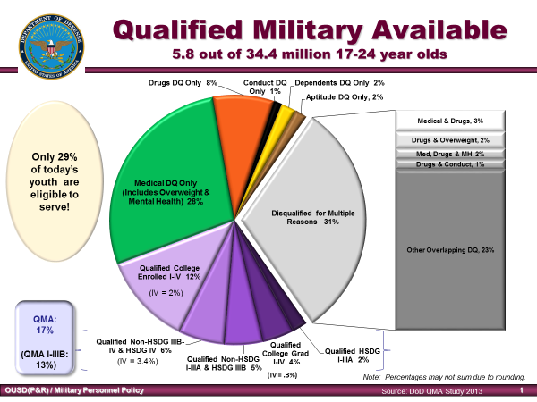
Empirical Data re: Qualified Military Available

Slide 10
Numbers of Students participating in ASVAB CEP
Year Number of Students Tested
2012 672,311
2013 670,836
2014 690,950
2015 687,900
2016 706,200
2017●● 684,223
●● School year runs from July 1- June30 (data includes CEP-iCAT)

Slide 11
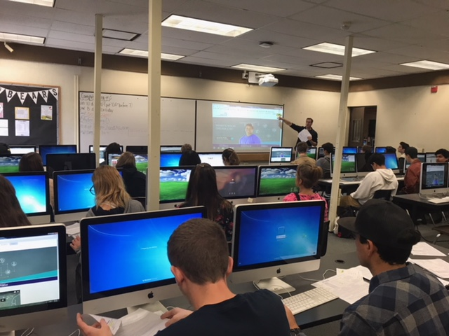
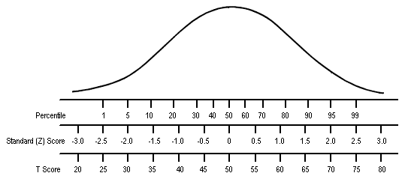
Temecula Valley HS Best Practice Experience
Temecula Valley HS Best Practice with the ASVAB CEP
● Go over Standard scores and statistics (Make sure the students understand their scores and what they really mean)
Use small groups of 35 or less in classroom for online post interpretation

Slide 12
Temecula Valley HS Best Practice Experience
Temecula Valley HS Best Practice with the ASVAB CEP
● Looking at handout (sample ASVAB Results Summary) regarding interpreting ASVAB results. Go over Percentile Ranks and Standard score and focus on their strengths. Next link this to a Personality Test.
● Students take a 90 question Personality test using Hollands Code (RIASEC). Referred to the simulation online interpretation process
● The unique Holland Personality Code results will link students with their ASVAB Aptitude results and strengths, where they can investigate careers.
● Students will investigate Colleges/Schools that offer their Career and discuss Salary, job outlook of growth, majors etc.
Explain how the results can be used to focus on their future
https://www.bls.gov/ooh/

Slide 13
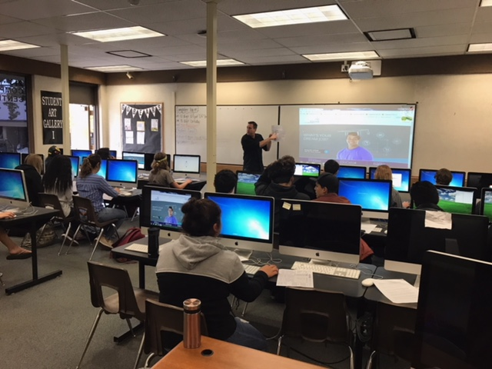
Temecula Valley HS Best Practice Experience
Temecula Valley HS Best Practice with the ASVAB CEP
● Future plans at TVHS may include online ASVAB testing using the computer labs for the 2018/2019 year
● Getting more parent involvement with results and sparking conversations on post-secondary plans.
● Include results in the assessment tab of our schools database to help counselors advise in a variety of areas (SST, 504, IEP etc.,). ASVAB is a standardized test and not subjective much like many career inventories.

Slide 14
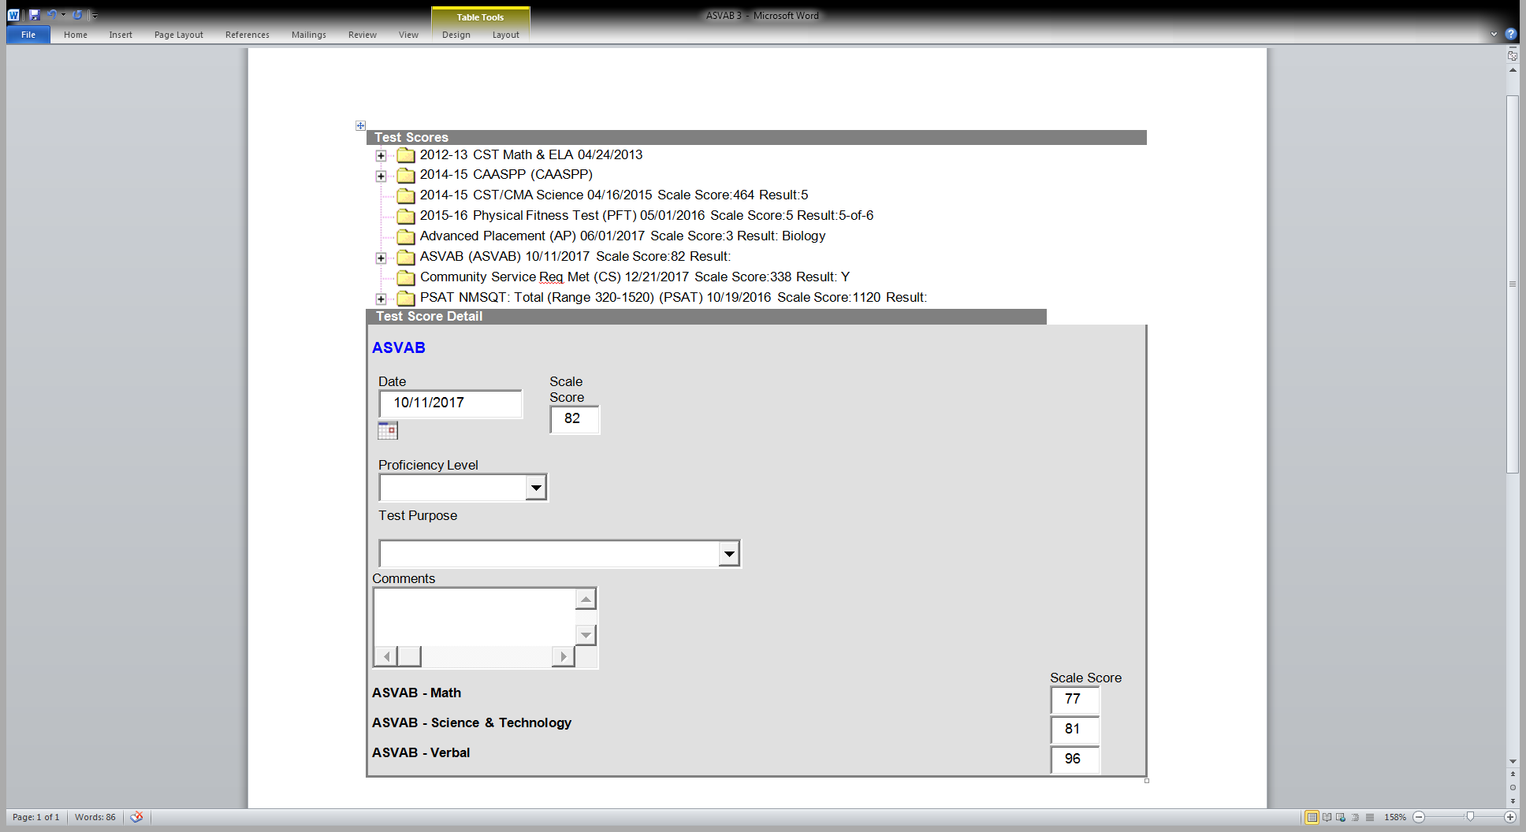
Using the Results in Meetings

Slide 15
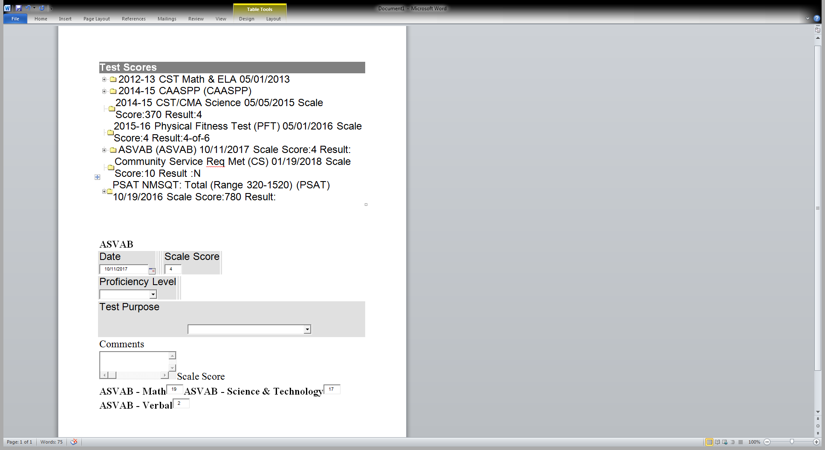
Example of a possible SST

Slide 16
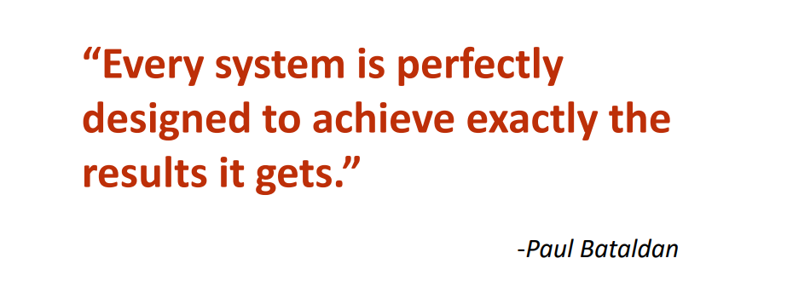
THE FIRST LAW OF IMPROVEMENT

Slide 17
Be Careful During Your Journey

Slide 18
HOW TO GET TO THE VISION

Slide 19
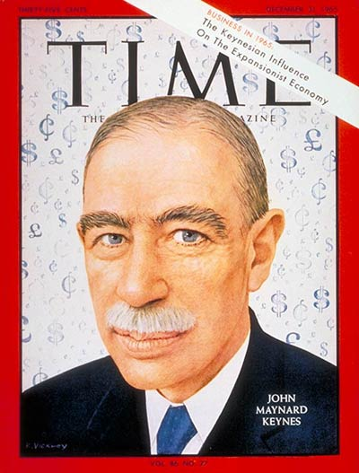
MOVE FROM OLD IDEAS TO NEW IDEAS (PARADIGM SHIFT)
The real difficulty in changing the course of any enterprise lies not in developing new ideas
but in escaping old ones.
- John Maynard Keyes

Slide 20
Localocal controlontrol fundingunding Formulaormula
LCFF
The World has Changed

Slide 21
New Data Points
LCAP ENVIRONMENT
The LCAP Environment
Academic Indicators
College and Career Indicators
Attendance, suspensions, expulsions
English Language Program Indicator
Graduation rates
Parent Engagement
Offering and Access to Course of Study
Basic Services
Student Level
Subgroup Level
School/District Level

Slide 22
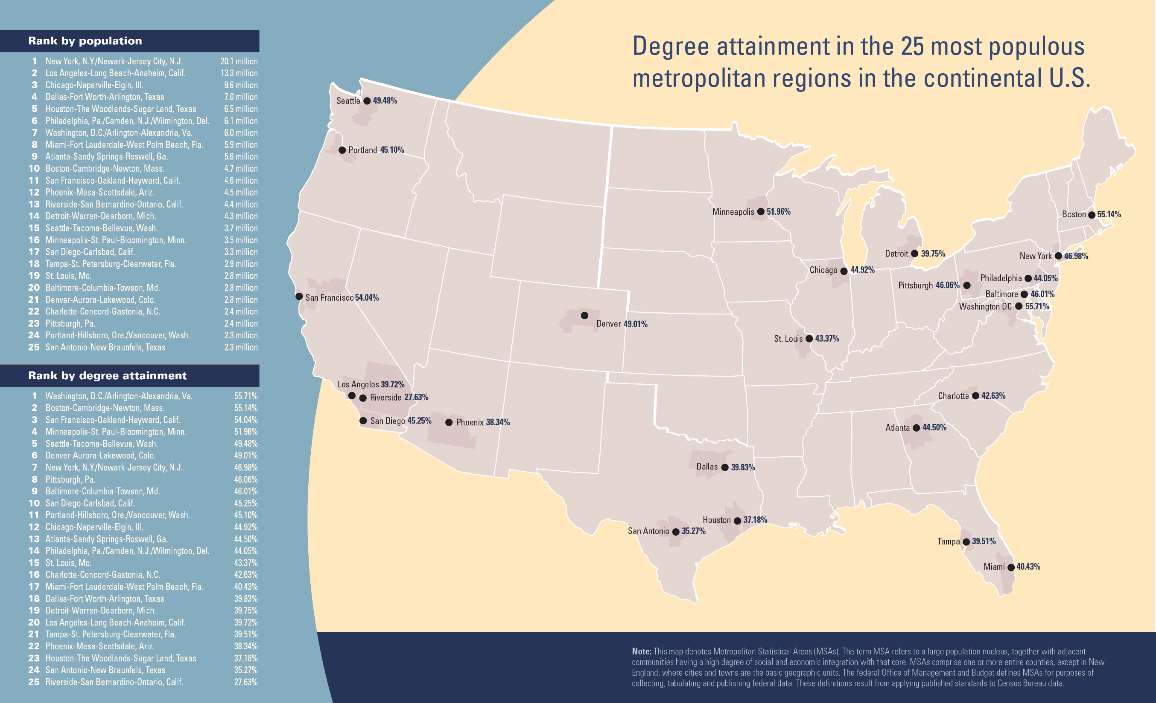
25 METRO REGIONS

Slide 23
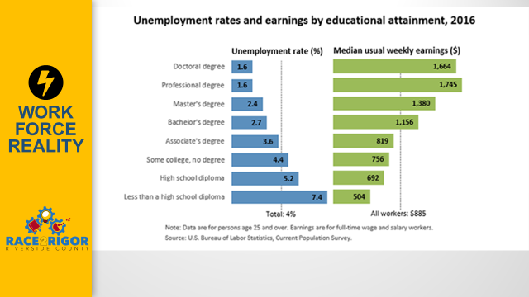
WORK FORCE REALITY

Slide 24
CPanCaree Indicator)
CALIFORNIA CCI (COLLEGE AND CAREER INDICATOR)
Prepared Level
Approaching Prepared Level
Not Prepared
College and Career Readiness
AP/IB/DE courses
CTE Pathways
SBAC Scores
A-G Completion

Slide 25
DR. STEPHEN COVEY (1992)
Circle of Influence
Circle of Concern

Slide 26
WINNING
Linking College and Career
to the ASVAB
Linking ASVAB to PSAT
Linking AP Potential to ASVAB
Linking ASVAB to CTE Pathways
Linking College Major to ASVAB
Linking ASVAB to
Post-Secondary training

Slide 27
CLOSING REMARKS
Questions and Answers

Slide 28
MUTLIPLE HANDOUTS FOR ALL ATTENDEES
All attendees will receive the key ASVAB CEP resources, including
ASVAB CEP Thumb Drive (Video Overview)
ASVAB CEP Fact Sheet
ASVAB Summary (sample) Result Sheet
ASVAB CEP Guide Book
ASVAB CEP Tri-Fold

