Slide 1
Master Schedule Driver

Slide 2
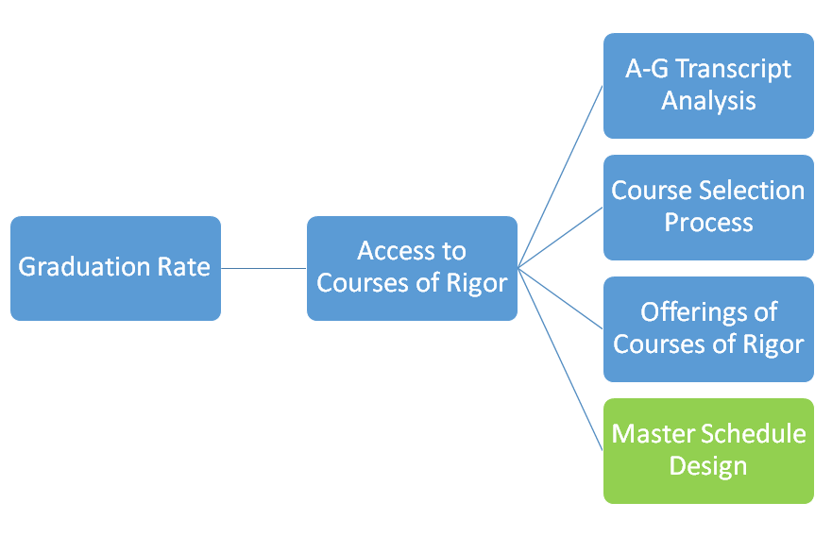
Master Schedule Driver Diagram
The Master Schedule is a secondary driver that impacts student access to courses of rigor.

Slide 3
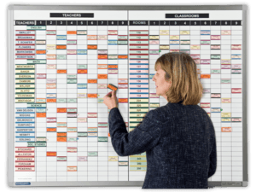
Why Focus on the Master Schedule?
“The master schedule is to a school what grading policies are to teachers and classrooms. It reveals the true beliefs, attitudes, values, and priorities of the school. The school’s master schedule is like looking at an MRI of the inner workings of a school. It is the window to the soul of the school.”
- National Association of Secondary School Principals

Slide 4
Master Schedule - Objective
Maximize staffing allocations
Integrate programs and course offerings across instructional time
Maximize facility use

Slide 5
Master Schedule - Considerations
Current/historical Master Schedule structure
Student Information System structure
Counseling Calendar for Course Selection
Course Selection Process, including forms.
AP/IB/DE/CTE/Athletics/JROTC/Activities student recruitment timelines and processes
Staffing – FTE numbers and specific credentials
Teacher experience and assignment preference
Physical classroom space
Contract Language with respect to class size, transfer, and assignment

Slide 6
Master Schedule Structure
Number of 6/5ths
Zero period
After School periods
On campus detention/suspension room/assignment
TOSA assignments (period/part time/full time release)
Special Education staffing
SAI Courses/Push-In Courses
Single course impact (singletons)
__________________

Slide 7
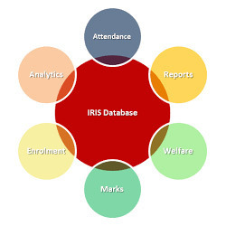
Student Information System
Who builds schedule in computer system?
Student Information System (SIS) training/refresher
Class limits and overrides (permissions)
Timeline to load
Course conflict reports
How do we measure a successful build?
What is an acceptable error rate?
SIS

Slide 8
The importance of the Counseling Calendar
Planning, building, and managing the master schedule is a year-around activity that is primarily driven by both the guidance and administrative staff.
Roles and responsibilities are coordinated through the use of a well defined counseling calendar.
The goals and functions of the master schedule are embedded in the Counseling Calendar and take into consideration -
Staffing allocations
Student Course Requests
Student success (grades and credits)
The counseling calendar outlines how and when staff build the master schedule

Slide 9
Counseling Calendar - Considerations
Consideration from the counseling office include . . .
How and when to add extra staff and/or extra duty to the counseling office to handle course selection, student and parent meetings, etc.
How and when to review D/F reports
Impact of summer school and credit recovery programs
New student enrollment
Senior graduation check
A-G transcript tracking (system)

Slide 10
Staffing – FTE numbers and specific credentials
HRD Interface
Business Office interface
Retirements
Hires
New positions/programs
Special Education numbers and staffing (including Instructional Aides)
6/5ths
A-G analysis (Access)

Slide 11
Course Selection Process
Overlay of Counseling Calendar
Forms used
Input into SIS
Student communication/meetings
Parent communication/meetings
Program Recruitment
Prerequisites
RSP/SDC scheduling

Slide 12
AP/IB/DE/CTE/Athletics/JROTC/Activities Recruitment timelines and processes
Who is responsible for what?
Administrative support
Clerical support
Tracking of student in digital form
Entering/logging information
Forms/format/forum (F3)

Slide 13
Teacher experience and assignment preference
Form used
Department Chair input
Seniority
New Programs
Transfers from other sites
Growing or declining student enrollment
CREDENTIALING!

Slide 14
Staff Report (Sample)
 | Credential | Experience | Preference | Would like to teach
Mrs. Alpha | Geo World / AP US / AP Gov’t / AP Econ / AP | Geo - 3 World -2 World AP -2 | World World AP | US AP
Mr. Bravo | Geo World / AP US / AP Gov’t / AP Econ / AP | US – 12 US AP -7 Gov’t - 5 | US AP | World Religions
ETC. . .

Slide 15
Physical classroom space
Number of Chemistry Labs on Campus
SDC/SH classrooms
Facility Efficiency Measures
Construction
Remodel
Access to technology
Athletics and PE / Locker room use
CTE and other program needs

Slide 16
Contract Language with respect to class size, transfer, and assignment
The CBA is your friend!
Rules to follow
Meetings with Union Leader(s)
HRD Interface – always check
Morale, Culture, and Climate impact

Slide 17
Task
Examine our current master schedule at the department level in relationship to:
A-G Transcript Analysis Tracker by student
Graduation requirements
A-G requirements for CSU and UC entrance
Course sequence and Grade level
Student passage rates (failure rates)
Remediation strategies
Teacher credential, training, and assignment
Master Schedule symmetry and prep periods
Course Catalog (Synergy and UC Doorways)

Slide 18
Conditions
The conditions under which the task is to be completed:
Current/Past master schedule design
Current/Past teaching assignments
Teacher credentials
Anticipated Student enrollment
Anticipated FTE count
Needed sections of all courses
Student graduation requirements
Programs - AP, AVID, ELL, RSP, SDC, Athletics, Remediation, CTE, Core, etc. . .

