Slide 1
Master Schedule
2019 - 2020

Slide 2
Master Schedule Process

Slide 3
Icebreaker
On post-it, what is a successful master schedule?

Slide 4
Article
“The master schedule is to a school what grading policies are to teachers and classrooms. It reveals the true beliefs, attitudes, values, and priorities of the school. The school’s master schedule is like looking at an MRI of the inner workings of a school. It is the window to the soul of the school.”
https://www.nassp.org/2018/09/01/master-schedules-translating-values-into-practice/

Slide 5
Protocol
4 A’s:
Read silently and look for
Agreements: Which parts of the text do we agree with?
Aspirations: Which parts of the text do we aspire to, or want to work
toward?
Alignments: What is the current reality, and what is the gap between
where we are and our aspirations?
Ah...Implications: What does this mean for our work with teachers
and students?

Slide 6
Protocol
In the first round, have each person identify one area of agreement, referring back to the specific text. Group members speak one at a time by going around the circle, taking 2 minutes total.
Repeat for 2 minutes each
Aspirations:
Alignments:
Ah...Implications:
Notes:
8 minutes

Slide 7
Other Articles
Scheduling for Impact
What does it say?

Slide 8
Part A:
Plan It
Communicate It

Slide 9
Step 1: Reflect
Reflect and analyze priorities and goal
Based on your reflections and staff input:
What about your schedule is working well?
Not working well?
What does the master schedule need to accomplish for your students and teachers?

Slide 10
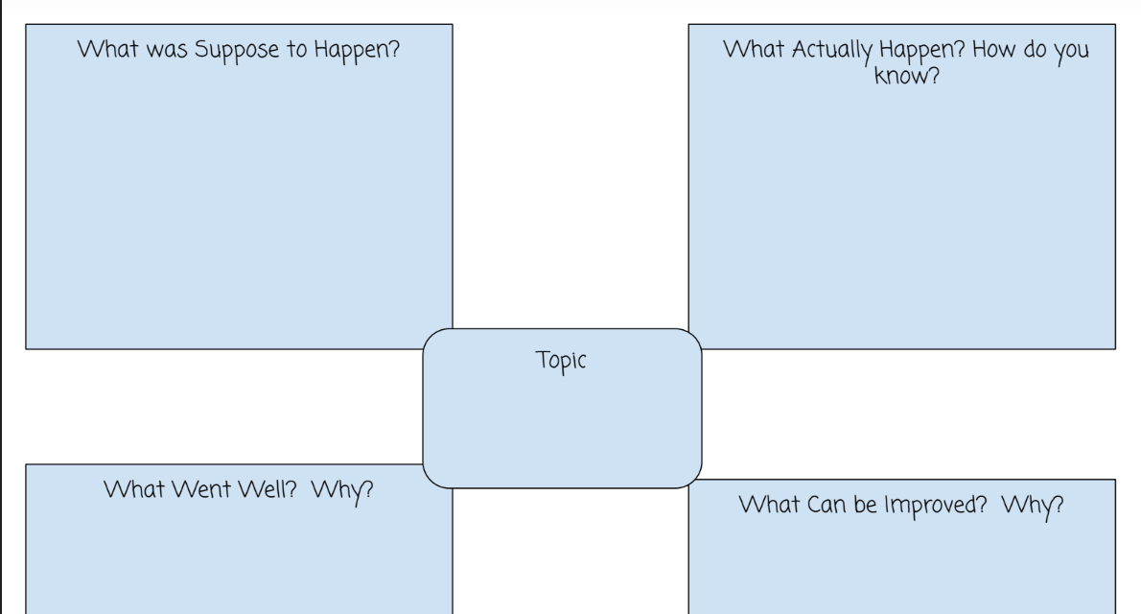
After Action Review

Slide 11
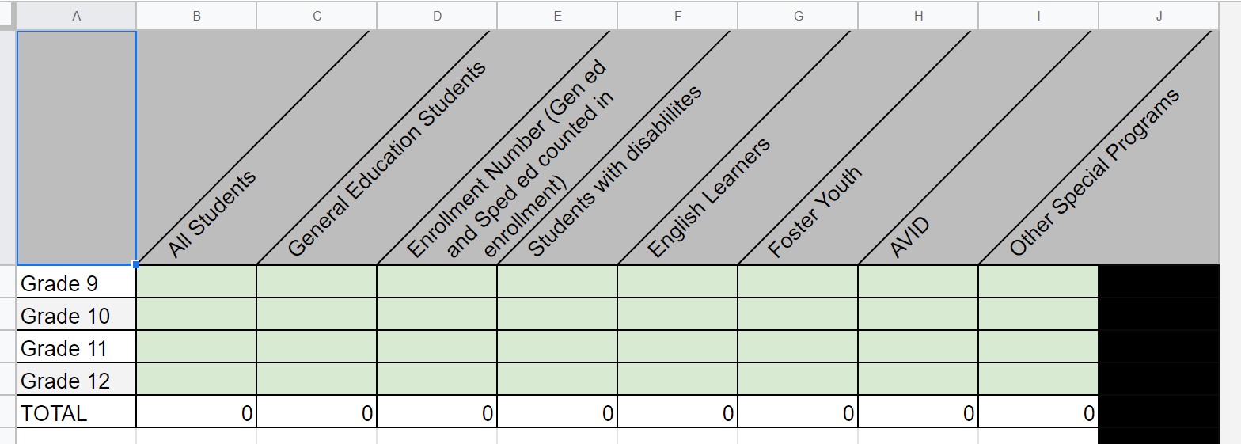
Current reality: Students

Slide 12
Current reality: Courses

Slide 13
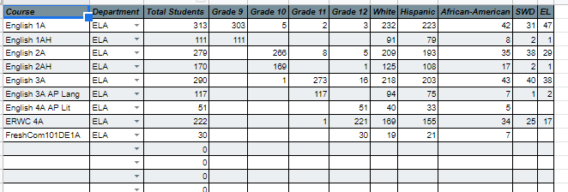

Slide 14
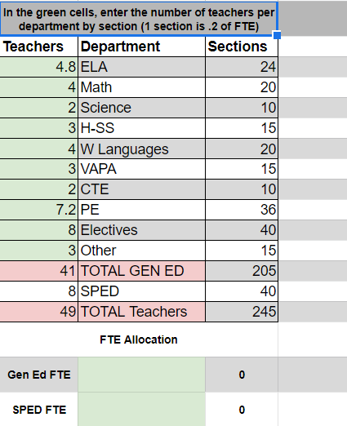
Current Reality: FTEs

Slide 15
Understand your formula
Projected Enrollment: How is this number determined? Which students are counted?
Staffing Ratio: What number is that?
Magic Number: What does it mean?

Slide 16
Sample Formulas
Add Hemet and Val Verde

Slide 17
Step 2: Analyze

Slide 18
Step 2: New Information gathering
Gather data on student needs
Explore different schedule options
Gather input from your staff INSERT SAMPLE SURVEY
Facilities Constraints

Slide 19
Part B:
Build It
Communicate It

Slide 20
Step 3: Build It
Collaborative process with Master Schedule Team
Master Schedule Considerations:
Current/historical Master Schedule structure
Student Information System structure
Counseling Calendar for Course Selection
Course Selection Process, including forms.
AP/IB/DE/CTE/Athletics/JROTC/Activities student recruitment timelines and processes
Staffing – FTE numbers and specific credentials
Teacher experience and assignment preference
Physical classroom space
Contract Language with respect to class size, transfer, and assignment

Slide 21
Course Request
Sample Tool
Teacher/Class Total
LIST MST CRS TCH MST.SC MST.CN CRS.CO CRS.DC MST.SM MST.SE MST.PD TCH.TE MST.RM MST.TS BY CRS.CO IF CRS.DC =

Slide 22
The importance of the Counseling Calendar
Planning, building, and managing the master schedule is a year-around activity that is primarily driven by both the guidance and administrative staff.
Roles and responsibilities are coordinated through the use of a well defined counseling calendar.
The goals and functions of the master schedule are embedded in the Counseling Calendar and take into consideration -
Staffing allocations
Student Course Requests
Student success (grades and credits)
The counseling calendar outlines how and when staff build the master schedule

Slide 23
Step 4: Post Build Reflection
Review answers/reflections from Step 1 and debrief

