Slide 1
New School Counselor Academy (NSCA)
Session 1: Developing Your Program
Dr. Pedro Caro
Coordinator, College and Career Readiness

Slide 3
Who’s In the Audience?
Elementary School Counselors (14)
Middle School Counselors (8)
High School Counselors (21)
School Counseling Interns (6)
College and Career Counselors (2)
Administrators (1)

Slide 4
Today’s Agenda
-What Fills Your Bucket?
-ASCA 101
-Today’s School Counselor
-Introducing Yourself
-Marketing Your Program
-Helpful Resources
-Calendars

Slide 5
Objectives
As a result of this session, participants will be able to:
Identify the components of a comprehensive school counseling program
Explain differences between reactive vs. proactive school counseling
Develop a plan to conduct a needs assessment with key stakeholders
Access several useful websites to gain resources

Slide 6
What Fills Your Bucket?
Current placement What inspired you to become a school counselor?
Name and title
University/program What do you hope to gain at NSCA?

Slide 7
The Why
The range of school counselors who have high levels of emotional exhaustion and burnout is between 30% and 60%
The most common factors of burnout:
Depletion of affect
Depersonalization
Feelings of lacking personal accomplishment
Currently, there are no evidence-based professional support networks specifically designed for beginning school counselors.

Slide 8
What the Research Shows (from Enhancing the Principal-School Counselor Relationship Toolkit)
Key Findings
Both school counselors and principals ranked communication and respect as the two most important elements in the relationship
Communication--Principals focused on quality, school counselors focused on frequency
Respect--Principals focused on respect for vision and goals, school counselors focused on personal respect
A CollegeBoard study on the principal-school counselor relationship determined four elements present:
Communication
Collaboration
Shared Vision
Respect

Slide 9
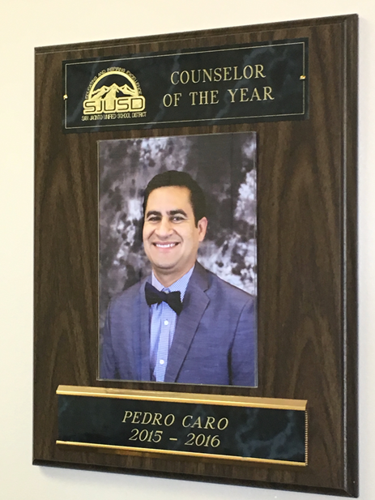

Slide 10
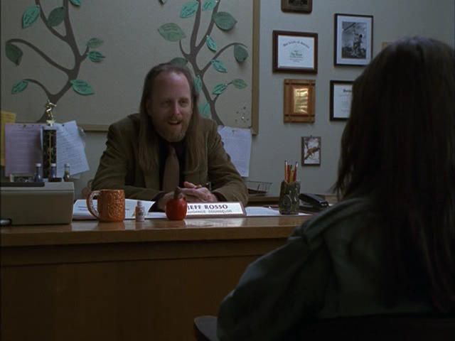
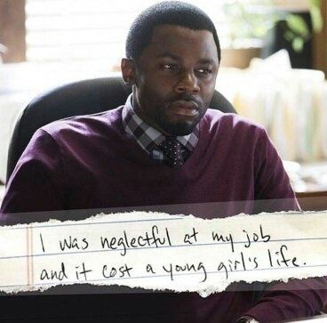
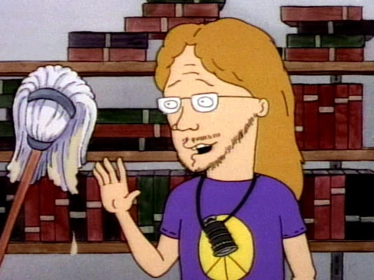
What We COULD Be Viewed As

Slide 11
What We COULD Be Viewed As...
Perris Union High Race to Submit
https://youtu.be/g7tPa-6bMJo
Oceanside USD School Counseling Grant
https://youtu.be/HplRzoP47Ag
Former First Lady Michelle Obama
https://youtu.be/SXrPIWYw8fE

Slide 15
ASCA 101
www.schoolcounselor.org

Slide 16
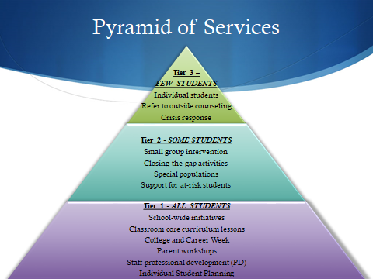

Slide 17
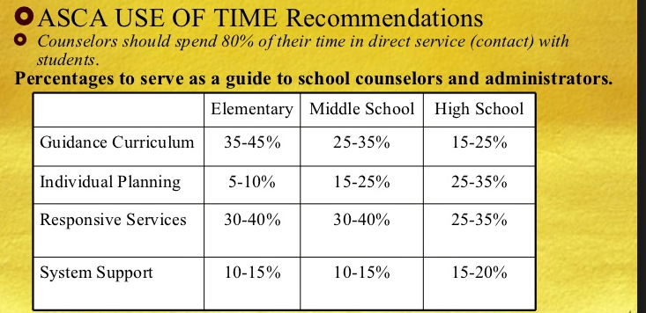
Use of Time

Slide 18
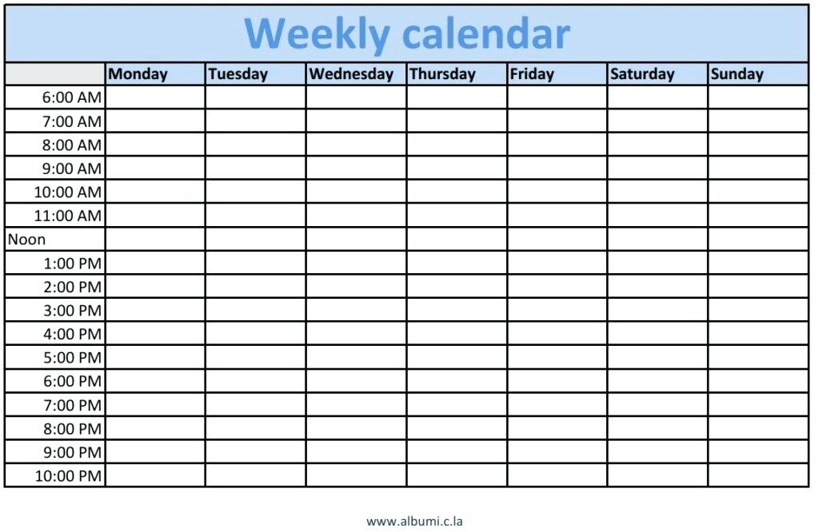
Calendars
How do you currently manage your daily/weekly/monthly tasks?
Where is your time spent?
What goes in your calendar?
Calendar Up Video
https://youtu.be/my095a0KAxo

Slide 19
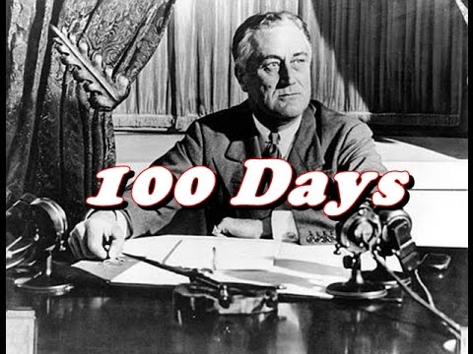
The First 100 Days
Tips from the field...
“Be a team player”
“Learn names and meet people”
“Build relationships with students”
“Be visible!”
“Learn systems and culture”
“Join a committee”

Slide 20
Hidden Resource: Informal Leaders
-Administrative Assistants
-Custodial Staff
-Instructional Aides
-Bus Drivers
-Library and Media Technicians
-Health Clerks
-Attendance Clerks

Slide 21
Introducing Yourself
Staff Presentation
“Meet the School Counselor” mini classroom lesson/video
Back to School Night booth
If YOU do not define your role, someone else WILL.

Slide 22
Setting up Processes
What is currently being done?
What was done before you?
How will your process improve the system?

Slide 23
Needs Assessments
Parent Needs Assessment
Used for parent workshops
Teacher Needs Assessment
Used for classroom lessons
Perceptions of what school counselors do
https://docs.google.com/forms/d/1xeeux-ByPOT2_VzgoIUAKu67SGPokU6_Lcel3N-s_0k/edit
Student Needs Assessment
To create programs (groups)
https://docs.google.com/forms/d/1bW1OUmt2Ev4eI1R0LrtkdoZoNZoDswbVKbQNmIs7KaU/edit

Slide 24
Marketing Your Program
How do people know there is a school counseling program at this school?

Slide 25
Branding Your Franchise
Equity and Access
Consider Equity and Access

Slide 26
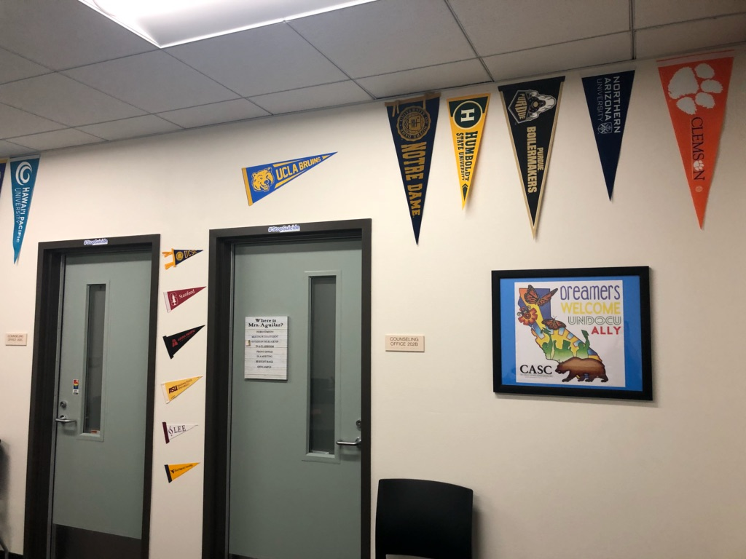
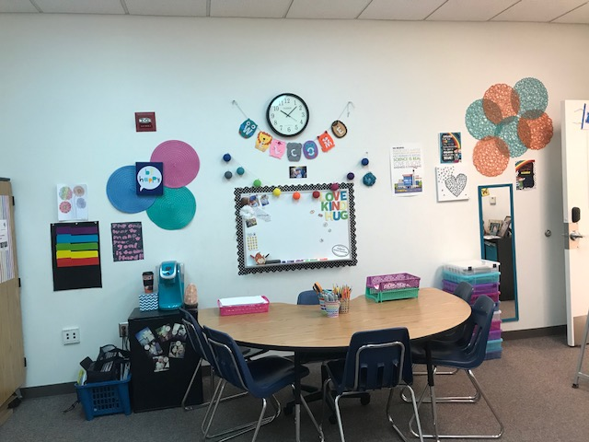
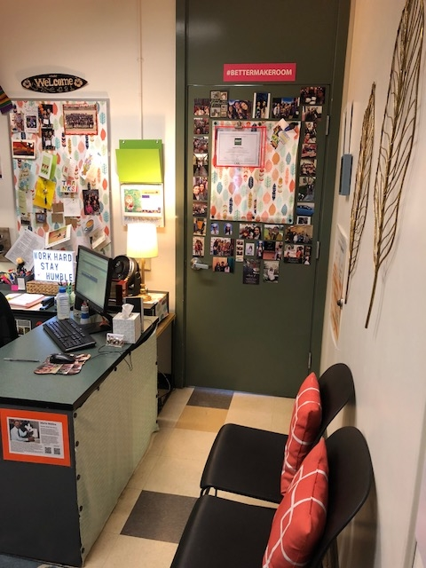
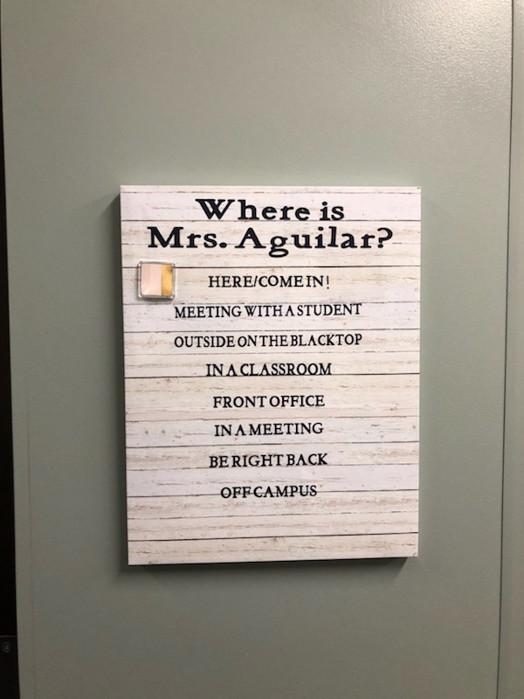
What Does Your Office Say About You?
Cautions:
Who do you serve?

Slide 27
All Means All

Slide 28
Your School Counseling Program Website
Who is Your Audience?
What to Include:
Contact information (Accurate)
Your role
Confidentiality
Outside counseling support
Referral process
Grade-level activities and classroom lessons

Slide 29
Sample Websites
Elementary--Pate’s Creek Elementary (Stockbridge, GA.)
https://schoolwires.henry.k12.ga.us/domain/2350
Middle/Jr. High/Intermediate--Potter Jr. High (Fallbrook, CA.)
https://pjh.fuesd.org/apps/pages/index.jsp?uREC_ID=774328&type=d&pREC_ID=1174289
High School--San Jacinto High (San Jacinto, CA.)
https://sjhs.sanjacinto.k12.ca.us/apps/pages/index.jsp?uREC_ID=331315&type=d&pREC_ID=739624

Slide 30
Need Ideas?
A Few FREE Helpful Sites
List of resource sites by level
https://www.mastersincounseling.org/best-school-counseling-sites/
Missouri Department of Education--College and Career Readiness
https://dese.mo.gov/college-career-readiness/school-counseling/school-counseling-curriculum-and-gles
Elementary School Counseling Blog--Lessons, Small Group Resources (Elementary)
http://www.elementaryschoolcounseling.org/marissas-blog
West Virginia Department of Education--Curriculum
https://wvde.state.wv.us/counselors/
Center For Excellence in School Counseling and Leadership (CESCaL)--Lessons Plans, Pre/Post Tests
http://www.cescal.org/resources/flashlight/flashlight-search.cfm

Slide 31
Looking Ahead
December 5, 2018
Differentiated structure
Purpose
Data sources
Collecting and analyzing data
Tier 1 and Tier 2 interventions
Working with stakeholders

Slide 32
Summary
Did we meet our objectives?
Additional Support
Google Folder
Site Visits
Conferences
Contact:
pcaro@rcoe.us
(951)-826-6323
@pedro_caro2
rcecus
Post Test

Slide 33
Exit Ticket
Post-Test
Thank You!

