Slide 1
College and Career Readiness
Kick-Off to College 2015

Slide 2
District Goals
Goal #1: All students will attain proficiency in all academic areas.
Goal #2: All students will graduate from high school prepared for post-secondary and career options
Goal #3: All departments and sites will provide a safe and positive learning environment for all students and staff.
Goal #4: Secure and strengthen home-school-community connections and communications.

Slide 3
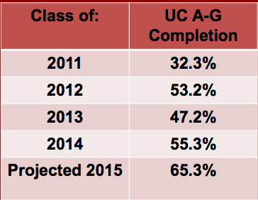
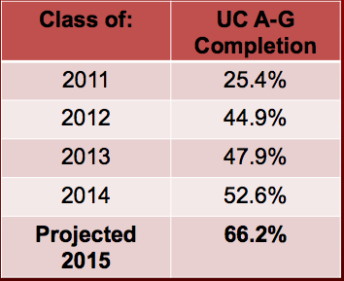
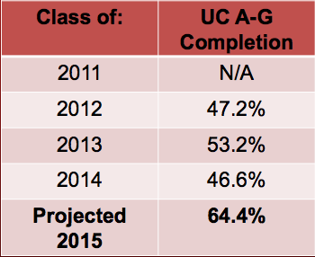
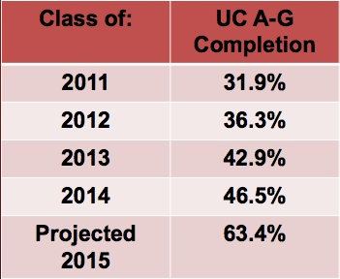
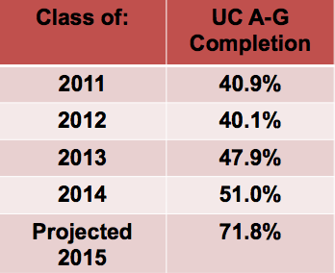
Riverside County Surrounding Schools
Murrieta Valley HS
Vista Murrieta HS
Murrieta Mesa HS
Rancho Verde HS
Citrus Hill HS

Slide 4
PUHSD Data
Heritage High School
Perris High School
Class of: | Graduation Rate | A-G Completion
2011 | 88.5% | 30.5%
2012 | 91.1% | 29.4%
2013 | 91.4% | 26.3%
2014 | 91.9% | 32.4%
2015 | 94.7% (Est) | 38.7% (Est)
Paloma Valley High School
Class of: | Graduation Rate | A-G Completion
2011 | 86.5% | 24.3%
2012 | 80.7% | 26.7%
2013 | 80.7% | 24.8%
2014 | 79.4% | 34.0%
2015 | 84.5% (Est) | 29.4% (Est)
Class of: | Graduation Rate | A-G Completion
2011 | 89.6% | 27.6%
2012 | 88.1% | 27.2%
2013 | 90.4% | 24.5%
2014 | 91.6% | 34%
2015 | 91.7% (Est) | 30.2% (Est)

Slide 5
Definition of College and Career Ready
A student who is ready for college and career can qualify for and succeed in entry-level, credit bearing college courses leading to a baccalaureate or certificate, or career pathway-oriented training programs without the need for remedial or developmental coursework. Not every student requires the same proficiency in all areas. A student’s interests and post-high school aspirations influence the precise knowledge and skill profiles necessary to be ready for postsecondary studies
Conley, 2012

Slide 6
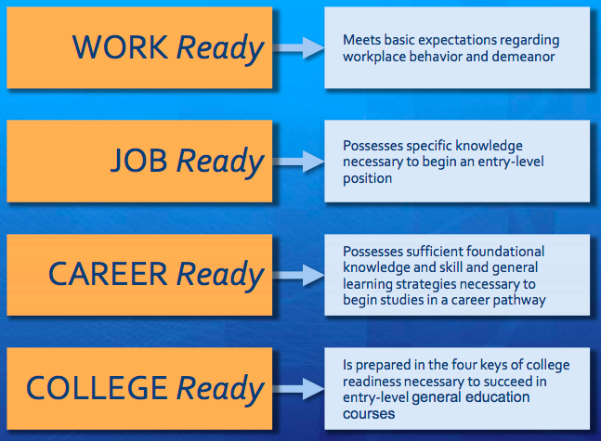
What does College and Career Ready Look Like?

Slide 7
Four Components to College and Career Readiness

Slide 8
College and Career Readiness Acronyms
CTE
EAP
ELM/EPT
Accuplacer
CCGI
FAFSA
PSAT
SAT
ACT
ASVAB

Slide 9
FAFSA
Free Application for Federal Student Aid (FAFSA) : Form used to determine the amount of money a family is expected to contribute to the price of attending a postsecondary institution. The results of the FAFSA are used in determining student grants, work study, and loan amounts.
FAFSA Forecaster: Estimate eligibility and understand options for paying for college.
https://fafsa.ed.gov/FAFSA/app/f4cForm?execution=e1s1

Slide 10
PSAT and SAT
Preliminary Scholastic Aptitude Test/National Merit Scholarship Qualifying Test (PSAT/NMSQT): This test serves two purposes. One, it is a kind of rehearsal for students who plan to take the SAT, and it is the initial screening for the National Merit Scholarship for students in their junior year.
Scholastic Aptitude Test (SAT/SAT Subject Test): The SAT and SAT Subject Tests are designed to assess your academic readiness for college. These exams provide a path to opportunities, financial support, and scholarships, in a way that's fair to all students. The SAT and SAT Subject Tests keep pace with what colleges are looking for today, measuring the skills required for success in the 21st century.

Slide 11
ACT
American College Test (ACT): The ACT consists of four multiple-choice tests: English, mathematics, reading, and science that measures the skills of students preparing to enter post secondary education.

Slide 12
ASVAB
Armed Services Vocational Aptitude Battery (ASVAB): a multiple-aptitude battery that measures developed abilities and helps predict future academic and occupational success in the military. It is administered annually to more than one million military applicants, high school, and post-secondary students.
Fact Sheet Counselor and Educator Resources

Slide 13
CTE
Career Technical Education: A program of study that involves a multiyear sequence of courses that integrates core academic knowledge with technical and occupational knowledge to provide students with a pathway to postsecondary education and careers.
CA Dept of Ed CTE Resources

Slide 14
EAP
Early Assessment Program (EAP): collaborative effort among the State Board of Education (SBE), the California Department of Education (CDE) and the California State University (CSU). The program was established to provide opportunities for students to measure their readiness for college-level English and mathematics in their junior year of high school, and to facilitate opportunities for them to improve their skills during their senior year.
CSU Placement Tests

Slide 15
Accuplacer
Accuplacer: The Accuplacer is an adaptive, multiple-choice and essay test that is designed to be a clear measure of academic skills in the areas of math, reading and English. The Accuplacer is divided into 6 individual sections: Sentence Skills, Reading Comprehension, Arithmetic Test, Elementary Algebra, College Level Math Test & Written Essay. This test is administered online, and is generally given to students as they are entering a college or university. The test is designed to let colleges and universities know exactly where their students stand in these particular areas for placement purposes.

Slide 16
ELM and EPT
English Placement Test (EPT): The EPT is a one-time assessment that helps CSU determine what reading and writing courses you should take upon enrollment. The test is broken down into one 45-minute essay section and two 30-minute multiple choice sections that will test your reading and comprehension skills.
Entry Level Mathematics Exam (ELM): a one-time assessment that helps CSU determine what mathematics courses you should take upon enrollment. The test consists of 50 questions that you have 90 minutes to answer. The topics covered include numbers and data, algebra and geometry.
CSU Placement Tests

Slide 17
CCGI
California Colleges Guidance Initiative (CCGI): Housed at the Foundation for California Community Colleges, the California College Guidance Initiative (CCGI) works to ensure that all 6th-12th grade students in California receive a systematic baseline of guidance and support as they plan, prepare, and pay for college. CCGI partners with K-12 school districts to support students, counselors, parents, and community-based organizations with technological tools that help guide the college planning and preparation process.
California Colleges Tools and Resources

Slide 18
Kick Off to College
October 14, 2015
District-wide Participation
Activities for all Grade Levels
Create a College Culture
PSAT for all 10th Graders
PSAT for all 11th Graders on Track for A-G

Slide 19
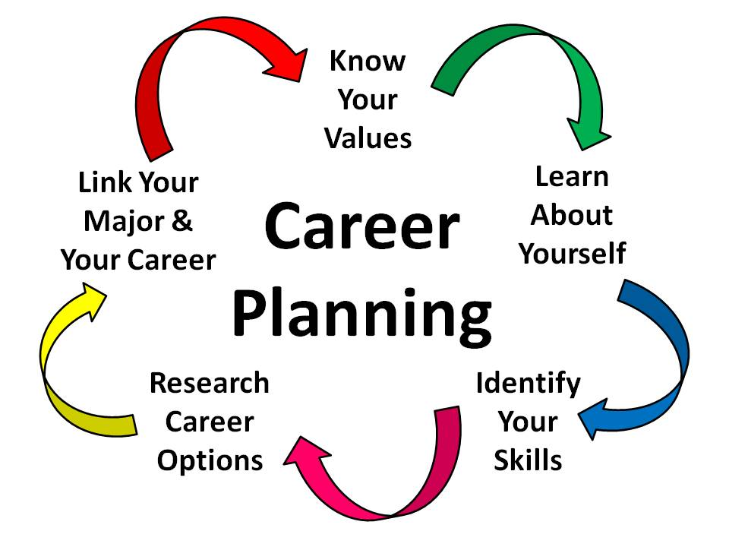
Grade 9
Career Interest Survey
College Interest Survey
FAFSA Forecaster
Four Year Plan
A-G Course Review
How to be Successful in High School

Slide 20
Grade 10
All 10th grade students are scheduled to take the PSAT
Students on IEP’s will be provide appropriate accommodations
English Language Learners will be placed with accommodations
After the test, all 10th grade students will complete California Colleges interest survey

Slide 21
Grade 11
Juniors on Track for A-G taking the PSAT
Career Interest Survey
College Interest Survey
Career Technical Education Pathways and Certification Overview
Military Programs Overview
Create a Plan with Action Step

Slide 22
Grade 12
UC Applications
CSU Applications
Community College Applications
FSA ID/FAFSA Worksheet/Financial Aid
ASVAB/Military Overview
UC Prompts
Practice ELM
Practice Accuplacer
Scholarships
Dream Act Workshop

Slide 23
Site Plans
Logistics for Testing and Grade Level Activities
PSAT Preparation and Planning
Grade Level Teams Created
Prepping Your Staff for Activities

Slide 24
District Support
Ed Services Team Support for Each Site
Bell Schedule Collaboration with PSEA
District Level Public Relations and Parent Communication

Slide 25
Inspiring Dreams and Creating Opportunity

