Slide 1
7th Grade Kick-Off to College
student name: Sample Student
Today’s Date: Wednesday, October 14 , 2015
Teacher’s Name: Sample Teacher

Slide 2
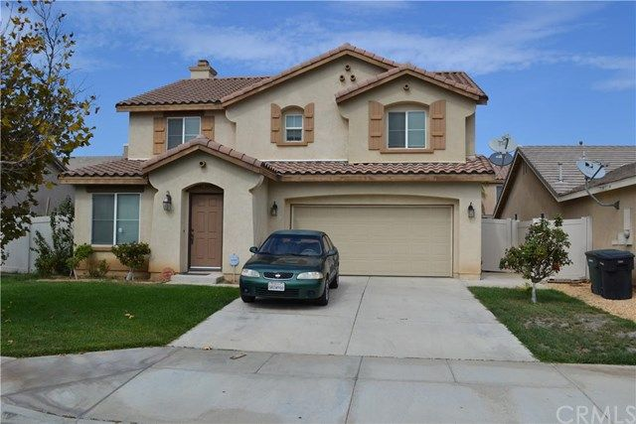
Where will you live?
Are you renting an apartment, renting a house or buying a house? I’m buying a house.
What city are you living in? Perris CA.

Slide 3
What is your career?
Name of career: Doctor
Annual Salary: $164,448
Monthly salary: $13704
What college would you attend to earn your degree? UCLA.

Slide 4
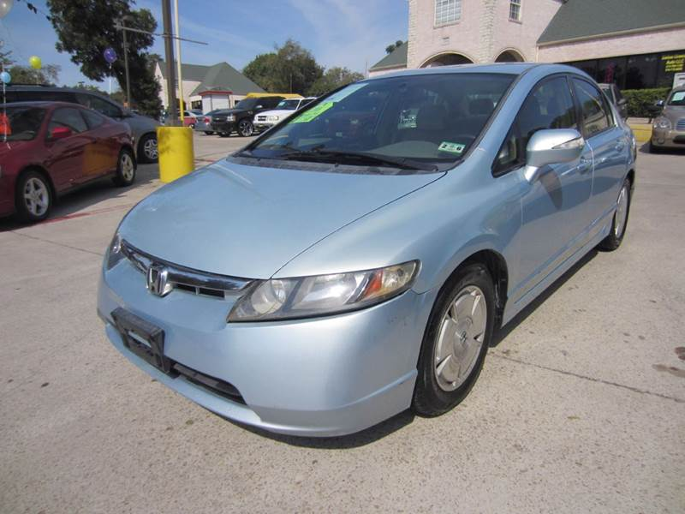
What kind of car will you drive?
Type of car: Sedan
Make: Honda
Model: Civic
Year: 2006
New or Used: Used
Cost of the car: 4,900
Monthly payment: $82

Slide 5
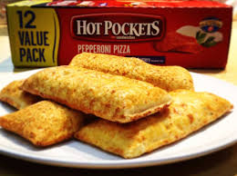
What is your meal plan for the week?
Total cost: $59.76

Slide 6
What are your other expenses?
Cell phone company: LG G4
Provider’s name that you pay for your bundle (TV, Internet and home phone) through: T-Mobile
Accident insurance: Yes

Slide 7
What will you do for fun?
I would go on a family trip with my family or friends. For example, we could go camping or go to restaurant.

Slide 8
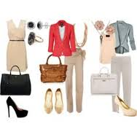
What will you do with your leftover money?
If I had any leftover money I would go buy some clothes and any other grocery that I might need. I would also donate money to the poor.

Slide 9
What did you learn from this project?
I learned that life is not easy… You have to work hard to earn what you want. You have to try your best to make your way to college and have good paying job. You also have to figure out how much you will pay for your phone, food, and other necessities.

Slide 10
The End!
Thank you!
Any Questions?

