Slide 2
Practicing Social Justice and Equity with Intention
Know the who, what, when, where, how, and why

Slide 3
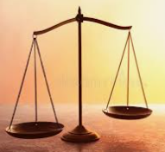
What is Social Justice?
It is rooted in the premise of equity (where resources and supports are sufficient to the need) and encompasses the ideas of access, diversity, participation and inclusion.
Social Justice is the idea of making unequal institutions equal in their service to all members of a society.

Slide 4
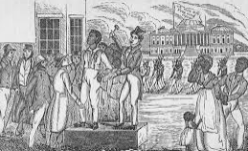
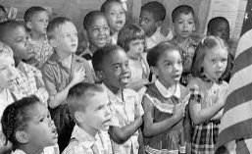
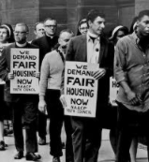
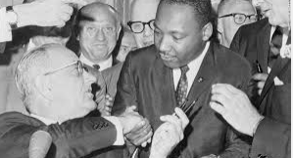
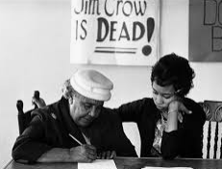
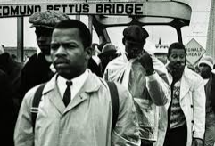
Quick History Lesson
Significant Years in the quest for Social Justice
1863 – Lincoln’s signs the Emancipation Proclamation
1865 – 13th Amendment (Congress)
1954 – Brown vs. Board of Education (Supreme Court)
1964 – Civil Rights Acts (Congress)
1965 – Voter Rights Act (Congress)
1968 – Fair Housing Act – (Congress)

Slide 5
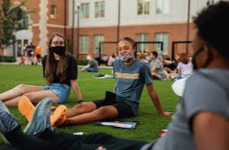
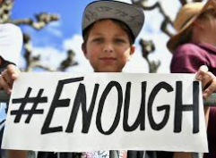
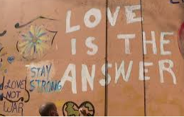
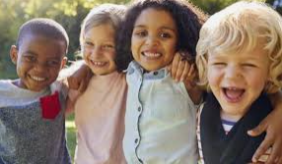
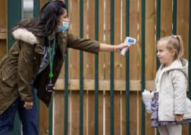
So what does all that mean and WHY is this work important?

Slide 6
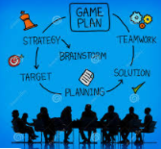
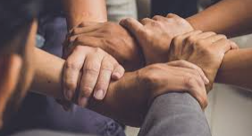
So how do we go about intentionally, strategically and consistently working toward Social Justice?

Slide 7
Know the WHAT?
What barriers to education exist that are embedded in the way your district, school, department, classroom, clubs and sports do business? Who are these barriers impacting?

Slide 8
Identify WHO is involved and the various different roles.
Understanding that the barriers to social justice are maintained in systemically it is key to identify the different individuals and roles within the systems in your district and schools

Slide 9
Determine HOW will you do the work. Build both awareness and your network.
What tools and resources do you have or need at your disposal to make change.

Slide 10
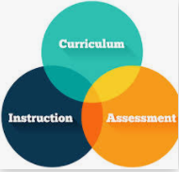
Know WHERE you need to focus your change efforts?
After you have reviewed data and policy, rules, procedures and identified where equity issues exist make those areas known to stake holders and begin to develop action plans to affect change.

Slide 11
Develop timelines and priority lists for WHEN action plans will commence and end?
Pace yourself with deliberate speed.
Prioritize your goals and multi-task. Be prepared to give attention to issues that instantly develop or suddenly have momentum behind them.
Be aware of important timelines and dates that may impact your advocacy efforts.

Slide 12
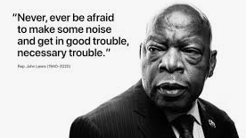
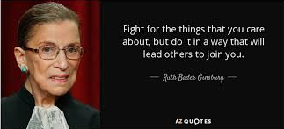
He taught us how to love in the face of hate and to mobilize, organize and legislate.
She taught us the women belonged anywhere decisions were being made and power of education and the pen.

Slide 13
What questions do you have?

