Slide 1
Elementary School Counseling Data Presentation
Presented By
Jovianne Pereyra, San Jacinto Unified
Erika L Zamora, Alvord Unified

Slide 2
Welcome!
About Us...
Jovianne Pereyra Elementary & Middle School Counselor Monte Vista Middle School San Jacinto Unified School District Email: jpereyra@sanjacinto.k12.ca.us Website: https://sites.google.com/sanjacinto.k12.ca.us/montevistaschoolcounseling/home | Erika L Zamora Elementary School Counselor Rosemary Kennedy Elementary School Alvord Unified Email: ErikaZam2018@gmail.com Instagram: RMKCounselor

Slide 3
Who’s in the room?
First year
2-3 years
Future School Counselors
COSAs
Notes:
Erika

Slide 4
Objectives
Review Types of Data and Examples
Learn How to Create to a Pre/Post Test and Utilize Results
Learn how to Develop SMART Goals using the ASCA Template
Review Action Plan Templates and Examples
Learn Different Ways to Share Data with Stakeholders
Notes:
Erika

Slide 5
Notes:
Erika

Slide 6
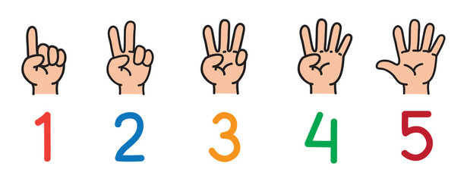
Data… how comfortable are you?
Notes:
Erika

Slide 7
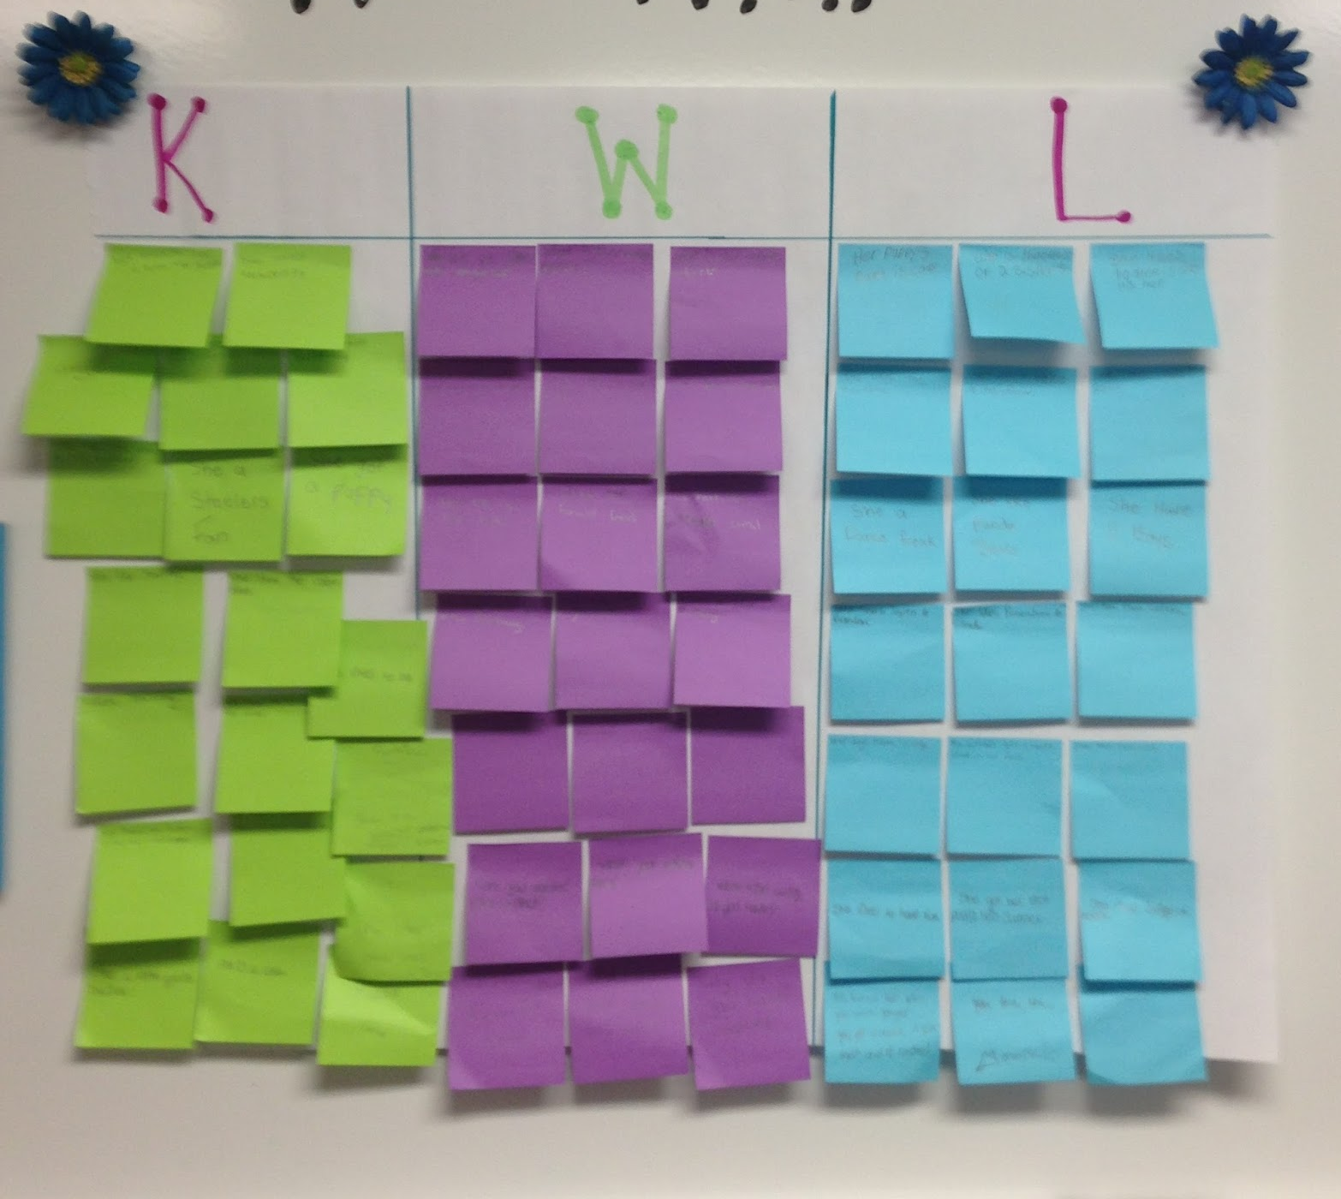
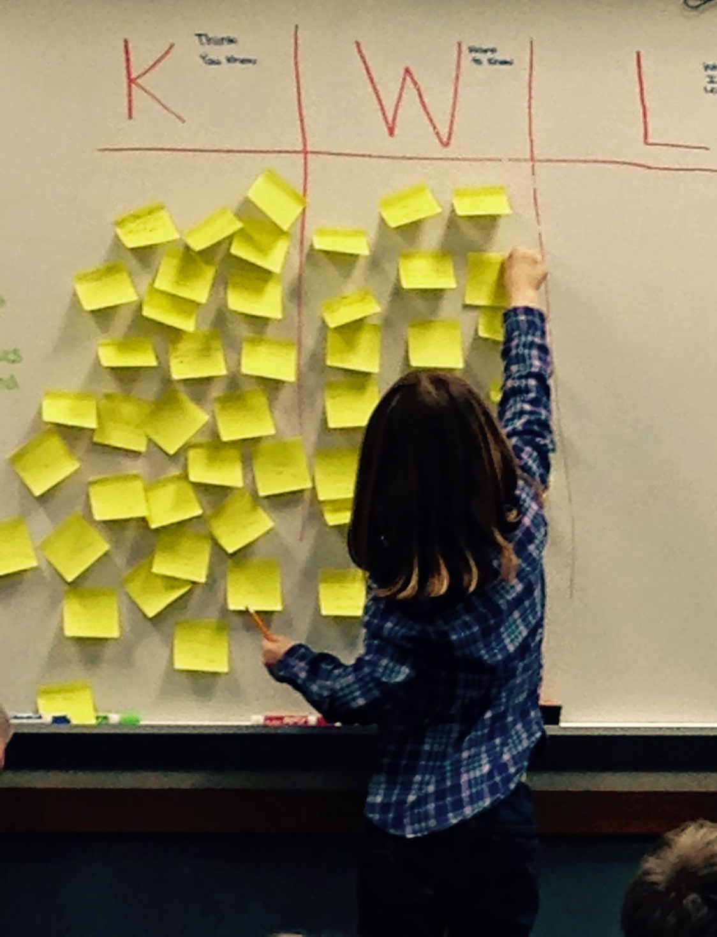
KWL Chart for Data!
K- What I Know W- What I Want to Know L- What I Learned
Directions: Please take 2 Post-It Notes
1. On the 1st Post-It write down What
You Know about data already (You
will later post it on the “K” Column”)
2. On the 2nd Post-It write down
What You Want to Know about data
(You will later post it on the “W” Column”)
3. After you write on both Post-Its, post
them on the appropriate Column
on the Chart Paper
Notes:
Jovi

Slide 8
Finding Data
What student information system do you use? Where else can you find data?
AERIES
Attention 2 Attendance
Schoolzilla
California Dashboard
California Healthy Kids Survey (West Ed)
Counselor Created Forms
Reports to Run
Attendance (e.g. students chronically absent)
Discipline (e.g. office referrals, suspensions, detentions, etc.)
Achievement (e.g. test scores, report card grades, etc.)
Achievement Related (e.g. attendance rates, behavior grades, etc.)
Notes:
Jovi

Slide 9
What data are you using now?
Where are you getting it from?
How are you using it?
Notes:
Jovi

Slide 10
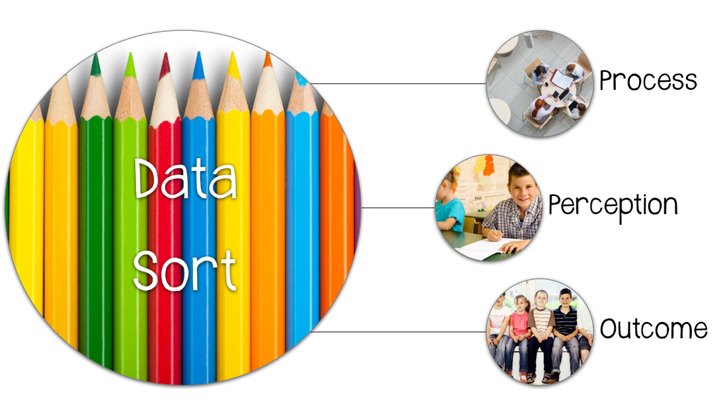
Three Types of Data
Process - Number of students impacted (Who, What, Where, When)
Perception - Student’s Knowledge, Attitudes, and Skills (Pre/Post Tests, Surveys, etc.)
Outcome
Achievement- Academic achievement (benchmark & standardized tests scores, and academic proficiency levels)
Achievement Related- Data elements proven to support student achievement (attendance, behavior, parent engagement, etc.)
Notes:
Jovi

Slide 11
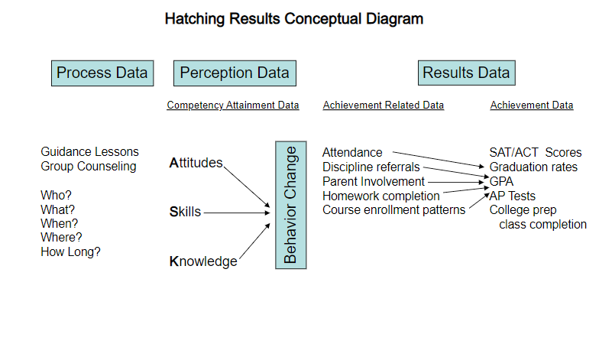
Types of Data
Notes:
Jovi

Slide 12
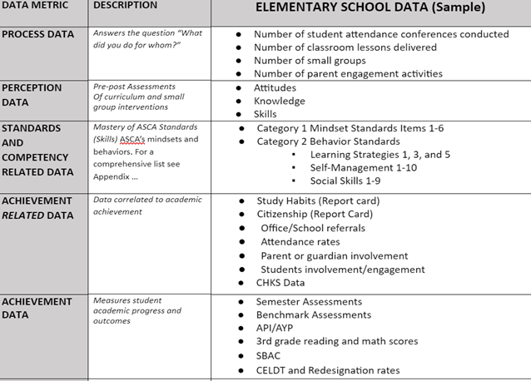
Examples
Notes:
Erika

Slide 13
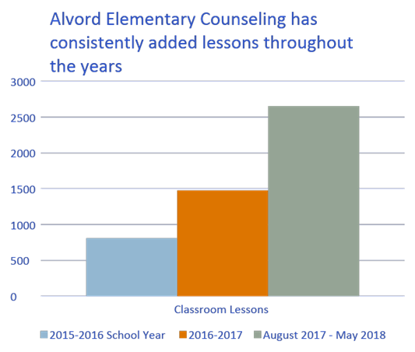
Process Data
Number of students impacted (Who, What, Where, When)
Reached ALL Science Classes Nov. 2017 - Jan. 2018 (approximately 930 students)
Taught 32 Lessons on College/Career using Naviance Website
College Super Match
Career Clusters
Strengths Finder
Roadtrip Nation (Career Video Exploration)
1,178 more than 2016-2017
Notes:
Erika

Slide 14
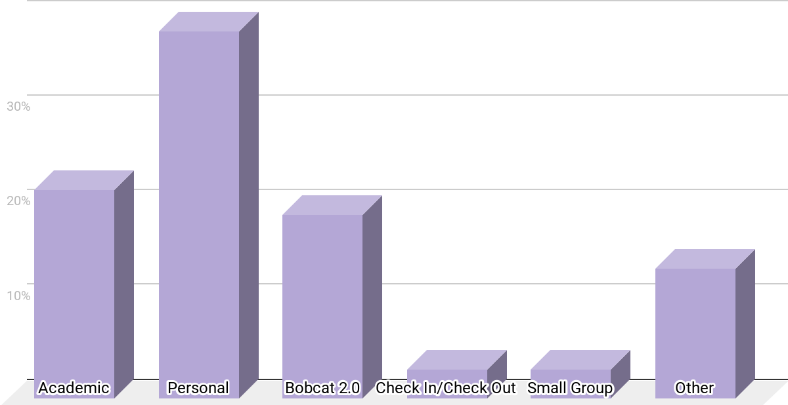
Reason Students Were Seen (Quarter 1)
Students Visited the Counseling Center mainly for: Personal/Social Reasons, Schedule Change Requests, and Bobcat 2.0.
38.8%
22%
19.4%
13.7%
3.1%
3.1%
Notes:
Jovi

Slide 15
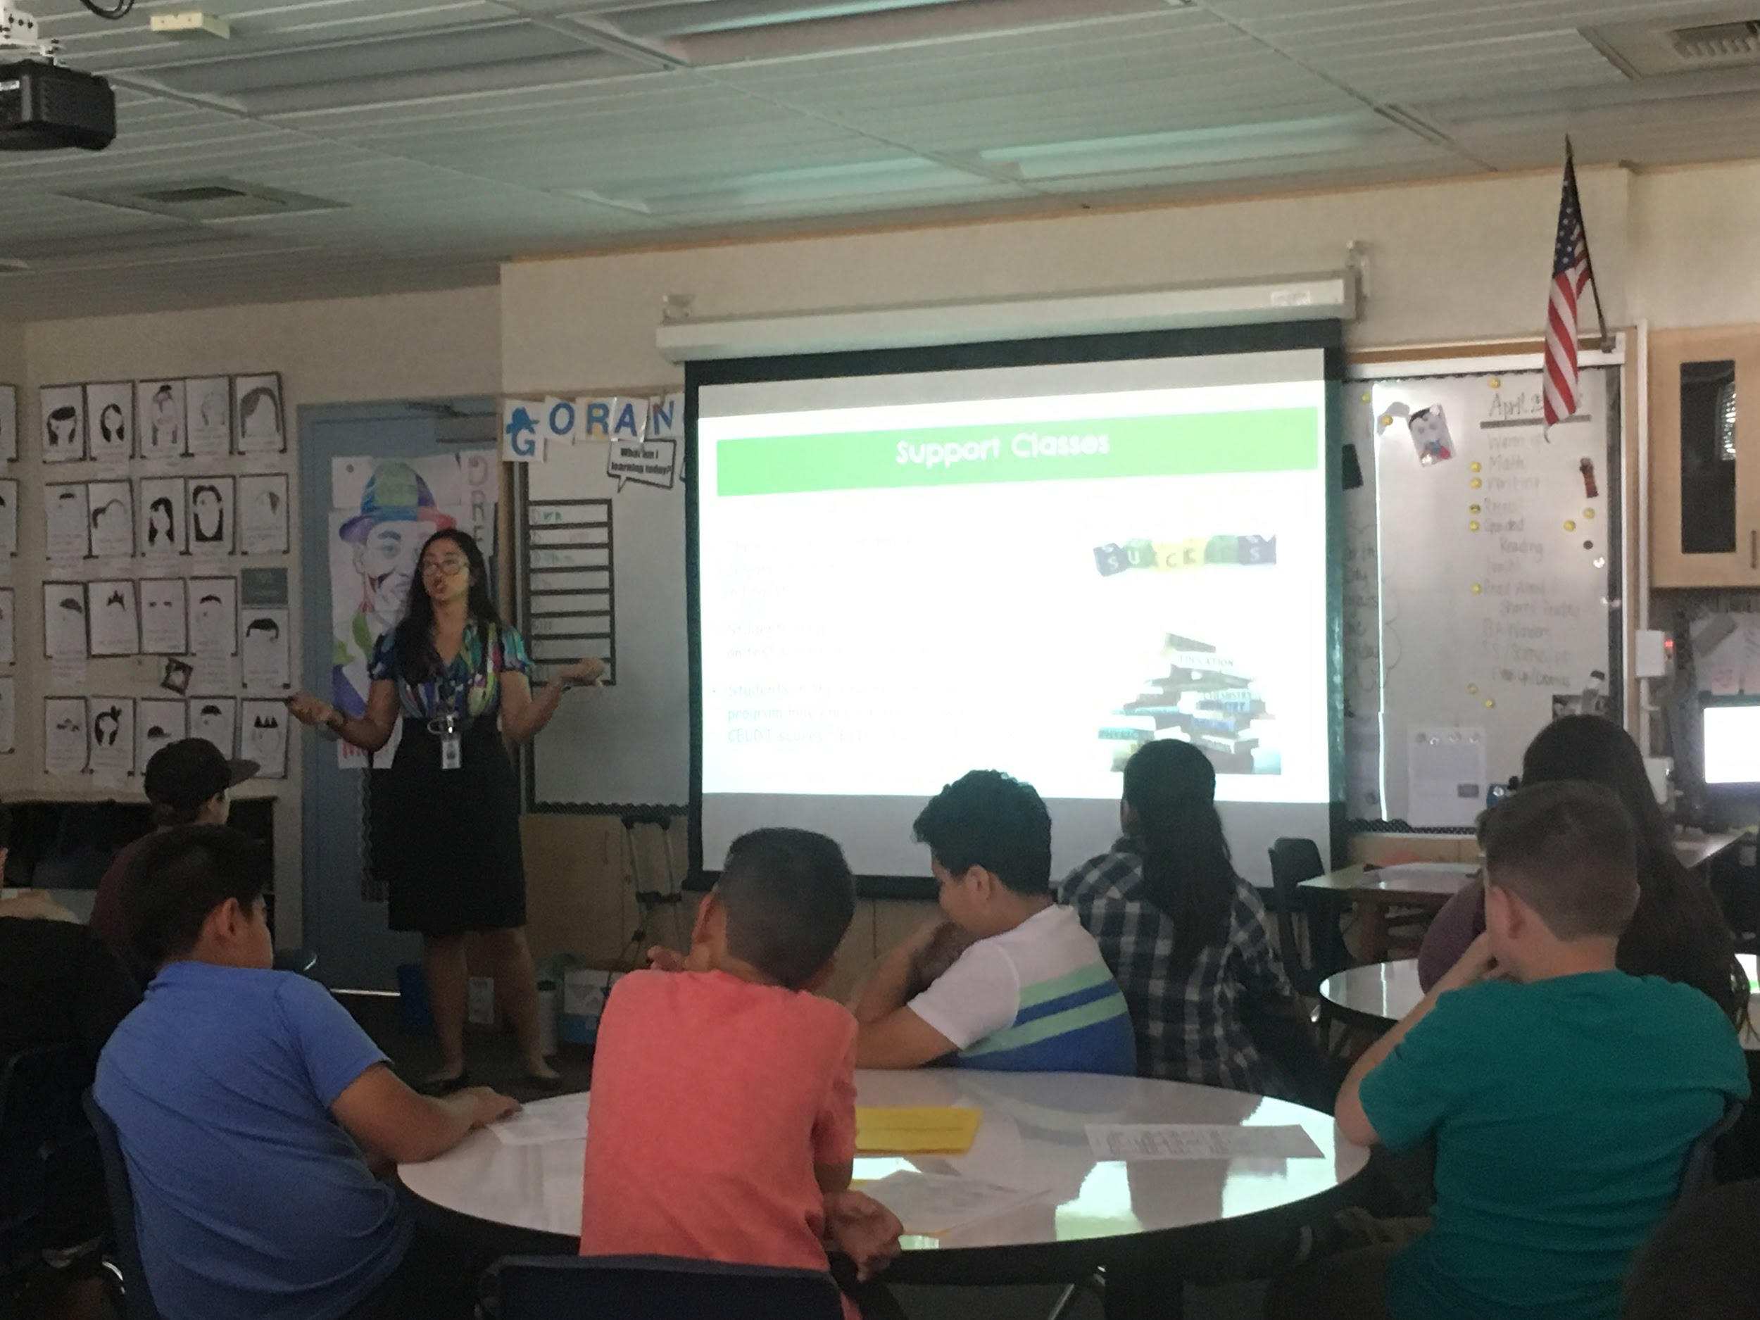
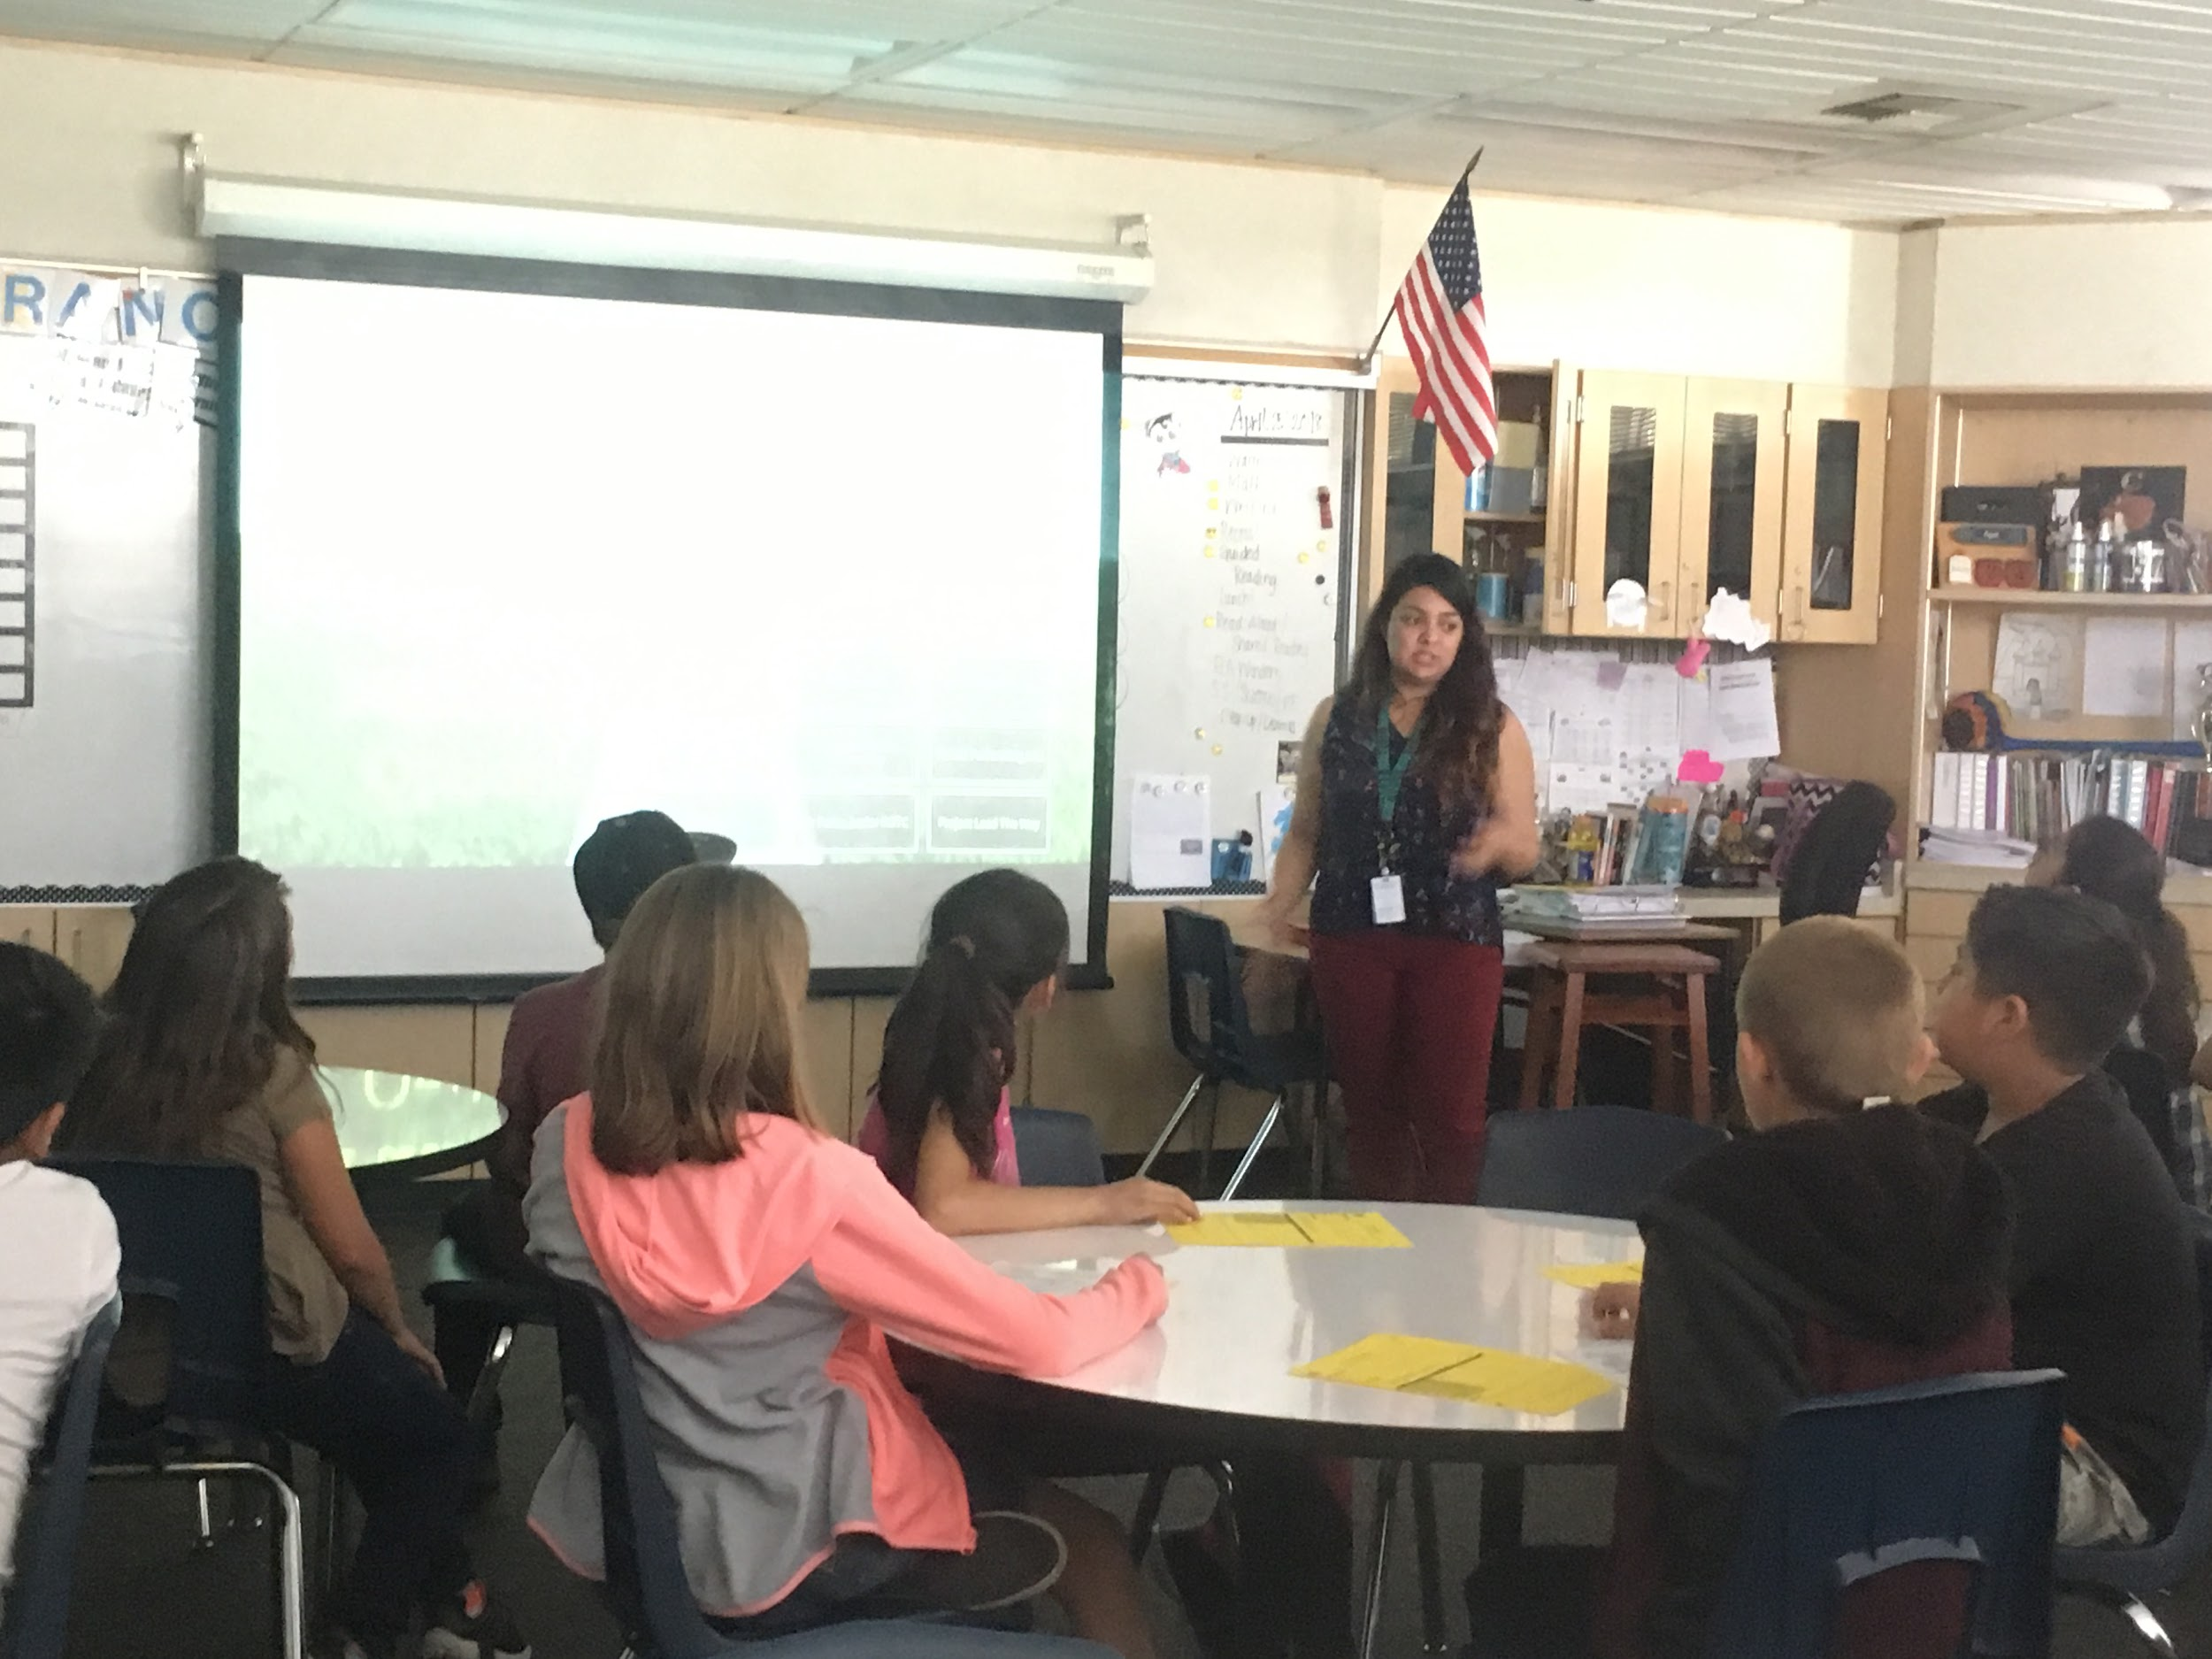
Elementary School Lessons
Presented 2 Lessons at Each Feeder School (8 Lessons)
Middle School Transition
Course Selection
Planned First 5th Grade Visit & Orientation @ MVMS - Approximately 354 5th Graders Attended!
Parent Component - 24+ Families Attended
Notes:
Jovi
Add parent attendance Data
Add Data from Visit Survey?

Slide 16
Perception Data
Student’s Knowledge, Attitudes, and Skills (Pre/Post Tests, Surveys, etc.)
District wide agrees on data to determine site based needs. (CHKS shown)
Notes:
Erika

Slide 17
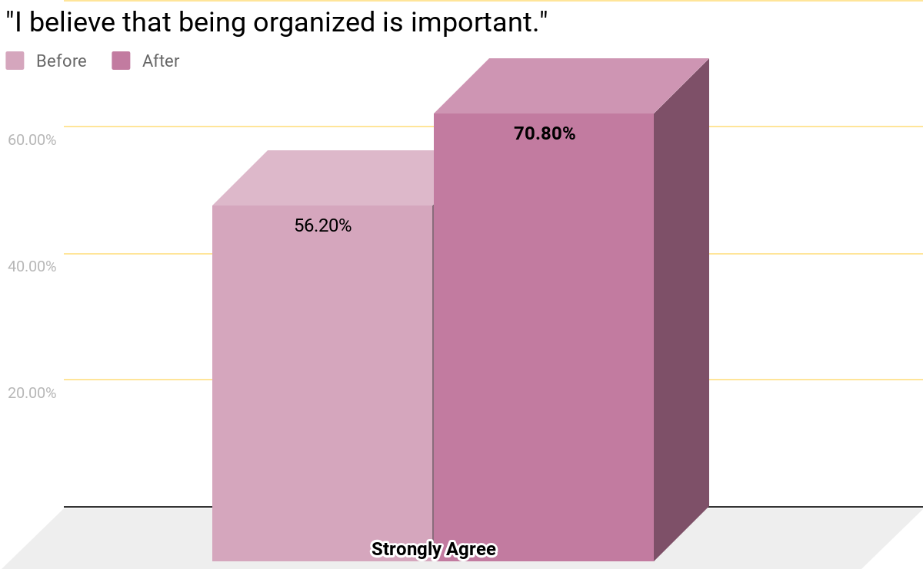
Academic Classroom Presentation Data: 6th Grade
A 26% Increase!
Notes:
Jovi

Slide 18
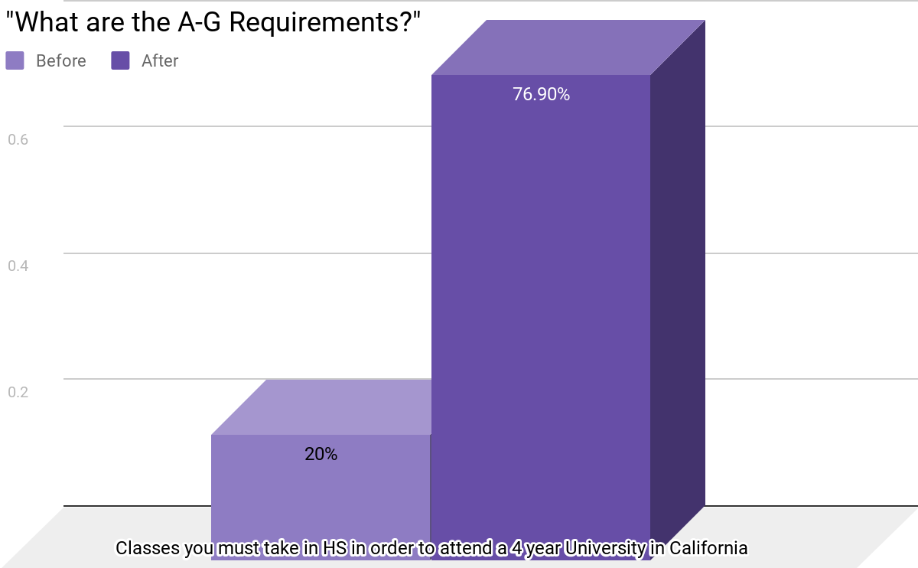
Academic Classroom Lesson Data: 7th Grade
A Huge Increase!
Notes:
Jovi

Slide 19
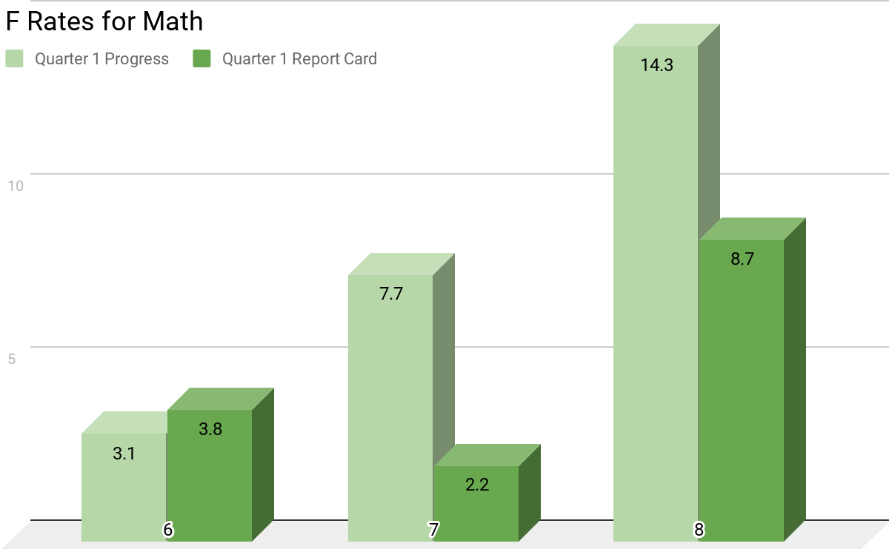
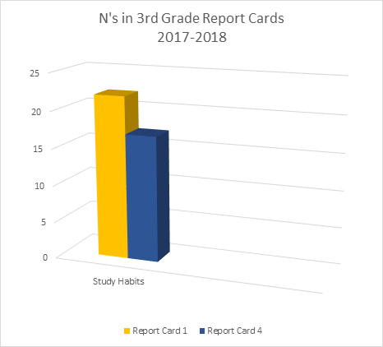
Outcome Data
Achievement & Achievement Related
Decrease in F rates for 7th and 8th grade
Increase in F rates for 6th grade
Notes:
Erika

Slide 20
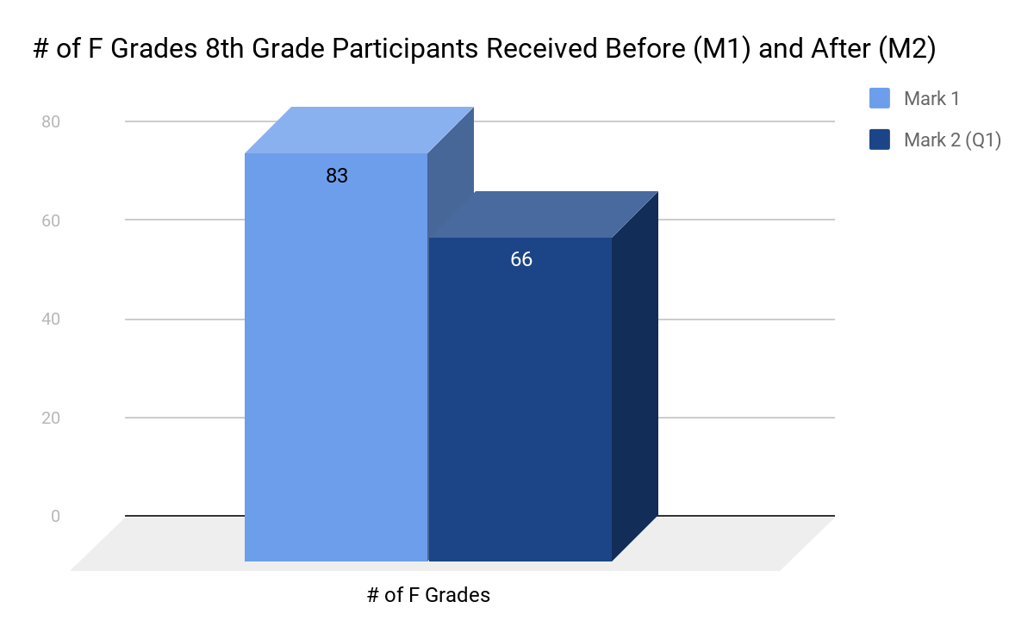
8th Grade Bobcat 2.0 Data
A 20.5% Decrease in F Grades!
Notes:
Jovi

Slide 21
Process, Perception, or Outcome?
482 Students participated in Problem Solving Lessons
Attendance increased from 95.7% to 96.9%
78% of 5th graders reported feeling confident
The EL Reclassification rate increased by 27% in 2017-2018
8 small groups on social skills of 2nd graders at RMK were conducted
Notes:
Erika

Slide 22
What data can you use right now?
Notes:
Erika

Slide 23
Pre/Post Tests
Notes:
Jovi

Slide 24
What is a Pre/Post Test?
Assessments given after a lesson/intervention is delivered in order to…
Determine how to improve your lesson/intervention
Advocate for Students and School Counseling Services
Promote Systemic Change
(The Use of Data in School Counseling, Hatch, 2013)
Notes:
Jovi

Slide 25
Important to do a PRE AND POST
Reviewing the results of the PRE test help shape the delivery of the lessons
Showcases Growth
Shows if the lesson is important
What content areas should we focus on the most during the presentation
If you can’t do a PRE (or if it is forgotten), facilitating a Post is better than doing nothing at all
DO NOT pre/post every lesson. Pick one or two grade levels & one or two lessons - use data to pick which grade/lesson
(The Use of Data in School Counseling, Hatch, 2013)
Notes:
Jovi

Slide 26
Creating A Pre/Post Test
Develop Questions that Measure Participant’s:
Attitudes - What you want me to believe that I did not believe before?
Likert Scale Questions (can use pictures and/or scales to measure attitudes/beliefs)
“I believe that adults care about me”
“I believe being organization will help me be successful”
Knowledge- What you want me to know that I didn’t know before?
Either correct or not correct. Multiple Choice. (Don’t make them too easy!)
“What are the three R’s of Bullying?”
“What are the Calm Down Steps?”
Skills- What you want me to demonstrate that I did not demonstrate before?
Application/Demonstration
“Here is a copy of Sally’s recent grades, what is her GPA?”
(The Use of Data in School Counseling, Hatch, 2013)
Notes:
Jovi

Slide 27
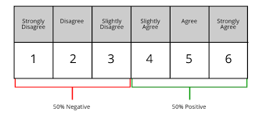
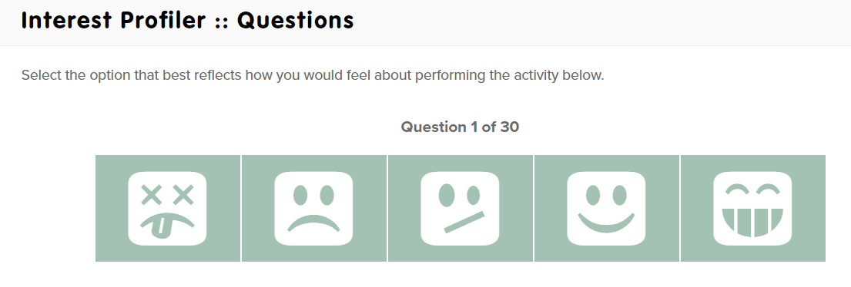
Attitudes: Likert Scales
Notes:
Jovi

Slide 28
True/False and Multiple Choice Questions
Avoid using T/F questions, students have a 50% chance of getting the correct answer, and results could show minimum growth
The more choices available in a Multiple Choice Question, the more difficult the question, and the more valid the results
(The Use of Data in School Counseling, Hatch, 2013)
Notes:
Jovi

Slide 29
Skills Question Examples:
Demonstrate Calm Down Steps
What are the Second Step Problem Solving STEPS? Fill out a problem solving Worksheet.
Demonstrate how to ask for help Assertively
Using a Transcript or Grade Information to Calculate GPA
Notes:
Jovi

Slide 30
Tips for Creating Pre/Posts
Keep it short 1-8 questions for elementary AVOID essay tests, fill in the blanks or short answers! Try not to use paper! But if using paper use programs like EADMS Try, google doc., Edusoft, Naviance, CLICKERS! Pilot your survey- modify if needed Try giving it a week before the lesson to see what they already know | It’s best if you don’t try to not use questions with double negatives Pay attention to language that is developmentally appropriate Use symbols with younger children Your lesson is the BEST way to decide what to ask
(The Use of Data in School Counseling, Hatch, 2013)
Notes:
Jovi

Slide 31
Pre/Post Test Examples
Notes:
Erika

Slide 32
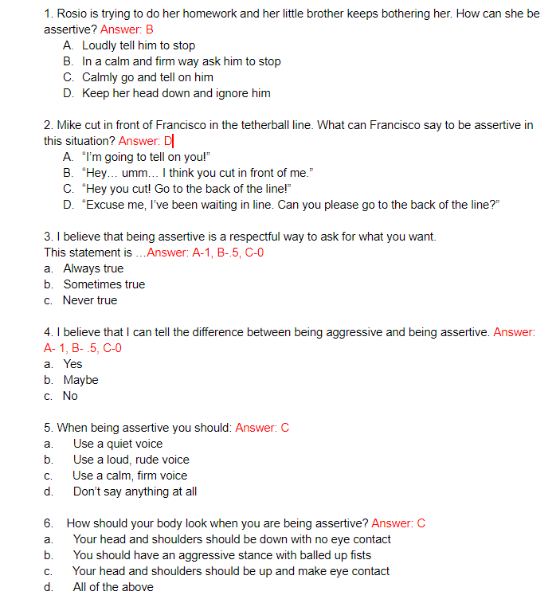
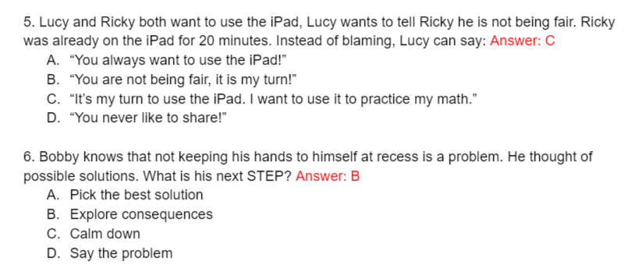
ASK
4th Grade Pre/Post
Lesson: Problem Solving
3rd Grade Pre/Post
Lesson Being Assertive
Notes:
Erika

Slide 33
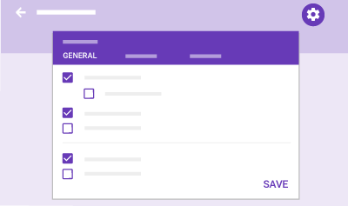
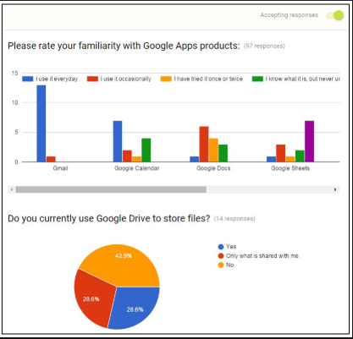
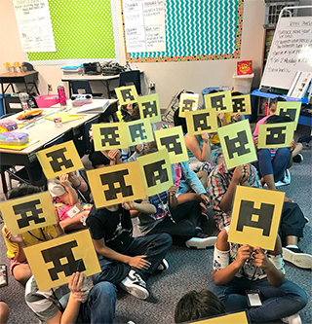
Digital Pre/Posts
Link to Copy of MVMS 8th Grade Academic Lesson Pre/Post:
https://docs.google.com/forms/d/1r1vYuQpuzx33kyF45CjwsK0lJIYg4SNPzkTBGBlxorM/edit
Notes:
Jovi

Slide 34
Presenting Your
Pre/Post Results

Slide 35
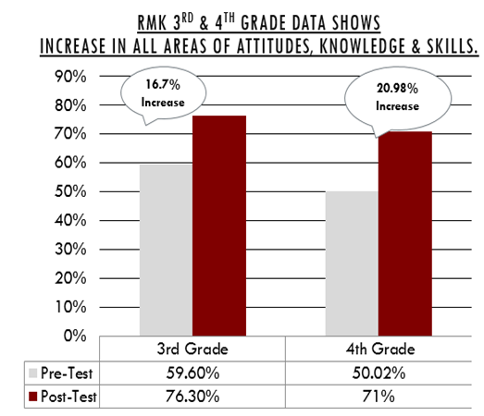
WHAT DO STUDENTS KNOW?
Notes:
Erika

Slide 36
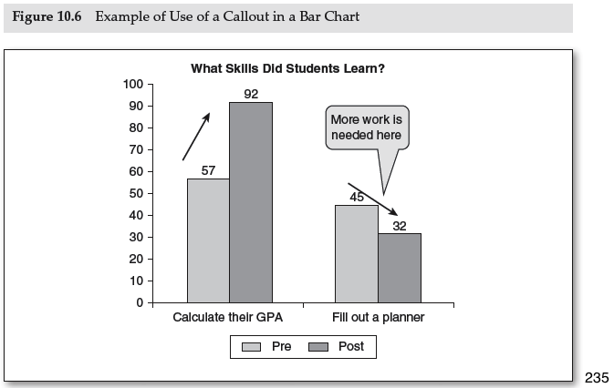
WHAT CAN STUDENTS DO?
(The Use of Data in School Counseling, Hatch, 2013)
Notes:
Erika

Slide 37
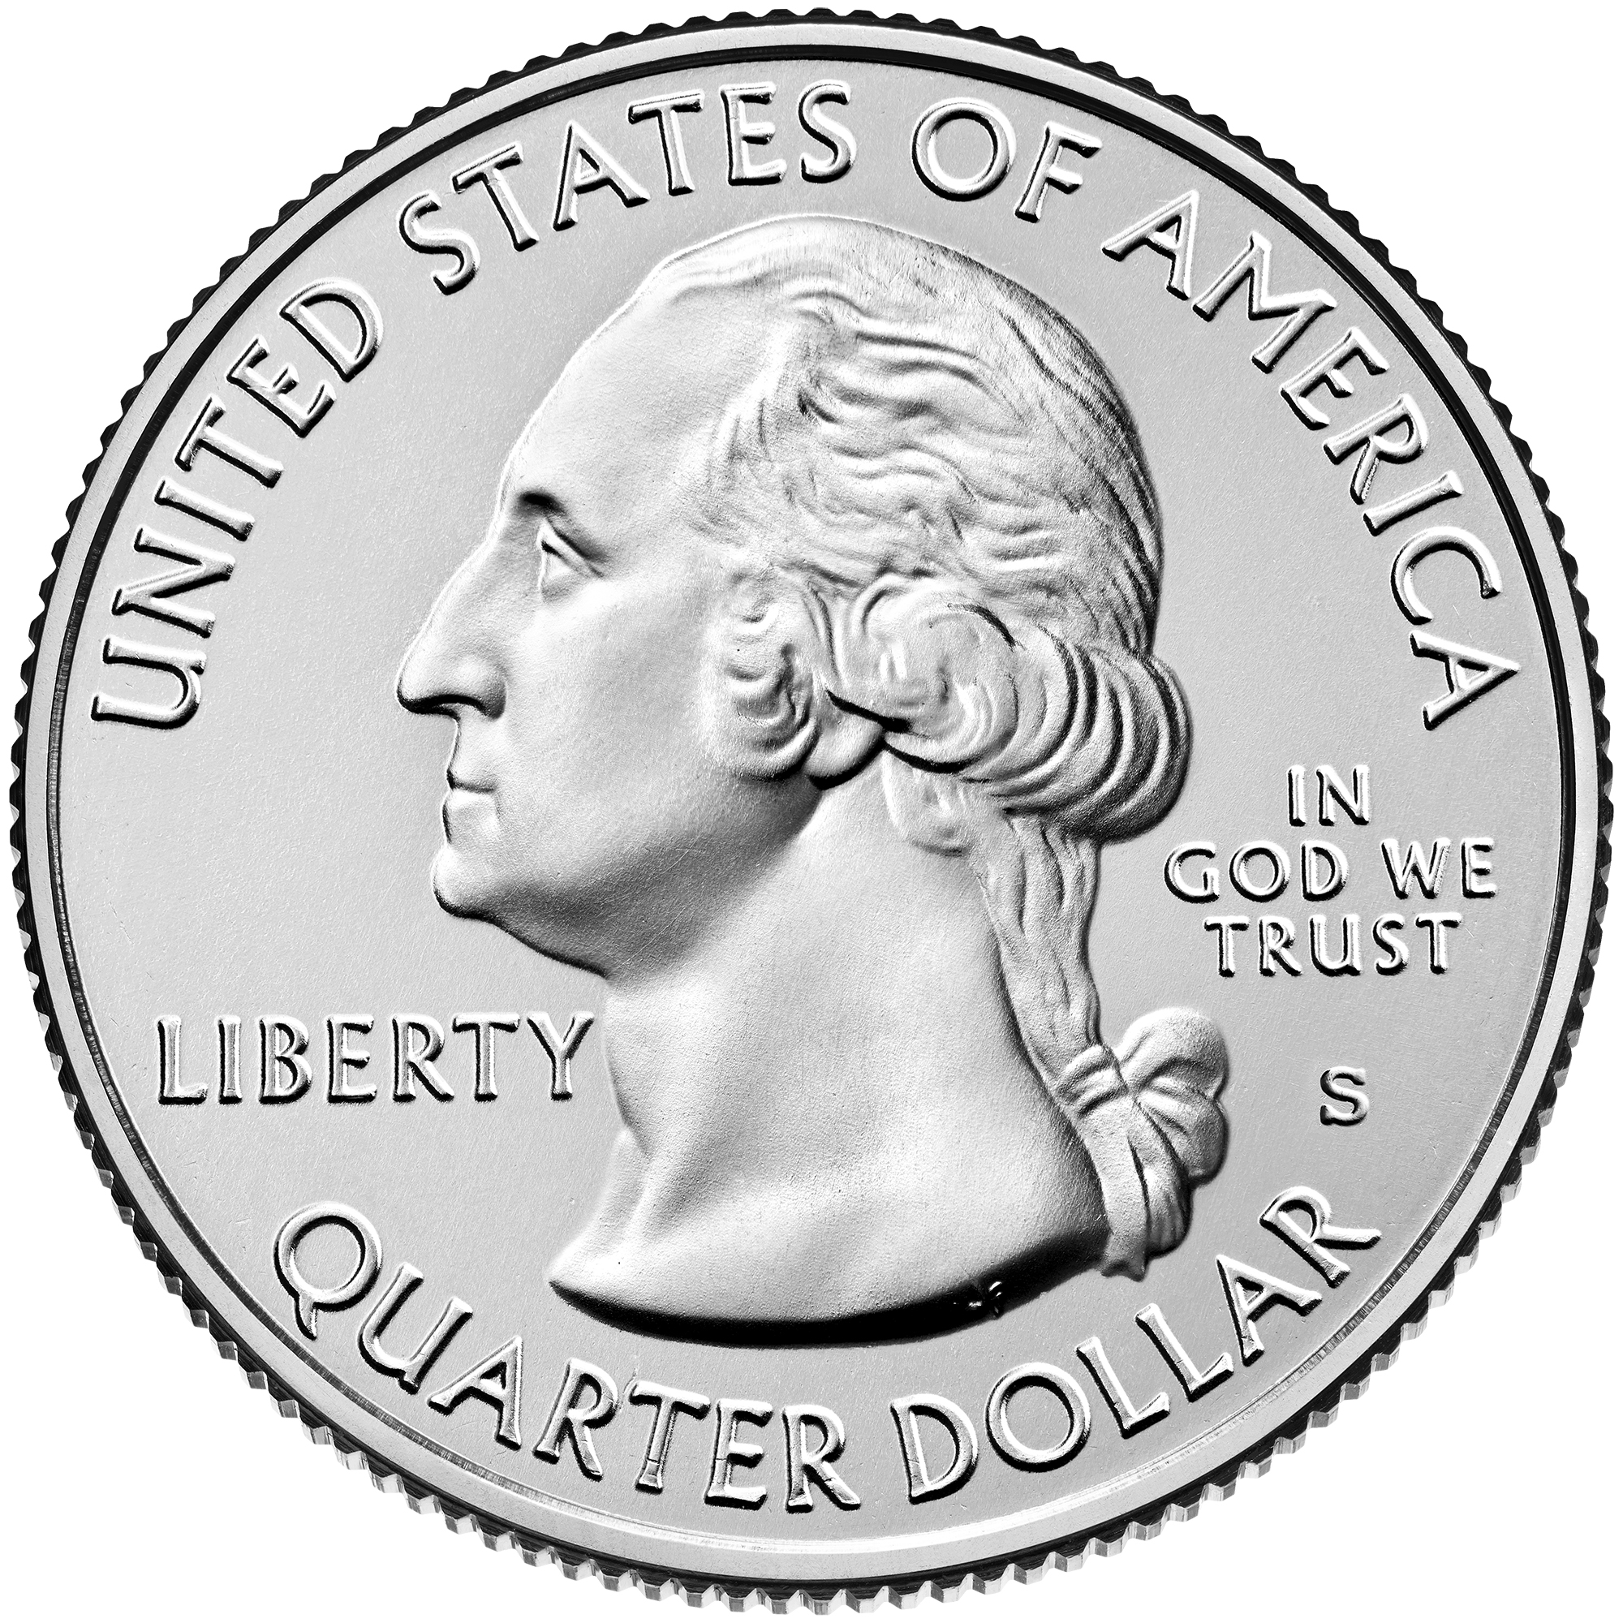
Use Percentage Change to Show Growth (David Effect)
It’s not the pointage of growth it’s the amount of change based on two variables
How much growth is shown here?
I originally had one Quarter, then I gained another Quarter. What is the percentage change?
Calculating Percent Change:
http://www.percent-change.com/
Original
New
% Change = (New-Original) X 100%
Original
Notes:
Jovi

Slide 38
Why do you think it is important to show Pre/Post data to Stakeholders?
How do you share your data?
Notes:
Jovi

Slide 39
Presenting Data to Stakeholders
Staff Presentations
School Board Presentations
National School Counselor Week
Results Report
Newsletter
Website
School Site Council (SSC)
ELAC
School Counseling Advisory Council
Notes:
Erika

Slide 40
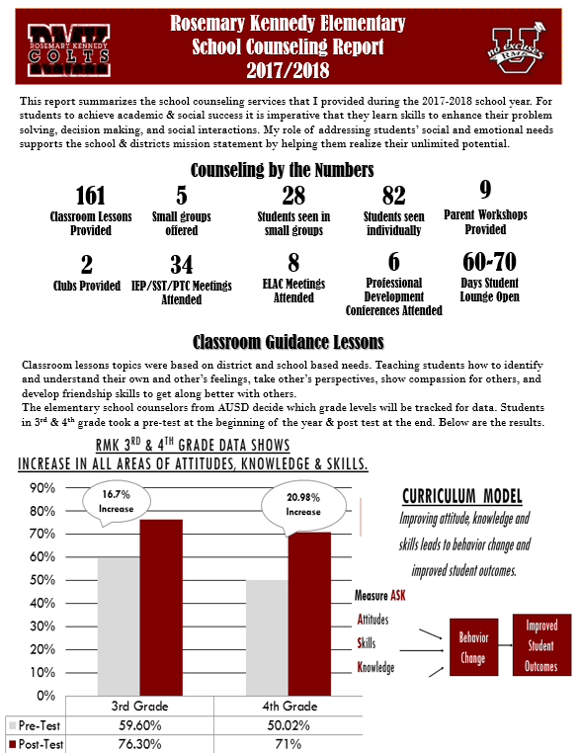
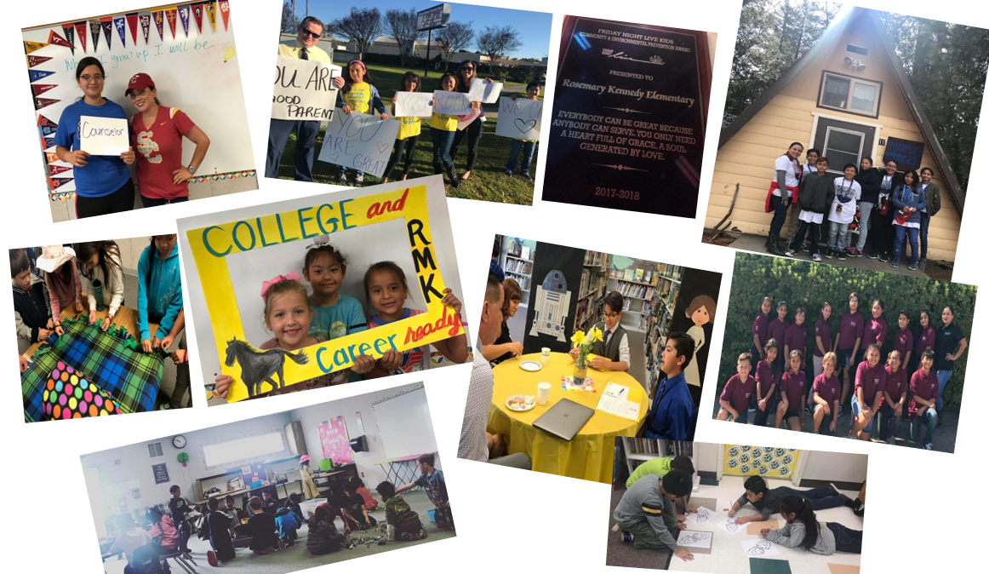
Focus on a few things
Keep it short
Include pictures
Ask for feedback
Notes:
Erika

Slide 41
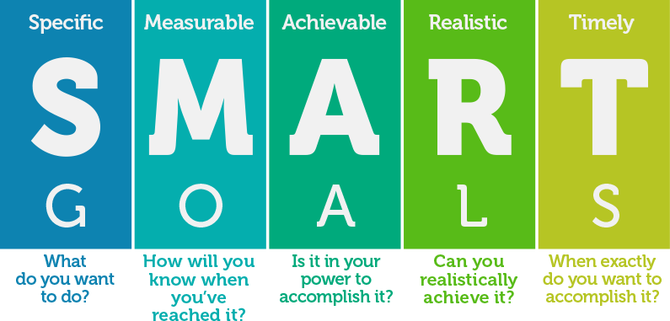
Developing Goals and Action Plans
Notes:
Jovi

Slide 42
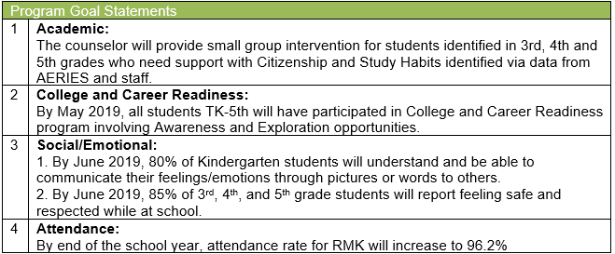
Developing SMART GOALS
Include in your Annual Agreement- incorporate school/district goals
Smart Goal Examples:
By June 2018, current 8th Grade Chronically Absent students will increase their average daily attendance at school by 10% from 87.6% (baseline) to 96.4% (target data).
ASCA SMART Goal Template
Notes:
Jovi

Slide 43
Action Plans
What Are Action Plans Used For?
What Goes in an Action Plan?
What information should you look at to complete your Action Plans?
Who Should you Share an Action Plan With?
ASCA Action Plan Templates
Download Templates from ASCA Website: www.schoolcounselor.org
Notes:
Jovi

Slide 44
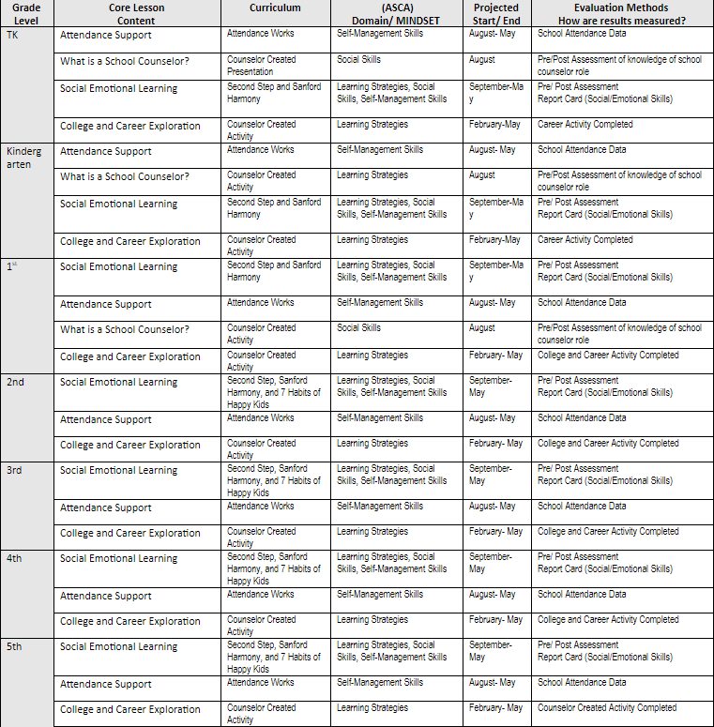
Tier 1
(Core Curriculum)
Action Plan
Notes:
Erika

Slide 45
Tier 2 Data-Driven Action Plan - Elementary
 | ELEMENTARY (TK-5) | Interventions*
Attendance/ Tardies | Monthly Screening Data Attendance Letter 2 (SART : 5-7 absences) | School counselors provide resources/support to families as needed Collaborate with SART Coordinator and attend meetings as appropriate
Behavior | Each In-School/Out of School Suspension | Post-suspension meeting with student individually upon returning from suspension
Report Card (Study Habits) | 1 U at mark 1 5 or more N’s and/or U’s at mark 2 | At Mark 1: School counselor participates in parent teacher conference, if possible, or contacts family. At Mark 2: School counselor will screen 2nd – 5th grade students to assess appropriateness to participate in small group intervention
Report Card (Citizenship) | 1 U at mark 1 3 or more N’s and/or U’s at mark 2 | At Mark 1: School counselor participates in parent teacher conference, if possible, or contacts family. At Mark 2: School counselor will screen 2nd – 5th grade students to assess appropriateness to participate in small group intervention
Course Failures | Students identified for SST based on low academic performance | School counselor participates in SST when there is an Identified behavior and /or social/emotional concern
Incoming Indicator | Outgoing 5th Graders Indicator of risk: Attendance, Behaviors and Academic Placement (for ELA and Math levels) By end of April | Provide school counselor at feeder middle school with information about at-risk students
Notes:
Erika

Slide 46
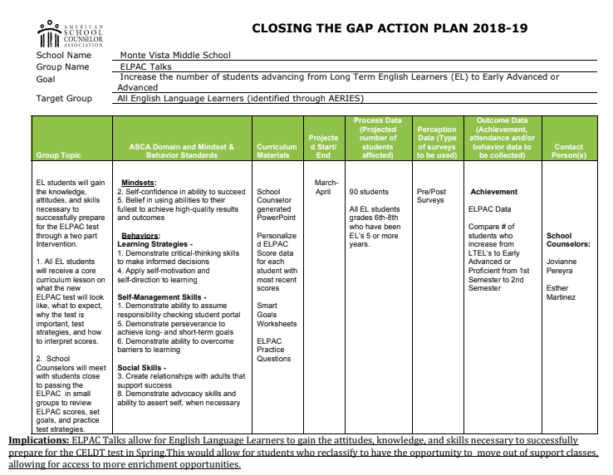
Action Plan Examples
Monte Vista Middle School Closing the Gap
Notes:
Jovi

Slide 47
KWL Chart for Data - Did We Learn Anything New?
K- What I Know W- What I Want to Know L- What I Learned
Directions: Please take 3 Post-It Notes
1. On the 1st Post-It write down What
You Know about data already (You
will later post it on the “K” Column)
2. On the 2nd Post-It write down
What You Want to Know about data
(You will later post it on the “W” Column)
3. On the 3rd Post-It write down What
you Learned and/or plan to use at
your site (Post to “L” Column)
Notes:
Jovi

Slide 48
Next Steps:
What data can you present this school year?
How can we support you?
Any Questions?
jpereyra@sanjacinto.k12.ca.us
Erika.Zam2018@gmail.com

