Slide 1
Riverside County Office of Education
School Counseling Leadership Network
S.M.A.R.T. School Counseling Programs
Showcasing, Meaningful, Aligned, Results and Tools for School Counseling Programs
Notes:
Erica-SMART-like our SMART goals

Slide 2
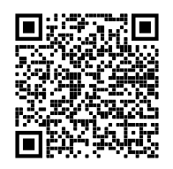
QR Code
Presentation Access
Notes:
Erica

Slide 3
Who Are We?
Erica Espinoza
District College/Career Counselor
Stephanie Mitchell
Director of College/Career
Notes:
Erica/Stephanie

Slide 4
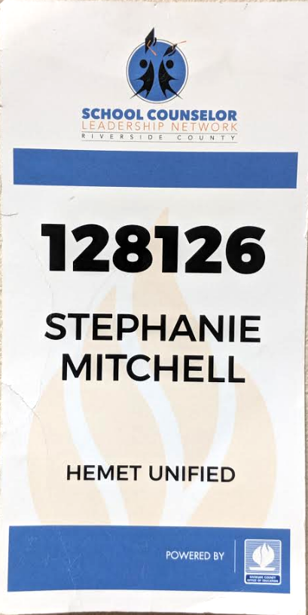
Our Journey
14-15
12% - Dropout Rate
81% - Graduation Rate
26% - A-G Completion Rate
We embarked on developing a TK-12 Comprehensive School Counseling Program.
Notes:
Stephanie

Slide 5
Who Are We?
28 Schools
4 - High
4 - Middle
12 - Elementary
3 - K-8
3 - Alternative
1 - Preschool
1 - Charter
22,400 Students
Student Groups:
84% Socio-Economically Disadvantaged
14% Students with Disabilities
11% English Learners
1% Foster Youth
Ethnicities:
60% Hispanic
25% White
9% African American
4% Two or More Races
2% Other
Notes:
Stephanie

Slide 6
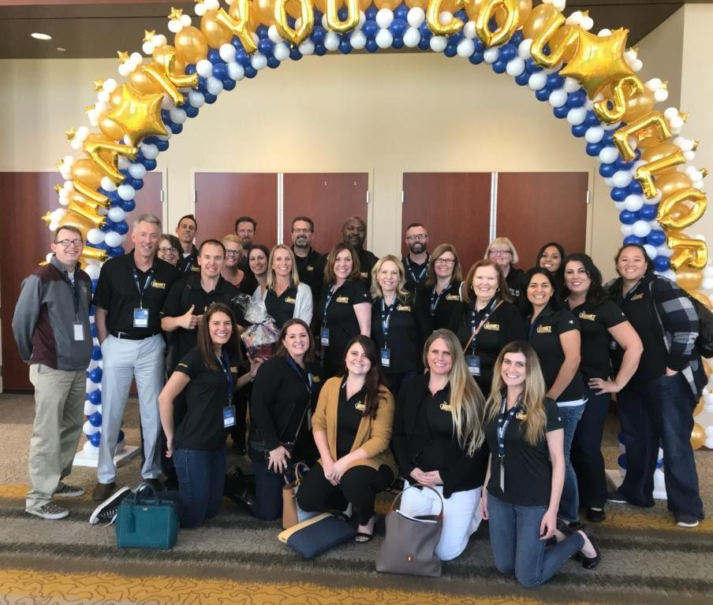
Who Are We?
Hemet Unified
School Counseling Team
49 School Counselors
&
1 Director of College/Career
12-Elementary School Counselors
4-K-8 School Counselors
9-Middle School Counselors
18-High School Counselors
4-Alternative School Counselors
2-District School Counselors
Notes:
Stephanie - LCAP survey indicated increase of counselors added full time elementary and ccc and middle school

Slide 7
HUSD 2019-2020 Vision
~
EMBRACE
EDUCATE
EMPOWER
Notes:
Erica

Slide 8
HUSD 2019-2020 Goals
Teaching and Learning
Provide High Quality Teaching and Learning for Students
Systems of Support
Develop an Integrated System Framework of MTMDSS for Academic, Behavioral, and Social Emotional Success for All Students
Culture and Climate
Fully Engage Stakeholders to Create a Culture and Climate to Support All Students
Notes:
Erica District Alignment of Goals/Principal Goals
Alignment in the System

Slide 9
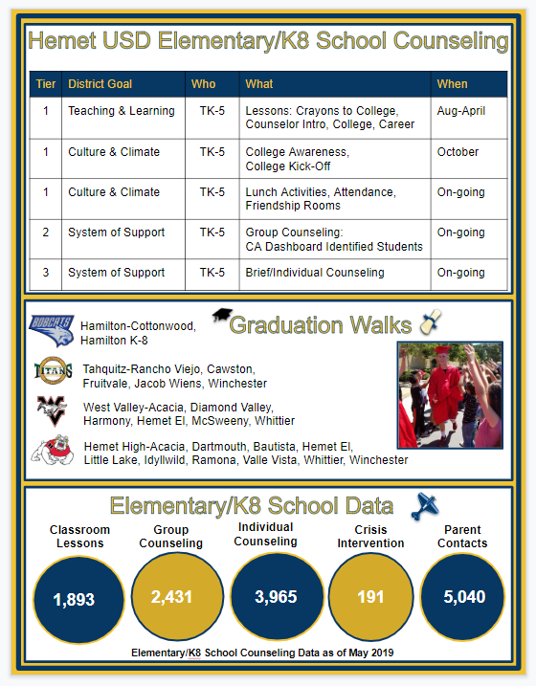
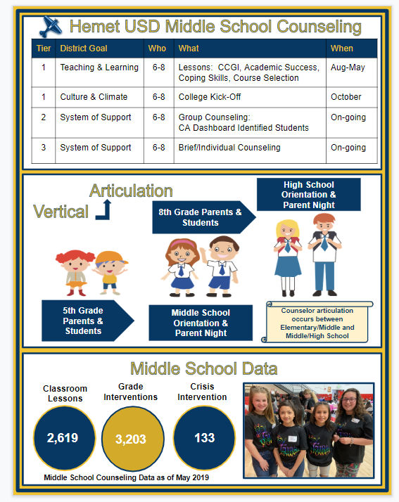
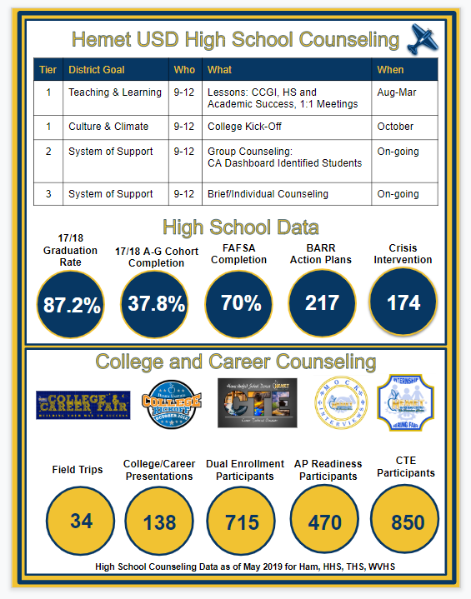
HUSD School Counseling Infographic
Notes:
Erica- results of our tools and process for collecting data

Slide 10
Infographic Scavenger Hunt
As a small group, please find the following data points from the
HUSD School Counseling Infographic
Which ES Crayons to College lesson is scheduled for February?
How many Middle School grade interventions were completed in 18-19?
_________ Hemet USD CTE participants in 2018-2019
What 4 tools do our School Counselors use to manage their program?
Identify 1 of the 4 marketing tools our School Counselors use.
https://youtu.be/4Lm0o3XGKIY
What If Everybody Did That?
3,654
850
Action Plan
Tracker
Field Guide
Results Report
College/Career Catch Up, Twitter, Website, Brochure
Notes:
Erica-comprehensive, vertically aligned and showcase for stakeholders

Slide 11
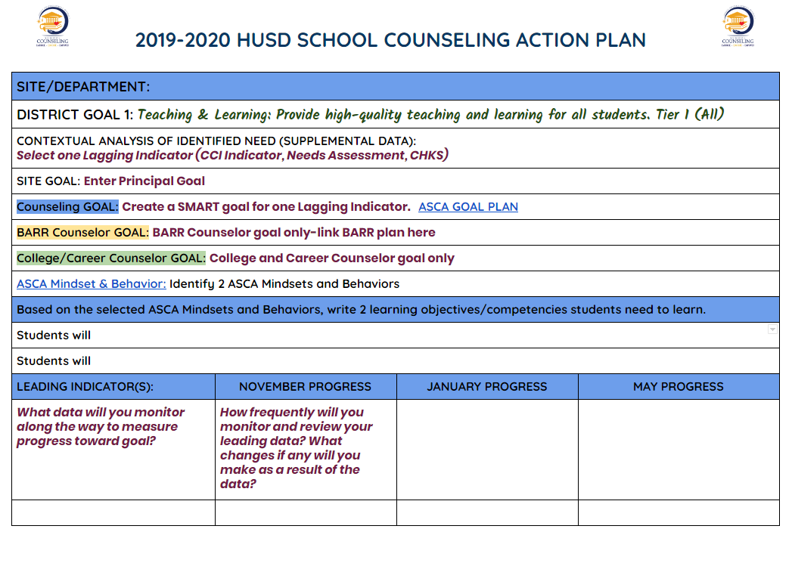
Action Plans
District/
Site/
Principal goal alignment
Lagging Indicator/
Data to support need
Counseling
SMART Goal
ASCA templates embedded
Progress Monitoring
The Action Plan is the foundation of the Results Report.
Notes:
Stephanie- action steps and progress monitoring.

Slide 12
Action Plans
Meaningful
Feedback
“I am in my eighth year as a counselor and believe it or not, this is the first time I have created a structured action plan. It has been a great tool and serves as a guide through the school year. One thing I think that we should do is stay engaged with our action plans throughout the year so that it does not fall into the backdrop during the day to day. Some sort of monthly check in with our action plans and progress would help me to stay on top of it.”
- Ryan Wikert, Hamilton K-8 Counselor
“I like the organization that the Action Plans provides us as counselors. These also allow us to work side by side with our Admin and know we have goals that support each other.”
- Chelsey Hallberg, Rancho Viejo Counselor
Notes:
Stephanie

Slide 13
S.M.A.R.T. Goals
SPECIFIC. MEASURABLE. ATTAINABLE. REALISTIC. TIME BOUND
District Goal | Tier | Data
Goal 1- Teaching and Learning | Tier 1 Classroom Lessons | CCI Indicator, Needs Assessments, Test Scores
Goal 2- Systems of Support | Tier 2 Small Groups | CA Dashboard (red and orange student populations)
Goal 3- Culture and Climate | Tier 3 Individual | SIS System, CHKS, Plus Survey
Notes:
Stephanie

Slide 14
SMART Goals
Meaningful
Feedback
“SMART goals have increase focus, direction and meaningfulness to my practice. They have provided me with an annual road map to be able to plan, implement and attain most goals. They also allow me to reflect on the things that may be improved the following year.”
-Leticia Milbauer, Helen Hunt Jackson
“Establishing SMART goals has helped to maintain a focus/theme for classroom presentations and small groups.”
-Brenda Friday, Whittier Elementary School
Notes:
Stephanie

Slide 15
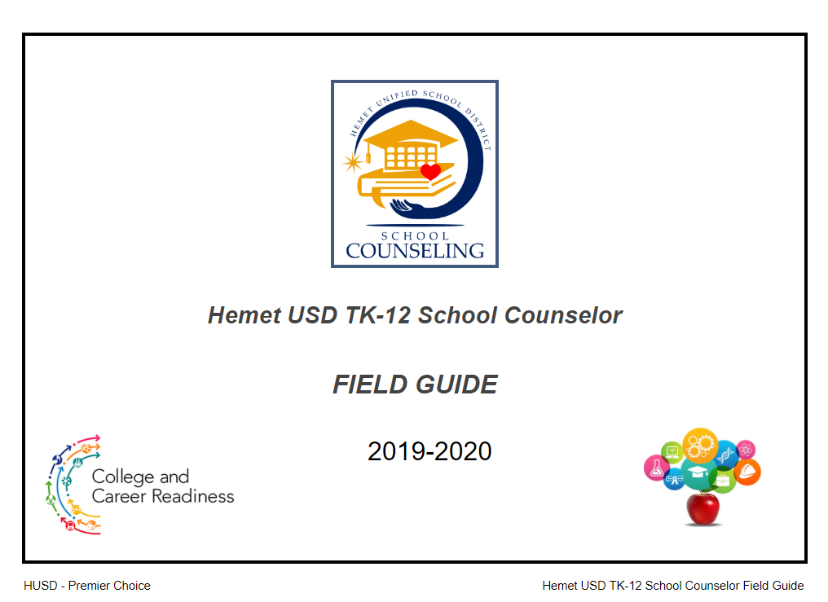
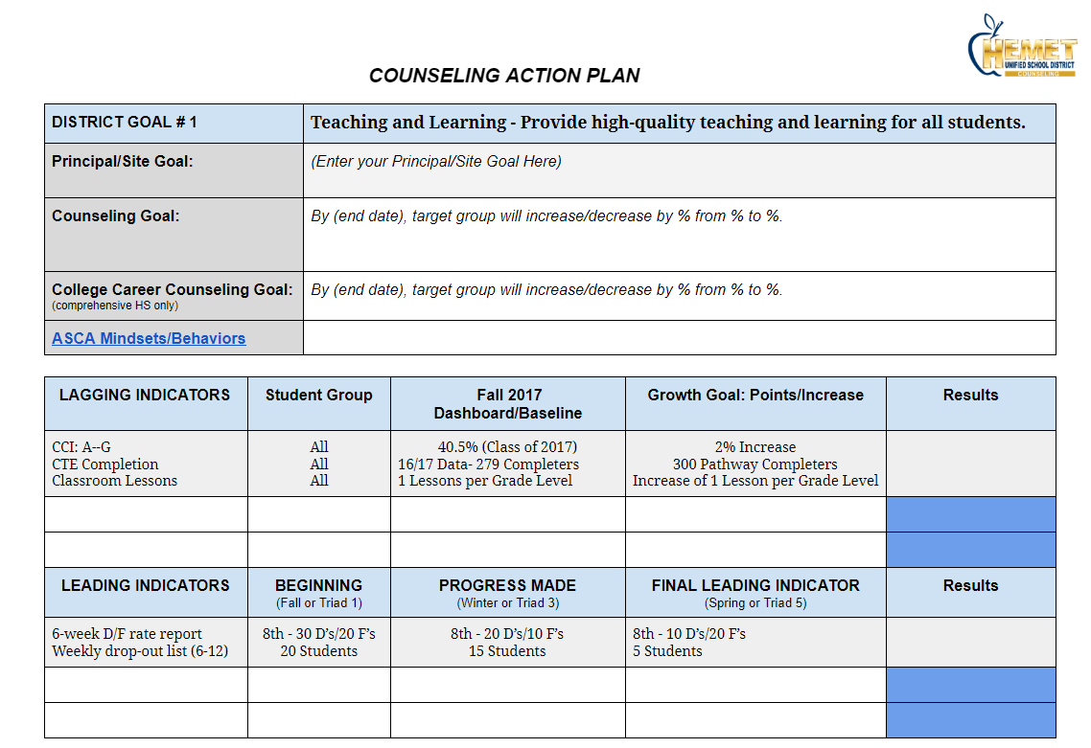
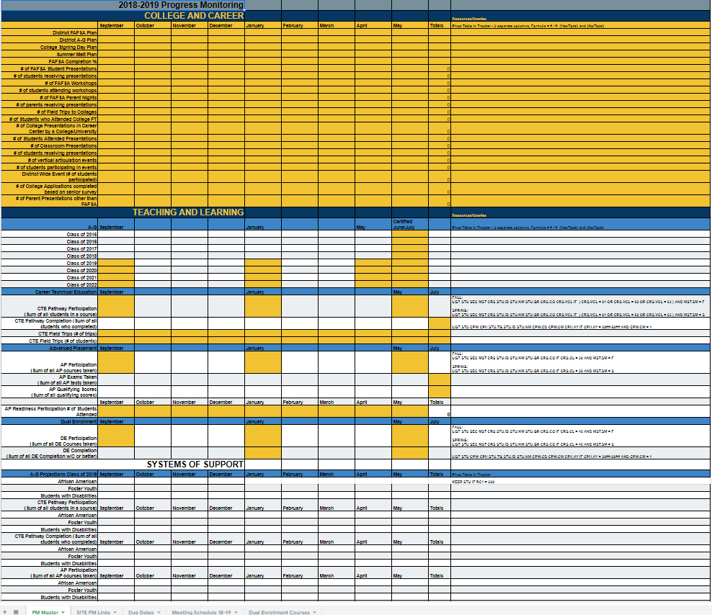
Ensuring Access and Equity
Field Guide
Alignment of Roles
Vertical Articulation
Core Deliverables
Action Plans
Alignment of 3 Goals
Data Driven
Action Steps
Trackers
Elementary
Middle
High
Field Guides TK-12
Data Trackers TK-12
Notes:
Stephanie-Snapshot of services in the system
Data for infographics
Communicate with administration at site
Ensure access to core curriculum

Slide 16
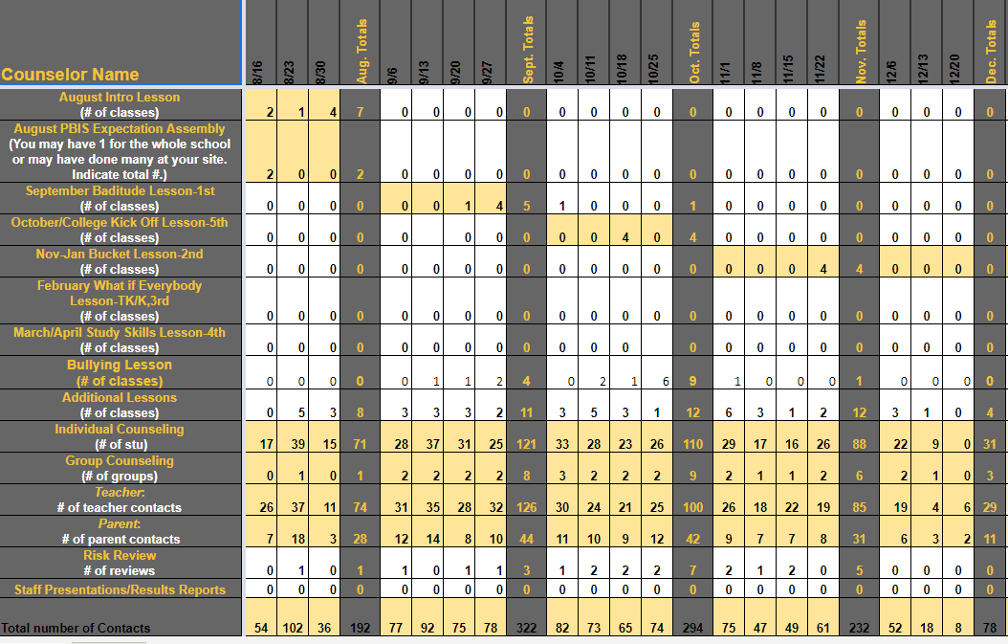
ES
Tracker
Notes:
Erica Elementary and Middle School
Complete Tracker every Friday
Core Curriculum Lessons
Individual and Group Counseling
Parent and Teacher Contacts
Risk Assessments

Slide 17
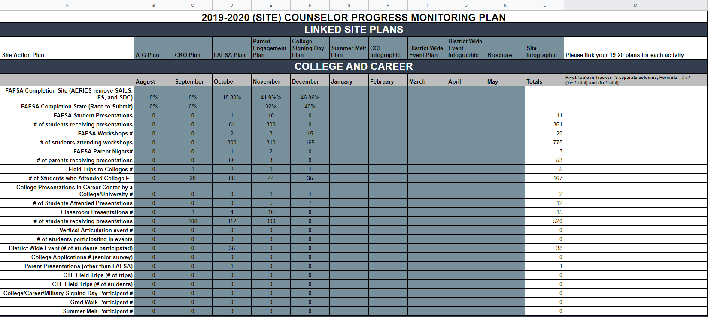
HS Tracker
Notes:
High School
Complete 1x per month
College and Career Counselor - CCI Metrics
Complete 1x per triad
Caseload - Academic Interventions

Slide 18
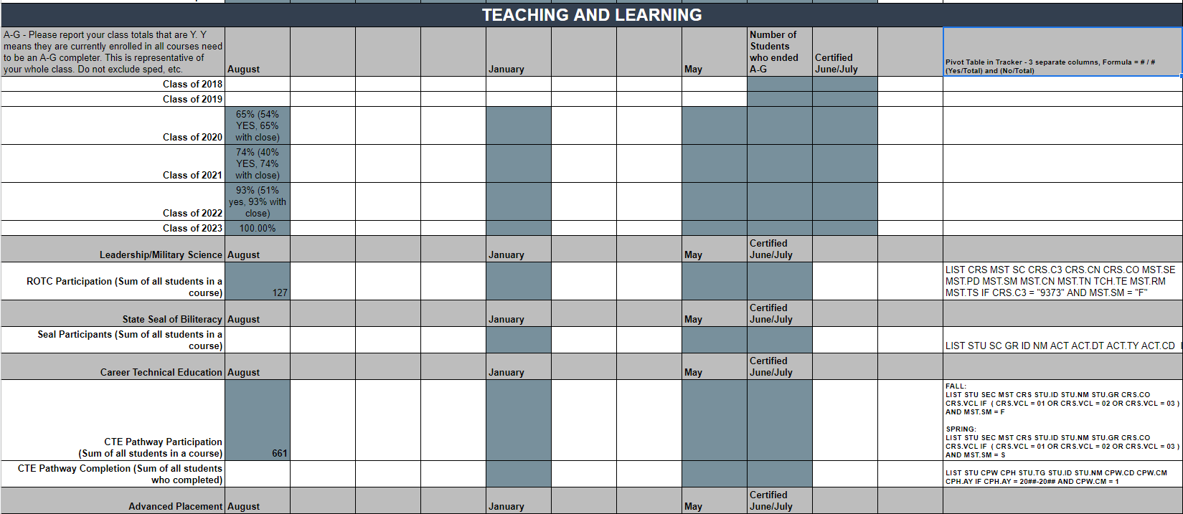
HS Tracker
Notes:
Erica-CCI metrics
Caseload more detailed student level data

Slide 19
Trackers
Meaningful
Feedback
“I'm able to use my student tracker to find specific student groups that I need to target. For example, I can check to see if my Foster/Homeless students have completed their FAFSA.“
-Brian Strawter, Alessandro High School
“The student tracker provides weekly opportunity for reflection and shows trends throughout the year. It can also be used as a framework for planning events throughout the school year. This document helps all counselors district wide to schedule events at the same time throughout the year; ranging from College Kick Off to Academic Intervention Meetings to Skill Lessons.”
-Anthony Boenzi, Diamond Valley High School
Notes:
Erica-work but there is value and they are asking for more metrics. Helping align district initiatives such as cko and services.

Slide 20
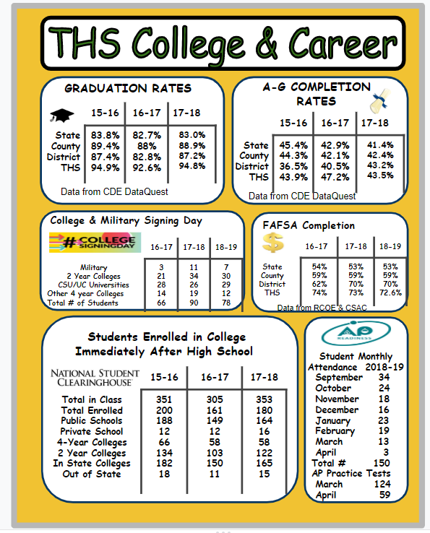
Showcasing the Program
Brochures
Site Specific
Programs and Services
Contact Information
Results Reports
Celebrate Success
Share Results
Opportunity to Reflect
Site Infographics
Visual Aid
Data
Stakeholders
Multi-Use
Notes:
Stephanie

Slide 21
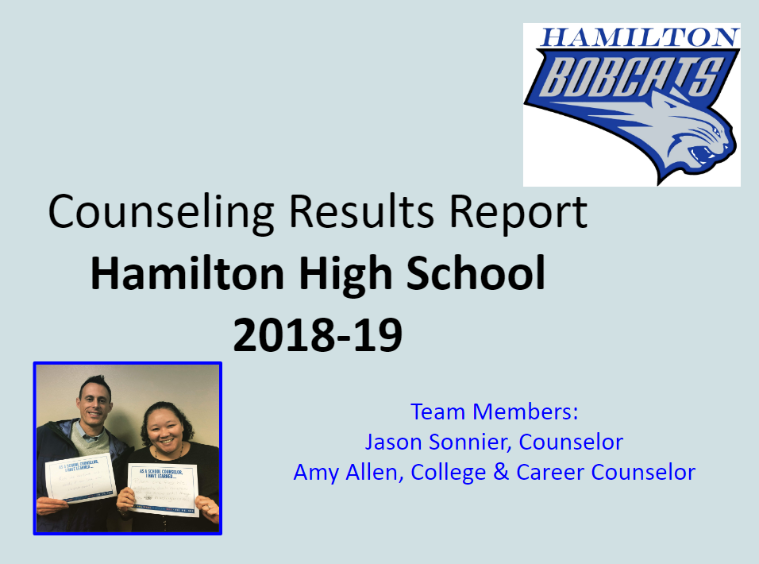
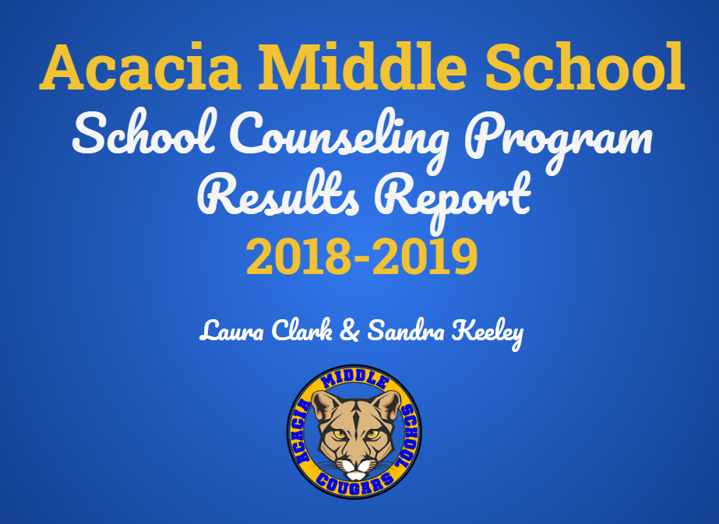
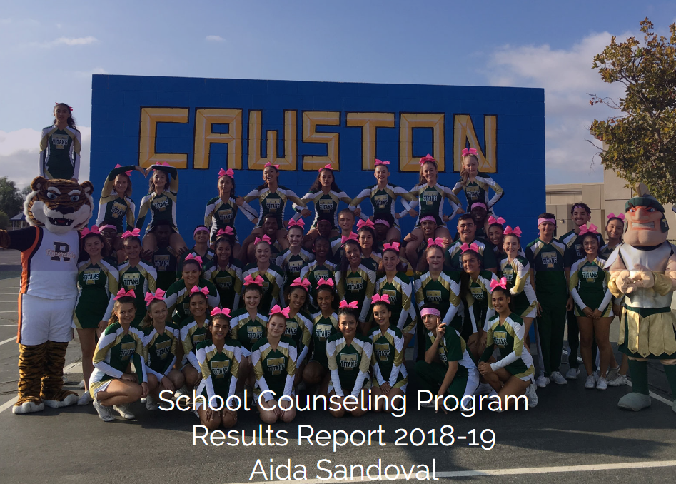
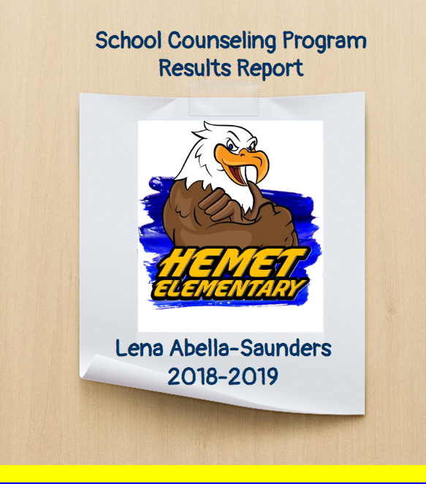
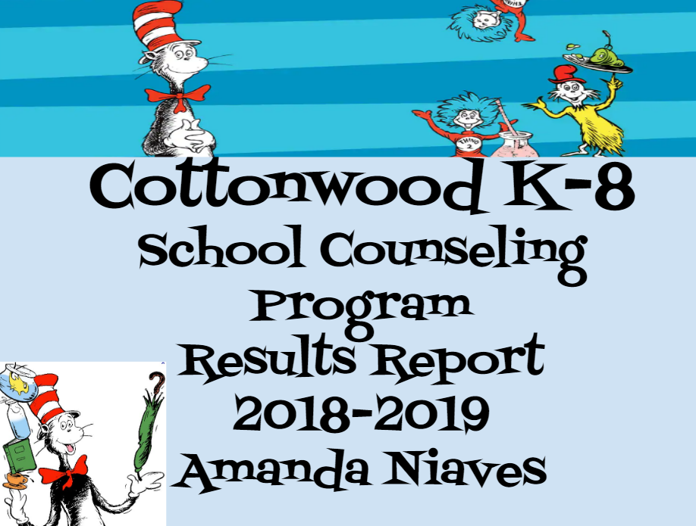
Results Reports
Parents
Administration
Staff
RCOE
Students
Notes:
Stephanie

Slide 22
Results Reports Panel
Site Administration
Principals and Assistant Principals
District Administration
Assistant Superintendents, Directors and Coordinators
District AVID TOSA, District School Counselors
County Administration
County Representatives
School Counselors
Notes:
Stephanie

Slide 23
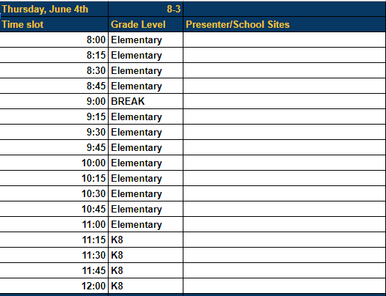
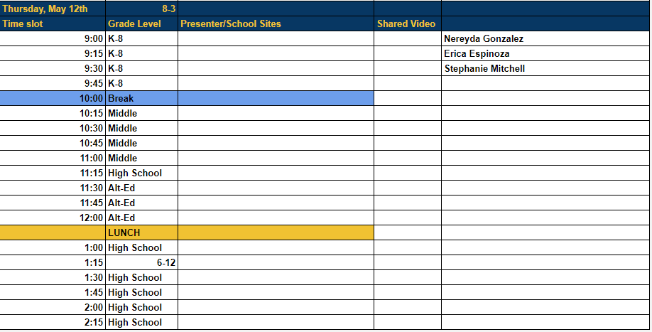
Results Report Schedule
Sign Up Sheet
Scheduled dates/times
Sites sign up for time slot
15 minute time slots
10 minutes for each team to present
Notes:
Stephanie-15 minute time slots are so our teams can present in staff meetings in limited amount of time and to prepare for presentation to the board which is 8 minutes

Slide 24
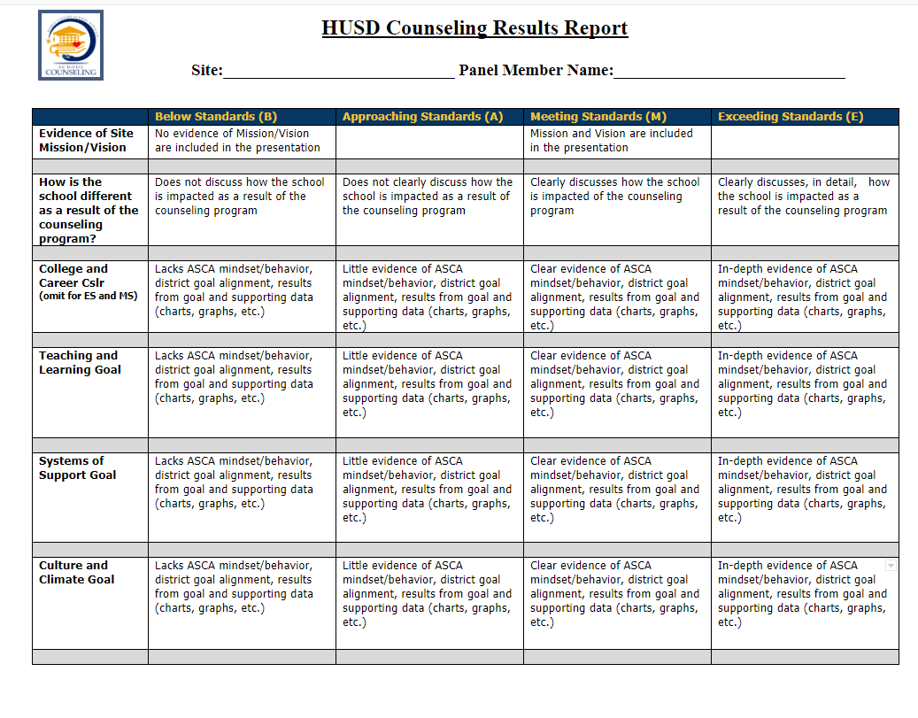
Results Report Rubric
Notes:
Stephanie -GIve Rubric
Give Rubric back to teams after the report so they can use feedback to validate or change their presentation

Slide 25
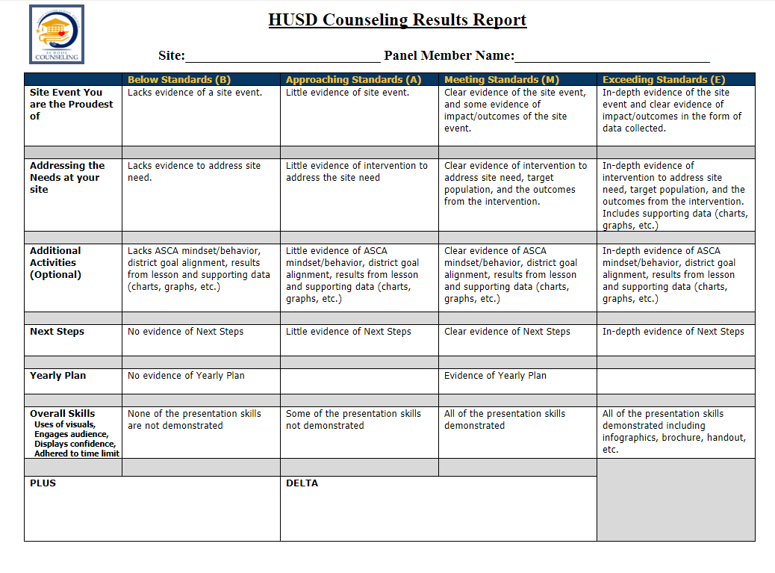
Results Report Rubric
Notes:
Stephanie

Slide 26
Results Report Best Practices
Notes:
Erica

Slide 27
Results Report Sample
Pictures
tell the story
Reflect school theme
Notes:
Erica

Slide 28
Results Report Sample
Notes:
Erica

Slide 29
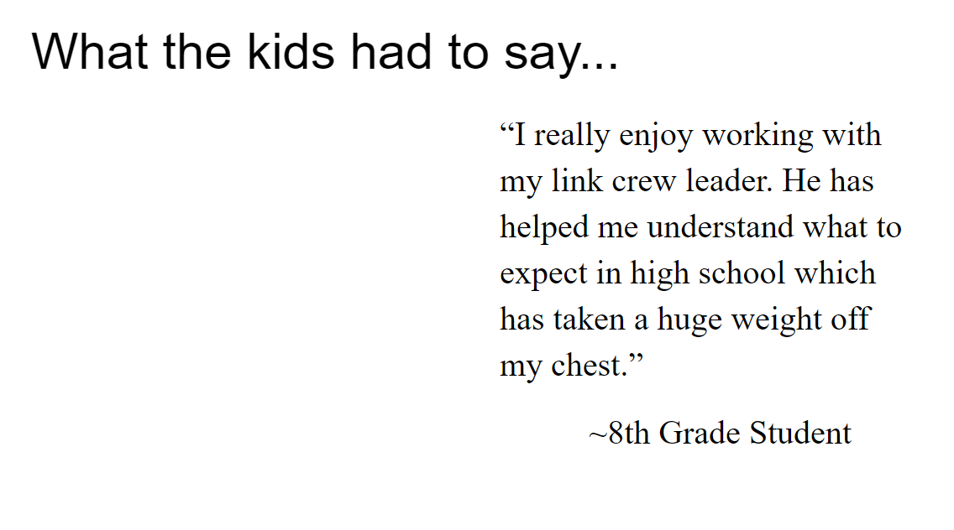
Results Report Sample
Outcome Data
Qualitative Data
Mindsets/
Behaviors Data
Notes:
Erica

Slide 30
Results Report Template
Notes:
Erica give template, best practices

Slide 31
Results Reports
Meaningful
Feedback
“Love this! This is a great way to market our programs, share the amazing things we are doing for students and also so important for accountability!”
-Shannon Vargas, West Valley High School
“I believe the results reports have given counselors a chance to showcase the work we are doing. I believe this has had a positive impact on our counseling staff as a whole. Personally, it has helped me feel more confident and accomplished when I look back on all I have done throughout the year.”
-Lauren LLoyd, Hemet High School
Notes:
Erica-showcase program, shows result of their work

Slide 32
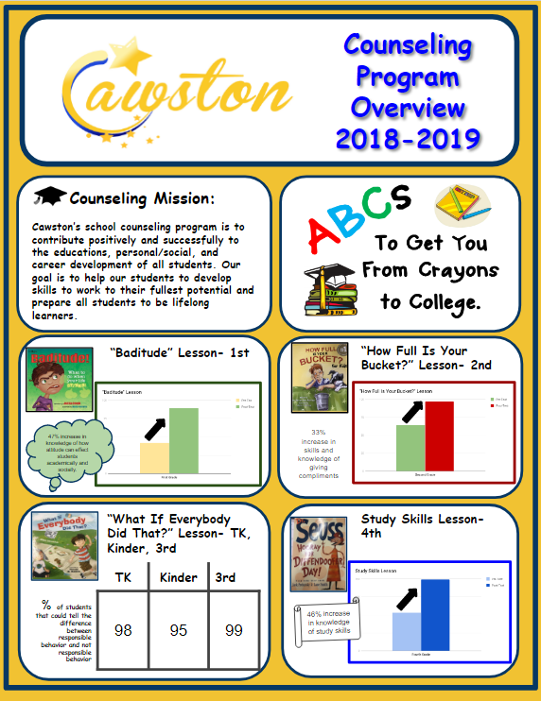
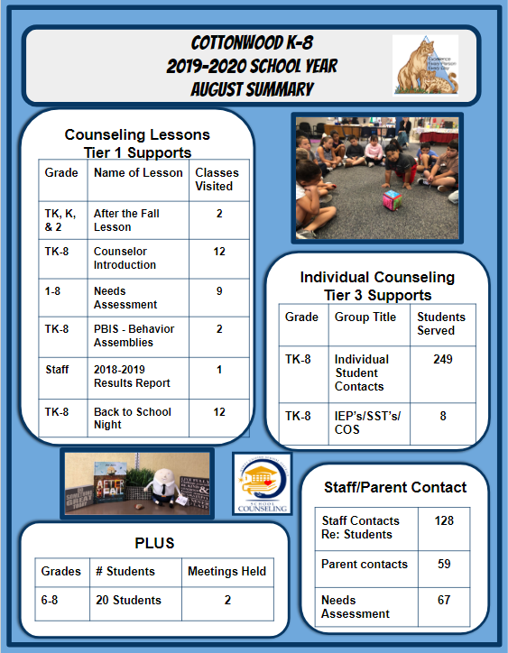
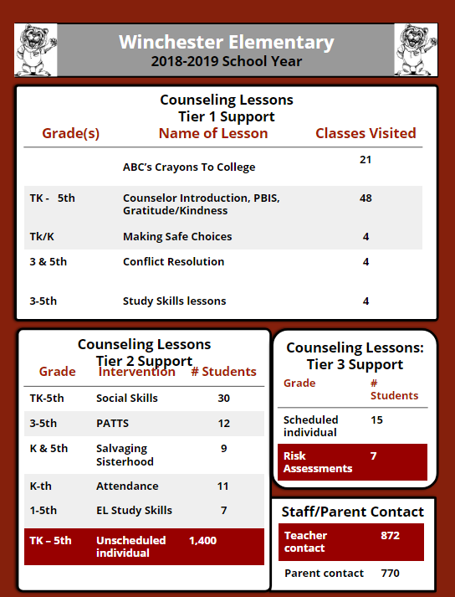
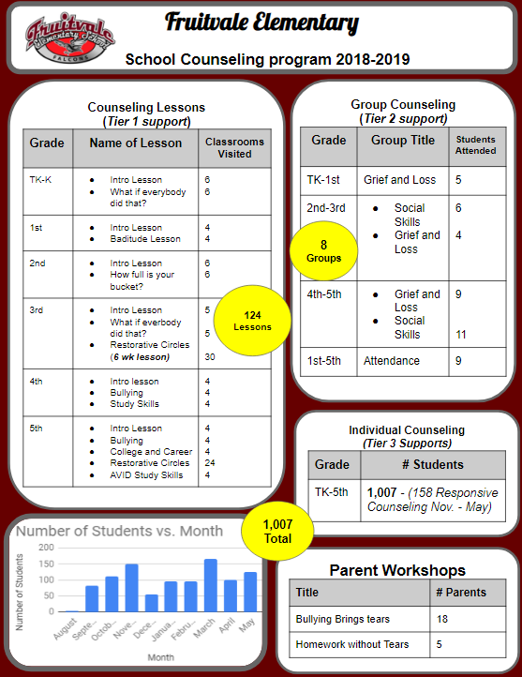
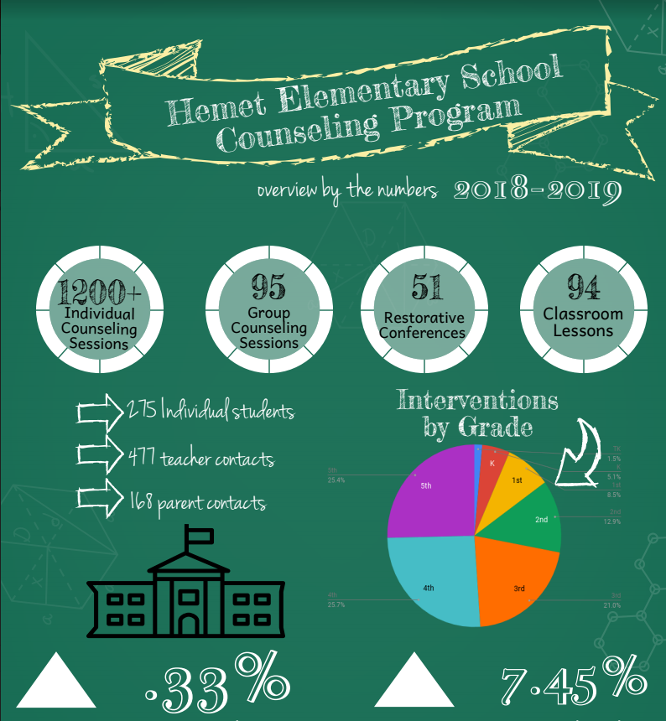
Site Infographics
Notes:
Stephanie

Slide 33
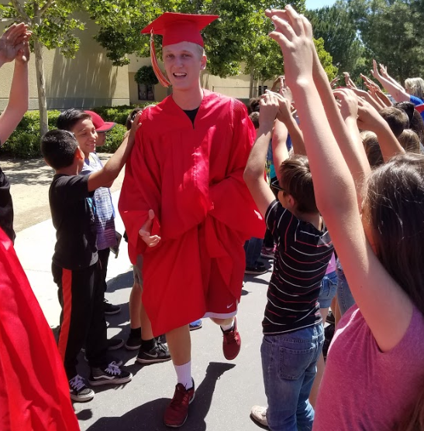
Vertical Articulation
ES and MS Counselors
Collaborate
High School Orientation &
Parent Night
5th Grade Parents and Students
Graduation Walks
MS and HS Counselors
Collaborate
8th Grade Parents & Students
Notes:
Erica

Slide 34
District-Wide Events
Notes:
Stephanie

Slide 35
Our Journey
14-15
18-19
068742
HEMET UNIFIED
Notes:
Stephanie

Slide 36
Model the Way
Feedback, we gather from the team at different points in school year
Surveys, needs assessments, informal and formal conversations
Plus/Delta at each PD
Professional Development
Data driven topics
Calendared at beginning of year
Grade Level specific-High School, Middle School and Elementary and K-8
Combinations of Grade Levels-vertical articulation, best practices, celebrations
Templates
Trackers, Action Plans, Brochures, Surveys, Rubrics, Infographics, etc.
Support
Support (feedback, phone, email and 1:1 visits)
New, Intern and Sub Counselor Orientation
Site Visits
Formal and Informal
Notes:
Stephanie/Erica

Slide 37
Overall
Meaningful
Feedback
“I feel we are much more intentional in everything we do. The changes make me confident in what my duties are. Changes, while we may balk at them sometimes, have improved our A-G rate, CCI prepared rate, and overall student preparedness.”
-Maureen Fernandes, Hemet High School
“We (HUSD) came to the realization to achieve our goals we needed to tap into the expertise of our counselors. In order to capitalize on this expertise, we needed to be systematic about our counseling program and anchored in data. Our counseling department is more cohesive, aligned, and data-driven. ”
-Nereyda Gonzalez, Director of Secondary
Notes:
Stephanie

Slide 38
Q & A

Slide 39
Resources/Links
Results Report Template
Result Report Rubric
Elementary School Tracker
Middle School Tracker
High School Tracker
Infographic Template

Slide 40
Contact Info
Erica Espinoza
District College/Career Counselor
eespinoza@hemetusd.org
(951)765-5100 ext.3210
@eespinozaCOSA
Stephanie Mitchell
Director of College/Career
smitchell@hemetusd.org
(951) 765-5100 ext.3115
@calicounz

Slide 41
SlidesCarnival icons are editable shapes. This means that you can:
Resize them without losing quality.
Change fill color and opacity.
Change line color, width and style.
Isn’t that nice? :) Examples:

Slide 42
😉
Now you can use any emoji as an icon! And of course it resizes without losing quality and you can change the color. How? Follow Google instructions https://twitter.com/googledocs/status/730087240156643328
✋👆👉👍👤👦👧👨👩👪💃🏃💑❤😂😉😋😒😭👶😸🐟🍒🍔💣📌📖🔨🎃🎈🎨🏈🏰🌏🔌🔑 and many more...

