Slide 2
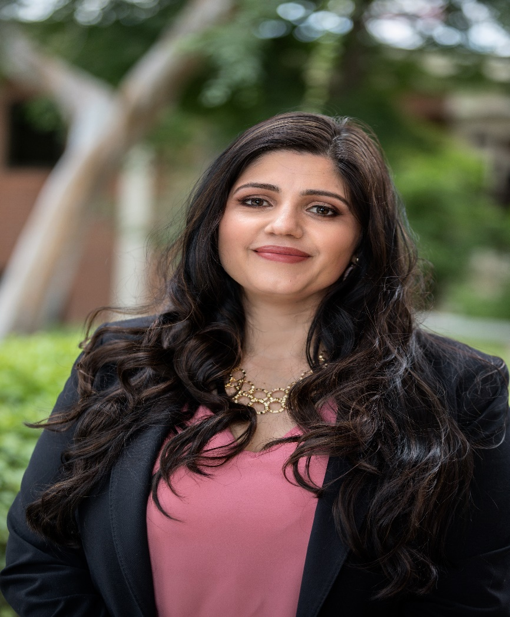
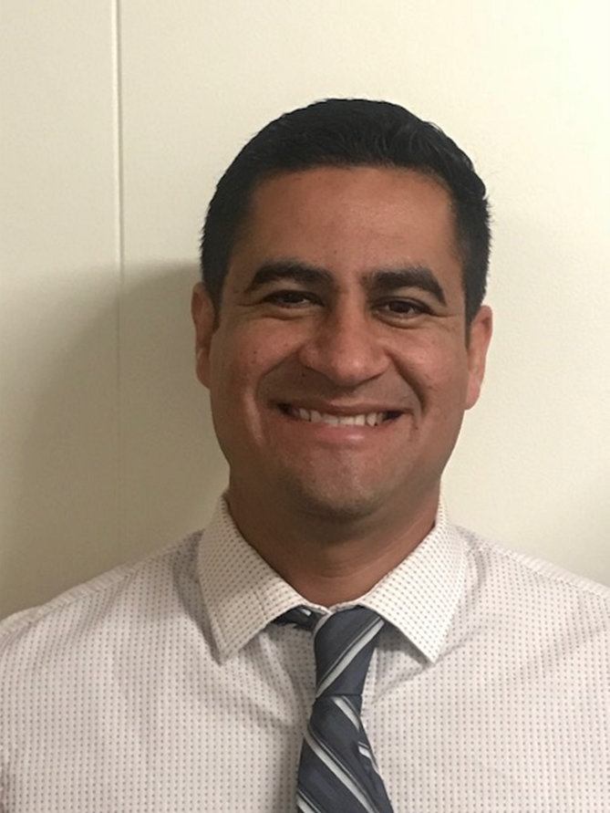
Catalina Cifuentes
Executive Director,
College and Career Readiness
ccifuentes@rcoe.us
Dr. Pedro Caro
Coordinator,
College and Career Readiness
pcaro@rcoe.us

Slide 3
Webinar Tips
This webinar is being recorded so that others may listen to it at a later time for reference and will be uploaded to the RCEC Youtube page as well as www.rcec.us once you log in to access the content of the webinar series
All connections to this live Webinar feature have been accounted for so please do not forward the Zoom link or invite anyone to join because you are taking someone else’s spot and Zoom will automatically start kicking off connections randomly
All participant mics have been muted and only panelists and facilitators have the ability to unmute anyone
Since all participants have been muted, please use the Q&A and chat screens to enter your questions
Participants can submit a question in the Q&A box at the bottom of the screen for the panelists
Only panelists and facilitators will be able to respond back to those questions and can do so publicly or privately to the individual
Participants can submit comments or questions in the chat box if they would like to engage with each other
**Every effort has been made to ensure the security of this webinar from “zoombombers” but in the event that we experience that, please stay calm and we will resume as soon as the technical difficulties have been resolved.**

Slide 4
FOR MORE INFORMATION AND RESOURCES PLEASE VISIT US @
www.rcec.us

Slide 5
Making the Connection:
Supporting Grieving Children & Teens During COVID-19
Jana DeCristofaro, LCSW
www.dougy.org
Notes:
JD & KS – Introduce ourselves

Slide 6
Notes:
JD – Who we are, who we serve

Slide 7
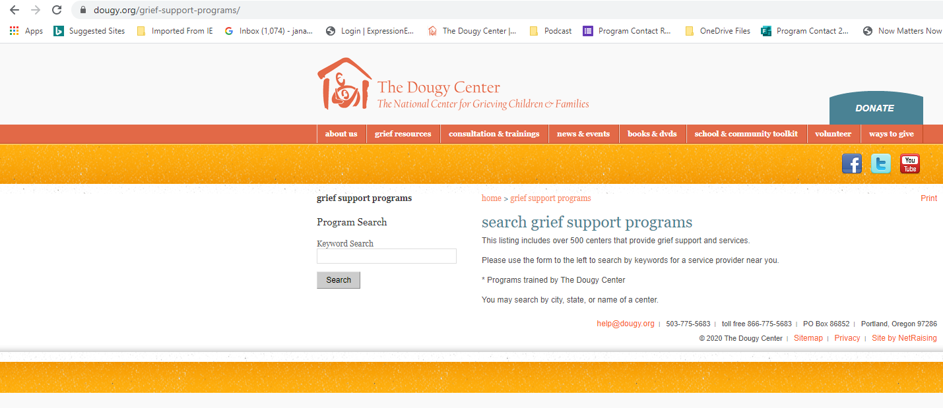
Is There a Program Near Me?
www.dougy.org/grief-support-programs
Notes:
JD – Not telling you anything you didn’t already know, just confirming that what you do naturally is exactly what these grieving students need. And a plug to start a group in your school setting…

Slide 8
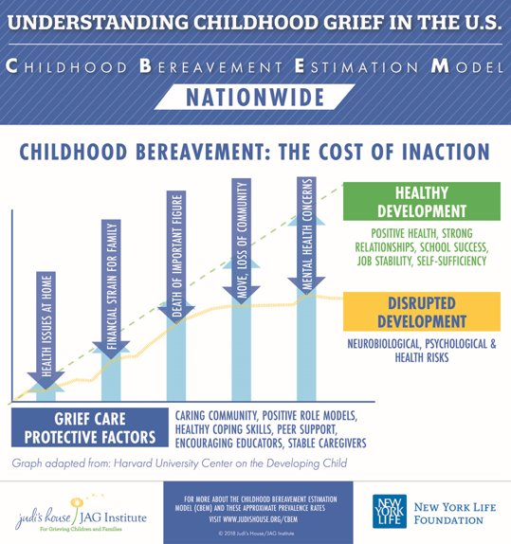
What is needed?
Caring community
Positive role models
Peer support
Healthy coping skills
Encouraging educators
Stable caregivers
27% of bereaved children parents born outside of U.S.
(Weaver, 2019)
Notes:
JD – Not telling you anything you didn’t already know, just confirming that what you do naturally is exactly what these grieving students need. And a plug to start a group in your school setting…

Slide 9
Who are these students?
Notes:
JD – Brief hx of Road to Resilience -

Slide 10
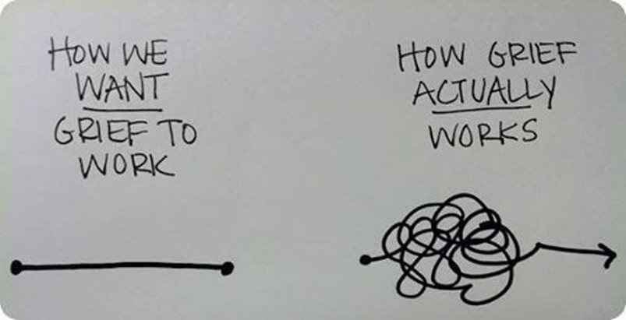
Premise of Grief
Notes:
KS
Talk about expectations of school admin, etc- want THE intervention... but nope, this is what it looks like

Slide 11
Principles of grief
Grief is a natural response to loss​
There is no right or wrong way to grieve​
Duration and intensity are unique for everyone​
Acknowledgment and understanding help​
Grief happens in a social & cultural context​
Grief needs to be seen and heard, not fixed​
​
The way to survive grief is by allowing pain to exist, not in trying to cover it up or rush through it.​
~Megan Devine​
Notes:
KS
- Grief doesn’t fit well into a classroom plan and that's why we created these principles, refer to Lillies " What I needed"
-"there is no right or wrong way to grieve"- ex of what we hear kiddos say "you should be over it.."
-"duration and intensity are unique"- refer back to image of straight line vs squiggles
-"ack and understanding..." Quick ex of midd school card
-"social and cultural"- informs our grief
-"seen, heard, not fixed"- fixing/helping/serving text from sf zen center- and role of ssw is to often "fix" (survey group)

Slide 12
Factors that influence grief​
Age​
Death​
Relationship​
Response of others​
Family history​
Oppression/racism​
Cultural aspects​
Social support​
Notes:
JD – Can’t make assumptions on the story. GMA might be most significant relationship. These are just death losses we are talking about, but don’t discount non-death losses.

Slide 13
What is grief?
Way more than sadness…
Cognitive
Emotional
Behavioral
Physical
Spiritual
Social
Cultural
Notes:
JD

Slide 14
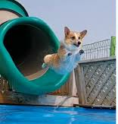
What Does Grief Look Like?​
Notes:
JD – What’s the stereotype of what grief looks like? Who gets left out? How are grief reactions penalized in your school?
Looks different for everyone. Similar expressions could be for different emotions. Will look at the ways it affects body, mind, and heart.

Slide 15
Reach Out – Make the Connection
How the world responds
What grieving students need
Platitudes
Euphemisms
Pathologizing
Awkwardness
Avoidance
Tries to…
Rescue
Take it away
Acknowledgement
Understanding
Acceptance
Space to grieve
Listening
Interest
Support
Notes:
JD -

Slide 16
Notes:
JD

Slide 17
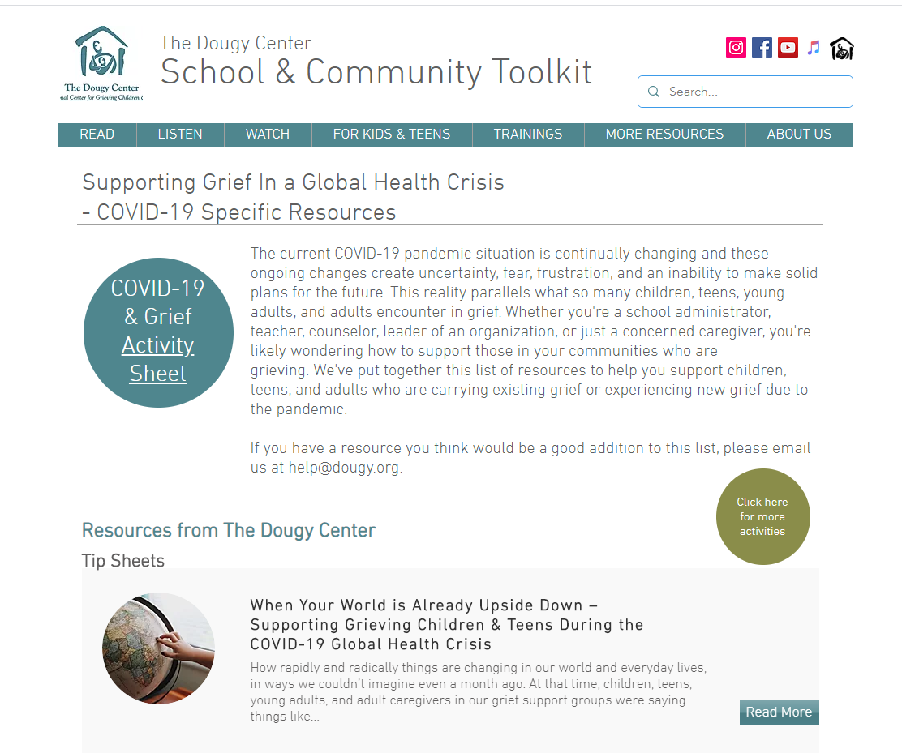
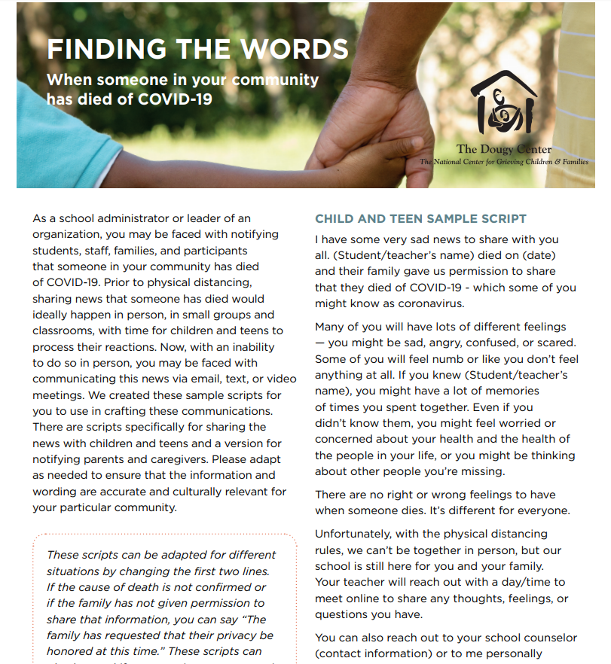
www.tdcschooltoolkit.org
Notes:
JD -

Slide 18
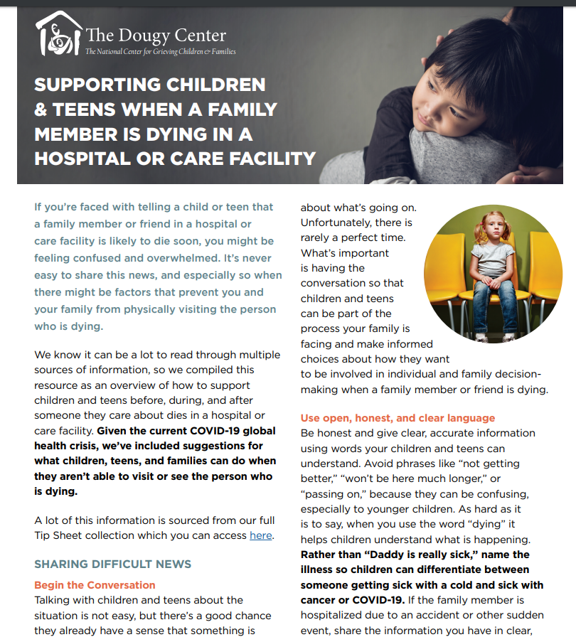
Notes:
JD -

Slide 19
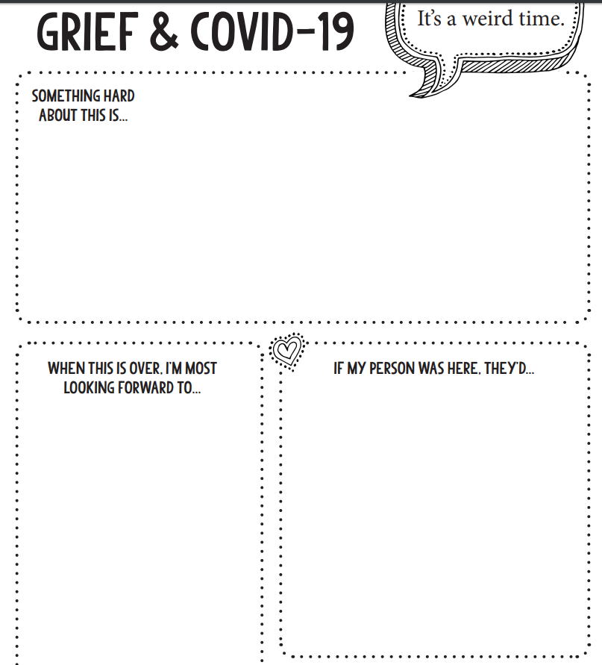
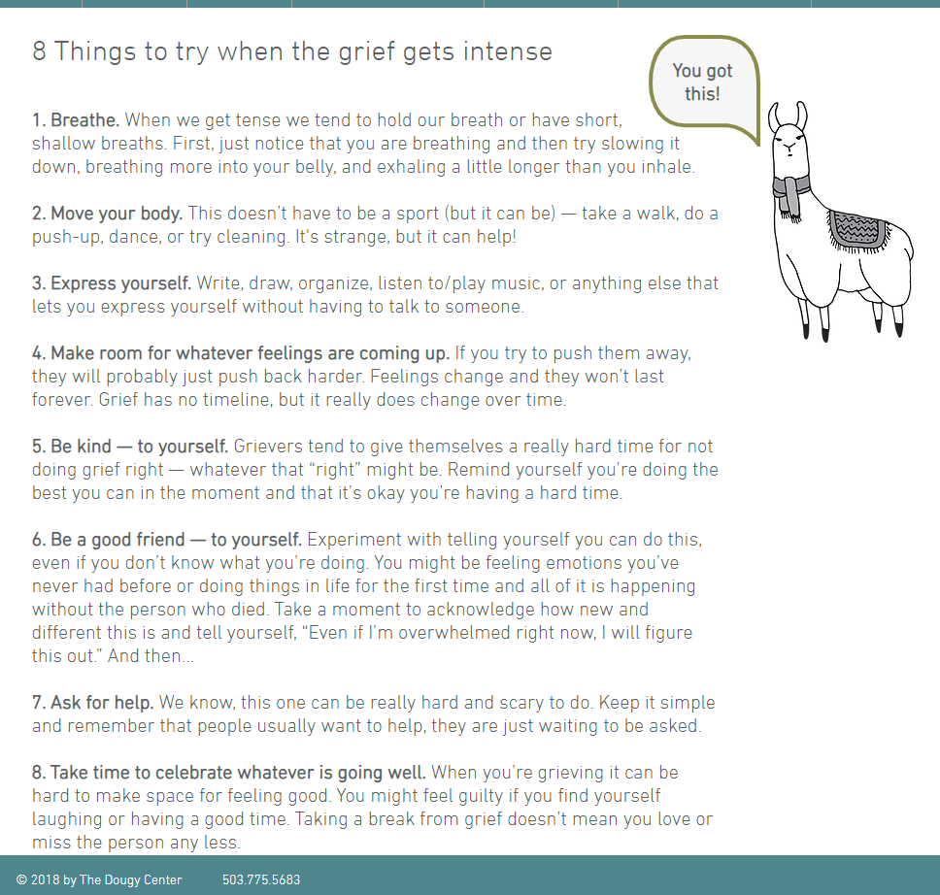
Notes:
JD -

Slide 20
Notes:
Both

Slide 22
Behavioral Health and Public Health Prevention and Early Intervention, Crisis Supports, Outpatient MH Treatment Presenters: Diana A. Brown, PEI Coordinator Rebecca Antillon, Program Coordinator
Programming During COVID and Beyond

Slide 23
Prevention and Early Intervention
Mental Health Services Act

Slide 24
Goals of PEI
Increase community outreach and awareness regarding mental health within unserved and underserved populations.
Increase awareness of mental health topics and reduce discrimination.
Prevent the development of mental health issues by building protective factors and skills, increasing support, and reducing risk factors or stressors.
Address a condition early in its manifestation that is of relatively low intensity and is of relatively short duration (less than one year).
Services for all ages, with a focus on youth (51% for 0-25 y.o.)
All services are free of charge
Riverside Workplans: 1) MH Outreach, Awareness, & Stigma Reduction; 2) Parent Education & Support; 3) Early Intervention for Families in Schools; 4) TAY Project; 5) First Onset for Older Adults; 6) Trauma Exposed Services; 7) Underserved Cultural Populations

Slide 25
Community Education and Stigma Reduction Programs

Slide 26
Toll Free 24/7 Helpline and 2-1-1
24/7 Crisis and suicide prevention hotline
Provides referrals and resource information
Information regarding County’s Response to COVID-19
Community Connect
Contact: 2-1-1
Serving: Riverside County

Slide 27
Promotores de Salud Mental
Provides virtual presentations on behavioral health topics and resources in Spanish
Visión y Compromiso
Contact: Marisela Blancas
Marisela@visionycompromiso.org
Serving: Western and Desert Region

Slide 28
Community Mental Health Promotor Program
Asian American
Special Services for Groups
Contact: Estee Song
esteesong@apctc.org
Serving: Western and Mid-County Regions
Promotes awareness of mental health topics and resources specifically tailored to identified ethnic and cultural groups through virtual presentations
African American
African American Health Coalition
Contact: Linda Hart
Hartl.aamhc@gmail.com
Serving: Western, Mid-County and Desert Region
Native American
Riverside San Bernardino County Indian Health Inc.
Contact: Vernon Motschman
vmotschman@rsbcihi.org
Serving: Western, Mid-County and Desert Regions

Slide 29
Contact for Change
Virtual presentations in which two presenters share their lived experience with mental illness and their personal stories of recovery to reduce stigma and increase hope and help-seeking
RI International
Contact: Ron Hoffman
(951) 217-5517
ron.hoffman@riinternational.com
Serving: Western, Mid-County, and Desert Regions

Slide 30
Parent and Family Education and Support Programs

Slide 31
Strengthening Families Program (SFP)
A virtual 14-week program for parents and families with children ages 6-11
Focus is to help prevent teen problem behaviors and substance abuse, strengthen parenting skills, and build on family strengths
Gift card and gift basket incentives upon completion
MFI Recovery
Contact: Cesia Alvarenga or
Maria Alcaraz
951-683-6596
CesiaAlvarenga@mfirecovery.com
MariaAlcaraz@mfirecovery.com
@mfiriverside
MFIRecovery
Serving: Western and Mid- County Regions
Riverside Latino Commission
Contact: Alan Mora-Lopez
760-398-9000
amora@latinocommission.com
Serving: Desert Region

Slide 32
Triple P (Positive Parenting Program)
A virtual 8-week parent education program for parents and caregivers of children age 2-12 and adolescents age 12-16.
Learn a variety of parenting skills and how to promote your child’s development.
$20 gift card upon completion
The Carolyn E. Wylie Center
Contact: Lucinda Chagolla
(951) 683-5193
lchagolla@wyliecenter.org
TheWylieCenter
Serving: Western, Mid-County, and Desert Regions

Slide 33
Transition Age Youth (TAY) Programs

Slide 34
Stress and Your Mood (SAYM)
An early intervention program used to reduce and treat depression. Provided over 12-20 virtual sessions.
$20 gift card upon completion
Operation SafeHouse
Contact: Nicole Watson
(760) 285-1740
nwatson@operationsafehouse.org
Serving: Western, Mid-County, and Desert Regions

Slide 35
TAY Peer-to-Peer Services
Virtual presentations of hope and recovery with TAY presenters to reduce stigma
Virtual LGBTQ support groups
Virtual Coping and Support Training for at-risk youth to help with suicide prevention ($20 gift card upon completion)
Operation SafeHouse
Contact: Nicole Watson
(760) 285-1740
nwatson@operationsafehouse.org
@CupofHappyEast
@CupofHappyWest
Serving: Western and Desert Regions
Victor Community Support Services
Contact: Shaterra Mahone
(951) 436-5312 Shaterra.mahone@victor.org
Serving: Mid-County Region

Slide 36
Teen Suicide Awareness and Prevention Program
Live stream training for students on suicide prevention, self-care strategies and resources
Virtual Know the Signs Presentation for parents and school staff
Provide digital or mail out suicide prevention, mental health resources to families, students and school staff
For more information, please contact Rebecca Antillon at:
951-358-7171 or rantillon@ruhealth.org

Slide 37
Older Adult Programs

Slide 38
Cognitive-Behavioral Therapy (CBT) for Late-Life Depression
An early intervention program that focuses on structured problem-solving to reduce depression and suicide risk in older adults.
The Scott Hines Mental Health Clinic
at The Center
Contact: (760) 416-7899
Serving: Desert Region

Slide 39
Program to Encourage Active Rewarding Lives for Seniors (PEARLS)
Virtual individual sessions over the course of 19-weeks for people 60 years or older who have minor depression.
Utilizes an empowering and skill-building approach.
Inland Caregiver Resource Center
Contact: (800) 675-6694
Serving: Western, Mid-County, and Desert Regions

Slide 40
Care Pathways – Caregiver Support Groups
Provides virtual support groups for caregivers of seniors with mental illness, dementia, or receiving PEI services
Groups will be starting in July – contact for more information
Riverside County Office on Aging
Contact: 1-800-510-2020
Serving: Western, Mid-County, and Desert Regions

Slide 41
Specialized Ethnic Community Programs

Slide 42
Mamás y Bebés (Mothers & Babies)
Virtual 8-week individual or group support groups
A mood management course provided during and after pregnancy for women at risk of post-partum depression.
$50 gift card upon completion
Free Diapers
Riverside Community Health Foundation
Contact: Terri Akens
951-788-3471 ext. 137
Terri@rchf.org
Serving: Mid-County Region
Reach Out
Contact: Gloria Lopez
909-982-8641
Gloria@we-reachout.org
Serving: Western Region

Slide 43
Keeping Intergenerational Ties in Ethnic Families (KITE)
Virtual 10-session parent education groups for Asian-American Pacific Islander parents with school-aged children and adolescents (6-17)
$40 gift card upon completion
Special Services for Groups
Contact: Karen Lim
kchnglim@apctc.org
Serving: Western and Mid-County Regions

Slide 44
Training for School Staff, Community Organizations, and Parents

Slide 45
Available Now - Virtually
Mental Health 101
Self Care/Wellness during COVID
45-60 minutes
Know the Signs
Suicide prevention training
60 minutes

Slide 46
Available Later – when we can gather
safeTALK
ASIST
Mental Health First Aid
For Youth
For Adults

Slide 47
Crisis Services and Supports

Slide 48
Mental Health Urgent Care
If you or someone close to you is experiencing troubling thoughts, feelings, or behaviors, and you would like to speak with someone today, call or walk into one of Riverside Counties 24/7 Mental Health Urgent Care locations anytime. Someone who has been in your situation and knows how to help will be there to greet you. Whether you are in crisis or just need someone to talk to, all services are voluntary. Counseling and nursing, as well as, psychiatric medications are available.
All locations are open 24/7. Call or walk-in. No appointments needed.
All are welcome regardless of insurance type or ability to pay.
Riverside (for adults ages 18 and over)
9890 County Farm Rd. Bldg. 2
Riverside, CA 92503
(951) 509-2499
Perris (Youth and Adults ages 13 and older)
85 Ramona Expressway Suites 1-3
Perris, CA 92571
(951) 349-4195
Palm Springs (Youth and Adults ages 13 and older)
2500 N Palm Canyon Dr. Suite A4
Palm Springs, CA 92262
(442) 268-7000

Slide 49
Community Response Evaluation and Support Team (CREST)
CREST units work collaboratively with local Police and Sheriff Departments to decrease the need for inpatient hospitalizations as well as decreasing the amount of time that law enforcement personnel are dedicating to consumers in psychiatric crisis. Any age person that is experiencing a psychiatric crisis.
Those with insurance and those without.
Schools can call the team directly:
Crisis Call Center 888-374-1113

Slide 50
RUHS-BH Outpatient Services
CARES Line Phone: (800) 706-7500 The Community Access, Referral, Evaluation and Support line (CARES Line) is available Monday-Friday 8am – 5pm and answered by licensed clinicians who provide support and crisis intervention, as well as connections to outpatient, inpatient and community resources. After hours service is available to refer individuals across Riverside County with appropriate mental health resources in their area. This resource provides information and referrals for Medi-Cal beneficiaries seeking Mental Health Services in English and Spanish.
Substance Use CARES Line (24/7 in English and Spanish) Phone: (800) 499-3008

Slide 51
Take My Hand App
The following is a hyperlink to RUHS-BH Live Peer Chat, Take My Hand at www.takemyhand.co (and yes, the “m” is missing on purpose). It is a free on-line chat service that encourages any community member to reach out and chat. It is operated by an All-Peer Support staff. Peer Support Specialists are on-line 24/7 to assist and support anyone who is looking for someone to talk to, a resource in the community and to create a sense of belonging, in a time when many are feeling very isolated and alone. If you know anyone who may benefit from this unique service, someone who may not want to talk on the phone or use face-to-face “skype-style” communication, Peer Support is just a click away.

Slide 52
Essential Staff Crisis Support Line

Slide 53
Crisis/Support Lines
National Suicide Prevention Lifeline
1-800-273-8255
Crisis Text Line
Text “Home” to 741741
HELPline/211
951-686-HELP (4357)
What’s Up Safehouse Text line
Text SHHELP to 844-204-0880
Trevor Project (LGBTQ Youth)
866-4-U-TREVOR (866-488-7386)

Slide 54
RUHS – Public Health
COVID-19 Information and Resources

Slide 55
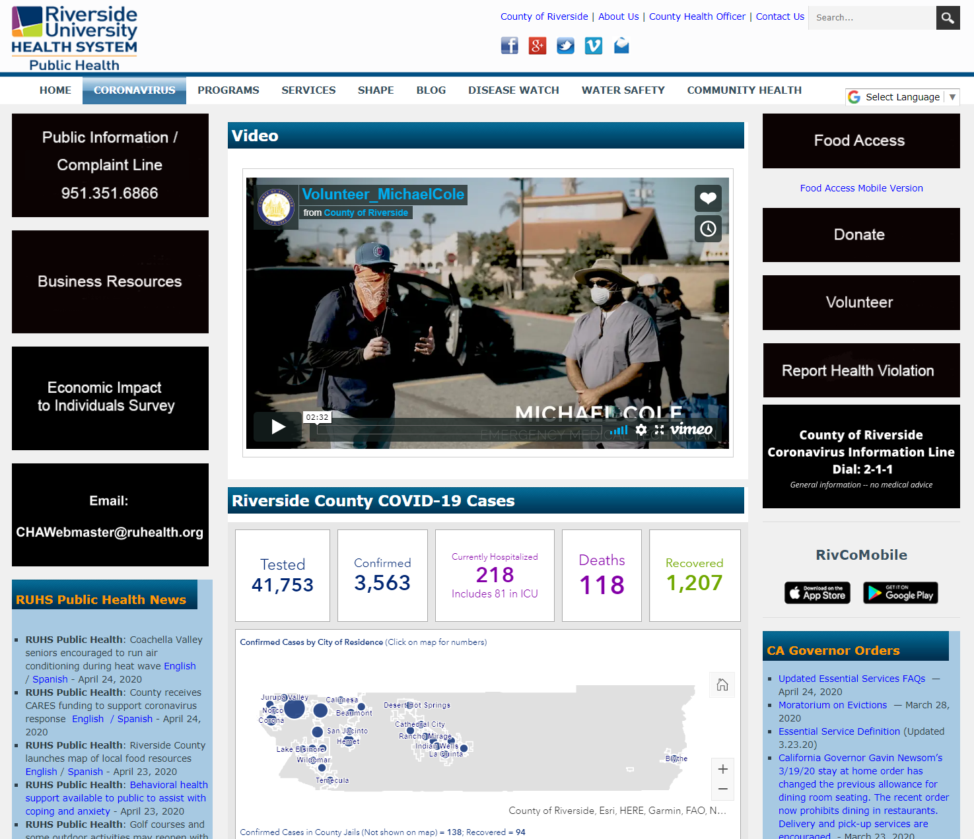
Website
https://rivcoph.org/coronavirus
The webpage was developed to provide current and comprehensive information on COVID-19 related issues in Riverside County.
This includes updated case numbers, local public health orders, and resources.

Slide 56
Website
https://rivcoph.org/coronavirus
As part of our ongoing effort to provide accurate information to the public, we have created toolkits specific to organizations/ populations within Riverside County. Each toolkit includes information such as sanitizing and hygiene guidelines, orders and recommendations. The toolkits are updated frequently as new information becomes available.

Slide 57
Website
https://rivcoph.org/coronavirus
When you click on a toolkit, a pop up screen will appear.
Each screen will include links, or PDF documents addressing various resources or needs that are specific to that population/organization. In many cases, translated information is also included.

Slide 58
Website
https://rivcoph.org/coronavirus
ADDITIONAL RESOURCES
Expanded COVID-19 Testing (Riverside County residents)
800-945-6171
General COVID-19 Resources/Information Riverside County Complaint Line
211 or 800-464-1123 951-351-6866
Medi-Cal, CalFresh, CalWorks Enrollment
877-410-8827
http://dpss.co.riverside.ca.us/self-sufficiency
Domestic Violence Resources
Alternatives to Domestic Violence - 951-320-1370
Shelter from the Storm (Palm Desert) - 760-328-7233
Homeless Resources
Path of Life Ministries Access Shelter
951-462-9822 – western/mid region
760-601-5424 – eastern region
Follow us on Facebook!

Slide 59
Dr. Yuri Nava- School Counselor
Riverside Poly High School
Adjunct Professor-La Sierra University School Psychology & Counseling Program
ynava@riversideunified.org
ynava@lasierra.edu
951-788-7203 x 64217
Throughout time there have always been individuals who have counseled others. For our purposes, counseling refers to a profession whose primary purpose is to help individuals improve the overall quality of their lives academically, socially, emotionally, and for their future dreams and aspirations ~ SOE Beliefs
Notes:
i will share that I run a grief group at Poly and have run them also at the MS and Elementary level
every single handout will be on the rcec.us website, if you haven't already created an account- your going to want to create it NOW
these activities can be used with students who have lost someone due to COVID-19 or with students experiencing loss due to the school closure
they are adaptable and practical and you can customize the handouts with your school logo or information on the sheets

Slide 60
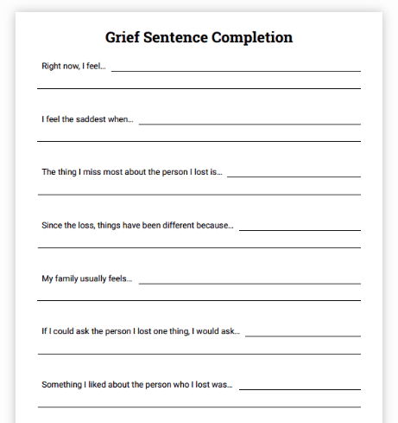
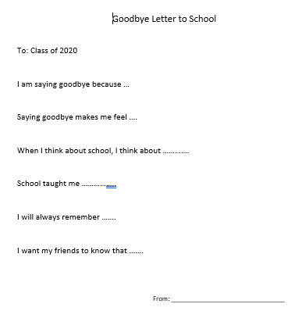
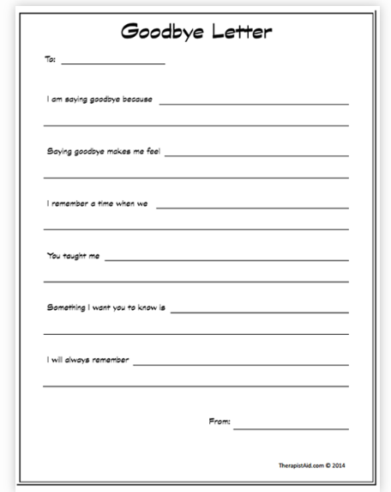
Three Simple Grief Activities During Covid-19 MS/HS - TherapistAid.com
The Good Bye Letter ~ English/Spanish
For a person or pet
For the school closure
Grief Sentence Completion- English/Spanish
For a person or pet
For the school closure
Individual check ins or with multiple students
Stages of Grief- English/Spanish
Individual check ins or with multiple students
Notes:
these help us as SC’s as well because I know that sometimes it's uncomfortable to talk about grief and loss, we don't know what to say ,etc
Help children and adolescents process their grief using the Goodbye Letter writing exercise. Your students will be asked to describe who they are grieving or what they are grieving, special memories with that person or place , and lessons learned from the relationship or best memories of school
The goal of this grief worksheet is to build positive meaning associated with the lost relationship, and to begin moving toward closure. This worksheet will be helpful with children and adolescents who have difficulty talking openly about their loss.
these three simple activities can be done synchronously and asynchronously. - you can ask your students to email you the answers- and you can give feedback, you can video conference with them, you can meet with them in peer groups formerly known as Group Counseling. The difference in group counseling in brick and mortar and counseling during COVID-19 is that prior to the closure we always ran closed groups. Now we have to think of our peer support groups as open groups that anyone can join to share feelings and thoughts and learn from each other collectively.
you can do these with your own caseload and open it can be per grade level or all of your students. Remember that not just your seniors are grieving school being closed. Lets not forget about all our other students whome school was a place to see their friends and have their cup filled with those relationships. They are grieving too
I suggest using this worksheet as an education piece, encouraging your students to explore how they have personally experienced the stages. Try pairing this worksheet with the My Stages of Grief worksheet to increase their involvement.
you can create a collage of these - with the students who participate and create a digital “Good Bye Video” using Flipagram
students can film themselves, they can post it to their to their social media, you can repost with permission to your schools social media for anyone who wants to particiapte, it becomes a way to validate what our students are feelings. You can make this a social media campaign and customize the forms to be related to the school closure - our students never to to say good bye . Right now alog of people are posting those fillable blank forms on their Instagram accounts.
I held office hours last week and the students who joined, we used the grief sentence completion as our chat guide. Students were able to express themselves and felt so good to be there for each other. We know that helping others during grief is helpful for our students. It gives them a sense of purpose and relief.
can also send to students through Remind and they can send back individually or share with the group- allows flexbility

Slide 61
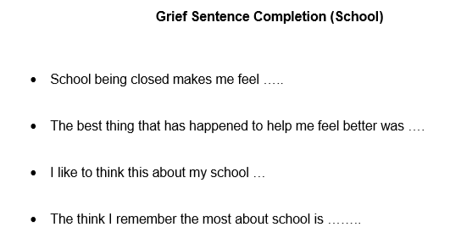
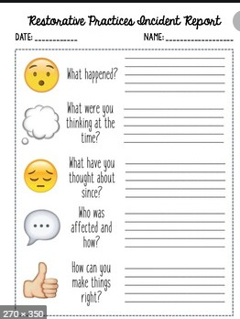
Three Simple Grief Activities During Covid-19 - Elementary
Read a Book ~ Tier 1 (School Wide)
The Fall of Freddy the Leaf (
Live or Pre-Recorded
Restorative Questions or Elmo Video~ Tier 2 (Multiple Students)
Peer Support Groups
Include a video~ Psychoeducation
Students can type, answer in emojis, or bitmojis
Example “Share what your feeling with a picture”
Grief Sentence Completion~ Tier 3 (Individually)
Can be used for individuals or regarding school closure
Activity Resource Handbook
Notes:
if you pre record- have a surprise guest “puppet” children love stuffed animals surprise guests. It could be your school mascot plush or whatever you have at home. They would help with the process questions at the end
this can be adjusted for everyone's comfort level- if you are more comfortable talking to studetns about grief you can do this live, if you are not, you can pre record and create your own youtube channel where students and parents can access the reading later
any of these can be synchronously or asynchronously and across all three tiers 1-3
VIDEO
In a televised segment, Katie Couric speaks with Dr. Jeanette Betancourt and Sesame Street's Elmo about how children cope with grief. Review the video and identify segments that will help your students further understand grief. Show the selected segments to the class after your initial conversation. Extend the conversation by discussing the things Elmo learned about grief when he lost someone close to him.
www.cbsnews.com/video/watch/?id=6392732n

Slide 62
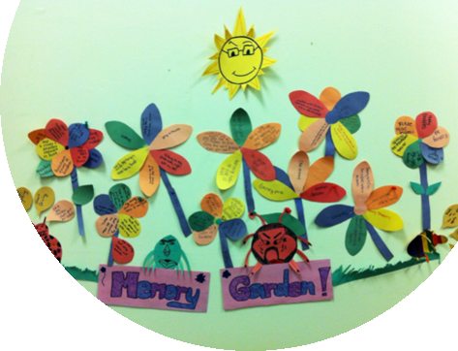
OTHER GRIEF ACTIVITIES
rief Activities
Digital Memory Mural Collage
Digital Memory Book
Digital Memory Video
Tools
Canva
Flipagram
Flipchart
Slidely
Instagram Collage
Google Slides
Notes:
can be done individually or in groups
can be done as worksheets, homework assignments, and adapted for different age levels
Digital Memory Mural Collage- perfect for school closure, students can share all the images related to school and what school means to them, seniors can do this for graduation or senior year - then they can take turns sharing and post to social media. students can share their top 3-5 images and explain what they mean
Digital Memory Book- create a collage of pictures of their loved one or school. this is one picture at a time. students can share their pictures and why they chose them- share out individually or small groups. You can then put them together to make one for your groups
Digital Memory Video - a video that includes audio (songs) or videos from the person or school. These are part of the collage and students can incorporate a song that is like their anthem about school or if doing this of a person then their favorite song. you can select time frame like 1 min or 2 min for each students- this is something students can share with freinds and family, post on social media

Slide 63
Know the Signs During COVID-19
Images
Lethal Language
Other Warning Signs
Making Preparations
What Can You Do ?
Be Preventative
Educate Parents/Students on signs of crisis/suicide
Smore Newsletter to Parents
Smore Newsletter or Video to Students
Notes:
t's also super important to be familiar with what key words or emojis youth may use that signal lethality or harm to self or others. Research by the National Crisis Text Line skimmed 129 million words in their chat and they found that the Pill Emoji, crying face emoji, now there are also other emojis such as the syringe. Also, the words you should look for are the words that are the mode of attempting harm rather than words like depressed or sad. Words that are the mode of attempting harm are pictured here... MG for example which means milligrams and could signal substance abuse or overdose. here is the link to the research which even breaks down data by state.
Lethal language is predictive. Crisis Text Lines use Artificial Intelligence to triage texters so it can support people at risk for suicide within seconds. Through machine learning, it has learned that when a texter uses the words “Excedrin,” “Ibuprofens” and “800mg,” the conversation is more likely to lead to an active rescue.
Making preparations: Often, a person considering suicide will begin to put his or her personal business in order. This might include calling/textingfriends and family members, giving away personal possessions or telling others what will go to them, cleaning up his or her room or home. Some students will write a note before committing suicide. And they will say something I am writing a letter to my family, or im leaving a note for my parents,
When you ask the student o what have you been doing? And they say things like “getting ready” and when you ask “getting ready for what” and they cant answer- its important to follow up with the parent and ask if there is an event or if they have noticed something strange.
talk to your principal about having a parent forum, parent virtual group meeting, or sending out a newsletter.. Empower our parents and students to know what these warning signs are so that they can get help if someon they know is struggling with grief. It is a myth that talking about grief or suicide will lead to grief or suicide. Talking about it allows for validation, it allows for the student to feel SEEN, Heard, and buys time to then talk, process, have a plan, and get help.

Slide 64
TIPS WHAT TO SAY/WHAT QUESTIONS TO ASK
Considerations
Age
How close they where they to their loved one
Curiosity
Assess For Understanding
Be Honest & Straightforward
Don't use euphemisms
Validate emotions
Reassure, Reassure, Reassure
Death was not their fault
Death was not a choice
They are safe and their family is safe
What they can control to prevent COVID-19 spread
You will be honest and keep them informed
Prepare them for customary rituals
If you think it’s necessary, help them to decide what they will say and/or share if people ask them about their loved one’s death.
Help them identify other support people who they feel comfortable talking with
WHAT TO AVOID
Notes:
1) As a caring and loving SC, you likely already have the qualities necessary to navigate this situation
(2) Qualities like reliability, consistency, warmth, and openness are far more beneficial to the child’s well-being than having the perfect words and right answers.
(3) I can’t tell you exactly what to say, but I can offer you tips on talking to kids about death and grief.
What to Avoid Writing
There are both inappropriate and overused messages of sympathy that should be avoided. The following cliched or insensitive messages may offend, confuse, or generally harm the grieving person. This is not a time to display your own pride or be shallow. Do not use the following ten types of messages of sympathy:
"He had a good life." While this isn't necessarily offensive, it is overused. On top of that, saying that the deceased had a good life may not even be true.
"That is not fair that ________ died. Why did it have to be him? He didn't deserve to die. He was a better man than most. It's just not fair." This type of message honing in on the unfairness only focuses on the pain that the living is already dealing with and doesn't do anything to help with the healing process.
"He is finally getting some rest now. He feels no pain because he is in a better place." This is not necessarily offensive, but rather, again, is cliched and overused. Chances are the receiver has heard these phrases a few times already.
"At least he was able to live a good, pleasurable, full life. He lived much longer than some." This message is similar to the one above and bringing up the fact that one lived a long life, regardless of how long, is unnecessary because that person's life is never going to be long enough.
"I know how you feel. You'll get over it. Time heals all wounds." This comes off as insensitive and offers very little consolation to the receiver.
"Try to stay positive. Everything works together for a reason." This may come off as a bit condescending to the receiver. If not that, it's unhelpful to hear in the mourning process.
"At least you're still alive, you have to be grateful for that." The focus should never be on the receiver directly but rather their relationship to the deceased and their mourning process.
"I guess it was just his time to go." Again, this is unhelpful, unnecessary, and insensitive to say this, regardless of its truth (which can't be verified, anyway).
"You should get over this in a couple of weeks. He will be a faded memory and you will move on with your life." While these things may or may not happen, it's again very insensitive to dictate whether someone will "get over" something, especially something as serious and tragic as a death in an arbitrary amount of time.
"I hated the jerk anyway. I'm glad he's dead." Self-explanatory.

Slide 65
Dr. Yuri Nava- School Counselor
Riverside Poly High School
Adjunct Professor-La Sierra University School Psychology & Counseling Program
ynava@riversideunified.org
ynava@lasierra.edu
951-788-7203 x 64217

Slide 66
Round of Applause for our Presenters!!
Jana DeCristofaro
Dougy Center
Diana Brown
RUHS-Behavioral Health
Rebecca Antillon
RUHS-Behavioral Health
Dr. Yuri Nava
Riverside Unified School District
Notes:
Castro Slide

Slide 67
We are here to support you!
Please reach out to College and Career Readiness with any needs at your school site, professional development topics, or general questions at:
Catalina Cifuentes ccifuentes@rcoe.us
Dr. Pedro Caro pcaro@rcoe.us
Notes:
Castro Slide

Slide 68
FOR MORE INFORMATION AND RESOURCES PLEASE VISIT US @
www.rcec.us

Slide 69
