Slide 2
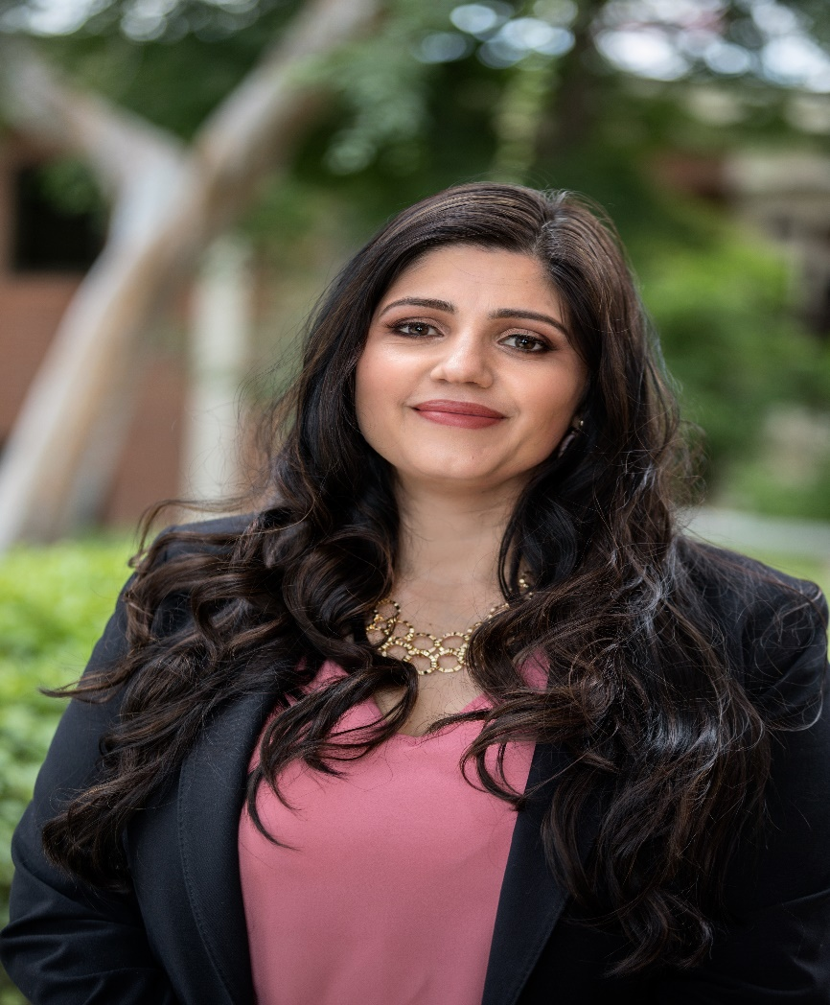
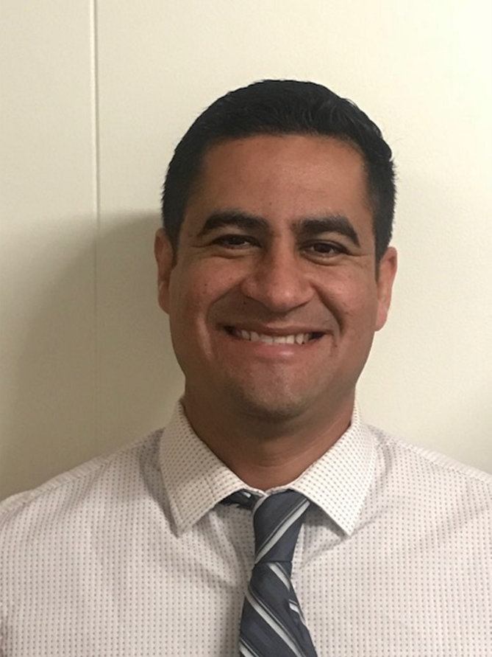
Catalina Cifuentes
Executive Director,
College and Career Readiness
ccifuentes@rcoe.us
Dr. Pedro Caro
Coordinator,
College and Career Readiness
pcaro@rcoe.us

Slide 3
Webinar Tips
This webinar is being recorded so that others may listen to it at a later time for reference and will be uploaded to the RCEC Youtube page as well as www.rcec.us once you log in to access the content of the webinar series
All connections to this live Webinar feature have been accounted for so please do not forward the Zoom link or invite anyone to join because you are taking someone else’s spot and Zoom will automatically start kicking off connections randomly
All participant mics have been muted and only panelists and facilitators have the ability to unmute anyone
Since all participants have been muted, please use the Q&A and chat screens to enter your questions
Participants can submit a question in the Q&A box at the bottom of the screen for the panelists
Only panelists and facilitators will be able to respond back to those questions and can do so publicly or privately to the individual
Participants can submit comments or questions in the chat box if they would like to engage with each other
**Every effort has been made to ensure the security of this webinar from “zoombombers” but in the event that we experience that, please stay calm and we will resume as soon as the technical difficulties have been resolved.**

Slide 4
Essential Advocacy for School Counselors During the Budget Crisis and COVID-19
College and Career Readiness Unit
Riverside County Office of Education

Slide 5
Objectives
Understand the implication of the revised California budget on education and school counseling programs
Explore the needs assessment as tool to inform key stakeholders and drive program planning action for the upcoming school year
Develop an Annual Student Outcome Goal Plan to create SMART goals and multi-tiered systems of support

Slide 6
Agenda
Introduction
Budget Updates and Implications
Step 1 - Identifying Needs
Step 2 - Using Data to Drive Action
Step 3 - Program Planning for Next Year/Action and Advocacy
A Call to Action and Next Steps

Slide 7
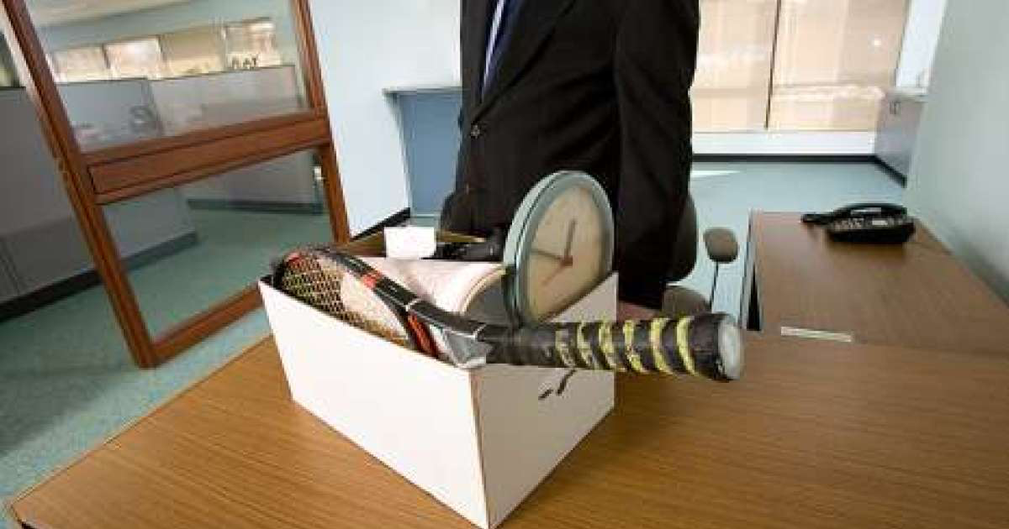
We’ve Been Here Before...
2008

Slide 8
California State Budget Headlines
$19 Billion decrease in Education Funding due to financial crisis caused by the COVID-19 situation
Loss of expected $2.31 cost of living increase
10% loss to Local Control Funding Formula without Federal funding
$5.3 Billion in funding deferrals creating major cash flow disruption for districts to payroll
Approximately 90% of school district budgets are for personnel costs
Notes:
Gil

Slide 9
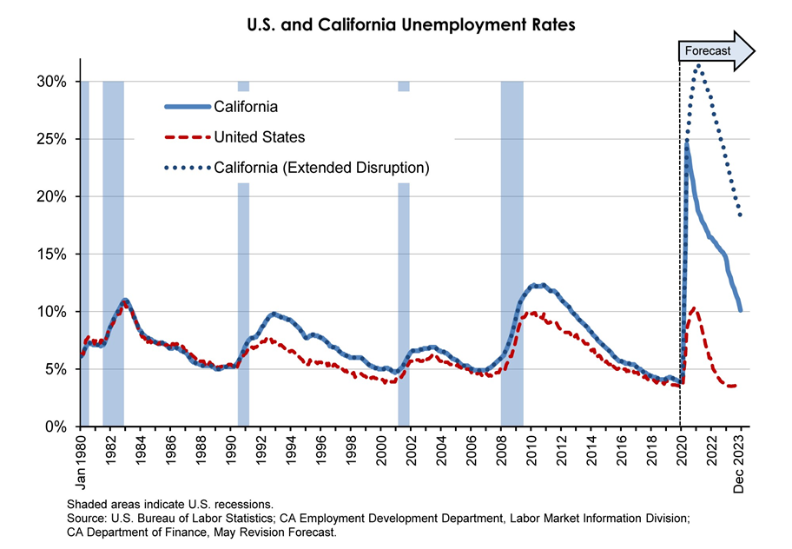
Present
Great Recession
Notes:
Gil

Slide 10
January Budget Proposals Withdrawn
Educator Workforce Investment Grants: $350 million
Opportunity Grants: $300.3 million
Community Schools Grants: $300 million
Special Education Preschool Grant: $250 million
Workforce Development Grants: $193 million
Teacher Residency Program: $175 million
Credential Award Program: $100 million
Child Nutrition Programs: $70 million
Classified Teacher Credential Program: $64.1 million
Local Services Coordination (CCEE): $18 million
Computer Science Supplementary Incentive: $15 million
Online Resource Subscriptions for Schools: $2.5 million
California College Guidance Initiative: $2.5 million
Computer Science Resource Lead: $2.5 million
School Climate Workgroup: $150,000

Slide 11
How Do Districts Make Staffing Decisions?
Attempt to keep cuts as far from the classroom as possible
Evaluate “Value Added” positions for district mission
Measure impact of decreasing or eliminating particular job functions (Layoffs?)
Negotiate with Labor Unions (Certificated and Classified)
Reduction in Force
Notes:
Gil

Slide 12
STEP 1 : Needs Assessment
Understand the current state of students, teachers and families
Identify strengths, areas of growth and gaps
Help develop action plans and SMART goals for the upcoming school year for classroom lessons, small groups
Identify individual or group students needs
Gather data beneficial to school or programs such as but not limited to (Athletics, ASB, Clubs, Mental Health Providers, agencies, admin, SpEd, AVID, Homeless, Foster Youth, etc).
Notes:
Yuri- needs assessments are important because it helps you gather initial baseline data on your students and school CLIMATE. It assesses the culture and current state of your students
They help a school and counseling program determine the gaps that are preventing it from reaching its desired goals. FOr example, if you can pinpoint that your Homeless, First generation students need help completing the FAFSA< this could drive your completion rates to be higher by identifying those students and providing counselors with a special list (TLC) or people in charge of their students in such a program.
Remember that the object of a needs assessment is not for the counselor or counseling team to take on the entire data and actions. It’s also to collaborate and share results with those who CAN also help your students succeed. Remember the saying, “it takes a village” if for example your homeless students all need helps with school supplies, you advocate for that from your admin or district person in charge and show the results to get needed supplies. Needs assessments data is to be shared with stakeholders such as teachers, school psych, admin, district personnel, coordinators, attendance offices, etc.
Needs assessment addresses these concerns from all levels, starting at the 30,000 foot view and drilling down further and further into the individual school, groups of students, and individual students, in order to arrive at a plan with specific actions for improvement.

Slide 13
Helpful Considerations
Who is your target audience?
What information do you want to know about them?
Why are you asking this particular question?
How will you collect data?
How will you use this data strategically?
Who might you share this data with?
Notes:
Pedro

Slide 14
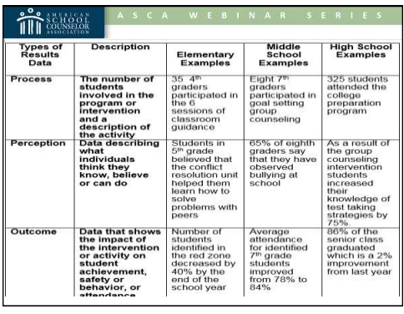
Determine Questions & Distribution Framework
GET CREATIVE! HAVE A PLAN!
Perception Questions = Likert Scale (1-10)
I FEEL, I THINK, I BELIEVE, I KNOW, I CAN
Ask students to fill out needs assessment during the initial classroom visit in the FALL or during registration in the spring for next year planning
Have incoming 9th graders fill out a needs assessment during 8th grade registration/orientation
Have PTA, ELAC, or other evening parent clubs/school organizations put the survey on their agenda and ask them to have parents fill it out (digitally & electronically)
Always have paper copies for students/parents w/out WiFi or phones
Ask Club or Program Advisors to partner with you and have students fill out needs assessments for participation points. This data benefits them also!
Give incentives (first ten students to complete, random drawings, class with most participation ,etc)
ASCA Handout
Notes:
Yuri – we have multiple choice, open ended, but I always get asked as a ASCA RAMP reviewer, when do you do scaling questions… anytime you want to gage perceptions of your students, parents, teachers, staff you use Likert scales also known as rating scales
Perception – what students think they believe (attitudes), can do (skills) or understand (knowledge) (e.g., 75% of group believe their school is safe; 58% of students know how to write a goal) what students FEEL, THINK, I believe, I know, ETC
Perception data is meaningful because it provides answers to how students are different because of the school counselor's intervention. This is captured in POST tests (after you have delivered a classroom lesson or small group)
Perception data is used to effect changes in the learning environment which is captured when you ask them in a needs assessment
Having a plan is important, it creates collaboration, transparency, and buy in from different stakeholder groups. If you take the time to state why this is important and how their help will assist students, it 1) educates and 2) build your ally group so that you don’t have to do everything ALONE . There is no reason to carry to weight of an entire counseling program alone, just like we share in the education of our kids assigned to us with their teachers they have or coaches, we too must look to others to assist us in delivering services.

Slide 15
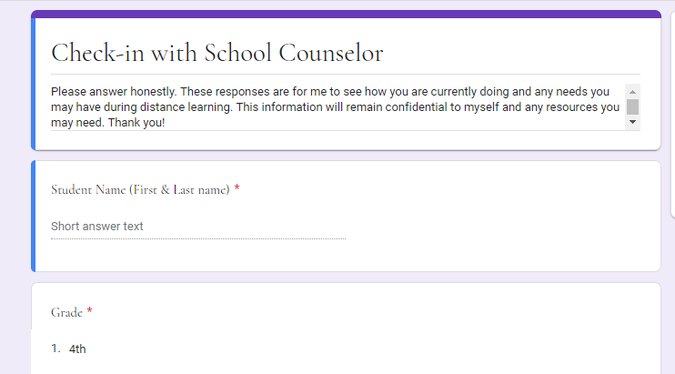
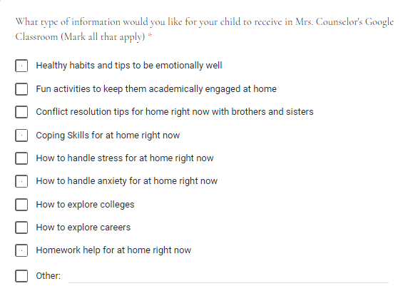
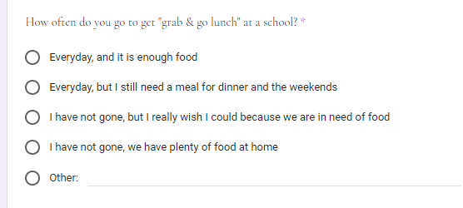
Sample Needs Assessments
Needs Assessment to Use for Students During COVID-19
Needs Assessment to Use for Families During COVID-19
Notes:
Pedro

Slide 16
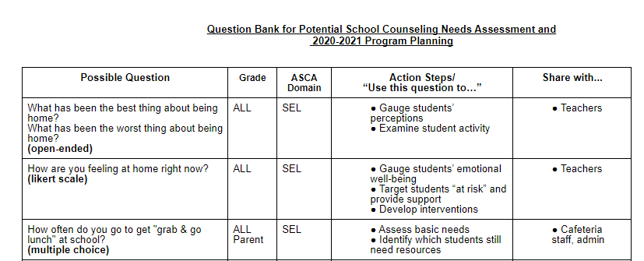
Have A Question Bank
BENEFITS!
Efficiency
Collaboration
Evaluation/Reflection
Question Enhancement
RCOE QUESTION BANK LINK
Notes:
having other teachers, admin, or even classified staff take a look at your question bank or surveys gives you another fresh set of eyes or a different way to ask a question that could make 1) better sense for your student or parent or 2) ask in a way that your student/parent can easily understand- sometimes what we think in our head sounds right but it may be confusing for others
Question bank can be used for pre-testing, development, review and revision of a lesson. When question banks are established in schools, students can use them for self evaluation in their spare time to get student perspective on the sample questions

Slide 17
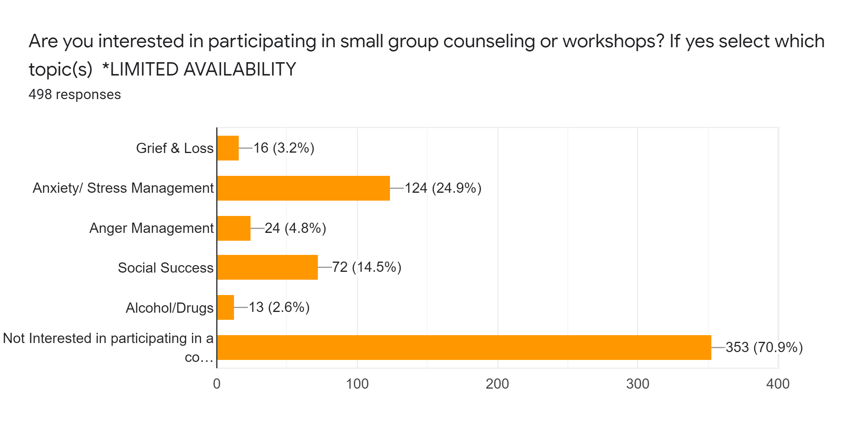
Using Needs Assessments Results: Poly High School
Fall Needs Assessment = Baseline Data Results
9th
1% Depression
5% Grief & Loss
11% Stress/Anxiety
10th
18% Anxiety/Stress
2% Drugs/Alcohol
11th
26% Anxiety/Stress
6% Anger Management
12th
25% Anxiety/Stress
50% First Generation
20% Transition
Avg. of 20% Stress/Anxiety across all grades
Notes:
SOPHIA-
Going through a pandemic can increase trauma and anxiety so having already a list of kids to check in with was helpful . We had already asked kids to identify some potential topics for groups/workshops during the year.
We identified a TREND on campus that caused us to run specific workshops on campus. That being on Stress Management.
If you take a look at our data presented on this slide and add all percentages together regarding this topic, 20% of our students ON CAMPUS are suffering from Stress/Anxiety. Therefore during COVID-19 our FOCUS WAS Social EMotional and MAKING MENTAL HEALTH RESOURCES AVAILABLE FOR ALL KIDS-
We created a new Poly Counseling Website with COVID-19 resources but an entire mental health section with a lot of stress an anxiety resources (THank you to our interns)
This data was shared with our district counseling lead, and he was able to take this to our assistant superintendent and director of instructional services- and advocated for and approve a District Counseling Website (MS/HS) TAB with specific to SEL /Mental health resources, so that ALL students in our district could have EQUAL ACCESS AND school counselors could have uniform resources

Slide 18
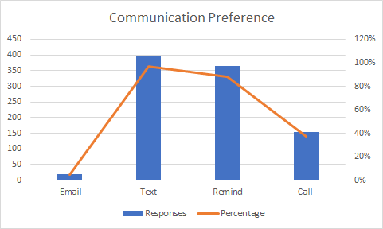
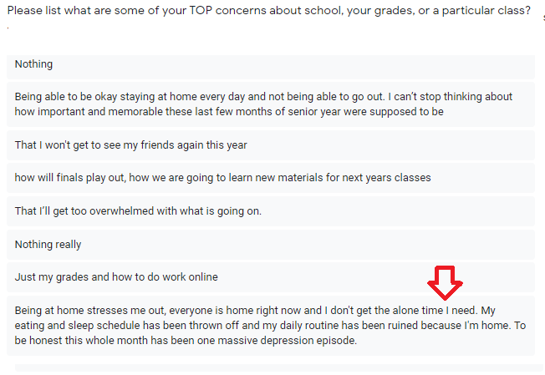
COVID-19 Needs Assessments Results: Poly High School
Starting point for COVID-19 Needs
Shared information with Therapists/School Psychologists
Contacted students with mental health needs FIRST
Referred students who were in need of resources
Computers
Materials
Food
Continued Group Counseling services
Offered virtual peer support check ins
Set up individual student check ins based on NEED and open ended questions
Set up Google Voice/Remind
Notes:
I didn't set up a google classroom - share story of personal experience as a parent (Kindergartener)
I set up Remind/Google Voice- my students replied to me indicating their preferred method of communication over email- I was able to text information to parents/students & push out important updates via Remind. Resulted in me being able to connect with 98% of my caseload. I was only not able to get ahold of 2% of my student (homeless even with help from district, they did a home visit)
Created REMIND FIRST_ imported their emails and it texts THEM if you log in to remind from the website, sent out this specific question to them via remind. They filled out a google form)
We plan on having an IG account next year …. We currently use the main Poly IG to push out information (admin controlled)
Lots of open ended questions to give students an opportunity to VENT/ BE HEARD! Its validating , they WILL TELL YOU!
See sample of one kid who explicitly shared about their depression, another kid who was helping take care of his sibling parents were essential workers, , shared with his teachers they were able to accommodate him and lessen workload

Slide 19
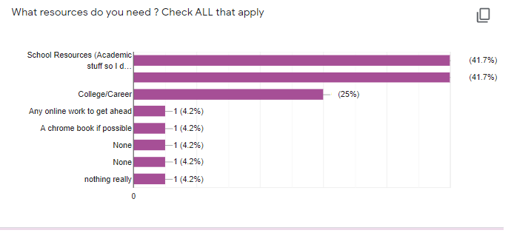
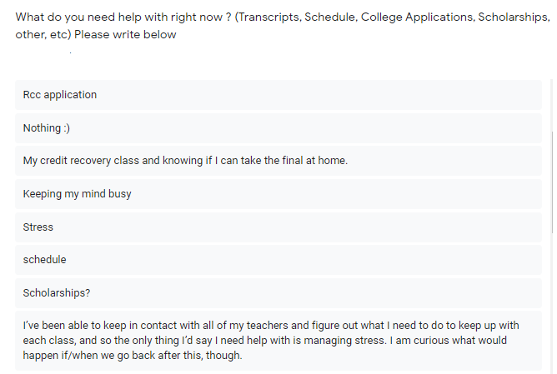
COVID-19 Assessments Results
25% of students still wanted college/career readiness assistance
Scholarships
College Applications
FAFSA/CADAA
Notes:
NOT EVERYTHING WAS TRAUMA
Needs Assessments prevent assumptions & guessing - it gives you specific INTENTIONAL Items to take actions on
=talk about DATA RESULTS
Establishing a sense of normalcy helps to relieve trauma and is the number one recommendation for those experiencing loss or trauma and its healing to get back into “normal activities”
By sending out a COVID_19 needs assessment, it took care of my students BASIC NEEDS - those things essential to them that would help push them forward during the 8 weeks. This is the same concept as Maslows Hierarchys of needs, we have to have our basic needs met in order to perform at our best.
As you plan for next school year, dont assume that everyone is going to be about mental health. Assess your student needs so that you can be intentional and most importantly accurate about what services to deliver with data to back your reasoning. This is what makes you an essential component of a school.

Slide 20
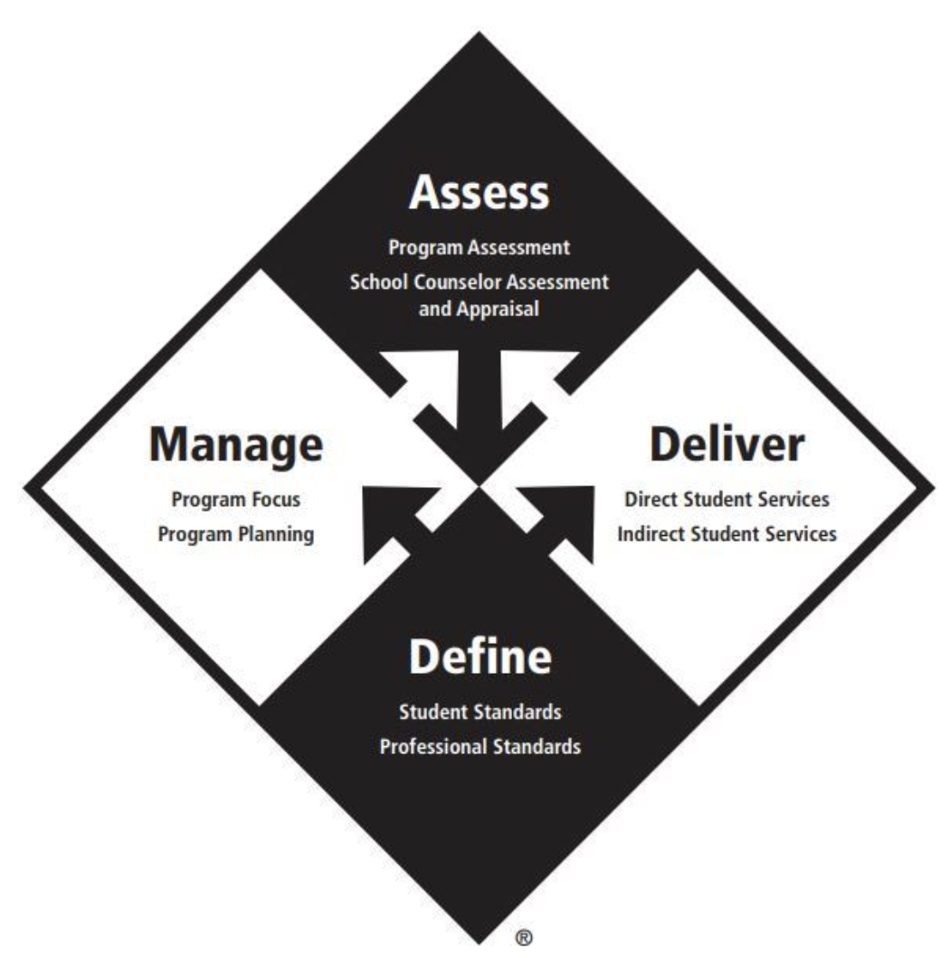
STEP 2: Using Data to Drive Action
CATHERINE WALLACE
Career Technical Education Counselor
Corona-Norco Unified School District

Slide 21
Using Data and Needs to Drive Program
The results from the questions you created from your “Needs Assessment” need to drive your counseling program.
Use the results to create baseline data
Analyze the results to determine your greatest areas of need
Target Student Population (gender, ethnicity, grade level?)
By which domain?
Create goals for 2020-2021 school year with your baseline data
Who will you target?
How will you measure if you achieved your goal?
Participation, Assessment (Pre and Post),
Student Performance (Grades, G.P.A, Engagement)
Use the ASCA National Model or another template to organize your goals and action plan
COVID-19 has created a new set of challenges and needs for our students and families.

Slide 22
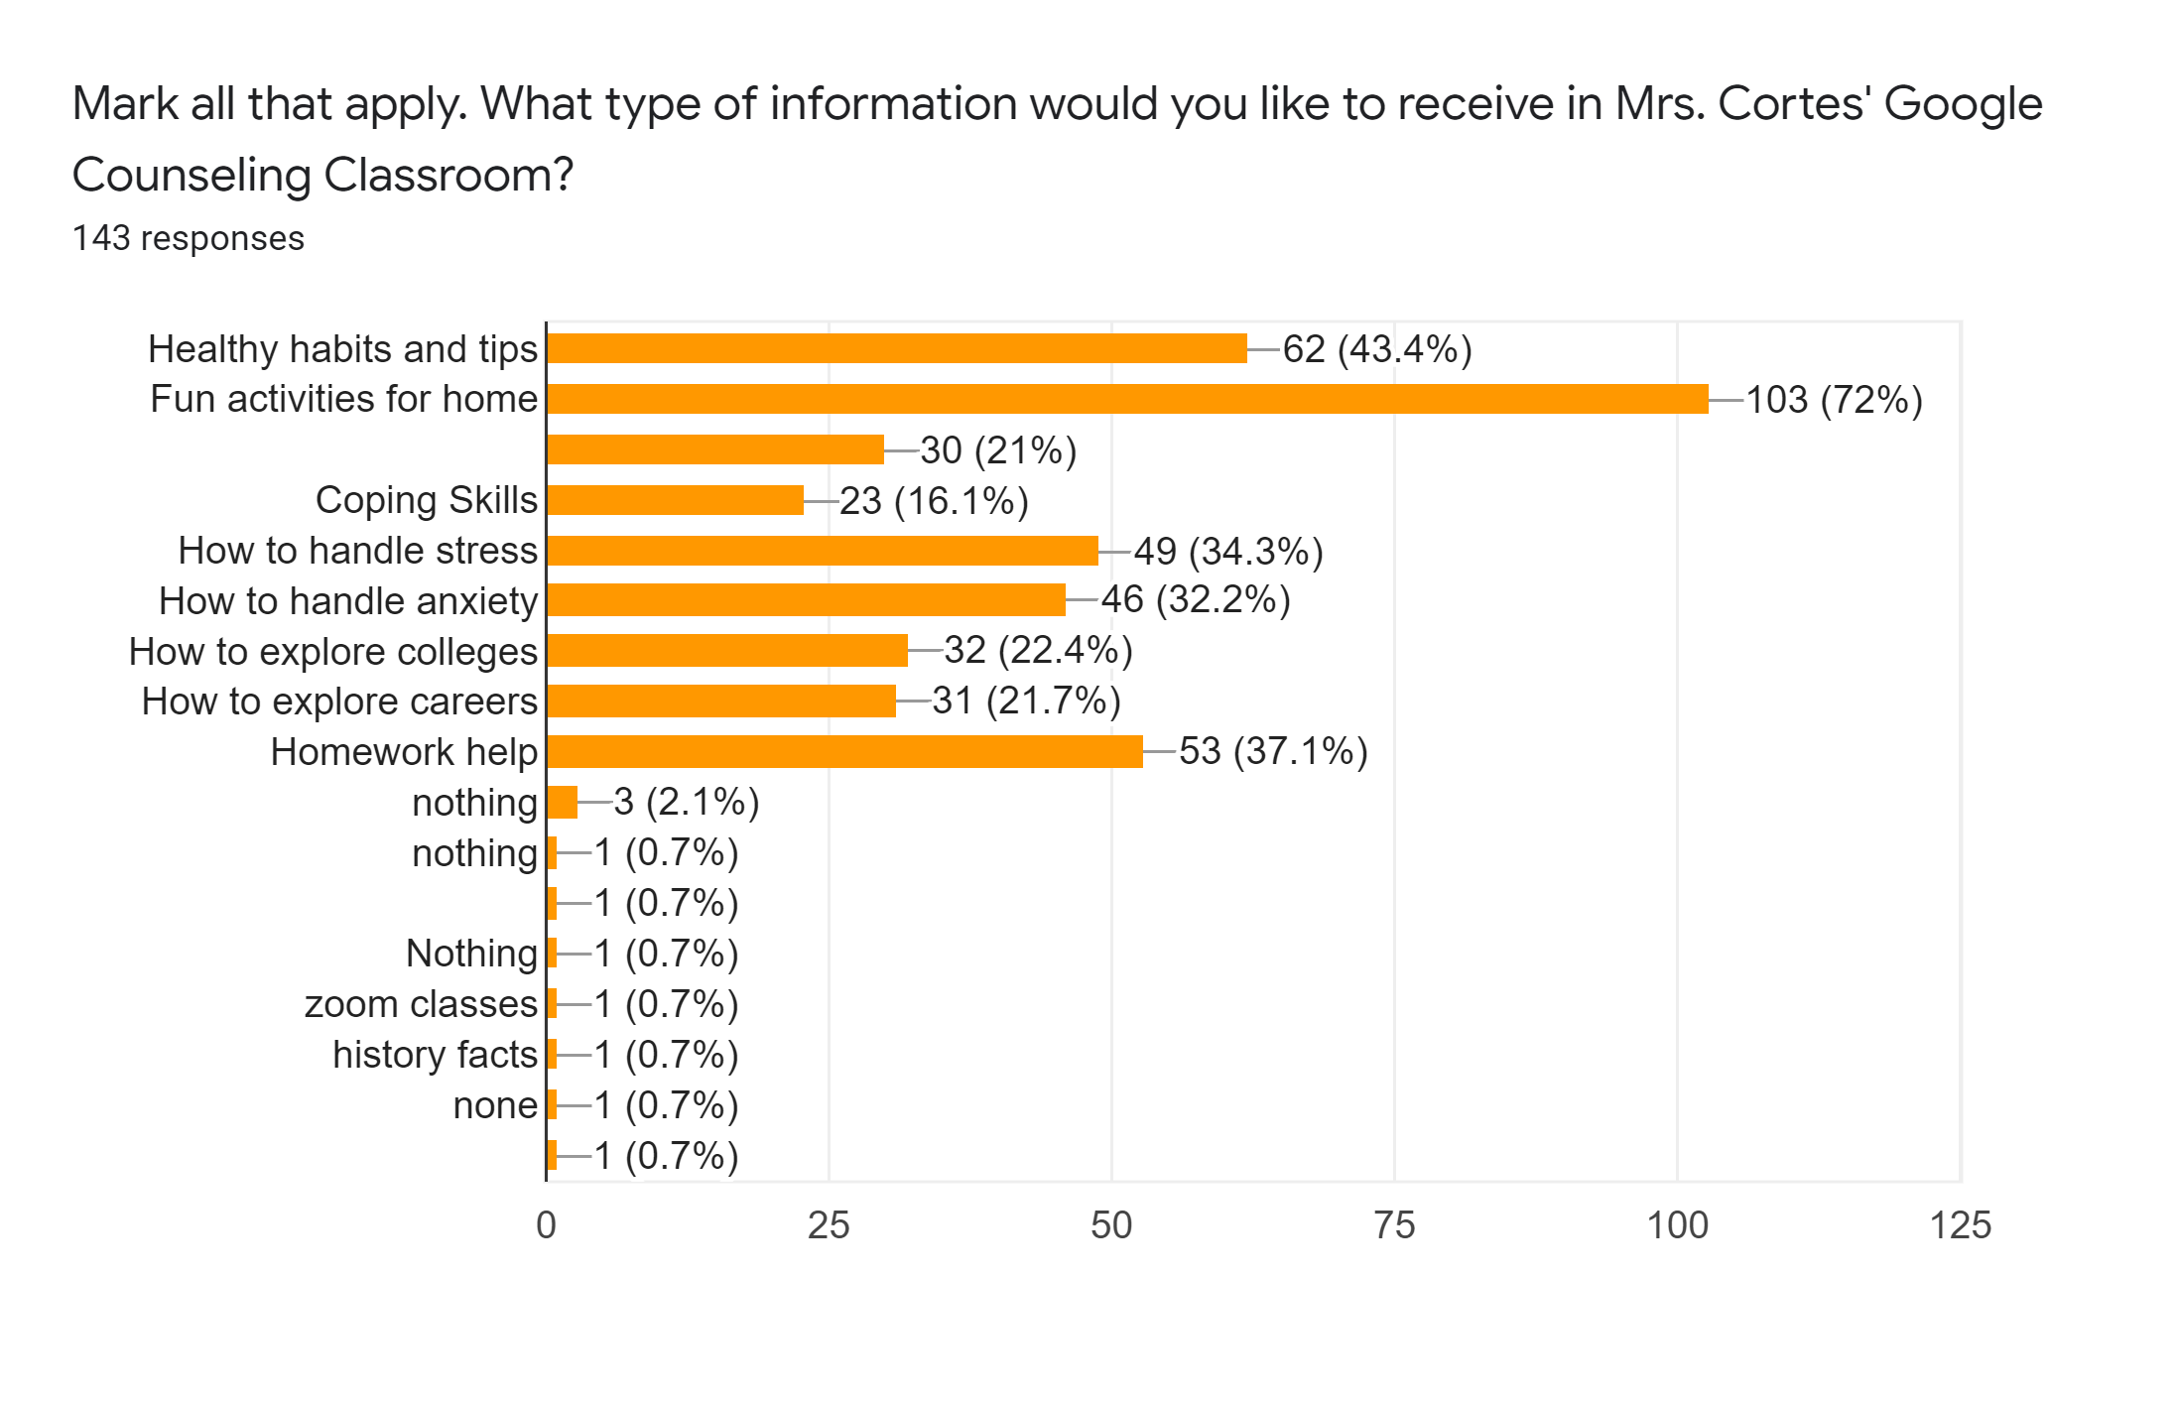
The Results

Slide 23
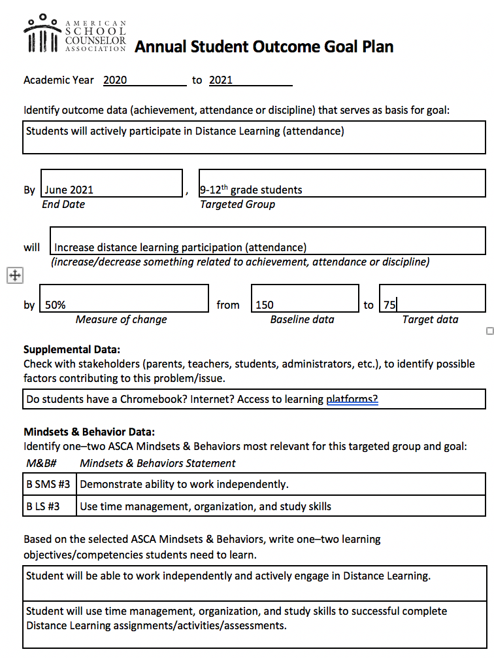
Annual Student Outcome Goal Plan
Based on results of Needs Assessment
Academic Goal for 2020-2021
Increase student engagement in Distance Learning
Domain - Academic
Target students (9th -12th grade)
How will I assess?
Pre/Post Assessment
Track Participation (collaborate with teachers)
Grades

Slide 24
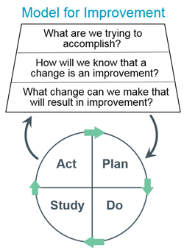
Additional Ways To Track Your Data
Model for Improvement Template
Moreno Valley USD
Intentional Counselor Action Plan (ICAP)

Slide 25
Step 3: Program Planning for Next Year/Action and Advocacy
Orange Vista High School
Matthew Elder: Assistant Principal
(Master Schedule, Guidance, and College & Career Readiness)
and
Counseling Team
For samples of any files or direct links, they have been removed from this PPT so please e-mail Matt Elder directly at melder@valverde.edu.

Slide 26
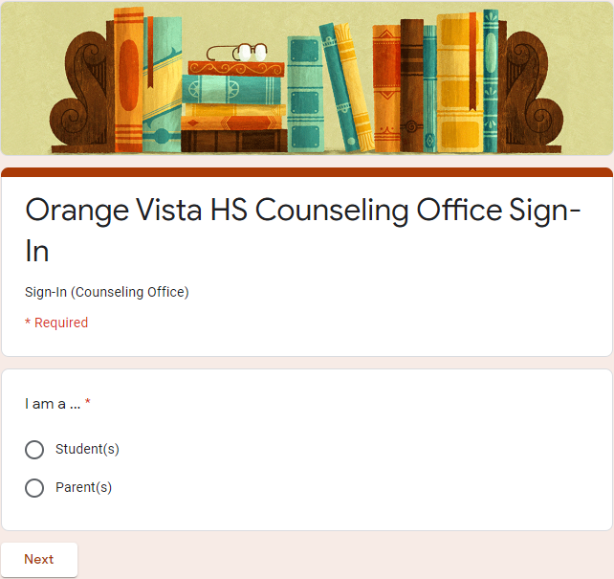
Data Collection: Why it is necessary!
How were you tracking how many students were being seen daily, weekly, and/or monthly in your site’s Guidance Office?
What are students most being seen for in your office(s)?
Which grade level is seen more? Which period are students being seen more? Which counselor sees more students?
How can you use that data to determine what needs to happen during distance learning?

Slide 27
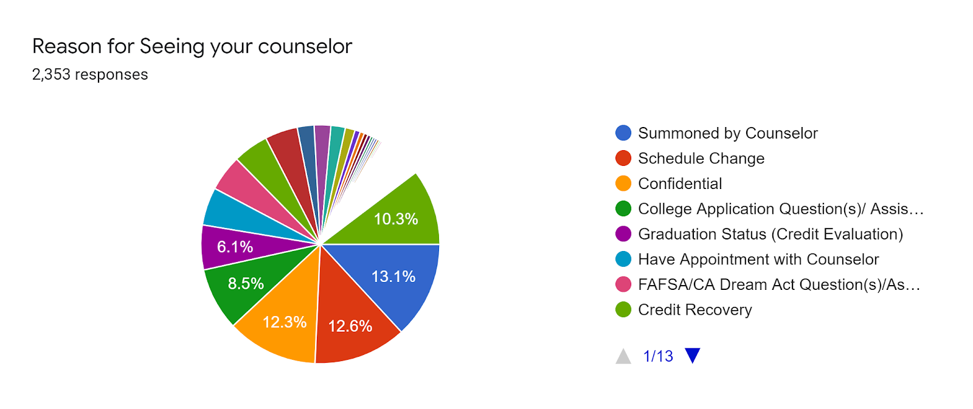
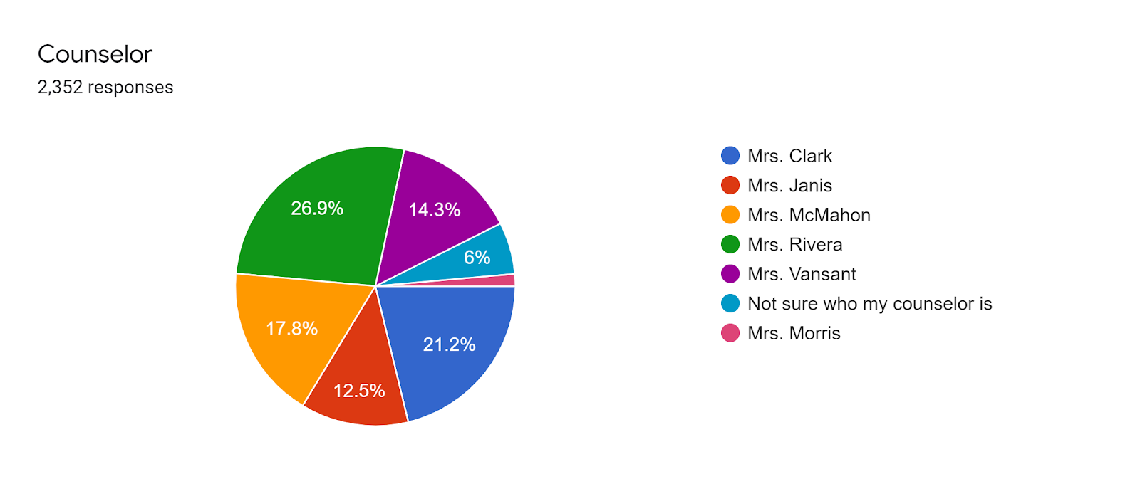
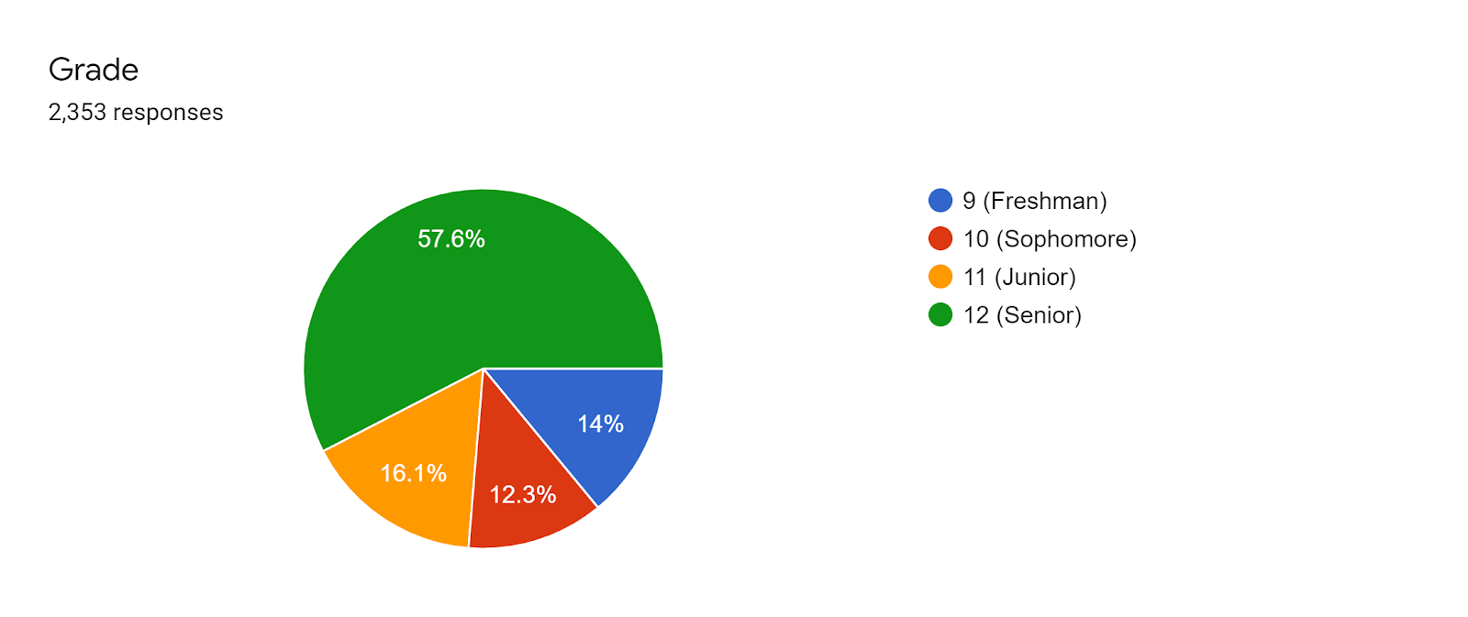
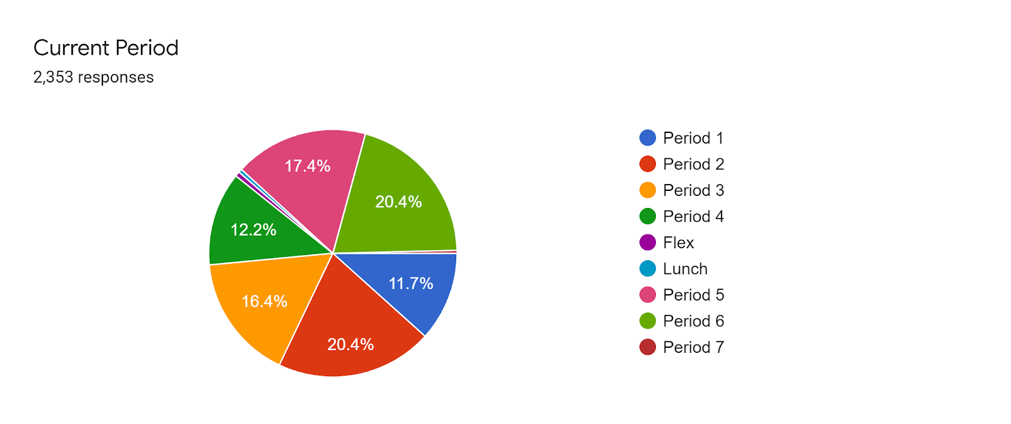
Data Collection: Orange Vista HS Counseling Office

Slide 28
What type of information are you providing and why?
Weekly? Daily?
We will be posting to this Google Classroom, Code gvgxwzp, each day using our themes below:
Monday - Mindfulness Mondays (Breathing Exercises, Coping Skills, Meditation)
Tuesday - College and Career Tuesdays
Wednesday - Where You Going? Wednesdays (Acceptances, Virtual Tours)
Thursday - Thoughtful Thursdays (Motivation, Quotes, Sharing Positivity)
Friday - Fun Fitness Fridays (Take Time off from electronic devices, Funny Video Clips)
Counseling Office Hours:
Monday: Class of 2020
Tuesday: Class of 2021
Wednesday: Class of 2022
Thursday: Class of 2023
Celebrating our Students:
Celebrating students with our Staff:
Celebrating our Staff:

Slide 29
Counselor Connections
Redesigning our Counseling Website
District Email: Secure Network
Google Classroom(s): 2020; 2021; 2022; 2023
Social Media: Instagram, Twitter, Tik Tok, etc.
Calendly: Schedule Appointments
Website: Smores (Google/Spark combined)
AERIES Communication (PD Training)
Newsletter(s): Monthly → Weekly: May 28th
Office Hours: (Zoom Meetings)
Google: (AP Interest Google Forms, Program interest lists for teachers (Google Sheets), Course request Google Forms, etc.)
Grade Watchlists: Seniors / Ghosted
Credit Recovery
Summer School
Financial Aid clean-up
Celebrating our students/staff
Preparing for Distance Learning next year, just in case.

Slide 30
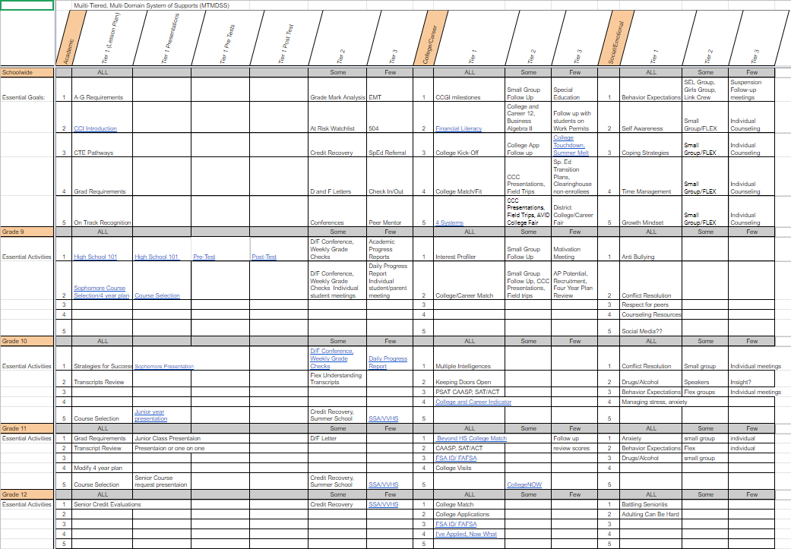
Orange Vista HS: Multi-Tiered Multi-Domain Systems of Support (MTMDSS)
How will your data guide how you are providing information to your students during Distance Learning and help your planning moving forward?
We want to thank RCOE for their amazing Webinar Series and our ASCA Model Trainers for the progress we are making as a newer counseling team at Orange Vista High School.

Slide 31
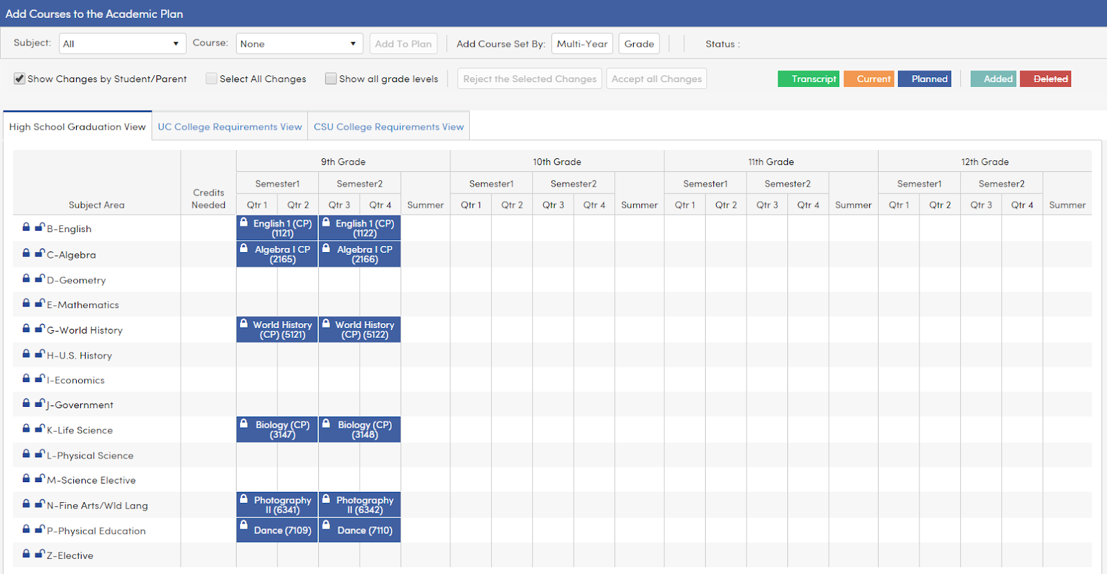
Academic Plan: Incoming 9th Grader

Slide 32
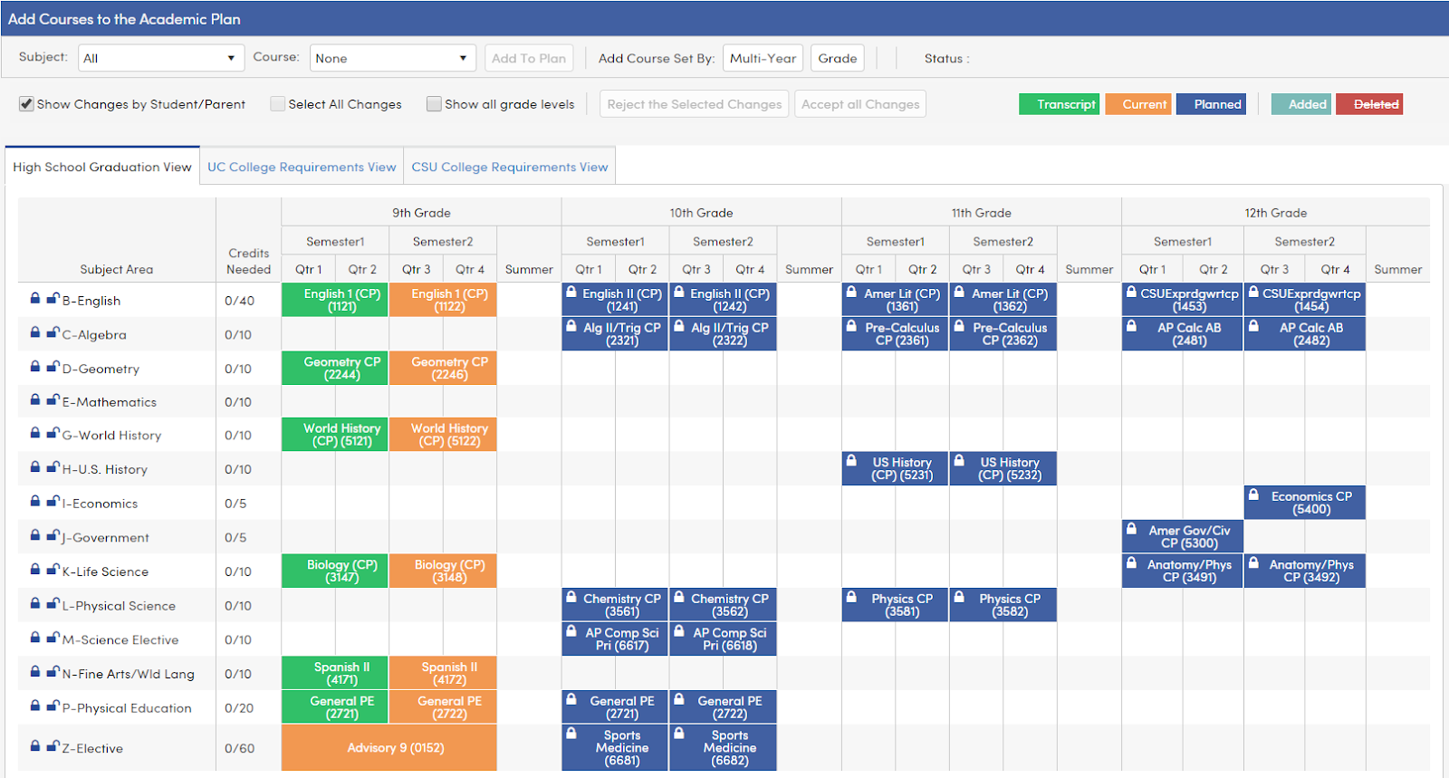
Academic Plan: Advantages of Building it Out

Slide 33
A Call to Action
Would your site level leadership, teachers, families, etc. advocate for your role and do they have data examples of why your position is essential?
Have you reviewed your communication and outreach plan for students, families and community members including replying to emails, counseling website, newsletters, etc.?
Can you demonstrate through outcome data and results your impact on various student groups? (ex: Students with Disabilities, English Learners, etc.)
Have you modified and updated your school counseling program to meet the needs of our new student learning environment?
Have you analyzed your current data including student participation in distance learning to be proactive for the upcoming school year which could include distance or a hybrid model?
Are you prepared to provide more than anectodal stories to advocate just how essential you are in the lives of students, families, and school community?

Slide 34
FOR MORE INFORMATION AND RESOURCES PLEASE VISIT US @
www.rcec.us

Slide 35
We are here to support you!
Please reach out to College and Career Readiness with any needs at your school site, professional development topics, or general questions at:
Catalina Cifuentes ccifuentes@rcoe.us
Dr. Pedro Caro pcaro@rcoe.us
Notes:
Castro Slide

Slide 36
