Slide 1
New School Counselor Academy (NSCA)
Session II: Using Data in Your School Counseling Program
Dr. Pedro Caro
Coordinator, College and Career Readiness
(951)826-6323 I pcaro@rcoe.us

Slide 2
Pre-Test
https://tinyurl.com/NSCA2Pretest

Slide 4
Today’s Agenda
Share feedback
Data in school counseling
School Level Breakouts
Collaborating with administrators
Guest speakers

Slide 5
Objectives
As a result of this session, participants will be able to:
Identify key external and internal data sources to use at their specific school level
Develop several practical tools to use for collecting data, including pre and post tests, action plans and SMART goals
Understand best practices to effectively collaborate with administrators

Slide 6
Networking
What is one thing you have implemented or used from the first session? What was the outcome?
What is one success you have experienced this school year?
What has been your experience with using data in your school counseling program?

Slide 7
Feedback Share-out from Session 1
49% increase in participants who believed they could explain the basic components of the ASCA National Model
81% increase in participants who successfully identified “communication and respect” as the two most important elements in the principal-school counselor relationship
67% increase in participants who knew the recommended use of time for direct/indirect services

Slide 8
External Data Sources School Counselors Must Know—What’s Available to You!
Dataquest
https://www.cde.ca.gov/ds/sd/cb/dataquest.asp
CA Dashboard
https://www.cde.ca.gov/ta/ac/cm/
Ed Data
http://www.ed-data.org/
Kidsdata
https://www.kidsdata.org/
California Healthy Kids Survey
https://www.wested.org/project/california-healthy-kids-survey-chks/

Slide 9
Breakout Sessions
Elementary School (Suite 6)
Jovianne Pereyra
Erika Zamora
Middle School (Conference Room A)
Dr. Pedro Caro
High School (Suite 2)
Erika Gardner
Kristina Gurganus

Slide 10
Internal Data Sources
What SIS do you use?
Attendance
Discipline
Achievement
Reports to Run

Slide 11
Collecting Data
Academic Data
Grades
Failure Rates
G.P.A.s
Discipline Data
Suspension Rates
Office Referrals
Demerits
Attendance Data
Truancy Rates
SARB reports
Where does your data live?
What data can you access?

Slide 12
School Level Data
Elementary | Middle | High
Attendance rates | Attendance rates | Attendance rates
Demerits/referrals | Suspension rates | Suspension rates
Report card marks (Life skills/work habits) | Failure rates | Graduation rates
ELA proficiency | Passing rates | A-G completion rates
Math proficiency | G.P.A.s | FAFSA completion
 | Honors enrollment | CTE completions
 |  | Honors enrollment

Slide 13
College and Career Readiness Indicators
Elementary School Indicators | Middle School Indicators | High School Indicators
Attendance | 8th graders with a 3.0 or higher | Graduation rates
Discipline | Suspension rates | A-G completion rates
Report card marks | Attendance | FAFSA/CA Dream Act completion rates
Homework completion | Honors course enrollment | AP course enrollment
 |  | CTE Certificate completers
 |  | Suspension rates
 |  | Attendance

Slide 14
Measuring Data
Process—increase in services?
Perception—did students’ attitudes/knowledge/skills change?
Outcome—impact on achievement and achievement-related indicators?

Slide 15
Core Curriculum At-A-Glance
Total # of classroom lessons: 115 (includes SpEd)
6% increase in number of lessons from last year!
 | 6th grade | 7th grade | 8th grade
Fall (August-Sept) Academic | Academic Success MS Transition | Academic Success MS Success | Academic Success HS Transition
Winter (Oct-Dec) Socio-Emotional | Bullying Prevention | Bullying Prevention and Cyberbullying | Safe School Culture and Early Warning Signs
Spring (Mar-Apr) College/Career | Naviance: Strengths Explorer | Naviance: Career Key | Naviance: College Supermatch
Few Students
INDIVIDUAL
/REFERRAL
Some Students
Intentional Interventions
All Students
CORE CURRICULUM
Notes:
Fix order of lessons, add pyramid- show increase of lessons from last year.

Slide 16
Intentional Guidance at-a-Glance
Group Name | Type of Group | Timeline | Students Impacted
Academic Motivation | Academic |  | 7
Husky Heart-to-Heart | Academic |  | 51
BG’s- Discipline Group | Socio-Emotional |  | 7
Hemet Hospice Bereavement | Socio-Emotional |  | 5
CASA Girls’/Boys’ Empowerment | Socio-Emotional |  | 10
EL Newcomers | Academic/Socio-Emotional |  | 14
Teen Issues/Insight | Academic/Socio-Emotional |  | 14
Mind, Body and Soul | Socio-Emotional |  | 13
8th grade Final Push | Academic |  | 48
Few Students
Some Students
Intentional Interventions
All Students
CORE CURRICULUM

Slide 17
Creating a Pre/Post Test
Attitudes—What do they believe?
Knowledge—What do they know?
Skill—What can they do?

Slide 18
Sample Pre/Post Test
Attitude
Knowledge
Skill

Slide 19
Tips for Creating Pre/Post-Tests
Keep it short 1-8 questions for elementary AVOID essay tests, fill in the blanks or short answers! Try not to use paper! But if using paper use programs like EADMS Try, google doc., Edusoft, Naviance, CLICKERS! Pilot your survey- modify if needed Try giving it a week before the lesson to see what they already know | It’s best if you don’t try to not use questions with double negatives Pay attention to language that is developmentally appropriate Use symbols with younger children Your lesson is the BEST way to decide what to ask
(The Use of Data in School Counseling, Hatch, 2013)
Notes:
Jovi

Slide 20
Attitude: % of students Who Believed they Could help to Make NMMS Safer
Question: “I believe I can take a part in helping to make NMMS a safer place to be.”
PRE-TEST
42 % of students chose Agree or Strongly Agree
POST-TEST
78% of students chose Agree or Strongly Agree
This is an 86% INCREASE! SHIFTING ATTITUDES!
Notes:
pedro

Slide 21
David Effect

Slide 22
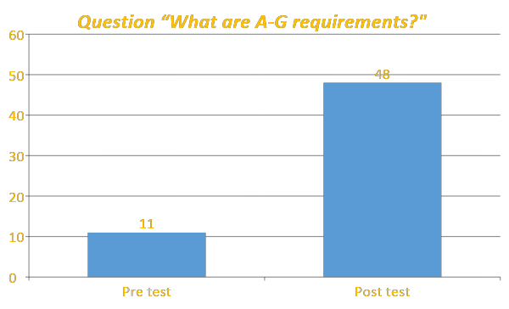
Knowledge: # of Students who Knew A-G Requirements
Notes:
pedro

Slide 23
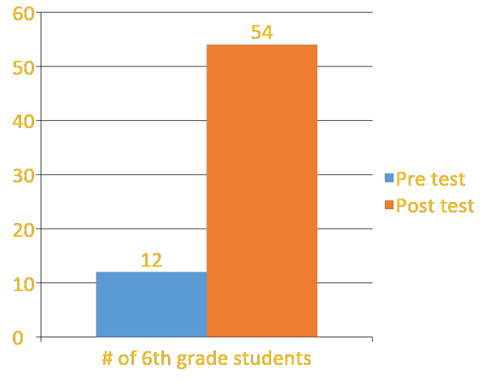
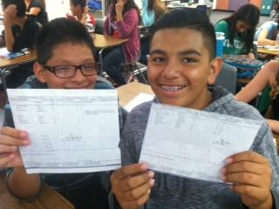
Skill: # of Students who Could Calculate a GPA from a Scenario
Question: “Calculate a student’s GPA”
Notes:
pedro

Slide 24
Outcome Data—The “Big Ticket” Items
Achievement | Achievement-Related
PSAT Scores | Attendance
Test/benchmarks scores | Discipline referrals
GPA | Parent involvement
Honors course completion | Homework completion
 | Course enrollment patterns

Slide 25
Action Plans
What are action plans used for?
What goes in an action plan?
Where to access an action plan?
Who to share an action plan with?

Slide 26
Core Curriculum Action Plan

Slide 27
Small Group Action Plan

Slide 28
Closing The Gap Action Plan

Slide 29
Developing SMART Goals

Slide 31
Now It’s Your Turn!

Slide 32
Program SMART Goals
Goal #1—Decrease in the % of 6th grade suspensions as compared to last year
Goal #2—Decrease in the # of 6th grade boys with 3 or more Fs between Q1 and Q2
Goal #3—Increase in % of ALL students who can calculate GPAs as measured by a pre/post test
Notes:
Erika

Slide 33
SMARTen up these Goals
Decrease K-8 discipline rates for the whole year
Improve perceptions of safety, connectedness and self-efficacy in 8th graders
Increase Foster Youth attendance
Improve college readiness rates for seniors

Slide 34
Presenting Your Data to Stakeholders
Staff presentation
National School Counselor Week
Results report
Newsletter
Website
School Site Council (SSC)
English Language Advisory Committee (ELAC)
School Counseling Advisory council

Slide 35
Collaborating with Administrators

Slide 36
Mrs. Traci Vaughan
Valley View Elementary School (Alvord Unified School District)
Arizona Middle School (Alvord Unified School District)
Norte Vista High School (Alvord Unified School District)
Wells Middle School (Alvord Unified School District)

Slide 37
Mr. Gil Compton
Director, College and Career Readiness, Riverside County Office of Education
Chaparral High School (Temecula Valley Unified School District)
Menifee Valley Middle School (Menifee Valley Union School District)

Slide 38
Q and A
What did communication with your school counselor consist of?
What expectations did you have for your school counselor(s)?
How did you support the role of school counselors as leaders?
What steps did you take to protect school counselor appropriate duties?
What did your school counselor evaluation look like?
What tools/resources helped you learn the role of the school counselor?

Slide 39
Looking Ahead
Tuesday, March 26
Assessing Your Program
Purpose
SWOT Analysis
School Counseling Program Assessment
Results Report
Planning for Next Year

Slide 40
Exit Ticket
Post-Test
https://tinyurl.com/NSCA2Posttest
Thank You!

