Slide 1
StudentTracker for High Schools:
Account Management
Presenter: Shawn Jen
©2015 National Student Clearinghouse. All rights reserved.

Slide 2
Agenda
Users vs. User Administrators
Adding a Web User
User Roles
View Diploma Record History
NSC Mission Statement
©2015 National Student Clearinghouse. All rights reserved.

Slide 3
Users vs. User Administrators
Users
User Administrators
Edit their own contact information
Change their own password
Same as Users, plus:
Add additional Users
Remove Users
Edit contact information for all contacts
Reset User passwords
Update User roles
©2015 National Student Clearinghouse. All rights reserved.
Notes:
End users have access to view account information once logged in at the landing page.
Users assigned with the User Administrator role have access to add colleagues to the account, remove user access, reset passwords for other users, and update user roles.

Slide 4
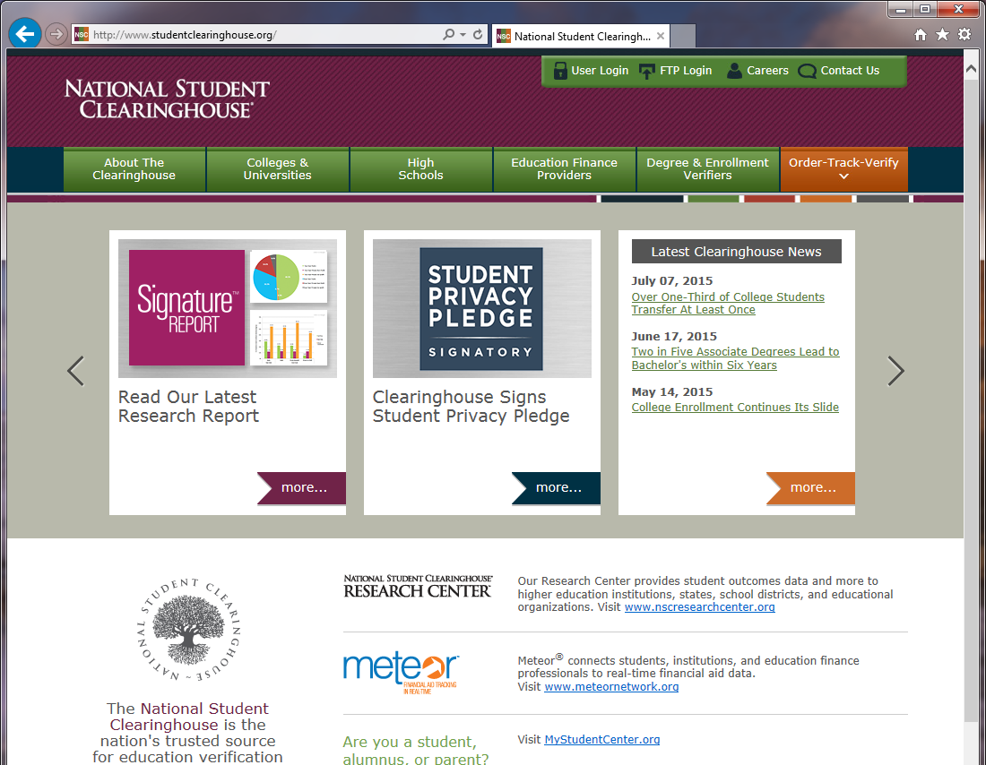
STHS Web Tool (User Login)
www.studentclearinghouse.org
©2015 National Student Clearinghouse. All rights reserved.
Notes:
New and existing users will log in at this screen after selecting the ‘User Login’ portal at www.studentclearinghouse.org.

Slide 5
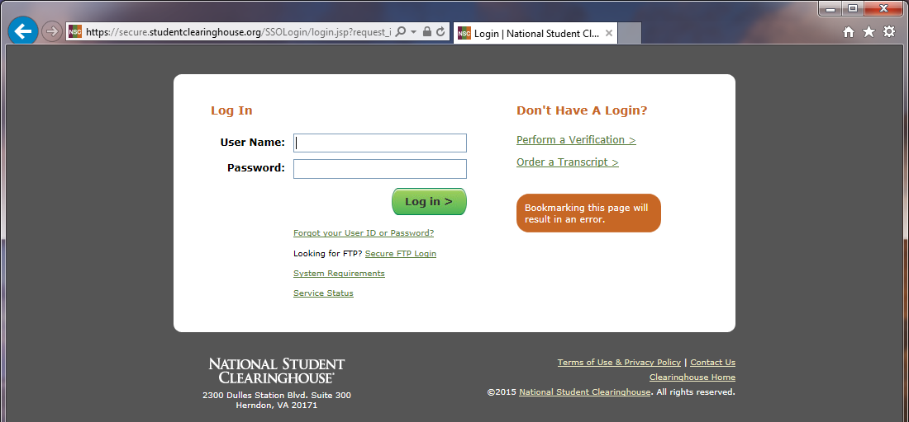
STHS Web Tool (User Login)
©2015 National Student Clearinghouse. All rights reserved.
Notes:
Existing users will be taken to the STHS landing page once logged in.
New users will be prompted to change the temporary password that was provided via email and select and answer challenge questions that can be used for Web UID recovery or the resetting password. Once logged in with a newly created password, new users will be taken to the STHS landing page.

Slide 6
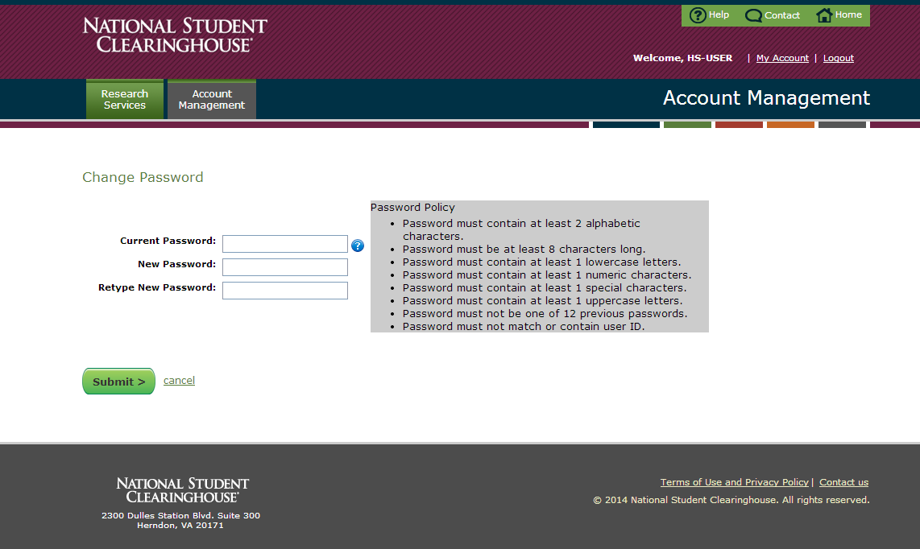
Create a Permanent Password
©2015 National Student Clearinghouse. All rights reserved.
Notes:
For new users and existing users who reset their password, this is the screen you will be directed to upon your initial log in to change the password. Password creation requirements are on the right.

Slide 7
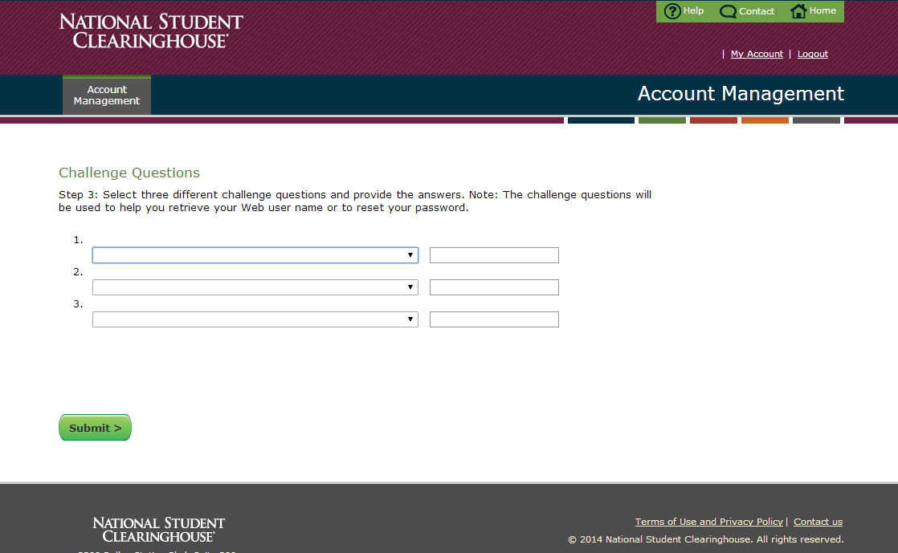
Create Challenge Questions
Notes:
For new users, this page provides options to select and answer challenge questions.
For security purposes, you will need to reset your password every 90 days.

Slide 8
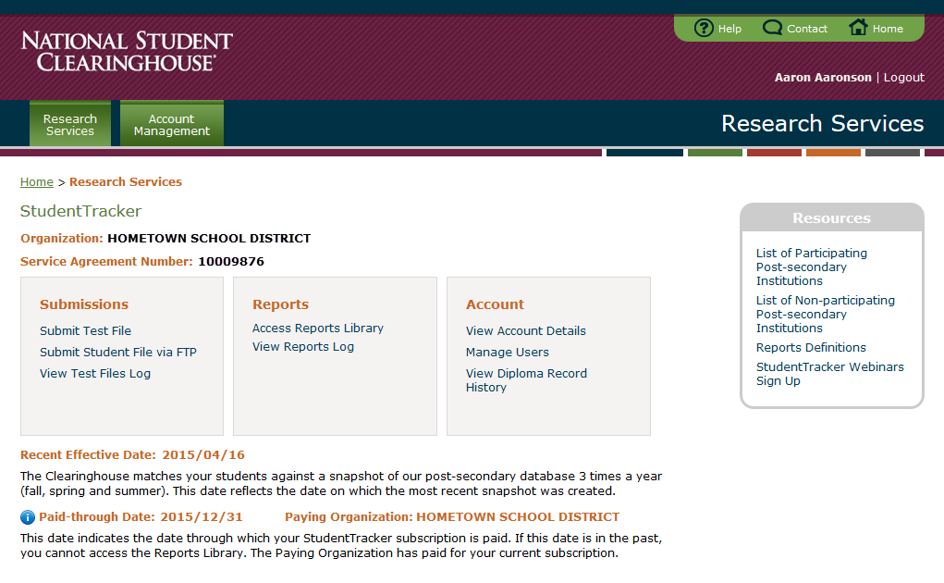
STHS Web Tool (User Login)
Notes:
Existing users and new users that have changed their password and logged in, will be brought to your account’s landing page. Account information including the Account Number and paid-through date are on this screen.
There are three sections highlighted in orange: Submissions, Reports, and the focus of this Webinar – Account for managing your account.
Clicking ‘View Account Details’ directs to your personal information (job title, work address, email address, etc).
This can be accessed from the User Login option at: http://www.studentclearinghouse.org/

Slide 9
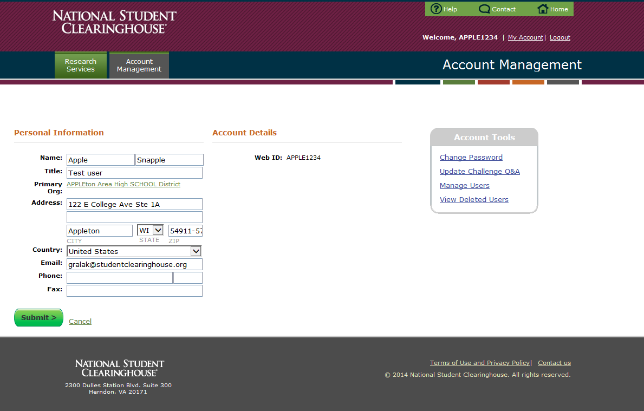
View Account Details
©2015 National Student Clearinghouse. All rights reserved.

Slide 10
STHS Web Tool (User Login)
Notes:
Contacts designated as User Administrators have access and authorization to manage users to the service. User Administrators can update the contact list and user access at the ‘Manage Users’ option in the Account section.
***Please note the User Administrator role should always be paired with the Service Administrator role.
This can be accessed from the User Login option at: http://www.studentclearinghouse.org/

Slide 11
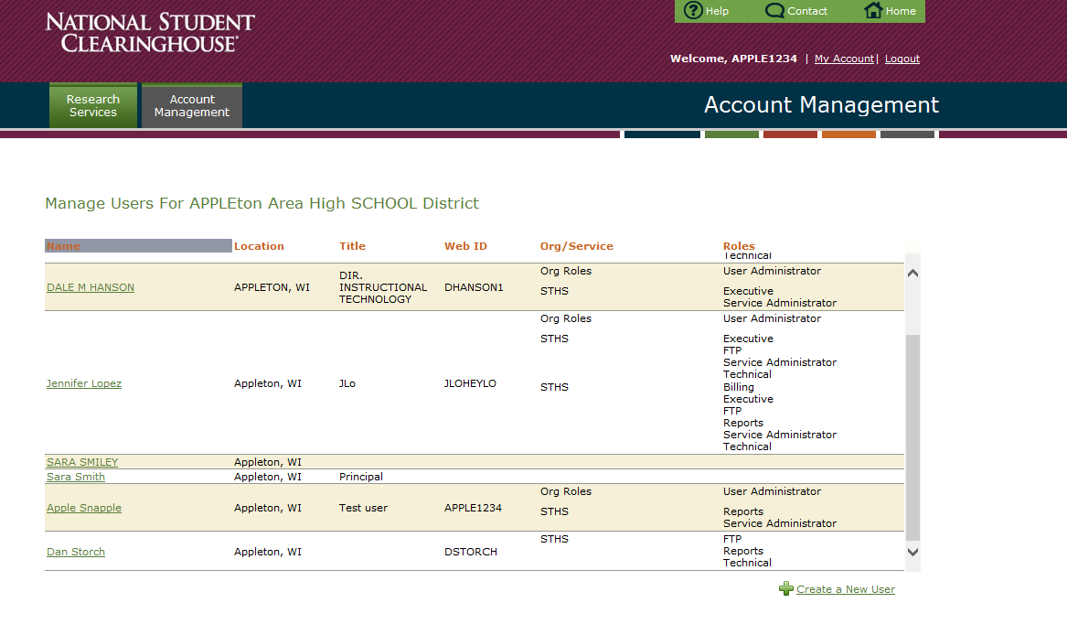
Manage Users
Notes:
At the ‘Manage Users’ link, User Administrators can perform account management functions including adding and removing access, resetting passwords, and locking accounts.
***Please note the User Administrator role should always be paired with the Service Administrator role.
This can be accessed from the User Login option at: http://www.studentclearinghouse.org/

Slide 12
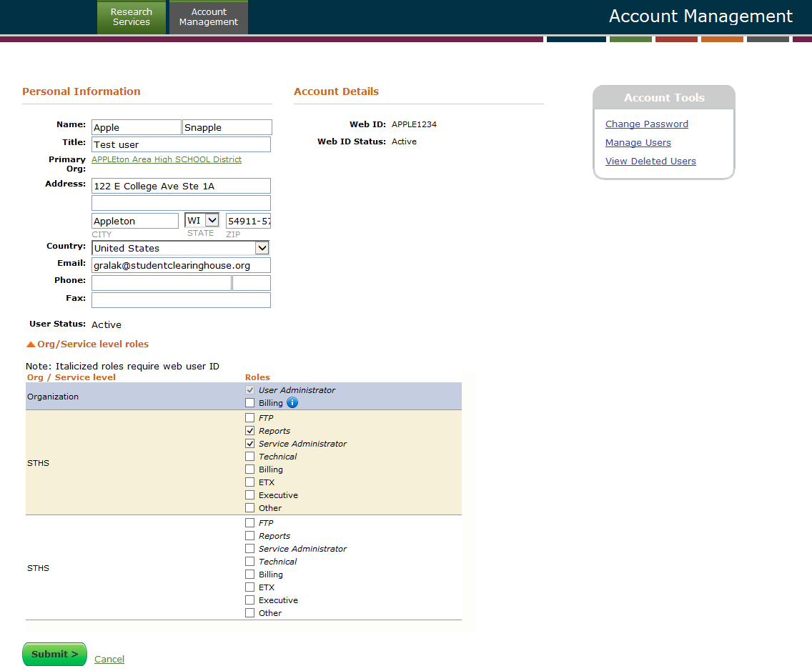
Manage Users
©2015 National Student Clearinghouse. All rights reserved.

Slide 13
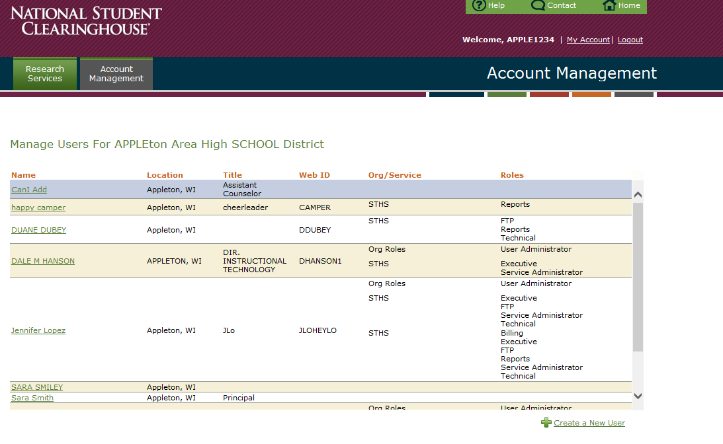
Add a New User
Notes:
User Administrators can create a new user to the account by selecting the ‘Create a New User’ option in the bottom right.
This can be accessed from the User Login option at: http://www.studentclearinghouse.org/

Slide 14
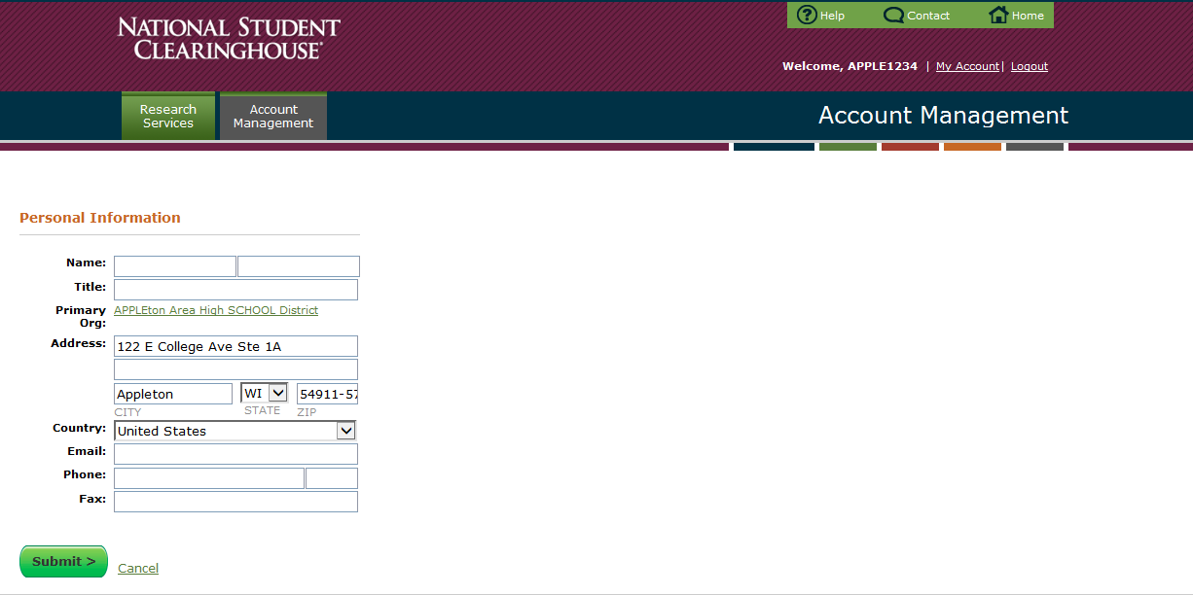
Add a New User
Populate this information
©2015 National Student Clearinghouse. All rights reserved.
Notes:
When all of the colleague’s contact information has been entered click ‘Submit.’
This can be accessed from the User Login option at: http://www.studentclearinghouse.org/

Slide 15
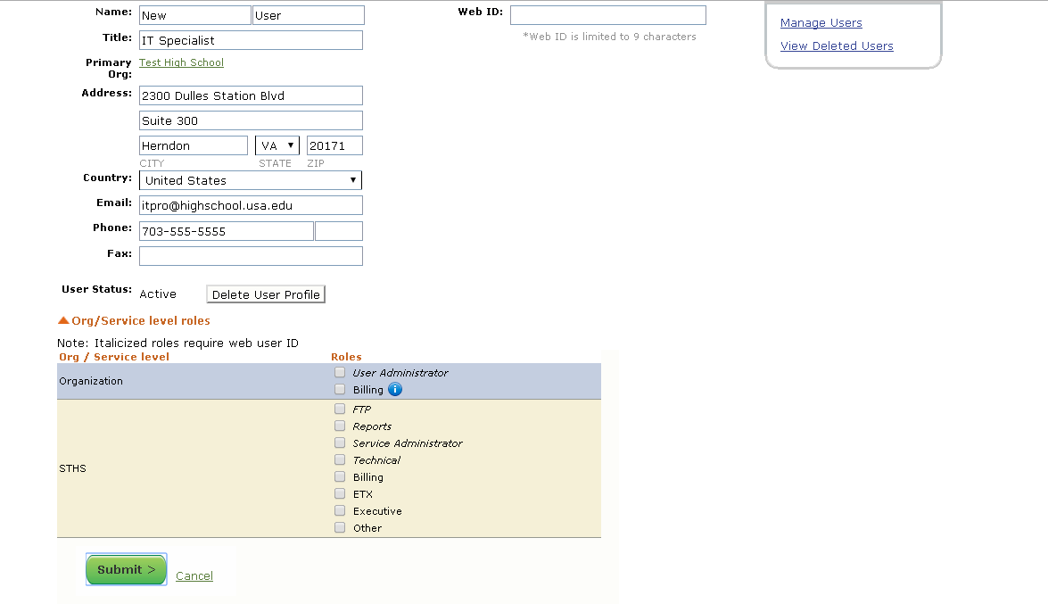
Add a New User – Assign Roles
User Roles Requiring a Web ID
User Administrator – Manages user account setup and access privileges
FTP – Requires access to the FTP account to upload files and/or download reports
Reports – Requests reports via the Reports Library
Service Administrator – Always pair with User Administrator
Technical – Creates, tests, and uploads files
©2015 National Student Clearinghouse. All rights reserved.
Notes:
User Administrators can assign access and roles on each contact’s profile page here. There are 2 role types: those that require a Web ID and those that do not require a Web ID. Users can be assigned multiple roles.
Roles that do require Web ID (All listed in Italics):
FTP – contacts who have access to FTP to upload files and/or download reports.
Reports – has access to request reports on the Web Tool that will be made available in FTP.
Technical – creates and/or submits data and has access to run test files through the
User Administrator combined with the Service Administrator role provides access to manage user account set-up and access privileges.
***Please note the User Administrator role should always be paired with the Service Administrator role.
A Web ID must can created for any role assigned that requires a personal Web login.
Once the needed roles are assigned for the user and a Web ID is entered, clicking ‘Submit’ will save the information and prompts our system to send an email from accounts@studentclearinghouse.org to the user with Web access information.

Slide 16
Add a New User – Assign Roles
User Roles Without Web Access
Billing – Receives STHS invoices (only 1 user)
ETX – Uses the High School Electronic Transcript Exchange service
Executive – Manages the contractual relationship with the Clearinghouse
Other – Responsible for tasks outside the scope of the aforementioned options
©2015 National Student Clearinghouse. All rights reserved.
Notes:
Roles that do not require Web ID:
Billing - is the Clearinghouse’s contact for invoices associated with the account
ETX – the Clearinghouse’s contact for your account for the High School Electronic Transcript Exchange service if your organization subscribes.
Executive – your organization’s contact for the contractual relationship with the Clearinghouse
Other - designates any other relationship that falls outside the score of the above options but is still an individual that should be included on the account’s contact list.

Slide 17
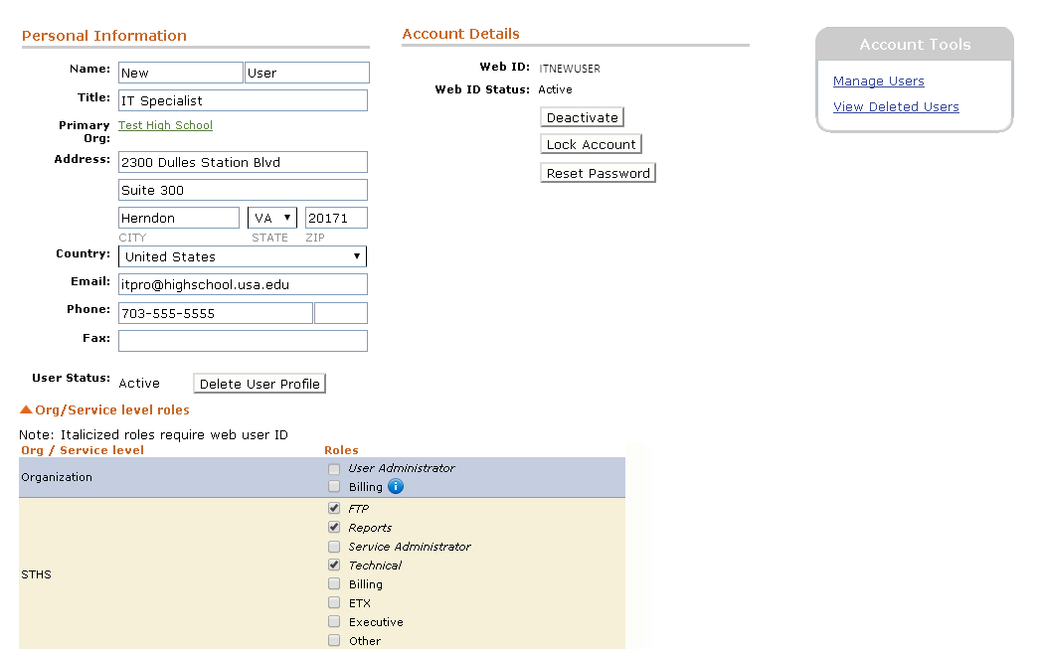
Add a New User – Web ID Active
Notes:
After a User Administrator selects ‘Submit’ the assigned Web ID and Web ID status of ‘active’ will be displayed.
Selecting ‘Manage Users’ will direct back to the list of current account users.

Slide 18
Manage Users
Notes:
Here you can see all of the users that are currently on the account.
Selecting the ‘Research Services’ tab will direct back to the Home Page once again.

Slide 19
STHS Web Tool (User Login)
Reports Role
Notes:
‘View Diploma History’ provides a tally of the total students stored from Graduates file submissions for the past 8 graduated classes and for each high school, if there are more than one, on your account.

Slide 20
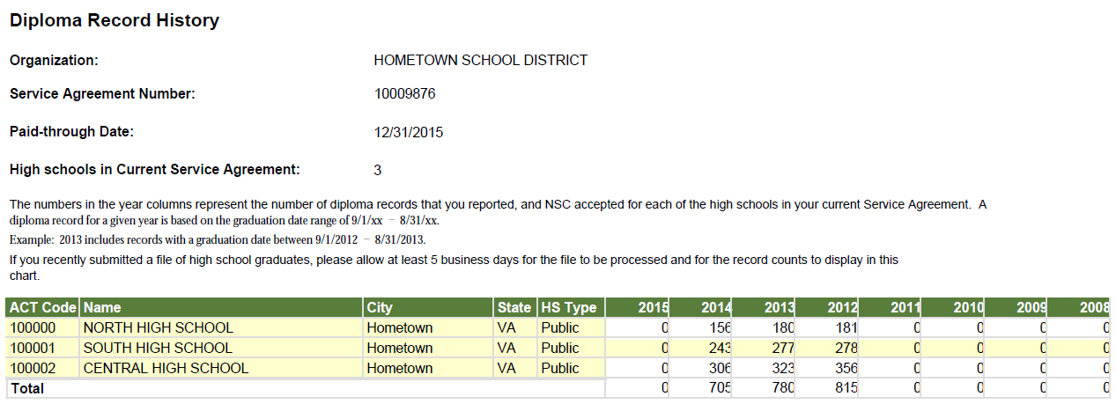
View Diploma Record History
Notes:
This screen provides a summary of the high school graduate records you have submitted to NSC. The chart breaks out the records out by academic year and by individual high school.
The chart will display the most recent 8 academic years of data that you have submitted.
This is helpful because you can (1)quickly identify how many records you have sent to us through the years, (2) ensure that you sent the correct number of students for each school for each year, (3) see the aggregate numbers for each class and school that will be included in your STHS reports.

Slide 21
Getting Started: Review Your Pending Queue
Questions?
©2015 National Student Clearinghouse. All rights reserved.

Slide 22
Contact Information
Email | StudentTracker@studentclearinghouse.org
Phone | 703-742-4211
Website | www.studentclearinghouse.org/highschools
Webinars | www.studentclearinghouse.info/webinars
If you are interested in the National Student Clearinghouse Mission Statement, please continue to the following slide.
©2015 National Student Clearinghouse. All rights reserved.

Slide 23
NSC Mission Statement
To serve the education community by facilitating the exchange and understanding of student enrollment, performance and related information.
©2015 National Student Clearinghouse. All rights reserved.

