Slide 1
Generating and Understanding Your Reports Angela Tobin
StudentTracker

Slide 2
Agenda
Graduate Files
Reports timeline
Understanding your reports
StudentTracker Resources
NSC Mission Statement
Notes:
Before we get started, I’d like to review what we will cover in this presentation.
First, we will go over Graduate Files: what they are, and how they fit into the StudentTracker for High Schools process.
Then, we’ll show you the reports timeline (when reports are automatically generated).
After that, we’ll quickly go over how to interpret the reports we return to you.
Finally, we will have time for questions at the end, along with an overview of the National Student Clearinghouse and the Research Center.

Slide 3
Graduate Files
Include entire class(es) of graduates.
1 file per diploma year, or 1 file for all graduates (8 years).
Only graduates should be included.
All information submitted is stored in our database.
Notes:
A Graduate File is a list of students who have graduated from your school(s).
We generally receive 1 Graduate File per diploma year, but you do have the option to submit 1 large file for all of your historical graduates (8 year limit).
All information you enter in a Graduate File is stored in our database.
Updated information on prior graduates are available every Spring, Summer, and Fall.

Slide 4
Batch
Class of
2012
Class of
2013
Class of
2014
Notes:
Once an effective date has been set, we will merge the most recent 8 years of your stored data into a batch. Please note, if you have submitted more than 8 years of data, the batch will still only contain the most recent 8 years.
This information will be matched against our post-secondary enrollment database. Your reports will contain information on the students included in the graduation years included in your batch. You will receive an e-mail notification from your FTP account when your reports are ready.

Slide 5
Established Process for Fall PSE Information
July to October
High Schools send in Graduate files
Mid-November
NSC sets the effective date based on postsecondary enrollment
Late-November
StudentTracker matching commences and report generation begins
Notes:
Generally around July of each year, we begin to receive your Graduates files with your most recent graduates (.i.e., 2014). Each November, we closely monitor our intake of postsecondary enrollment information for the fall term. Once we have attained a comprehensive picture of Fall 2014 postsecondary data, we will set the effective date for your high school reports. Generally, this happens around the middle of November.
At that point in time, we will begin to match the most recent 8 years of your high school graduate data from the Graduates files you’ve sent in to us. Once your students have been matched, your reports are generated and sent to your FTP account.

Slide 6
Established Process for Spring and Summer PSE Information
Spring
The Spring effective date will be set by the Clearinghouse around mid-April each year.
Summer
The Summer effective date will be set by the Clearinghouse around mid-August each year.
Note: Spring and Summer reports are NOT auto-generated.
Notes:
The Spring reports are usually available around mid-April and the Summer reports are usually available around mid-August of each year. Please note: The Spring and Summer reports are not auto-generated. Report contacts on each account will receive an email letting them know that the Clearinghouse has a new effective date set for the Spring and Summer. To receive updated reports during these seasons the user will need to select reports to be generated from our Reports Library feature.
To access the Reports Library, please log in under the User Login option at: http://www.studentclearinghouse.org/

Slide 7
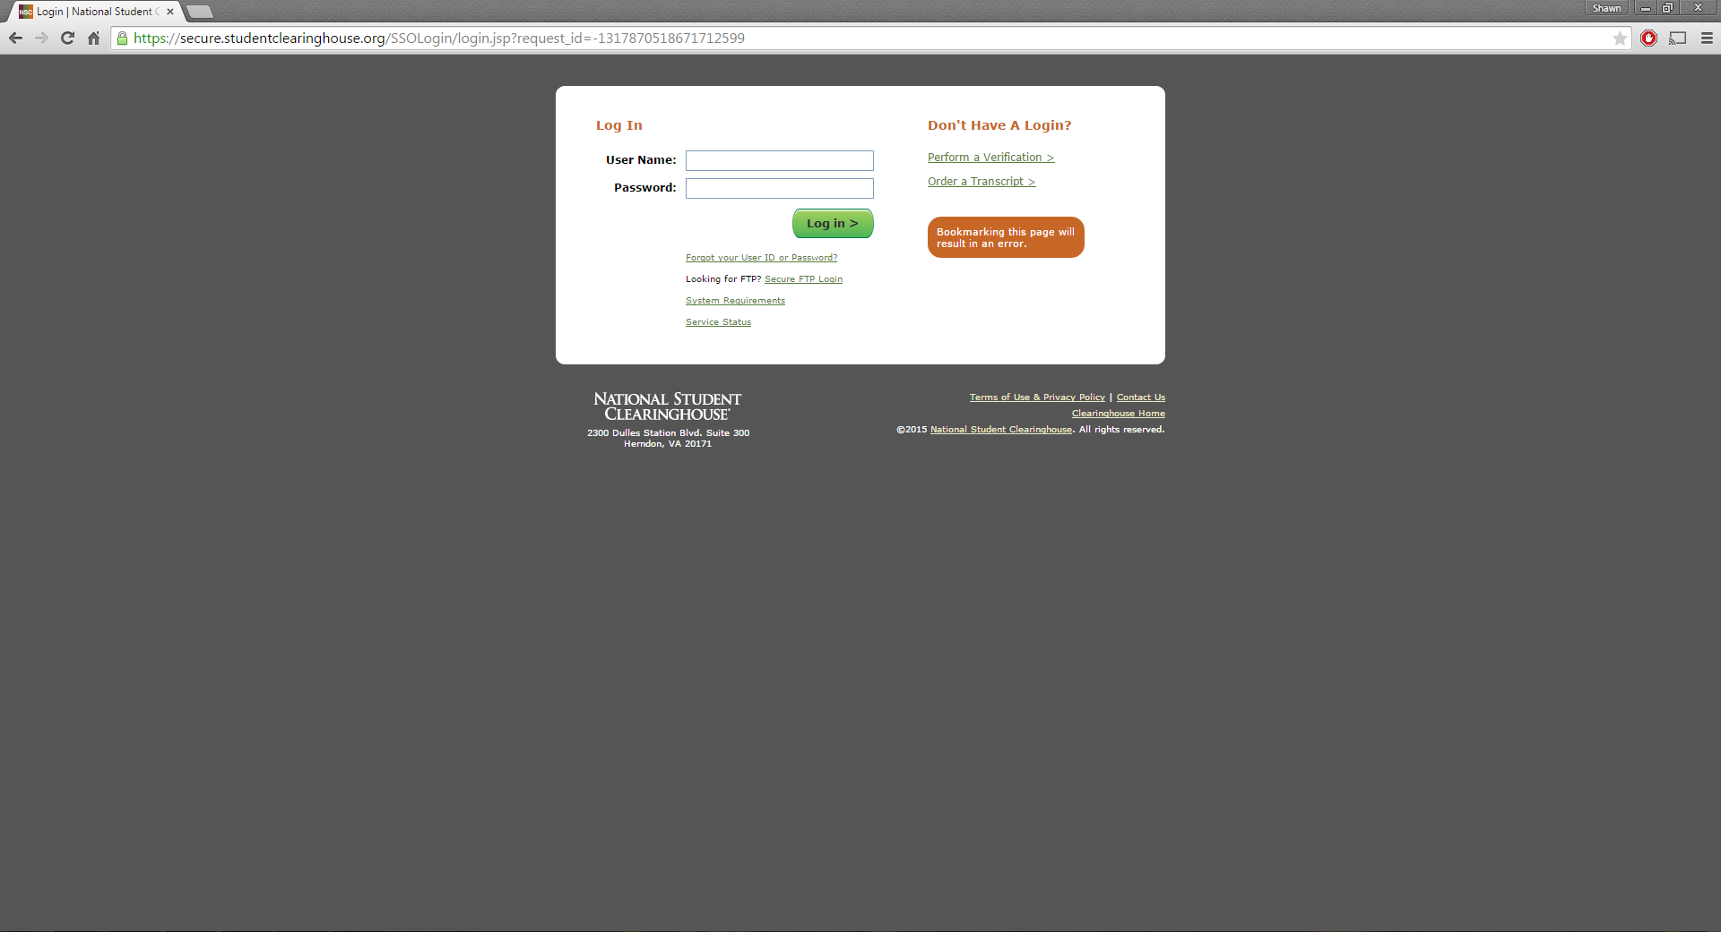
User Login
Notes:
To gain access to the Reports Library feature, the user will need to login using their web account. Here is the STHS login page.
This can be accessed from the User Login option at: http://www.studentclearinghouse.org/

Slide 8
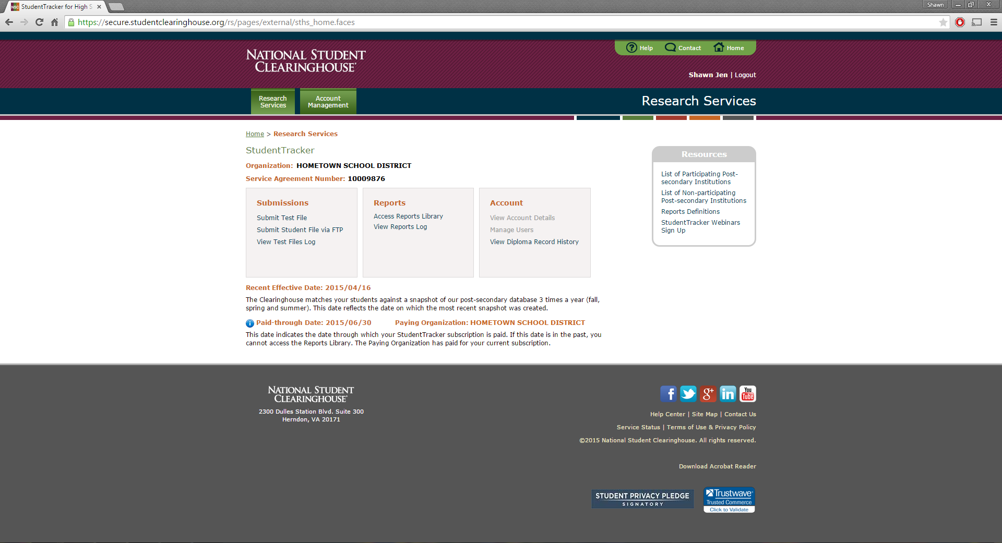
Web ID Landing Page
Notes:
Once you’ve logged in, you will be directed to our landing page. Under the Reports section, it displays two links: Access Reports Library and View Reports Log.
The View Reports Log will provide an audit of all the reports the Clearinghouse has created for your account.
The other link is the Access Reports Library.

Slide 9
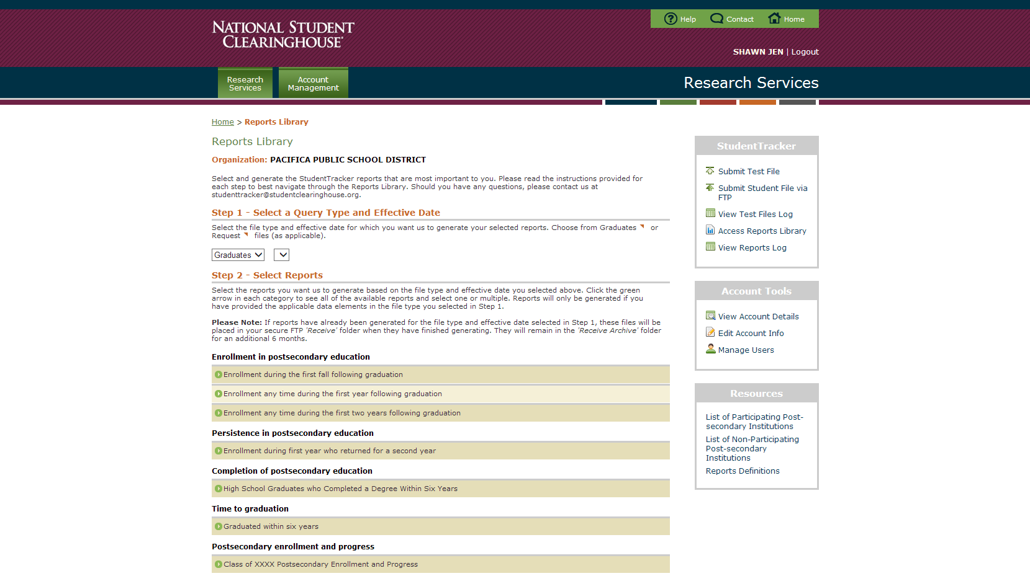
Reports Library
Effective 08/15/2014 ˅
Notes:
Once you have selected the Access Reports Library, you will be taken to the following page.
You will notice there are specific steps you will need to complete before your reports can be generated.
You will need to confirm the batch for your report.
A batch is defined as a set of data sent by you to the clearinghouse for matching (Graduate or Request files). This drop-down menu will provide you with the ability to select different batches/effective dates in case you need to run reports on past batches or cohorts. By default, this will be set to the most recent set of data that you sent to us.

Slide 10
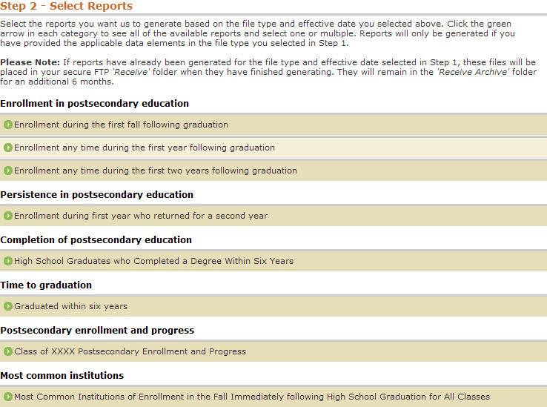
Available Reports
Notes:
Here we see the Enrollment in Postsecondary education report portfolio.
This gives you the flexibility of choosing the reports that are the most important to you. For each of the subsets of reports, you have the option of picking from the following:
Enrollment during the first fall following graduation.
Enrollment any time during the first year following graduation.
Enrollment any time during the first two years following graduation.
Link to report definitions: https://secure.studentclearinghouse.org/rs/imgs/ReportDefinitions.pdf

Slide 11
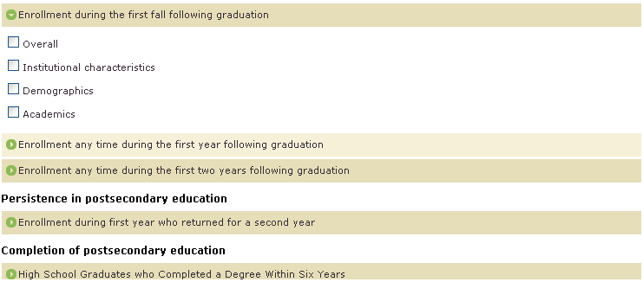
Selecting Specific Reports
Notes:
Within each report portfolio, you have additional breakout options to further analyze the data. Those options include:
Overall
Institutional characteristics
Demographics
Academics
The overall report will provide how the overall class performed during this time period.
The institutional characteristics provides what types of institutions your students attended, whether they be 2 year of 4 year, instate or out-of-state, and public or private.
Demographic reports are specific to those users that are providing us with the additional data elements related to race/ethnicity, gender, and economic disadvantaged status.
Academic reports provide detailed information on your students who have scores available for 8th grade math/reading assessments and completion of specific math semesters.
Link to report definitions: https://secure.studentclearinghouse.org/rs/imgs/ReportDefinitions.pdf

Slide 12
Most Common Institutions
Notes:
An additional report that our secondary education organizations find most helpful is the “Most Common Institutions” list.
This list will provide you with an overall summary of the most common postsecondary institutions that your students have attended.
Link to report definitions: https://secure.studentclearinghouse.org/rs/imgs/ReportDefinitions.pdf

Slide 13
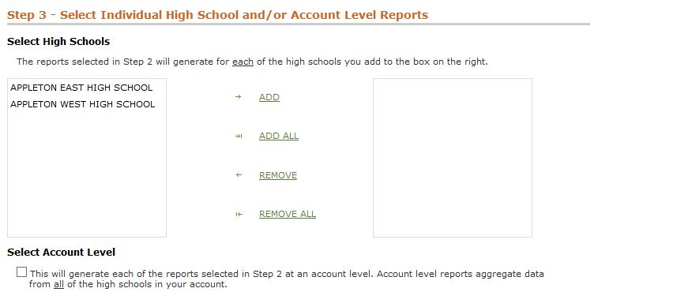
Selecting Your School(s)
Notes:
Once we have selected the reports we want to generate, we move on to the next step: Selecting the schools that you would like reports generated for. If you are a larger school district you may want to make sure you include all the high schools listed on your account. You can do this by selecting the ADD ALL link. The user has the option of clicking the ‘Select Account Level’ feature. This will generate reports at the account level.

Slide 14
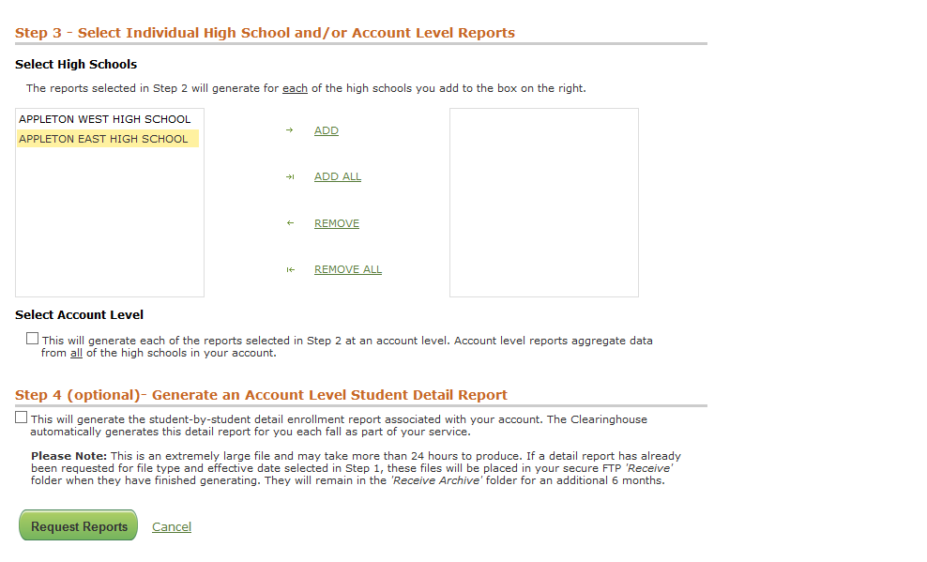
Selecting Your School(s)
Notes:
If you only want to have reports generated for individual high schools on your account, click the ‘ADD’ link. After clicking the ‘ADD’ link the high school should display on the right side. In order to avoid producing an account level report for the selected reports, DO NOT select the “Select Account Level” box.
You also have the option of selecting the Student Detail level report. Checking this box will have our system generate the Student Detail Level Report of all the students in your selected batch.
Once you have selected the reports you would like to generate, click the ‘Request Reports’ link.

Slide 15
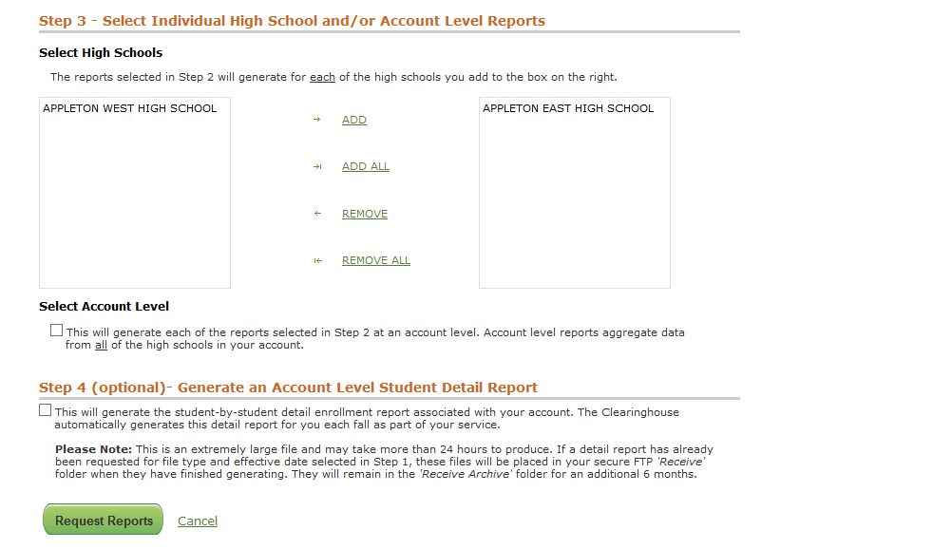
Generating Your Reports

Slide 16
!!! CONGRATULATIONS !!!

Slide 17
Reviewing Your Reports
Aggregate Reports
Student Detail Report
Reports Appendix
Notes:
We will now go over a very brief overview of what types of reports you can expect to see. We’ll examine specific examples of the aggregate reports, the student detail report, and the reports appendix.
Link to report definitions: https://secure.studentclearinghouse.org/rs/imgs/ReportDefinitions.pdf

Slide 18
Aggregate Report
First Fall
First Year
First 2 Years
Retention
Graduation (6-Year Rate)
Time to Graduation
Enrollment and Progress per class
Notes:
Let’s start our overview by the types of aggregate reports offered.
We have:
First Fall
First Year
First Two Years
Retention
6-Year Graduation Rate
Time to Graduation
And Enrollment and Progress Per Class
Link to report definitions: https://secure.studentclearinghouse.org/rs/imgs/ReportDefinitions.pdf

Slide 19
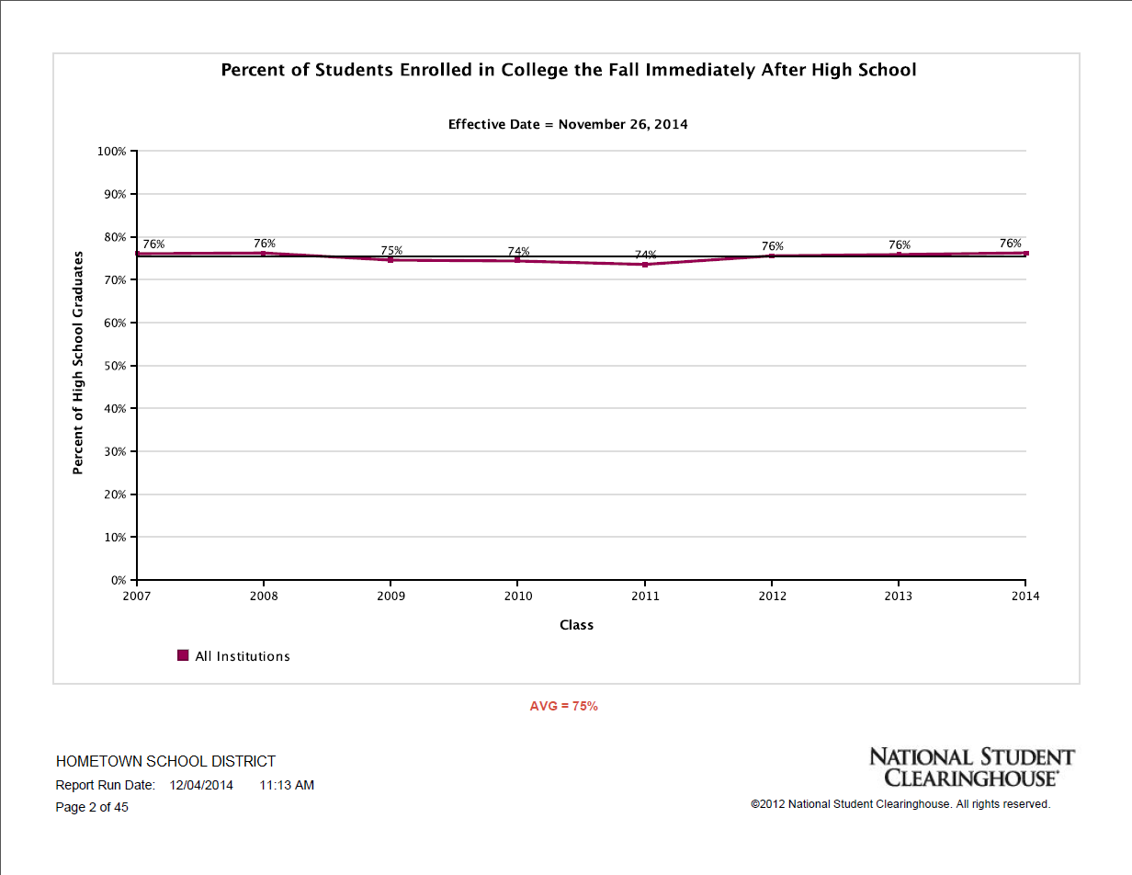
Sample Aggregate Report
Notes:
This report is called PERCENT OF STUDENTS ENROLLED IN COLLEGE THE FALL IMMEDIATELY AFTER HIGH SCHOOL. This particular example takes the percentage of graduates of each graduating class (Class of 2007 through Class of 2014) that enrolls in college the fall semester immediately after graduation and aggregates the data into a line graph.
At the bottom of this chart, the report provides an average statistic that represents the outcome across all 8 graduating classes. In this example, an average of 75% of high school graduates from the requesting school attended college immediately following high school graduation.
Reports Definitions: https://secure.studentclearinghouse.org/rs/imgs/ReportDefinitions.pdf

Slide 20
Detail Report
Student-level enrollment and graduation data by term
Notes:
The student level detail information provides individualized data on each of the students you have submitted to us. The information includes graduation and enrollment data, and is broken out by term.
Link to report definitions: https://secure.studentclearinghouse.org/rs/imgs/ReportDefinitions.pdf

Slide 21
Sample Detail Report
Notes:
In this example of the student detail report, we are looking at 3 specific students: Susan Smart, Nancy Smith, and Frank Jones.
If we focus on Susan Smart, we see that she started at the local community college on June 23rd of 2002 . For each reported enrollment, there is a separate line listing the dates of enrollment and the enrollment status. In 2004, Susan transferred to a private institute . She was enrolled half time for the first three enrollment reportings. For the second three, she was enrolled full time, and graduated in 2007 with a Bachelors in History.
Nancy Smith enrolled in a private institute in September of 2003 as a full time student. We can also see that in the same semester, she withdrew, and there is no additional reporting information available for her.
Frank Jones has an N associated with the Record Found column. This means one of two things: we were unable to find any information on Frank Jones, or this student had a FERPA block that prevents his information from being viewable by other schools.
Link to report definitions: https://secure.studentclearinghouse.org/rs/imgs/ReportDefinitions.pdf

Slide 22
Reports Appendix
Notes:
One of the most useful resources you will find when working with your reports is the Report Definitions chart, which is available on your Web ID landing page. Clicking the Reports Definition link will take you to a comprehensive list of basic reports we offer, along with their definitions.
In addition, you have a list of non-participating post-secondary institutions (schools that DO NOT submit enrollment data to us), and a list of participating post-secondary institutions (schools that DO submit enrollment data to us).
New for this year, you may now access the STHS Webinar Sign-Up page via the link underneath the Reports Definition link.
Reports Definitions: https://secure.studentclearinghouse.org/rs/imgs/ReportDefinitions.pdf

Slide 23
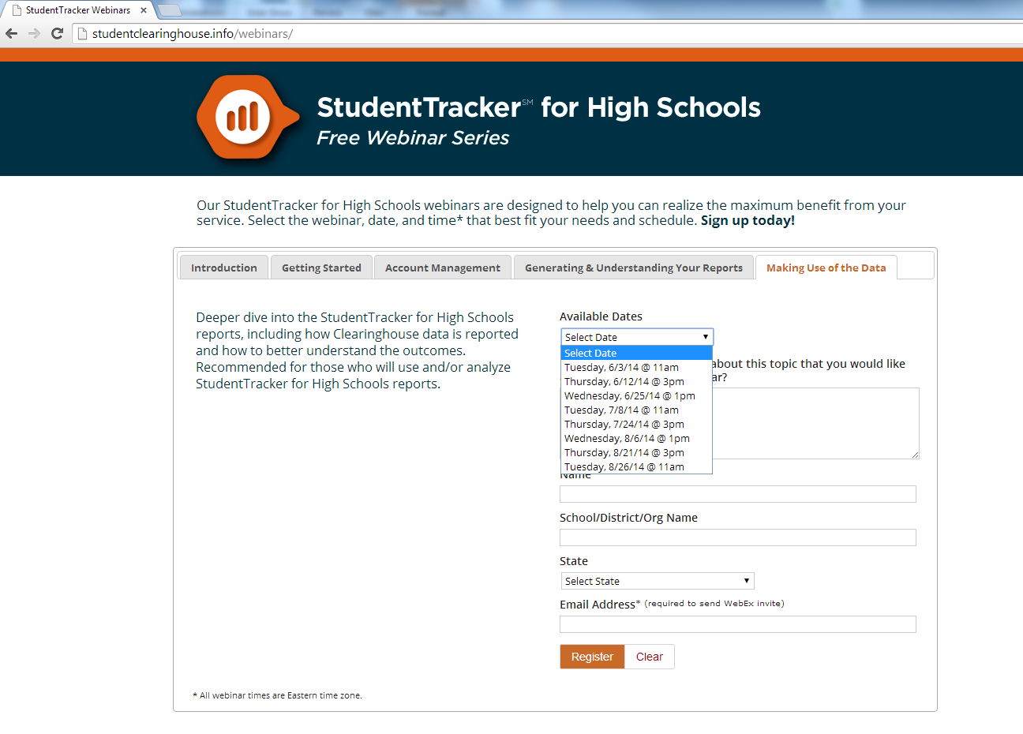
Making Use of Data
http://studentclearinghouse.info/webinars/
Notes:
If your school is interested in attending our ‘Making Use of the Data’ webinar, please sign up using our ST for High Schools webinar series.
www.studentclearinghouse.info/webinars

Slide 24
Questions?

Slide 25
THANK YOU!

Slide 26
Contact Information
E-Mail | StudentTracker@studentclearinghouse.org
Phone | 703-742-4211
Website | www.studentclearinghouse.org/highschools
Webinars | www.studentclearinghouse.info/webinars
If you are interested in learning more about the National Student Clearinghouse mission statement please continue to the following slide. If you have any questions please contact us.
Notes:
Please contact us if you have any questions or concerns.

Slide 27
NSC Mission Statement
To serve the education community by facilitating the exchange and understanding of student enrollment, performance and related information.
Notes:
NSC’s Mission: The National Student Clearinghouse (NSC) was formed in 1993 as a non-profit organization to facilitate a safe and secure data exchange for all aspects of the education arena. It performs compliance reporting for 98% of colleges in the country. In addition to that, the Clearinghouse uses the data it receives for degree verification, institutional research support and transcript services. Through this, the Clearinghouse saves schools hundreds of millions of dollars in expenses.

