Slide 1
StudentTracker for High Schools:
Getting Started
Presenter: Colin Hutchison,
StudentTracker Client Coordinator
©2015 National Student Clearinghouse. All rights reserved.

Slide 2
Agenda
StudentTracker
Creating a Graduate File
Web ID vs. Secure FTP
Testing your File
Uploading via FTP
NSC Mission Statement
©2015 National Student Clearinghouse. All rights reserved.

Slide 3
What is StudentTracker?
Reliable, non-survey-based reports
Enrollment
+ Persistence
+ Completion
Education Preparedness
Most commonly attended post-secondary institutions
Academic and Demographic identifiers
Post-Secondary
Case Studies
Testimonials
©2015 National Student Clearinghouse. All rights reserved.
Notes:
StudentTracker provides reliable, non-survey-based reports illustrating the postsecondary enrollment, persistence, and completion of your former graduates or students.
Helps you better understand how well your academic programs are preparing former graduates for postsecondary education.
Educates your staff on the schools most graduates are attending after high school graduation.
Illustrates the postsecondary success of your former graduates based on various demographic characteristics and academic histories.
If you would like to see how other high schools, districts, or state agencies have used StudentTracker for High Schools, or if you are interested in what StudentTracker for High Schools users are saying about the service, these two links will direct you to the Case Studies and Testimonials that we have published on our website.

Slide 4
Completed Graduate File (Excel)
HEADER = The first row in the file.
STUDENT DETAIL ROWS = Between the Header and Trailer.
TRAILER = The last row in the file.
ALWAYS REMEMBER:
- Column A text (PH3, PD3, PT3) always capitalized.
- All dates are in YYYYMMDD format.
©2015 National Student Clearinghouse. All rights reserved.
Notes:
Example of a completed StudentTracker Graduate File created using Excel. All fields have been entered to show how the final layout would look in Excel.
The file is divided into three sections:
Header Row – RED
Student Detail Rows – PURPLE
Trailer Row – GREEN
Link to Graduate File Layout Guide: http://sths.helpdocsonline.com/#submit_a_graduates_file

Slide 5
Header Row
- PH3 is always capitalized.
- All dates are in YYYYMMDD format.
©2015 National Student Clearinghouse. All rights reserved.
Notes:
The Header Row is independent from the Student Detail Rows. The file does not require column headings as the Header Row is used internally to identify who sent the file and what diploma range the file contains.
PH3 (Cell A1) indicates to our system that the row it is in is the Header Row. PH3 must be capitalized, and it will only need to show up once in the file.
As a reminder, all dates must be in YYYYMMDD format.
Link to Graduate File Layout Guide: http://sths.helpdocsonline.com/#submit_a_graduates_file

Slide 6
Student Detail Rows
- PD3 is always capitalized.
- All dates are in YYYYMMDD format.
- Column J is the Student ID field. This is an optional field; it is there to help you better identify your students in the detail report. Our system does not match using Student IDs.
©2015 National Student Clearinghouse. All rights reserved.
Notes:
The section highlighted is the graduate information you will submit to us so that we may generate your StudentTracker reports. Again, this shows that both the required information as well as additional data elements have been entered.
Link to Graduate File Layout Guide: http://sths.helpdocsonline.com/#submit_a_graduates_file

Slide 7
Required Data Elements
First Name
Last Name
Date of Birth
Diploma Type
Graduation Date
FERPA Block
High School Name
ACT Code
ED (in Column AB)
©2015 National Student Clearinghouse. All rights reserved.
Notes:
The information listed in this slide is what is required for all students in your StudentTracker Graduate File.
If any of the sections are blank or formatted incorrectly, it may result in you receiving inaccurate reports.
Link to Graduate File Layout Guide: http://sths.helpdocsonline.com/#submit_a_graduates_file
Please note that in the Graduate File Layout Guide, the required information shown in this slide is denoted with an *.

Slide 8
Required Data Elements
©2015 National Student Clearinghouse. All rights reserved.
Notes:
The sections highlighted show where the required graduate information is located in a Graduate File. Again, all of these fields must be filled in correctly to ensure that you receive accurate reports.
Note:
PD3 must be entered in Column A for each student. Please note that PD3 is capitalized.
The SSN field (Column B) must not be left blank. If no SSN is submitted, enter NO SSN.
Link to Graduate File Layout Guide: http://sths.helpdocsonline.com/#submit_a_graduates_file
Please note that in the Graduate File Layout Guide, the required information shown in this slide is denoted with an *.

Slide 9
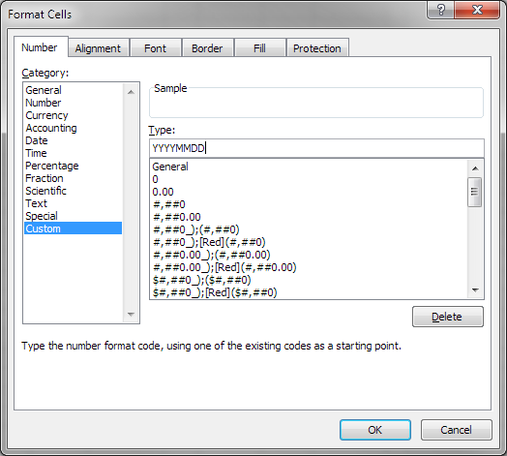
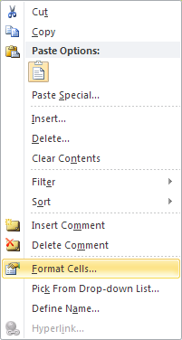
Proper Date Format
©2015 National Student Clearinghouse. All rights reserved.
Notes:
To format dates in your file properly (in YYYYMMDD format)…
Highlight the column or cell of the date(s) to be formatted.
Right click and select FORMAT CELLS.
When the Format Cells window appears, select CUSTOM under the CATEGORY field.
Then in the TYPE box, delete/remove the word General and replace it with YYYYMMDD.
Select OK and the dates you highlighted will be properly formatted in YYYYMMDD format.
Link to Graduate File Layout Guide: http://sths.helpdocsonline.com/#submit_a_graduates_file

Slide 10
Diploma Types
Endorsed/Advanced Diploma
General Education Development (GED) Credential
High School Equivalency Credential (other than GED)
International Baccalaureate
Modified Diploma
Regular Diploma
Vocational Certificate
Other
©2015 National Student Clearinghouse. All rights reserved.
Notes:
We strongly encourage you to use one of the diploma types listed here that best describes your graduate. By using a diploma type from this list, we maintain consistent diploma information across all service participates. This will allow for additional opportunities to provide you with more comprehensive assessments and benchmarking reports.
The diploma types we use are defined by IPEDS.

Slide 11
Additional Data Elements
Academic Data
Demographic Data
8th Grade State Assessment Result, Math; ELA/Reading
High School Assessment Result, Math; ELA/Reading
Number of Math Semesters Completed
Dual Enrollment Indicator
Gender
Ethnicity
Economically Disadvantaged Indicator
English as a Second Language
©2015 National Student Clearinghouse. All rights reserved.
Notes:
The additional data element section is optional. None of these fields need to be filled out unless you decide to submit the information. If you refrain from submitting this information, simply leave these fields blank; nothing else has to be entered in these fields. Submitting N/A or anything else will result in a delay on having your file processed (our system will interpret N/A or anything else as data errors).
If the additional data elements are not submitted, the demographic and academic reports you receive back will be blank. Please keep this in mind as you make your decision on whether or not to provide this information.
Link to Graduate File Layout Guide: http://sths.helpdocsonline.com/#submit_a_graduates_file

Slide 12
Additional Data Elements
©2015 National Student Clearinghouse. All rights reserved.
Notes:
The sections highlighted show where the additional data elements are located in a Graduate File. Again, all of these fields are optional.
Link to Graduate File Layout Guide: http://sths.helpdocsonline.com/#submit_a_graduates_file

Slide 13
Ethnicity Codes
AM | American Indian / Native Alaskan
AS | Asian
BL | Black / African American
HI | Hispanic / Latino
PI | Pacific Islander / Native Hawaiian
WH | White
MU | 2 or more races
©2015 National Student Clearinghouse. All rights reserved.
Notes:
When filling out the Ethnicity field, the seven codes listed above are the only ones that will be accepted by our system. Please use the codes provided or our system will interpret invalid codes as data errors, causing a delay in processing your file.
Link to Graduate File Layout Guide: http://sths.helpdocsonline.com/#submit_a_graduates_file

Slide 14
Assessment Scores
1 | Does not meet standards
2 | Proficient / Meets standards
3 | Advanced / Exceeds standards
©2015 National Student Clearinghouse. All rights reserved.
Notes:
When filling out Assessment Scores, the numbers listed above are the only ones that will be accepted by our system. Please use the numbers provided or our system will interpret invalid numbers as data errors, causing a delay in processing your file.
Link to Graduate File Layout Guide: http://sths.helpdocsonline.com/#submit_a_graduates_file

Slide 15
Program Code
©2015 National Student Clearinghouse. All rights reserved.
Notes:
You can add additional customization to your student detail report by using the program code column (Column AA). The information populated in the program code column of the file will be returned in the reports. This will allow you the ability to track specific cohorts of students if necessary. Please note that this is an optional field.
If you would like more information on this field, please feel free to contact us.
Link to Graduate File Layout Guide: http://sths.helpdocsonline.com/#submit_a_graduates_file

Slide 16
Trailer Row
- PT3 is capitalized.
- The Record Count reflects the number of rows in the file.
©2015 National Student Clearinghouse. All rights reserved.
Notes:
The Trailer Row is independent from the Student Detail Rows. It is used internally to let our system know that the file ends at that row.
PT3 (Trailer Row, Column A) indicates to our system that the row it is in is the Trailer Row. PT3 must be capitalized, and it will only need to show up once in the file.
The Record Count (Trailer Row, Column B), is a tally of the number of rows in your file. The number should always reflect the number of rows there are in the file, including the Header Row, Student Detail Rows and Trailer Row. For example, if you submit a Graduate File with 98 students, the Record Count should read 100.
Link to Graduate File Layout Guide: http://sths.helpdocsonline.com/#submit_a_graduates_file

Slide 17
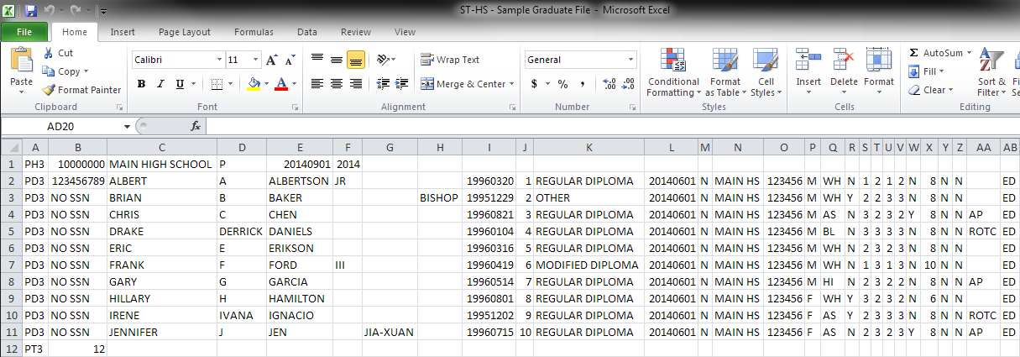
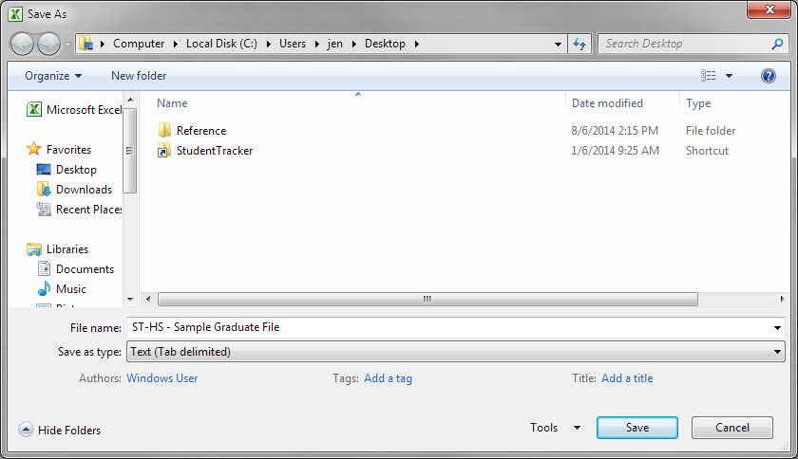
Save As: Text (Tab delimited)
©2015 National Student Clearinghouse. All rights reserved.
Notes:
ALL FILES MUST be submitted in Text (Tab Delimited) format. Any files submitted in any other format are automatically rejected by our system and will result in you having to resubmit your file.
Link to Graduate File Layout Guide: http://sths.helpdocsonline.com/#submit_a_graduates_file

Slide 18
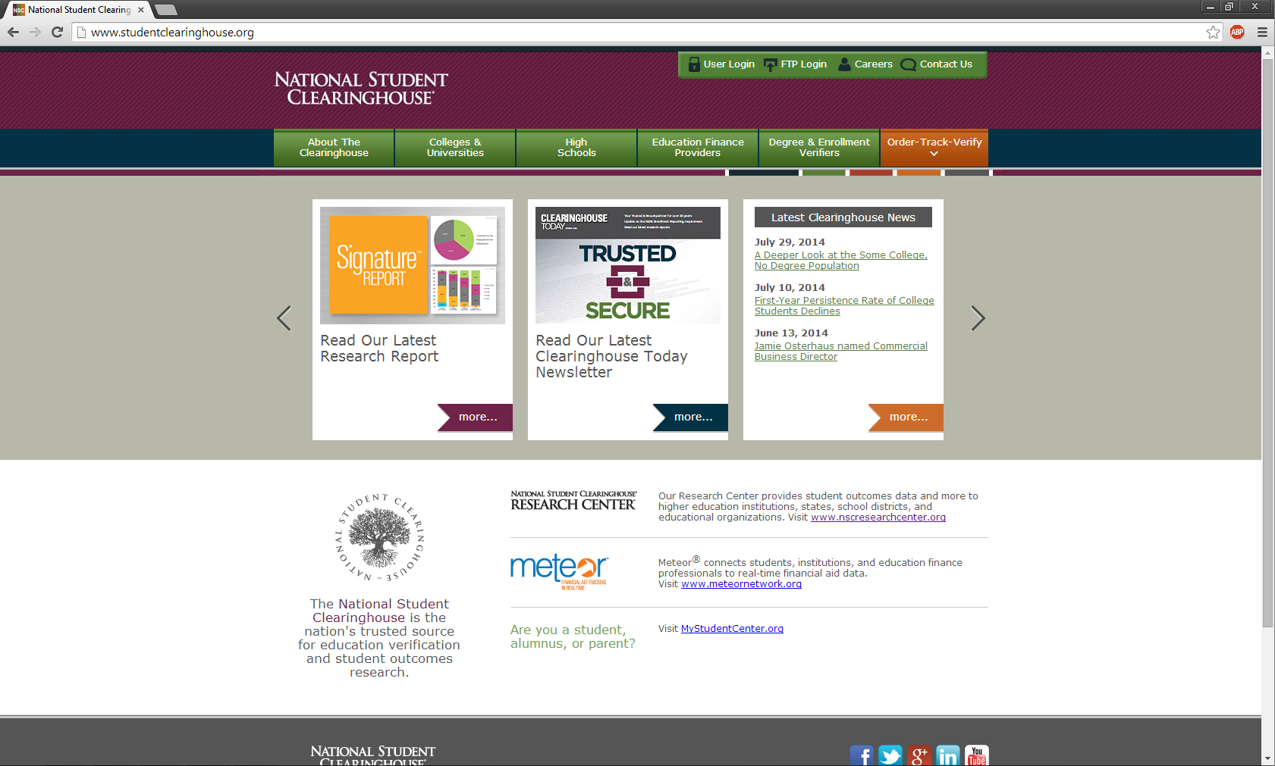
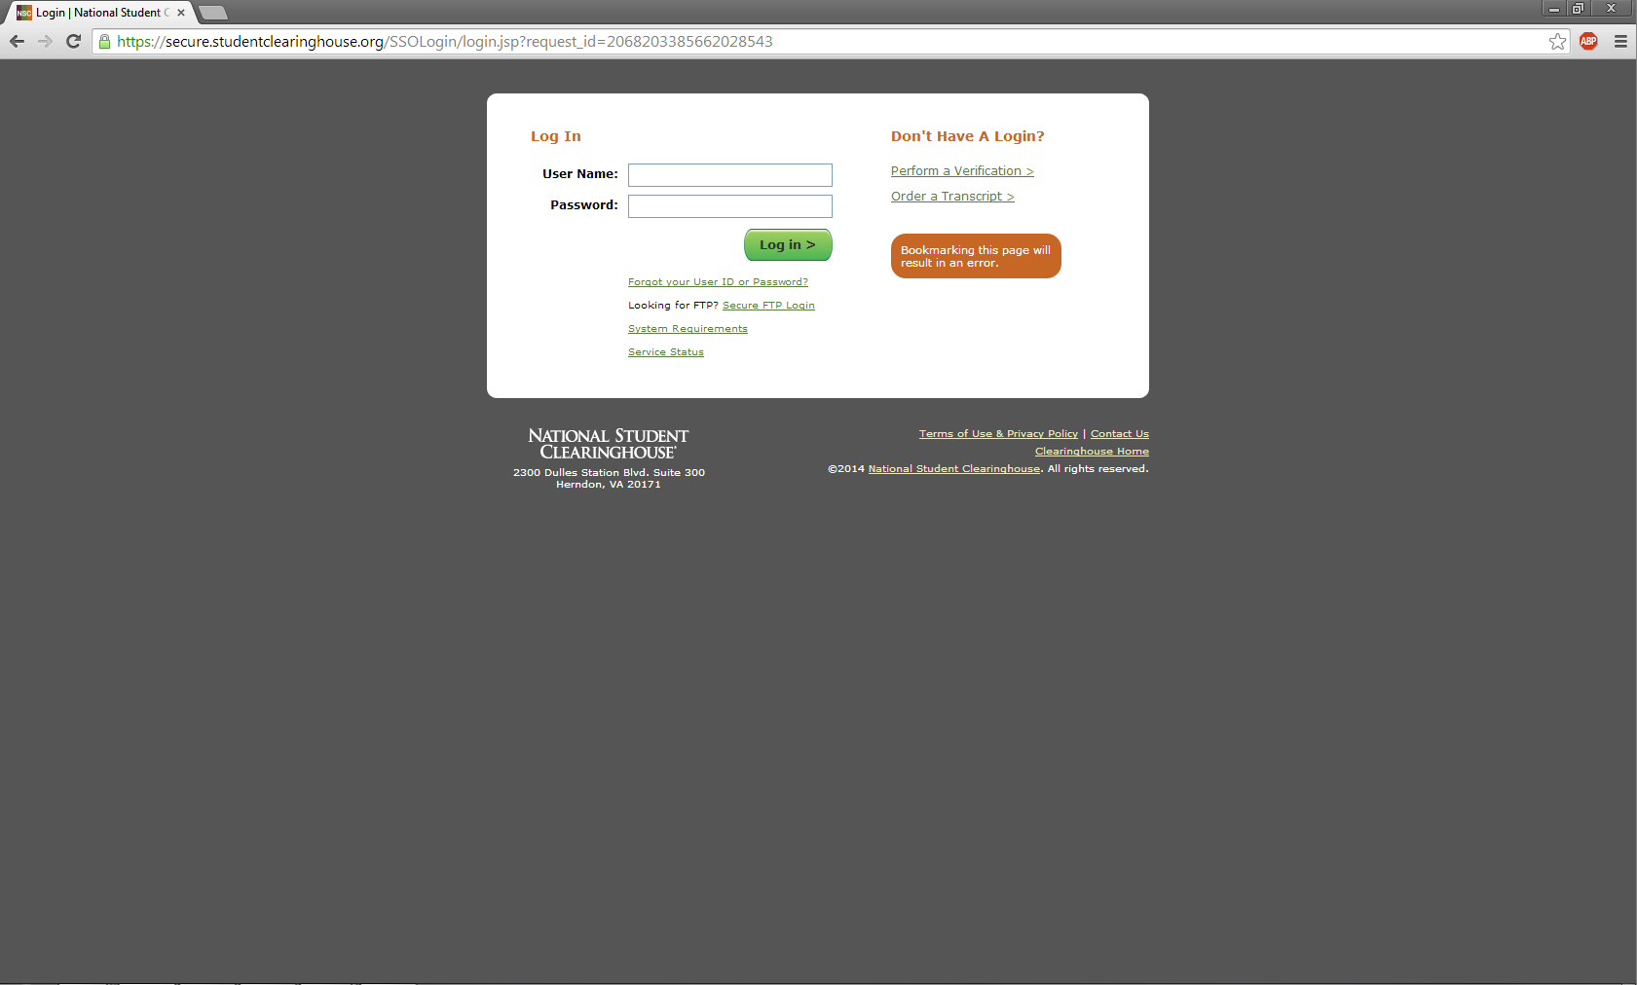
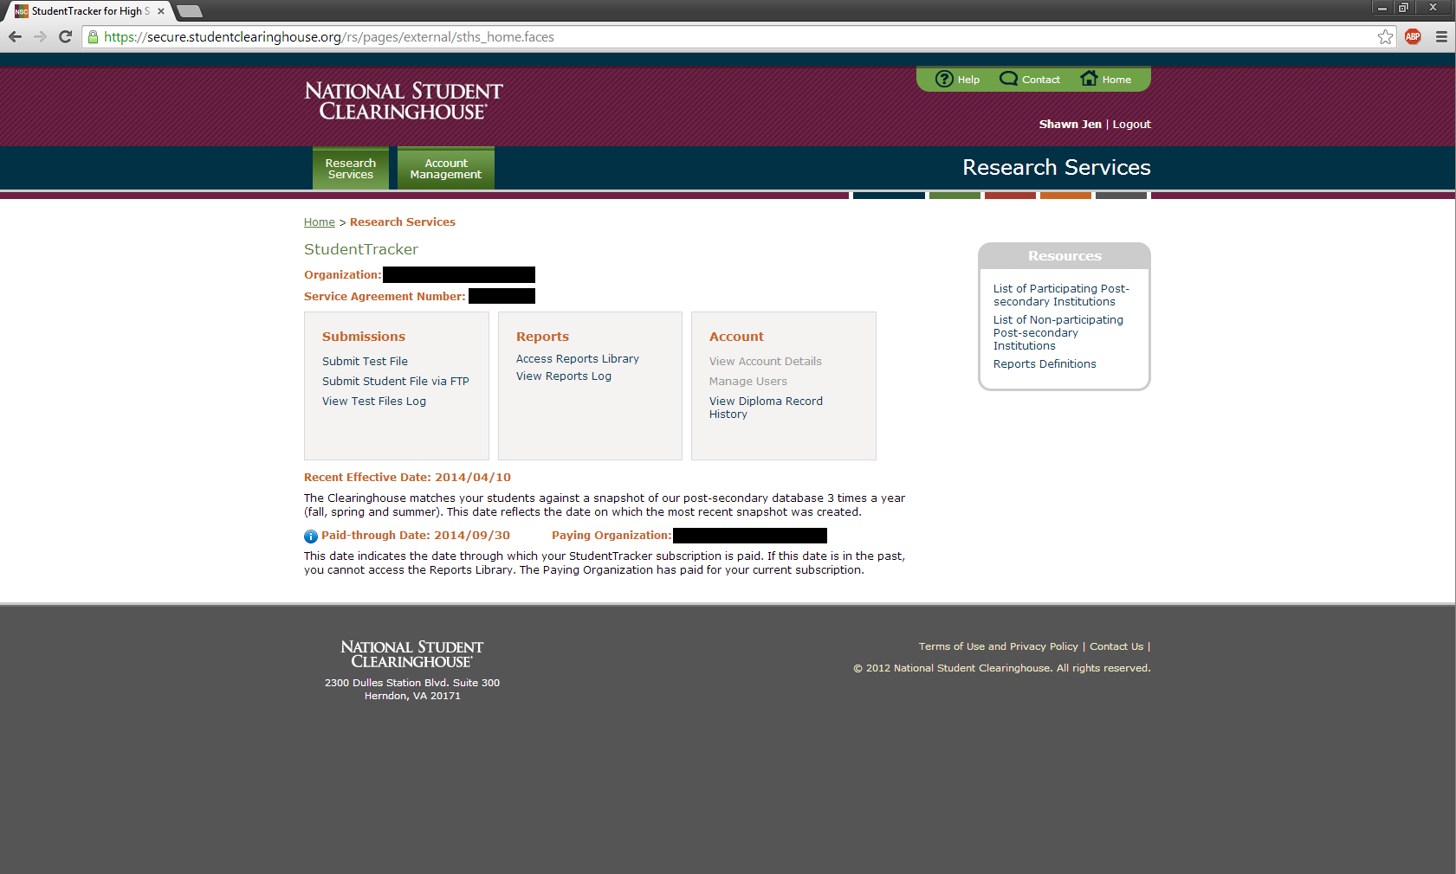
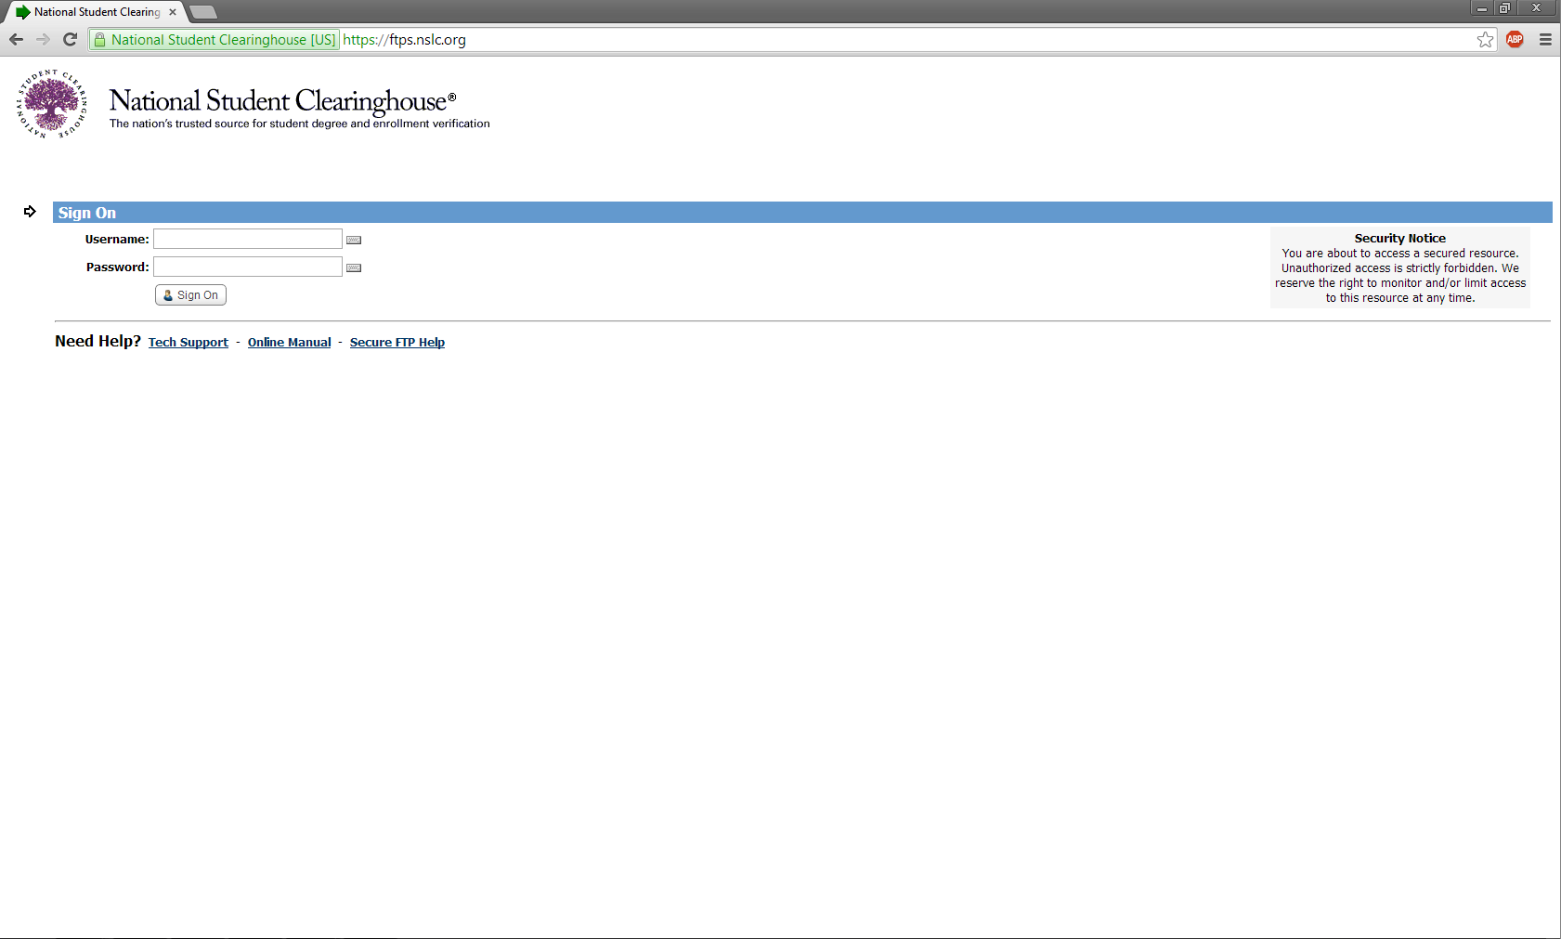
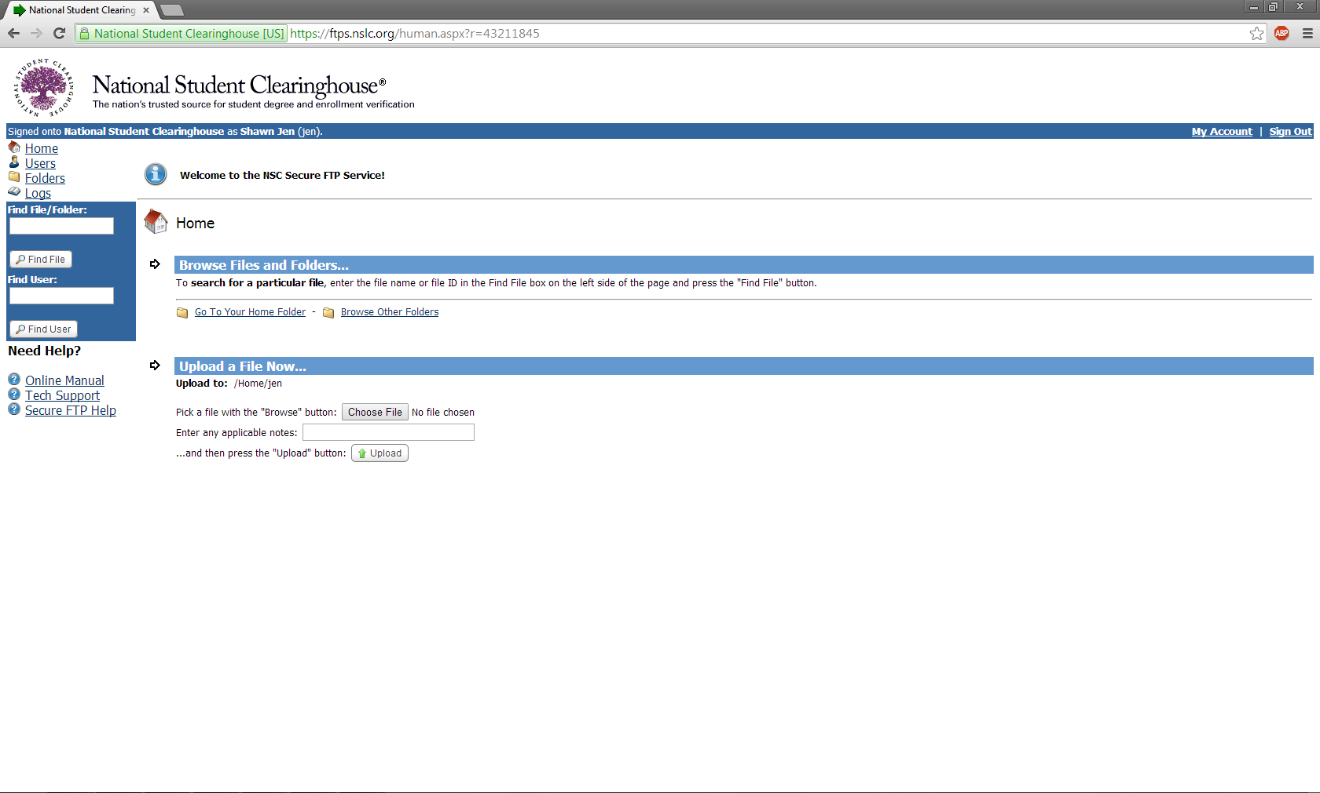
Web ID vs. Secure FTP
©2015 National Student Clearinghouse. All rights reserved.
Notes:
Here, we are going to distinguish for you the two types of account you may have. Both accounts are accessed via www.studentclearinghouse.org. You have a personal Web ID, accessed via * User Login, and you have a shared FTP account, accessed via * FTP login. We are going to first look at the * Web ID and what you can do with it.
After you click on User Login, you will be taken to * this page. Enter you login credentials, and you will be taken to * your Web ID home page. Here you can submit a test file, submit a graduate file, access your reports library and view your diploma history. The home page also provides you with account details, include the most recent effective date as well as your account’s paid-through date.
Now let us head back to StudentClearinghouse.org and click on * FTP login. The button will take you to * ftps.nslc.org. Enter the login credentials for your FTP account and hit Sign On. * Here, you can upload files and download reports. Please remember that all file transactions with us should be done through this website.

Slide 19
Test File
Encouraged for new StudentTracker users
Why?
Helps ensure accurate matching
Decrease report turnaround time
Tips
1000-row limit
Edit Trailer Row
Include “TEST” in the file name
Save as: Text (Tab delimited)
©2015 National Student Clearinghouse. All rights reserved.
Notes:
The Test File feature will list all errors and warnings in your Graduate File. Test file results are specific to the formatting errors and warnings in your file. It is HIGHLY recommended that you utilize the Test File feature prior to uploading your completed file.
For smaller schools (< 1000 students), you will be able test an entire file.
Any errors in the file must be corrected or the file will not be able to be processed. Warnings are acceptable; they are there to inform you of any possible data errors in case you may have overlooked something. Please be sure to resolve your file of all errors before submitting your completed Graduate File via your school’s FTP account.
The Test File can only be submitted using your Web ID (User Login on the www.studentclearinghouse.org). If not, you will not be able to view the errors/warnings that may be present in your file.
Only the completed and finalized file you want processed should be uploaded via the FTP site (https://ftps.nslc.org).

Slide 20
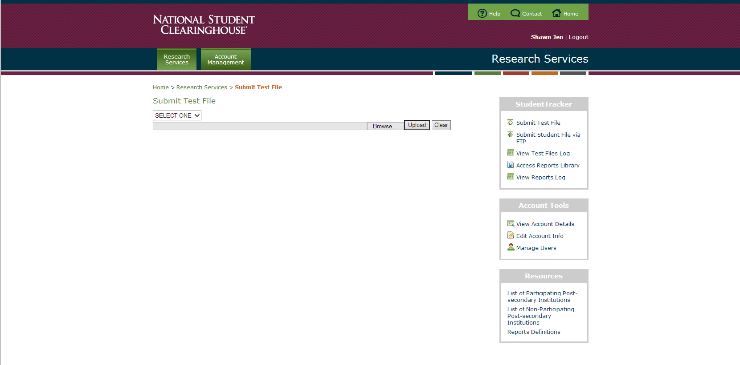
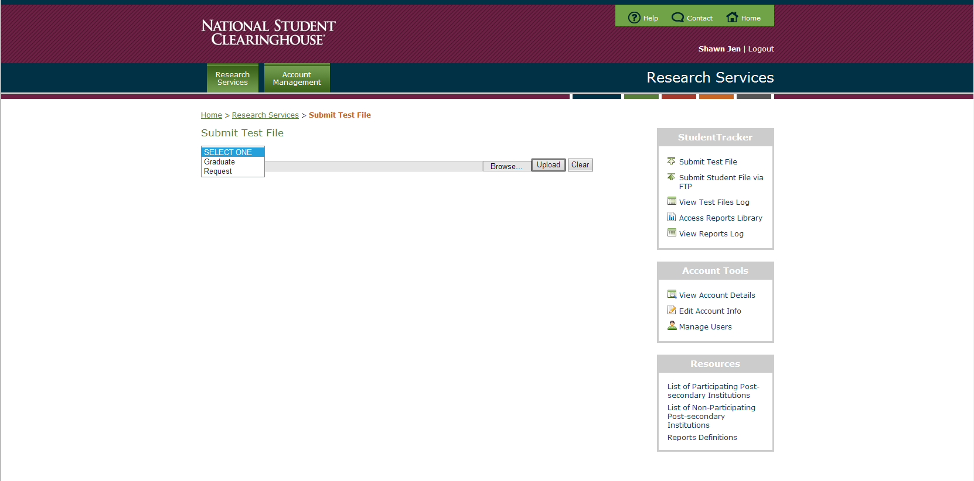
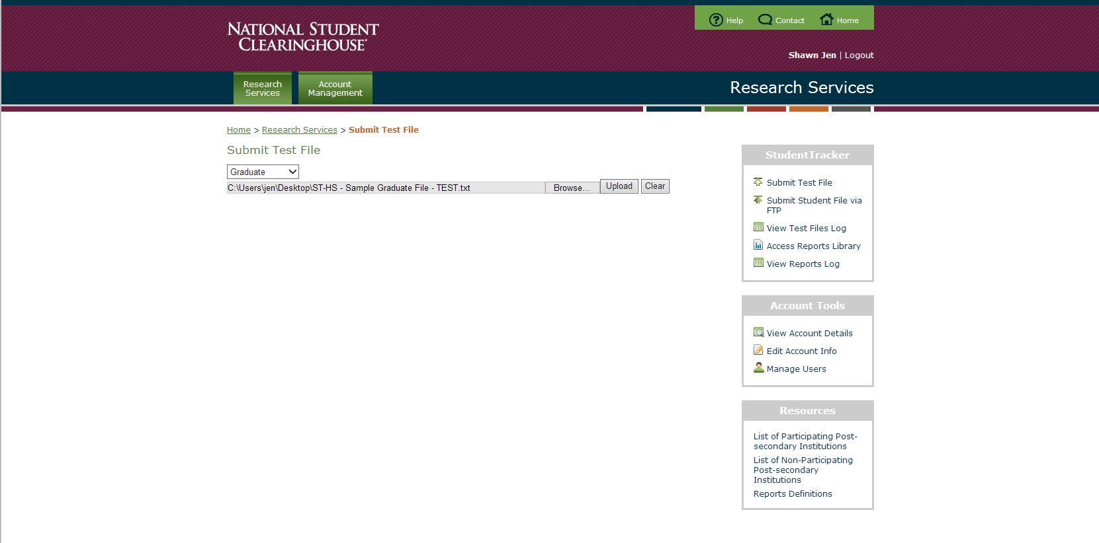
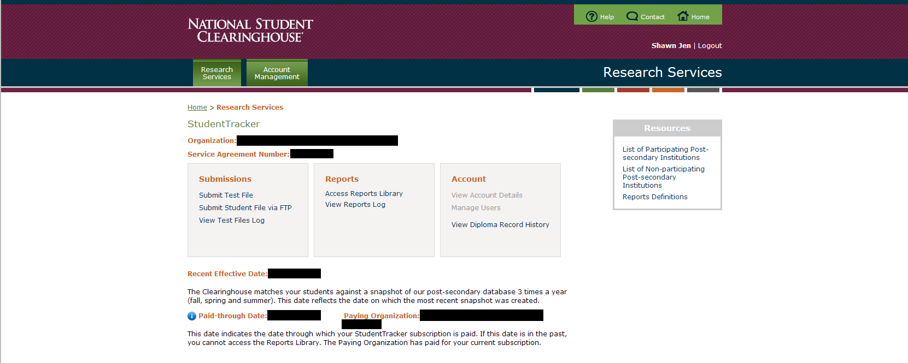
Submitting your Test File
©2015 National Student Clearinghouse. All rights reserved.
Notes:
Make sure you select GRADUATE before uploading your Test File.

Slide 21
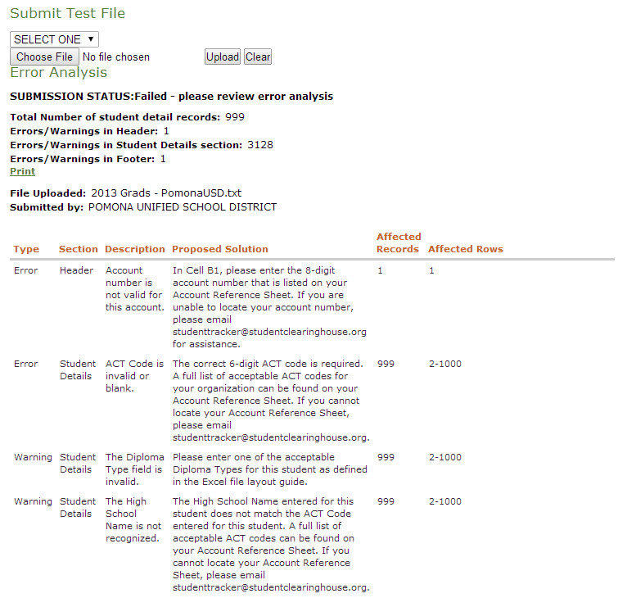
Test File Error Analysis
©2015 National Student Clearinghouse. All rights reserved.
Notes:
This page shows all of the errors and warnings present in your file that you uploaded via the Test File feature.
Here you will see:
Whether the result was an error or a warning.
What section the error/warning was found.
A description of the error/warning.
A proposed solution on how to make the correction.
How many records were affected.
How many rows wee affected.
From this page you have the option to print out your Test File Results.

Slide 22
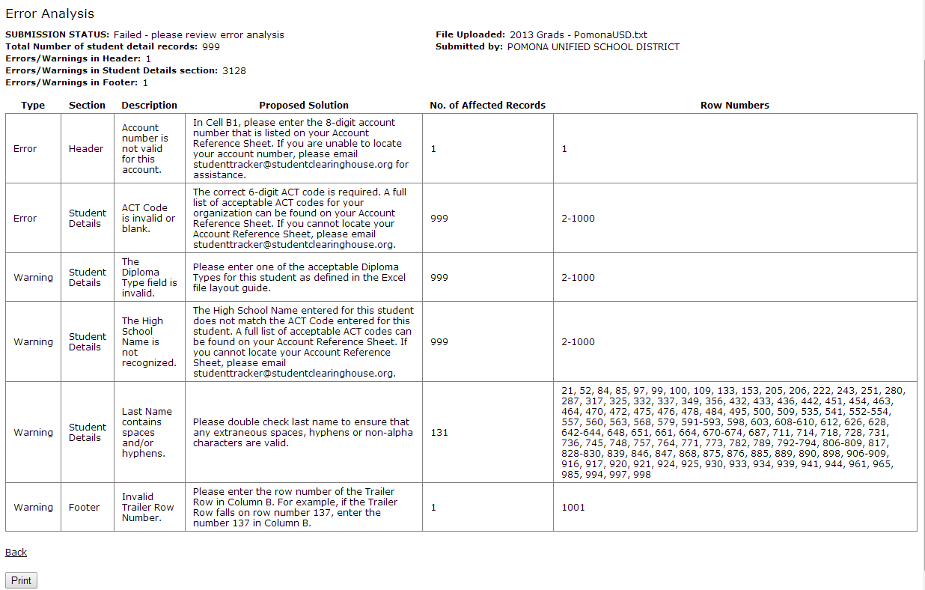
Printable “Error Analysis”
©2015 National Student Clearinghouse. All rights reserved.
Notes:
Here your Test File Results are available to you in print-friendly format.

Slide 23
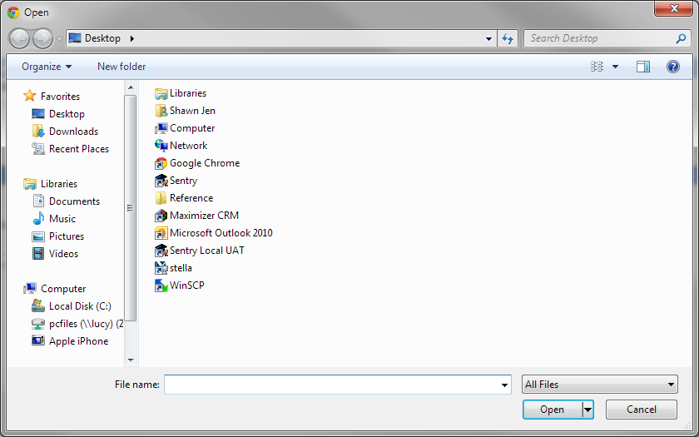
Uploading via FTP
©2015 National Student Clearinghouse. All rights reserved.
Notes:
Upload your completed Graduate File via the FTP site (https://ftps.nslc.org).
You may upload your file either using the Upload/Download Wizard (which you will have to install), or manually via the BROWSE button.

Slide 24
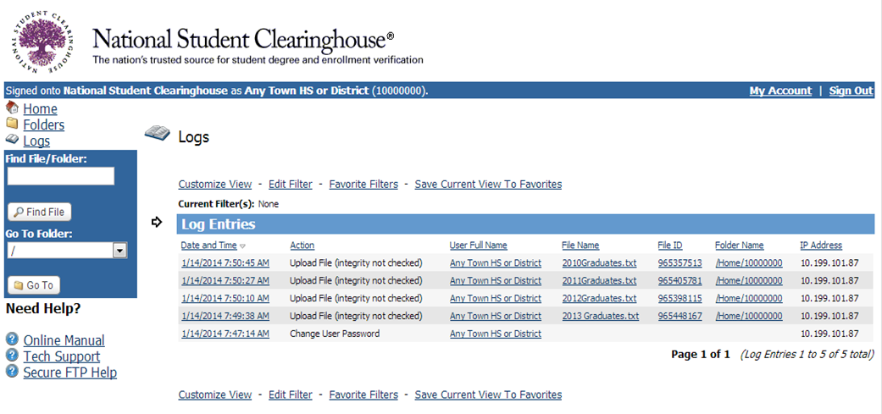
FTP Logs
©2015 National Student Clearinghouse. All rights reserved.
Notes:
The Logs feature on your FTP account shows and verifies that we received your StudentTracker Graduate File. Once your file has successfully uploaded, all individuals on the FTP account’s notification list will receive a confirmation e-mail.

Slide 25
Getting Started: Review Your Pending Queue
QUESTIONS?
©2015 National Student Clearinghouse. All rights reserved.
Notes:
This demonstration shows how a requestor selects a school and enters his or her personal information, the first steps in placing a transcript order.

Slide 26
Contact Information
E-Mail | StudentTracker@studentclearinghouse.org
Phone | 703-742-4211
Website | www.studentclearinghouse.org/highschools
Webinars | www.studentclearinghouse.info/webinars
If you are interested in learning more about the National Student Clearinghouse Mission Statement please continue to the following slide. If you have any questions please contact us.
©2015 National Student Clearinghouse. All rights reserved.

Slide 27
NSC Mission Statement
To serve the education community by facilitating the exchange and understanding of student enrollment, performance and related information.
©2015 National Student Clearinghouse. All rights reserved.

