Slide 1
Advocating & Supporting Undocumented Students during the Admissions Process
By: Aldair Arriola Gomez, Caltech
Paola Reyes Noriega, Pomona College
Notes:
3-5 mins
Land acknowledgment, Name, pronouns, position (admissions + undoc person) + school, share our undoc status (as undocumented professionals in admissions, we wanted to share our expertise)

Slide 2
Intersectional Identities
Sexuality (Undocuqueer)
Gender Identity (Trans, gender non-conforming)
Socioeconomic status
Race/Ethnicity
Nationality
Disability
Amount of time in the US
English Fluency
Notes:
Aldair
3 mins: Not a monolith of a group. So many different variations of what it means to be undocumented. Don’t assume and don’t generalize. We all have our own story. People’s experiences are different within the community. European undoc experience vs african, not exhaustive (this list), other identities can and should be represented.

Slide 3
Background: Setting the Stage
 | # of Graduating Unauthorized Immigrant Students | % of Graduating Unauthorized Immigrant Students
United States | 98,000 | 100
California | 27,000 | 27
Texas | 17,000 | 17
Florida | 5,000 | 6
New York | 4,000 | 4
New Jersey | 4,000 | 4
Illinois | 4,000 | 4
-Approximately 125,000 Unauthorized Immigrants reach high school graduation age but only around 98,000 actually graduate.
-Immigrant students who arrive to the US at age 6 or older are more likely to drop out from high school than those who arrived at younger ages.
-English Learners (ELs or ESL) have a lower four-year high school graduation rate (66%).
“How many unauthorized immigrants graduate from U.S. high schools annually? ” Migration Policy Institute, 2019
Notes:
Aldair- 4-6 minutes (Explain the table, explain the Migration Policy Institute Project where info is from). College-going rate for undocumented students. Up to date data. 65 vs 98 thousand.

Slide 4
Barriers for Undocumented Students to Attend College
Cost (ineligible for federal financial aid, some scholarships being only available to US citizens, etc.)
Lack of status (not having DACA)
Member of other marginalized community
Family ties
Stigma of undocumented status
Fear of deportation
Lack of information/resources
Ever-changing federal laws
Notes:
4 minutes
Paola
Make sure to lead into international vs domestic

Slide 5
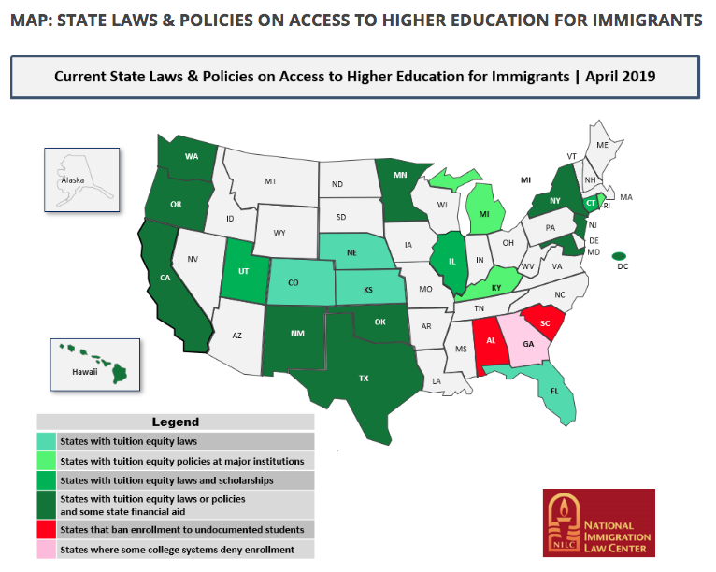
International vs Domestic
Before we get into that… what about state schools?
“Toolkit | Access to Postsecondary Education” National Immigration Law Center, 2019
Notes:
3 minutes
While private colleges and universities can set their own admissions policies for undocumented students, many of these students may want to stay close to home and attend a state school. This isn’t always possible.
In some states, are not allowed to attend college at all
Twenty states offer in-state tuition to unauthorized immigrant students, 16 by state legislative action and four by state university systems.
9 states offer state aid, some allow public institutions to use private sources of funding for undocumented students
The requirements for undocumented students to establish residency in a state in order to access in-state tuition are often times stricter than the residency requirements for out-of-state students to gain in-state tuition.

Slide 6
International vs Domestic
Domestic: students graduating from a high school in the United States, regardless of citizenship status, US Citizens & Permanent Residents
Need-blind
100% of demonstrated need
Eligible for aid, including Federal
Notes:
3 minutes
Private colleges and universities can set their own policies and these are the two general options:
Undocumented students are considered domestic students.
Providing financial aid to undocumented students is limited to private sources of funding. Only some institutions have the means for this.

Slide 7
International vs Domestic
Make clear what your institution’s policy is.
International: students who have citizenship outside the US and will study in the US with a visa
Need-aware
Ineligible for Federal aid, but other (limited) sources are available
Notes:
3 minutes
Undocumented students are considered international students.
Need-aware
Pew Hispanic center estimates that about ⅓ of undocumented students live below the poverty line. In other words, they will require a lot of aid, limiting their chances of admission.
Budgets are limited.
The experiences international students bring to campus are valuable. The experiences undocumented students bring to campus are valuable. But these are not the same.
Only five schools offer need-blind, 100% of demonstrated need policies for international students (MIT, Harvard, Princeton, Yale and Amherst), all of which are already friendly to undocumented students
Sometimes being categorized as an international student also means taking the TOEFL or IELTS
Undocumented students went to high school in the US and were taught in English
Undocumented students should NOT be considered along with (and essentially competing against) international students, whose experiences studying abroad/with a visa in the US are different than those of undocumented students
Undocumented students have grown up and studied in the US
*Making clear what your institution’s policy is* We understand there is bureaucracy to institutions, so changing your policy may not be the most feasible.

Slide 8
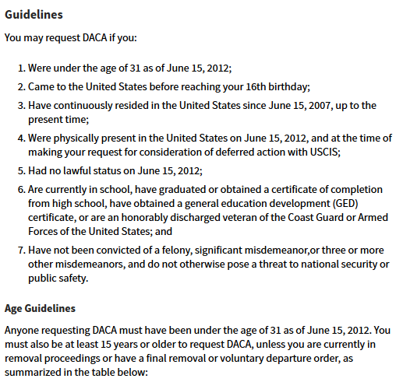
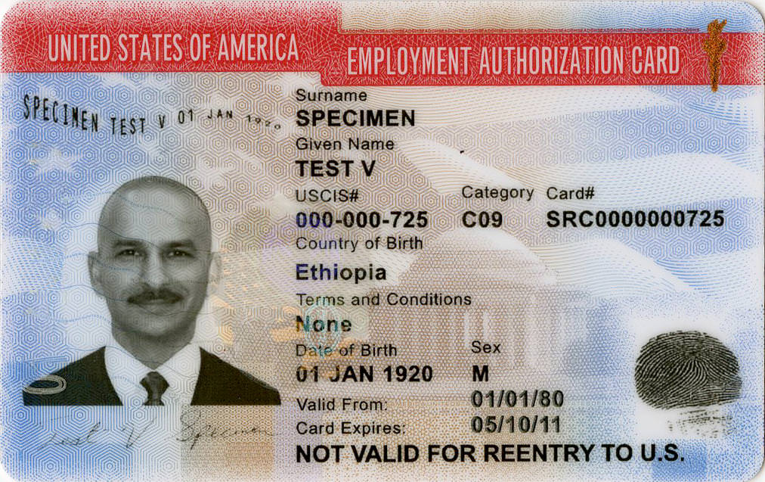
DACA
“Do human capital decisions respond to the returns to education? Evidence from DACA” National Bureau of Economic Research, 2018
Notes:
Aldair: 3 mins Screenshot of what you need to get DACA, band-aid solution, no longer accepting new application. Students graduating without DACA. Everyone who has waiting to apply when they turned 15 couldn’t anymore. NYT article.
DACA led to statistically significant increases in school attendance of 14-18 year olds.
DACA increased high school completion for all age categories. DACA lead to an additional 49,000 high school graduates. (15% increase)
20% increase in college enrollment rates (across all types of institutions)
EAD, social security number and the deferral from deportation.

Slide 9
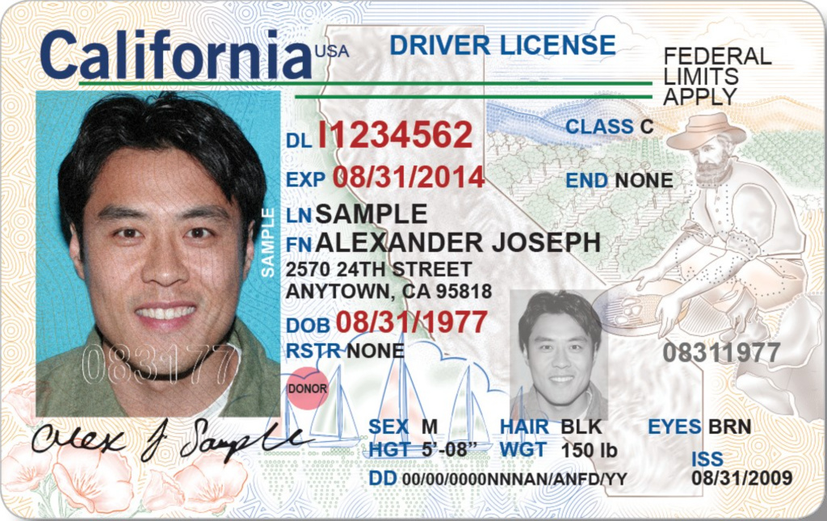
Implications if DACA ends...
Eligible students will lack a social security number, EAD (employment authorization document), protection from deportation, and potentially a driver’s license.
Some states provide driver’s licenses to undocumented immigrants but most have federal limits.
Schools that use DACA to frame admissions policies must update them.
Travel logistics will be more complicated (specially students who have to fly and/or cross through border states.)
Notes:
Aldair: 3 mins
DACA is not over. Only accepting renewals. If it goes to the supreme court.

Slide 10
Questions to consider:
Are there are other undocumented students on campus?
Does your campus offer employment opportunities that do not require employment authorization? Ex. department fellowships, stipends, etc.
What type of resources do you offer for undocumented students? (a resource center, support staff, club, mentor program, etc.)
What is this campus climate like in regards to immigration and undocumented immigrants? Is your school a sanctuary campus?
What type of legal support can your institution provide to an undocumented student? Can their family take advantage of this?
Will there be allies available to the student?
Notes:
3 mins
Paola
Questions for admissions counselors and high school counselors. Advise students to ask these questions.
Different undocumented students will have different questions, often times dependent on their identities.

Slide 11
Evaluating an Application
Things to consider when evaluating an undocumented student’s file:
Does the student disclose their status? (geography and citizenship question, personal essay, short responses, letters of recommendation?)
Lack of extracurricular activities due to limited mobility (parents/guardians scared to drive, fear of travel to summer programs)
Alternative extracurricular activities such as: translating for parents/community members, assuming adult roles (paying bills, negotiating contracts, tutoring/taking care of siblings, etc.)
Notes:
Aldair: 2-3 mins
“Look at visa info, someone can still have a visa and not be ‘documented’”
Use these things to clue you in. Student might be in the process of obtaining “legal status”

Slide 12
Evaluating an Application
Things to consider when evaluating an undocumented student’s file:
An undocumented student DOES NOT have to disclose their status.
Retelling your immigration story can be triggering and shouldn’t be expected.
If the student comes to campus, be cautious about disclosing their status to members of the community. Let the student do this.
Do not uphold the good vs bad immigrant narrative.
If a student writes about their experience being undocumented, it’s important for readers to set aside their political opinions.
Notes:
Aldair: 2-3 mins

Slide 13
Resources
Stay informed and be knowledgeable about terminology
Identifying students or letting students self-identify
Webpage with clear information and a contact person
Sanctuary city/campus
UndocuAlly Training for staff
Do not provide incorrect information
Fly-in programs
Check in with students
Avoid flights in border states
Have staff meet student at airport
On-call lawyer or other resources
Make sure students know “Know Your Rights” from ACLU
Notes:
Paola: 5 mins
We understand changing your institution's policy is a lengthy process that requires many checks and balances. When that change is made or if you are already welcoming of undocumented student applicants, consider having these resources on hand:
Be informed and knowledgeable about terminology
Many changes due to political climate and changing administrations
Identifying students vs. having them self-identify
Webpage with clear info/contact person
Undocually Training for admissions staff?
Dept of Education Resource Guide: Supporting Undocumented Youth
Fly-in programs
Check in with students
Avoiding connecting flights in border states
Get in and out of airports quickly
On-call lawyer/other resources
ACLU know your rights

Slide 14
Additional Resources
Immigrants Rising (formerly Educators for Fair Consideration) Scholarship Guides
College Greenlight

Slide 15
Questions?

Slide 16
Contact Info:
Aldair Arriola Gomez
Admissions Counselor
Caltech
aarriola@caltech.edu
Paola Reyes Noriega
Admissions Officer
Pomona College
paola.reyesnoriega@pomona.edu

