Slide 2
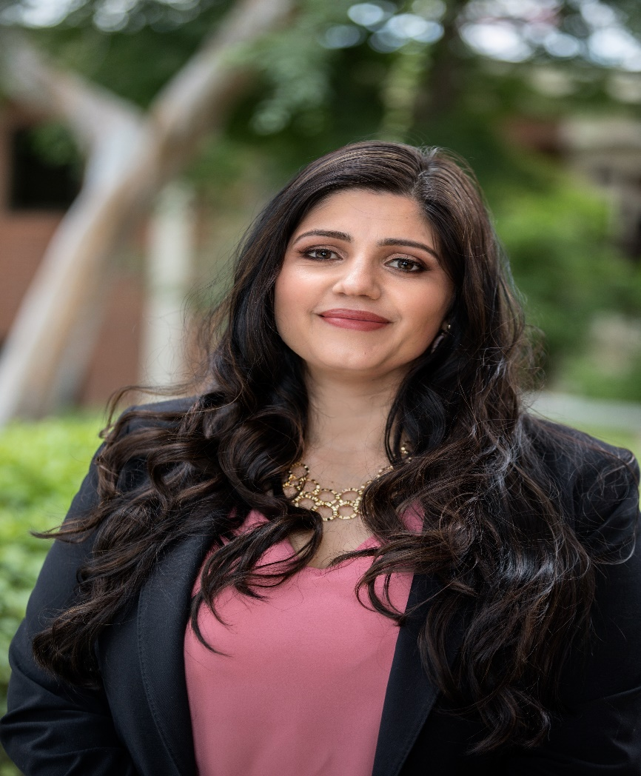
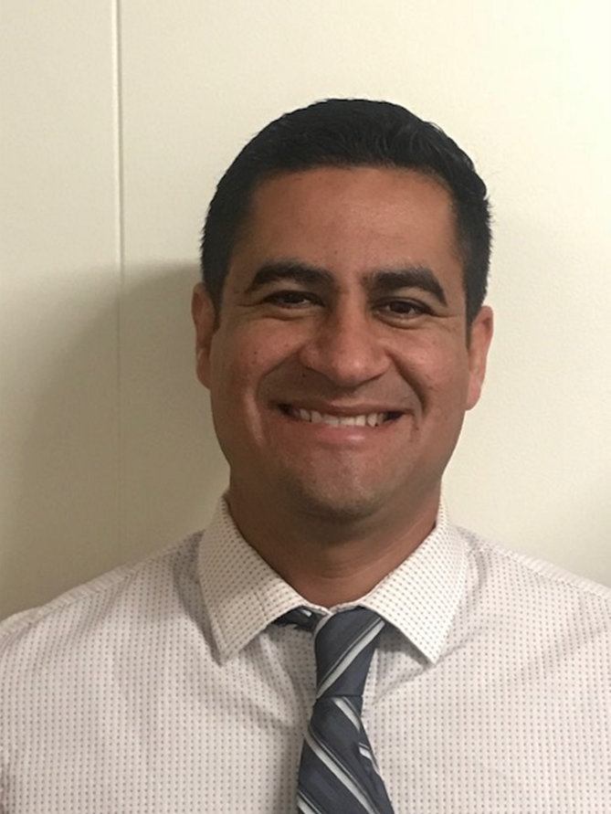
Catalina Cifuentes
Executive Director,
College and Career Readiness
ccifuentes@rcoe.us
Dr. Pedro Caro
Coordinator,
College and Career Readiness
pcaro@rcoe.us

Slide 3
Webinar Tips
This webinar is being recorded so that others may listen to it at a later time for reference and will be uploaded to the RCEC Youtube page as well as www.rcec.us once you log in to access the content of the webinar series
All connections to this live Webinar feature have been accounted for so please do not forward the Zoom link or invite anyone to join because you are taking someone else’s spot and Zoom will automatically start kicking off connections randomly
All participant mics have been muted and only panelists and facilitators have the ability to unmute anyone
Since all participants have been muted, please use the Q&A and chat screens to enter your questions
Participants can submit a question in the Q&A box at the bottom of the screen for the panelists
Only panelists and facilitators will be able to respond back to those questions and can do so publicly or privately to the individual
Participants can submit comments or questions in the chat box if they would like to engage with each other
**Every effort has been made to ensure the security of this webinar from “zoombombers” but in the event that we experience that, please stay calm and we will resume as soon as the technical difficulties have been resolved.**

Slide 4
FOR MORE INFORMATION AND RESOURCES PLEASE VISIT US @
www.rcec.us

Slide 5
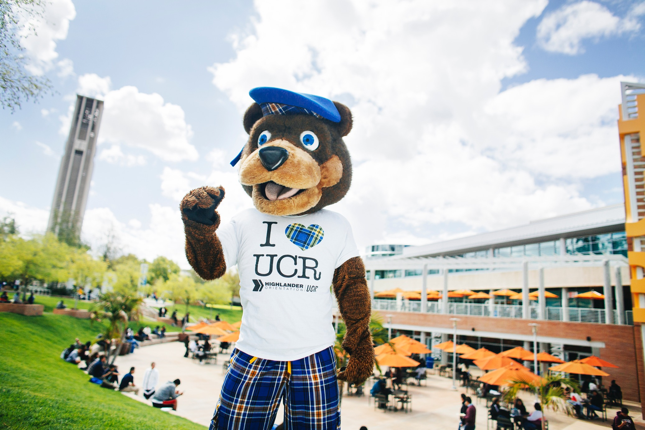
Freshman Admissions
Riverside County:
Rachel “Rae” Reynolds
(she/they pronouns)
rachel.reynolds@ucr.edu
951-285-5360
Need more info? Have more questions?
housinginfo@ucr.edu
finaid@ucr.edu
honors@ucr.edu
orientation@ucr.edu
Check out our Video Webinars from Highlander Week Live:
https://highlanderday.ucr.edu/freshman-webinars
THANK YOU!
Take a guided or self-guided virtual tour of UC Riverside today!
admissions.ucr.edu/visit
admissions.ucr.edu
admissions@ucr.edu
(951) 827-3411
Follow us on social media!
ADMISSIONS.UCR.EDU

Slide 6
Round of Applause for our Presenters!!
Laura Macchia Amescua
UC-Office of the President
Rachel Reynolds
UC, Riverside Admissions
Notes:
Castro Slide

Slide 7
We are here to support you!
Please reach out to College and Career Readiness with any needs at your school site, professional development topics, or general questions at:
Catalina Cifuentes ccifuentes@rcoe.us
Dr. Pedro Caro pcaro@rcoe.us
Notes:
Castro Slide

Slide 8
FOR MORE INFORMATION AND RESOURCES PLEASE VISIT US @
www.rcec.us

Slide 9
