Slide 1
The Untapped Talent in the Inland Empire: Supporting Students of Color, First-generation, Low-income, and all Underserved populations
By: Aldair Arriola Gomez
Admissions Counselor

Slide 2
Defining highly-selective institutions
-Low Acceptance Rate
-Traditionally a PWI
- Usually a Private Institution
-Competitive Financial Aid Package
Notes:
Describe what a highly-selective institution typically looks like.
-Provide some insight into my perspective of attending Pomona and working at Caltech.

Slide 3
Impostor Syndrome
Definition: Psychological pattern in which an individual doubts their accomplishments and has a persistent internalized fear of being exposed as a fraud.
Consumption of social media leads teenagers to craft an image that they convey to the rest of their followers. This curated image doesn’t reflect the struggles and hardships they face, therefore leading others to believe that these barriers don’t exist.
Students from marginalized backgrounds more than often face this issue. Although this issue is mainly discussed in the college setting, it also affects high school students, specially during the college application process.
Notes:
Define Impostor Syndrome and how it can manifest itself on HS students

Slide 4
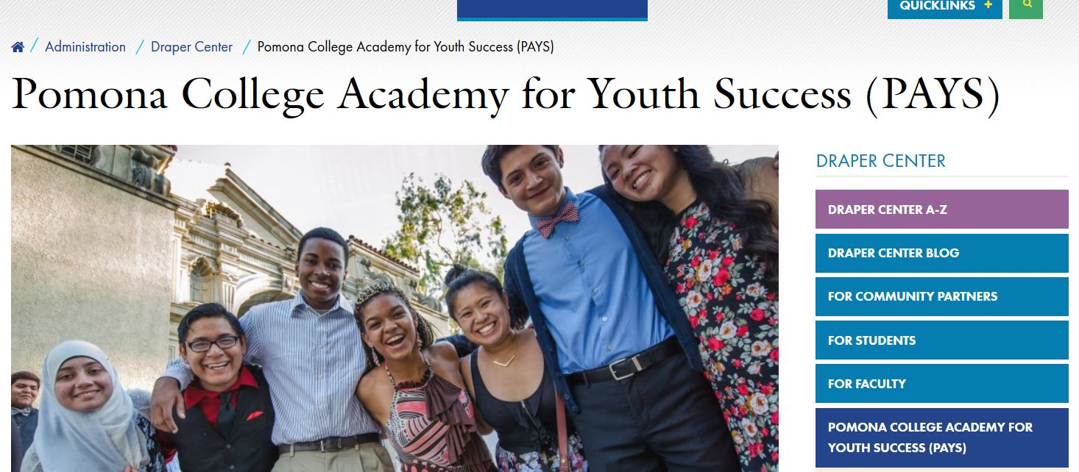
Summer Enrichment Programs
-Pomona College Academy for Youth Success
-Scripps College Academy
-USC Summer Programs
-Annenberg Youth Academy for Media and Civic Engagement
-Summer Academy for Advanced High School Students UCR
Notes:
Pros of attending programs like this one.
-college-level courses exposure
-college access is usually one of the missions
-potential research experience
-guidance and assistance with applying to colleges
-access to faculty members
-tutoring (specially in math and writing)

Slide 5
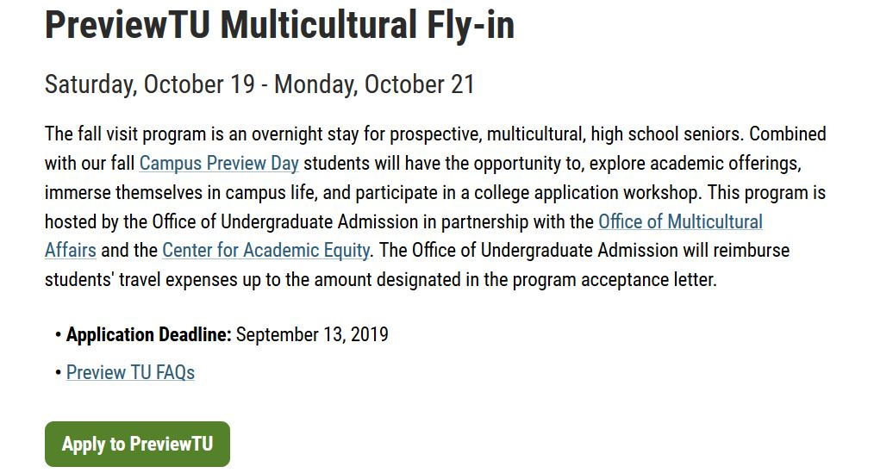
Fall Fly-In Programs
-Applications generally are released at the end of a student’s junior year (April/May)
-Most cover the cost of travel and provide lodging and food
Notes:
Explain the benefits of a fall fly-in program:
They are becoming more selective since more students are finding out about them.
Could expose a student to colleges they aren’t familiar with.
If not selected, typically students receive a fee waiver.
Fully-paid.

Slide 6
On-Campus Support
-Support Staff
-Dean of Students
-Dream Center
-Counseling
-Health Center
-Academic Support
-Faculty
-Career Planning Services
-Clubs
-Organizations
-Financial Aid
-Grants
-Scholarships
Notes:
Support Networks for marginalized students:
Go through each and explain why they are important. Talk about offices on campus, centers, financial/monetary support, wellness-oriented support, peer support, academic and career support.
^Students should be encouraged to ask questions about these support networks for colleges they are interested in.

Slide 7
Support throughout the Application Process
-Contact the Admissions Representative if you have questions (email or phone call).
-Encourage students to share the full context of their story.
-Teach students how to be advocates for themselves.

Slide 8
Contact Info
Aldair Arriola Gomez
Admissions Counselor
aarriola@caltech.edu

