Slide 1
School Counselor Leadership Network-Riverside
UTILIZING PEER COLLEGE COUNSELORS EFFECTIVELY
Presented by:
Sylvia Yi
El Camino Real Charter High School

Slide 2
What do we do?
Organize and maintain the center with catalogs, brochures, handbooks and resource materials
Coordinate and implement college information
Provide specific information regarding entrance requirements, applications, scholarships, costs, tuitions, financial aid etc…
Provide current information regarding financial aid opportunities and deadlines
Provide college counseling services through group and individual counseling
Help students become aware of all phases of post secondary school options
Maintain records
Provide staff and faculty with current information related to college admissions
Coordinate visitations by college reps during the school

Slide 3
Goes on and on and on……..
Organize fieldtrips
Provide assistance such as workshops
Write letters of recommendations
Coordinate and articulate information regarding admissions and scholarships
Provide necessary information for students on the PSAT, SAT, ACT, SAT II
AP Coordinator
Update website
Supervision and coordinate PCC program

Slide 4
Peer College Counselors
The major emphasis of the course is to provide students with the knowledge and skills to assist students through the college application and admission process, including financial aid and testing or any post high school options. Peer College Counselors provide information to students about colleges, requirements, testing and completing all components of the college application and meeting deadlines. Students make class presentations and lead group discussions about college choices, preparing for admission tests, the college application process, and the financial aid process.
***PCCs are the extension of the College Counselors

Slide 5
PCC is a Leadership Program
College Office “outreach program” like other college outreach programs
High expectations of PCC’s - they are always representing the college office
Treat it like a leadership program
Coach our students- not just on college knowledge but communication skills, leadership skills, “customer service” skills
If necessary, use Interventions and probations
Implement rules and expect them to be followed

Slide 6
General Job Duties of PCC
Primary Duty is to counsel students every day. We try to get through all the students.
Seniors- Fall
 Juniors- Fall
 Sophomores-Spring
Freshmen-Spring
Presentations in the classrooms (9-12th graders in English classes)
Attend different Events
College Fair, Evening Events, help with PSAT test, Senior Awards Night
Help with students with applications, SAT/ACT registration, Senior Survey
Nutrition Duty

Slide 7
Daily Duties
Each PCC is given a caseload. In the Fall the entire senior class is divided amongst the PCC group. The primary role from August-October is to see everyone on their list. Then they will start working on the 11th graders later in the semester and into the spring. Will dip into 10th and 9th grades as well.
The experience is very hands on - get students on the computer to look at the application, different websites, Naviance, to get them to sign on to ACT or College Board etc.
Make notes on their sheets of the student and their plans

Slide 8
What are we looking for?
Coachable- We do not emphasize their college knowledge since we will train them.
Good attitude and enthusiastic
Positive outlook
Can work well with diverse populations
Understands social cues
Accept feedback well
Can work with parents/adults/teachers
Presentation skills
Knows how to communicate well with everyone including us
Knows how to say the right things
Mature and responsible-Appropriate behavior
Grades is not necessarily a factor but we want to make sure they can retain critical information.
Can we leave the office and expect them to do what we need them to do?

Slide 9
Selecting Your PCC
PCC serves 3 terms
Spring semester as Junior PCC
Fall semester as Senior PCC
Spring semester, seniors train the new JPCC
Applications starts October/November of the student’s Junior year
Interviews in November so students can put in the PCC period into schedule for the Spring Semester
13-17 PCCs with a period 2-3 PCC’s in a period

Slide 10
Interviews and Training Process
Paper application
Interviews varied every year; it’s a learning process for us too.
Senior PCCs are involved in the process
Once Juniors start, they learn from observing in their period
They are obligated for a once week lunch training.
Give quizzes to gauge their retention on college knowledge.

Slide 11
Code of Ethics
I will respect the dignity and individuality of the person I am helping and of my fellow peer counselor
I will respect the confidentiality of the helping relationship and of the training sessions.
I understand that I have a “Duty to Inform” my adult supervisor about situations regarding potential or suspected suicide attempts, abuse, or threatened violence or homicide.
I will be supervised by an adult and agree to follow the guidance that is offered in supervision.
I will not use my position as a peer counselor for my own gain or profit.
I will refer to the adult supervisor those situations for which I am not adequately trained or too emotionally connected with to be an effective resource or help.
I agree to follow this “Code of Ethics” to the best of my ability.
I agree to ask my adult supervisor when I am unsure about these rules.
I understand that I may be dismissed from my role as a Peer College Counselor for violation of this “Code of Ethics”.
.

Slide 12
Counseling
They are given an opportunity to see how senior PCCs counseled students
They are given opportunity to observe the college counselors
They are required to sit in on college visit presentations and our evening event presentations
They practice counseling sessions with both their senior PCC and at lunch with each other to present different scenarios and questions
We watch them counsel and give them feedback
PCCs need to be intentional and say things right and correctly.
PRACTICE, COACH, PRACTICE, COACH, PRACTICE!!!

Slide 13
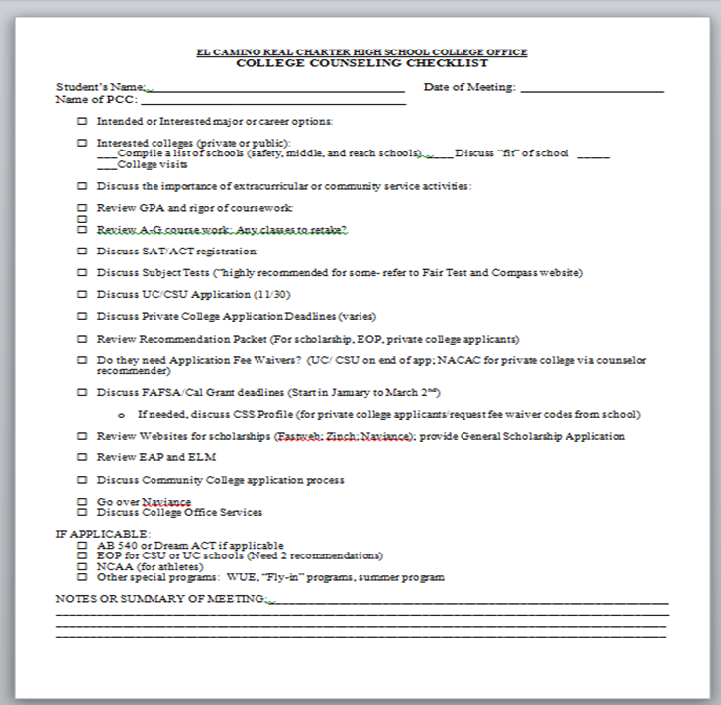

Slide 14
PCC Committees/Managers
Publicity Committee
Boards and Calendars
Forms in the Office
PCC Activities- Mixers
College Clips
Leading PCC Meetings
You can pick up to three PCC Managers to help you. These are your “go-to” students.

Slide 15
Sample PCC Quiz
How do you calculate a UC/CSU GPA? What classes get the extra point?
What is validation? What subjects can it be utilized? Please give an example.
What does superscoring mean and which types of colleges do this?
What is ELC and what does it mean? Which college system does it refer to? Why is it good to be an ELC student?
Explain requirement “G” – College Prep. What are some of the courses that cover this?
If a student as a freshman takes Spanish 3 and passes both semesters with a B, would he/she meet the foreign language requirement without taking any other Spanish classes?
A student is determined to go to a competitive UC school, how do you best advise the student? How can you use the admissions stats given by UCs to explain this?
A student wants to go to San Diego State, explain the requirements/ admission criteria
A student says they want to apply for Early Decision for UCLA. How do you advise?
Explain the difference between early decision and early action?
What can you tell a student about the SAT Subject tests?
A student comes to see Mrs. Yi because she needs a recommendation for UCLA. How do you handle this?
·

Slide 16
Questions?
Contact Info:
Sylvia Yi
Email: s.yi@ecrchs.net

